Slide 1
Spreadsheets
You will learn about some important features of spreadsheets, as well as a few principles for designing and representing information.

Slide 2
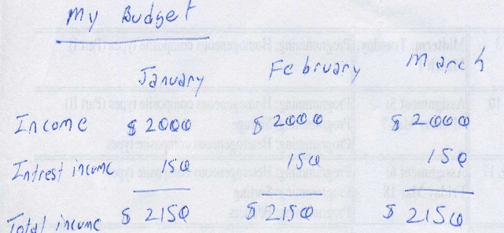
Background
Electronic spreadsheets evolved out of paper worksheets.
  Calculations were manually calculated and entered in columns and rows on paper often drawn with grids.
Making changes could be awkward:
  Correcting errors
  Attempting variations :
    e.g., for a personal budget what would be the effect of living in a 1 bedroom vs. 2 bedroom apartment
    e.g., going on a vacation to Vulcan Alberta vs. going to Dubai in the U.A.E.
    e.g., how would my term grade change if I received a “B” vs. “B+” on the final exam

Slide 3
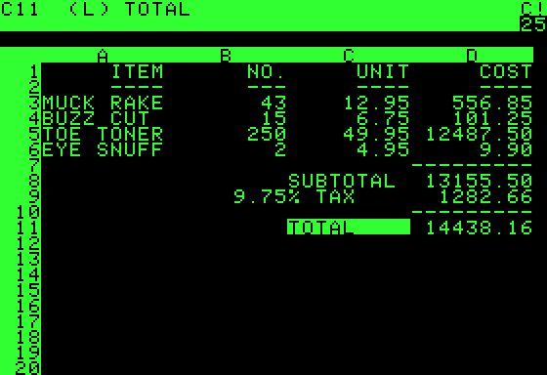
The First Spreadsheet
Early versions of electronic spreadsheets were primitive but could at least automate calculations.
VISICALC for the Apple II computer: Image from: http://www.cultofmac.com (last accessed Jan 2015)

Slide 4
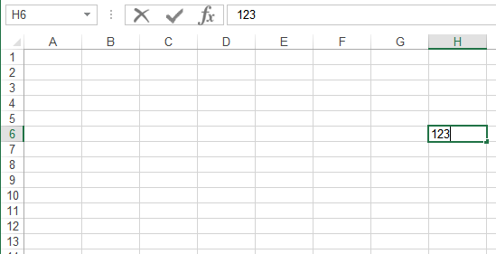
Spreadsheets 101
Column headings
Coordinates of current cell
Row numbers
Current cell
Contents of current cell

Slide 5
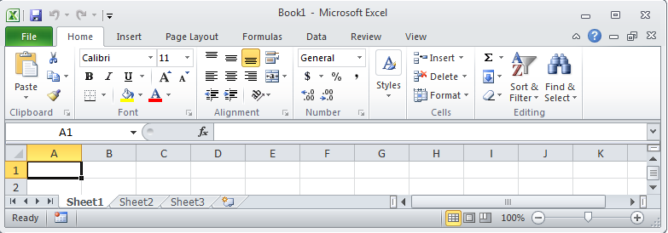
Worksheets
Each spreadsheet can consist of multiple worksheets.
Worksheet
Spreadsheet

Slide 6
When To Use Multiple Worksheets
Rules of thumb:
  When there are multiple sheets of related information, each group of information can be stored in it’s own worksheet.
  Information from one worksheet may be used in another worksheet.
Grades for lecture 01
(worksheet)
Grades for lecture 02
(worksheet)
Grades for lecture 03
(worksheet)
Grades for all sections(spreadsheet)
Budget for dad (worksheet)
Budget for mom
(worksheet)
Budget for sunny-boy
(worksheet)
Family budget (spreadsheet)

Slide 7
When Not To Use Multiple Worksheets
If the information consists of groups of unrelated information then the information about each group should be stored in a separate spreadsheet/workbook rather than implementing it a spreadsheet with multiple worksheets.
Grades for mom (spreadsheet)
Expenses for the family business (spreadsheet)
Daily calorie intake for dad (spreadsheet)

Slide 8
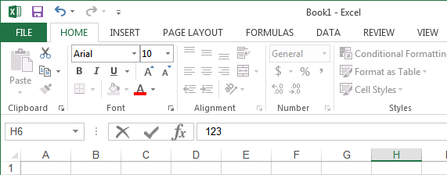
The Excel Ribbon
Tabs are used to group related functions

Slide 9


High Level View Of Each Tab
File:
  Functions associated with documents (creating, opening, saving, printing etc.)
Home (default) **:
  Many of the most commonly used functions (such as formatting fonts, cells and numerical data)
Insert:
  Tables, illustrations, apps, charts, graphs, text, and symbols
Page layout:
  Page setup (many similar to print options)
Formulas *:
  Location and groupings of the pre-created built-in mathematical formulas

Slide 10
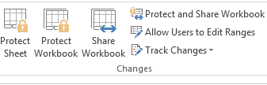
High Level View Of Each Tab (2)
Data:
  Arranging, organizing existing data (e.g., sort)
Review:
  Proofing, Language, Comments, and Changes
View (different views of the same data):
  Workbook Views, Show, Zoom, Window, and Macros

Slide 11
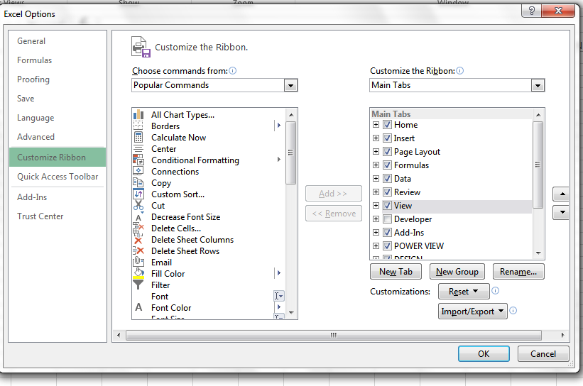
Customizing The Ribbon
Select the “File” Ribbon and then “options”
File -> Options

Slide 12

Constants (Data) Vs. Calculations
In the cell calculations are signified with a leading ‘=‘ (equals sign)
Example:
4.2
3.3
=(A2*0.4)+(B2*0.6)

Slide 13
Designing Spreadsheets: Rules Of Thumb
Do not directly enter values as data that can be calculated from other values.
  Example
    Assignment grade (assume one assignment) = 4.3 (data in cell A2)
    Exam grade (assume only one exam) = 3.3 (data in cell B2)
    Term grade point =(A2*0.4)+(B2*0.6) OR enter 3.66?

Slide 14
Designing Spreadsheets: Rules Of Thumb (2)
Label information so it can be clearly understood

Slide 15
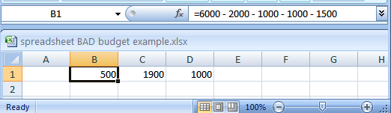
Label Formulas
Similar to data unless the formula is very obvious to the reader of the spreadsheet (and not the author) label all parts.
  Most of the time it won’t be obvious so label most everything.

Slide 16
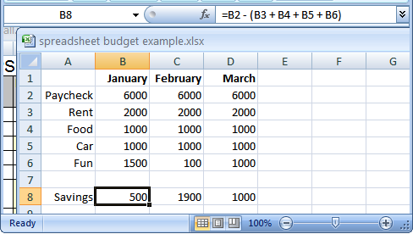
Previous Example: Explicitly Labeled Formulas
Whenever possible label the different parts of a calculation to make easier for the reader to interpret and understand how your calculations work.

Slide 17
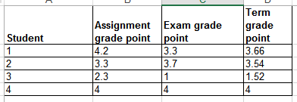
Designing Spreadsheets: Rules Of Thumb (3)
Never enter the same information more than once
  Advantages: reduces size and complexity of the sheet, making changes can be easier.
  Seems obvious? Not always
  Example: What if the previous spreadsheet were used to calculate the grades for a class full of students?
  Some would create the sheet this way:
  spreadsheet example name: example1_grades.xlsx
=(B2*0.4)+(C2*0.6)
=(B2*0.4)+(C2*0.6)
Etc.

Slide 18
Designing Spreadsheets: Rules Of Thumb (4)
=(B2*0.4)+(C2*0.6)
  Issues:
    Clarity: What does the 0.4 & 0.6 refer to (sometimes not so obvious)?
    Making changes: What if the value of each component (40% assignments, 60% exams) changed?
=(B2*0.4)+(C2*0.6)
Etc.

Slide 19
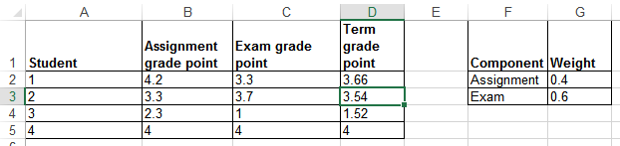
Lookup Tables
As the name implies it contains information that needs to be referred to (“looked up”) in a part of the spreadsheet.
Can be used to address some of the issues related to the previous example:
  Clarity
  Entering the same data multiple times
=(B2*G2)+(C2*G3)

Slide 20
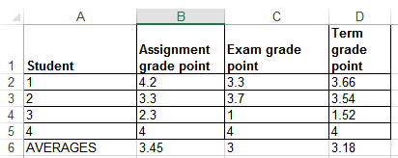
Mathematical Functions
As mentioned calculations must be preceded with an equals sign (actually an assignment operator) e.g., = 2 * 2
The formula can either be directly entered (custom formula) or you can use one of the pre-created ones that come built into the spreadsheet.
Example:
  spreadsheet example name: example2_grades2.xlsx
=(D2+D3+D4+D5)/4
=AVERAGE(D2:D5)

Slide 21
Order Of Operation
When a series of operators from same level are encountered in a cell the expression is evaluated from in order in which they appear (left to right).
  2 + 3 * 3 Equals 11
  8 / 2 ^ 2 Equals 2
Level | Operation | Symbol
1 | Brackets (inner before outer) | ()
2 | Exponent | ^
3 | Multiplication, Division | * /
4 | Addition, Subtraction | + -

Slide 22
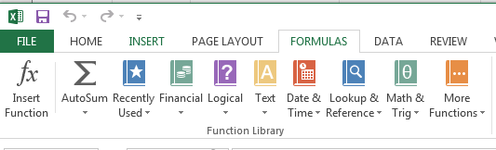
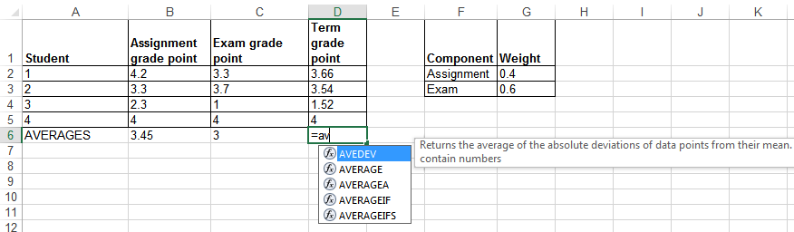
What Function Is Right For Your Situation?
Excel provides reminders.
Recall the location of built in functions.
Also Excel provides “name completion”

Slide 23
Built-In Excel Functions
They will be covered in greater detail in tutorial
  “Lookup functions” excepted (because they relate to a concept that will be covered in lecture “if-branching”)

Slide 24
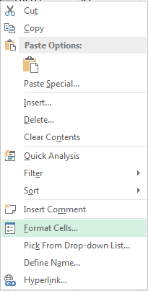
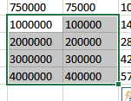
Formatting Cells
Excel provides the ability to format the spreadsheet in various locations of the ribbon.
You also can access these functions in the context of a cell or cells in the spreadsheet.
  Select a cell or cells for which you wish to apply similar formatting effects.
  Right click and select “Format Cells”

Slide 25
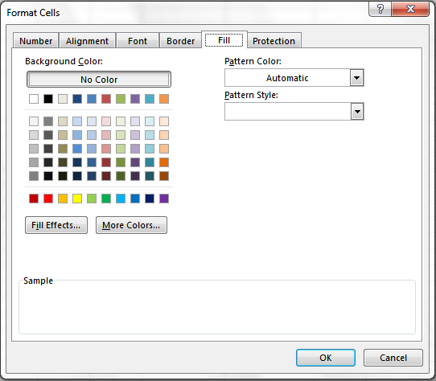
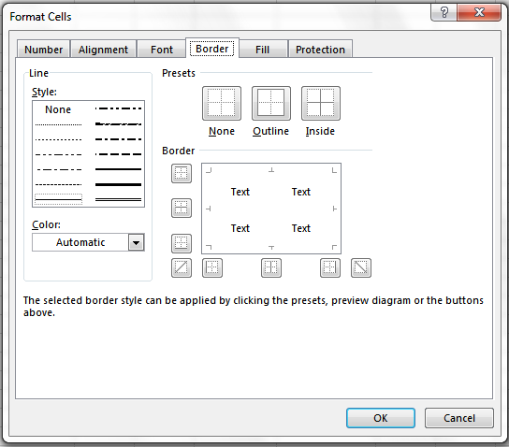
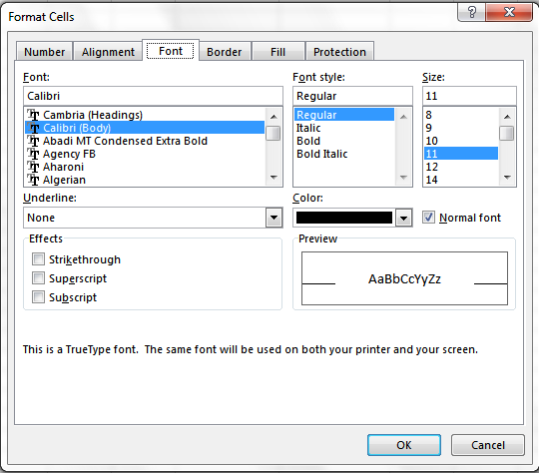
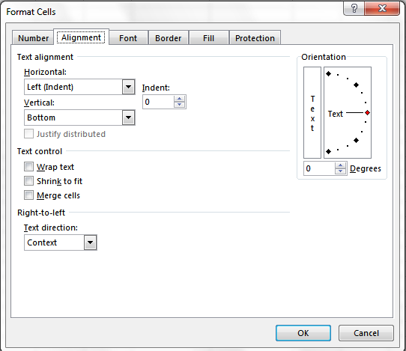
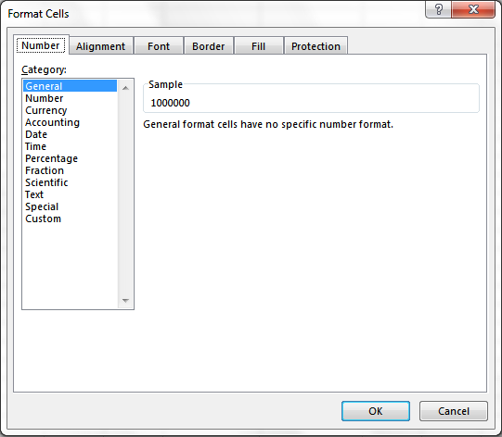
Formatting Cells (2)
General: no special format
Number:
  number of decimal places.
  Separator (every 3 digits)

Slide 26
Formatting Cells (3)
General: no special format
Number:
  Separator (3 digits)
  Several options for displaying negative numbers
Currency:
  Currency sign
  Several options for displaying negative numbers
  Columns aligns decimal points
Accounting:
  Similar to currency but no special options for displaying negative values
Date, Time:
  Both allow display in different formats
Percentage: %
Fraction: /

Slide 27
Formatting Cells (3)
Scientific:
Text:
  Treats everything (even numbers) as text
  Cell is displayed exactly as entered.
Special:
  Country specific information (phone, social insurance number)
Custom:
  Example: prevent Excel from dropping leading zeros

Slide 29
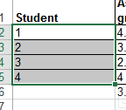
Autofill
Allows for a series to be extended
  E.g., The series “1, 2, 3” (can be extended to include “…4, 5, 6”)
Steps:
  Highlight the cells containing the series to extend (selecting one cell just repeats the contents of that one cell).
  Move the mouse pointer to the ‘handle’ at the bottom right

Slide 30
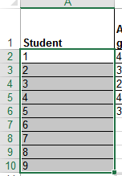
Autofill (2)
    Drag the mouse as far down as you wish the series to be extended to.

Slide 31
‘If-Else’ (Branching)
Returns one value if a condition has been met.
  “If condition met”
Can return another value if the condition hasn’t been met.
  “Else if the condition not met”
Boolean (logic): either true or false that the condition was met
Grade >= 50%
True
False
“Passed”
“Failed”

Slide 32
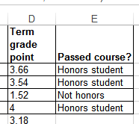
Applying Branches: Grade Example
(Assume that a grade point of 3.0 or greater is required as the minimum cut-off for ‘honors’ for a course).
In column ‘E’ the sheet will display “Honors student” if term grade point is 3.0 or greater “Not honors” otherwise.
  spreadsheet example name: example3_if_grades.xlsx
Condition
Condition true
Condition false “else”
=IF(D2>=3,"Honors student","Not honors")

Slide 33
Format: If-Else
Format:
  =if (<condition to check>,
  <return: condition true>,
  <return: condition false>)
Example:
  =IF(D2>=3,"Honors student","Not honors")
Note: the return value is not limited only to text (quotes)

Slide 34
Comparators
Math | Excel | Meaning
< | < | Less than
> | > | Greater than
= | = | Equal to
≤ | <= | Less than, equal to
≥ | >= | Greater than, equal to
≠ | <> | Not equal to

Slide 35
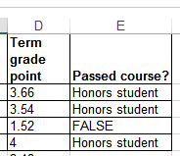
If: Specifying Only The True Case
If only a return value for the true case has been specified:
  When the condition is false e.g., student has not met the honors requirement then literally the text “FALSE” will be displayed.
Previous example: else case (when condition has not been met).
=IF(D2>=3,"Honors student")

Slide 36
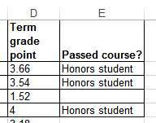
If: Specifying Only The True Case (2)
Consequently:
  Even if a specific return value is desired only for the ‘if condition case’ (true that the condition has been met)
  Something, even an empty message, should be specified for the ‘else case’ (false that the condition has been met).
Previous example: amended
  spreadsheet example name: example3A_if_only_grades.xlsx
=IF(D2>=3,"Honors student","")

Slide 37
Nested Conditions
Applies when different conditions must be checked
Example:
  Display “Perfect” if grade point is 4.0 or greater
  Display “Excellent” if grade point is 3.0 or greater but less than 4.0
  Display “Adequate” if grade point is 2.0 or greater but less than 3.0
  Display “Pass” if grade point is 1.0 or greater but less than 2.0
  Otherwise display “Fail”
  spreadsheet example name: example4_nested_if_grades.xlsx

Slide 38
Previous Grade Example: Specifying Conditions
GPA >= 4.0?
True
“Perfect”
False
Nesting
Later conditions are described as being ‘nested’ within early conditions
The GPA cases for 3.0, 2.0, 1.0 are described as being ‘nested’ within the 4.0 case (only checked if the previous case proves to be false)
GPA >= 3.0?
True
“Excellent”
False
GPA >= 2.0?
True
“Adequate”
False
GPA >= 1.0?
True
“Pass”
False
“Fail”

Slide 39
Previous Example: Initial Cases
If GPA >= 4.0 “Perfect”, if 3.0 <= GPA < 4.0, “Excellent”
TRUE >= 4.0
FALSE >= 4.0
TRUE >= 3.0

Slide 40
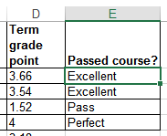
Previous Example: Nested Solution
T
=IF(D2>=4,"Perfect",
IF(D2>=3,"Excellent",
IF(D2>=2,"Adequate",
IF(D2>=1,"Pass",
"Fail"))))
F
=IF(D2>=4,"Perfect",IF(D2>=3,"Excellent",IF(D2>=2,"Adequate",IF(D2>=1,"Pass","Fail"))))

Slide 41
Nested “If’s”
Format:
  =IF(<condition to check>, <return: true>, <return: condition false>)
Example:
  =IF(D5>=4,"Perfect", )
Another if-check
if (<condition to check>, <return: true>, <return: false>)
IF(D5>=3,"Excellent","")

Slide 42
Logical Operations In Excel
The basic logical operations: AND, OR, NOT can be invoked as functions in Excel
Format:
  AND(<True or False>,<True or False>)
  OR(<True or False>,<True or False>)
  NOT (<True or False>)
Examples:
  AND(C1>=45,D1=“John Smith”) # Requires both
  OR(C1>=0,D2>=0) # Requires either
  NOT(AA12) # AA12 Must contain a logical: TRUE, FALSE Value
TRUE

Slide 43
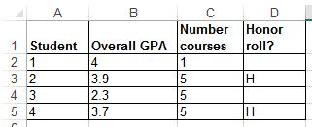
Logic And IF’s: Example
The honor roll for each semester requires that grade point is 3.7 or greater and a full load of at least 5 courses must be taken.
Signify when a student has met the honor roll requirements with an “H”, blank cell otherwise.
  Spreadsheet example name: example5_if_logic.xlsx
=IF(AND(B5>=3.7,C5>=5),"H","")

Slide 44
Conditional Formatting
A very practical example of how conditional branching “if’s” can be applied.
Use of conditional formatting will be covered in tutorial.

Slide 45
Lookup Tables
Can be instead of many nested IF’s.
  Easier to enter, update, understand.
Requirements of previous example:
  0 <= GPA < 1: Fail
  1 <= GPA < 2 : Pass
  2 <= GPA < 3 : Adequate
  3 <= GPA < 4 : Excellent
  GPA >= 4 : Perfect
Previous solution:
=IF(D2>=4,"Perfect",IF(D2>=3,"Excellent",IF(D2>=2,"Adequate",IF(D2>=1,"Pass","Fail"))))

Slide 46
VLOOKUP
A function that can be used to lookup values from a table.
  Another function (“LOOKUP”) will be covered in tutorial
Format:
  VLOOKUP(<Lookup value>, *
  <Lookup table Start : End>, *
  <Lookup table Return value>, *
  <Exact match required?>)
  A star * indicates a required value.
Example:
  =VLOOKUP(D2, D11:E15, 2)
Cell:
Contains value to find in table e.g., a grade point
Lookup table:
Start : End
cell coordinates
Lookup table:
Column value to return
(1 = first col. ‘D’,
2 = second col. ‘E’)

Slide 47
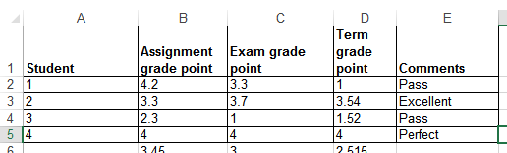
VLOOKUP: Previous Example
=VLOOKUP(D2,D11:E15,2)
Min. GPA | Comment
0 | Fail
1 | Pass
2 | Adequate
3 | Excellent
4 | Perfect
  Spreadsheet example name: example6A_vlookup.xlsx

Slide 48
VLOOKUP: Optional Value = TRUE
VLOOKUP(=VLOOKUP(D2,D11:E15,2,TRUE))
TRUE:
  Look for an exact match or approximate match.
  If an exact match is not found, the next largest value that is less than lookup value is returned.
  If this value is omitted then it’s the equivalent of including a ‘TRUE’ value.
  Values must be sorted in ascending order
GPA = 3.54
Min. GPA | Comment
0 | Fail
1 | Pass
2 | Adequate
3 | Excellent
4 | Perfect
>3.54?
>3.54?
>3.54?
>3.54?
⬅ Backup and use this value Return “Excellent”
>3.54?..No!

Slide 49
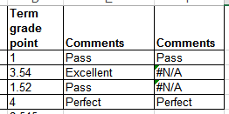
VLOOKUP: Optional Value = FALSE
VLOOKUP(=VLOOKUP(D2,D11:E15,2,FALSE))
FALSE:
  Looks only for an exact match
  If a match is found then the value at the specified location is returned.
  Else if no match is found the an error message is displayed.
  Table values do not have to be sorted.
Min. GPA | Comment
0 | Fail
1 | Pass
2 | Adequate
3 | Excellent
4 | Perfect

Slide 50
Additional Resources: VLOOKUP
For more information about VLOOKUP and other Excel functions use the help lookup “?”
Specific help for VLOOKUP:
  http://office.microsoft.com/en-ca/excel-help/vlookup-HP005209335.aspx

Slide 51
Testing Spreadsheets
Test formulas to ensure that they are correct.
  Enter a few test values and see if the results match expectations.
  Simple interest example:
  Amount = Principle + (Principle * Interest rate * Time)
  E.g., $100 at 10% for 3 years
  Amount = 100 + (100 * 0.1 * 3)
  = 100 + (30)
  = $130
  Some example test cases:
  Nothing to invest: principle is nothing, everything else non-zero.
  Interest rates are rock bottom: zero interest rates, everything else non-zero
  No time passed: time is zero, everything else non-zero.
  Normal case: No zero values for: principle, interest or time.

Slide 52
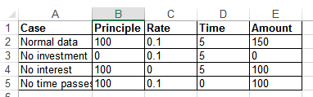
Example Testing A Formula
<- All non-zero
<- No principle
<- No interest
<- No time elapsed

Slide 53
Testing Ranges
Min. GPA | Comment
0 | Fail
1 | Pass
2 | Adequate
3 | Excellent
4 | Perfect
The following are the minimum test cases
Provide test values for each range
  In this example try grade points of 0, 1, 2, 3, 4
Also for at least one of the ranges test the boundaries (just above and below)
  Example: testing the boundary for 1 / “Pass”
  Slightly above a boundary value e.g., 0.9 should return “Fail”
  Slightly above a boundary value e.g., 1.1 should return “Pass”

Slide 54
Methods Of Referring To Cells
Absolute
Relative

Slide 55
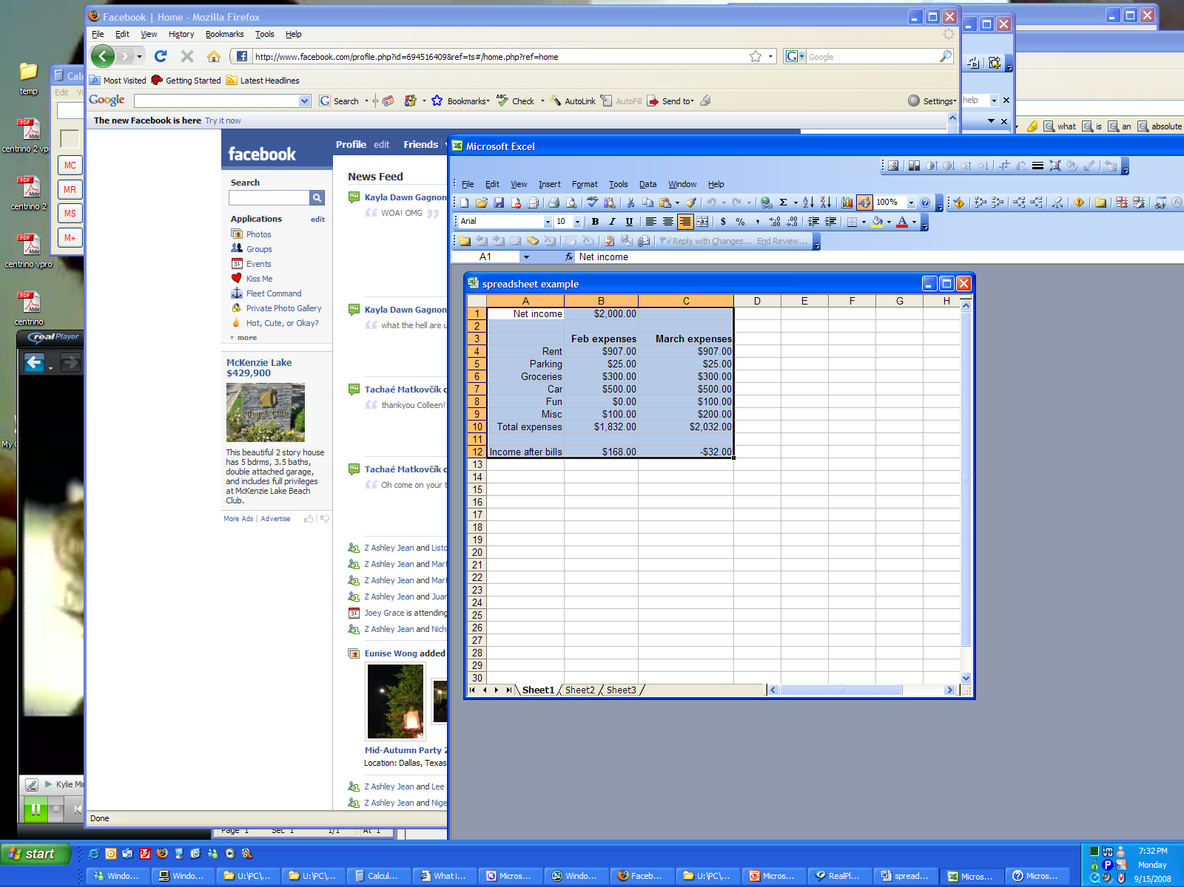
Absolute Reference
When a reference to an cell or range of cells doesn’t change when the contents of a cell or cells is copied or the sheet changes in size.
Original formula (B12)
=$B$1-B10
Copied (C12)
=$B$1-C10

Slide 56
Absolute Reference (2)
Original formula (B12)
=$B$1-B10
Copied (C12)
=$B$1-C10
Absolute reference
Absolute reference
Absolute reference because the same (absolute) reference to cell B1 is made when the formula is copied.

Slide 57
Absolute Reference (3)
Typically it’s used in conjunction with constants (data that won’t change).
References to B1 are absolute because income doesn’t change
Original formula (B12)
=$B$1-B10
Copied (C12)
=$B$1-C10

Slide 58
Relative Reference
A reference to a cell or group of cells that may change if the cell/cells are copied or the sheet changes in size.
Original formula (B12)
=$B$1-B10
Copied (C12)
=$B$1-C10

Slide 59
Relative Reference (2)
Note:
Total expenses (row 10) is a calculated value. It sums rows 4 – 9.
Original formula (B12)
=$B$1-B10
Copied (C12)
=$B$1-C10
Relative reference
Relative reference
Relative reference because the copied formula will change relative to how far it’s copied.

Slide 60
Relative Reference (3)
Typically it’s used with variable data (that may change over time or in different parts of the sheet).
Total expenses may change from month-to-month so references will likely be relative.
Original formula (B12)
=$B$1-B10
Copied (C12)
=$B$1-C10

Slide 61
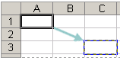
Absolute, Relative And Mixed References: Examples¹
Example | Reference type | Copied result
$A$1 | Absolute column Absolute row | $A$1
A$1 | Relative column Absolute row | C$1
$A1 | Absolute column Relative row | $A3
A1 | Relative column Relative row | C3
1 Examples from the Excel 2003 Help System

Slide 62
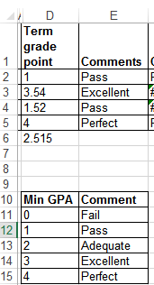
Absolute & Relative References: Extra
With the previous examples, which part of each formula should be an absolute reference and which part should be a relative reference.
=VLOOKUP(D2,D11:E15,2)
  Don’t look at the solution until you have tried working it out yourself!
  Spreadsheet solution name: example6B_vlookup_absolute_relative_addressing

Slide 63
Graphic Design And Spreadsheets
Using color
C.R.A.P.
Fonts and font effects
Text vs. graphs and charts

Slide 64
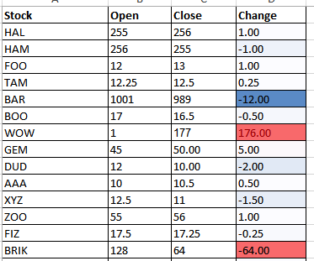
Color: Properly Used
When used sparingly color can draw attention to important information.
This is an especially valuable tool when there is a large amount of information.
  The information may be “all there” but don’t make it any harder than it has to be for the viewer to find it.

Slide 65
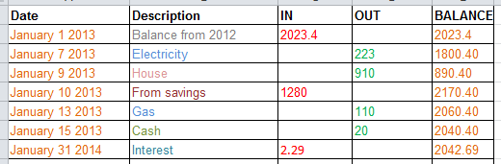
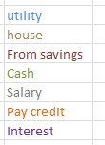
Color Misused
The overuse of color:
  Reduces it’s ability to make information stand out.
  Makes it harder to understand what information is mapped to a particular color.

Slide 66
Rule Of Thumb For Color: Make It Subtle
We have all seen the use of ‘loud’ and clashing colors that can make text very hard to read.
Balance the use of color between noticeability and subtlety
  Make it as subtle as possible while still conveying the necessary information using color
Ingredients
Sugar, lactose, fructose, corn syrup, glucose…lots of carbohydrates
JT: I’ve actually seem green-red color combinations on listings of ingredients

Slide 67
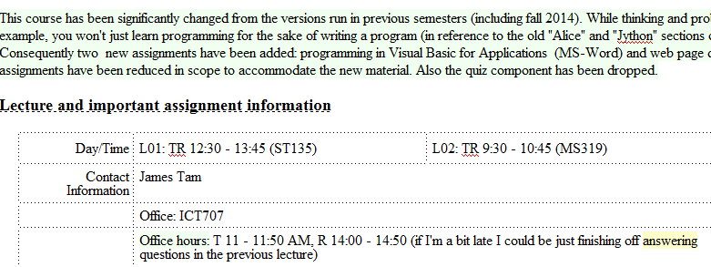
Additional Issues Associated With Color
Color blindness affects a portion of the population:
  The majority of people who are color blind are red-green color blind so using only these colors to represent information should be avoided.
Field size
  The larger the area to be color coded, the more easily that colors can be distinguished.
Larger areas: colors can be more subtle
Smaller areas: colors may have to employ greater contrast

Slide 68
Additional Issues Associated With Color (2)
  When objects are small (text or small graphics) and color is used to distinguish information use highly saturated colors.
Conventions
  “Commonly accepted” conventions can vary widely by culture and their use should be carefully considered
This is important information!
This is important information!

Slide 69
Color And Cultural Associations
 | Egypt | China | Japan | India | France
Red | Death | Happiness | Anger, Danger | Life, creativity | Aristocracy, Freedom, Peace
Blue | Virtue, Faith, Truth | Heavens, Clouds | Villainy |  | Freedom, peace
Green | Fertility, Strength | Ming Dynasty, Heavens, Clouds | Future, Youth, Energy | Prosperity, Fertility | Criminality
Yellow | Happiness, Prosperity | Birth, Wealth, Power | Grace, Nobility | Success | Temporary
White | Joy | Death, Purity | Death | Death, Purity | Neutrality
From “How Fluent is Your Interface? Designing for International Users” Proceedings of the INTERCHI’93. Russo P. and Boor S.

Slide 70
Fonts And Font Effects
Example fonts:
  Ariel
  Calibri
  Helvetica
  Times New Roman
Font effects:
  Italics
  Bold
  Underline
  Normal
Font sizes

Slide 71
Fonts And Font Effects (2)
As a rule of thumb use no more than 3 sizes and font effects in a particular document.
  Similar to color, their overuse reduces their effectiveness and makes it harder to interpret meaning.
  Also if you don’t know much about fonts just stick to the common or default ones provided (Ariel, Calibri, Helvetica, Times New Roman)
  If you’re not sure if a font is a good one for a particular situation then it probably isn’t:
    (This is a real font called “Wing dings”): wing dings

Slide 72
C.R.A.P.¹
Simple design principles that can be applied in a variety of situations
Contrast
Repetition
Alignment
Proximity
1 From “The non-designers type book” by Robin Williams (Peach Pit express)

Slide 73
Contrast & Repetition
  Contrast:
  Make different things look significantly different
Repetition (Consistency):
  Repeat conventions throughout the interface to tie elements together

Slide 74
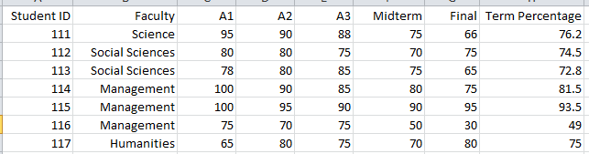
Example: No Contrast

Slide 75
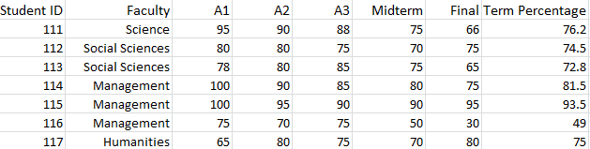
Example: Weak Contrast

Slide 76
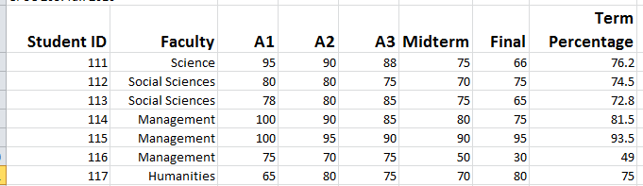
Example: Headings Stand Out
Good contrast:
  If contrast is not (or weakly) employed for a small set of data it may not be a large issue.
  But for larger data sets (“real data”) it may make it more work than is necessary.
Repetition:
  Same fonts, font sizes and font effects used in the headings vs. the data.
  Makes it easier to see and understand the structure

Slide 77
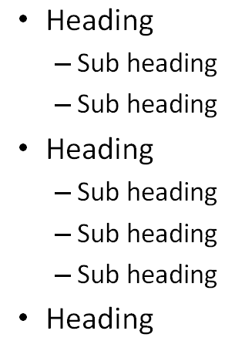
Alignment
It can be used to structure a document (represents hierarchical relationships).

Slide 78
Alignment And Repetition
Consistent alignment (left or right) can be used to represent relationships.
  All the data in a column are consistently aligned to signify they belong a group
Example: movie credits
The Kung Fu master
Arch villain
Kung Fu student #1
Kung Fu student #2
Thug #1
Thug #2
Damsel in distress
James “The Bullet” Tam
James (Evil dude) Tam
Eager Tam1
Eager Tam2
Cannon-fodder Tam #1
Cannon-fodder Tam #2
Jamie Tametta

Slide 79
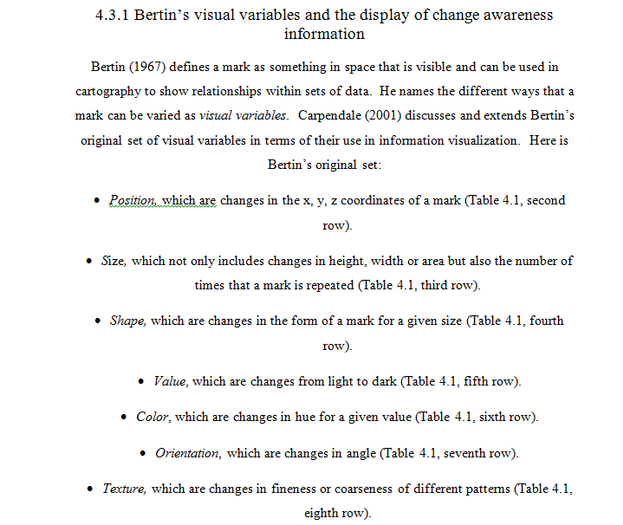
Centre Alignment
Sparing use can be used to provide contrast e.g., slide titles vs. content.
Because they remove a common method for structuring a document it can make reading text more difficult.

Slide 80
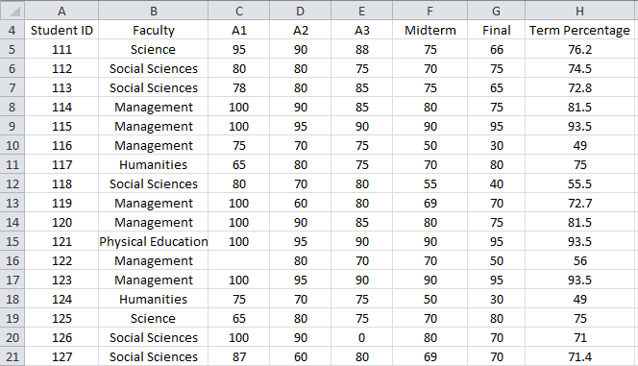
Center Alignment
Again: while sparing use of center alignment can be used to provide contrast it should NEVER be used as the default in documents such as spreadsheets.

Slide 81
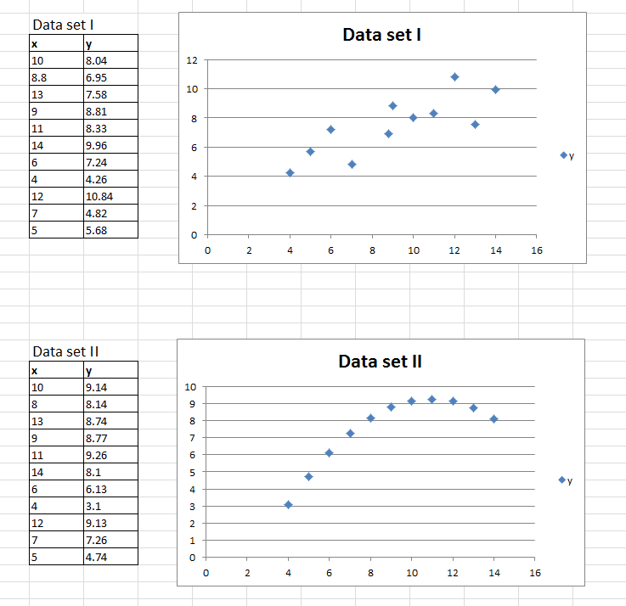
Proximity
Related items are in close proximity
Unrelated items are separated

Slide 82
Text Or Graphics?
Text?
A graph or chart?
  What type to use? (Pie, bar, line etc.)

Slide 83
The Benefits Of Using Text
Text is the best representation to use when accuracy is paramount.
Example term grades for individual students.
Student ID | Percentage
111 | 95
222 | 88
333 | 100
444 | 66
555 | 86
666 | 79
Vs.

Slide 84
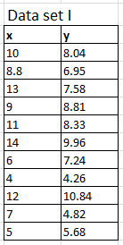
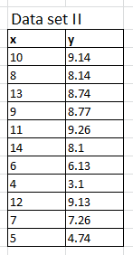
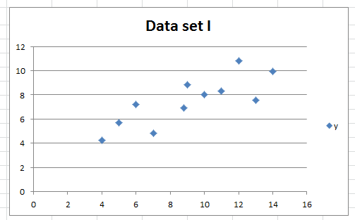
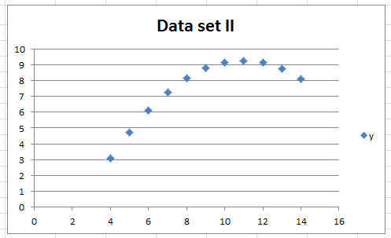
Benefits Of Graphics
Graphics:
  Useful for illustrating relationships or visualizing patterns
Example: Anscombe’s Quartet¹
  Shown one way (a set of numbered pairs) it’s hard to analyze the information e.g., is there any trends or patterns?
Anscombe, F. J. (1973). "Graphs in Statistical Analysis". American Statistician 27 (1): 17–21

Slide 85
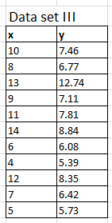



Benefits Of Graphics (2)
Example: Anscombe’s Quartet (continued)

Slide 86
Benefits Of Graphics (3)
Graphical representations can make a powerful impression!
Letter | No. occurrences
F | 0
D | 1
D+ | 1
C- | 2
C | 8
C+ | 12
B- | 17
B | 25
B+ | 33
A- | 45
A | 30
A+ | 10

Slide 87

Ways Of Graphically Representing Information
Pie chart
Bar graph
Line graph

Slide 88
Pie Charts
Good for showing proportions, how much of the whole does each item contribute.
It’s poor for showing exact numeric values.

Slide 89
Bar And Line Graphs
  For showing trends
  Comparing functions

Slide 90
Rules Of Thumb For Graphs
The X axis is used to plot known data (e.g., letter grades), while the Y axis is used to plot the unknown data (e.g., the number of students who received particular letter grades).

Slide 91
Rules Of Thumb For Graphs (2)
    Bar graphs are used to plot non-continuous data
      e.g., the number of patients that go to different hospitals.
    Line graph are used to plot continuous data
      e.g., mortality trends over time.

Slide 92
Excel And Other Spreadsheets
Excel:
  The most commonly used format (along with other MS-Office products).
  Other office software claiming compatibility with MS-Office documents aren’t always 100% compatible.
  Familiar interface
Google spreadsheet:
  Part of the “Google docs” suite of programs.
  Why use it: It’s free and doesn’t require an install on a particular computer operating system.
  Normally documents are saved on the Google servers (convenient but balance that out vs. potential security concerns – private data stored on another company’s servers).
  Simple interface but fewer features than office.

Slide 93
Excel And Other Spreadsheets
Open Office:
  Acquired by Sun Microsystems and eventually provided in an open source form (access license is free)
  Documents are stored in its own format but could read other formats (including MS-Office).
  Available for many operating systems: Linux, Windows and later for it was also available for Solaris and Apple’s OS X.
  Now part of the Apache Software Foundation
  Free
  Not as widely used as MS-Office and not 100% compatible
  Interface may be foreign to MS-Office users
  https://www.openoffice.org/

Slide 94
Sources: Other Spreadsheet
When looking online for comparisons beware of biased reviews e.g., “The Google spreadsheet must be good because everything that comes out of that company is just great!” – Paraphrased from an actual ‘review’
Fairly reasonable sources
  http://www.cogniview.com/blog/spreadsheet-battle-excel-vs-google/
  http://www.usatoday.com/story/tech/2013/08/31/review-google-apple-decent-contenders-to-office/2723315/
  http://www.techradar.com/reviews/pc-mac/software/business-and-finance-software/apache-openoffice-4-0-1171091/review

Slide 95
After This Section You Should Now Know
The benefit of electronic over paper spreadsheets
Spreadsheets 101: The basic layout and components of a spreadsheet
What is a worksheet
  When to use multiple spreadsheets vs. multiple worksheets
How Excel groups functions according to tabs on the ribbon
  What are the most commonly used tabs and what some of the functions available on those tabs
What is the difference between constants (data) and calculations (formulas)
  How is a formula differentiated from data

Slide 96
After This Section You Should Now Know (2)
The three rules of thumb for designing spreadsheets
  Don’t make something data if it can be derived
  Label everything
  Don’t duplicate data
Lookup tables
  How to create a use a lookup table
Formulas:
  Directly entering custom formulas
  Using built-in pre-created formulas
  What is the order of operation for common operators
How to format cells using the “format cell” option
  What is the effect of different numeric formatting options
How to use the auto fill operation

Slide 97
After This Section You Should Now Know (3)
How to use ‘if-else’ for branches that return different values
  The different ways of expressing logical comparators
  How to write or evaluate nested ‘if’s’
Logical operations in Excel: AND, OR, NOT
  How to write or evaluate logical operations
  How to apply the logical operations in conjunction with the ‘if-else’
How to use the VLOOKUP function
How to come up with set of reasonable test cases for a spreadsheet
  Formulas and ranges
What is the difference between an absolute vs. relative cell reference and when to use each one

Slide 98
After This Section You Should Now Know (4)
Rules for using and not misusing color
Issues associated with color: color blindness, field size, conventions for color
Rules of thumb for using fonts and font effects
C.R.A.P.
  What does each part mean
  How it can be used for effective graphic design
When to use text vs. graphics
When to use a pie chart vs. bar graph vs. line graph

Slide 99
Copyright Notification
“Unless otherwise indicated, all images in this presentation are used with permission from Microsoft.”
Images of spreadsheets (save VisiCalc) are curtesy of James Tam

