Slide 1
JavaScript
You will learn more advanced html tags for creating graphical ‘GUI’ controls and the basics of JavaScript programming.
Pictures courtesy of James Tam

Slide 2
Advanced HTML
In the last section you learned how to use html to: format text, embed content and link to other pages.
In this section you will learn how to use HTML to create graphical controls such as buttons and input fields.

Slide 3

Creating GUI Controls
Format:
  <input type="<control type>" value="<Text description>"/>
Name of example: 1emptyControl.htm
  <input type="button" value="Press me"/>
Pressing the button does nothing! Why???
You need to write the JavaScript instructions to indicate what happens next (details come later)

Slide 4



Types Of GUI Controls
GUI control | HTML | Appearance
Button | <input type="button" value="Press"/>
Checkbox (select 1+) | <input type="checkbox" value="Checkbox one of many"/>
Password (input hidden) | <input type="password" value="def"/>
Radio (select exactly 1) | <input type="radio"/>
Text (single line input) | <input type="Text" value="Type a line of text here"/>
There’s numerous places online where you can find information about how to use these controls
Example:
https://msdn.microsoft.com/en-us/library/ie/ms535262(v=vs.85).aspx

Slide 5
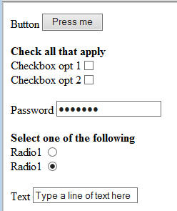

Graphical Controls: More Complete Example
Name of example: 2manyEmptyControls.htm
  Button <input type="button" value="Press me"/><br>
  <br>
  <b>Check all that apply</b><br>
  Checkbox opt 1<input type="checkbox"/><br>
  Checkbox opt 2<input type="checkbox"/><br>
  <br>
  Password <input type="password" value="default"/><br>
  <br>
  <b>Select one of the following</b><br>
  Radio1 <input type="radio"/><br>
  Radio2 <input type="radio" checked="checked"/><br>
  <br>
  Text <input type="Text" value="Type a line of text here"/>

Slide 6
Adding JavaScript To A Webpage
This is where you can augment a web page to make it interactive.
  The JavaScript instructions must be enclosed with a ‘script’ tag at the start of your webpage.
  <script>
  </script>
JavaScript program
Similar to defining a ‘sub’ in VBA you need to define a ‘function’ in JavaScript.
A function is a series of instructions that run when an event occurs e.g., the user clicks on a button

Slide 7
Defining A JavaScript Function
Format:
  function <function name>()
  {
  }
Example:
  function saySmartResponse()
  {
  alert("Don't press that button");
  }
Instructions in body (indent 4 spaces);
Notes:
https://msdn.microsoft.com/en-us/library/ie/ms535841(v=vs.85).aspx

Slide 8
Getting The GUI To React To User Input
Name of example: 3controlsButton.htm
  <script>
  function saySmartResponse()
  {
  alert("Don't press that button");
  }
  </script>
  <input type="button" value="Press me" onclick="saySmartResponse()"/>
onclick
When user clicks on button

Slide 9
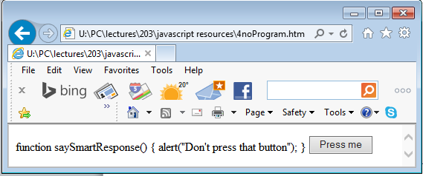
Common Mistake #1
Forgetting the opening and closing script tags
Name of example: 4noProgram.htm
  function saySmartResponse()
  {
  alert("Don't press that button");
  }
  <input type="button" value="Press me"
  onclick="saySmartResponse()"/>
Result

Slide 10
Variables
Format:
  var <variable name> = <value>;
Example:
  var num = 2;

Slide 11
Variables: Contrast Between Languages
Contrast with VBA:
  dim num as Long
  num = 2
Unlike VBA the type of information to be stored in the variable doesn’t have to be specified:
  var num1 = 12;
  var num2 = 1.5;
  var text = "boo2!";
Data specifies integer variable
Data specifies real number variable
Data specifies String variable (text)
Notes:
* While JavaScript allows Strings to be enclosed in single quotes most languages don’t do this so it’s not a good idea to do it like this

Slide 12
A Program With Variables
Name of example: 5variables.htm
  <script>
  function buttonPress()
  {
  var num = 2;
  alert("Value = " + num);
  }
  </script>
  <input type="button" value="Press" onclick="buttonPress()"/><br>

Slide 13
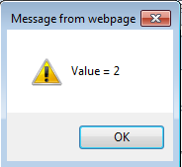
Common Mistake #2
A variable is just that – it can change as a program runs.
  <script>
  function buttonPress()
  {
  var num = 2;
  alert("Value = " + num);
  }
  </script>
Vs.
  <script>
  function buttonPress()
  {
  alert("Value = 2");
  }
  </script>

Slide 14
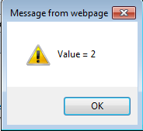
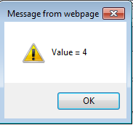
Changing The Value Of Variable
<script>
function buttonPress()
{
var num = 2;
alert("Value = " + num);
num = num * 2;
alert("Value = " + num);
}
</script>

Slide 15
Naming Variables
JavaScript language requirement (syntax ~ grammar)
  Name can be alphanumeric but cannot start with a number
  num1 (OK) vs. 2num (Not OK)
  Spaces are not allowed
  first name (Not OK) vs. firstName OR first_name (OK)
  Style requirement (~quality writing)
  Variable names should be self-descriptive and lower case
  x, foo, AGE (Not OK) vs. firstName, age, height (OK)
Notes:
Constants
// define my_fav as a constant and give it the value 7
const my_fav = 7;
// this will fail silently in Firefox and Chrome (but does not fail in Safari)
my_fav = 20;

Slide 16
Operators
The common operators that you will see in JavaScript are the same as other languages and applications (such as MS-Excel)
Operation | JavaScript operator
Division | /
Modulo (remainder) | %
Multiplication | *
Subtraction | /
Addition₁ | +
1 Note:
Performs mathematical addition only if all the inputs are numeric
  e.g., 12 + 12 = 24
If one or more inputs are strings then a concatenation is performed
e.g., alert("Value = " + num);
Notes:
num = "hi" + 2;
alert("Value = " + num);
Yields hi2

Slide 17
Documentation
Single line
// Everything to the end of the line is not counted as a
// JavaScript instruction (used to explain details of the
// program to other programmers).
// Works just like prefacing text with the ' (VBA)
Multiple line
  Start of documentation uses /*
  End of documentation uses */
  Everything in between is not counted as a JavaScript instruction
  /*
  Author: James Tam
  Tutorial: 888
  */

Slide 18
Where To Document
Immediately after the <script> “open tag”
  <script>
  // Single line documentation
  /*
  Multi-line documentation
  */
  function <function name>()
  {
  // If needed additional documentation can be added here.
  }
  </script>

Slide 19
Documentation: Common Mistake #3
Take care not to nest multi-line comments
This is an error!
  /*
  /* Author: James Tam */
  Tutorial: 888
  */
Invalid statement (not JavaScript)

Slide 20
Minimum Documentation Needed For CPSC 203
// Name
// Student ID
// Tutorial #
/*
A list of each program feature and an indication if the
feature was completed (yes or no).
*/
// (If applicable): explicit instructions on the name and
// location of any data files required. For a
// detailed example see: 17forLoop2.htm

Slide 21
Multiple Controls
If you need to identify one control from another then you can use the ‘id’ attribute when creating a control using html
Format:
  id ="<Descriptive string>"
Example:
  <input type="text" id="text1"/>
When choosing a descriptive string to identify the control it’s a good idea to apply the same conventions used as when you are naming variables e.g., no spaces, good and self-descriptive names

Slide 22
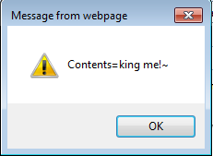

Example Of Using Multiple Controls
Name of example: 6multipleControls.htm
  <script>
  function buttonPress()
  {
  var text1 = document.getElementById("text1").value;
  alert("Contents=" + text1)
  }
  </script>
  <input type="button" value="Press me" onclick="buttonPress()"/><br>
  <input type="text" id="text1" value="default1"/><br>

Slide 23
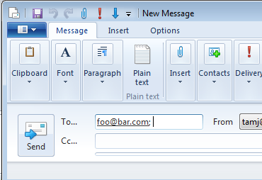
Sending Email: Basic Version
Name of example: 7sendingEmail.htm
  <script>
  function buttonPress()
  {
  window.open("mailto:foo@bar.com");
  }
  </script>
  <input type="button" value="Send mail" onclick="buttonPress()"/>
Notes:
Left out Window.open from final exam API

Slide 24
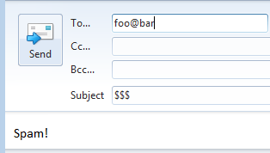
Sending Mail: Fixed Subject And Body
Name of example: 8sendingEmail.htm
  <script>
  function buttonPress()
  {
  window.open("mailto:foo@bar" + "?subject=$$$
  &body=Spam!");
  }
  </script>
  <input type="button" value="Send mail" onclick="buttonPress()"/>

Slide 25
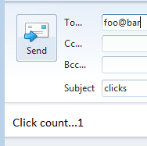
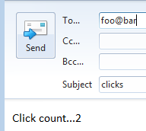
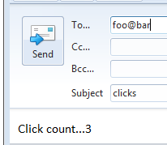
Sending Mail: Fixed Subject And Body Is Variable
Name of example: 9sendingEmail.htm
  <script>
  var count = 0
  function buttonPress()
  {
  count = count + 1;
  window.open("mailto:foo@bar" +
  "?subject=clicks&body=Click count..."+count);
  }
  </script>
  <input type="button" value="Send mail" onclick="buttonPress()"/>
Creating ‘count’ outside of the function means that the previous count is retained
Notes:
* Modify program and show what happens if count is inside the function

Slide 26
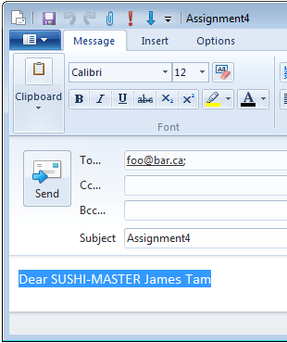
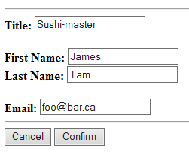
Sending Mail: Assignment
Variable data
Fixed data: subject is always the same
Variable data
Example: 6multipleControls.htm
One example of accessing the data value of a control

Slide 27
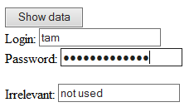
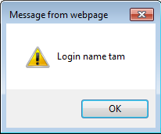
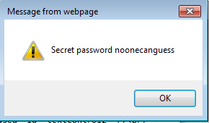
Accessing Data Of GUI Controls
Name of example: 10getData.htm
  <script>
  function buttonPress()
  {
  var login = document.getElementById("textControl1").value;
  var password =
  document.getElementById("passWordControl1").value;
  alert("Login name "+ login);
  alert("Secret password "+ password);
  }
  </script>
  <input type="button" value="Show data" onclick="buttonPress()"/><br>
  Login: <input type="text" id="textControl1" /><br>
  Password: <input type="password" id="passwordControl1"/><br>
  <br>
  Irrelevant: <input type="text" value="not used" id="textControl2" /><br>

Slide 28
Acknowledgments
The functional requirements of the email program were based on the assignment description produced by James Tam
The different versions of the email program were based on a solution produced by Omar Addam

Slide 29
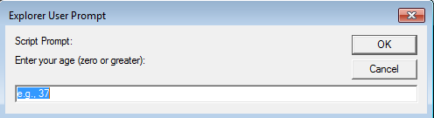
Getting User Input
Getting Input:
  Format:
  <variable> = prompt("<Prompting message>", "<default input>")
  Example (assume we create a variable called ‘age’):
  age = prompt("Enter your age (zero or greater):","e.g., 37");

Slide 30
Getting JavaScript To Run Automatically
Name of example: 11getInputAutoRun.htm
  <script>
  function main()
  {
  var age = -1;
  age = prompt("Enter your age (zero or greater):","e.g., 37");
  };
  window.onload=main;
  </script>

Slide 31
Branching: IF
VBA
  if then
  if then, else
  if then, elseif, else
JavaScript
  if
  if, else
  if, else if, else
When to use
  React when true
  React true & false
  At most only one if-case can be true (“select one of the following”)

Slide 32
If: General Format
if (<Boolean expression>)
{
<body>; // Indent the body by an additional 4 spaces
}

Slide 33
If: An Example
Name of example: 12ifExample.htm
  <script>
  function main()
  {
  var age = -1;
  age = prompt("Enter your age (zero or greater):","e.g., 37");
  if (age < 0)
  {
  alert("Age cannot be negative");
  }
  };
  window.onload=main;
  </script>

Slide 34
If-Else: General Format
if (<Boolean expression>)
{
<body if>;
}
else
{
<body else>;
}

Slide 35
If-Else: An Example
Name of example: 13ifElseExample.htm
  <script>
  function main()
  {
  var age = -1;
  age = prompt("Enter your age (zero or greater):","e.g., 37");
  if (age < 0)
  {
  alert("Age cannot be negative");
  }
  else
  {
  alert("Age verified as OK");
  }
  };
  window.onload=main;
  </script>

Slide 36
If, Else-If: General Format
if (<Boolean expression1>)
{
<body if1>;
}
else if (<Boolean expression2>)
{
<body if1>;
}
...
else // Not mandatory/optional
{
<body else>;
}

Slide 37
If, Else-If: An Example
Name of example: 14ifElseIfExample.htm
  window.onload=main;
  function main()
  {
  var age = -1;
  MAX_AGE = 122; // const MAX_AGE = 122 not supported by IE
  age = prompt("Enter your age (zero or greater):","e.g., 37");
  if (age < 0)
  {
  alert("Age cannot be negative");
  }
  else if (age < 6)
  {
  alert("Little kid");
  }

Slide 38
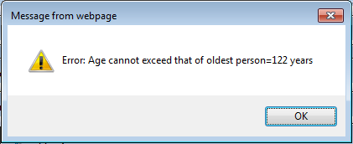
If, Else-If: An Example (2)
else if (age < 18)
{
alert("Grade schooler");
}
else if (age < 65)
{
alert("Non-senior");
}
else if (age <= MAX_AGE)
{
alert("Senor citizen");
}
else
{
alert("Error: Age cannot exceed that of oldest person="
+ MAX_AGE + " years");
}

Slide 39
Allowable Operators For Boolean Expressions
if (value operator value) then
JavaScript Mathematical
operator equivalent Meaning Example
< < Less than 5 < 3
> > Greater than 5 > 3
== = Equal to 5 == 3
<= ≤ Less than or equal to 5 <= 5
>= ≥ Greater than or equal to 5 >= 4
!= ≠ Not equal to x != 5
Notes:
http://www.w3schools.com/js/js_comparisons.asp

Slide 40
Logical Operators
Logical operation JavaScript Example
AND && if (x > 0 && y > 0)
OR || if (x > 0 || y > 0)
NOT ! if !(x > 0)

Slide 41
Loops
For
While

Slide 42
For Loops: General Format
for (<Set counter to initial>;
<Boolean Expression>;
<Increment or decrement counter>)
{
<Body>; // Indent 4 spaces
}
Note: the three statements in the form loop do not have to reside on three separate lines.

Slide 43
For Loops: An Example
Name of example: 15forLoop1Example.htm
  <script>
  function main()
  {
  var i = -1;
  var last = -1;
  last = prompt("Enter last value in number series: ", "");
  for (i = 0; i <= last; i = i + 1)
  {
  alert("i=" + i);
  }
  };
  window.onload=main;
  </script>

Slide 44
While Loops: General Format
while (Boolean Expression)
{
<Body>; // Indent 4 spaces
}

Slide 45
While Loops: An Example
Name of example: 16whileLoop1Example.htm
  <script>
  function main()
  {
  var i = -1;
  var last = -1;
  last = prompt("Enter last value in number series: ", "");
  i = 0;
  while (i <= last)
  {
  alert("i=" + i);
  i = i + 1;
  }
  };
  window.onload=main;
  </script>

Slide 46
Loops: A More Complex Example
Learning concepts:
  How JavaScript can change a document contents via document.write()
  Using a loop to produce ‘special effects’
    Change the image to be added

Slide 47
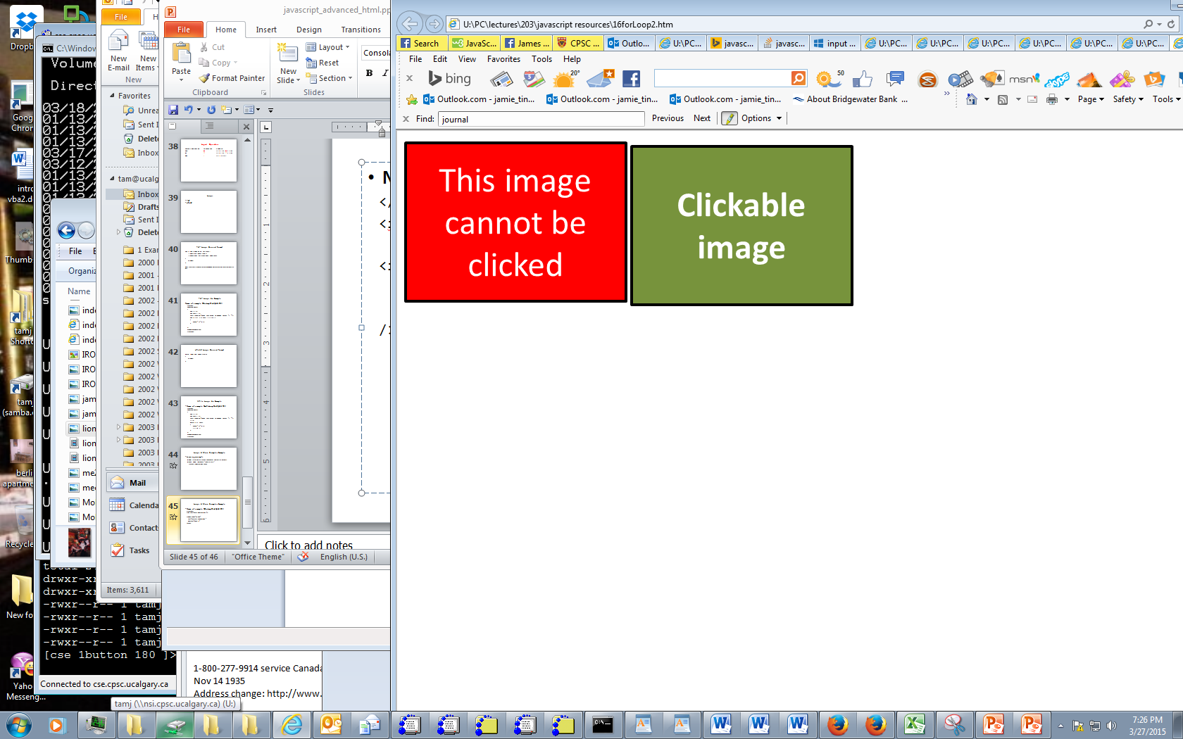
Loops: A More Complex Example (HTML Portion)
Name of example: 17forLoop2Example.htm
  </script>
  <img src="pics/noClick.png">
  <input type="image"
  src="pics/clickable.png"
  onclick="main()"
  /><br>

Slide 48


Loops: A More Complex Example (JavaScript Portion)
  <script>
  function main()
  {
  var i = -1;
  funImage = ("<img src='pics/funGuy.jpg'>");
  fungiImage = ("<img src='pics/fungi.jpg'>");
  for (i = 1; i <= 4; i = i + 1)
  {
  prompt("Hit ok to continue", i);
  if (i % 2 == 0) // % Modulo operator
  {
  document.write(funImage); // even
  }
  else
  {
  document.write(fungiImage); // odd
  }
  }
  }
4 more spaces (4+4 = 8)
4 spaces

Slide 49
Arrays
Unlike ‘simple’ variables such as integers and real numbers an integer can hold multiple values e.g., a real number variable can store one student’s grades while an array can store the grades for an entire class.
Format (creating an array):
  var <array name> = new Array(<Number of elements>);
Example (creating an array):
  var grades = new Array(4);

Slide 50
Accessing Array Elements
Use an ‘index’
  The first index begin at zero
  The last index ends at (size of the array minus 1).
  Example: an array of size 10 will have index values from 0 to (10-1 or 9)
Format (assigning value to an element):
  <array name>[<index>] = value;
Example (assigning value to elements):
  grades[0] = 4;
  grades[1] = 3;
  grades[2] = 2;
  grades[3] = 3;

Slide 51
A More Realistic Example Program (HTML Portion)
Name of example: 18array.htm
  <img src="pics/noClick.png">
  <input type="image" src="pics/clickable.png" onclick="main()" /><br>

Slide 52





A More Realistic Example Program (JavaScript Portion)
  function main()
  {
  var SIZE = 4;
  var pics = new Array(SIZE);
  var i = 1;
  for (i = 0; i < SIZE; i = i + 1)
  {
  pics[i] = "<img src='pics/" + i + ".jpg'>"
  }
  for (i = 0; i < SIZE; i = i + 1)
  {
  prompt("Hit ok to continue","");
  document.write(pics[i]);
  }
  }
i = 0
i = 1
i = 2
i = 3

Slide 53
Backup Your Work Frequently!
This is always a good idea but imperative when writing JavaScript programs.
JavaScript will NOT give you helpful error messages!
  Usually you get no error message at all.
  Determining where the problem lies can be a great challenge!

Slide 54
Example Program With An Error (Or Errors)
  Program name: 19error.htm
  function main()
  {
  var const SIZE = 4;
  var pics = new Array(SIZE);
  var i = 1;
  for (i = 0; i < SIZE; i = i + 1)
  {
  pics[i] = "<img src='pics/" + i + ".jpg'>"
  }
  for (i = 0; i < SIZE; i = i + 1)
  {
  prompt("Hit ok to continue","");
  document.write(pics[i]);
  }
  }
Notes:
* Error (for IE) is const

Slide 55
Backups: Benefit
If you accidentally introduce an error to your program and you cannot find it
You can always:
  Compare the backup version vs. the current version in order to more easily find the difference
  Simply revert to the backup (if you cannot find the error)
When you make backups always ensure that your backup is working prior to making a backup.
You have been forewarned!
  Failure to make a proper set of backups won’t allow you to get an extension.

Slide 56
If All Else Fails
What to do if you still didn’t take this advice and you are desperately trying to find the error.
First: there are no guarantees with this technique.
Second: make liberal use of comments
  “Comment out” the entire body of the function save for an alert (to tell you that the function is running properly).

Slide 57
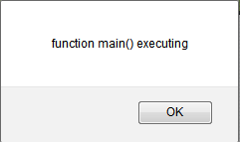
“Commenting Out Code” Previous Example
  Program name: 20findingError.htm
  function main()
  {
  alert("function main() executing");
  /*
  var const SIZE = 4;
  var pics = new Array(SIZE);
  var i = 1;
  for (i = 0; i < SIZE; i = i + 1)
  {
  pics[i] = "<img src='pics/" + i + ".jpg'>"
  }
  for (i = 0; i < SIZE; i = i + 1)
  {
  prompt("Hit ok to continue","");
  document.write(pics[i]);
  }
  */
  }

Slide 58
“Commenting Out Code”: Gradually Move The Comments To Expose More Code
  function main()
  {
  alert("function main() executing");
  /*
  var const SIZE = 4;
  var pics = new Array(SIZE);
  var i = 1;
  for (i = 0; i < SIZE; i = i + 1)
  {
  pics[i] = "<img src='pics/" + i + ".jpg'>"
  }
  for (i = 0; i < SIZE; i = i + 1)
  {
  prompt("Hit ok to continue","");
  document.write(pics[i]);
  }
  */
  }
As you ‘uncomment’ code take care that you don’t introduce new errors e.g., mismatch braces

Slide 59
Finding Errors
This technique of “commenting out” JavaScript code will not work if the error is in your html tags.
(Recall: documentation is used only conjunction with programming instructions and html does not include programming instructions).
Example: documentation will not help, what you were taught was commenting out JavaScript code (so BACKUP YOUR WORK)
  <script>
function main()
{
alert("function main() executing");
}
  </script>
  <img src="pics/noClick.png">
  <input type="image" src="pics/clickable.png" onclick="main" /><br>
Notes:
* Call to main is not a function call

Slide 60
Strings
A series of characters: alpha, numeric and other values that can be entered via the keyboard.
A string has a length
Examples:
  var string1 = "a12!"; // 4 characters
  var string2 = ""; // 0 characters
The length method will return the length
Format:
  <string>.length;
Example:
  userInput.length == 0 // Assume userInput is a String

Slide 61
Example Using The Length Method
  Program name: 21stringLength.htm
  function main()
  {
  var userInput = document.getElementById("input1").value;
  if (userInput.length == 0)
  {
  alert("Input field empty!");
  }
  else
  {
  alert(userInput);
  }
  }
  </script>
  <input type="button" value="Press me" onclick="main()"/><br>
  Enter some text and press the button <input type="input" id="input1"/>

Slide 62
Changing Capitalization
This can be done with the methods:
  toUpperCase();
  toLowerCase();
Format:
  <string variable> = <string>.toUpperCase();
  <string variable> = <string>.toLowerCase();
Example:
  userInput = userInput.toUpperCase(); //userInput is a string

Slide 63
Example Of Changing Case
  Program name: 22changingCase.htm
  function main()
  {
  var userInput = document.getElementById("input1").value;
  if (userInput.length == 0)
  {
  alert("Input field empty!");
  }
  else
  {
  userInput = userInput.toUpperCase();
  alert(userInput); // All caps
  userInput = userInput.toLowerCase();
  alert(userInput); // All lower now
  }
  }
  </script>
  <input type="button" value="Press me" onclick="main()"/><br>
  Enter some text and press the button <input type="input" id="input1"/>

Slide 64
Strings Are Indexed
Similar to arrays each character in a string is indexed from: 0 to (length – 1).
Example:
  var aString = "ab1";
The indexOf() method can be used to find the index of the first occurrence of a character.
If the character is not found then the method returns -1.
Format:
  <variable> = <string>.indexOf(<character>);
Example:
  index = aString.indexOf("!");
Elements: a b 1
Index: 0 1 2

Slide 65

Example: Finding Location
  Program name: 23findingIndex.htm
  <input type="button" value="Press me" onclick="main()"/><br>
  Character to search for <input type="input" id="data"/><br>
  Search string <input type="input" id="search"/>
  function main()
  {
  var searchCharacter =
  document.getElementById("data").value;
  var stringSearched =
  document.getElementById("search").value;
  if ((searchCharacter.length == 0) ||
  (stringSearched.length == 0))
  {
  alert("Unable to search. Either search string or
  character empty");
  }

Slide 66
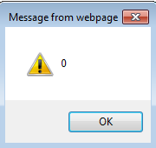
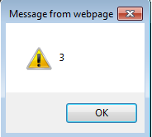
Example: Finding Location (2)
  else
  {
  // Index of character in input field
  var index = stringSearched.indexOf(searchCharacter);
  alert(index);
  // Index of exclamation mark '!'
  var index = stringSearched.indexOf("!");
  alert(index);
  }
  }

Slide 67
Additional Online Resources
http://www.w3schools.com/js/
https://msdn.microsoft.com/en-us/library/ie/ms535262(v=vs.85).aspx
http://trainingtools.com/online/javascript/index.htm

Slide 68
After This Section You Should Now Know
How to use html to create a graphical controls such as buttons
How to include JavaScript instructions via the <script> </script> tag
How to define a ‘sub-part’ of a program using a function definition
Getting a program to react to events (e.g., onclick,) by defining a function
The display of output via alert()
Defining variables with ‘var’
Variable naming conventions
Common operators: mathematical (+, -, *, /) and concatentation (+)

Slide 69
After This Section You Should Now Know (2)
Single and multi-line documentation
How to use documentation and “commenting out” code in order to find and fix errors in a JavaScript program
What should be included in the documentation for the programs that you write for this class
In HTML: How to use the ‘id’ property to uniquely identify controls
JavaScript: How to use the document.getElementById(“<string>”) method to access a graphical control
Different variations when sending email using JavaScript instructions

Slide 70
After This Section You Should Now Know (3)
How to get a JavaScript program to automatically run when the web page is loaded into a web browser via window.onload()=<function name>
Getting input with a prompt()
Branching/decision making mechanisms:
  if
  if-else
  if, else if, else
Defining variables with a stylistic convention (capitalization) and with a language defined approach (‘const’)
Valid operators for Boolean expressions
Valid logical operators

Slide 71
After This Section You Should Now Know (4)
Getting JavaScript instructions to repeat using looping mechanisms:
  For
  While
Changing the contents of a webpage via document.write()
How to create an array and how to access the elements
Common string operations
  Determining length
  Converting case
  Finding the location of the first instance of a character

