Slide 1
The Internet
You would learn about the basics of how the Internet works, how to effectively search for information online as well as how to evaluate the quality of online sources.

Slide 2
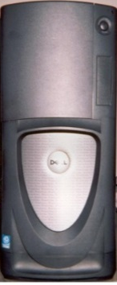

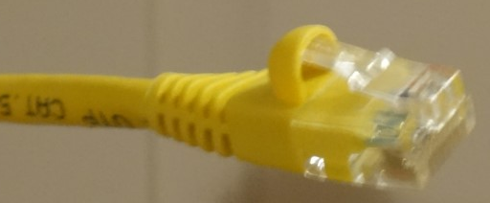
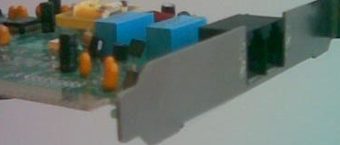
Computer Networks
Networks can of course be wired (requires physical connections) or wireless.
Computers (and now other devices such as mobile phones) that are connected via special hardware and a specific means of communication (“network protocol”).
  Hardware: a wired or wireless Network interface card/controller (NIC)
Modern computers and many devices automatically have the hardware and knowledge of the necessary protocol included by default (it’s ‘built-in’).
Images: James Tam

Slide 3
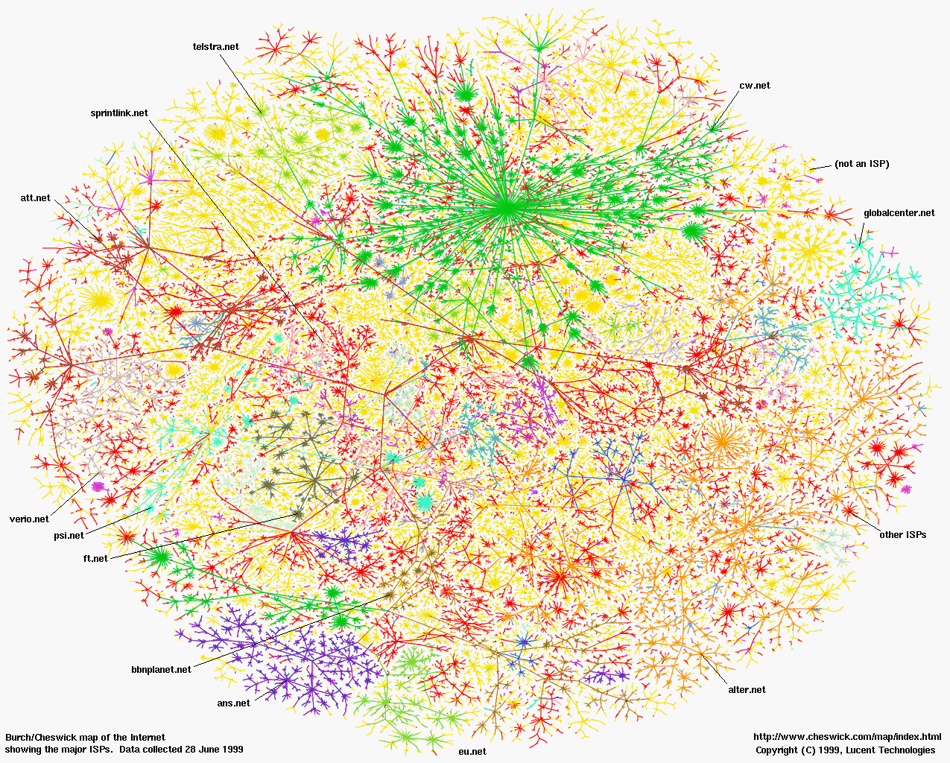
The Internet
It can be viewed as a large collection of networks
  A “network of networks”

Slide 4
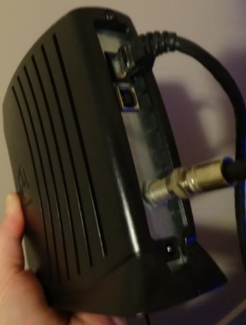
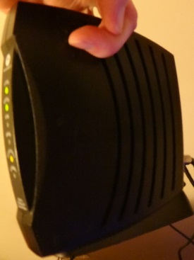
What’s Required For An Internet Connection
Network hardware (NIC) and the software to run it (driver software) – as mentioned it’s typically included.
An internet ‘provider’
Hardware to connect to the Internet service Provider (ISP):
  A ‘modem’:
    Allows computer information to be transmitted to the Internet
    Allows information from the Internet to be received by the computer
Internet modem: James Tam
ISP
Internet modem: James Tam

Slide 5
Bandwidth
It’s the speed at which information can be transmitted along a network or online.
Example maximum transmission speed of a NIC:
  Intel's Reliable PCI Express Gigabit CT Network Interface Card: Max speed (CAT6 network cable) 1000 Mbps (1,000 Mega bits per second)
  Recall: 1 byte = 8 bits
  1000 Mbps = 1000/8 = 125 MB per second
  Also recall M = Mega (1,000,000)
  125 MB = 125 million bytes transmitted per second
  …so why is my ‘Internet [connection]’ so slow??!!
Bandwidth | 4 MB image | (Standard def. movie) 70 MB / 1 hour movie | (Hi-def. movie) 2.4 GB / 1 hour
125 MB per second (1000 mbps) | 0.032 second | 0.56 seconds | 19.2 seconds

Slide 6
Bottleneck
Information traveling along different media is constrained by the speed of the slowest medium.
Traveling from south to north Calgary may include Deerfoot trail (100 km)
  But traveling through school or playground zones will slow travel (30 km)

Slide 7
Example Speeds Provided By Calgary ISP’s
Shaw cable
Telus
5 – 100 Mbps (625,000 bytes to 12.5 MB per second)
3 – 100 Mbps (375,000 bytes to 12.5 MB per second)

Slide 8
Realty Check: Actual Bandwidth
Speed of the NIC hardware (max hardware speed from a previous slide)
Speed of your Internet connection provided by the ISP (bottlenecked speed)
Bandwidth | 4 MB image | (Standard def. movie) 70 MB / 1 hour movie | (Hi-def. movie) 2.4 GB / 1 hour
125 MB per second (1000 mbps) | 0.032 seconds | 0.56 seconds | 19.2 seconds
Bandwidth | 4 MB image | (Standard def. movie) 70 MB / 1 hour movie | (Hi-def. movie) 2.4 GB / 1 hour
0.625 MB per second (5 Mbps) | 6.4 seconds | 112 seconds | 3,840 seconds (64 minutes)
12.5 MB per second (100 Mbps) | 0.32 second | 5.6 seconds | 192 seconds (3 minutes, 12 seconds)

Slide 9
Final Reality Check
These speeds specify download speeds (getting information down from the Internet).
  E.g., downloads: watching a streaming video, going to a web page, viewing or saving an email attachment.
Upload speeds (putting information up on the Internet is significantly slower)
  E.g., uploads: sending an email with an attachment, putting content such as images or videos online.
  Upload speeds range from 1/10 to 1/20 the listed speeds for advertisements for various Internet packages (time is x10 to x20)
Bandwidth | 4 MB image | Standard def. movie 70 MB | Hi-def. movie 2.4 GB
0.0625 MB per second (0.5 Mbps) | 60.4 seconds | 1120 seconds (over 18 minutes) | 38,400 seconds (over 10 hours)
1.25 MB per second (10 Mbps) | 3.2 seconds | 56 seconds | 1,920 seconds (over half an hour)

Slide 10
“Who” Of The Internet
Who invented the Internet:
  Because the Internet runs on protocols (rules of communication) it can be argued that the developers (several people) of the protocols played a major role in it’s invention.
    Students: Steve Crocker, Vint Cerf, Bob Kahn
    Prof: Leonard Kleinrock
Who owns the Internet:
  Not the US government (although it still has some influence).
  The networks that make up the Internet are owned by companies, non-profit organizations, governments and individuals.
Who funds the Internet:
  Originally it was a research project funded by the US government.
  Now it’s the owners of the networks that make up the Internet.

Slide 11
The Internet
The impetus for it’s creation came out of the Cold War
Some of the original goals
  Develop a common means of communication among computers through a standard protocol
  Allow the network to operate in the event of partial failure
NATO
USA
Great Britain
France
West Germany
Canada
Etc.
Warsaw pact
USSR
East Germany
Poland
Etc.

Slide 12

Allowing The Internet To Survive Disasters
UCLA
U of Utah
U of California
Stanford
From www.clipartbest.com

Slide 13
Modern Consequence Of Historical Roots
Information is typically routed among several computers and may take multiple paths even in one ‘session’ e.g., one session could = the viewing of a single video or even a single financial transaction.
Unknown ISP
Unknown ISP
Tam’s machine
Tam’s ISP
Bank’s ISP
Tam’s bank
Unknown ISP
Unknown ISP
Unknown ISP
Always
Sometimes

Slide 14
Reasons For Multiple Paths Along The Internet
Unknown ISP
Unknown ISP
Stability
Speed
Tam’s machine
Tam’s ISP
Bank’s ISP
Tam’s bank
Unknown ISP
Unknown ISP
Unknown ISP

Slide 15

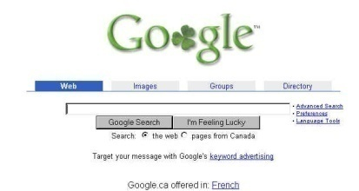
How Do Search Engines Work
When you search, you employ the search engine of a website.
  Using a search engine involves searching the library of pages built up by that engine.
The library is built up by the search engine’s spiders (web)
Image from: www.clipartbest.com
Linked page (1st level)
  Link1
  Link2
  Etc.
Linked page (2nd level)
  Link1
  Link2
  Etc.
Popular web site
  Link1
  Link2
  Etc.
Search Engine Database
Linked page (1st level)
Linked page (2nd level)
Popular web site
Linked page (1st level)

Slide 16


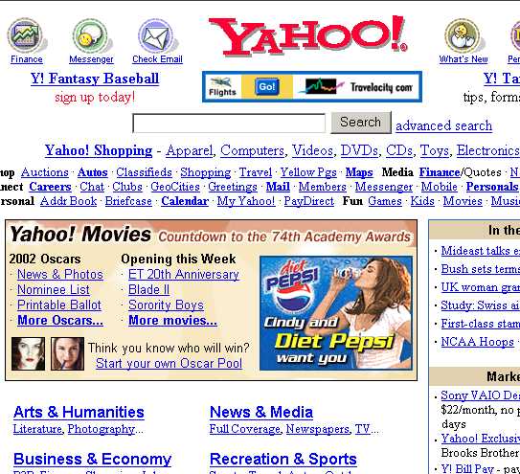

Some Search Engines Use People Instead Of Technology
Rather than using search programs to build the database some search engines organize results based on human scrutiny.
Person submits page
Yahoo database
Yahoo librarian
Person searching for info
Database is organized by Yahoo librarians (a person not automated)
Clipart from: Clipartbest.com

Slide 17
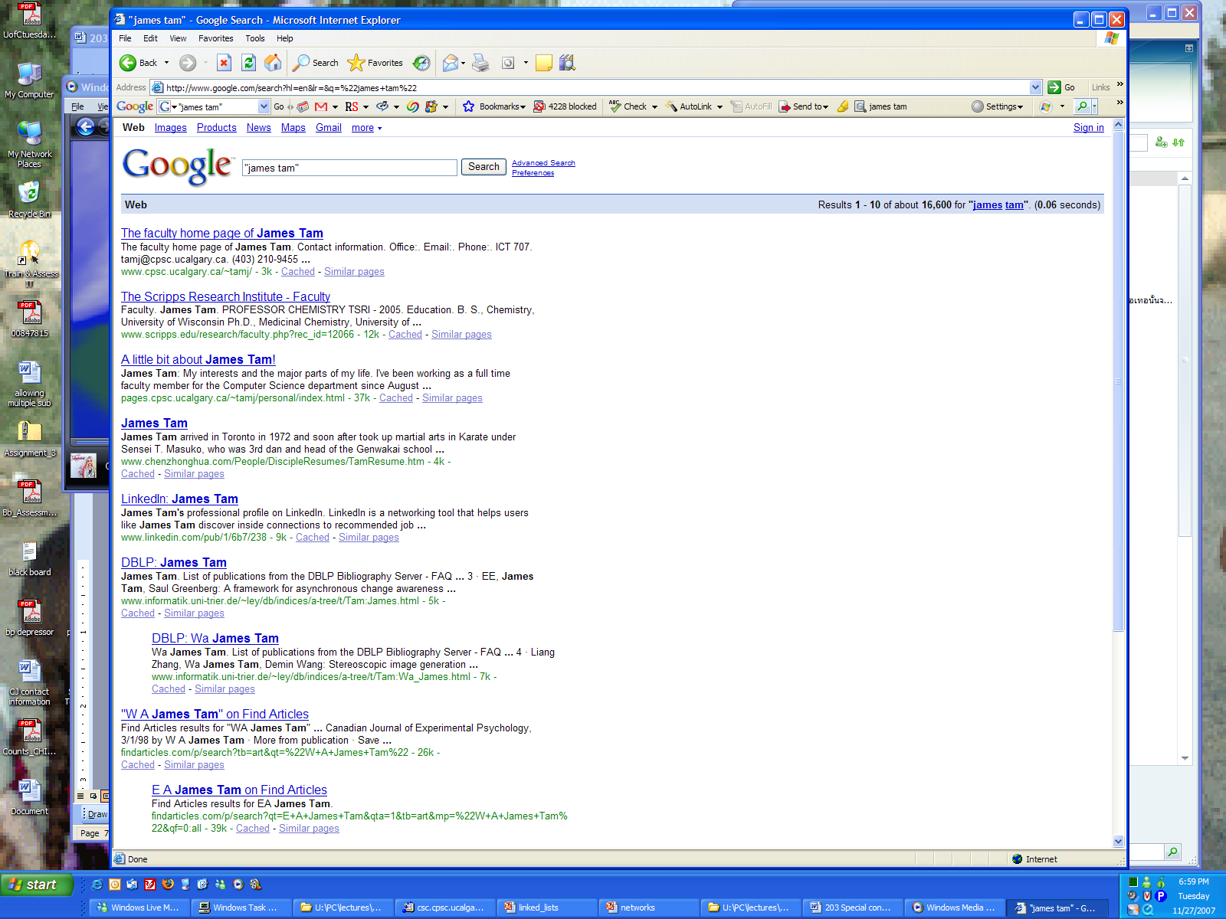
Search Engines Rank Results According To Relevance

Slide 18
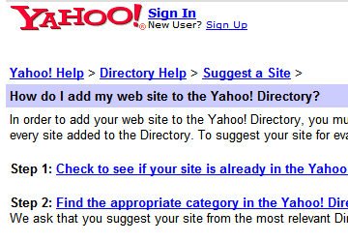
Making A Site More Noticeable (Higher Rank)
Search database built via search spiders (e.g., Google):
  Add relevant keywords to your page.
  The frequency and location of keywords may play a role in determining relevance.
  Trying to artificially rank your page higher in search results may result in a page being put at the bottom of the list e.g., adding celebrity ‘gossip’ to my CPSC page may rank it higher but not relevant info for most visitors.
Search databases built via human researchers (e.g., Yahoo):
  Make sure that your site is examined by the people who build the database.

Slide 19
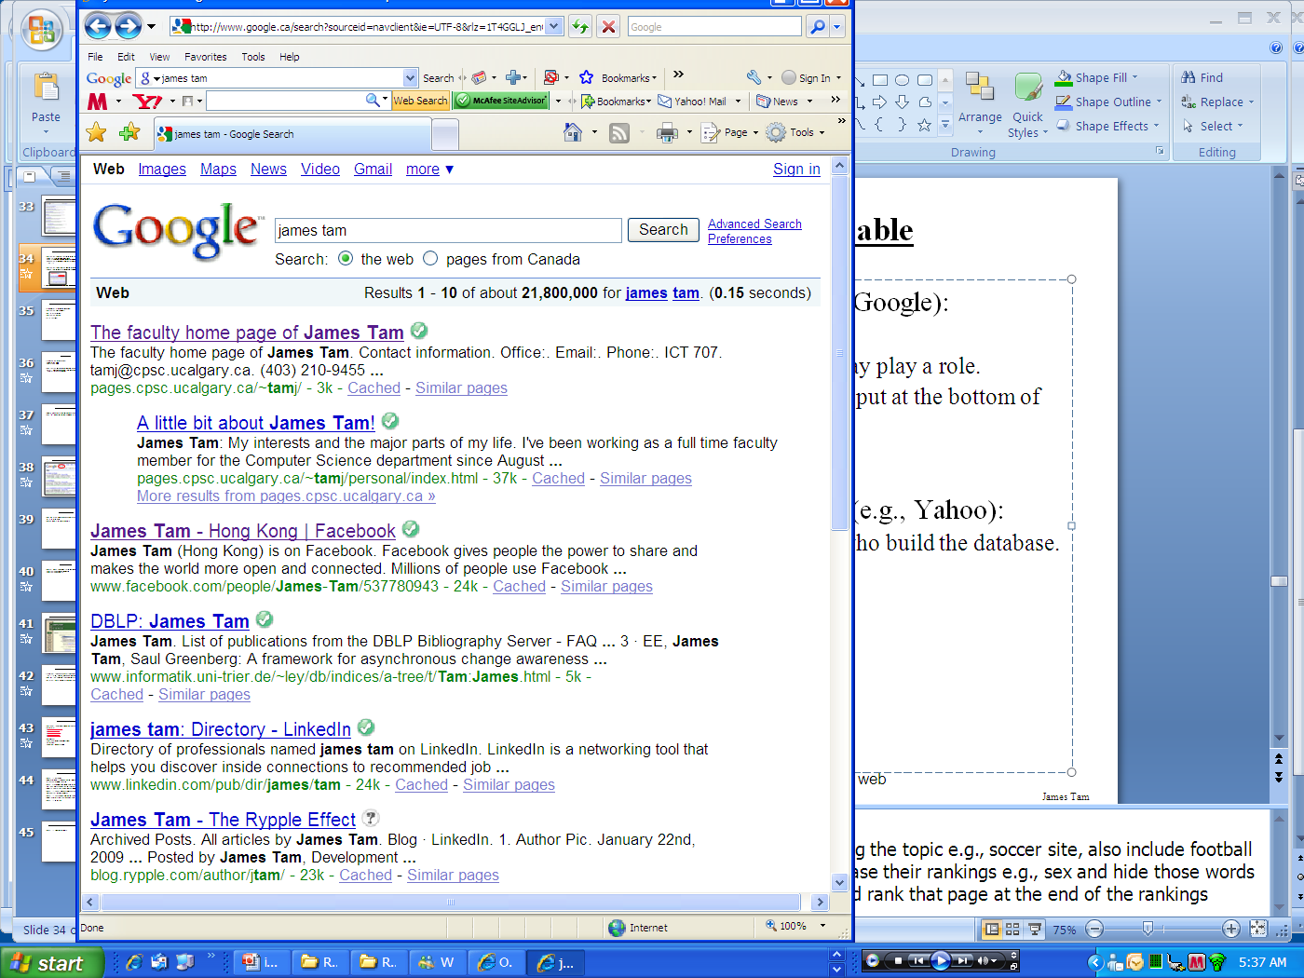
Searching For Information On The Internet: Google
Easy? Just type in what you’re searching for…
…you may get the information that you were looking for plus much more!

Slide 20
You Will Learn Strategies For Narrowing Your Search Results (For Google But Applies To Others):
Reducing the number of unrelated results.
Explicitly avoiding pages with certain words.
Searching for information from select pages.
Source (last accessed 2009): http://www.google.com/support/websearch and http://www.googleguide.com

Slide 21
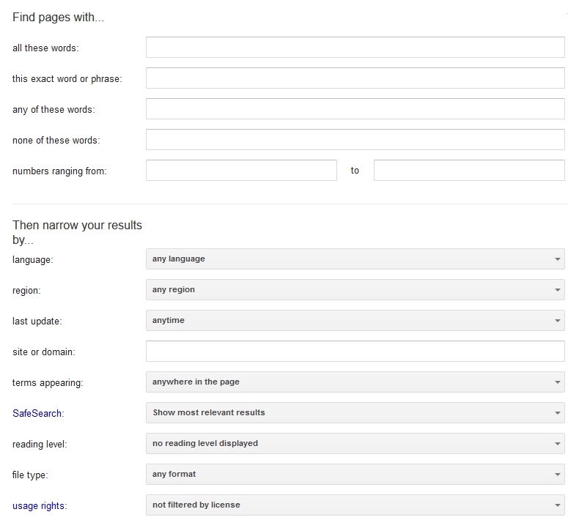
Employing These Search Strategies
Many (but not all) of the features can be found through an “Advanced Search” subpage of the Google site.
  http://www.google.com/advanced_search
This leads you to a page with several options (to be covered shortly):

Slide 22
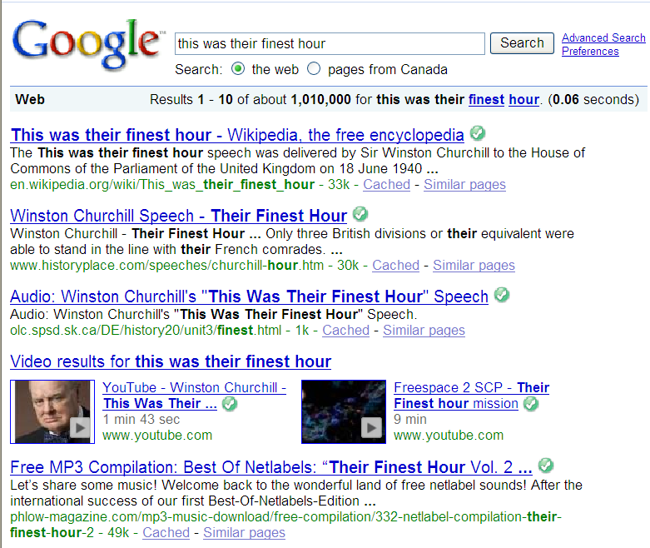
Searching For Exact Phrases
Sometimes you may be looking for information about a famous quote.
  “This was their finest hour!” – Winston Churchill
Many results must be reviewed.
Unrelated websites show up: Their finest hour

Slide 23
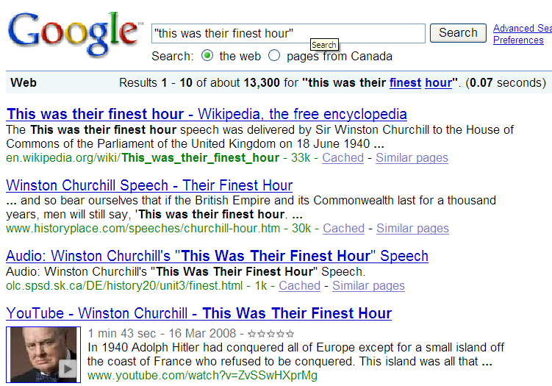
Searching For Exact Phrases (2)
Enclosing the phrase that you are searching for in quotes will search for pages that contain only that specific phrase.
The desired phrased enclosed quotation marks.
Fewer but more relevant results show up

Slide 24
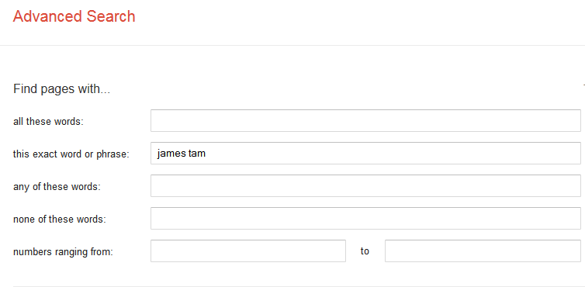
Searching Exact Phrases: Advanced Search
No other combinations are possible

Slide 25
Words That Are Commonly Ignored By Google
Stop words are ignored by search engines such as Google:
  Common words
  Reserved words
The search engine can be forced to include the stop words:
  Use quotes
  best places to eat in Calgary
  Vs.
  “best places to eat in Calgary”
  Use the ‘plus’ operator.
  Star Wars I
  Vs.
  Star Wars +I

Slide 26
What If More Than One Word Can Be Used?
Some concepts can be represented by using different words.
The ‘~’ operator includes synonyms in the search.
Example:
  ~cheap computers

Slide 27


The Search Criteria Is Incomplete/Partially Unknown
For example, searching for information on this person:
How is his name spelled?
  Arnold Scwartzengger?
  Arnold Schwartzenger?
  Arnald Scwartzencker?
FYI it’s “Arnold Schwarzenegger”
Image: Koch/Munich Security Conference
Image: www.cnn.com (2015)
Note: many search engines try to ‘guess’ what you are thinking but sometimes software guesses wrong (“auto correct” on mobiles)
Also handy for less common words and phrases e.g., technical terms, foreign languages translated to English

Slide 28
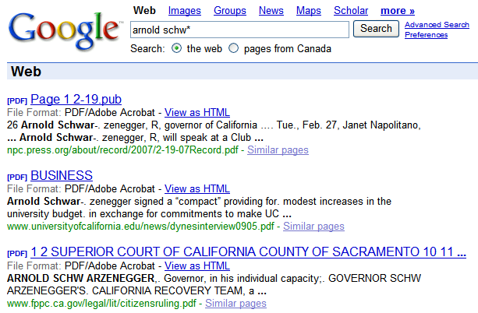
Using The Wildcard In Searches

Slide 29
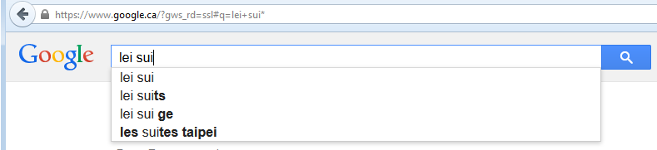
Using The Wildcard
Search engines such as Google have been refined to reduce but not entirely remove the need for wildcards.
Google may not provide useful alternatives when searching for technical terms or foreign words translated into English
Example: “Lei Sui, Lung” (English translation of the Chinese name of the famous martial artist/movie star: Bruce Lee)

Slide 30
Searching A Range
Searching numerical values within a certain min – max range
Range operator .. (multiple dots)
Example:
  Qatar History 2000..2009
  computer 2000 QR..5000 QR

Slide 31
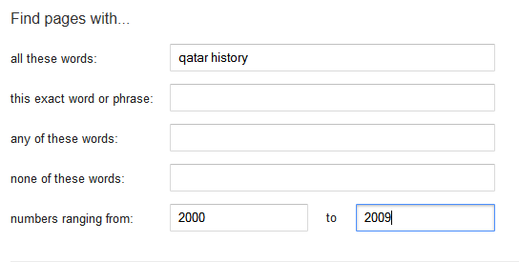
Range Searching: Advanced Search
Search criteria
Numerical range

Slide 32
Searching Among Alternatives
Normally when a word is included in the search box Google will try to find web pages that include all those words.
Example:
  cute wallpapers cats dogs
  Vs.
  cute wallpapers cat OR dogs
Example:
  “Bruce Lee” OR “Little Dragon” OR “Lee Siu Lung”

Slide 33
Searching Among Alternatives (2)
Note: Google is case sensitive in this situation! (OR must be upper case in order to search for alternatives).
To be or not to be
Vs.
To be OR not to be

Slide 34
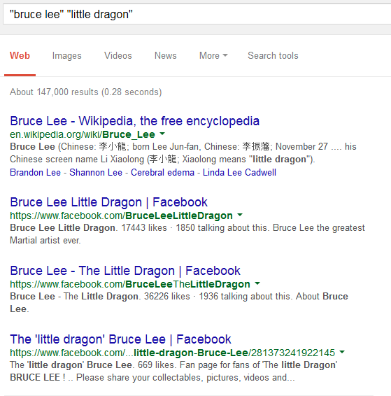
Example: Multiple Search Terms

Slide 35
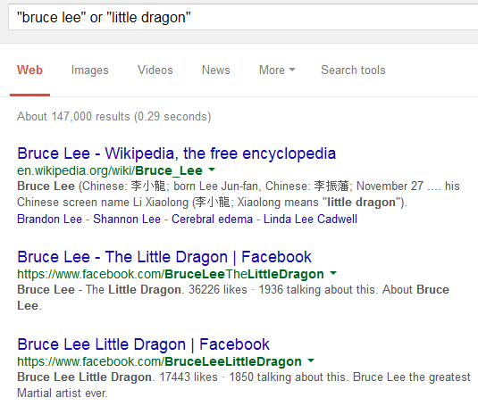
Example: Multiple Search Terms, OR - No Caps

Slide 36
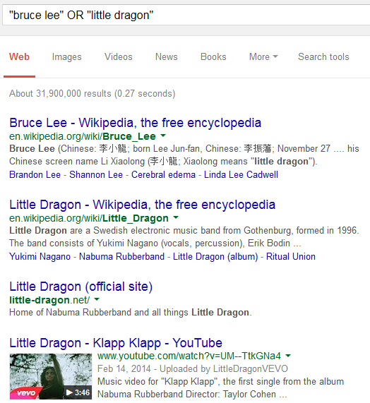
Example: Multiple Search Terms, OR-Caps

Slide 37
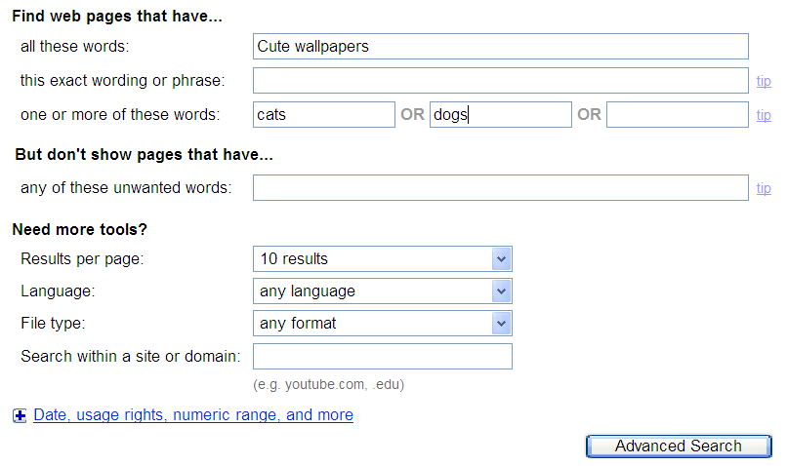
Searching Alternatives: Advanced Search
All words that must appear
One of more of these words can appear

Slide 38
Using ‘OR’: Exceptions¹
Google was designed to approximate how people think and behave when searching for information.
Consequently exceptions to the rules are sometimes made.
Example:
  What you tell the search engine: For better OR for worse
  What the search engine looks for: For better or for worse
1 From http://www.google.com/support/websearch

Slide 39
Excluding Words
There may be times when you want Google to exclude sites with certain words or phrases.
This can be done with the subtraction operator (subtract the words that follow the operator from search results).
Example:
  “James Tam”
  Vs.
  “James Tam” -calgary

Slide 40
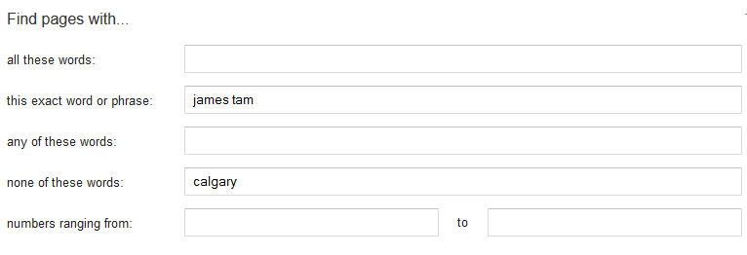
Excluding Words: Advanced Search
Exact search phrase
Excluded word

Slide 41
Site Specific Searches
Useful when a webpage is large and/or not well organized:
  Searching the current webpage
  Searching the entire site (and only that site)

Slide 42
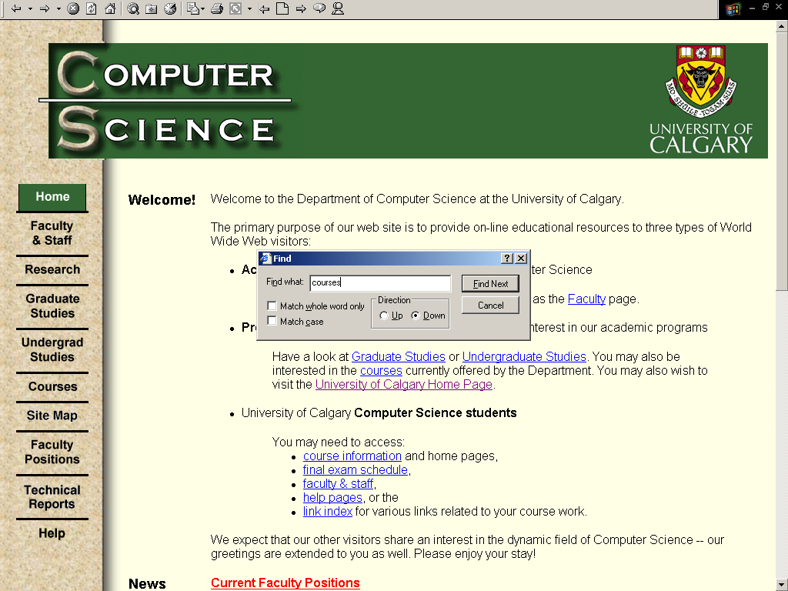
Searching The Currently Viewed Web Page

Slide 43
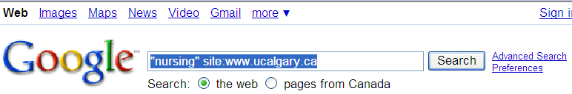
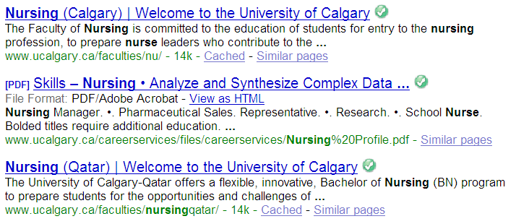
Searching One Website
Involves searching one entire site (and not just the page from the site that is currently loaded into the web browser). Results from other sites will not be shown.
  Use the ‘site’ keyword
Example:
Search only the University of Calgary website for the desired text
Results are only from the University of Calgary website

Slide 44
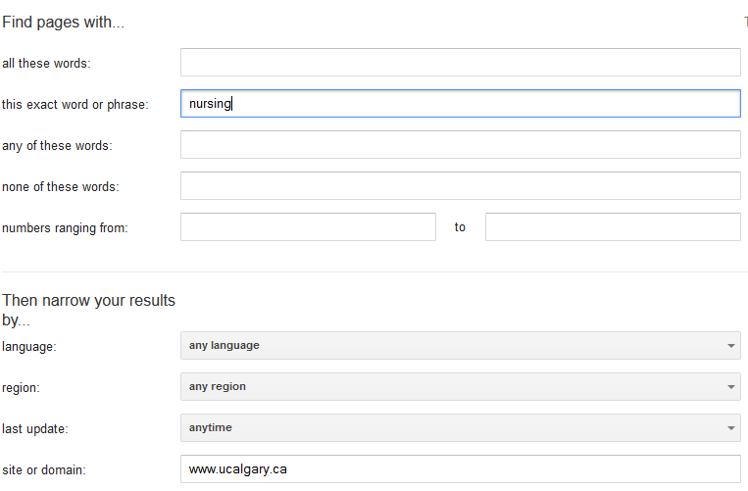
Searching One Website: Advanced Search
Information sought
Site being searched

Slide 45
Finding And Evaluating Information
This section is crafted for students who need to conduct research for an undergraduate course e.g., writing a paper
  But the principles can be applied when researching information for personal reasons because it may improve the quality of the results (e.g., “Are there technical reasons why a MAC is any more or less secure than a Windows-PC?”)
Finding: Where to look for information
Evaluating: Determining the quality of information?

Slide 46
Finding Information
When conducting formal research information sources should be evaluated for quality
  Not all sources of information are equal in terms quality.
  Contrast: a private individual’s personal blog vs. a website containing the current research being conducted by the experts in a particular field.
Where to start?
  Check with your course instructor: what level of research is expected?
  Journals and conference proceedings
  Books
  Online: websites

Slide 47
Journals And Conference Proceedings
Publications that describe the latest theories and research produced by domain experts
The quality of publications can vary
  First tier publications:
  Second tier “average” publications:
  However in terms of undergraduate research the quality of papers produced at either category should be sufficient (check with your course instructor)
Overall the quality of the information is generally good
Since it is written by ‘experts’ for ‘experts’ it may be difficult for the typical student to read and understand
Examples (in case you’re curious):
    http://www.sigchi.org/conferences/ “User-friendly technology”
    http://cscw.acm.org/2015/ “Technology to support groups”

Slide 48
Books
Books: First look at the intended audience
  General population: with no background knowledge in the domain?
    e.g., “A brief history of time” by Stephen Hawking
    Probably too rudimentary for use in post-secondary courses.
  Students: high school or post-secondary
    May be at an appropriate level of detail (for the latter category) if you just want general knowledge of a topic (e.g., instead of taking a course)
    Probably not specialized enough if you need to write a paper for a course
    e.g., you are taking CPSC 203 there is a brief hardware introduction but the introduction is probably not sufficient if you need to write a paper on the specific hardware needed for high-end gaming computers

Slide 49
Online: Websites
Even more than the other sources, websites vary greatly in quality
  The publishers of conference may host websites describing the latest research conducted by the experts
  On the other hand: anyone can make their own website about a particular topic
Some things to keep in mind when evaluating the quality of a website:
  Who is the author:
    Widely regarded expert in the field
    Industry expert (which field, is it similar to the one described in the website)
    Does the person have any apparent conflicts or agendas e.g., a CEO of a computer manufacturing company writing a review of laptops (sometimes not obvious)
    Are points backed by facts? Are those facts citing reputable sources?
      Some people present opinions as facts.

Slide 50
Online: Websites (2)
  Who is the intended audience of the website:
    Expert researchers?
    General population?
    Combination? E.g., www.mayoclinic.org, http://www.hopkinsmedicine.org
If the content is produced by a university or reputable research group then it’s probably correct
  E.g., Mayo clinic, Johns Hopkins
  But may or may not be targeted specifically to a ‘general’ audience and be of insufficient depth for your research
In general use websites with a strong degree of a caution.

Slide 51
Wikipedia
“Wikipedia is a collaboratively edited, multilingual, free Internet encyclopedia…” – from www.wikipedia.org
“Many eyes view it”
Q: Is this a good quality source of information for this type of research?

Slide 52
Wikipedia (2)
Many ‘eyes’ view but are those the ‘right eyes’
  Some topics require expert knowledge e.g., ‘Rocket science’
There is no guarantee that the experts in the area will be viewing, let alone actively editing Wikipedia documents
Furthermore the document that you view one day may not be the same one that you view on another day
  Actively study the history of changes of a document and compare differences?
Subject to bias - extreme cases of “vandalism” has lead to “lock downs”
  What’s the point of a wiki (anyone on the web can edit)

Slide 53
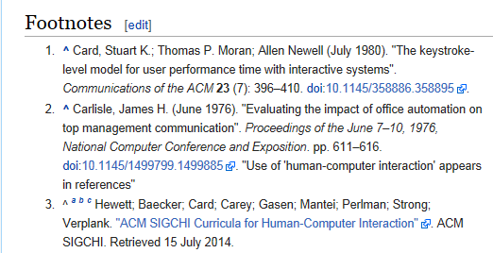
Using Wikipedia
Similar to regular paper encyclopedia or perhaps a newspaper article it’s a distillation of different sources of information.
  Generally it is not accepted as a direct primary source (don’t directly cite a Wikipedia article in your research paper).
It may be a starting point to find good sources of information that can directly be cited.
Example: “Human-Computer interaction”
Wikipedia cites a good research conference (usability “user friendly” technology)

Slide 54

Using The University Library
Services provided for students:
  From http://library.ucalgary.ca/student-support)
    “As a student attending the University of Calgary, you have access to the books, journals and online resources of a major research institution. Your subject librarians are available for research assistance as well.
    Your University of Calgary ONEcard is your library card, and gives students the following privileges:
      Borrowing books with a loan period of two weeks for undergraduate students and a term loan for graduate students
      Interlibrary loan
      Off-campus access to Library Research Databases”

Slide 55

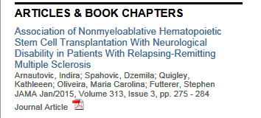
The University Library: Online Resources
The publications of many journals and conference proceedings can be accessed “for free” (licensed) through the university portal:
  Requires login with the UC login credentials.
  Combine it with an online web search:
Use the search to find the relevant paper.
  E.g., “Direct Stimulation of Angiotensin II Type 2 Receptor Initiated After Stroke Ameliorates Ischemic Brain Damage” – found via Google scholar
Then access the content of the paper through the university portal

Slide 56
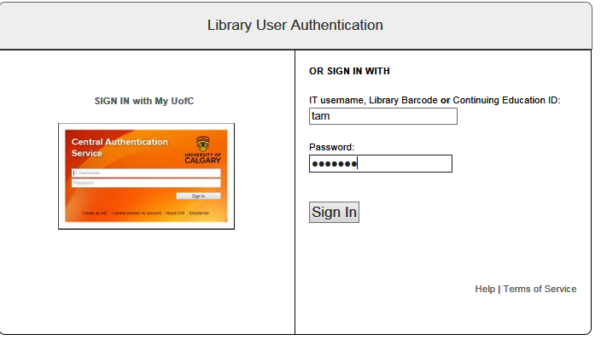
Authentication Is Require To Access The Article

Slide 57

Online Web Search Without The Library
The general Internet user does not have a license to access many good online resources.
After finding the publisher of the article: Journal of American Medical Association

Slide 58
After This Section You Should Now Know
The requirements for a computer or device to be connected to a network
How the Internet can be viewed as a large network of networks
The requirements for a computer to be connected to the Internet
What is ‘bandwidth’
  How to determine transmission times of files with a known size and a given bandwidths
The “Who’s” behind the Internet
The original goals for the Internet and how it affects its current design
How do search engines build up a database of websites using spiders
Some factors that can determine the ranking of search results

Slide 59
After This Section You Should Now Know (2)
Techniques for more effective web searches:
  Searching for exact phrases: using quotes
  How to include “stop words” in searches: quotes and the plus operator +
  How to search for synonyms: ~
  How to use the wildcard: *
  Benefits of the wildcard vs. relying on “suggested searches”
  Searching ranges: ..
  Searching for alternates: OR
  Excluding words and phrases: - (subtraction operator)
  Conducting site specific searches:
    Finding content within the webpage currently viewed: ‘find in page’
    Searching for content within a particular website: site

Slide 60
After This Section You Should Now Know (3)
Sources for researching information (journals/conferences, books, websites)
  Strengths and weaknesses
  How to evaluated their value
How a website such as Wikipedia can and should not be used when conducting research
How the university library can complement a web search (licensed access to online resources)

