Slide 1
Databases
In this section of notes you will learn about: different types of databases, how information is stored in databases, the different types of relations that can exist within a database, how information can be retrieved via queries and how to normalize a database.

Slide 2
Purpose Of A Database
To store information
Francesco Rollandin/OpenClipart
Database: Customer information

Slide 3
Purpose Of A Database
To retrieve information information
Sale $$$
Sale $$$
Database: Customer information

Slide 4
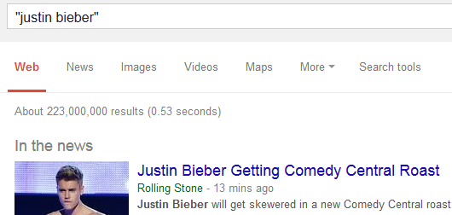
Databases: Storing / Retrieving Information
As you will see this isn’t as easy as it seems.
Information must be stored such that:
  Information can be quickly retrieved

Slide 5
Databases: Storing / Retrieving Information (2)
  The database is designed to reduce problems during maintenance (additions, modifications, deletions)
    Example: You will see this actual issue when we talk about database normalization.
Information Technology
Archie Bunker
Marketing Dept.
Loren Coleman
William McCloud
Finance & Accounting
Victor Davion
Ester Flowers

Slide 6
Databases: Storing / Retrieving Information (3)
  Minimizes redundancy:
Students data base table
ID | First Name | Last Name | Phone | Class 1 | Class 2
123456 | Jamie | Smyth | 553-3992 | CPSC 203, 01 | PSYC 205, 03
123457 | Stacey | Walls | 790-3992 | ACCT 321, 02 | FNCE 353, 05
123458 | Angel | Lam | 551-4993 | MATH 211, 02 | MATH 251, 01
Classes data base table
ClassName | ClassNumber | Lecture No | ClassDescription
CPSC | 203 | 01 | Introduction to Computers
CPSC | 231 | 01 | Introduction to Computer Science I
CPSC | 233 | 01 | Introduction to Computer Science II

Slide 7
With Bother With Databases?
Are used to store and retrieve information
Why bother, use a simple file as an alternative?
  E.g., tracking client information
MILES EDWARD O’BRIAN
DS9 Corp
Electrical engineering
2007 purchases: $10,0000,000
2006 purchases: $1,750,000
JAMIE SMYTHE
Cooperative services
Gasoline refining
2006 purchases: $5,000,0000
2005 purchases: $5,000,0000
2004 purchases: $5,000,0000
2003 purchases: $5,000,0000
2002 purchases: $5,000,0000
SCOTT BRUCE
Bryce Consulting
Investment analysis
2007 purchases: $500,000
2006 purchases: $1,500,000
2005 purchases: $2,500,000
2004 purchases: $500,000
Etc.
If the list is short then a simple text file may suffice
As the list grows organizing and updating the information becomes more challenging (duplicates or inaccuracies?)
Also searching the list according to specific criteria may become difficult
  e.g., Show all clients whose purchases in 2007 were between one and five million dollars
  e.g., Show all clients that made a year purchase exceeding 10 million dollars.

Slide 8
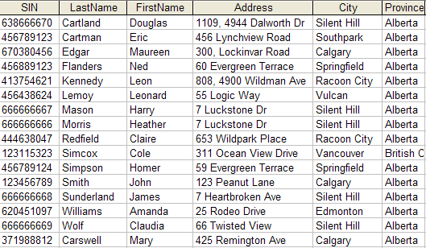
Storing Information In A Database
Information is stored in tables:
‘Employees’ table

Slide 9
Storing Information In A Database (2)
Row = Record: An example instance of data within the table.
  Employees Table: one row is an employee in the organization
Records of the table
One record, ‘Simpson, Homer’

Slide 10
Storing Information In A Database (3)
Column: are that attributes that we track for each record
  Employees Table: each column specifies the information we store about employees in this database.
Attributes of each record

Slide 11
Primary Key
Each table should typically have one field designated as the primary key:
  The primary key must be guaranteed to be unique
  It identifies one record from another
Primary Key for table ‘Employees’ is the ‘SIN’ field

Slide 12
Choosing A Primary Key
A primary key must be unique to each record because it is the one thing that distinguishes them.
If there is at least one instance where records can have the same value for a field then that field cannot be a primary key. (When in doubt if this will ever be the case verify with your users).
If a single key field cannot be found then several fields can be combined into a composite key. (Each field is still a separate field but together they form a unique primary key for each record).
  E.g., Course name, course number, lecture section (CPSC 203 L01)
If a unique primary key still cannot be found then ‘invent’ one.
  E.g., DepartmentID from the Departments table

Slide 13
Example Problem: Tracking Employees
You want to store employee and other information.
Information we need to track for each employee:
  Social insurance number
  Last name
  First name
  Address
  City
  Province
  Postal code
  Home phone number
  Date of birth
  Hourly pay rate

Slide 14
Example Problem: Tracking Employee Pay
Employees are paid hourly and may work for different departments. A job may cross department bounds
  e.g., James Tam worked 25 hours on a chemical cleanup job on a chemical spill that occurred on the accounting and HR floor on Jan 15, 2015 to be billed to accounting and human resources.
Information we need to track for pay
  Employee to pay
  Department to bill for the cost
  Start date of the work
  Hours worked
Department information
  Name of the department
  Annual budget
  Each department is assigned an ID code:
    Human Resources = 1, Marketing = 2, Finance = 3, Management information systems = 4

Slide 15
Initial Database
Three tables are required and start off with the following attributes:
EMPLOYEES
SIN | LName | FName | Address | City | Province | Postal code | Phone | Birth date | Hourly pay rate
TIMEBILLED
Employee info | Department | Start date | Hours worked
DEPARTMENTS
Department Code | Department Name | Budget

Slide 16
Refinements Needed: Employees
Primary key?
EMPLOYEES
SIN | LName | FName | Address | City | Province | Postal code | Phone | Birth date | Hourly pay rate

Slide 17
Refinements Needed: Employees
Primary key?
EMPLOYEES
SIN | LName | FName | Address | City | Province | Postal code | Phone | Birth date | Hourly pay rate

Slide 18
Refinements Needed: Departments
Primary key?
DEPARTMENTS
Department Code | Department Name | Budget

Slide 19
Refinements Needed: Departments
Primary key?
DEPARTMENTS
Department Code | Department Name | Budget
    Recall:
    Human Resources = 1
    Marketing = 2
    Finance = 3
    Management information systems = 4

Slide 20
Refinements Needed: TimeBilled
TIMEBILLED
Primary key?
  A composite key may be possible
  With a composite key: It’s improbably that there may exist the case there will be duplicates but not impossible
    E.g., One employee performs two separate jobs for the same department during the same time period that both last the same number of hours.
  “Inventing” a primary is the safest solution.
Employee info | Department | Start date | Hours worked
TIMEBILLED
Time BilledID | Employee info | Department | Start date | Hours worked

Slide 21
Refinements Needed: TimeBilled
TIMEBILLED
How to determine which employee to pay?
  There is already information that uniquely identifies each employee (SIN)
  We can add the employee Social Insurance number as a new column
Time BilledID | Employee info | Department | Start date | Hours worked
TIMEBILLED
Time BilledID | Employee info | Department | Start date | Hours worked | SIN

Slide 22
Refinements Needed: TimeBilled
How to determine which department should pay?
  We can add the department identification as a new column
TIMEBILLED
Time BilledID | Employee info | Department | Start date | Hours worked | SIN
TIMEBILLED
Time BilledID | Employee info | Department | Start date | Hours worked | SIN | DepartmentID

Slide 23
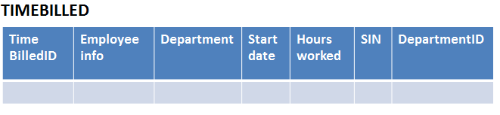
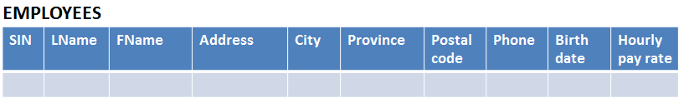
Foreign Key
A key in one table that refers to a key in another field:
  E.g. SIN and DepartmentID field of the TimeBilled table

Slide 24
MS-Access Tables Used In The Example
This example can be found online:
  http://pages.cpsc.ucalgary.ca/~tamj/203/topics/databases.html
Employees table (tracks information about individual employees)
  SIN
  LastName
  FirstName
  Address
  City
  Province
  PostalCode
  HomePhone
  BirthDate
  PayRate

Slide 25
Tables Used In The Example (2)
Departments table (maps each department to a number e.g., Human Resources = 1, Marketing = 2)
  DepartmentID
  DepartmentName
  Budget
TimeBilled table (for each pay period information about how many hours each employee worked and how much they are owed is tracked with this table).
  TimeBilledID
  SIN
  DepartmentID
  StartPayPeriod
  HoursWorked

Slide 26
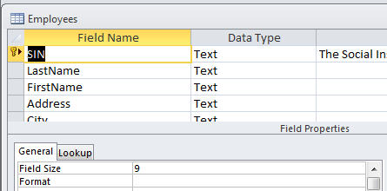
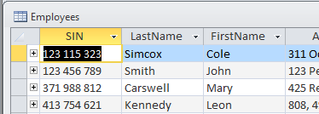
MS-Access: Views Of Your Database
Design view
  Typically start with this view
  Used to specify what fields that a table will consist of:
    e.g., DepartmentID, DepartmentName
  Used to specify the type and the format of the information in each field:
    e.g., SIN is field with 9 characters that must be in the format 000 000 000
Datasheet view
Once the fields have been specified in the Design view using the Datasheet view allows for each record to be entered.

Slide 27
Types Of Tables
Data tables
  Stores data that provides information about the database
  Dynamic, will likely be manipulated over the life the database (add, delete, modify)
  E.g. Employees, TimeBilled tables (address and hours worked may change over time)
Validation tables
  Used to ensure data integrity (to ‘lookup’ values)
  Typically it maps one value to another (e.g., product to product code, book to ISBN number)
  Rarely (if ever) changes
  E.g., Departments table
DepartmentID | DepartmentName
1 | Human Resources
2 | Marketing
3 | Finance
4 | Management Information Systems

Slide 28
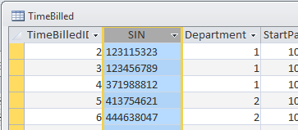
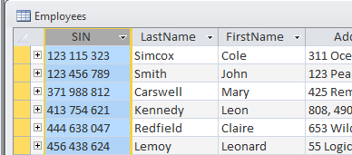
Parent And Child Tables
A table whose primary key is the foreign key of another table is the parent table.
The table whose foreign key is the primary key of another table is the child table.
Example:
SIN is a foreign key of the ‘TimeBilled’ table that corresponds to the SIN primary key of the ‘Employees’ table (CHILD TABLE)
SIN: Primary key for ‘Employees’ table (PARENT TABLE)

Slide 29
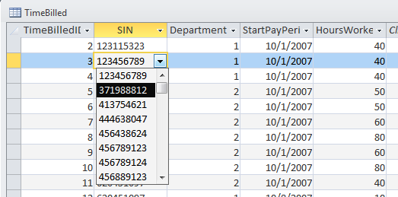
Purpose Of Foreign Keys
To ensure the integrity of the foreign key.
(MS-Access: Ensure referential integrity): as new records are entered in a table with a foreign key as one of the fields, it will ensure that the record will only be entered with a foreign key value that is listed in the appropriate table.
SIN is a foreign key referring to the primary key of the EMPLOYEES table.
This ensures that a SIN entered in TimeBilled will only be one of the SIN numbers of an actual employee

Slide 30
Null Values
Refers to empty fields of a record
Primary keys cannot be null but other fields may be null

Slide 31
Types Of Data Integrity In Databases
Table-level integrity (entity integrity):
  Ensuring that no duplicate records exist.
  Ensuring that no primary keys are null: MS-Access (automatic) indexed – no duplicates.
Relationship-level integrity (referential integrity):
  Ensuring that relationship between a pair of tables is sound and the records in the tables are synchronized when data is entered into, updated in or deleted from either table (MS-Access: only partially implemented).
Field-level integrity (domain integrity):
  Ensuring that the values in each field are valid and accurate.
  In MS-Access this is done through input masks and validation rules.

Slide 32
Input Masks
Ensures the proper format for the data entered into the database
Example for A2: SIN number in the Employees table must be entered as:
  <three digits> <space> <three digits> <space> <three digits>
Invalid inputs:
  Abc def ghi
  321 22 4234

Slide 33
Validation Rules
Validation rules check the data that is entered that it is in the correct range.
Examples for A2 (all employ the logical AND):
  ‘Employees’: BirthDate
  ‘Employees’: PayRate
  ‘TimeBilled’: HoursWorked

Slide 34
Guidelines For Naming Tables
Create a unique and descriptive name.
  “VehicleMaintenance” vs. “CarInfo”
Do not use words that convey physical characteristics or database terminology.
  “File”, “Record”, “Table”
While names should be short avoid using acronyms and abbreviations unless they are well-known.
  “SC” = ???
Consider using the plural form of a name.
  “Employees” vs. “Employee”
Avoid the use of spaces in names.
  “Undergraduate students” vs. “Undergraduate_Students”

Slide 35
Guidelines For Naming Fields
Select a unique and descriptive name (similar to tables).
Create a name that accurately, clearly and unambiguously identifies the characteristic that the field represents.
  “Mobile” vs. “CellPhone” or “MobilePhone”
While names should be short avoid using acronyms and abbreviations unless they are well-known (similar to tables).
Use the singular form of a name.
Avoid the use of spaces in names (similar to tables).

Slide 36
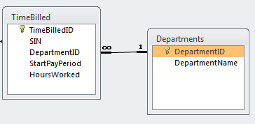
Relationships Between Tables
Relationships occur when a field of one table is a foreign key in another table.
Multiplicity: indicates how many instances of a particular item participates in the relationship:
  One to one
  One to many
  Many to many

Slide 37
Multiplicity
One to one relationships
  One entity participates in the relationship from the ‘left’ and one entity participates in the relationship from the ‘right’.
  Person : head
  Worker : Social Insurance Number
  This type of relationship is rare in databases
One to many relationships
  On one side of the relationship one entity participates in the relationship while on the other side: zero or more entities may participate in the relationship.
  Person : Hair
  Employees : TimeBilled : Departments

Slide 38
Multiplicity (2)
Many to many relationships
  On each side of the relationship zero or more entities may participate in the relationship.
  Students : Classes

Slide 39
Multiplicity (3)
Many to many relationships
  This type of relationship is not directly implemented in databases:
Students table
StudentID | StudentFirstName | StudentLastName | StudentPhone
123456 | Jamie | Smyth | 553-3992
123457 | Stacey | Walls | 790-3992
123458 | Angel | Lam | 551-4993
Classes table
Class Name | Class Number | Lecture No | ClassDescription
CPSC | 203 | 01 | Introduction to Computers
CPSC | 231 | 01 | Introduction to Computer Science I
CPSC | 233 | 01 | Introduction to Computer Science II

Slide 40
Multiplicity (4)
Many to many relationships
  Typically implemented as two one to many relationships in databases:
Students table
Classes table
Student ID | StudentFirst Name | …
123456 | Jamie
123457 | Stacey
Class Name | Class Number | …
CPSC | 203
CPSC | 231
Registrations table (linking table)
Student ID | ClassName | Class- Number | Lecture No
123450 | ENGL | 201 | 01
123457 | CPSC | 203 | 01
123460 | MATH | 271 | 01

Slide 41
Many : Many, What If The Rule Is Ignored?
Students table
StudentID | StudentFirstName | StudentLastName
123456 | Jamie | Smyth
123457 | Stacey | Walls
123458 | Angel | Lam
Class 1 | Class 2 | Class 3 | Class 4 | Class 5 | … | Class ‘N’
CPSC 203 | PSYC 205 | MATH 221 | MATH 251 | SOCI 201 |  | NULL
CPSC 203 | ART 201 | MATH 271 | NULL | NULL |  | NULL
CPSC 203 | CHIN 201 | KINE 221 | MGIS 323 | OPMA 341 |  | NULL

Slide 42
Many : Many, What If The Rule Is Ignored? (2)
Classes table
Class Name | Class Number | Lecture No | ClassDescription
CPSC | 203 | 01 | Introduction to Computers
CPSC | 231 | 01 | Introduction to Computer Science I
CPSC | 233 | 01 | Introduction to Computer Science II
S₁ | S₂ | S₃ | S₄ | S₅ | S₆ | S₇ | … | S_{N}
Bill | Bob | Mary | Jane | NULL | NULL | NULL |  | NULL
Jim | NULL | NULL | NULL | NULL | NULL | NULL |  | NULL
Alice | Brett | Charlie | Deacon | Ernie | Edgar | Freda |  | NULL

Slide 43
Diagrammatically Representing Databases
Entity-Relation diagrams (E-R Diagrams or E.R.D.’s): show the fields of a table.
Format
TABLE NAME
Primary key
Attribute
Attribute
Example
DEPARTMENTS
DepartmentID
DepartmentName
Budget

Slide 44
Primary : Foreign Keys Again
When there is a one to many relationship the primary key of the ‘one’ side becomes a foreign key on the ‘many’ side.
Examples:
  Employees : TimeBilled
  Departments : TimeBilled
1
Many
SIN:
Primary key
SIN:
Foreign key
1
Many
DepartmentID:
Primary key
DepartmentID:
Foreign key

Slide 45
Diagrammatically Representing Relationships
Graphically representing relationships between tables as well as any enforced rules on multiplicity:
Person
1
1
Head
Person
1
*
Hairs
*
*
*
*
Students
Classes
Students
Registrations
Classes
1
1

Slide 46
The ERD For The Example Database
Employees
DEPARTMENTS
SIN
LastName
FirstName
Address
City
Province
PostalCode
HomePhone
BirthDate
PayRate
DepartmentID
DepartmentName
Budget
1
1
TimeBilled
TimeBilledID
SIN
DepartmentID
StartPayPeriod
HoursWorked
*
*

Slide 47
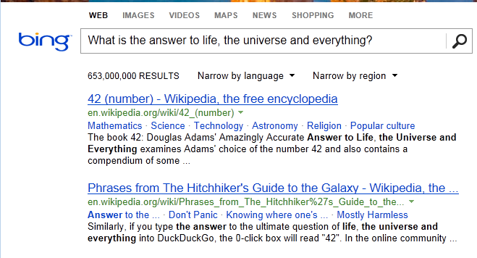
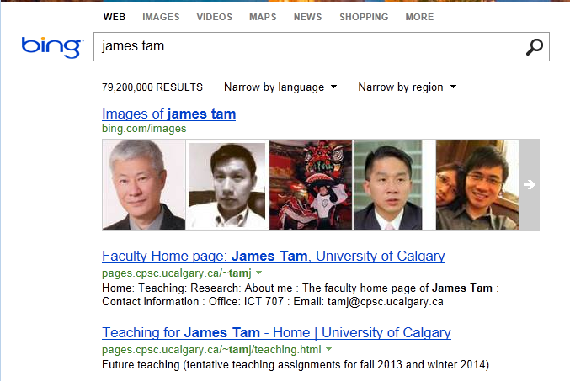
Database Queries
Queries are questions ‘asked’ of/to the database in order to retrieve information.

Slide 48
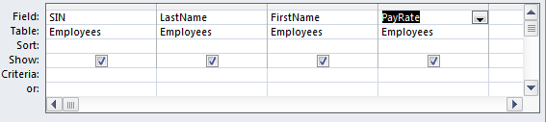
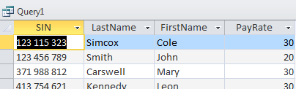
Retrieving Data Via Queries
Data retrieval occurs through the use of ‘queries’:
  A query is a question asked of the data in the database.
  Typically worded to show only the parts of the database for which the answer to the question is true.
  Example: What is the SIN, name and pay rate of every employee in the Employees Table:
Query
Result of the query

Slide 49
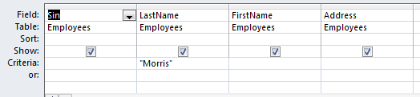

Retrieving Data Via Queries (2)
  Example: What is the SIN, name & address of all employees that have the last name of Morris?
Query
Query
Result of the query

Slide 50
Databases And Set Theory
Each table can be viewed as a set of information.
EMPLOYEES (TABLE/SET)
* 456 789 123, Cartman Eric, Southpark
* 456 789 124, Simpson Homer, Springfield
* 666 666 666, Morris Heather, Silent Hill
* 666 666 667, Mason Harry, Silent Hill
* 670 380 456, Edgar Maureen, Calgary
Departments (TABLE/SET)
* 1, Human Resources
* 2, Marketing
* 3, Finance
* 4, Management Information Systems
TimeBilled (TABLE/SET)
* 8, 456 789 123, 2, 10/1/2007, 80
* 9, 456 789 124, 2, 10/1,2007, 60
* 14, 666 666 666, 3, 10/1/2007, 50
* 15, 666 666 667, 3, 10/1/2007, 50
* 18, 670 380 456, 4, 10/1/2007, 40

Slide 51
Queries And Set Theory
Queries retrieve a subset of the information:
  Example: Which employees come from ‘Southpark’
EMPLOYEES (TABLE/SET)
* 456 789 123, Cartman Eric, Southpark
* 456 789 124, Simpson Homer, Springfield
* 666 666 666, Morris Heather, Silent Hill
* 666 666 667, Mason Harry, Silent Hill
* 670 380 456, Edgar Maureen, Calgary
SOUTHPARK EMPLOYEES? (QUERY)
QUERY RESULT = SUBSET
* 456 789 123, Cartman Eric, Southpark

Slide 52
Queries And Set Theory (2)
Queries can be asked of multiple tables
  Example: Which employees come from ‘Silent Hill’, and have an employee number 666 666 667 or greater, and worked 50 or more hours?
EMPLOYEES (TABLE/SET)
* 456 789 123, Cartman Eric, Southpark
* 456 789 124, Simpson Homer, Springfield
* 666 666 666, Morris Heather, Silent Hill
* 666 666 667, Mason Harry, Silent Hill
* 670 380 456, Edgar Maureen, Calgary
ID>= 666 666 667, City = Silent Hill (QUERY)
QUERY RESULT
= SUBSET
666 666 667, Mason Harry,
Silent Hill, 50 hours worked
Hours worked >= 50 (QUERY)
TimeBilled (TABLE/SET)
* 8, 456 789 123, 2, 10/1/2007, 80
* 9, 456 789 124, 2, 10/1,2007, 60
* 14, 666 666 666, 3, 10/1/2007, 50
* 15, 666 666 667, 3, 10/1/2007, 50
* 18, 670 380 456, 4, 10/1/2007, 40

Slide 53
Queries And Set Theory (3)
QUERY RESULT
= SUBSET
666 666 667, Mason Harry, Silent Hill,
50 hours worked
This is referred to as a ‘join’ because it combines data from multiple tables.

Slide 54
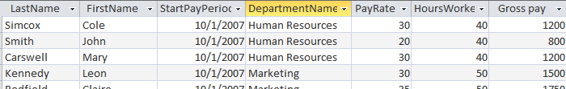
Multi-Table Queries
Example: What is the full name, start pay period, name of the department billed and gross pay of employees in the organization (3 tables searched)?
Query
Result of the query

Slide 55
Multi-Table Queries (2)
Note in the previous example:
  The result of one column was calculate from the columns of two tables.
A calculated value
Gross pay: [PayRate] * [HoursWorked]

Slide 56
Logical Operations
Operation | Description | MS-Access operator
AND | All conditions must be true for the result to be true. If any condition is false then the entire result is false. | And
OR | All conditions must be false for the result to be false. If any condition is true then the entire result is true. | Or

Slide 57
Logical Comparisons
Operator | Description
< | Less than
<= | Less than or equal to
> | Greater than
>= | Greater than or equal to
<> | Not equal to

Slide 58
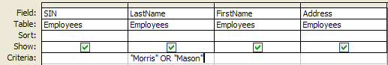
Forming Queries
Queries may be specified graphically:
Also queries may be specified in the form of text descriptions of the question (SQL).

Slide 59
SQL (Structured Query Language)
It’s the universal language for querying a relational database (very widely used!)
The statements are portable between different database programs.
Queries are formed using text descriptions (can be more powerful but more complex than graphical queries):
  SELECT: Specifies the fields/columns shown in the query results e.g., SIN field.
  FROM: Lists the tables from which the data is to be selected e.g., look in the Employees table.
  WHERE: Provides the conditions to determine if rows/records are shown by the query.
  ORDER BY: Specifies the order in which rows are to be returned by the query.
Note: Capitalizing of the above four words is a standard SQL convention.

Slide 60

Using Logic While Forming Queries
Logical operators and logical comparisons can be performed during queries.
  Examples: Which employees have the last name of ‘Morris’ or ‘Mason’?
Query
Result of the query

Slide 61
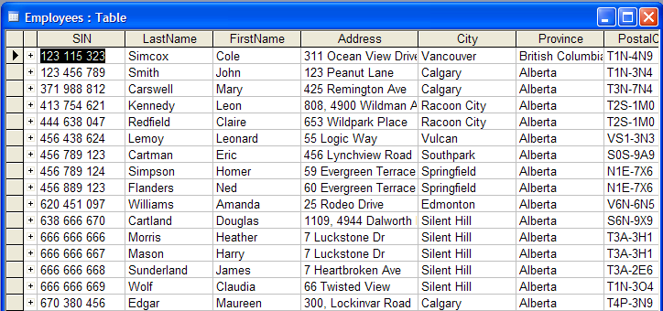
SQL Equivalent
(Employees table):
SELECT Employees.SIN, Employees.LastName, Employees.FirstName, Employees.Address
FROM Employees
WHERE (
( (Employees.LastName)="Morris" Or (Employees.LastName)="Mason")
)

Slide 62
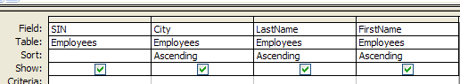
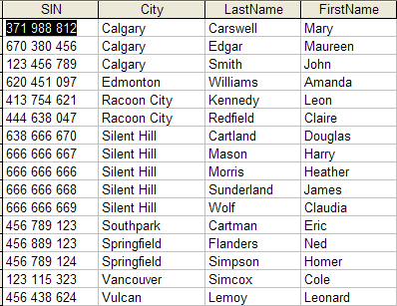
Ordering Queries
Show the SIN, city, first name and last name of all employees in ascending order according to: city, last name and then first name.
Query
Query results

Slide 63
SQL Equivalent
SELECT Employees.SIN, Employees.City, Employees.LastName, Employees.FirstName
FROM Employees
ORDER BY Employees.City, Employees.LastName, Employees.FirstName;

Slide 64
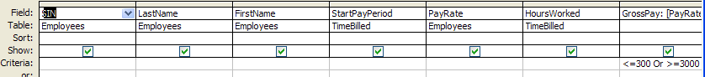
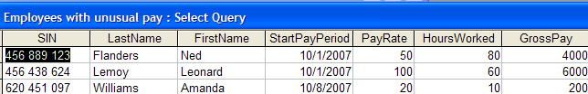
Queries With Ranges: Logical OR
Ranges can be specified during the query.
  Example: Which employees have a gross pay on their time card that’s less than $300 or greater than $3,000 (inclusive)?
Query
Calculated field
GrossPay: [PayRate]*[HoursWorked]
Result of the query

Slide 65
SQL Equivalent
SELECT Employees.SIN, Employees.LastName, Employees.FirstName, TimeBilled.StartPayPeriod, Employees.PayRate, TimeBilled.HoursWorked, [PayRate]*[HoursWorked] AS GrossPay
FROM Employees JOIN TimeBilled ON Employees.SIN = TimeBilled.SIN
WHERE (
(([PayRate]*[HoursWorked])<=300 Or ([PayRate]*[HoursWorked])>=3000)
);

Slide 66
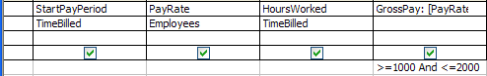
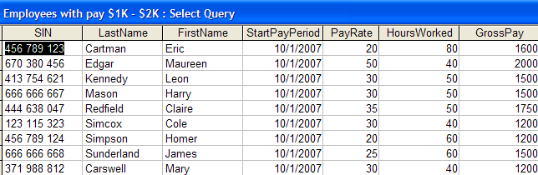
Queries With Ranges: Logical AND
Ranges can be specified during the query.
  Example: Which employees have a gross pay within the range of $1,000 - $2000 (inclusive) on one of their timecards?
Query
Result of the query

Slide 67
SQL Equivalent
SELECT Employees.SIN, Employees.LastName, Employees.FirstName, TimeBilled.StartPayPeriod, Employees.PayRate, TimeBilled.HoursWorked, [PayRate]*[HoursWorked] AS GrossPay
FROM Employees JOIN TimeBilled ON Employees.SIN = TimeBilled.SIN
WHERE (
(([PayRate]*[HoursWorked])>=1000 And ([PayRate]*[HoursWorked])<=2000)
);

Slide 68

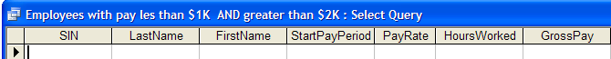
Empty Queries
Take care not to specify queries that can never be true!
This will result in an “Empty Query”, a query that yields no results.
  Example: Which employees have a gross pay lower than $1,000 AND higher than $2,000 (inclusive for both) on one of their time cards?
Query
Result of the (empty) query

Slide 69
SQL Equivalent
SELECT TimeBilled.StartPayPeriod, Employees.PayRate, TimeBilled.HoursWorked, [PayRate]*[HoursWorked] AS GrossPay
FROM Employees JOIN TimeBilled ON Employees.SIN = TimeBilled.SIN
WHERE (
(([PayRate]*[HoursWorked])<=1000 And ([PayRate]*[HoursWorked])>=2000)
);

Slide 70
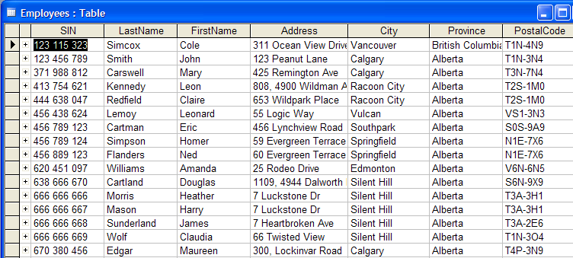
Using The Wildcard In Queries
The ‘wildcard’ character can stand for any number of characters in the position that the wildcard is positioned:
  Example queries that follow will be in the Employees table:

Slide 71
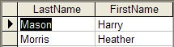
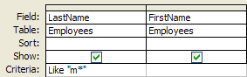
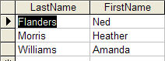
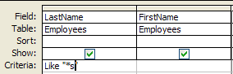
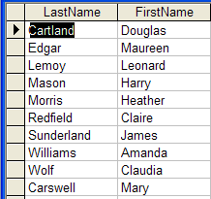

Using The Wildcard In Queries (Access)
Examples:
  Which employees have a last name that begins with ‘m’?
  Which employees have a last name ends with ‘s’?
  Which employees have the letter ‘a’ anywhere in their first name?

Slide 72
Using The Wildcard In Queries (SQL)
Examples:
  Which employees have a last name that begins with ‘m’?
  Which employees have a last name ends with ‘s’?
  Which employees have the letter ‘a’ anywhere in their first name?
SELECT Employees.LastName, Employees.FirstName
FROM Employees
WHERE (((Employees.LastName) Like "m*"));
SELECT Employees.LastName, Employees.FirstName
FROM Employees
WHERE (((Employees.LastName) Like "*s"))
SELECT Employees.LastName, Employees.FirstName
FROM Employees
WHERE (((Employees.FirstName) Like "*a*"))

Slide 73
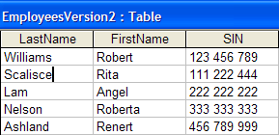
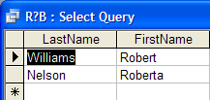
Single Character Wildcard
The ‘?’ stands for a single character wildcard:
  Querying the following table
  Which employees have the following string of characters in their first name: <R> <any character> <B> <any number of characters>

Slide 74
Database Design (And Redesign)
The design-redesign process is referred to as “normalization”
Each stage of redesign is referred to as a “form”:
  Stage 1: First normal form
  Stage 2: Second normal form
  Stage 3: Third normal form
  (For the purposes of this course getting a database into third normal form is sufficient although there are other stages as well).

Slide 75
Why Is Normalization Necessary?
Normalization is regarded as good style
My database ‘works’ that’s “good enough” why bother?
It also helps to prevent errors or problems which are caused by how the database is designed:
  e.g., insertion anomalies: difficulties when adding new information
  e.g., deletion anomalies: deleting information may result in the inadvertent loss of information

Slide 76
Example Database Table: Projects¹
This table shows:
  ResearcherID: each professor working on a research project is given a computer generated login name.
  Research project: name of the projects worked on in a particular department.
    Professors can work on multiple projects
    Research projects can be initiated without a professor
  Location: room number of the research lab.
ResearcherID (PK) | Research projects (PK) | Location
aturing | Graph Coloring Traveling Salesman | QC-103 QC-201
rdescartes | Knapsack | QC-121
cbabbage | Traveling Salesman Knapsack | QC-201 QC-121
bowen | Knapsack | QC-121
1 From “Database Development for Dummies” by Allen G. Taylor

Slide 77
Problem: Some Cells Can Contain Multiple Entries
Queries can be awkward to form
  E.g., Using the ‘Like’ operator is difficult because it must deal with special cases (or more entries in each cell).
  Example:
Research projects
Graph Coloring Traveling Salesman
Knapsack
Traveling Salesman Knapsack
Knapsack
With this format searching for projects under “Knapsack” won’t work correctly (some labs show up with others will not).

Slide 78
Databases In First Normal Form
F.N.F.: Each cell can contain at most one element (one value or a null value, the latter for non-primary key fields).
The previous table in first normal form:
ResearcherID (PK) | Research project (PK) | Location
aturing | Graph Coloring | QC-103
aturing | Traveling Salesman | QC-201
rdescartes | Knapsack | QC-121
cbabbage | Traveling Salesman | QC-201
cbabbage | Knapsack | QC-121
bowen | Knapsack | QC-121

Slide 79
First Normal Form: Critique
Improvements:
  Cells contain only one value which reduces some of the problems associated with forming queries.
Further improvements needed:
  There is redundancy in the table e.g., “aturing”
  It may be subject to modification (addition and deletion) anomalies.
ResearcherID | ResearchProject | Location
aturing | Graph Coloring | QC-103
aturing | Traveling Salesman | QC-201

Slide 80
Deletion Anomaly
Allan Turing (“aturing”) no longer works on the “Graph Coloring” project.
Before
After
Researcher ID | Research Project | Location
aturing | Graphic Coloring | QC-103
aturing | Traveling Salesman | QC-201
rdescartes | Knapsack | QC-121
cbabbage | Traveling Salesman | QC-201
cbabbage | Knapsack | QC-121
bowen | Knapsack | QC-121
Researcher ID | ResearchProject | Location
aturing | Traveling Salesman | QC-103
rdescartes | Knapsack | QC-121
cbabbage | Traveling Salesman | QC-201
cbabbage | Knapsack | QC-121
bowen | Knapsack | QC-121

Slide 81
Insertion Anomalies
A new research project ‘UFO’ is added to the department and room ‘Area-57’ is to be used as the research lab but a researcher has not been hired.
This is an incomplete record that cannot yet be properly added to the database (PK = researcher and project name)
ResearcherID | Research project | Location
aturing | Graph Coloring | QC-103
aturing | Traveling Salesman | QC-201
rdescartes | Knapsack | QC-121
cbabbage | Traveling Salesman | QC-201
cbabbage | Knapsack | QC-121
bowen | Knapsack | QC-121
Notes:
.

Slide 82
Problem With This Table
The ‘Projects’ table combines two related but separate concepts:
  Which research project a particular researcher working on
  What is the location of a particular project
It’s a sign that a single unique key cannot be assigned
By itself this isn’t necessarily a problem (i.e., ‘ResearcherID’ and ‘Research project’ form a composite primary key).
But the non-primary key element “Location” depends only on a part of the primary key (“Research project”) which can lead to anomalies.
ResearcherID | Research project | Location
aturing | Graphic Coloring | QC-103
aturing | Traveling Salesman | QC-201

Slide 83
Databases In Second Normal Form
Every non-primary key element must be dependent on the primary key (and the entire primary key if the key is composite).
The previous table split into two tables that are each in second normal form.
ResearchProject
ResearchLocation
ResearcherID | Project
aturing | Graph coloring
rdescartes | Knapsack
cbabbage | Traveling Salesman
bowen | Knapsack
Project | Location
Graph coloring | QC-103
Knapsack | QC-121
Traveling Salesman | QC-201

Slide 84
Critique Of Second Normal Form
Dependencies can still exist that affects the database but in a slightly more subtle fashion.
All non-key fields are dependent upon the primary key but some may be dependent in an indirect fashion.

Slide 85
Example¹: “SalaryRange” Table
ResearcherID | AcademicRank | RangeCode
eschroedinger | Full professor | 4
pdirac | Associate professor | 3
wheisenberg | Full professor | 4
hbethe | Assistant professor | 2
jwheeler | Adjunct professor | 1
Non-key fields whose values are dependent on the primary key (second normal form)
Primary key
1 From “Database Development for Dummies” by Allen G. Taylor

Slide 86
The Example In 2nd Normal Form Are Still Subject To Some Anomalies
Example Professor Dirac leaves the university.
Before
ResearcherID | AcademicRank | RangeCode
eschroedinger | Full professor | 4
pdirac | Associate professor | 3
wheisenberg | Full professor | 4
hbethe | Assistant professor | 2
jwheeler | Adjunct professor | 1
After
ResearcherID | AcademicRank | RangeCode
eschroedinger | Full professor | 4
wheisenberg | Full professor | 4
hbethe | Assistant professor | 2
jwheeler | Adjunct professor | 1

Slide 87
Problem With The Database (2nd Normal Form)
While both non-key elements are dependent upon the primary key, with “RangeCode” that dependency is indirect.
“RangeCode” is dependent upon “AcademicRank” which is in turn dependent upon “ResearcherID”.
This is referred to as a transitive dependency:
ResearcherID | AcademicRank | RangeCode
eschroedinger | Full professor | 4
pdirac | Associate professor | 3
RangeCode
AcademicRank
ResearcherID

Slide 88
Third Normal Form
A database in third normal form fulfills the requirements of second normal form and has no transitive dependencies.
Previous example in third normal form:
ResearcherRank
RankRange
ResearcherID | AcademicRank
eschroedinger | Full professor
pdirac | Associate professor
wheisenberg | Full professor
hbethe | Assistant professor
jwheeler | Adjunct professor
AcademicRank | Range Code
Full professor | 4
Associate professor | 3
Assistant professor | 2
Adjunct professor | 1

Slide 89
The Normal Forms Have A Nested Structure
1NF (First Normal Form)
2NF (Second Normal Form)
3NF
(Third Normal Form)

Slide 90
After This Section You Should Now Know
How a database is broken down into tables and how tables are broken down into it's component parts
What are the type of tables and the purpose of each
What is the purpose of a primary key
What is a foreign key
When table are related what is the rule for determining which table contains the primary vs. foreign key
What is a null value
What are forms of data integrity in databases
Guidelines for naming tables and the fields of the tables
What are the three relationships that may exist between tables and how they differ

Slide 91
After This Section You Should Now Know (2)
How is a many-to-many relationship typically implemented in a database
The ERD representation of databases
How to form different queries in order to retrieve data from a database
What is an empty query
How wildcards can be used in queries
What is database normalization, what are the different forms and how to convert from one form to another

Slide 92
You Should Now Know (3)
How to normalize a database
What are the characteristics of a database in: first normal form, second normal form, third normal form

