Slide 1

CPSC 203
NOW
Web
Databases
Spreadsheets
Macros
LATER
Introduction to practical problem solving

Slide 2


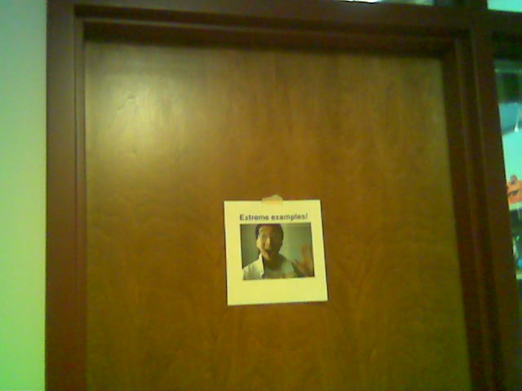
Administrative (James Tam)
Contact Information
  Office: ICT 707
  Email: tamj@cpsc.ucalgary.ca
Office hours
  Office hours: Tuesday 11:00 – 11:50, Thursday 14:00 – 14:50
  If I’m not in my office give me a few minutes or check the lecture room.
  Email: (any time)
  Appointment: email, phone or call
  Drop by for urgent requests (but no guarantee that I will be in if it’s outside of my office hours!)
My Office

Slide 3
Course Resources
Required resources:
  Course website: http://www.cpsc.ucalgary.ca/~tamj/203 (Get the notes off the course webpage before lecture)
Additional resources (external) will be provided for these topics:
  VBA
  Java script

Slide 4
How To Use The Course Resources
They are provided to support and supplement this class.
  The notes outline the topics to be covered (not sufficient to do well)
  You will get the details (e.g., explanations) during lecture time

Slide 5
Tips For Success
When you’re in lecture make sure you take your own notes
If you miss a class then get a copy of someone else’s notes

Slide 6
Tam’s “House Rules”
I always endeavor to keep the lecture within the prescribed time boundaries
You won’t pack up and end before time is up

Slide 7




Tam’s “House Rules”
No recordings/captures without permission during class please
(Recall that learning tends to increase with additional levels of engagement).

Slide 8
Learning Objectives
Understand basic technological concepts, such but not limited to: the key parts of a computer, the Internet and computer security.
Practical thinking and problem solving by using pre-created software such as MS-Office. This will include writing simple programs (through VBA macros) as well as using the built in functionality of the office suite.
Learning the mechanics of building a web page as well as good design principles. Practical thinking and problem solving by augmenting a web page with computer software (written by the student)

Slide 9

Course Outcomes
You get to learn 3! Count ‘em 3 commonly used software packages!
But wait-there’s more!!!
Database!!!
Web builder!!!
Spreadsheet!!!
SALE!!!

Slide 10


Course Outcomes (2)
  Employer XYZ wants to hire an Access © database developer or someone familiar with SQL queries now.
  This is what’s hot, hot, hot
  But what’s hot today may not look so good tomorrow
  Technology changes: get used to it

Slide 11
Course Outcomes (3)
You will not only learn how to use existing technologies (spreadsheet, database, web builder) but also how to problem solve and create your own new software.
Problem solving is required in the programming component: VBA office macros and augmenting a web page by writing supplementary software.
Some corporations have recognized the relationship between problem solving skills and success in the work world:
  E.g., “Killer” interview questions
    Google
    http://www.businessinsider.com/15-google-interview-questions-that-will-make-you-feel-stupid-2009-11?op=1
    Apple
    http://www.businessinsider.com/apple-interview-questions-2011-5#how-do-you-test-the-prototype-of-the-vending-machine-5

Slide 12
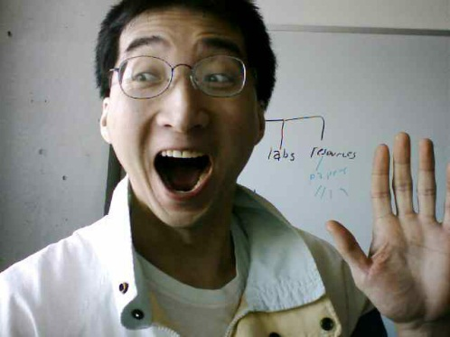
What If 203 Still Isn’t Technical Enough For You?
Think this course is too easy?
There are other introductory courses that may be of interest.
Both are introductions to problem solving by writing/creating computer programs.
  Program writing (“programming”) is a major component.
  CPSC 217: For non-Computer Science majors
  CPSC 231: For Computer Science majors
Image of James curtesy of James Tam, other images from Microsoft

Slide 13
Evaluation Components
Assignments
Examinations
In class bonus quiz questions

Slide 14
Assignments (40% Of Term Grade)
A1: Spreadsheet (Excel): 10% of term grade
A2: Database (Access): 10% of term grade
A3: Macro programming using VBA (writing a computer programming instructions to augment an existing computer program MS-Office): 10% of term grade
A4: Web design and web programming: 10% of term grade

Slide 15
Assignments: Software Version¹
It is your responsibility to make sure that your submission works on the machines in MS 236 and MS 237.
A1 – A3:
  Microsoft Office 2007 (or newer) is required
We use a Windows machine to mark whatever you submit (A1 – A4) using MS Office 2010 (A1 – A3, A4 is web-based)

Slide 16
Examinations (60% Of Term Grade)
A mix of short answer and multiple choice questions
Closed book (don’t bring anything into the exam: just yourself and writing implements)
Midterm examination (20% of term grade)
  Scheduled by your course instructor and will occur during the semester
    Friday March 6 starting at 6:30 PM and ending at 7:45 PM in MFH 162
  There’s multiple lectures so the exam will be out of class (don’t miss it!)
Final examination (40% of term grade)
  Cumulative but with a focus on topics covered after the midterm
  The exam occurs during the regular end of term examination period so it will be scheduled by the Office of the Registrar

Slide 17
In Class Bonus Questions (2% Bonus On Term Grade)
They will be administered using TopHat Monacle
  https://app-ca.tophat.com
The questions will be ‘randomly’ administered during lecture (only) – no ‘make up’ questions
  You will be given ample notice before the first questions begin (they won’t start immediately)
  Note that the questions will act as a ‘bonus’ (you may potentially be awarded an “A” grade even if you receive no marks on the TopHat questions).
  The questions will be directly related to lecture material.
  Questions will be lecture specific: to receive a grade for a particular question you need to attend the lecture in which you are registered

Slide 18
Estimating Your Term Grade
As stated in the course information sheet (official signed document) each major component will be awarded a grade point (and not a percentage)
  Individual assignment
  Total score for in-lecture TopHat questions
  Midterm exam
  Final exam
The mapping of raw score to grade point will be posted before each assignment is due (variation between assignments may occur).
Mapping of TopHat bonus questions to grade point
The mapping of the midterm to grade point will be posted sometime after the midterm.
The mapping of final to grade point cannot be provided until after the official term marks have been released (Department policy).
Percent | 96 – 100 | 91 – 95 | 86 – 90 | 81 – 85 | 76 - 80 | 71 - 75 | 65 – 70 | 61 – 64 | 56 -60 | 51 - 55 | 46 - 50 | < 46
GPA | 4.0 | 3.7 | 3.3 | 3.0 | 2.7 | 2.3 | 2.0 | 1.7 | 1.3 | 1.0 | 0.7 | 0.0

Slide 19
Estimating Your Term Grade (2)
To determine your weighted term grade point simply multiply each grade point by the weight of each component.
Sum the weighted grade points to determine the term grade.
Simple and short example (not exactly the same as this term but it should be enough to give you an idea of how to do the specific calculations required this semester):
  Assignments:
  Midterm: weight = 30%, example score = B+
  Final: weight = 40%, example score = C-
  Weighted assignments: 0.3 * 4.0 = 1.2
  Weighted midterm: 0.3 * 3.3 = 0.99
  Weighted final: 0.4 * 1.7 = 0.68
  Total term grade point = 1.2 + 0.99 + 0.68 = 2.87
Official university listing of letter grades/grade points: http://www.ucalgary.ca/pubs/calendar/current/f-2.html

Slide 20
Estimating Your Term Grade (3)¹
1 The grade point to letter grade mapping employs the official university cutoffs:
http://www.ucalgary.ca/pubs/calendar/current/f-2.html
(I may employ a more lenient set of cutoffs at the end of term but the official cutoffs will provide you with a ‘worse case’ estimate of your grade).

Slide 21

Feedback
Wow I am the greatest speaker in the world!
What is he talking about???
Let me know how things are going in the course:
  Am I covering the material too slowly or too quickly.
  Can you read the slides and my hand writing.
  Can you hear me in the class.
  Etc.
Image copyrights unknown

Slide 22
Copyright Notification
“Unless otherwise indicated, all images in this presentation are used with permission from Microsoft.”

