Slide 1
VBA (Visual Basic For Applications) Programming
Overview of concepts covered in this section:
  Finding and replacing things in a document
  Branching
  Looping
  Strings
  Linking MS-Office documents
  Printing documents

Slide 2
Collection
An object that consists of other objects
Example: The Documents collection will allow access to the documents that have been opened.
Access a collection rather than the individual objects may be time-saving shortcut.
  Instead of manually closing all open documents this can be done in one instruction:
  Documents.close

Slide 3
Types Of Collections
Some attributes of a document that return a collection.
    Lists: allows access to all lists in a document
    Shapes: allows access to all shapes in a document
    Tables: allows access to all tables in a document (detailed example coming up but a few brief examples below).
      E.g., ActiveDocument.Tables – to access the tables in your document
      ActiveDocument.Tables(1) – to access the first table in a document.
    Windows: briefly introduced in the last section

Slide 4
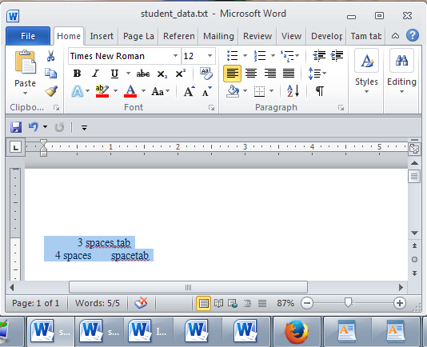
The ActiveDocument Object
Quick recap: although you may have many documents open, the ‘active document’ is the document that you are currently working with:
The active document

Slide 5
Attributes Of The ActiveDocument Object
Some of the basic attributes of ActiveDocument.
  Application: the application/program associated with the document (useful if a VBA macro is linking several applications)
  Name: the name of the current document (useful for determining the active document if multiple documents are currently open).
  Path: the save location of the active document.
  FullName: the name and save location of the current document.
  HasPassword: true/false that document is password protected
  SpellingChecked: true/false that has been spell checked since document was last edited
  Note: Information for these attributes can be viewed by passing the information as a parameter to a message box e.g., MsgBox (ActiveDocument.Name)

Slide 6
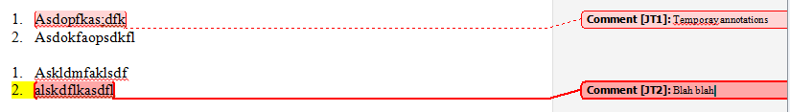
Methods Of The ActiveDocument Object
Some useful methods of ActiveDocument.
  Checkspelling(): exactly as it sounds!
  Close(): covered in the previous section
  CountNumberedItems(): see image (this slide)
  DeleteAllComments(): see image (this slide)
  Printout(): prints current active document on the default printer
  Save() : covered in the previous section
  SaveAs2() : covered in the previous section
  Select(): covered in the previous section
  SendMail(): see image (next slide)

Slide 7
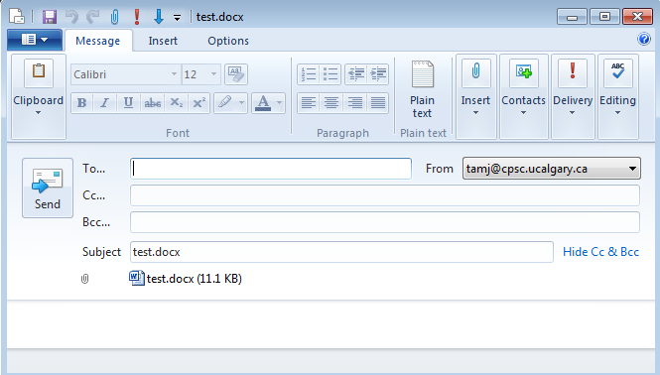
ActiveDocument.SendMail()
Runs the default email program
The active document automatically becomes an attachment
Subject line = name of document
(For anything more ‘fancy’ you should use VBA to create and access an MS-Outlook object)

Slide 8
“Finding” Things In A Document
It can be done in different ways
Example (common) ‘Find’ is an object that is part of the ‘Selection’ object in a document.
  JT’s note: although it may appear to be confusing at first it doesn’t mean that the find (or find and replace) requires text to be selected.
  Making ‘Find’ a part of ‘Selection’ was merely a design decision on the part of Microsoft.
Example (alternative is JT’s preferred approach) ‘Find’ is an object that is part of the ‘Content’ object of the ‘ActiveDocument’
One source of information:
http://msdn.microsoft.com/en-us/library/office/aa211953(v=office.11).aspx

Slide 9
Single Replacement
Word document containing the macro: simpleFind.docm
sub simpleFind()
  ActiveDocument.Content.Find.Execute FindText:="tamj",ReplaceWith:="tam"
  end Sub
  'The instruction can be broken into two lines without causing
  'An error by using an underscore as a connector
  ActiveDocument.Content.Find.Execute FindText:="tamj", _
  ReplaceWith:="tam"
Background for example:
My old email address (still works): tamj@cpsc.ucalgary.ca
My new email address: tam@ucalgary.ca
Incorrect variant: tamj@ucalgary.ca

Slide 10
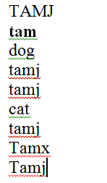
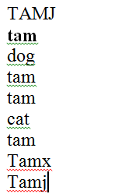
More Complex Find And Replace
Word document containing the macro: findReplaceAllCaseSensitive.docm
  Sub findReplaceAllCaseSensitive()
  ActiveDocument.Content.Find.Execute FindText:="tamj", _
  ReplaceWith:="tam", Replace:=wdReplaceAll, _
  MatchCase:=True
  End Sub
Before
After

Slide 11
With, End With
ActiveDocument.Content.Find.Execute
For ‘deep’ commands that require many levels of ‘dots’, the ‘With’, ‘End With’ can be a useful abbreviation.
Example
  With ActiveDocument.Content.Find
  .Text = "tamj"
  Equivalent to (if between the ‘with’ and the ‘end with’:
  ActiveDocument.Content.Find.Text = "tamj"
Previous example, the ‘Find’ employing ‘With’, ‘End With’:
Also the search and replacement text are specified separately to shorten the ‘execute’ (the “ActiveDocument.Content.Find” listed once)
  With ActiveDocument.Content.Find
  .Text = "tamj"
  .Replacement.Text = "tam"
  .Execute MatchCase:=True, Replace:=wdReplaceAll
  End With
‘Find text’ and ‘replacement text’ moved here to simplify the ‘.execute’

Slide 12
Find And Replace
It’s not just limited to looking up text.
Font effects e.g., bold, italic etc. can also be ‘found’ and changed.

Slide 13
Finding And Replacing Bold Font
Word document containing the macro: findBold.docm
  Sub findBold()
  With ActiveDocument.Content.Find
  .Font.Bold = True
  With .Replacement
  .Font.Bold = False
  End With
  .Execute Replace:=wdReplaceAll
  End With
  End Sub
  'Removes bold facing effect on all text

Slide 14
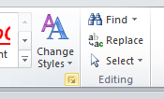
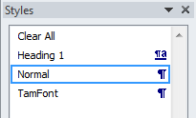
Finding/Replacing Formatting Styles
You may already have a set of pre-created formatting styles defined in MS-Word.
You can redefine the characteristic of a style if you wish.
Assume for this example that you wish to retain all existing styles and not change their characteristics.
But you want to replace all instances of one style with another style e.g., all text that is ‘normal’ is to become ‘TamFont’
‘Find’ can be used to search (and replace) instances of a formatting style.

Slide 15
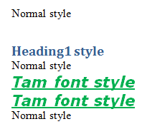
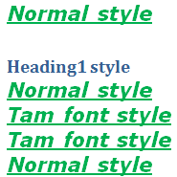
Finding/Replacing Formatting Styles (2)
Word document containing the macro: findReplaceStyle.docm
  Sub findReplaceStyle()
  With ActiveDocument.Content.Find
  .Style = "Normal"
  With .Replacement
  .Style = "TamFont"
  End With
  .Execute Replace:=wdReplaceAll
  End With
  End Sub
BEFORE
AFTER
‘Normal’ style becomes ‘TamFont’

Slide 16
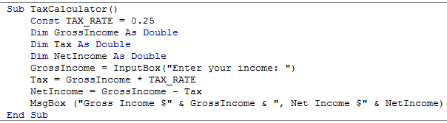
Recap: Programs You’ve Seen So Far
How to write a program with a sequence of VBA instructions
  Each instruction executes from beginning to end, one after the other
When the last instruction is reached then the program ends
Start
End

Slide 17
What You Will Learn: Branching/Decisions
What if alternatives may occur during execution (a branch in execution)
  Each alternative may result in a different series of instructions being executed
Ask for income
>= $0?
No
Yes
Show error message
Calculate and display tax

Slide 18
How To Make Decisions In A Program
Check if some condition has been met (e.g., password for the document correctly entered)
Program may react one way if it’s true that the condition has been met (e.g., password matches: display confirmation message)
Program may also react another way if it’s false that the condition has been met (e.g., password doesn’t match: display error message)

Slide 19
Branching/Decision Making Mechanisms
If-Then
If-Then, Else Similar to Excel if-then
If-Then, ElseIf, Else Similar to Excel nested if’s

Slide 20
New Terminology
Boolean expression: An expression that must work out (evaluate to) to either a true or false value.
  e.g., it is over 45 Celsius today
  e.g., the user correctly entered the password
Body: A block of program instructions that will execute under a specified condition.
  Style requirement
    The ‘body’ is indented
Private Sub Document_Open()
MsgBox ("Fake virus!")
End Sub
This/these instruction/instructions run when you tell VBA to run the macro, the ‘body’ of the macro program

Slide 21
Decision Making With ‘If-Then’
Boolean
True
Then execute an
instruction or instructions
False
Remainder of
the program

Slide 22
If-Then
Format:
  If (Boolean expression) Then
  If-Body
  End if
Example:
  If (totalWords < MIN_SIZE) Then
  MsgBox ("Document too short, total words " &
  totalWords)
  End If

Slide 23
If-Then: Complete Example
Word document containing the macro: wordCount.docm
  ' Try deleting all the words in the Word doc and run the
  ' macro again
  Sub wordCount()
  Dim totalWords As Integer
  MIN_SIZE = 1000
  totalWords = ActiveDocument.Words.Count
  If (totalWords < MIN_SIZE) Then
  MsgBox ("Document too short, total words " &
  totalWords)
  End If
  End Sub

Slide 24
Allowable Operators For Boolean Expressions
if (value operator value) then
VBA Mathematical
operator equivalent Meaning Example
< < Less than 5 < 3
> > Greater than 5 > 3
= = Equal to 5 = 3
<= ≤ Less than or equal to 5 <= 5
>= ≥ Greater than or equal to 5 >= 4
<> ≠ Not equal to x <> 5

Slide 25
Different Actions Required For The True Vs. False Cases
While it is possible to explicitly state both cases using two if-then expressions…
  If (totalWords < MIN_SIZE) Then
  MsgBox ("Document too short, total words " &
  totalWords)
  End If
  If (totalWords >= MIN_SIZE) Then
  MsgBox ("Document meets min. length requirements")
  End If
The previous approach can be simplified
Why? (What characteristics of the two if-then expressions may allow for an easy simplification)?
It’s true that the document is too short
It’s false that the document is too short

Slide 26
Decision Making With An ‘If, Else’
Boolean
True
Execute an instruction
or instructions (if-body)
False
Execute an instruction
or instructions (else-body)
Remainder of
the program

Slide 27
If-Then (True), Else (False)
Format:
  If (Boolean expression) Then
  If-Body
  Else
  Else-Body
  End if
Example:
  If (totalWords < MIN_SIZE) Then
  MsgBox ("Document too short, total words " & totalWords)
  Else
  MsgBox ("Document meets min. length requirements")
  End If

Slide 28
If-Then, Else: Complete Example
Word document containing the macro: wordCount2.docm
  Sub wordCount2()
  Dim totalWords As Integer
  MIN_SIZE = 1000
  totalWords = ActiveDocument.Words.Count
  If (totalWords < MIN_SIZE) Then
  MsgBox ("Document too short, total words " &
  totalWords)
  Else
  MsgBox ("Document meets min. length requirements")
  End If
  End Sub
  ' Try deleting words or changing the minimum size and observe ' the effect on the program.

Slide 29
What To Do When Multiple Conditions Must Be Checked
Case 1: If each condition is independent of other questions
  Multiple if-then expressions can be used
  Example:
  Q1: Are you an adult?
  Q2: Are you a Canadian citizen?
  Q3: Are you currently employed?

Slide 30
What To Do When Multiple Conditions Must Be Checked (2)
Case 2: If the result of one condition affects other conditions (when one condition is true then the other conditions must be false)
  If-then, elseif, else can be used
  Which of the following is your place of birth? (Answering true to one option makes the options false)
    Calgary
    Edmonton
    Lethbridge
    Red Deer
    None of the above

Slide 31
Decision Making With Multiple If-Then’s
Boolean 1
False
  Q1: Are you an adult?
  Q2: Are you a Canadian citizen?
  Q3: Are you currently employed?
True
Instruction or
instructions
Boolean 2
False
True
Instruction or
instructions
Remainder of
the program

Slide 32
Multiple If-Then's
Any, all or none of the conditions may be true
Employ when a series of independent questions will be asked
Format:
if (Boolean expression 1) then
body 1
end if
if (Boolean expression 2) then
body 2
end if
...
statements after the conditions

Slide 33
Multiple If-Then's (2)
Word document containing the macro: multipleIf.docm
  Sub multipleIf()
  ' Check if there were any 'comments' added to the document.
  If (ActiveDocument.Comments.Count > 0) Then
  MsgBox ("Annotations were made in this document")
  End If
  ' A numbered item includes numbered and bulleted lists.
  If (ActiveDocument.CountNumberedItems() > 0) Then
  MsgBox ("Bullet points or numbered lists used")
  End If
  End Sub

Slide 34
Multiple If's: Mutually Exclusive Conditions
At most only one of many conditions can be true
Can be implemented through multiple if's
Word document containing the macro (empty document, see macro editor for the important details): “gradesInefficient.docm”
Inefficient combination!
If (grade = 4) Then
letter = "A"
End If
If (grade = 3) Then
letter = "B"
End If
If (grade = 2) Then
letter = "C"
End If
If (grade = 1) Then
letter = "D"
End If
If (grade = 0) Then
letter = "F"
End If

Slide 35
Decision Making With If-Then, Elseif, Else
Boolean
True
Instruction or
instructions
False
Boolean
True
Instruction or
instructions
False
JT’s note: once the first ‘true’ case is encountered all remaining and related Boolean expressions (using ‘Elseif’) are skipped
Instruction or
instructions
Remainder of
the program

Slide 36
Multiple If-Elif-Else: Use With Mutually Exclusive Conditions
Mutually exclusive
One condition evaluating to true excludes other conditions from being true
Example: having your current location as ‘Calgary’ excludes the possibility of the current location as ‘Edmonton’, ‘Toronto’, ‘Medicine Hat’
Format:
if (Boolean expression 1) then:
body 1
elseif (Boolean expression 2):
body 2
...
else
body n
' Only one ‘end-if’ at very end
end if
statements after the conditions

Slide 37
If-Elseif-Else: Mutually Exclusive Conditions (Example)
Word document containing the macro (empty document, see macro editor for the important details): “gradesEfficient.py”
  If (grade = 4) Then
  letter = "A"
  ElseIf (grade = 3) Then
  letter = "B"
  ElseIf (grade = 2) Then
  letter = "C"
  ElseIf (grade = 1) Then
  letter = "D"
  ElseIf (grade = 0) Then
  letter = "F"
  Else
  letter = "Invalid"
  End If
This approach is more efficient when at most only one condition can be true.
Extra benefit:
The body of the else executes only when all the Boolean expressions are false. (Useful for error checking/handling).

Slide 38
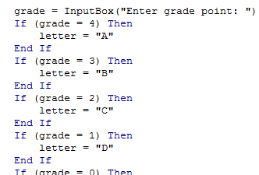
Location Of The “End If”: Multiple If’s
Independent If-then’s:
  Since each ‘if’ is independent each body must be followed by it’s own separate ‘end if’

Slide 39

Location Of The “End If”: If-then, Else
If-then, Else:
  Since the ‘if-then’ and the ‘else’ are dependent (either one body or the other must execute) the ‘end if’ must follow the body of the ‘else- body’ (last dependent “if-branch”)
Document either does or does not have enough words

Slide 40
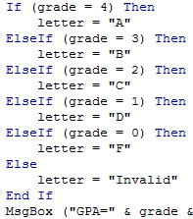
Location Of The “End If”: If-Then, ElseIf
Dependent If-then, Else-If:
  Since the results of earlier Boolean expressions determine whether later ones can be true (reminder: because at most only one can be true) all of the if-then and Elseif expressions are dependent (one related block).
  The “end if” belongs at the very end of the block

Slide 41
Logic Can Be Used In Conjunction With Branching
Typically the logical operators And, Or are used with multiple conditions/Boolean expressions:
  If multiple conditions must all be met before the body will execute. (And)
  If at least one condition must be met before the body will execute. (Or)
The logical Not operator can be used to check if something has ‘not’ occurred yet
  E.g., If it’s true that the user did not enter an invalid value then the program can proceed.

Slide 42
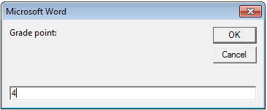
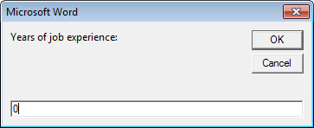
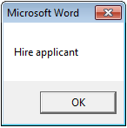
Logic: The “Or” Operator
Format:
If (Boolean expression) Or (Boolean expression) then
body
End if
Word document containing the macro (empty document, see macro editor for the important details): “if_or_hiring.docm”
  gpa = InputBox("Grade point: ")
  experience = InputBox("Years of job experience: ")
  If (gpa > 3.7) Or (experience > 5) Then
  result = "Hire applicant"
  Else
  result = "Insufficient qualifications"

Slide 43
Hiring Example: Example Inputs & Results
If (gpa > 3.7) Or (experience > 5) then
GPA | Years job experience | Result
2 | 0 | Insufficient qualifications
1 | 10 | Hire
4 | 1 | Hire
4 | 7 | Hire

Slide 44
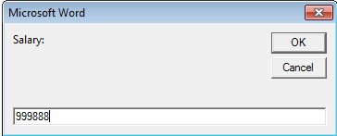
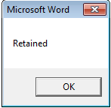
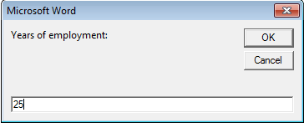
Logic: The “AND” Operator
Format:
If (Boolean expression) And (Boolean expression) then
body
End if
Word document containing the macro (empty document, see macro editor for the important details): if_and_firing.py
  salary = InputBox("Salary: ")
  years = InputBox("Years of employment: ")
  If (salary >= 100000) And (years < 2) Then
  result = "Fired!"
  Else
  result = "Retained"

Slide 45
Firing Example: Example Inputs & Results
If (salary >= 100000) And (years < 2) Then
Salary | Years on job | Result
1 | 100 | Retained
50000 | 1 | Retained
123456 | 20 | Retained
1000000 | 0 | Fired!

Slide 46
Logic: The “Not” Operator
Format:
  If Not (Boolean Expression) then
  body
  End if
Word document containing the macro example: checkSave.docm
  If Not (ActiveDocument.Saved) Then
  MsgBox ("You haven't saved " & ActiveDocument.Name
  & " yet")
  End If

Slide 47
Line Continuation Character
To increase readability long statements can be split over multiple lines.
  If (income > 99999) And _
  (experience <= 2) And _
  (numRepramands > 0) Then
  MsgBox ("You’re fired!")
  End If
To split the line the line continuation character (underscore) must be preceded by a space.
Keywords cannot be split between lines
Strings require the concatenation operator ‘&’
For more details see: http://support.microsoft.com/kb/141513

Slide 48
Line Continuation Character (2)
Strings split over multiple lines require a combination of the proper use of the line continuation character '_' and the concatenation operator '&‘:
  MsgBox ("Your " _
  & "name")

Slide 49
Nested Decision Making
Decision making is dependent.
  One branch is ‘nested’ inside of another branch
The first decision must evaluate to true (“gate keeper”) before successive decisions are even considered for evaluation.
Question 1?
Question 2?
True
True
Statement or
statements
False
False
Remainder of
the program

Slide 50
Nested Decision Making
One decision is made inside another.
Outer decisions must evaluate to true before inner decisions are even considered for evaluation.
Format:
if (Boolean expression) then
if (Boolean expression) then
body
end if
end if
Outer body
Inner body

Slide 51
Example: Nested Branches
Word document containing the macro (empty document, see macro editor for the important details): “nested.docm”
  Sub nested()
  Const TAX_RATE = 0.5
  Dim citizen As String
  Dim taxCredit As Long

Slide 52
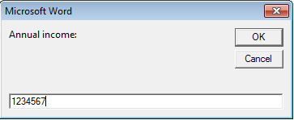
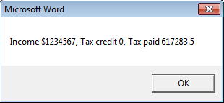
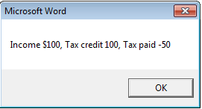
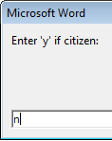
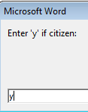
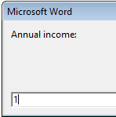
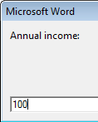
Example: Nested Branches (2)
  income = InputBox("Annual income: ")
  If (income < 10000) Then
  citizen = InputBox("Enter 'y' if citizen: ")
  If (citizen = "y") Then
  MsgBox ("This person can receive social
  assistance")
  taxCredit = 100
  End If
  End If
  tax = (income * TAX_RATE) - taxCredit
  MsgBox ("Income $" & income & ", Tax credit " & taxCredit & ", Tax paid " & tax)
  End Sub

Slide 53
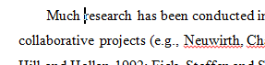

The Selection Object again
With a previous example if no text was selected then the program would produce no visible effect.
  Sub SelectedFontChange()
  Selection.Font.Bold = wdToggle
  End
Another example automatically selected text for you “expanded” the selection.
  Sub AutoSelectedFontChange()
  Selection.Expand
  Selection.Font.Bold = wdToggle
  End Sub
Before
After

Slide 54
Constants For The Selection Object
Name of constant | Meaning of constant
wdSelectionIP | No text selected
wdSelectionNormal | Text (e.g., word, sentence) has been selected
wdSelectionShape | A graphical shape (e.g., circle, text book) has been selected

Slide 55
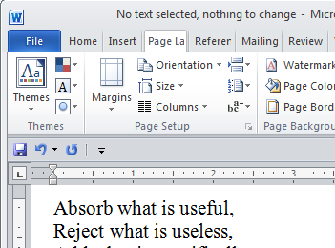
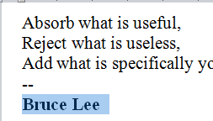
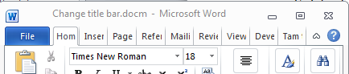
The Selection Object again
Application of branching: check if a selection has been made and only apply the selection if that is the case.
Word document containing the macro: “selectionExample.docm”
  Sub checkSelection()
  If Selection.Type = wdSelectionIP Then
  MsgBox ("No text selected, nothing to change")
  Else
  Selection.Font.Bold = wdToggle 'wdToggle, constant
  End If
  End Sub
Run macro: No selection
Run macro: selected text bolded
Default title bar

Slide 56
Marking/Spelling Checking A Document
Suppose you want to mark a document with a pass/fail grade based on the number of typographical errors (e.g., more than 30 is a fail, anything less is a pass).
Assume that document names match student names
For document to be marked you will create another document in the same folder.
To make it easier to pair up marking with the student the ‘marking document’ will be named “Marking for: <document name>”
  E.g., “james tam.doc” would produce a marking document called “Marking for: James Tam.doc”
  Inside the marking document will be the text “Marking for: <document name> <pass or fail>”

Slide 57
“Marking_Program”
Word document containing the macro: markingProgram.docm
Sub MarkingForSpelling()
Dim totalTypos As Integer
Const MAX_TYPOS = 30
Dim currentDocument As String
Dim markingDocument As String
Dim fileLocation As String
Dim feedback As String

Slide 58
“Marking_Program” (2)
'Get Name of current document
currentDocument = ActiveDocument.Name
'Name of marking document based on current doc
markingDocument = "MARKS FOR " & currentDocument
fileLocation = ActiveDocument.Path
totalTypos = ActiveDocument.SpellingErrors.count
'Feedback is prefaced by student(document) name
feedback = currentDocument

Slide 59
“Marking_Program” (3)
'Creates a new word document based on the 'normal' template
'Create a variable ‘wordDocument’ to refer to the newly created
'document
Set wordDocument = Documents.Add("Normal.dot")

Slide 60
“Marking_Program” (4)
'Recall: before this feedback just = document name
If (totalTypos > MAX_TYPOS) Then
feedback = feedback & ": Too many typographical
errors: Fail"
Selection.TypeText (feedback)
Else
feedback = feedback & ": Pass"
Selection.TypeText (feedback)
End If
‘Saving feedback doc in same location but under name of
‘marking (and not the student) document
wordDocument.SaveAs2 (fileLocation & "\" &
markingDocument)
End Sub

Slide 61
Example Run Of Marking Program
Suppose that this macro was part of a word document “marking program.docm”
Running the macro would then produce a file called “MARKS FOR marking program.docm”
  (Assuming that the program had no spelling errors) this file would contain the following text:
Marking program.docm: Pass

Slide 62
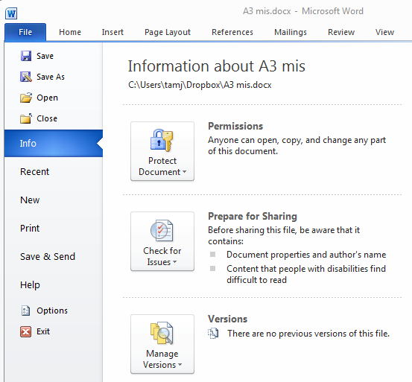
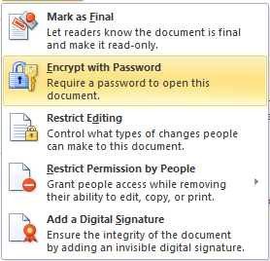
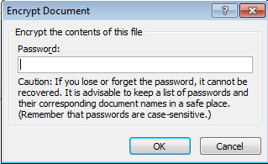
Securing A Document: Using MS-Word
Documents can be configured so a password is required to view the contents.

Slide 63
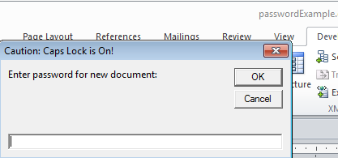
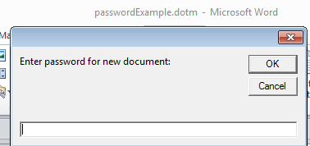
Securing A Document: Simple VBA Example
Word document containing the macro: passwordBranchExample.docm
  Sub passWordExample()
  Dim yourPassword As String
  Dim warningCaps As String
  If (Application.CapsLock = True) Then
  warningCaps = "Caution: Caps Lock is On!"
  Else
  warningCaps = ""
  End If
  yourPassword = InputBox("Password for document: ",
  warningCaps)
  ActiveDocument.Password = yourPassword
  End Sub

Slide 64
What You Will Learn: Repetition/Loops
How to get the program or portions of the program to re-run itself
  Without duplicating the instructions
  Example: you need to calculate tax for multiple people
Ask for income
Loop: allows you to repeat the same tasks over and over again
Calculate deductions
Display amounts

Slide 65
Types Of Loops
Fixed repetition loops: runs some integer ‘n’ times e.g., generates taxes for 10 clients
  For-next
Variable repetition loops: runs as long as some condition holds true e.g., while the user doesn’t quit the program re-run the program, while the user enters an erroneous value ask the user for input.
  Do-while loop

Slide 66
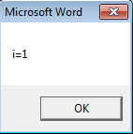
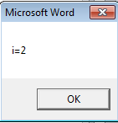
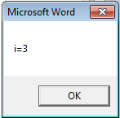
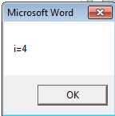
For-Next Loops
A ‘counting’ loop: counts out a sequence of numbers
Format:
  For <counter> = <start> To <end> Step <step size>¹
  <Statement(s)>
  Next <counter>
Example: “for1.docm”
  Dim i As Integer
  For i = 1 To 4 Step 1
  MsgBox ("i=" & i)
  Next i
1 Step size can be a positive or negative integer e.g., 1, -1, 5, -10 etc.

Slide 67
For-Next Loops (2)
For-next loops can count down as well as up
The Steps can be values other than one.
Example: “for2.docm”
  Dim i As Integer
  For i = 12 To 0 Step -3
  MsgBox ("i=" & i)
  Next i
12
9
6
3
0

Slide 68
Do-While Loop
Start
Condition?
F
T
Format:
  Do While <Condition>
  <Statement(s)>
  Loop
Example: “while1.docm”
  Dim i As Integer
  i = 1
  Do While i <= 4
  MsgBox ("i=" & i)
  i = i + 1
  Loop
Statements
Loop
End
Any valid mathematical expression here

Slide 69
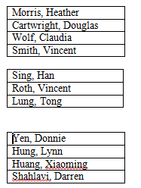
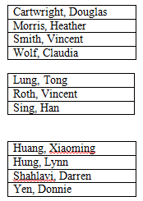
Simple Example: Sorting Three Tables
Instructions needed for sorting 3 tables
  ActiveDocument.Tables(1).Sort
  ActiveDocument.Tables(2).Sort
  ActiveDocument.Tables(3).Sort
Before
After

Slide 70
Previous Example
Critique of the previous approach: the program ‘worked’ for the one document but:
  What if there were more tables (cut and paste of the sort instruction is wasteful)?
  What if the number of tables can change (i.e., user edits the document)
Notice: The process of sorting just repeats the same action but on a different table.
  ActiveDocument.Tables(1).Sort
  ActiveDocument.Tables(2).Sort
  ActiveDocument.Tables(3).Sort
Sorting can be applied reduce the duplicated statements

Slide 71
Revised Example: Sorting Tables With A Loop
  Word document containing the macro: “sortingTables.docm”
  Sub Sort()
  Dim CurrentTable As Integer
  Dim NumTables As Integer
  NumTables = ActiveDocument.Tables.Count
  If NumTables = 0 Then
  MsgBox ("No tables to sort")
  Else
  For CurrentTable = 1 To NumTables Step 1
  MsgBox ("Sorting Table # " & CurrentTable)
  ActiveDocument.Tables(CurrentTable).Sort
  Next
  End If
  End Sub

Slide 72
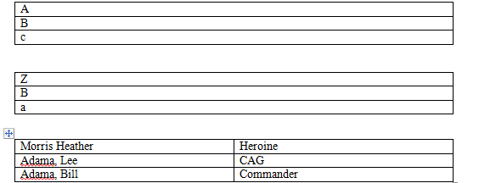
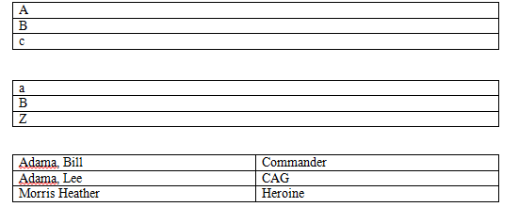
Result: Sorting Tables
Before
After

Slide 73


More On Sort
A handy parameter that can be used to configure how it runs.
Format
  Sort (<Boolean to Exclude header – True or False>)
Example
  ActiveDocument.Tables(CurrentTable).Sort(True)
  Before
  After

Slide 74
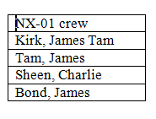
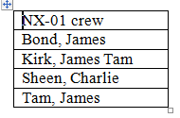
Second Sorting Example: Exclude Headers
Document containing the macro: “sortingTablesExcludeHeader.docm”
  Sub Sort()
  Dim CurrentTable As Integer
  Dim NumTables As Integer
  NumTables = ActiveDocument.Tables.Count
  If NumTables = 0 Then
  ' Don't bother sorting
  MsgBox ("No tables to sort")
  Else
  For CurrentTable = 1 To NumTables Step 1
  MsgBox ("Sorting Table # " & CurrentTable)
  ActiveDocument.Tables(CurrentTable).Sort (True)
  Next
  End If
  End Sub
Before
After

Slide 75
The Need For String Operations
Sometimes you only want a part of a string (“substring”)
Example a string containing location information
  Address = “ABCalgary”
If there is a standard format in the data e.g., the first two characters will always be the province then you can apply a string operation to remove the desired sub-string from the original string
  “AB”
  Left(address,2) <= start counting from the left extract the first two
  characters

Slide 76
More On Strings
A string consists of a series of characters.
Each character in a string has a position (referred to as an ‘index’).
  The first character is at position zero
Examples
  “Hello”
  “u r”
0 | 1 | 2 | 3 | 4
‘H’ | ‘e’ | ‘l’ | ‘l’ | ‘o’
0 | 1 | 2
‘u’ | <SPACE> | ‘r’

Slide 77
Some Useful String Operators
Assume we have the following strings created for the examples
  Dim str1 as String
  Dim str2 as String
  Dim num as Integer
  str1 = "hello world“
  str2 = "hello"
Desired operation | Function | Example usage | Result
Retrieve the first ‘n’ characters (count from left) | Left(<string>, n) | str2 = left(str1,5) | Str2 contains the string “hello”
Retrieve the last ‘n’ characters (count from right) | Right(<string>,n) | Str2 = right(str1,4) | Str2 contains the string “orld”
Determine a string length | Len(<string>) | num = Len(str1) | Num is 11
Comparing strings | StrComp(<string1>, <string2>) | Num = strComp(str1,str2) | Num is zero if identical, non-zero if different

Slide 78
String Compare Example
  Word document containing the macro (empty document, see macro editor for the important details): stringCompare.docm
    Sub stringCompare ()
    Dim str1 As String
    Dim str2 As String
    Dim num As Integer
    str1 = InputBox("enter a string")
    str2 = InputBox("enter a string")
    num = StrComp(str1, str2)
    MsgBox (num)
    End Sub
Str1= “ab”
Str2 = “ab”
Num = 0
Str1= “ab”
Str2 = “ba”
Num = -1
Str1= “ab”
Str2 = “aa”
Num = 1
JT: “Why are we learning this stuff (string compare function)???”

Slide 79
Linking Office Documents
One document contains a link to another document (typically this is done with two different type of MS-Office applications to take advantages of the strengths of each application).
Pro
  There are two separate documents (saves on file size, changes in the original document automatically show in document containing the link)
Con:
  It’s location specific (moving documents or sharing documents results in ‘breaking’ the link)
For more information: http://support.microsoft.com/kb/76993

Slide 80
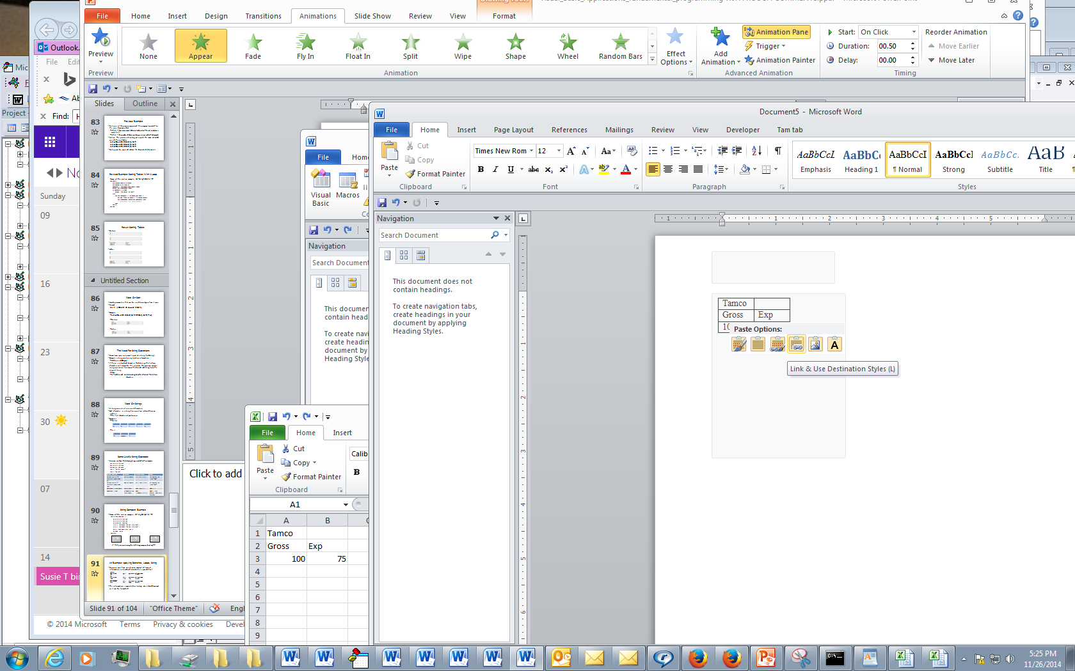
How To Link Documents (Word Linked To Excel)
Suppose you have an extensive amount of financial information entered and calculated in a spreadsheet
The information is imported via ‘linking’ into a Word document so it can be formatted
TAMCO
Gross income | Costs | Net income | Net:Gross Income
100 | 75 | 25 | 25.00%
HAL
Gross income | Costs | Net income | Net:Gross Income
1500 | 1250 | 250 | 16.67%
Pear computer
Gross income | Costs | Net income | Net:Gross Income
9999 | 999 | 9000 | 90.01%

Slide 81
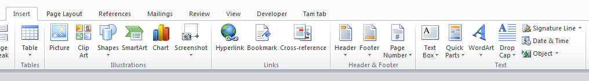
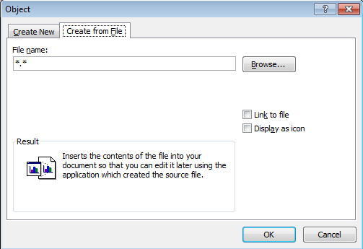
Alternate Approach For Linking Documents
Insert->Object
Create from file->Link to file->Browse

Slide 82
Embedding Office Documents
Copy all of the information from one document to another document (e.g., embed a copy of an Excel spreadsheet inside of Word document).
The capabilities of another application such as Excel can be used inside of Word (formulas, updated calculations etc.)
Pro
  The document with another document embedded is complete. That file can copied, shared etc.
Con:
  The embedded document is copied and if the file is large a great deal of space can be duplicated
  If the original document is changed (spreadsheet updated), the changes are not reflected in the document that contains the embedded document (word document containing the spreadsheet)
For more information: http://support.microsoft.com/kb/76993

Slide 83
How To Embed One Document In Another
Insert->Object
Create from file->Browse

Slide 84
Example: Using Branches, Loops, Strings
Suppose that this data is not only extensive (many tables), it is also dynamic (changes over time).
You need to analyze the data and highlight the important information
  Which companies may be a good investment?
  Which criteria make it a good investment?
  With a real example many companies are listed on the stock exchange
  For each company there can be a great deal of background information
    “Minimum” current stock price, dollar value of change
    Other information could include detailed financial statements (e.g., how much money is that company making, what’s the ratio of debt vs. cash etc.)

Slide 85
Example: Using Branches, Loops, Strings (2)
(Note: the problem of having to sort through large sets of data is not unique to finance and investing)
  E.g., Suppose you want to work at companies that are hiring based on certain qualifications (“MS-Word VBA programming”) or provide certain benefits (“Unlimited vacation time”)

Slide 86
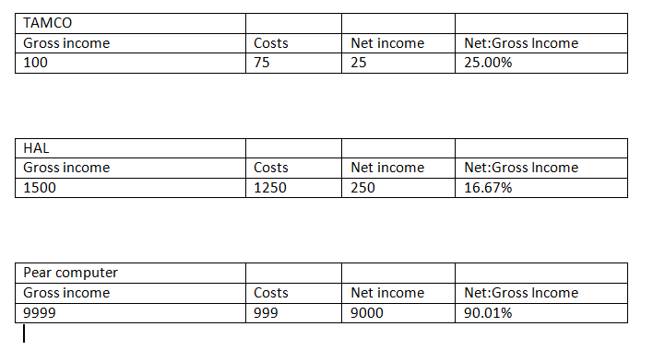
Example: Background Knowledge
Gross income: total income earned (total sales dollars)
Costs: expenses of running the business
  Cost to purchase items sold
  Salaries
  Rent
  Utilities
  Taxes etc.
Net income: Gross income minus costs
Ratio of net to gross income
  Ratio = (Net income) / (Gross income) * 100

Slide 87
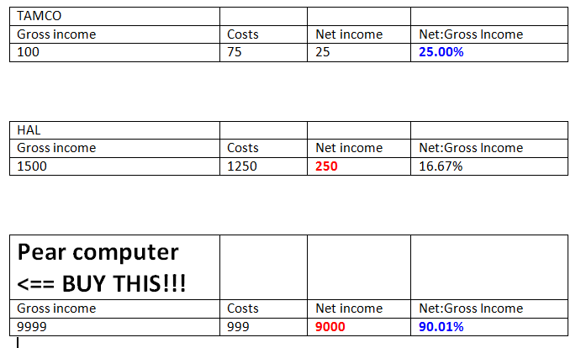
Example Requirements
Highlight companies with a net income that is $250 or greater (red)
Highlight companies whose ratio of net to gross income is 25% or greater (blue)
If a company meets both requirements draw extra attention (bold, larger font, extra comments - “BUY THIS!!!”

Slide 88
Example File: Before

Slide 89
Example File: After

Slide 90
Highlighting Important Table Data: VBA Solution
  Word document containing the macro: “tableHighLight.docm”
  Sub tableHighlight()
  Const MIN_INCOME = 250
  Const MIN_RATIO = 25
  Const MATCH = 0
  Dim CurrentTable As Integer
  Dim NumTables As Integer
  Dim NetString As String
  Dim NetNumber As Integer
  Dim RatioString As String
  Dim RatioNumber As Integer
  Dim CompanyName As String
  Dim TempString As String
  Dim StringLength As Integer
  Dim i As Integer

Slide 91
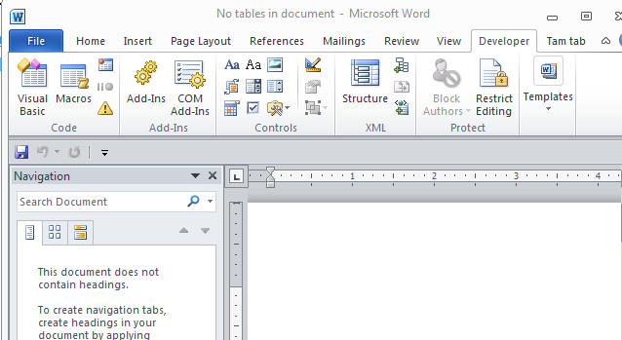
Highlighting Important Table Data: VBA Solution (2)
  ' No tables to analyze, end the program
  NumTables = ActiveDocument.Tables.Count
  If NumTables = 0 Then
  ActiveDocument.ActiveWindow.Caption = "Error: No _
  tables in document!"
  Exit Sub
  End if

Slide 92
Highlighting Important Table Data: VBA Solution (2)
  For CurrentTable = 1 To NumTables Step 1
  NetString =
  ActiveDocument.Tables(CurrentTable). _
  Rows(3).Cells(3).Range.Text
  StringLength = Len(NetString)
  ' column labels 0 1 2 3
  ' data in each column 1 2 ? ?
  ' left("12??", (4-1 = 2)) so yields "12"
  TempString = Left(NetString, (StringLength - 1))

Slide 93
Highlighting Important Table Data: VBA Solution (3), Net Income
  If IsNumeric(TempString) Then
  NetNumber = CLng(TempString)
  Else
  MsgBox ("Error non-numeric net income information")
  NetNumber = 0
  End If
  If (NetNumber >= MIN_INCOME) Then
  ActiveDocument.Tables(CurrentTable). _
  Rows(3).Cells(3).Range.Select
  With Selection
  .Font.Bold = True
  .Font.Color = wdColorRed
  End With
  End If
Const MIN_INCOME = 250

Slide 94
Highlighting Important Table Data: VBA Solution (4), Ratio (Net:Gross)
  RatioString = ActiveDocument.Tables(CurrentTable). -
  Rows(3).Cells(4).Range.Text
  StringLength = Len(RatioString)
  TempString = Left(RatioString, (StringLength - 3))
  If IsNumeric(TempString) Then
  RatioNumber = CLng(TempString)
  Else
  MsgBox ("Error non-numeric information in ratio of net _
  income:gross")
  RatioNumber = 0
  End If

Slide 95
Highlighting Important Table Data: VBA Solution (5), Ratio
Const MIN_RATIO = 25
  If (RatioNumber >= MIN_RATIO) Then
  ActiveDocument.Tables(CurrentTable). _
  Rows(3).Cells(4).Range.Select
  With Selection
  .Font.Bold = True
  .Font.Color = wdColorBlue
  End With
  End If

Slide 96
Highlighting Important Table Data: VBA Solution (6)
  If (RatioNumber >= MIN_RATIO) And (NetNumber >= MIN_INCOME) _ Then
  CompanyName =
  ActiveDocument.Tables(CurrentTable). _
  Rows(1).Cells(1).Range.Text _
  CompanyName = CompanyName & "<== BUY THIS!!!“
  ActiveDocument.Tables(CurrentTable). _
  Rows(1).Cells(1).Range.Text = CompanyName
  ActiveDocument.Tables(CurrentTable). _
  Rows(1).Cells(1).Range.Select
  With Selection
  .Font.Size = 20
  .Font.Bold = True
  End With
  End If
  Next ' Examine the next table

Slide 97
Printing: Single
Printing a single document (currently opened, active MS-Word document)
  Word document containing the macro example: “singleDocumentPrint.docm”
  Sub PrintSingleDocument()
  ActiveDocument.PrintOut
  End Subs

Slide 98
Printing: Multiple
Printing all the documents currently open in MS-Word.
  Take care that you don’t run this macro if you have many documents open and/or they are very large!
  Word document containing the macro example: “multiDocumentPrint.docm”
  Sub PrintDocumentsCollection()
  Dim numDocuments As Integer
  Dim count As Integer
  numDocuments = Documents.count
  count = 1
  Do While (count <= numDocuments)
  Documents.Item(count).PrintOut
  count = count + 1
  Loop
  End Sub
Learning: another practical application of looping e.g., automatically open multiple documents, make changes, print and save them without user action needed

Slide 99
The ‘Dir’ Function
A directory = Folder
The Dir function allows access to the files in a directory
Examples:
  Check if a file exists in a particular location
  Loop through all the files in a directory and process each file

Slide 100
Example: Using Dir To Check If File Exists (2)
  Word document containing the macro example: openExistingDocument.docm
    Sub openExistingDocument()
    Dim filename As String
    Dim checkIfExists As String
    Dim last As Integer
    filename = InputBox ("Enter the path and name of file to
    open e.g., 'C:\temp\tam.docx'")
    ' Error case: nothing to open, user entered no info
    If (filename = "") Then
    ActiveDocument.ActiveWindow.Caption =
    "Path/filename cannot be empty"

Slide 101
Example: Using Dir To Check If File Exists (2)
    ' No error: non-empty info entered
    Else
    checkIfExists = Dir(filename)
    If (Len(checkIfExists) = 0) Then
    MsgBox ("File doesn't exist can't open")
    Else
    MsgBox ("File exists opening")
    Documents.Open (filename)
    End If
    End If
    End Sub

Slide 102
Example: Using Dir To Access Each File In A Directory
  Word document containing the macro example: loopDirectory.docm
      Sub DirectoryLoop()
      Dim directoryPath As String
      Dim currentFile As String
      directoryPath = InputBox
      ("Enter full path of search folder")
      currentFile = Dir(directoryPath & "*.*")
      Do While currentFile <> ""
      MsgBox (currentFile)
      currentFile = Dir
      Loop
      End Sub

Slide 103
Revision Of An Earlier Example
The original version created a single document and creating an accompanying marking document.
This new version will automatically mark all the documents in a user-specified folder and insert the marking information at the bottom of each document.
Details:
  Open each document in the folder
  Run a spell check of the document
  Based on the number of spelling mistakes the document will be marked as either a pass or fail
  The comments will be inserted at the end of the document
  The marked document is then automatically closed and the program moves onto the next document until there are no more documents in that folder.

Slide 104


Revised Marking Program
Word document containing the macro: “markAllFolderDocuments.docm”
  Sub markAllFolderDocuments()
  Const MAX_TYPOS = 3
  Const LARGER_FONT = 14
  Dim directoryPath As String
  Dim currentFile As String
  Dim totalTypos As Integer
  Dim feedback As String

Slide 105

Revised Marking Program (2)
  directoryPath = InputBox("Location and name of folder
  containing assignments (e.g., C:\grades\")
  If (Len(directoryPath) = 0) Then
  MsgBox ("No path specified, looking in default
  location C:\temp\")
  directoryPath = "C:\temp\"
  End If

Slide 106

Revised Marking Program (3)
currentFile
FileExample.docm
  currentFile = Dir(directoryPath & "*.doc*")
  Do While currentFile <> ""
  feedback = vbCr 'Comments on a separate line
  feedback = feedback & currentFile
  currentFile = directoryPath & currentFile
  Documents.Open (currentFile)
  totalTypos = ActiveDocument.SpellingErrors.Count
  'Marking is based solely on typos
  If (totalTypos > MAX_TYPOS) Then
  feedback = feedback & ": Too many typographical
  errors: Fail (# typos=" & totalTypos & ")"
  Else
  feedback = feedback & ": Pass (# typos=" &
  totalTypos & ")"
  End If
Feedback
<Enter>
Feedback
<Enter>
FileExample
Feedback
<Enter>
FileExample
Pass (# typos=1)

Slide 107
Revised Marking Program (4)
  'Comments appear at end of document
  Selection.EndOf Unit:=wdStory
  Selection.Text = feedback
  'Visually highlight the feedback text
  Selection.Font.Bold = True
  Selection.Font.Size = LARGER_FONT
  ActiveDocument.Close (wdSaveChanges)
  currentFile = Dir 'Access next document
  Loop 'Each loop: open and mark a document each
  End Sub

Slide 108
After This Section You Should Now Know
Collections
  What are they
  What is the advantage in using them
  Common examples found in Word documents
The Active document
  What are some of the commonly accessed attributes
  What are some useful methods
Finding things using macros
  How to find and replace: text, font effects or font styles
Using the end-with

Slide 109
After This Section You Should Now Know (2)
How to use branches to make decisions in VBA
  If
  If-else
  Multiple If’s
  If, else-if, else
  Nested branches
  Using logic (AND, OR, NOT) in branches
How to use the line continuation character to break up long instructions
How to get a program to repeat one or more instructions using loops
  For-next
  Do-while

Slide 110
After This Section You Should Now Know (3)
Strings
  What is a string
  How to access the individual elements of a string
  How common and useful string functions work
The advantages of linking vs. embedding MS-Office documents
How to print documents from VBA programs
How to use the ‘Dir’ function to access a folder/directory

