Slide 1
Creating And Publishing A Webpage
You will learn the basic html ‘tags’ for formatting a webpage, including internal and external content and augmenting a webpage with JavaScript

Slide 2
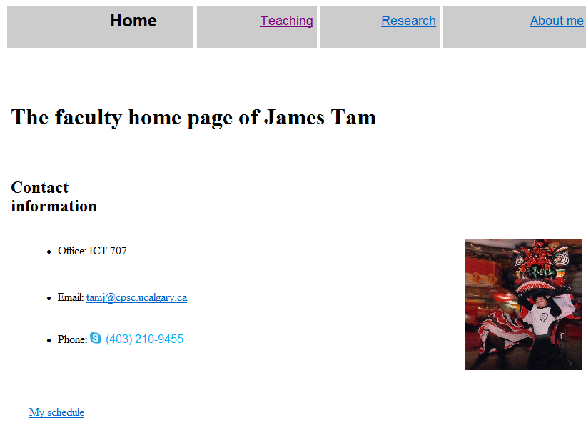
Web Page
A document that can be seen “online” via the World-Wide-Web
Going to the web address:
www.cpsc.ucalgary.ca/~tamj (or pages.cpsc.ucalgary.ca/~tamj)
Retrieves a document called “index.html” from the computer science web server to your web browser

Slide 3
Making A University Webpage
Use a simple editor WordPad (don’t use MS-Word because it will generate a great deal of extra garbage information).
Save it as a text file
Make sure you manually add the .htm or .html suffix to the end of the file otherwise it will be text .txt file and not display properly (uses a text editor such as Notepad instead of web browser to view).

Slide 4
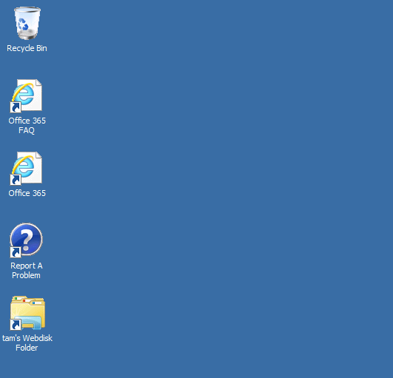
Saving The Webpage
In the “Webdisk” folder on the 203 lab computers create a “public_html” folder
For students the Web disk folder name may be different slightly different
(Its where you save documents on the UC-IT server and not on a local drive)
My account in the CPSC 203 computer lab

Slide 5
Web Address Of Your Page
The first part is the general University of Calgary web address for personal web pages:
https://webdisk.ucalgary.ca/
The final part after the “.ca/” identifies you:
Format:
<tilde><your U of C login name>
Example:
~tam/
(The web server will look in your public_html folder and try to load the ‘index.html’ file into the browser when the above web address is entered).
Web address of my U of C web page (not Computer Science)
https://webdisk.ucalgary.ca/~tam/index.html

Slide 6
Viewing Website: Reminder
To “publish the website” (make it viewable on the web).
Put the ‘.html’ document in your folder “public_html”
The web address is:
https://webdisk.ucalgary.ca/~<username>/<filename>
Example if the file were called ‘index.html’ my web address would be:
https://webdisk.ucalgary.ca/~tam/index.html
If you want to see what your website would look like with a browser when working from home:
Start up a web browser (e.g., IE, Firefox) and ‘drag’ the webpage document into the browser
OR
Just click on the document (your computer should pull up a web browser unless you reconfigured the default setup).

Slide 7
Transferring Your Work To/From UC/Home
You can use a flash memory device
(Just make sure that you don’t just transport your web document ‘htm’ file back and forth but ALSO all images and video that you have embedded into your web page (links to external pages don’t apply).

Slide 8
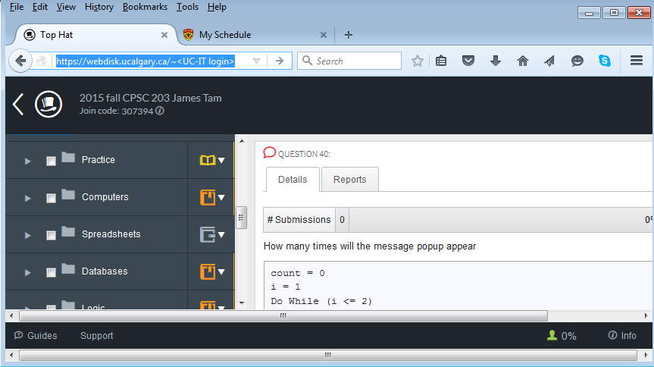
Recap
<Your Webdisk folder>
<public_html>
https://webdisk.ucalgary.ca/~<UC-IT login>
<Contents of your webpage>
index.html
<Contents of your webpage>

Slide 9
More Information: University Online Storage / Webpage
http://www.ucalgary.ca/it/services/webdisk-file-storage#quickset-field_collection_quicktabs_1

Slide 10
Alternative Methods Of Creating A Website
(The ‘content’ e.g., index.html and other documents must still be created).
Your website must be ‘hosted’
Minimum requirements for the host
Stores the content of your website (index.html and other files)
It has the ability to register your custom website
E.g., www.tamj.com
OR
Your website will be subaddress of their main web address
E.g.. www.somewebsitehost/com/tam

Slide 11
Website Hosts
Many Internet service providers automatically (without additional cost) provides hosting services for subscribers
Some Internet companies provide webhosting services without charge
http://www.geocities.ws

Slide 12
HTML
HTML (Hypertext Markup language): used to specify the format and content of a web page.
An Internet protocol (rules) that was developed in the early 1990’s decades after the creation of the original Internet.
The purpose of the protocol was to allow documents to be linked (sharing information by linking related documents).
“Rules for how documents would be linked together”
Also mechanisms for formatting the webpage were built into the protocol.
Examples of specifying formatting used in web page text: font effects (bold, italics, underline), font sizes, font types
Examples of specifying the content of a web page:
Multi-media such images and videos can be imbedded into a web page.
Links to other documents (or even external web sites)

Slide 13
Example Uses Of HTML
Font effects
External website
Image
Video

Slide 14
Formatting Your Webpage
You must use ‘tags’.
Formatting tags specify:
Exactly what part of the web page will be formatted e.g., a paragraph, line, word, single character etc.
How that section will be formatted e.g., bold, italics etc.
Many tags come in pairs
‘Opening tag’ (e.g., indicates the beginning of the formatting)
‘Closing tag’ (indicates the end of the formatting)
Other tags don’t require a closing tag
Example a tag to insert a ‘break’ just places a carriage return at the specified location

Slide 15
Common Formatting Tags
The text between the opening tag <tag name> and the closing tag </tag name> will be formatted in the manner specified by the tag.
Extra thing to keep in mind!
The formatting effect on appears when you view the webpage through a browser not when you are editing the page using the WordPad editor
View from WordPad
Bold
<b> this text is bolded </b> this text will not be bolded
Italics
<i>this text is italicized</i> this text is non-italicized
Underline
<u>underlined text</u> non-underline text
Strikethrough (alternative tag <strike></strike>)
<s>strike-through text</s>text with no strike

Slide 16
Tags Appear In Webpage Document But Not Through The Browser
Name of example web page: 1formatting_tags.htm
Viewed with WordPad (shows the formatting tags)
Viewed through a web browser (shows the effect of the tags in IE, Firefox etc.)

Slide 17
Moving Text To A New Line
Notice in the last example that the carriage return entered in WordPad did not separate lines when viewed through the browser (no ‘new lines’ to break up the text).
The tag to separate lines is <br>
There is no closing tag needed because the break-tag just moves the text after to the next line (again when viewed through the browser)

Slide 18
New Version Of The Webpage
(The previous web page with line separators)
Name of the web page: 2formatting_tags_line_breaks.htm
Viewed with WordPad (shows the formatting tags)
Viewed through a web browser (shows the effect of the tags)

Slide 19
Headings
Recall the CRAP design principles
Contrast: making different things really stand out
Heading?
CPSC 203: Assignment 4 (Creating web pages and writing Java Scripts for the web)
Due Tuesday March 24 at 4 PM
Creating a web page
You are to build a web page. Sample themes include a personal page, a page your favorite organization or group (team, charity etc.) Generally you are pretty free in your choice of website theme - it should be something that is appropriate for a university assignment submission.
Heading!
CPSC 203: Assignment 4 (Creating web pages and writing Java Scripts for the web)
Due Tuesday March 24 at 4 PM
Creating a web page
You are to build a web page. Sample themes include a personal page, a page your favorite organization or group (team, charity etc.) Generally you are pretty free in your choice of website theme - it should be something that is appropriate for a university assignment submission.

Slide 20
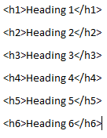
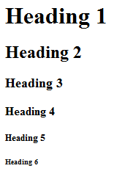
The Headings Tag
Each headings tag has an associated number
1 is first level (largest)
2 is second level (not as large)
Etc.
Example webpage: 3headings.htm

Slide 21
The List Tags
Lists can be:
unordered (bullet points) <ul>list</ul>
ordered (numbered in ascending order) <ol>list</ol>
The entire list (ordered or unordered must be enclosed in one of the above opening/closing tag pairs)
In both cases each list element must be enclosed in a list-tag <li><element></li>

Slide 22
The List Tags (2)
Name of example web page: 4lists.htm

Slide 23
Embedding “Content”
(Note: there are different ways of embedding content, this is one of the easier ways).
Like text, multi-media such as images and videos can be embedded into a website.
The multi-media can either be local (on the same computer as your web page document) or external (an external website such as: Vimeo, Bing video, Yahoo video, Youtube etc.
Video:
<embed src="<Video name>" autostart="false">
Images:
<img src="lion.jpg">

Slide 24
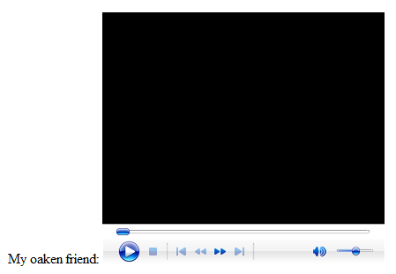
Embedding Local Multimedia
Name of the web document: 5content.htm
(Assumes that the image ‘lion.jpg’ and the video “WoodenMan.wmv” are in the same folder as this web document).
Video example

Slide 25
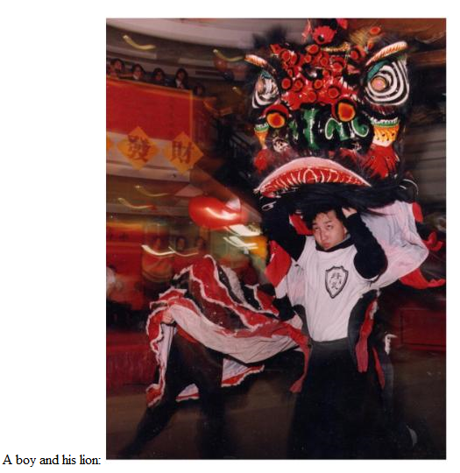
Embedding Local Multimedia (2)
Image example

Slide 26
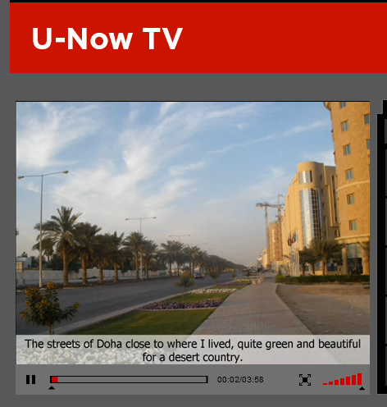
Links To Other (External) Webpages
Your web page links to a Youtube video or to an image located on another website.
You can use the ‘href’ tag for external links
<a href="<web address"</a>
Name of web document: 6links_external.htm
Video example
WordPad
Web browser

Slide 27
Links To Other (External) Webpages (2)
Image example:
WordPad
Web browser

Slide 28
A HREF: Contact Information
Use the ‘mailto’ in conjunction with “A href”
General format
<a href="mailto:<Email address>"> <Instructions> </a>
(From previous web document example – external links)
<a href="mailto:tam@ucalgary.ca">Email</a>

Slide 29
Running Programs Through A Webpage
Why bother?
Among other things adding a computer program to a webpage can make it more interactive.
Error checking user input e.g., email format in a web form
Games
Access to a database
Etc.
With JavaScript you can write programs that can execute when a webpage is downloaded and viewed through a web browser.

Slide 30
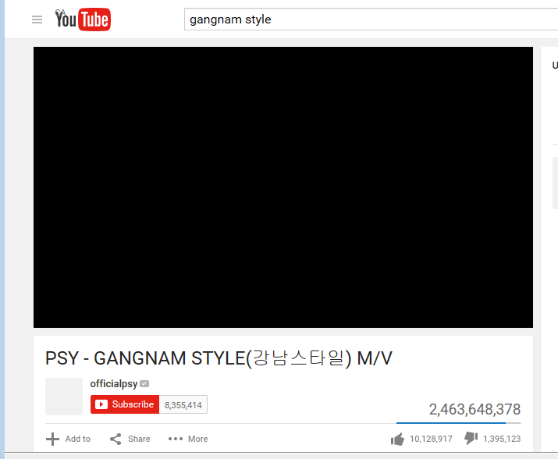
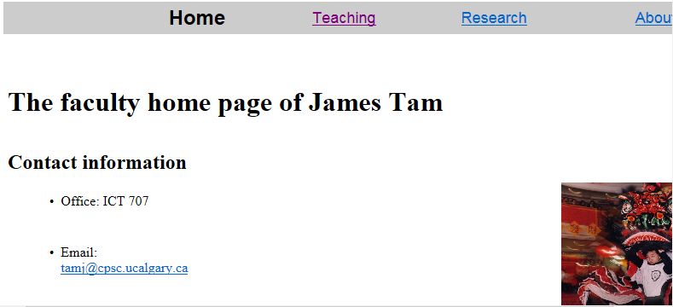
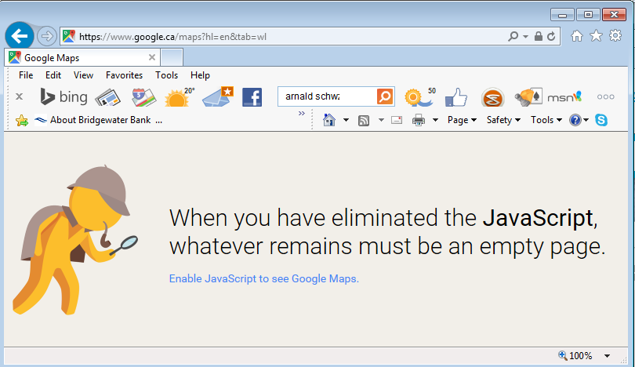
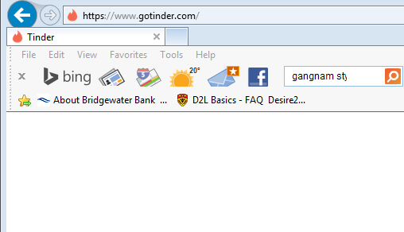
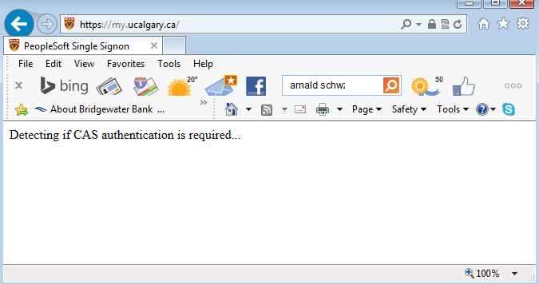
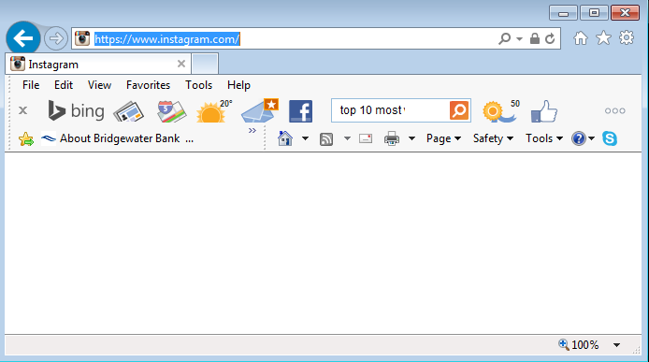
Many Popular Websites Rely On JavaScript
OK!

Slide 31
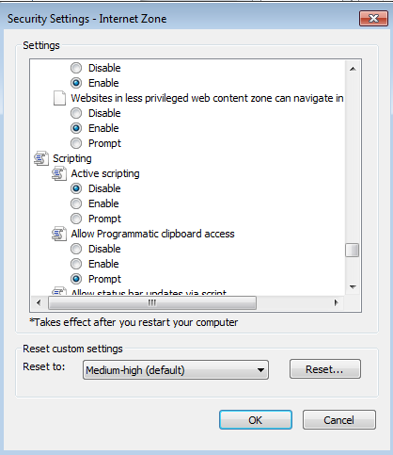
Enable/Disable Scripting (JavaScript)
IE: Tools->Internet Options->Security->Custom Level

Slide 32
Where/How To Include Programs
Separate from the webpage content (text, images, formatting tags)
Enclose them with a <script> tag
index.html
<script>
</script>
This is the <i>normal</i> <b>webpage content</b>
JavaScript program goes here

Slide 33
First Example Webpage With A JavaScript Program
Name of web document: 7autoRunInputOutputVariablesConstantsOperators.htm
Learning concepts:
Getting a JavaScript program to run automatically
Constants
Variables
Getting input
Displaying output
Using a mathematical operator

Slide 34
Webpage Content
7autoRunInputOutputVariablesConstantsOperators.htm
<script>
</script>
<h3>Function (subroutine) 'main()'</h3><br>
Automatically run script when the content of the page loads into the web browser>
JavaScript program
...
window.onload=main;

Slide 35
JavaScript Program: Documentation
<script>
/*
Author: James Tam
Version: December 2, 2015
Learning concepts:
* Getting a JavaScript program to run automatically via window.onload
* Constants (compatible with most browsers except for IE)
* Variables
* Getting input via 'prompt()'
* Displaying output via 'alert()'
* Using a mathematical operator
*/

Slide 36
JavaScript Program Instructions
</script>
function main()
{
const HUMAN_TO_CAT_AGE = 7; // Not IE compatible
var age = -1;
var catAge = -1;
age = prompt("Enter your age (zero or greater):","e.g. 37");
catAge = age * HUMAN_TO_CAT_AGE;
alert("You are " + age + " years young :)")
alert("As a cat you would be " + catAge + " years older :P")
};
window.onload=main;
</script>

Slide 37
Operators
The common operators that you will see in JavaScript are the same as other languages and applications (such as MS-Excel)
Operation | JavaScript operator
Division | /
Modulo (remainder) | %
Multiplication | *
Subtraction | /
Addition₁ | +
1 Note:
Performs mathematical addition only if all the inputs are numeric
e.g., 12 + 12 = 24
If one or more inputs are strings then a concatenation is performed
e.g., alert("Value = " + num);

Slide 38
Second Example Webpage With A JavaScript Program
Name of web document: 8interActiveWritingToSourcePage.htm
Learning concept:
Customizing a webpage 'Document.write("<string>")' based on user interaction

Slide 39
Example 8: Content And JavaScript
<script>
function main()
{
var name = "";
name = prompt("Enter your age (zero or greater):","");
document.write("Welcome to this webpage: " + name + "!");
};
window.onload=main;
</script>
<h3>Function (subroutine) 'main()'</h3><br>
Automatically run when the content of the page loads into the web browser

Slide 40
After This Section You Should Now Know
How to create a web document (‘htm’ or ‘html’ document) and have it published (viewable) on the web via the university web server
The web address for your university web page
Common html tags
Font effects: bold, italics, underline, strike out/strike through
Headings
Ordered and unordered lists
Embedding multi-media images and text within a web page
Creating external links via the “A href”

Slide 41
After This Section You Should Now Know (2)
How a simple JavaScript program can be added to a webpage
Automatically executing a script with a webpage
Enclosing a script with a ‘script’ tag
JavaScript variables and constants
Getting input “prompt()” and displaying output “alert()”
Writing text to a webpage “Document.write()”
Common mathematical operators

