Slide 1
Spreadsheets
You will learn about some important features of spreadsheets, as well as a few principles for designing and representing information.
  Online MS-Office information source: https://support.office.com/

Slide 2
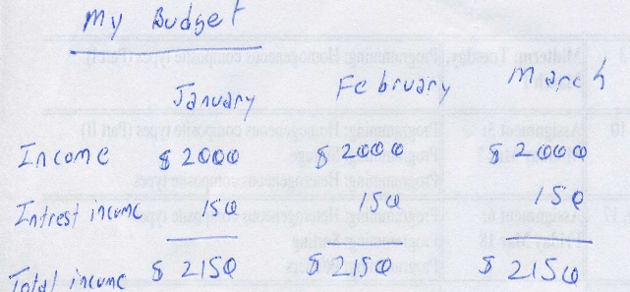
Background
Electronic spreadsheets evolved out of paper worksheets.
  Calculations were manually calculated and entered in columns and rows on paper often drawn with grids.
Making changes could be awkward:
  Correcting errors
  Attempting variations :
    e.g., for a personal budget what would be the effect of living in a 1 bedroom vs. 2 bedroom apartment
    e.g., going on a vacation to Vulcan, Alberta vs. going to Dubai, U.A.E.
    e.g., how would my term grade change if I received a “B” vs. “B+” on the final exam

Slide 3
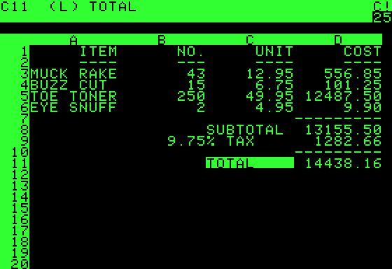
The First Spreadsheet
Early versions of electronic spreadsheets were primitive but could still automate calculations.
  So popular Visicalc was “The software tail that wags (and sells) the personal computer dog.” – Ben Rosen (Compaq)
VISICALC for the Apple II computer: Image from: http://www.cultofmac.com (last accessed Jan 2015)

Slide 4
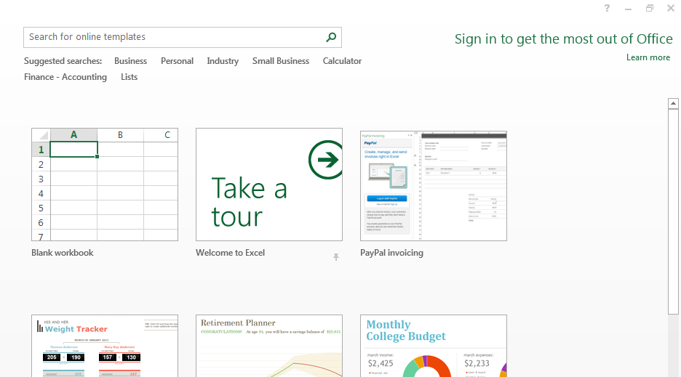
Getting Started: Creating A New Blank SpreadSheet (Excel: “Workbook”)
Starting from Windows 7 (Similar to starting other programs):
  Start button->All programs->Microsoft Office->Microsoft Excel
Once Excel started, creating a new sheet:

Slide 5
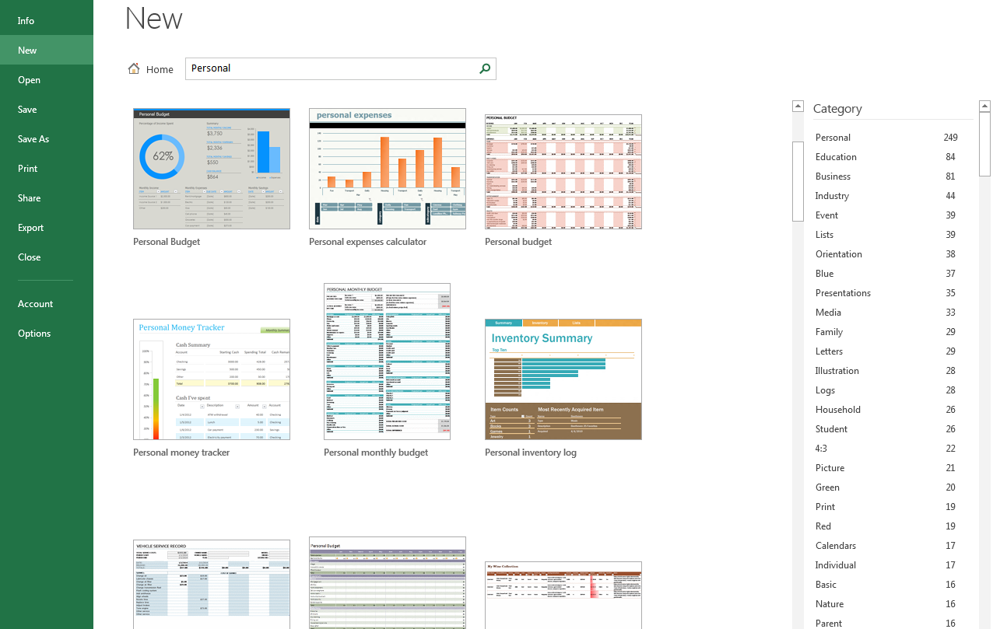
Templates
Pre-created spreadsheets for many types of problems

Slide 6
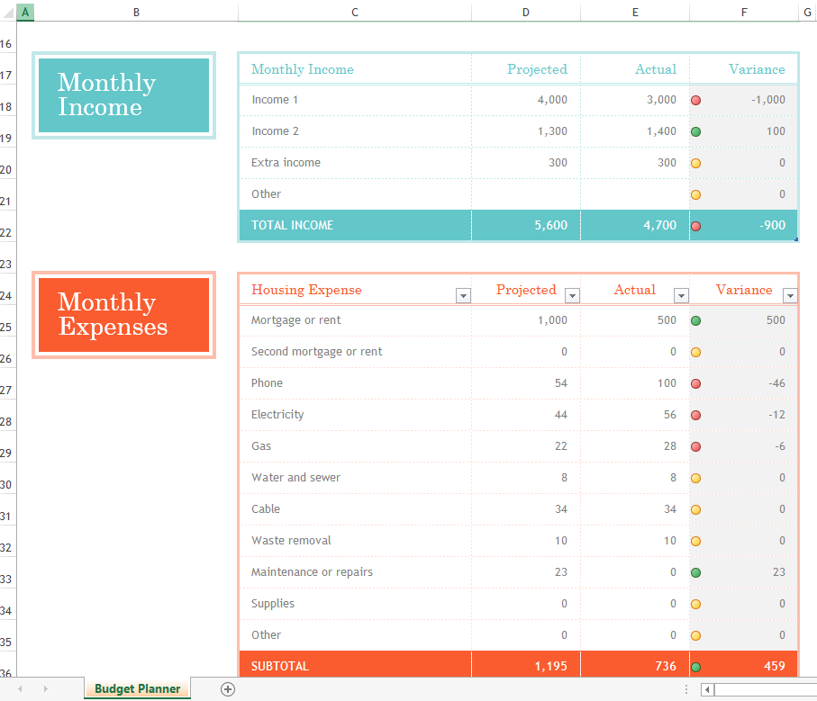
Example Template

Slide 7
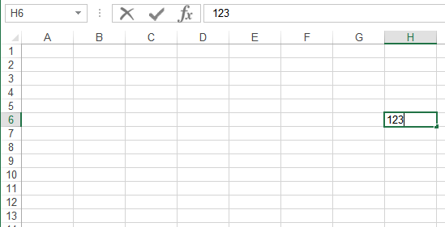
Spreadsheets 101
Column headings
Coordinates of current cell
Row numbers
Current cell
Contents of current cell

Slide 8
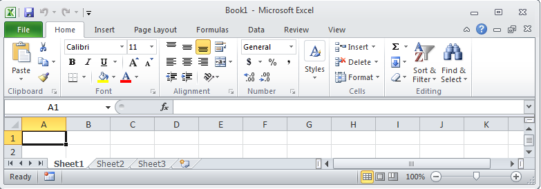
Worksheets
Each spreadsheet can consist of multiple worksheets.
Create new worksheet
Worksheet
Spreadsheet
Notes:
By default, Microsoft Office Excel provides three worksheets in a workbook

Slide 9
When To Use Multiple Worksheets
Rules of thumb:
  When there are multiple sheets of related information, each group of information can be stored in it’s own worksheet (self contained)
Grades for lecture 01
(worksheet)
Grades for lecture 02
(worksheet)
Grades for lecture 03
(worksheet)
Grades for all sections(spreadsheet)
Budget for dad (worksheet)
Budget for mom
(worksheet)
Budget for sunny-boy
(worksheet)
Family budget (spreadsheet)

Slide 10
When Not To Use Multiple Worksheets
If the information consists of groups of unrelated information then the information about each group should be stored in a separate spreadsheet/workbook rather than implementing it a spreadsheet with multiple worksheets.
Grades for mom (spreadsheet)
Expenses for the family business (spreadsheet)
Daily calorie intake for dad (spreadsheet)

Slide 11

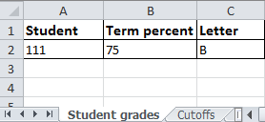
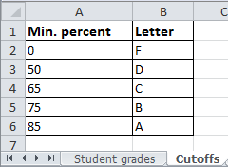
Referring To Other Worksheets
One worksheet can refer to information stored in another worksheet.
Name of example spreadsheet:
  1_multiple_worksheet_example
JT’s tip:
For examples like this you might want to take extra “in-class” notes
(It could be hard to understand the concepts at a level sufficient for the exam if you just look at the slides)

Slide 12
References Between Spreadsheets
In a fashion similar to using multiple worksheets, one spreadsheet can refer to information stored in another spreadsheet.
Name of example spreadsheets:
  2A_multiple_spreadsheet_example
  2B_multiple_spreadsheet_example

Slide 13
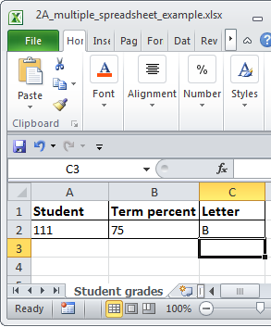
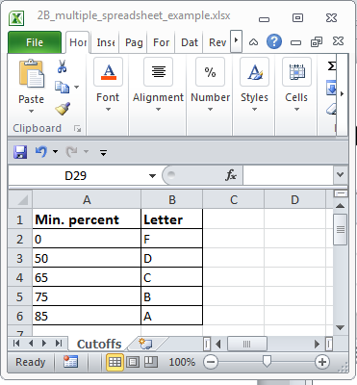
=VLOOKUP
(B2,
[2B_multiple_spreadsheet_example.xlsx]Cutoffs!$A$2:$B$6,
2)

Slide 14
Lecture Exercise #1: Cross References Between Multiple Worksheets

Slide 15
Why Use Cross References?
A typical reason why one worksheet may refer to another or one spreadsheet may refer to another is that the second worksheet or spreadsheet contains data that needs to be “looked up” (e.g., a lookup table)
Examples where cross reference lookups may be needed:
  Grade cutoffs
  Tax brackets
  Product numbers (lookup a product number to get more information about the product)

Slide 16
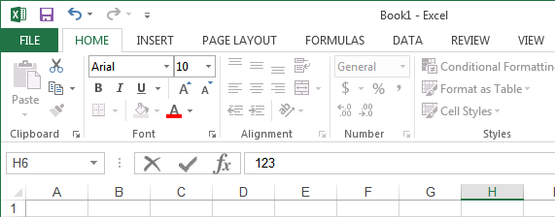
The Excel Ribbon
Tabs are used to group related functions

Slide 17


High Level View Of Each Tab
File **:
  Functions associated with documents (creating, opening, saving, printing etc.)
Home (default) **:
  Many of the most commonly used functions (such as formatting fonts, cells and numerical data)
Insert:
  Tables, illustrations, apps, charts, graphs, text, and symbols
Page layout:
  Page setup (many similar to print options)
Formulas *:
  Location and groupings of the pre-created built-in mathematical formulas

Slide 18
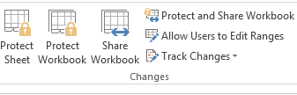
High Level View Of Each Tab (2)
Data:
  Arranging, organizing existing data (e.g., sort)
Review:
  Spell checking, thesaurus, translation, adding comments, and change tracking
View (different views of the same data):
  Workbook Views, Show, Zoom, Window, and Macros

Slide 19
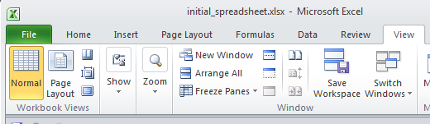
“Freezing” Panes: How/Why
Often used to lock the view so that crucial labels always stay onscreen regardless of which part of the sheet you are viewing

Slide 20
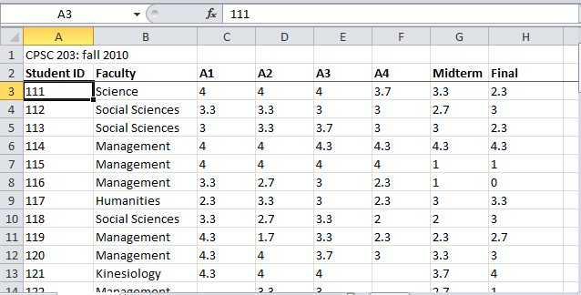
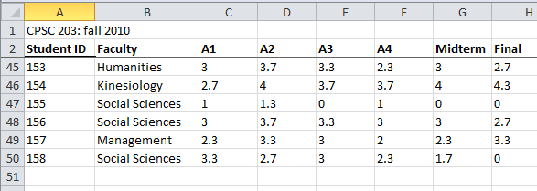
Freezing Panes: Effect On Example Spreadsheet

Slide 21
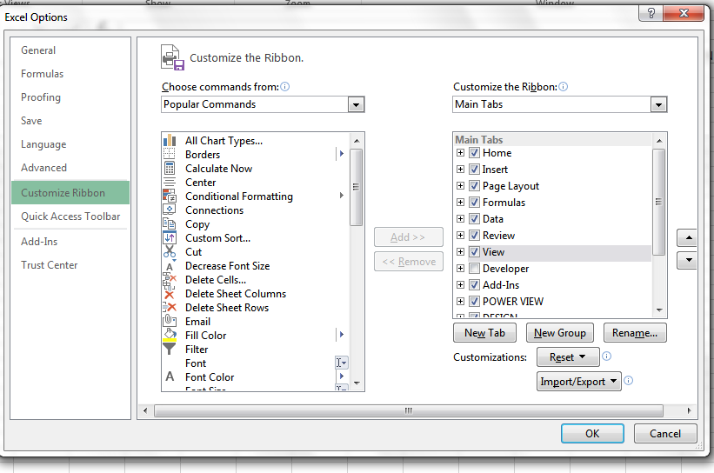
Customizing The Ribbon
Select the “File” Ribbon and then “options”
File -> Options

Slide 22
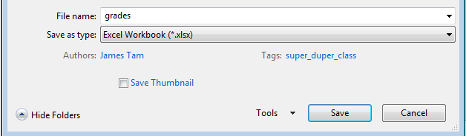
Saving Work
This feature is implemented in a similar fashion among the different MS-Office products
“Save”: save document under current name
“Save as”: allows the document to be saved under a different name
  But additional information such as: ‘tags’ and ‘titles’ may be entered

Slide 23
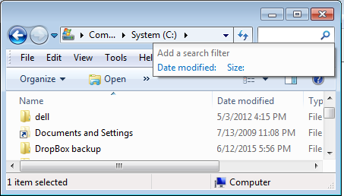
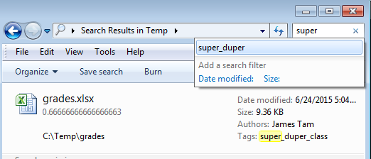
Example Using Tags
Separate from the file name but may still be used as search criteria

Slide 24
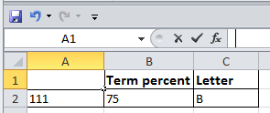
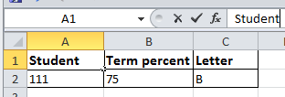
Entering Data
Click on cell to enter the data
Type in cell contents

Slide 25



Contents Of A Cell: Types
Raw data: also referred to as ‘constants’
Labels: describe the contents of another cell
Formula: values derived from the raw data (e.g., calculations, lookup values)

Slide 26


Specifying Formulas
In Excel all formulas must be preceded by the ‘=‘ symbol to distinguish it from a label
Label
2 + 2
Formula
= 2 + 2

Slide 27
Basic Mathematical Operators
Mathematical operation | Excel operator | Example
Assignment | = | = 888
Addition | + | = 2 + 2
Subtraction | - | = 7 – 2
Multiplication | * | = 3 * 3
Division | / | = 3 / 4
Exponent | ^ | = 3 ^ 2

Slide 28
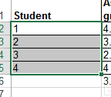
Autofill
Allows for a series (constant or addition by a constant amount) to be extended
  E.g., The series “1, 2, 3” (can be extended to include “…4, 5, 6”)
Steps:
  Highlight the cells containing the series to extend (selecting one cell just repeats the contents of that one cell).
  Move the mouse pointer to the ‘handle’ at the bottom right

Slide 29
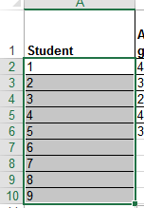
Autofill (2)
    Drag the mouse as far down as you wish the series to be extended to.

Slide 30
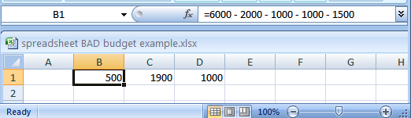
Label Formulas
Similar to data unless the formula is very obvious to the reader of the spreadsheet (and not the author) label all parts.
  Most of the time it won’t be obvious so label most everything.

Slide 31
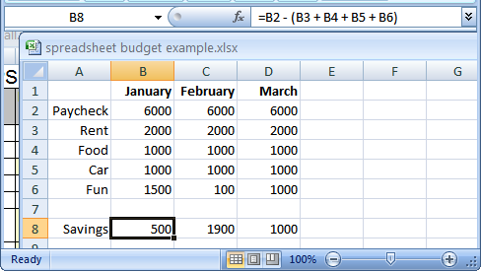
Previous Example: Explicitly Labeled Formulas
Whenever possible label the different parts of a calculation to make easier for the reader to interpret and understand how your calculations work.

Slide 32

Designing Spreadsheets: Rules Of Thumb
Do not directly enter values as data that can be derived from other values (calculation example)
  Example
    Assignment grade (assume one assignment) = 4.2 (data in cell A2)
    Exam grade (assume only one exam) = 3.3 (data in cell B2)
    Term grade point =(A2*0.4)+(B2*0.6) OR enter 3.66?
4.2
3.3
=(A2*0.4)+(B2*0.6)
A2
B2

Slide 33
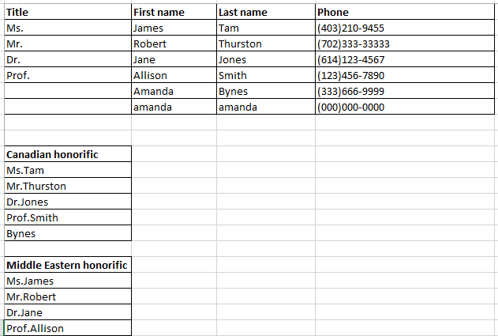
Designing Spreadsheets: Rules Of Thumb (2)
Do not directly enter values as data that can be derived from other values (data example, preview of 8_extracting_connecting_text)
=CONCATENATE(A2,C2)
=CONCATENATE(A2,B2)

Slide 34
Designing Spreadsheets: Rules Of Thumb (3)
Label information so it can be clearly understood

Slide 35
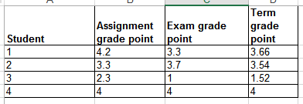
Designing Spreadsheets: Rules Of Thumb (4)
Never enter the same information more than once
  Advantages: reduces size and complexity of the sheet, making changes can be easier.
  Seems obvious? Not always
  Example: What if the previous spreadsheet were used to calculate the grades for a class full of students?
  Some would create the sheet this way:
  spreadsheet example name: 3_grades_formulas
=(B2*0.4)+(C2*0.6)
=(B3*0.4)+(C3*0.6)
Etc.

Slide 36
Designing Spreadsheets: Rules Of Thumb (5)
=(B2*0.4)+(C2*0.6)
  Issues:
    Clarity: What does the 0.4 & 0.6 refer to (sometimes not so obvious)?
    Making changes: What if the value of each component (40% assignments, 60% exams) changed?
=(B3*0.4)+(C3*0.6)
Etc.

Slide 37
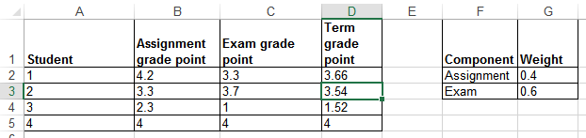
Lookup Tables
As the name implies it contains information that needs to be referred to (“looked up”) in a part of the spreadsheet.
Can be used to address some of the issues related to the previous example:
  Clarity
  Entering the same data multiple times
=(B2*G2)+(C2*G3)

Slide 38
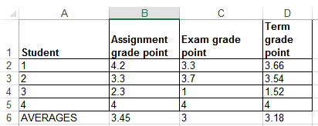
Mathematical Functions
As mentioned calculations must be preceded with an equals sign (actually an assignment operator) e.g., = 2 * 2
The formula can either be directly entered (custom formula) or you can use one of the pre-created ones that come built into the spreadsheet.
Example:
  spreadsheet example name: 4_grades_lookup
=(D2+D3+D4+D5)/4
=AVERAGE(D2:D5)

Slide 39
Order Of Operation
When a series of operators from same level are encountered in a cell the expression is evaluated from in order in which they appear (left to right).
  2 + 3 * 3 Equals 11
  8 / 2 ^ 2 Equals 2
Level | Operation | Symbol
1 | Brackets (inner before outer) | ()
2 | Exponent | ^
3 | Multiplication, Division | * /
4 | Addition, Subtraction | + -

Slide 40
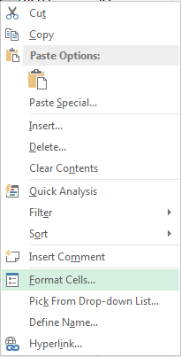
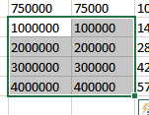
Formatting Cells
Excel provides the ability to format the spreadsheet in various locations of the ribbon.
You also can access these functions in the context of a cell or cells in the spreadsheet.
  Select a cell or cells for which you wish to apply similar formatting effects.
  Right click and select “Format Cells”

Slide 41
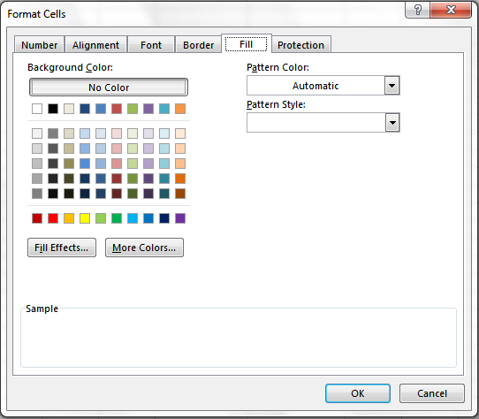
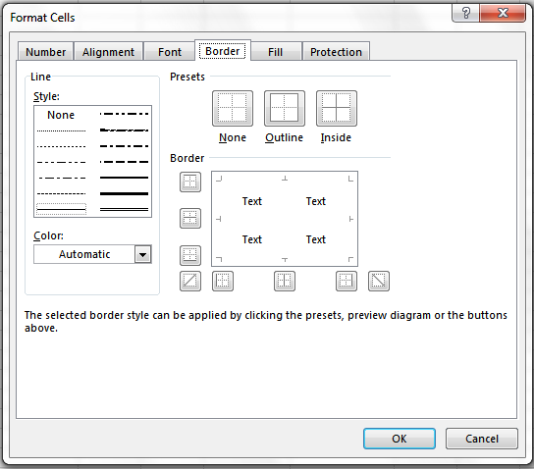
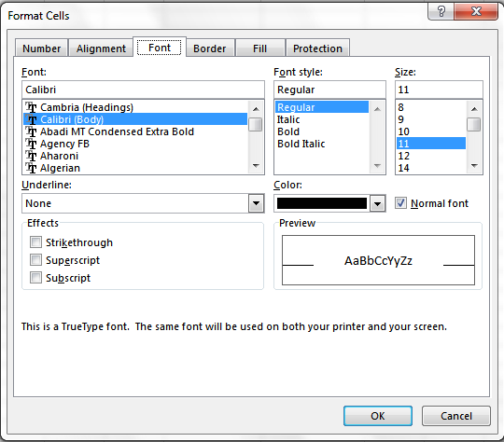
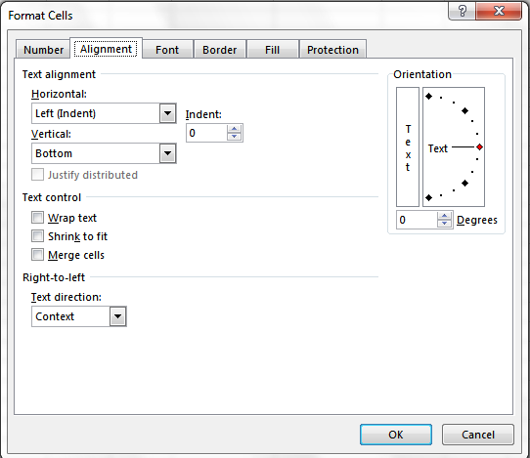
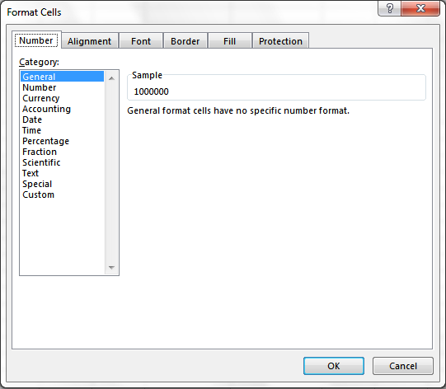
Formatting Cells (2)
General: no special format
Number:
  number of decimal places.
  Separator (every 3 digits)

Slide 42
Formatting Cells (3)
Currency:
  Currency sign
  Several options for displaying negative numbers
  Columns aligns decimal points
Accounting:
  Similar to currency but no special options for displaying negative values
Date, Time:
  Both allow display in different formats
Percentage: %
Fraction: /

Slide 43
Formatting Cells (3)
Scientific:
Text:
  Treats everything (even numbers) as text
  Cell is displayed exactly as entered.
Special:
  Country specific information (zip)
Custom:

Slide 44
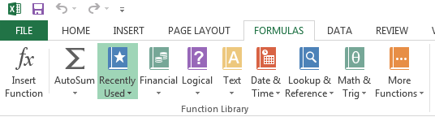
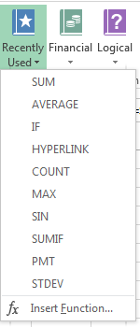
Pre-Created Excel Formulas

Slide 45
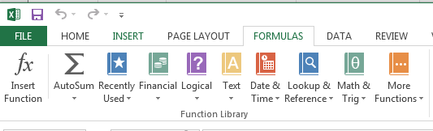
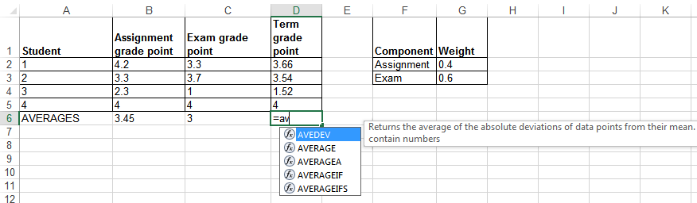
What Function Is Right For Your Situation?
Excel provides reminders.
Recall the location of built in functions.
Also Excel provides “name completion”

Slide 46
Basic Statistics
Name of example spreadsheet:
  5_basic_statistics
Example formulas: sum(), average(), min(), max()
General usage:
  Each formula requires as input a series of numbers
  E.g., formula(1,2,3):
    Sum = 6 , =sum(1,2,3)
    Average = 2 , =average(1,2,3)
    Min = 1 , =min(1,2,3)
    Max = 3 , =max(1,2,3)

Slide 47
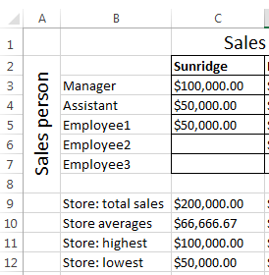
Basic Statistics (2)
The series of numbers can allow refer to a range of cells
  formula(<start cell> : <end cell>)
=SUM(C3:C7)
=AVERAGE(C3:C7)
=MAX(C3:C7)
=MIN(C3:C7)

Slide 48
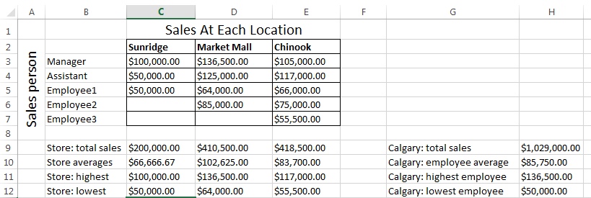
Basic Statistics (3)
Ranges can span multiple rows and columns
=SUM(C3:E7)

Slide 49
Counting Functions
All of these functions tally up the number of cells that do or do not contain a certain type of data e.g., numbers
General usage (all these formulas will require this information although one requires additional data).
  function(<start cell range> : <end cell range>)
  An array (list) of numbers can be the function argument but this is rare e.g., =COUNT(1,"A",2)
Name of example spreadsheet:
  6_counting_functions

Slide 50
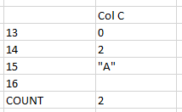
Counting Functions: Count()
Counts the number of cells within the specified range that contain numbers
https://support.office.com/en-US/article/COUNT-function-A59CD7FC-B623-4D93-87A4-D23BF411294C
=COUNT(C13:C16)

Slide 51
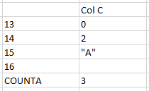
Counting Functions: Counta()
Counta()
  Counts the number of cells within the specified range that aren’t empty
  https://support.office.com/en-US/article/COUNTA-function-7DC98875-D5C1-46F1-9A82-53F3219E2509
=COUNTA(C13:C16)

Slide 52
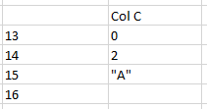
Counting Functions: Countblank()
Countblank()
  Counts the number of empty cells within the specified range
  https://support.office.com/en-US/article/COUNTBLANK-function-6A92D772-675C-4BEE-B346-24AF6BD3AC22
=COUNTBLANK(C13:C16)

Slide 53
String
A series of characters which include alphabetic characters, numeric digits and special characters such as space, punctuation or other symbols (#,$...).
String is another name for text

Slide 54
Excel String Functions
Functions that act on strings
Converting or changing alphabetic text
  Change text from one form to another
  lower(), upper(), proper()
Processing text
  Remove spaces
  Trim()
Connecting text:
  connecting a string or a part of that string with another string e.g. title with surname or first name
  concatenate()
Extract selected portions of text:
  A specific number of characters from some position are to be extracted from a string e.g., area code or country code from a phone number
  find(), left(), right(), mid()

Slide 55
Functions That Convert Text
Name of example spreadsheet:
  “7_converting_text”
  lower()
    Converts non-lower case alphabetic characters to lower case
    https://support.office.com/en-US/article/LOWER-function-3F21DF02-A80C-44B2-AFAF-81358F9FDEB4
  upper()
    Converts non-upper case alphabetic characters to upper case
    https://support.office.com/en-US/article/UPPER-function-C11F29B3-D1A3-4537-8DF6-04D0049963D6
  proper()
    For alphabetic text it converts the letters to ‘proper’ format:
      All letters are lower case except for the first letter of each word (which is capitalized)
    https://support.office.com/en-US/article/PROPER-function-52A5A283-E8B2-49BE-8506-B2887B889F94

Slide 56
Functions For Extracting And Connecting Text
Name of example spreadsheet:
  “8_extracting_connecting_text”
trim():
  Removes leading or trailing spaces (ignores single spaces within text)
  Format: trim(<string>)
  Examples:
    Trim(" james ")
    Trim("a b ")
  https://support.office.com/en-US/article/TRIM-function-410388FA-C5DF-49C6-B16C-9E5630B479F9
concatenate():
  Connects two or more strings
  Format: concatenate(string1, string2…)
    A string can be fixed e.g., concatenate(“wa”,”sup”) or the address of a cell e.g., concatenate(A1,”!”)
  https://support.office.com/en-US/article/CONCATENATE-function-8F8AE884-2CA8-4F7A-B093-75D702BEA31D

Slide 57
Functions For Extracting And Connecting Text (2)
left():
  Extracts the specified number of characters from the left side of the specified string.
  Format: left(<string>, <length>)
    String: the source string to extra characters from
    Length: the number of characters to extract
  https://support.office.com/en-US/article/Left-Function-D5897BF6-91F5-4BF8-853A-B63D7DE09681
  Examples:
    =left("Foo bar",2)
    =left("Foo bar",0)
    =LEFT("Foo",10)
Notes:
=left(“Foo bar”,2), returns Fo
=left(“Foo bar”,0), returns nothing (negative is an error)
=left(“Foo”,4), returns the whole source string
string
Required. String expression from which the leftmost characters are returned. If string contains Null, Null is returned.
length
Required. Variant (Long). numeric expression indicating how many characters to return. If 0, a zero-length string ("") is returned. If greater than or equal to the number of characters in string, the entire string is returned.

Slide 58
Functions For Extracting And Connecting Text (3)
right():
  Extracts the specified number of characters from the right side of the string
  Format: right(<string>, <length>)
  https://support.office.com/en-US/article/Right-Function-C02A18A8-B224-437E-AABA-1B785C6C61BF
  Examples:
    =RIGHT("Foo!bar",2)
    =RIGHT("Foo",10)

Slide 59
Functions For Extracting And Connecting Text (4)
mid():
  Starting at the specified position, the function extracts the specified number of characters from the string
  Format: left(<string>, <start>, <length>)
    String: the source string to extra characters from
    Start: the position in the string in which extraction should begin
    Length: the length of the sub-string to extract (sub-string begins at the position specified with the ‘start’ argument)
  https://support.office.com/en-US/article/Mid-Function-427E6895-822C-44EE-B34A-564A28F2532C
  Examples:
    =MID("not too hot",2,4)
    =MID("not too hot",8,55)
    =MID("not too hot",0,5)
    =MID("not too hot",7,0)

Slide 60
Functions For Extracting And Connecting Text (5)
find():
  Finds the starting position of one string within another string
  Format:
    find(<find text>, <within text>, [<start position>])
      Find text: search for the first occurrence of the find text within the within text
      Within text: the string on which the search is performed
      Start number (optional): the position of the ‘within text’ that you want the search to being
  https://support.office.com/en-US/article/FIND-function-06213F91-B5BE-4544-8B0B-2FD5A775436F
  Examples:
    =FIND("me", "james")
    =FIND("la","fa-la-la-la-la")
    =FIND("la","fa-la-la-la-la",6)
    =FIND("x","XYZ")

Slide 61
Combinations: Find(), Mid()
The return value of one function can be used as the argument of another function.
Consider this example
  Cell A10 contains the string “Apt #709, 944 Dallas Dr. NW”
  You wish to extract the apartment number information #ddd into a substring
  Assume that apartment numbers are always preceded by the number sign #
  Also you assume that apartment numbers are three digits in length
  You cannot make assumptions about the information that precedes the number sign (zero to ‘infinity’)
  Find() can be use to determine the start location of the apartment in the string
    FIND("#",A10)
  The start position of the apartment information can be used as one of the arguments for an extraction function

Slide 62
Combinations: Find(), Mid(): 2
  =MID(A10, ,4)
  But you can’t always assume that the apartment information begins at position five.
    “Apt #709, 944 Dallas Dr. NW”
    “#123, 4944 Dalton Dr NW”
    So the return value from find() must be used to first determine the location of the apartment information.
    Next this information is used as one of the arguments for the mid(), string extraction function.
    All together: “=MID(A10,FIND("#",A10),4)”
5
FIND("#",A10)
5
=MID(A10, ,4)

Slide 63
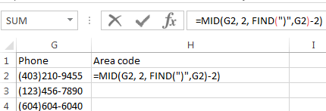
Why Bother?
When would you ever use Excel functions this way?
Sometimes the data has already been entered into the sheet
  Data may combine fields or include extraneous information:
  403-123-4567 (postal code and phone number combined, dash)
  (403)111-2222 (as above but adds additional brackets)
Labor saving
  Retyping a large dataset may be time consuming
  Solve the problem once and then reuse (copy and paste) the trimming formula wherever else it is needed

Slide 64
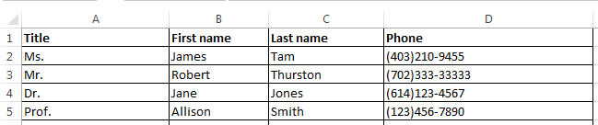
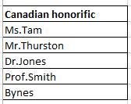
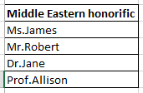
Why Bother? (2)
Different views of the same data may be needed (from an earlier example sheet)
  In Canada the proper greeting will be “Dr. Jones”
  =CONCATENATE(A2,C2)
  In other countries the proper greeting will be “Dr. Harry”
  =CONCATENATE(A2,B2)

Slide 65
Why Bother? (3)
It may useful to be familiar with these functions for the future!
    Job interviews, the exams, the bonus feature of A2 ;)

Slide 66
Lecture Exercise #2: String Functions

Slide 67
Lecture Exercise #3: String Functions (If There Is Time)

Slide 68
Date And Time Functions
Name of example spreadsheet:
  “9_date_time”
today()
  Displays the current date (month/day/year) e.g., 07/15/2015
now()
  Displays the current date (as above) and time (hour/minute with a 24 hour clock) e.g., 18:42
Both: determine the time/date based on the settings of the computer on which the worksheet is run.
  Updates occur when the files is opened or when the spreadsheet recalculates new values.

Slide 69
‘If-Else’ (Branching)
Grade point >= 1.0
Function returns one value if a condition has been met.
  “If condition met do an action”
Function can return another value if the condition hasn’t been met.
  “Else if the condition not met do another action”
Boolean (logic): either true or false that the condition was met
True
False
“Passed”
“Failed”

Slide 70

Applying Branches: Grade Example
In column ‘E’ the sheet will display “Pass” if term grade point is 1.0 or greater “Fail” otherwise.
  spreadsheet example name: 10_if_else_pass_fail
Condition
Action: condition true
=IF (D2>=1, "Pass", "Fail")
Action: condition false - “else case”

Slide 71
Format: If-Else
Format:
  =if (<condition to check>,
  <return value: condition true>,
  <return value: condition false>)
Example:
  =IF(D2>=3, "Pass", "Fail")
Note: the return value is not limited only to text
https://support.office.com/en-US/article/IF-function-69aed7c9-4e8a-4755-a9bc-aa8bbff73be2?CorrelationId=6aeb3056-a94b-47ac-af6e-90dff250a029

Slide 72
Comparators
Math | Excel | Meaning
< | < | Less than
> | > | Greater than
= | = | Equal to
≤ | <= | Less than, equal to
≥ | >= | Greater than, equal to
≠ | <> | Not equal to

Slide 73

If: Specifying Only The True Case
If only a return value for the true case has been specified:
  When the condition has not been met (false that the condition has been met) i.e., “Has the student passed the course?”…literally the text “FALSE” will be displayed.
  No spreadsheet example has been provided because this implementation is incorrect
    To see the result you can edit the previous sheet and just delete the false case “Fail” message (‘Column E’ data).
=IF(D2>=1,"Pass")

Slide 74

If: Specifying Only The True Case (2)
Consequently:
  Even if a specific return value is desired only for the ‘if condition case’ (true that the condition has been met)
  Something, even an empty message, should be specified for the ‘else case’ (false that the condition has been met).
Previous example: amended
  spreadsheet example name: 11_if_pass_only
=IF(D2>=1,"Pass","")

Slide 75
Nested Conditions
Conditions that are dependent upon or are affected by previous conditions.
‘Nesting’ refers to conditions that are ‘inside of other conditions’
Example (assume that the respondent previously indicated that his or her birthplace was an Alberta city)
Select the AB city in which you were born
  Airdrie
  Calgary
  Edmonton
  …
  Selecting Airdrie excludes the possibility of selecting Calgary
  Cities listed later are ‘nested’ in earlier selections)

Slide 76
Nested Conditions (2)
Applies when different conditions must be checked but at most only one applies (exactly 0 or 1 conditions can be true)
Example:
  Display “Perfect” if grade point is 4.0 or greater
  Display “Excellent” if grade point is 3.0 or greater but less than 4.0
  Display “Adequate” if grade point is 2.0 or greater but less than 3.0
  Display “Pass” if grade point is 1.0 or greater but less than 2.0
  Otherwise display “Fail”
Spreadsheet example name: 12_nested_if_grades

Slide 77
Previous Grade Example: Specifying Conditions
GPA >= 4.0?
True
“Perfect”
False
Nesting
Later conditions are described as being ‘nested’ within earlier conditions
The GPA cases for 3.0, 2.0, 1.0 are described as being ‘nested’ within the 4.0 case (only checked if the previous case proves to be false)
GPA >= 3.0?
True
“Excellent”
False
GPA >= 2.0?
True
“Adequate”
False
GPA >= 1.0?
True
“Pass”
False
“Fail”

Slide 78
Nested “If’s”
Format:
  =IF(<condition to check>, <return: true>, <return: condition false>)
Example:
  =IF(D5>=4,"Perfect", )
Another if-check
if (<condition to check>, <return: true>, <return: false>)
IF(D5>=3,"Excellent","")

Slide 79
Previous Example: Initial Cases
If GPA >= 4.0 “Perfect”, if 3.0 <= GPA < 4.0, “Excellent”
TRUE >= 4.0
TRUE >= 3.0
FALSE >= 4.0

Slide 80

Previous Example: Nested Solution
T
=IF(D2>=4,"Perfect",
IF(D2>=3,"Excellent",
IF(D2>=2,"Adequate",
IF(D2>=1,"Pass",
"Fail"))))
F
=IF(D2>=4,"Perfect",IF(D2>=3,"Excellent",IF(D2>=2,"Adequate",IF(D2>=1,"Pass","Fail"))))

Slide 81
Lookup Tables
Can be instead of many nested IF’s.
  Easier to enter, update, understand.
Requirements of previous example:
  0 <= GPA < 1: Fail
  1 <= GPA < 2 : Pass
  2 <= GPA < 3 : Adequate
  3 <= GPA < 4 : Excellent
  GPA >= 4 : Perfect
Previous solution:
=IF(D2>=4,"Perfect",IF(D2>=3,"Excellent",IF(D2>=2,"Adequate",IF(D2>=1,"Pass","Fail"))))

Slide 82

LOOKUP
https://support.office.com/en-US/article/LOOKUP-function-446D94AF-663B-451D-8251-369D5E3864CB
Typical use:
  Looking up a value from one column (“a vector”)
  Return a value from another column (“a vector”)
  (According to Microsoft): if you want to look up values from multiple columns (“an array”) then the VLOOKUP function should be used instead of LOOKUP.
Format:
  VLOOKUP(<Lookup value>,
  <Lookup column (vector) Start : End>,
  <result column (vector) Start : End>)

Slide 83


LOOKUP (2)
Name of example spreadsheet: 15_lookup
Row 2 data
  =LOOKUP(D2, D11:D15, E11:E15)
Cell:
Contains value to find in table e.g., a grade point
Lookup column:
Start : End
cell coordinates
Result column:
Start : End
Cell coordinates

Slide 84

LOOKUP (3)
=LOOKUP(D3,D11:D15,E11:E15)
D
E
Min. GPA | Comment
0 | Fail
1 | Pass
2 | Adequate
3 | Excellent
4 | Perfect
11
12
13
14
15
>3.54?
>3.54?
>3.54?
>3.54?
⬅ Backup and use this value Return “Excellent”
>3.54?..Yes!
  LOOKUP table Values must be sorted in ascending order

Slide 85
VLOOKUP
A more complicated (but more powerful) version of a lookup function.
https://support.office.com/en-US/article/VLOOKUP-function-0BBC8083-26FE-4963-8AB8-93A18AD188A1
Format:
  VLOOKUP(<Lookup value>, *
  <Lookup table Start : End>, *
  <Lookup table Column specifying the return value>, *
  [<Exact match required?>])
  A star * indicates a required value, brackets [] specify optional values
Example:
  =VLOOKUP(D2, D11:E15, 2)
Cell:
Contains value to find in table e.g., a grade point
Lookup table:
Start : End
cell coordinates
Lookup table:
Column value to return
(1 = first col. ‘D’,
2 = second col. ‘E’)

Slide 86

VLOOKUP: Previous Example
=VLOOKUP(D2,D11:E15,2)
D
E
Min. GPA | Comment
0 | Fail
1 | Pass
2 | Adequate
3 | Excellent
4 | Perfect
11
12
13
14
15
  Spreadsheet example name: 16_vlookup.xlsx

Slide 87
VLOOKUP: Optional Value = TRUE
VLOOKUP(=VLOOKUP(D2,D11:E15,2,TRUE))
TRUE (works like LOOKUP so values must be sorted)
  Look for an approximate match.
  If an exact match is not found, the next largest value that is less than lookup value is returned.
  If T/F value is omitted then the function assumes a ‘TRUE’ value.
GPA = 3.54
Min. GPA | Comment
0 | Fail
1 | Pass
2 | Adequate
3 | Excellent
4 | Perfect
>3.54?
>3.54?
>3.54?
>3.54?
⬅ Backup and use this value Return “Excellent”
>3.54?..No!

Slide 88

VLOOKUP: Optional Value = FALSE
VLOOKUP(=VLOOKUP(D2,D11:E15,2,FALSE))
FALSE:
  Looks only for an exact match
  If a match is found then the value at the specified location is returned.
  Else if no match is found the an error message is displayed.
  Table values do not have to be sorted.
Min. GPA | Comment
0 | Fail
1 | Pass
2 | Adequate
3 | Excellent
4 | Perfect

Slide 89
VLOOKUP: Optional Value = TRUE/FALSE
TRUE
  Use when looking a value in a range of values (must be in ascending order) E.g. grades, tax brackets
FALSE:
  Use when there is an exact value to lookup (order is not important) e.g., SIN numbers, product ID number
Income range | Min for range | Tax rate
0 - $20,000 | 0 | 0%
> $20,000 | 20,000 | 10%
Product number | Name | Price
B00KAI3KW2 | Xbox One | $449
B00BGA9WK2 | Playstation 4 | $449

Slide 90
Recap: If Function Vs. Lookup Functions
Multiple If’s:
  Can be used if there are only a handful of conditions to check (rule of thumb: 2 – 3 max e.g., 2 conditions)
  Complex and error prone for anything else (e.g. 5 conditions)
Lookup functions
  Steeper learning curve (but a “one-time investment”)
  Once learned the formulas are simpler (no nesting) and less error prone
=IF(D2>=3, "Honors",IF(D2>=0, "Pass","Fail"))
=IF(D2>=4,"Perfect",IF(D2>=3,"Excellent",IF(D2>=2,"Adequate",IF(D2>=1,"Pass","Fail"))))
  =VLOOKUP(D2, D11:E15, 2)
Min. GPA | Comment
0 | Fail
1 | Pass
… | …

Slide 91
Logical Operations In Excel
The basic logical operations: AND, OR, NOT can be invoked as functions in Excel
  All function inputs can only be a True or False value.
Format:
  AND(<True or False>,<True or False>...)
  OR(<True or False>,<True or False>...)
  NOT (<True or False>)
Examples:
  AND(C1>=45,D1="John Smith") # Requires all
  OR(C1>=0,D2>=0) # Requires at least one
  NOT(AA12) # AA12 Must contain a logical: TRUE, FALSE Value

Slide 92

Logic And IF’s: Example
The honor roll for each semester requires that grade point is 3.7 or greater and a full load of at least 5 courses must be taken.
AND Example: Honor roll
  Signify when a student has met the honor roll requirements with an “H”, blank cell otherwise.
  Spreadsheet example name: 13_if_logic
=IF(AND(B5>=3.7,C5>=5),"H","")

Slide 93


Logic And IF’s: Example (2)
OR Example: Hiring if at least one requirement met (work experience of 5+ years, grade requirement of 3.7 or higher)
E12
=IF(OR(E12>=5,G16>3.7),"1+ requirement met","")
G16

Slide 94
Lecture Exercise #4: Branching (And Other) Functions

Slide 95
Conditional Counting Functions
Increases a tally count if one or conditions have been met
COUNTIF(): count if a particular condition has been met
COUNTIFS(): count if all conditions have been met

Slide 96
Counting Functions Based On Conditions: Countif()
Counts the number of cells that meets a particular requirement
  https://support.office.com/en-US/article/COUNTIF-function-E0DE10C6-F885-4E71-ABB4-1F464816DF34
=COUNTIF(C13:C16,">0")

Slide 97
Counting Functions Based On Conditions: Countif(), 2
=COUNTIF(C13:C16,"B")

Slide 98
Counting Functions Based On Conditions: Countifs(), 3
Can be used when multiple requirements must be met:
  Counts the number of cells that meets all in a series of multiple requirements
  https://support.office.com/en-US/article/COUNTIFS-function-DDA3DC6E-F74E-4AEE-88BC-AA8C2A866842
Format:
  =countifs(
  <range 1>, <criteria 1>,
  … <optional additional range>, <optional additional
  criteria>)
Example: 14_conditional_counting_formulas
  =countifs(A1:A10,"A", B2:B7, ">=100")

Slide 99


Counting Functions: Countifs(), 4
Col C
Col D
14
15
16
17
18
19
Specify: count number of employees that met the
quota for both months

Slide 100
Conditional Formatting
A very practical example of how conditional branching “if’s” can be applied.
Use of conditional formatting will be covered in tutorial.

Slide 101
Methods Of Referring To Cells
Absolute:
  The formula won't change if you copy/cut and paste the formula or if the spreadsheet changes in size
Relative
  The formula changes depending how far that the formula is moved or how much the spreadsheet is changed in size.

Slide 102

Absolute Reference
When a reference to an cell or range of cells doesn’t change when the contents of a cell or cells is copied or the sheet changes in size.
Assumption
Row 10 sums row 4 – 9.
Original formula (B12)
=$B$1-B10
Copied (C12)
=$B$1-C10

Slide 103
Absolute Reference (2)
Original formula (B12)
=$B$1-B10
Copied (C12)
=$B$1-C10
Absolute reference
Absolute reference
Absolute reference because the same (absolute) reference to cell B1 is made when the formula is copied.

Slide 104
Absolute Reference (3)
Typically it’s used in conjunction with constants (data that won’t change).
References to B1 are absolute because income doesn’t change
Original formula (B12)
=$B$1-B10
Copied (C12)
=$B$1-C10

Slide 105
Relative Reference
A reference to a cell or group of cells that may change if the cell/cells are copied or the sheet changes in size.
Original formula (B12)
=$B$1-B10
Copied (C12)
=$B$1-C10

Slide 106
Relative Reference (2)
Reminder:
Total expenses (row 10) is a calculated value. It sums rows 4 – 9.
Original formula (B12)
=$B$1-B10
Copied (C12)
=$B$1-C10
Relative reference
Relative reference
Relative reference because the copied formula will change relative to how far it’s copied.

Slide 107
Relative Reference (3)
Typically it’s used with variable data (that may change over time or in different parts of the sheet).
Total expenses may change from month-to-month so references will likely be relative.
Original formula (B12)
=$B$1-B10
Copied (C12)
=$B$1-C10

Slide 108
Cell References: Important Details
Format: specify absolute cell references with a dollar sign ‘$’ immediately in front of the row or column value.
  [<dollar sign for column>]<column> [<dollar sign for row>]<row>
Examples:
  Relative column, relative row: A1
  Relative column absolute row: A$1
  Absolute column, relative row: $A1
  Absolute column, absolute row: $A$1

Slide 109

Absolute, Relative And Mixed References: Examples¹
Example | Reference type | Copied result
$A$1 | Absolute column Absolute row | $A$1
A$1 | Relative column Absolute row | C$1
$A1 | Absolute column Relative row | $A3
A1 | Relative column Relative row | C3
1 Examples from the Excel 2003 Help System

Slide 110

Absolute, Relative References: Example
Example: 17_absolute_relative
To E7
To G8
COLUMN F
ROWS
11
12
13
14
Original formulas (result)
=$C$4 (4)
=B$3 (1)
=$A2 (2)
=A2 (2)
To D14
To G16

Slide 111
Absolute/Relative Applied To A Previous Example
Which part of the formula should be:
  Absolute?
  Relative?
  Why?
=(B2*G2)+(C2*G3)

Slide 112
Lecture Exercise #4: Absolute, Relative Addressing (If There Is Time)

Slide 113
Testing Spreadsheets
Test formulas to ensure that they are correct.
  Enter a few test values and see if the results match expectations.
  Simple interest example:
  Amount = Principle + (Principle * Interest rate * Time)
  E.g., $100 at 10% for 3 years
  Amount = 100 + (100 * 0.1 * 3)
  = 100 + (30)
  = $130
  Some example test cases:
  Nothing to invest: principle is nothing, everything else non-zero.
  Interest rates are rock bottom: zero interest rates, everything else non-zero
  No time passed: time is zero, everything else non-zero.
  Normal case: Non zero values for: principle, interest or time.

Slide 114

Example Testing A Formula
<- All non-zero
<- No principle
<- No interest
<- No time elapsed

Slide 115
Testing Ranges
Min. GPA | Comment
0 | Fail
1 | Pass
2 | Adequate
3 | Excellent
4 | Perfect
The following are the minimum test cases
Provide test values for each range
  In this example try grade points of 0, 1, 2, 3, 4
Also for at least one of the ranges test the boundaries (just above and below)
  Example: testing the boundary for 1 / “Pass”
    Slightly below a boundary value e.g., 0.9 should return “Fail”
    Slightly above a boundary value e.g., 1.1 should return “Pass”
Total test cases for this example: 7 tests

Slide 116

Example: Good Design And Testing
Previous grading example: the following will likely be data (cannot be calculated from other values in the sheet)
Values that will be determined by the data
  Term grade point (calculated), comments (lookup)s

Slide 117

Term Grade Point
How should this value be calculated?
First step: make it mathematically correct
  Assignment: proportion of term grade = 40%
  Exam: proportion of term grade = 60%

Slide 118
Term Grade Point (2)
Second step: make sure that you follow good style:
  Be ‘lazy’, minimalize your work!
    If a value can be determined by existing data then don’t manually enter the value e.g., term grade point can be calculated by the grade points of each component and their weights.
      Future grade changes are easier to make
      Also reduces errors)
      Allow for reuse of the formula (copy-and-paste): correct application of absolute vs. relative addressing
Derive it, don’t type it
Once

Slide 119

Term Letter Grade
How should this value be derived?
  Use the cutoff values in the table below.
  Remember it must be correct AND it should follow good style conventions.

Slide 120
Absolute, Relative: Completed Example
  Spreadsheet solution name (don’t look at contents before we go over the concepts in lecture) 18_vlookup_absolute_relative_addressing

Slide 121
Graphic Design And Spreadsheets
Using color
C.R.A.P.
Fonts and font effects
Text vs. graphs and charts

Slide 122

Color: Properly Used
When used sparingly color can draw attention to important information.
This is an especially valuable tool when there is a large amount of information.
  The information may be “all there” but don’t make it any harder than it has to be for the viewer to find it.

Slide 123


Color Misused
The overuse of color:
  Reduces it’s ability to make information stand out.
  Makes it harder to understand what information is mapped to a particular color.

Slide 124
Rule Of Thumb For Color: Make It Subtle
We have all seen the use of ‘loud’ and clashing colors that can make text very hard to read.
Balance the use of color between noticeability and subtlety
  Make it as subtle as possible while still conveying the necessary information using color
Ingredients
Sugar, lactose, fructose, corn syrup, glucose…lots of carbohydrates
JT: I’ve actually seen green-red color combinations on listings of ingredients

Slide 125

Additional Issues Associated With Color
Color blindness affects a portion of the population:
  The majority of people who are color blind are red-green color blind so using only these colors to represent information should be avoided.
Field size
  The larger the area to be color coded, the more easily that colors can be distinguished.
Larger areas: colors can be more subtle
Smaller areas: colors may have to employ greater contrast

Slide 126
Additional Issues Associated With Color (2)
  When objects are small (text or small graphics) and color is used to distinguish information use highly saturated colors.
Conventions
  “Commonly accepted” conventions can vary widely by culture and their use should be carefully considered
This is important information!
This is important information!

Slide 127
Color And Cultural Associations
 | Egypt | China | Japan | India | France
Red | Death | Happiness | Anger, Danger | Life, creativity | Aristocracy, Freedom, Peace
Blue | Virtue, Faith, Truth | Heavens, Clouds | Villainy |  | Freedom, peace
Green | Fertility, Strength | Ming Dynasty, Heavens, Clouds | Future, Youth, Energy | Prosperity, Fertility | Criminality
Yellow | Happiness, Prosperity | Birth, Wealth, Power | Grace, Nobility | Success | Temporary
White | Joy | Death, Purity | Death | Death, Purity | Neutrality
From “How Fluent is Your Interface? Designing for International Users” Proceedings of the INTERCHI’93. Russo P. and Boor S.

Slide 128
Fonts And Font Effects
Example fonts:
  Ariel
  Calibri
  Helvetica
  Times New Roman
Font effects:
  Italics
  Bold
  Underline
  Normal
Font sizes

Slide 129
Fonts And Font Effects (2)
As a rule of thumb use no more than 3 sizes and font effects in a particular document.
  Similar to color, their overuse reduces their effectiveness and makes it harder to interpret meaning.
  Also if you don’t know much about fonts just stick to the common or default ones provided (Arial, Calibri, Helvetica, Times New Roman)
  If you’re not sure if a font is a good one for a particular situation then it probably isn’t:
    Extreme example “Wing dings”: wing dings

Slide 130
C.R.A.P.¹
Simple design principles that can be applied in a variety of situations
Contrast
Repetition
Alignment
Proximity
1 From “The non-designers type book” by Robin Williams (Peach Pit express)

Slide 131
Contrast & Repetition
  Contrast:
  Make different things look significantly different
Repetition (Consistency):
  Repeat conventions throughout the interface to tie elements together

Slide 132

Example: No Contrast

Slide 133

Example: Weak Contrast

Slide 134

Example: Headings Stand Out
Good contrast:
  If contrast is not (or weakly) employed for a small set of data it may not be a large issue.
  But for larger data sets (“real data”) it may make it more work than is necessary.
Repetition:
  Same fonts, font sizes and font effects used in the headings vs. the data.
  Makes it easier to see and understand the structure

Slide 135

Alignment
It can be used to structure a document (represents hierarchical relationships).

Slide 136
Alignment And Repetition
Consistent alignment (left or right and not center) can be used to represent relationships.
  All the data in a column are consistently aligned to signify they belong a group
Example: movie credits
The Kung Fu master
Arch villain
Kung Fu student #1
Kung Fu student #2
Thug #1
Thug #2
Damsel in distress
James “The Bullet” Tam
James (Evil dude) Tam
Eager Tam1
Eager Tam2
Cannon-fodder Tam #1
Cannon-fodder Tam #2
Jamie Tametta

Slide 137

Center Alignment

Slide 138
Centre Alignment (2)
Don’t use it for hierarchical documents because it removes or hides the organization.
  In a document that contains structure center alignment can look unorganized (the center alignment appears as no alignment, disorganized)
At most: sparing use can be used to provide contrast e.g., slide titles vs. content.
  Because it removes a common method for structuring a document it can make reading text more difficult.
  At most use it as an exceptional case to make an item stand out.

Slide 139

Center Alignment
Again: while sparing use of center alignment can be used to provide contrast it should NEVER be used as the default in documents such as spreadsheets.

Slide 140

Proximity
Related items are in close proximity
Unrelated items are separated

Slide 141
Text Or Graphics?
Text?
A graph or chart?
  What type to use? (Pie, bar, line etc.)

Slide 142
The Benefits Of Using Text
Text is the best representation to use when accuracy is paramount.
Example term grades for individual students.
Student ID | Percentage
111 | 95
222 | 88
333 | 100
444 | 66
555 | 86
666 | 79
Vs.

Slide 143




Benefits Of Graphics
Graphics:
  Useful for illustrating relationships or visualizing patterns
Example: Anscombe’s Quartet¹
  Shown one way (a set of numbered pairs) it’s hard to analyze the information e.g., is there any trends or patterns?
Anscombe, F. J. (1973). "Graphs in Statistical Analysis". American Statistician 27 (1): 17–21

Slide 144




Benefits Of Graphics (2)
Example: Anscombe’s Quartet (continued)

Slide 145
Benefits Of Graphics (3)
Graphical representations can make a powerful impression!
Letter | No. occurrences
F | 0
D | 1
D+ | 1
C- | 2
C | 8
C+ | 12
B- | 17
B | 25
B+ | 33
A- | 45
A | 30
A+ | 10

Slide 146

Ways Of Graphically Representing Information
Pie chart
Bar graph
Line graph

Slide 147
Pie Charts
Good for showing proportions, how much of the whole does each item contribute.
It’s poor for showing exact numeric values.

Slide 148
Bar And Line Graphs
  For showing trends
  Comparing functions

Slide 149
Rules Of Thumb For Graphs
The X axis is used to plot known data (e.g., letter grades), while the Y axis is used to plot the unknown data (e.g., the number of students who received particular letter grades).

Slide 150
Rules Of Thumb For Graphs (2)
    Bar graphs are used to plot non-continuous data
      e.g., the number of patients that go to different hospitals.
    Line graph are used to plot continuous data
      e.g., mortality trends over time.

Slide 151


Keep Your Graphs Simple
Similar to using multiple types of fonts and font effects unless you are a skilled graphic designer it’s best to keep it simple (clarity over ‘fancy effects).

Slide 152
After This Section You Should Now Know
The benefit of electronic over paper spreadsheets
Spreadsheets 101: The basic layout and components of a spreadsheet
What is a worksheet
  When to use multiple spreadsheets vs. multiple worksheets
  How to reference data in other spreadsheets or worksheets (cross references)
How Excel groups functions according to tabs on the ribbon
  What are the most commonly used tabs and what some of the functions available on those tabs
Entering data: manually and via autofill
How to freeze data

Slide 153
After This Section You Should Now Know (2)
Tags
  How to do tag a spreadsheet
  What is the benefit of using tags
Common mathematical operators and the order of operation
What is the difference between constants (data) and calculations (formulas)
  How is a formula differentiated from data
The three rules of thumb for designing spreadsheets
  Don’t make something data if it can be derived
  Label everything
  Don’t duplicate data

Slide 154
After This Section You Should Now Know (3)
Lookup tables
  How to create a use a lookup table
Formulas:
  Directly entering custom formulas
  Using built-in pre-created formulas
  What is the order of operation for common operators
How to format cells using the “format cell” option
  What is the effect of different numeric formatting options
How to use basic statistical formulas: sum(), average(), min(), max()
How to use counting functions: count(), counta(), countblank, countif(), countifs()

Slide 155
After This Section You Should Now Know (4)
How to use string functions: lower(), upper, proper(), trim(), concatenate(), find(), left(), right(), mid()
How to use the today(), now() functions
How to use ‘if-else’ for branches that return different values
  The different ways of expressing logical comparators
  How to write or evaluate nested ‘if’s’
Logical operations in Excel: AND, OR, NOT
  How to write or evaluate logical operations
  How to apply the logical operations in conjunction with the ‘if-else’
How to use the LOOKUP(), VLOOKUP function

Slide 156
After This Section You Should Now Know (5)
How to come up with set of reasonable test cases for a spreadsheet
  Formulas and ranges
What is the difference between an absolute vs. relative cell reference and when to use each one
Rules for using and not misusing color
Issues associated with color: color blindness, field size, conventions for color
Rules of thumb for using fonts and font effects
C.R.A.P.
  What does each part mean
  How it can be used for effective graphic design

Slide 157
After This Section You Should Now Know (6)
When to use text vs. graphics
When to use a pie chart vs. bar graph vs. line graph

Slide 158
Copyright Notification
“Unless otherwise indicated, all images in this presentation are used with permission from Microsoft.”
Images of spreadsheets (save VisiCalc) are curtesy of James Tam

