Slide 1
VBA (Visual Basic For Applications) Programming
Overview of concepts covered in this section:
  Collections
  Find and replace
  Branching
  Looping
  Linking MS-Office documents
  Practical application of VBA

Slide 2
Collection
An object that consists of other objects
  Real World example: a book consists of pages, a library consists of books
Example: The Documents collection will allow access to the documents that have been opened.
Access to a collection rather than the individual objects may be time-saving shortcut.
  Instead of manually closing all open documents this can be done in one instruction:
  Documents.close

Slide 3
Types Of Collections
Some attributes of a document that return a collection.
    Lists: access to all lists in a document (example coming up).
    Shapes: access to MS-Word shapes in a document (rectangles, circles etc. example coming up).
    InlineShapes: access to images inserted into a Word document (example coming up).
    Tables: access to all tables in a document (detailed example coming up but a few brief examples below).
      E.g., ActiveDocument.Tables –accesses all the tables in your document
      ActiveDocument.Tables(1) –access to the first table in a document.
    Windows: briefly introduced in the last section

Slide 4
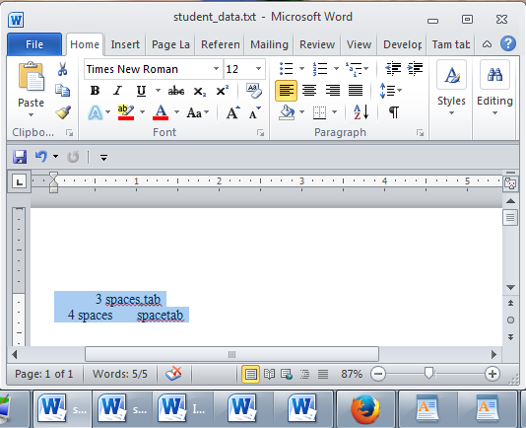
The ActiveDocument Object
Quick recap: although you may have many documents open, the ‘active document’ is the document that you are currently working with:
The active document

Slide 5
Attributes Of The ActiveDocument Object
Some of the basic attributes of ActiveDocument.
  Application: the application/program associated with the document (useful if a VBA macro is linking several applications)
  Name: the name of the current document (useful for determining the active document if multiple documents are currently open).
  Path: the save location of the active document e.g. C:\Temp\
  FullName: the name and save location of the current document.
  HasPassword: true/false that document is password protected
  SpellingChecked: true/false that has been spell checked since document was last edited
  Note: Information for these attributes can be viewed by passing the information as a parameter to a message box e.g., MsgBox (ActiveDocument.Name)

Slide 6
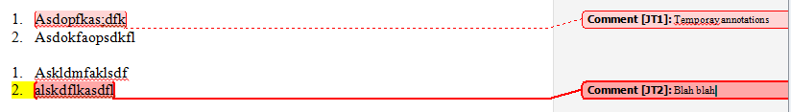
Methods Of The ActiveDocument Object
Some useful methods of ActiveDocument.
  Checkspelling(): exactly as it sounds!
  Close(): covered in the previous section
  CountNumberedItems(): see image (this slide)
  DeleteAllComments(): see image (this slide)
  Printout(): prints current active document on the default printer
  Save() : covered in the previous section
  SaveAs2() : rename document
  Select(): covered in the previous section
  SendMail(): see image (next slide)

Slide 7
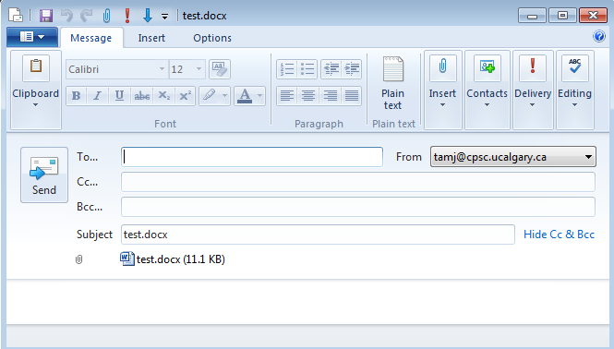
ActiveDocument.SendMail()
Runs the default email program
The active document automatically becomes an attachment
Subject line = name of document
(For anything more ‘fancy’ you should use VBA to create and access an MS-Outlook object)

Slide 8
“Finding” Things In A Document
It can be done in different ways
Example (common) ‘Find’ is an object that is part of the ‘Selection’ object in a document.
  JT’s note: although it may appear to be confusing at first it doesn’t mean that the find (or find and replace) requires text to be selected.
  Making ‘Find’ a part of ‘Selection’ was merely a design decision on the part of Microsoft.
Example (alternative is JT’s preferred approach) ‘Find’ is an object that is part of the ‘Content’ object of the ‘ActiveDocument’
  ActiveDocument.Content.Find
  More details coming up...
One source of information:
http://msdn.microsoft.com/en-us/library/office/aa211953(v=office.11).aspx

Slide 9
Single Replacement
Word document containing the macro: 1simpleFind.docm
sub simpleFind()
  ActiveDocument.Content.Find.Execute FindText:="tamj",ReplaceWith:="tam"
  end Sub
  'The instruction can be broken into two lines without causing
  'An error by using an underscore as a connector
  ActiveDocument.Content.Find.Execute FindText:="tamj", _
  ReplaceWith:="tam"
Background for example:
My old email address (still works): tamj@cpsc.ucalgary.ca
My new email address: tam@ucalgary.ca
Incorrect variant: tamj@ucalgary.ca
Notes:
Finds and replaces first instance of ‘tamj’ with ‘tam’

Slide 10
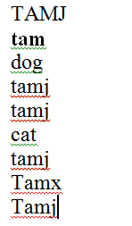
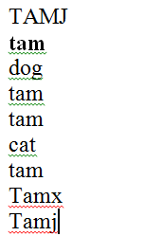
More Complex Find And Replace
Word document containing the macro: findReplaceAllCaseSensitive.docm
  Sub findReplaceAllCaseSensitive()
  ActiveDocument.Content.Find.Execute FindText:="tamj", _
  ReplaceWith:="tam", Replace:=wdReplaceAll, _
  MatchCase:=True
  End Sub
Before
After

Slide 11
With, End With
ActiveDocument.Content.Find.Execute
For ‘deep’ commands that require many levels of ‘dots’, the ‘With’, ‘End With’ can be a useful abbreviation.
Example
  With ActiveDocument.Content.Find
  .Text = "tamj"
  Equivalent to (if between the ‘with’ and the ‘end with’:
  ActiveDocument.Content.Find.Text = "tamj"
Previous example, the ‘Find’ employing ‘With’, ‘End With’:
Also the search and replacement text are specified separately to shorten the ‘execute’ (the “ActiveDocument.Content.Find” listed once)
  With ActiveDocument.Content.Find
  .Text = "tamj"
  .Replacement.Text = "tam"
  .Execute MatchCase:=True, Replace:=wdReplaceAll
  End With
‘Find text’ and ‘replacement text’ moved here to simplify the ‘.execute’
Notes:
Apparently end with not needed with only a single end-width pair
Only needed if you nest multiple with’s but it doesn’t hurt

Slide 12
Find And Replace
It’s not just limited to looking up text.
Font effects e.g., bold, italic etc. can also be ‘found’ and changed.

Slide 13
Finding And Replacing Bold Font
Word document containing the macro: 2findBold.docm
  'Removes all bold text
  Sub findBold()
  With ActiveDocument.Content.Find
  .Font.Bold = True
  With .Replacement
  .Font.Bold = False
  End With
  .Execute Replace:=wdReplaceAll
  End With
  End Sub

Slide 14
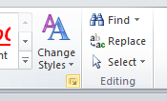
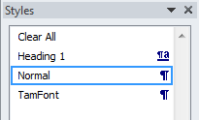
Finding/Replacing Formatting Styles
You may already have a set of pre-created formatting styles defined in MS-Word.
You can redefine the characteristic of a style if you wish.
Assume for this example that you wish to retain all existing styles and not change their characteristics.
But you want to replace all instances of one style with another style e.g., all text that is ‘normal’ is to become ‘TamFont’
‘Find’ can be used to search (and replace) instances of a formatting style.

Slide 15
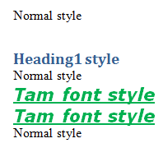
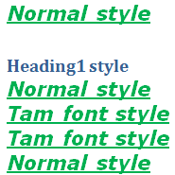
Finding/Replacing Formatting Styles (2)
Word document containing the macro: 3findReplaceStyle.docm
  Sub findReplaceStyle()
  With ActiveDocument.Content.Find
  .Style = "Normal"
  With .Replacement
  .Style = "TamFont"
  End With
  .Execute Replace:=wdReplaceAll
  End With
  End Sub
BEFORE
AFTER
‘Normal’ style becomes ‘TamFont’

Slide 16
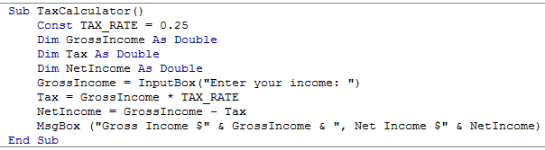
Recap: Programs You’ve Seen So Far Is Sequential Execution
Each instruction executes from beginning to end, one after the other
When the last instruction is reached then the program ends
Start
End

Slide 17
New Program Writing Concepts (Non-Sequential)
Making decisions (branching)
Looping (repetition)
Grade point >= 1.0
True
False
MsgBox(“Passed”)
MsgBox(“Failed”)
START
Run game
Y
Play again?
N
END GAME

Slide 18
New Terminology
Boolean expression: An expression that must work out (evaluate to) to either a true or false value.
  e.g., it is over 45 Celsius today
  e.g., the user correctly entered the password
Body: A block of program instructions that will execute under a specified condition.
  Style requirement
    The ‘body’ is indented (4 spaces)
    A “sub-body” is indented by an additional 4 spaces (8 or more spaces)
Sub Document_Open()
MsgBox ("Fake virus!")
End Sub
This/these instruction/instructions run when you tell VBA to run the macro, the ‘body’ of the macro program

Slide 19
Branching: Making Decisions In A Program
Similar to the Excel (IF-Function): Check if some condition has been met (e.g., password for the document correctly entered): Boolean expression
But the IF-Construct employed with programming languages is not just a function that returns a value for the true or false cases.
  For each condition: a statement or a collection of statements can be executed (this is referred to as “the body” of the if or else case.
  Example: entering a password
    Boolean expression true, password matches:
      True case body: display confirmation message and run program
    Boolean expression false, password doesn’t match:
      False case body: display error message

Slide 20
Branching/Decision Making Mechanisms
If-Then
If-Then, Else Similar to Excel if-then
If-Then, ElseIf, Else Similar to Excel nested if’s

Slide 21
Allowable Operators For Boolean Expressions
if (value operator value) then
VBA Mathematical
operator equivalent Meaning Example
< < Less than 5 < 3
> > Greater than 5 > 3
= = Equal to 5 = 3
<= ≤ Less than or equal to 5 <= 5
>= ≥ Greater than or equal to 5 >= 4
<> ≠ Not equal to x <> 5

Slide 22
Decision Making With ‘If-Then’
Boolean
True
Then execute an
instruction or instructions
False
Remainder of
the program

Slide 23
If-Then
Format:
  If (Boolean expression) Then
  If-Body
  End if
Example:
  If (totalWords < MIN_SIZE) Then
  MsgBox ("Document too short, total words " &
  totalWords)
  End If

Slide 24
If-Then: Complete Example
Word document containing the macro: 4wordCount.docm
  ' Try deleting all the words in the Word doc and run the
  ' macro again
  Sub wordCount()
  Dim totalWords As Integer
  MIN_SIZE = 100
  totalWords = ActiveDocument.Words.Count
  If (totalWords < MIN_SIZE) Then
  MsgBox ("Document too short, total words " &
  totalWords)
  End If
  End Sub

Slide 25
Decision Making With An ‘If, Else’
Used when different Actions (separate bodies) are required for the true result (IF-case) vs. the false result (ELSE-case)

Slide 26
Decision Making With An ‘If, Else’
Boolean
True
Execute an instruction
or instructions (if-body)
False
Execute an instruction
or instructions (else-body)
Remainder of
the program

Slide 27
If-Then (True), Else (False)
Format:
  If (Boolean expression) Then
  If-Body
  Else
  Else-Body
  End if
Example:
  If (totalWords < MIN_SIZE) Then
  MsgBox ("Document too short, total words " & totalWords)
  Else
  MsgBox ("Document meets min. length requirements")
  End If

Slide 28
If-Then, Else: Complete Example
Word document containing the macro: 5wordCountV2.docm
  ' Try deleting words or changing the minimum size and observe ' the effect on the program.
  Sub wordCountV2()
  Dim totalWords As Integer
  MIN_SIZE = 1000
  totalWords = ActiveDocument.Words.Count
  If (totalWords < MIN_SIZE) Then
  MsgBox ("Document too short, total words " &
  totalWords)
  Else
  MsgBox ("Document meets min. length requirements")
  End If
  End Sub

Slide 29
Logic Can Be Used In Conjunction With Branching
Typically the logical operators AND, OR are used with multiple conditions/Boolean expressions:
  If multiple conditions must all be met before the body will execute. (And)
  If at least one condition must be met before the body will execute. (Or)
The logical NOT operator can be used to check if something has ‘not’ occurred yet
  E.g., If it’s true that the user did not enter the correct password then the program will end.

Slide 30
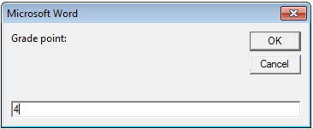
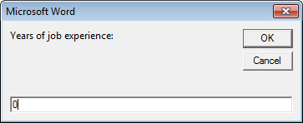
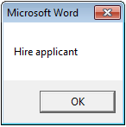
Logic: The “OR” Operator
Format:
If (Boolean expression) OR (Boolean expression) then
body
End if
Word document containing the macro (empty document, see macro editor for the important details): 6if_or_hiring.docm
  gpa = InputBox("Grade point: ")
  experience = InputBox("Years of job experience: ")
  If (gpa > 3.7) Or (experience > 5) Then
  result = "Hire applicant"
  Else
  result = "Insufficient qualifications"

Slide 31
Hiring Example: Example Inputs & Results
If (gpa > 3.7) Or (experience > 5) then
GPA | Years job experience | Result
2 | 0 | Insufficient qualifications
1 | 10 | Hire
4 | 1 | Hire
4 | 7 | Hire

Slide 32
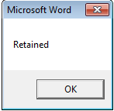
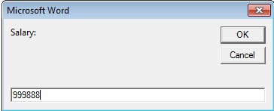
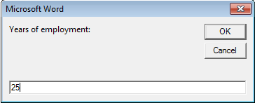
Logic: The “AND” Operator
Format:
If (Boolean expression) And (Boolean expression) then
body
End if
Word document containing the macro (empty document, see macro editor for the important details): 7if_and_firing.docm
  salary = InputBox("Salary: ")
  years = InputBox("Years of employment: ")
  If (salary >= 100000) And (years < 2) Then
  result = "Fired!"
  Else
  result = "Retained"

Slide 33
Firing Example: Example Inputs & Results
If (salary >= 100000) And (years < 2) Then
Salary | Years on job | Result
1 | 100 | Retained
50000 | 1 | Retained
123456 | 20 | Retained
1000000 | 0 | Fired!

Slide 34
Logic: The “NOT” Operator
Format:
  If Not (Boolean Expression) then
  body
  End if
Word document containing the macro example: 8checkSave.docm
  If Not (ActiveDocument.Saved) Then
  MsgBox ("You haven't saved " & ActiveDocument.Name
  & " yet")
  End If

Slide 35
Line Continuation Character
To increase readability long statements can be split over multiple lines.
  If (income > 99999) And _
  (experience <= 2) And _
  (numRepramands > 0) Then
  MsgBox ("You’re fired!")
  End If
To split the line the line continuation character (underscore) must be preceded by a space.
Keywords cannot be split between lines e.g.
    Msg _
    Box
For more details see: http://support.microsoft.com/kb/141513

Slide 36
Line Continuation Character (2)
Strings split over multiple lines require a combination of the proper use of the line continuation character '_' and the concatenation operator '&‘:
  MsgBox ("Your " _
  & "name")

Slide 37
What To Do When Multiple Conditions Must Be Checked
Case 1: If each condition is independent of other questions
  Multiple if-then expressions can be used
  Example:
  Q1: Are you an adult?
  Q2: Are you a Canadian citizen?
  Q3: Are you currently employed?

Slide 38
What To Do When Multiple Conditions Must Be Checked (2)
Case 2 (mutually exclusive): If the result of one condition affects other conditions (when one condition is true then the other conditions cannot be true)
  If-then, elseif, else should be used
  Which of the following is your place of birth? (Answering true to one option makes the options false)
    Calgary
    Edmonton
    Lethbridge
    Red Deer
    None of the above

Slide 39
Decision Making With Multiple If-Then’s
Q1: Boolean 1
False
  Each question is independent (previous answers have no effect on later questions because all questions will be asked).
  Q1: Are you an adult?
  Q2: Are you a Canadian citizen?
  Q3: Are you currently employed?
True
Instruction or
instructions
Q2: Boolean 2
False
True
Instruction or
instructions
Remainder of
the program

Slide 40
Multiple If-Then's
Any, all or none of the conditions may be true
Employ when a series of independent questions will be asked
Format:
if (Boolean expression 1) then
body 1
end if
if (Boolean expression 2) then
body 2
end if
...
statements after the conditions

Slide 41

Multiple If-Then's (2)
Word document containing the macro: 9multipleIfs.docm
  Sub multipleIf()
  ' Check if there were any 'comments' added to the document.
  If (ActiveDocument.Comments.Count > 0) Then
  MsgBox ("Annotations were made in this document")
  End If
  ' A numbered item includes numbered and bulleted lists.
  If (ActiveDocument.CountNumberedItems() > 0) Then
  MsgBox ("Bullet points or numbered lists used")
  End If
  End Sub

Slide 42
Multiple If's: Mutually Exclusive Conditions
At most only one of many conditions can be true
Can be implemented through multiple if's
Word document containing the macro (empty document, see macro editor for the important details): “10gradesInefficient.docm”
Inefficient combination!
If (grade = 4) Then
letter = "A"
End If
If (grade = 3) Then
letter = "B"
End If
If (grade = 2) Then
letter = "C"
End If
If (grade = 1) Then
letter = "D"
End If
If (grade = 0) Then
letter = "F"
End If

Slide 43
Decision Making With If-Then, Elseif, Else
Boolean
True
Instruction or
instructions
False
Boolean
True
Instruction or
instructions
False
JT’s note: once the first ‘true’ case is encountered all remaining and related Boolean expressions (using ‘Elseif’) are skipped
Instruction or
instructions
Remainder of
the program

Slide 44
Multiple If-Elif-Else: Use With Mutually Exclusive Conditions
Mutually exclusive
One condition evaluating to true excludes other conditions from being true
Example: having your current location as ‘Calgary’ excludes the possibility of the current location as ‘Edmonton’, ‘Toronto’, ‘Medicine Hat’
Format:
if (Boolean expression 1) then
body 1
elseif (Boolean expression 2) then
body 2
...
else
body n
' Only one ‘end-if’ at very end
end if
statements after the conditions

Slide 45
If-Elseif-Else: Mutually Exclusive Conditions (Example)
Word document containing the macro (empty document, see macro editor for the important details): “11gradesEfficient.docm”
  If (grade = 4) Then
  letter = "A"
  ElseIf (grade = 3) Then
  letter = "B"
  ElseIf (grade = 2) Then
  letter = "C"
  ElseIf (grade = 1) Then
  letter = "D"
  ElseIf (grade = 0) Then
  letter = "F"
  Else
  letter = "Invalid"
  End If
This approach is more efficient when at most only one condition can be true.
Extra benefit:
The body of the else executes only when all the Boolean expressions are false. (Useful for error checking/handling).

Slide 46
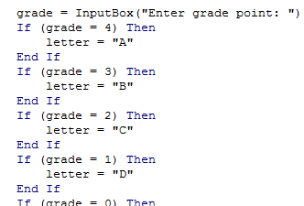
Location Of The “End If”: Multiple If’s
Independent If-then’s:
  Since each ‘if’ is independent each body must be followed by it’s own separate ‘end if’

Slide 47

Location Of The “End If”: If-then, Else
If-then, Else:
  Since the ‘if-then’ and the ‘else’ are dependent (either one body or the other must execute) the ‘end if’ must follow the body of the ‘else- body’ (last dependent “if-branch”)
Document either does or does not have enough words

Slide 48
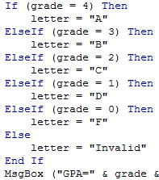
Location Of The “End If”: If-Then, ElseIf
Dependent If-then, Else-If:
  Since the results of earlier Boolean expressions determine whether later ones can be true (reminder: because at most only one can be true) all of the if-then and Elseif expressions are dependent (one related block).
  The “end if” belongs at the very end of the block

Slide 49
VBA: If, Else-If And Excel: Nested-Ifs
These two concepts are comparable:
VBA:
  If (grade = 4) Then
  letter = "A"
  ElseIf (grade = 3) Then
  letter = "B"
  ElseIf (grade = 2) Then
  letter = "C"
  ElseIf (grade = 1) Then
  letter = "D"
  ElseIf (grade = 0) Then
  letter = "F"
  Else
  letter = "Invalid"
  End If
  Excel (display different messages for different grade points e.g. Display “Perfect” if grade point is 4.0 or greater):
=IF(D2>=4,"Perfect",
IF(D2>=3,"Excellent",
IF(D2>=2,"Adequate",
IF(D2>=1,"Pass",
"Fail"))))

Slide 50
VBA (Programming Language): Nested-IFs
Similar to the IF, ELSE-IF: Decision making is dependent.
  One branch is ‘nested’ inside of another branch
  The first decision must evaluate to true (“gate keeper”) before successive decisions are even considered for evaluation.
Unlike the IF, ELSE-IF more than one case can be true:
Question 1?
Question 2?
True
True
Statement or
statements
False
False
Remainder of
the program

Slide 51
Nested Decision Making
One decision is made inside another.
Outer decisions must evaluate to true before inner decisions are even considered for evaluation.
Format:
if (Boolean expression) then
if (Boolean expression) then
body
end if
end if
Both (or all if 2+ IFs) must evaluate to true before the inner-most body will execute.
Outer body
Inner body

Slide 52
Nested IFs: Simple ‘Toy’ Example
Word document containing the macro (empty document, see macro editor for the important details): “12simpleNesting.docm”
  ' Suggested inputs
  ' num1=1, num2=1
  ' num1=1, num2=0
  ' num1=0, num2=1
  Sub simpleNestingExample()
  Dim num1 As Long
  Dim num2 As Long
  Dim result As String

Slide 53
Nested IFs: Simple ‘Toy’ Example (2)
  num1 = InputBox("Enter a whole number")
  num2 = InputBox("Enter a whole number")
  If (num1 > 0) Then
  result = "Num1 positive - "
  If (num2 > 0) Then
  result = result & "Num2 positive"
  End If
  Else
  result = "Num1 not positive, didn't bother checking
  num2"
  End If
  MsgBox (result)
  End Sub

Slide 54
Nesting: End-If
  If (num1 > 0) Then
  result = "Num1 positive - "
  If (num2 > 0) Then
  result = result & "Num2 positive"
  End If
  Else
  result = "Num1 not positive, didn't bother checking
  num2"
  End If

Slide 55
Multiple IFs: Distinguishes All Cases
Word document containing the macro (although you’ve seen multiple-Ifs this example is include to contrast vs. nesting): “13nonNestedExample.docm”
  ' Suggested inputs
  ' num1=0, num2=1
  ' num1=1, num2=0
  ' num1=1, num2=1
  ' num1=0, num2-0
  Sub nonNestedExample()
  Dim num1 As Long
  Dim num2 As Long
  Dim result As String

Slide 56
Multiple IFs: Distinguishes All Cases (2)
num2 = InputBox("Enter a whole number")
  If (num1 > 0) Then
  result = "Num1 positive - "
  End If
  If (num2 > 0) Then
  result = result & "Num2 positive"
  End If
  MsgBox (result)
  End Sub

Slide 57
From The Last Section: What If there Is No Selection?
The VBA program attempts to format the currently selected text but there is ‘no’ selection.
  What modifications can be made to the program to handle this case?
Selection.Font.Bold = wdToggle

Slide 58
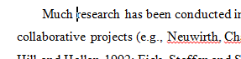

The Selection Object again
With a previous example if no text was selected then the program would produce no visible effect.
  Sub SelectedFontChange()
  Selection.Font.Bold = wdToggle
  End
Another example automatically selected text for you “expanded” the selection.
  Sub AutoSelectedFontChange()
  Selection.Expand
  Selection.Font.Bold = wdToggle
  End Sub
Before
After

Slide 59
Constants For The Selection Object
Name of constant | Meaning of constant
wdSelectionIP | No text selected
wdSelectionNormal | Text (e.g., word, sentence) has been selected
wdSelectionShape | A graphical shape (e.g., circle, text book) has been selected

Slide 60
The Selection Object And A Practical Application Of Branching
An example application of branching: check if a selection has been made and only apply the selection if that is the case.
  Checking if a condition is true
Word document containing the macro: “14selectionExample.docm”
  Sub checkSelection()
  If Selection.Type = wdSelectionIP Then
  MsgBox ("No text selected, nothing to change")
  Else
  Selection.Font.Bold = wdToggle 'wdToggle, constant
  End If
  End Sub

Slide 61
Application Branching: Marking Program
Word document containing the macro: “15Marking program.docm”
Synopsis:
  The program spells checks the document
    Assume each document includes the name of the person in the file name
  If the number of errors meets a cut-off value then it’s a ‘fail’
  Otherwise it’s a pass
  The feedback is ‘written’ to the beginning of the document using a specific font and several font effects in order to stand out
    The message is customized with the person’s name at the beginning of the feedback

Slide 62
Marking Program
Sub MarkingForSpelling()
Dim totalTypos As Integer
Const MAX_TYPOS = 30
Dim currentDocument As String
Dim feedback As String
'Get Name of current document
currentDocument = ActiveDocument.Name
'Tally the number of typos
totalTypos = ActiveDocument.SpellingErrors.Count
'Feedback is prefaced by student(document) name
feedback = currentDocument & " marking feedback..."

Slide 63
Marking Program (2)
' HomeKey move to the home position (start of document)
Selection.HomeKey Unit:=wdStory
'Recall: before this feedback just = document name and
'an indication that feedback is coming
If (totalTypos > MAX_TYPOS) Then
feedback = feedback & ": Too many typographical errors:
Fail"
Else
feedback = feedback & ": Pass"
End If
' Chr(11) adds a newline (enter) to the end of feedback
feedback = feedback & Chr(11) & Chr(11)
' Alternative use the constant vbCr (VB cursor return)

Slide 64
Marking Program (3)
' Font effects to make the feedback stand out
Selection.Font.ColorIndex = wdRed
Selection.Font.Size = 16
Selection.Font.Name = "Times New Roman"
' Write feedback into the document
Selection.TypeText (feedback)
End Sub

Slide 65
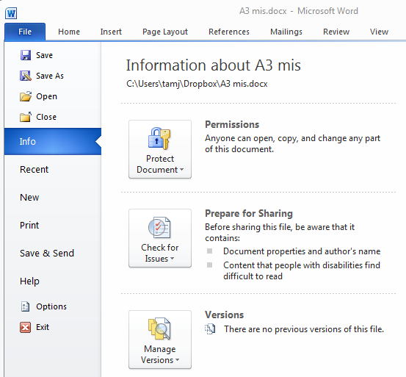
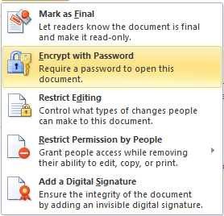
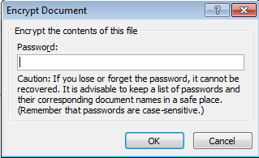
Securing A Document: Using MS-Word
Documents can be configured so a password is required to view the contents.

Slide 66
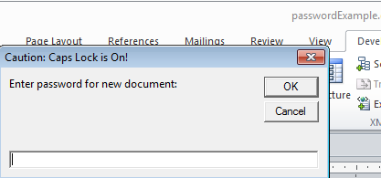
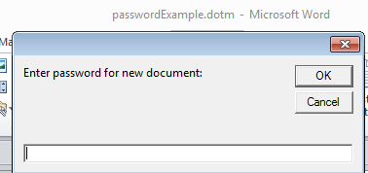
Securing A Document: Simple VBA Example
Word document containing the macro: 16passwordExample.docm
  Sub passWordExample()
  Dim yourPassword As String
  Dim warningCaps As String
  If (Application.CapsLock = True) Then
  warningCaps = "Caution: Caps Lock is On!"
  Else
  warningCaps = ""
  End If
  yourPassword = InputBox("Password for document: " _
  & warningCaps)
  ActiveDocument.Password = yourPassword
  End Sub
Notes:
*

Slide 67
Looping/Repetition
How to get the program or portions of the program to automatically re-run
  Without duplicating the instructions
  Example: you need to calculate tax for multiple people
Ask for income
Loop: allows you to repeat the same tasks over and over again
Calculate deductions
Display amounts

Slide 68

Looping/Repetition (2)
The entire program repeats
START
Play game again?
Run game
Y
Play again?
N
www.colourbox.com
END GAME

Slide 69
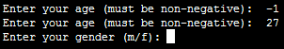
Looping/Repetition (3)
Only a specific part of the program repeats
Re-running specific parts of the program
Flowchart
Invalid input?
N
Y
Ask for input again
…rest of program

Slide 70
Types Of Loops
Fixed repetition loops: runs some integer ‘n’ times e.g., generates taxes for 10 clients
  For-next
Variable repetition loops: runs as long as some condition holds true
  e.g., while the user doesn’t quit the program re-run the program
  e.g., while the user enters an erroneous value ask the user for input.
  Do-while loop

Slide 71
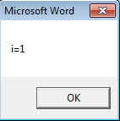
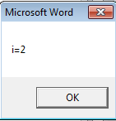
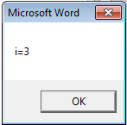
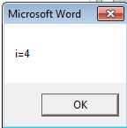
For-Next Loops
A ‘counting’ loop: counts out a sequence of numbers
Format:
  For <counter> = <start> To <end> Step <step size>¹
  <Statement(s)>
  Next <counter>
Complete Example: “17forUpOne.docm”
  ' Synopsis of code illustrating new concepts
  Dim i As Integer
  For i = 1 To 4 Step 1
  MsgBox ("i=" & i)
  Next i
1 Step size can be a positive or negative integer e.g., 1, -1, 5, -10 etc.

Slide 72
For-Next Loops (2)
For-next loops can count down as well as up
The Steps can be values other than one.
Complete example: “18forDownThree.docm”
  ' Synopsis of code illustrating new concepts
  Dim i As Integer
  For i = 12 To 0 Step -3
  MsgBox ("i=" & i)
  Next i
12
9
6
3
0

Slide 73
Do-While Loop
Start
Condition?
F
T
Format:
  Do While <Condition>
  <Statement(s)>
  Loop
Example: “19whileUpOne.docm”
  Dim i As Integer
  i = 1
  Do While (i <= 4)
  MsgBox ("i=" & i)
  i = i + 1
  Loop
Statements
Loop
End
Any valid mathematical expression here

Slide 74
Programming Style: Variable Names
In general variable names should be self-descriptive e.g., ‘age’, ‘height’ etc.
Loop control variables are an exception e.g., ‘i’ is an acceptable variable name
  It’s sometimes difficult to come up with a decent loop control name
  Loop control variables are given shorter names so the line length of a loop isn’t excessive
  Dim loopControl As Integer
  loopControl = 1
  Do While (loopControl <= 4)
  ...

Slide 75
Loops That Never Execute
Word document containing the complete program: 20nonExecutingLoops.docm
  Dim i As Integer
  i = 5
  Do While (i <= 4)
  MsgBox ("i=" & i)
  i = i + 1
  Loop
  For i = 4 To 1 Step 1
  MsgBox ("i=" & i)
  Next i

Slide 76
Exercise #1: Loops
The following program that prompts for and displays the user’s age.
  Sub errorChecking()
  Dim age As Long
  age = InputBox("Age (greater than or equal to zero)")
  End Sub
Modifications:
  As long as the user enters a negative age the program will continue prompting for age.
  After a valid age has been entered then stop the prompts and display the age.
  Hint: Use a do-while loop (not a for-loop)

Slide 77
Accessing Tables
The tables in the currently active Word document can be made through the ActiveDocument object:
  ActiveDocument.Tables: accesses the ‘tables’ collection (all the tables in the document).
  ActiveDocument.Tables(<integer ‘i’>): accesses table # i in the document
  ActiveDocument.Tables(1).Sort: sorts the first table in the document (default is ascending order)

Slide 78
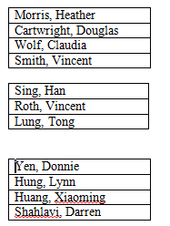
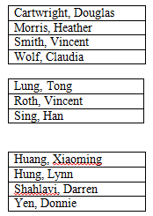
Simple Example: Sorting Three Tables
Instructions needed for sorting 3 tables
  ActiveDocument.Tables(1).Sort
  ActiveDocument.Tables(2).Sort
  ActiveDocument.Tables(3).Sort
Before
After

Slide 79
Previous Example
Critique of the previous approach: the program ‘worked’ for the one document with3 tables but:
  What if there were more tables (cut and paste of the sort instruction is wasteful)?
  What if the number of tables can change (i.e., user edits the document)
Notice: The process of sorting just repeats the same action but on a different table.
  ActiveDocument.Tables(1).Sort
  ActiveDocument.Tables(2).Sort
  ActiveDocument.Tables(3).Sort
Looping/repetition can be applied reduce the duplicated statements

Slide 80
Revised Example: Sorting Tables With A Loop
  Word document containing the complete macro: “21sortingTables.docm”
  Sub Sort()
  Dim CurrentTable As Integer
  Dim NumTables As Integer
  NumTables = ActiveDocument.Tables.Count
  If NumTables = 0 Then
  MsgBox ("No tables to sort")
  Else
  For CurrentTable = 1 To NumTables Step 1
  MsgBox ("Sorting Table # " & CurrentTable)
  ActiveDocument.Tables(CurrentTable).Sort
  Next
  End If
  End Sub

Slide 81
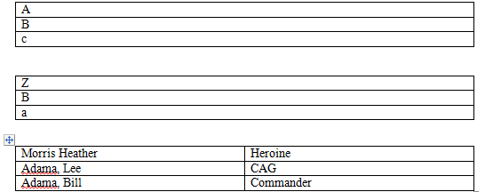
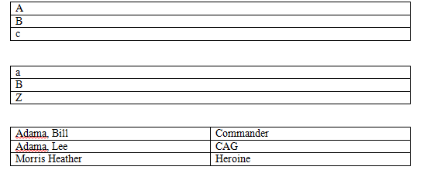
Result: Sorting Tables
Before
After

Slide 82


More On Sort
A handy parameter that can be used to configure how it runs.
Format
  Sort (<Boolean to Exclude header – True or False>)
Example
  ActiveDocument.Tables(CurrentTable).Sort(True)
  Before
  After

Slide 83
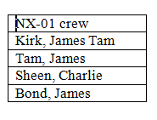
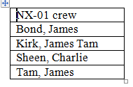
Second Sorting Example: Exclude Headers
Before
Document containing the macro: “22sortingTablesExcludeHeader.docm”
  Sub Sort()
  Dim CurrentTable As Integer
  Dim NumTables As Integer
  NumTables = ActiveDocument.Tables.Count
  If NumTables = 0 Then
  ' Don't bother sorting
  MsgBox ("No tables to sort")
  Else
  For CurrentTable = 1 To NumTables Step 1
  MsgBox ("Sorting Table # " & CurrentTable)
  ActiveDocument.Tables(CurrentTable).Sort (True)
  Next
  End If
  End Sub
After

Slide 84
Accessing Shapes And Images
Reminders (in VBA)
  Shapes (basic shapes that are drawn by Word)
  InlineShapes (images that are created externally and inserted into Word)
Both collections accessed via the ActiveDocument object:
  ActiveDocument.Shapes: access to all the shapes in the currently active Word document
    ActiveDocument.Shapes(<index>): access to shape #i in the document
  ActiveDocument.InlineShapes: access to all the images in the currently active Word document
    ActiveDocument.InlineShapes(<index>): access to image #i in the document

Slide 85
Example: Accessing Shapes And Images
  Word document containing the complete macro: “23accessingImagesFigures.docm”
  Dim numImages As Integer
  Dim numShapes As Integer
  numImages = ActiveDocument.InlineShapes.Count
  numShapes = ActiveDocument.Shapes.Count
  MsgBox ("Images=" & numImages)
  MsgBox ("Simple shapes=" & numShapes)

Slide 86
Example: Accessing Shapes And Images (2)
  ' Checks expected # images and alters first & third
  If (numImages = 4) Then
  ActiveDocument.InlineShapes(1).Height = _
  ActiveDocument.InlineShapes(1).Height * 2
  ActiveDocument.InlineShapes(3).Height = _
  ActiveDocument.InlineShapes(3).Height * 2
  End If
  ' Checks expected # shapes, alters 2nd & 6th
  ' Deletes the first shape
  If (numShapes = 6) Then
  ActiveDocument.Shapes(2).Width = _
  ActiveDocument.Shapes(2).Width * 4
  ActiveDocument.Shapes(6).Fill.ForeColor = vbRed
  ActiveDocument.Shapes(1).Delete
  End If

Slide 87
Printing: Multiple
Printing all the documents currently open in MS-Word.
  Take care that you don’t run this macro if you have many documents open and/or they are very large!
  Word document containing the macro example: “24multiDocumentPrint.docm”
  Sub PrintDocumentsCollection()
  Dim numDocuments As Integer
  Dim count As Integer
  numDocuments = Documents.count
  count = 1
  Do While (count <= numDocuments)
  Documents.Item(count).PrintOut
  count = count + 1
  Loop
  End Sub
Learning: another practical application of looping e.g., automatically open multiple documents, make changes, print and save them without user action needed

Slide 88
Nesting
Nesting: one construct is contained within another
  What you have seen: nested branches:
  If (Boolean) then
  If (Boolean) then
  End If
  End if
Branches and loops can be nested within each other
  Do while (Boolean)
  if (Boolean) then
  End if
  Loop

Slide 89
Example: Nesting
Write a program that will count out all the numbers from one to six.
For each of the numbers in this sequence the program will determine if the current count (1 – 6) is odd or even.
  The program display the value of the current count as well an indication whether it is odd or even.
Which Step (#1 or #2) should be completed first?

Slide 90
Step #1 Solution
  Sub nesting()
  Dim counter As Long
  counter = 1
  Do While (counter <= 6)
  counter = counter + 1
  Loop
  End Sub

Slide 91
Step #1 Completed: Now What?
For each number in the sequence determine if it is odd or even.
This can be done with the modulo (remainder) operator: MOD
  An even number modulo 2 equals zero (2, 4, 6 etc. even divide into 2 and yield a remainder or modulo of zero).
  If (counter MOD 2 = 0) then 'Even
  An odd number modulo 2 does not equal zero (1, 3, 5, etc.)
Pseudo code visualization of the problem
  Loop to count from 1 to 6
  Determine if number is odd/even and display message
  End Loop
  Determining whether a number is odd/even is a part of counting through the sequence from 1 – 6, checking odd/even is nested within the loop

Slide 92
Step #2 Solution
  Sub nesting()
  Dim counter As Long
  counter = 1
  Do While (counter <= 6)
  If (counter Mod 2 = 0) Then
  MsgBox ("Even: " & counter)
  Else
  MsgBox ("Odd: " & counter)
  End If
  counter = counter + 1
  Loop
  End Sub

Slide 93
The DIR Function
It can be used to go through all the documents in a folder (this course will illustrate in advanced examples)
It can be used to go through the entire contents of a folder including sub-folders and sub-sub folders (very advanced use: well beyond the scope of the this course)
Basic use: this function takes a location (e.g., C:\temp\) and a filename as an argument and it determines if the file exists at the specified location.
  If the file is found at this location then the function returns the name of the file.
  If the file is not found at this location then the function returns an empty string (zero length)

Slide 94
Simple Use Of The DIR Function
  Word document containing the macro example: 25DIRFunctionSimple.docm
    Dim location As String
    Dim filename As String
    Dim result As String
    location = "C:\temp\" 'Always look here
    filename = "Doc1.docx" 'C:\temp\Doc1.dox
    result = Dir(location & filename)
    MsgBox (result)
    result = Dir(location & "*.docx") 'Any .docx in C:\temp\
    MsgBox (result)
    filename = InputBox("File name in C:\temp")
    result = Dir(location & filename)
    MsgBox (result)

Slide 95
Example: Using Dir To Check If File Exists (2)
  Word document containing the macro example: 26DIRFunctionIntermediate.docm
    Sub openExistingDocument()
    Dim filename As String
    Dim checkIfExists As String
    Dim last As Integer
    filename = InputBox ("Enter the path and name of file to
    open e.g., 'C:\temp\tam.docx'")
    ' Error case: nothing to open, user entered no info
    If (filename = "") Then
    ActiveDocument.ActiveWindow.Caption =
    "No such file in this location"

Slide 96
Example: Using Dir To Check If File Exists (3)
    ' No error: non-empty info entered
    Else
    checkIfExists = Dir(filename)
    If (Len(checkIfExists) = 0) Then
    MsgBox ("File doesn't exist can't open")
    Else
    MsgBox ("File exists opening")
    Documents.Open (filename)
    End If
    End If
    End Sub

Slide 97
Practical Use Of Dir: Access Each File In A Directory
  Word document containing the macro example: 27loopFolder.docm
      Sub loopFolder ()
      Dim directoryPath As String
      Dim currentFile As String
      directoryPath = InputBox("Enter full path of search
      folder e.g. C:\Temp\")
      currentFile = Dir(directoryPath)
      If (currentFile = "") Then
      MsgBox ("No documents in the specified folder")
      End If
      Do While (currentFile <> "")
      MsgBox (currentFile) ' Display file name in popup
      currentFile = Dir
      Loop
      End Sub

Slide 98
Alternate Version: Access Only Word Documents
  Word document containing the macro example: 28loopWordFolder.docm
    Sub loopWordFolder()
    Dim directoryPath As String
    Dim currentFile As String
    directoryPath = InputBox("Enter full path of search
    folder")
    currentFile = Dir(directoryPath & "*.doc*")
    If (currentFile = "") Then
    MsgBox ("No documents in the specified folder")
    End If
    Do While (currentFile <> "")
    MsgBox (currentFile) ' Display file name in popup
    currentFile = Dir ' Move onto next document in folder
    Loop
    End Sub

Slide 99
Revision Of An Earlier Example
The original version only marked (and annotated at the top) a single document.
This new version will automatically mark all the documents in a user-specified folder and insert the marking information at the top of each document.
Details:
  Open each document in the folder
  Run a spell check of the document
  Based on the number of spelling mistakes the document will be marked as either a pass or fail
  The comments will be inserted at the top of the document
  The marked document is then automatically closed and the program moves onto the next document until there are no more documents in that folder.

Slide 100
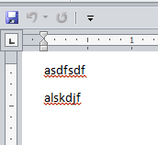
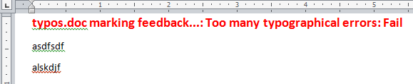
Revised Marking Program
Word document containing the macro: “29markAllFolderDocuments.docm”
  Sub markAllFolderDocuments()
  Const MAX_TYPOS = 1
  Const LARGER_FONT = 14
  Dim directoryPath As String
  Dim currentFile As String
  Dim totalTypos As Integer
  Dim feedback As String

Slide 101
Revised Marking Program (2)
  directoryPath = InputBox("Location and name of folder
  containing assignments (e.g., C:\grades\")
  currentFile = Dir(directoryPath & "*.doc*")
  If (directoryPath = "") Then
  MsgBox ("No Word documents in specified folder,
  looking in default location C:\Temp\")
  directoryPath = "C:\Temp\"
  End If

Slide 102
Revised Marking Program (3)
e.g. Feedback for “Typos.docx” = “Typos marking feedback…”
  Do While (currentFile <> "")
  Documents.Open (directoryPath & currentFile)
  currentDocument = ActiveDocument.Name
  totalTypos = ActiveDocument.SpellingErrors.Count
  feedback = currentDocument & " marking feedback..."
  Selection.HomeKey Unit:=wdStory
  If (totalTypos > MAX_TYPOS) Then
  feedback = feedback & ": Too many typographical
  errors: Fail"
  Else
  feedback = feedback & ": Pass"
  End If
  feedback = feedback & vbCr
  Selection.Text = feedback
  ' Loop body continued on next page
e.g. Feedback for “Typos.docx” = “typos.doc marking feedback...: Too many typographical errors: Fail”

Slide 103
Revised Marking Program (4)
  ' Loop body continued from previous page
  With Selection.Font
  .Bold = True
  .Size = LARGER_FONT
  .Color = wdColorRed
  End With
  ActiveDocument.Close (wdSaveChanges)
  currentFile = Dir
  Loop
  End Sub

Slide 104
Counting The Number Of Occurrences Of A Word
Example applications:
  Evaluating resumes by matching skills sought vs. skills listed by the applicant.
  Ranking the relevance of a paper vs. a search topic by the number of times that the topic is mentioned.
Complete Word document containing the macro: 30counting occurences.docm

Slide 105
Example: Counting Occurrences
  Sub countingOccurences()
  Dim count As Long
  Dim searchWord As String
  count = 0
  searchWord = InputBox("Word to search for")
  ' Exact match (assignment)
  With ActiveDocument.Content.Find
  Do While .Execute(FindText:=searchWord, Forward:=True, _
  MatchWholeWord:=True) = True
  count = count + 1
  Loop
  End With
  MsgBox ("Exact matches " & count)
  End Sub

Slide 106
Applying Many Of The Previous Concepts In A Practical Example & Linking Documents And (If There’s Time)
As you are aware different programs serve different purposes:
  Database: storing and retrieving information
  Spreadsheet: performing calculations, displaying graphical views of results
  Word processor: creating text documents with many features for formatting and laying out text
VBA allows the output of one program to become the input of another program.
  Although this can be done ‘manually’ (reading the documents and typing in changes) if the dataset is large this can be a tedious and error-prone process
  VBA can be used to automate the process

Slide 107
Example Problem
Financial statements (monetary data) about many companies can be stored in a spreadsheet where an analysis can be performed e.g. does the company have enough $$$ on hand to meet its financial commitments.
This information can be read into a VBA program which can further evaluate the data.
The results can be presented in Word using the numerous text formatting features to highlight pertinent financial information.
Names of the documents used in this example:
  FNCE.xlsx (contains the financial data: program input)
  31spreadSheetAnalyzer.docm (contains the VBA program as well as the presentation of results: program output)

Slide 108
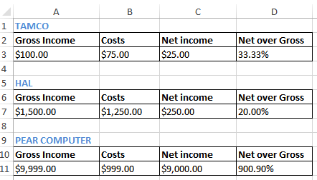
Spread Sheet Analyzer
  Sub spreadsheetAnalyzer()
  Const MIN_INCOME = 250
  Const MIN_RATIO = 25
  Const PERCENT = 100
  Dim company1 As String
  Dim income1 As Long
  Dim ratio1 As Long
  Dim company2 As String
  Dim income2 As Long
  Dim ratio2 As Long
  Dim company3 As String
  Dim income3 As Long
  Dim ratio3 As Long
  Dim comment1 As String
  Dim comment2 As String
  Dim comment3 As String
TAMCO: 33%
HAL: Net income $250
PEAR COMPUTER: Net income $9000, 901% <== BUY THIS!

Slide 109
Spread Sheet Analyzer (2)
Object =
Type for any MS-Office variable
https://msdn.microsoft.com/
Dim excel As Object
Set excel = CreateObject("excel.application")
excel.Visible = True
Dim workbook
Dim location As String
location = InputBox("Path and name of spreadsheet e.g.
C:\Temp\FNCE.xlsx")
Set workbook = excel.workbooks.Open(location)

Slide 110
Spread Sheet Analyzer (2)
Object =
Type for any MS-Office variable
https://msdn.microsoft.com/
Dim excel As Object
Set excel = CreateObject("excel.application")
excel.Visible = True
Dim workbook
Dim location As String
location = InputBox("Path and name of spreadsheet e.g.
C:\Temp\FNCE.xlsx")
Set workbook = excel.workbooks.Open(location)

Slide 111
Spread Sheet Analyzer (3)
' Get company names
company1 = excel.Range("A1").Value
company2 = excel.Range("A5").Value
company3 = excel.Range("A9").Value
' Get net income and ratio
income1 = excel.Range("C3").Value
ratio1 = excel.Range("D3").Value * PERCENT
income2 = excel.Range("C7").Value
ratio2 = excel.Range("D7").Value * PERCENT
income3 = excel.Range("C11").Value
ratio3 = excel.Range("D11").Value * PERCENT
' Move the selection to the top of the Word document
Selection.HomeKey Unit:=wdStory

Slide 112
Spread Sheet Analyzer (4): First Company
TAMCO: 33%
comment1 = company1 & ": "
If (income1 >= MIN_INCOME) Then
comment1 = comment1 & "Net income $" & income1
Selection.Font.Color = wdColorRed
Selection.TypeText (comment1)
If (ratio1 >= MIN_RATIO) Then
comment1 = ", " & ratio1 & "% <== BUY THIS!"
Selection.Font.Color = wdColorBlue
Selection.TypeText (comment1)
End If
Selection.TypeText (vbCr)
Else
If (ratio1 >= MIN_RATIO) Then
comment1 = comment1 & ratio1 & "%" & vbCr
Selection.Font.Color = wdColorBlue
Selection.TypeText (comment1)
End If
End If

Slide 113
Spread Sheet Analyzer (5): Second Company
HAL: Net income $250
comment2 = company2 & ": "
If (income2 >= MIN_INCOME) Then
comment2 = comment2 & "Net income $" & income2
Selection.Font.Color = wdColorRed
Selection.TypeText (comment2)
If (ratio2 >= MIN_RATIO) Then
comment2 = ", " & ratio2 & "% <== BUY THIS!"
Selection.Font.Color = wdColorBlue
Selection.TypeText (comment2)
End If
Selection.TypeText (vbCr)
Else
If (ratio2 >= MIN_RATIO) Then
comment2 = comment2 & ratio2 & "%" & vbCr
Selection.Font.Color = wdColorBlue
Selection.TypeText (comment2)
End If
End If

Slide 114
Spread Sheet Analyzer (6): Third Company
PEAR COMPUTER: Net income $9000, 901% <== BUY THIS!
comment2 = company2 & ": "
If (income2 >= MIN_INCOME) Then
comment2 = comment2 & "Net income $" & income2
Selection.Font.Color = wdColorRed
Selection.TypeText (comment2)
If (ratio2 >= MIN_RATIO) Then
comment2 = ", " & ratio2 & "% <== BUY THIS!"
Selection.Font.Color = wdColorBlue
Selection.TypeText (comment2)
End If
Selection.TypeText (vbCr)
Else
If (ratio2 >= MIN_RATIO) Then
comment2 = comment2 & ratio2 & "%" & vbCr
Selection.Font.Color = wdColorBlue
Selection.TypeText (comment2)
End If
End If

Slide 115
After This Section You Should Now Know
Collections
  What are they
  What is the advantage in using them
  Common examples found in Word documents
The Active document
  What are some of the commonly accessed attributes
  What are some useful methods
Finding things using macros
  How to find and replace: text, font effects or font styles
Using the end-with

Slide 116
After This Section You Should Now Know (2)
How to use branches to make decisions in VBA
  If
  If-else
  Multiple If’s
  If, else-if, else
  Nested branches
  Using logic (AND, OR, NOT) in branches
How to use the line continuation character to break up long instructions
How to get a program to repeat one or more instructions using loops
  For-next
  Do-while

Slide 117
After This Section You Should Now Know (3)
How to print multiple documents
How to use the ‘Dir’ function to access a folder
  Using this function to step through all the documents or specific types of documents in a folder
Accessing other types of MS-Office programs with an VBA program written for Word

Slide 118
Copyright Notice
Unless otherwise specified, all images were produced by the author (James Tam).

