Slide 1
Introduction to VBA (Visual Basic For Applications) Programming
Origins of VBA, creating and running a VBA program
Variables & constants
Interactive programs
Formatting documents
Debugger basics
Security
Introduction to program documentation
Online support: https://support.office.com/en-US/article/create-or-run-a-macro-c6b99036-905c-49a6-818a-dfb98b7c3c9c

Slide 2
B.A.S.I.C.
Beginner’s All-Purpose Symbolic Instruction Code (BASIC)
  From: www.acm.org (original full article: http://time.com/69316/basic/)
A widely used programming language
It was relatively simple to learn (statements were “English-like” e.g., “if-then”)
Widely popular and it was commonly packaged with new computers in the 1970’s and 1980’s
(A then relatively unknown company: Microsoft got it’s initial cash inflows and reputation producing several versions of the language)

Slide 3

B.G.
www.colourbox.com

Slide 4
Visual Basic
A newer programming language developed by Microsoft
It was designed to make it easy to add practical and useful features to computer programs e.g., programmers could add a graphic user interface, database storage of information etc.
Also it can take advantage of the built in capabilities of the various versions of the Windows operating system
  Why write a feature of a program yourself when it already “comes with the computer”
For more information:
  http://msdn.microsoft.com/en-us/library/2x7h1hfk.aspx

Slide 5
Visual Basic For Applications (VBA)
Shares a common core with Visual Basic.
  Statements ‘look’ similar
Unlike Visual Basic, VBA programs aren’t written in isolation (creating a program just for it’s own sake).
  Most programs are written to be standalone: a computer game can be run without (say) running a web browser or MS-Office.
VB = Visual Basic, VBA = Visual Basic for Applications
Each VBA program must be associated with a ‘host’ application (usually it’s Microsoft office document such as MS-Word but other applications can also be augmented by VBA programs).
  The host application is enhanced or supplemented by the VBA program
  “Why doesn’t this stupid word processor have this feature??!!”
    - Now you can add that feature yourself using VBA

Slide 6
Visual Basic For Applications (VBA): 2
Important! Because every VBA program must be run within the context of host application when you are learning to write your programs do not open up an important MS-Word document and run your programs.
  The host program often needs an Word document in order to run certain capabilities.
  VBA programs often change documents (formatting, style, text).
  Therefore use only small ‘test’ MS-Word documents when running your VBA programs otherwise your information may be lost or corrupted.

Slide 7
Macros
Macro: a sequence of keystrokes or mouse selections (instructions to the computer) that can be repeated over and over
  MS-Office can be augmented by writing Macros (essentially computer programs) that will run either for multiple documents or only for a particular document.
  In this class we will focus solely on MS-Word macro programming
VBA (as guessed) is an example of a macro programming language e.g., you can write a program that includes a series of formatting and other commands that you frequently carry out in Word documents
Write the commands once in the form of a program and just re-run this program instead of re-entering each command

Slide 8
Macros And The Web-Based Office
According to Microsoft macros are not accessible via their online Office products:
      https://support.office.com/en-us/article/Differences-between-using-a-workbook-in-the-browser-and-in-Excel-f0dc28ed-b85d-4e1d-be6d-5878005db3b6?CorrelationId=917b1609-97e9-4cc7-9eeb-d188939ad740&ui=en-US&rs=en-US&ad=US
Result: use a computer with the desktop version of Office installed.
  203 lab
  Other campus computers
    Some ‘labs’ may have open access hours
  It is CRUICIAL that you test your program on the computers in the 203 lab because your assignment must work on the lab machines in order to receive credit.

Slide 9
Writing Macros
It is not assumed that you have any prior experience writing computer programs (macro language or something else).
Consequently early examples and concepts will be quite rudimentary i.e., “we will go slow”
  The effect is that you may find that the capabilities of the early examples will duplicate familiar capabilities already built into MS-Word
    Why are we writing a macro program for this feature?
    Makes it easier to understand (you know the expected result).
    Keeps the example simpler.
Later examples will eventually demonstrate the ‘power’ of macros
  You can do things that would be impossible (or at least difficult) with the default capabilities built into MS-Word

Slide 10
Can You Complete The Following Tasks?
Open a MS-Word document and replace every instance of one phrase e.g., tamj@ucalgary.ca with another tamj@cpsc.ucalgary.ca
Open every document in a folder and perform the same search and replace operation:
  2 documents?
  10 documents?
  100 documents?
  All the documents in a particular folder?
  What if you just wanted to open the word documents with a particular word or phrase in the name e.g., “assignments_2014”?
This is an example where writing a macro once is a more efficient approach
  One answer to the question: “Why are we learning this???”

Slide 11
Advanced Use Of Macros
Although it’s beyond the scope of this class the following example is introduced now to make you aware of the power of VBA and macro languages.
  It can actually be used to perform real tasks.
You can use a macro to take advantage of the capabilities of each MS-Office application:
  Establishing references to applications to ‘link’ them
  Take the output from one application and making it the input of another.

Slide 12
Advanced Use Of Macros (2)
Example: macros can automate the following task
  Store data in MS-Access
  Store the query results in MS-Excel and perform calculations on the data
  Use the formatting capabilities of MS-Word to produce reports
  MS-Outlook can email the final documents

Slide 13
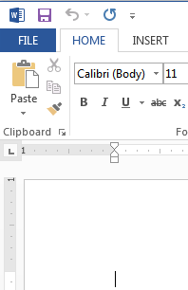
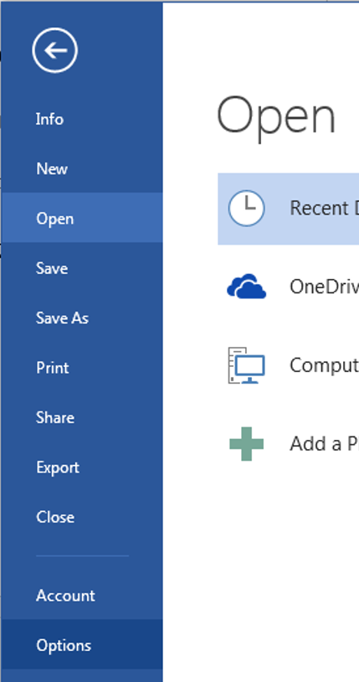
Viewing The ‘Developer’ Ribbon (MS-Word 2013)
The macro programming capability comes built-in to the MS-Office suite.
  You simply have to enable that functionality
Steps
  Select the ‘File’ ribbon
  Select ‘options’

Slide 14
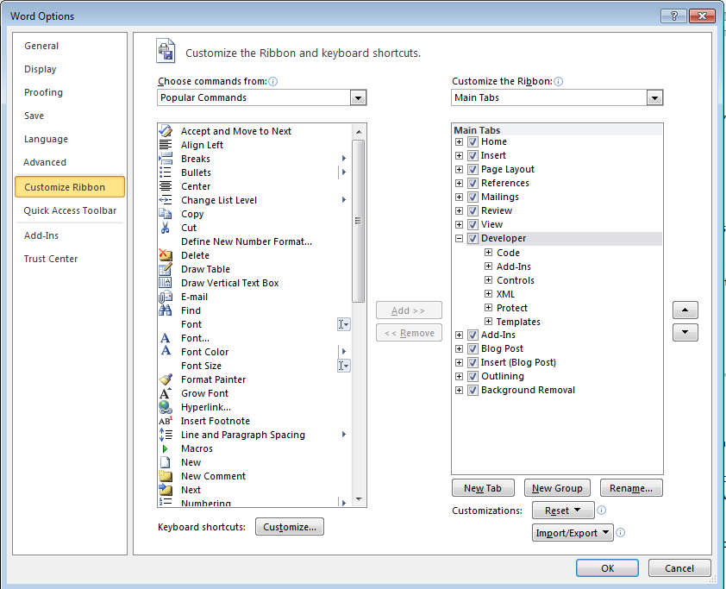
Viewing The ‘Developer’ Ribbon (MS-Word 2013): 2
3A) Select “customize the ribbon”
3B) Check the ‘Developers’ box

Slide 15

Viewing The ‘Developer’ Ribbon (MS-Word 2013): 3
This should add a new ribbon “Developer”

Slide 16
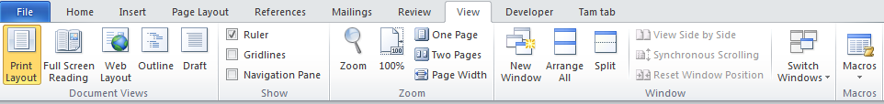
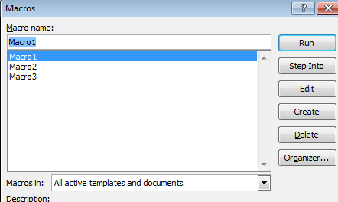
Alternate: View And Run Macros
You may or may not be able to edit the MS-Word ribbon with some computer labs.
You can see view macros via the ‘view’ tab on the ribbon (albeit with fewer options)

Slide 17
Macros And Computer Security
Computer viruses are simply malicious computer programs.
Macros can be a useful mechanism for reducing repetition or adding new capabilities to MS-Office.
But as is the case when writing a computer program malicious code can also be written with a macro and the virus can be activated by just opening the MS-office document that contains the macro.
Just because you are writing macro programs does not mean that you shouldn’t take macro security seriously!

Slide 18
Examples Macros Viruses
“Melissa”: Information about an old but ‘successful’ Macro Virus
  http://www.cnn.com/TECH/computing/9903/29/melissa.02.idg/index.html?_s=PM:TECH
  http://www.symantec.com/press/1999/n990329.html
  http://support.microsoft.com/kb/224567
Macro viruses aren’t just “ancient history”, take the potential threat seriously!
  http://www.symantec.com/avcenter/macro.html
  http://www.microsoft.com/security/portal/threat/encyclopedia/search.aspx?query=Virus
  http://ca.norton.com/search?site=nrtn_en_CA&client=norton&q=macro+virus

Slide 19
Enabling Macros To Run
If you can' t run macros in MS-office (you see odd error messages) then examine the "Trust Center“ settings in Word
  Select the ‘File’ ribbon
  Select ‘options’

Slide 20
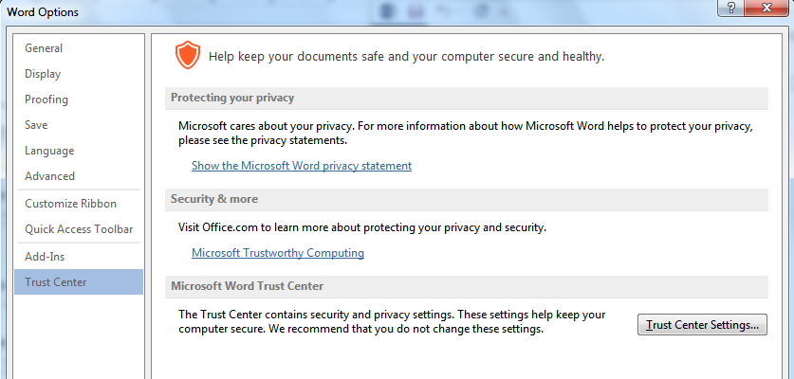
Enabling Macros To Run (2)
3A) Select “Trust Center”
3B) Select “Trust Center Settings”

Slide 21
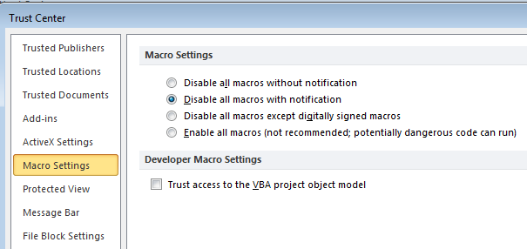
Enabling Macros To Run (3)
4A) Select “Macro Settings”
4B) Select “Disable all macros with notification”
More secure
Less
secure
5) Exit MS-Word (close ALL documents)

Slide 22
Enabling Macros To Run (4)
The default setting for MS-Word should already be set to “disable macros with notification” but these steps will allow you to use machines set differently

Slide 23
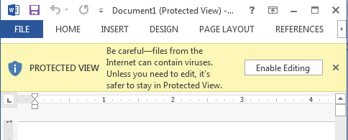
Effect: Opening Word Documents
Using this setting will disable all macros by default (safer approach) but you can still enable the macros as the document is opened.
JT’s caution
You should not casually select this option for all MS-Word documents
It’s recommended that you ONLY enable macros you have created (or the lecture examples)

Slide 24
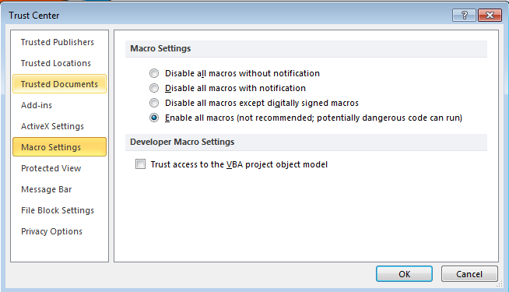
Macro Security
DO NOT take the ‘easy’ way out
More secure
NO!
Less
secure
For more information:
http://www.office.microsoft.com/en-us/help/enable-or-disable-macros-in-office-documents-HA010031071.aspx

Slide 25
Creating Macros
Record the macro automatically: keystrokes and mouse selections will be stored as part of the macro
Manually enter the Macro (type it in yourself into the VBA editor)

Slide 26
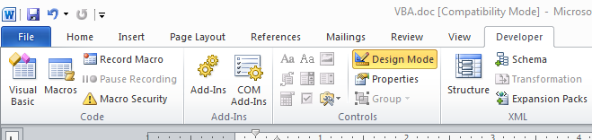
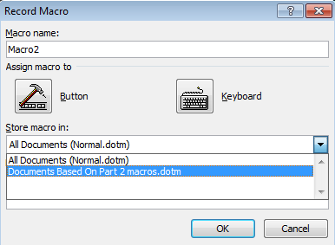
Recording Macros
Developer ribbon
  “Record Macro”
  Recording details
What to name the macro
Where to store the macro

Slide 27
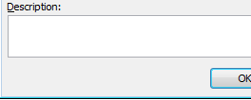
Naming The Macro: Conventions
Part of your assignment marks will be awarded according to how well your programs conform to stylistic conventions such as naming conventions employed.
  Macros should be given a good self-explanatory name: describes the purpose of the program e.g., ‘formatting_resume_headings’
  Additional information about the program can be provided in the ‘description’ field but for this class we will do this using ‘program documentation’ (described later).
Language requirements (macro name):
    Must start with an alphabetic letter, after than any combination of letters and numbers may be used
      OK: “assigment1”, “a2939” Not OK: “1assignment”, “*assignment”
    Maximum length of 80 characters
    It cannot contain spaces, punctuation or special characters such as # or !
      ‘resume headings’ (Not Allowed: space character)
      ‘macros!’ (Not Allowed: special character)
    Can contain underscores (separate long names)

Slide 28
The First Simple Macro
With word processing there’s sometimes a need to apply multiple formatting styles (bold, italics, underline) to high-lighted text
Manually applying the required formatting to each block of text can be tedious
  Recall: Macros can be used to automate or shorten some tasks
This first example macro program will be used to show:
  How to create a VBA macro for MS-Word
  How to automate a task using a macro

Slide 29
Recording A Simple Macro
(Of course a macro isn’t needed to use this formatting effect but it’s easiest to start with a simple example).
Bold face highlighted text.
  Select the developer tab and press record

Slide 30
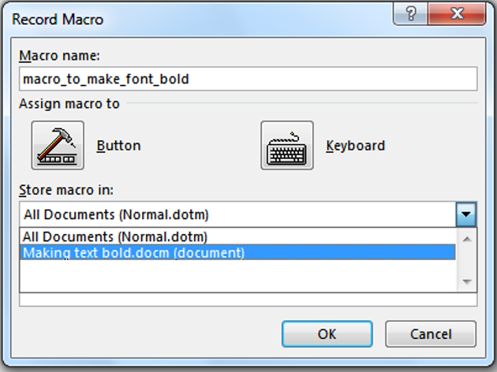
Recording A Macro (2)
    Give the macro a self explanatory name and press ‘OK’ (recording begins).
    Note: record the macro in the current document and not “All documents”.

Slide 31
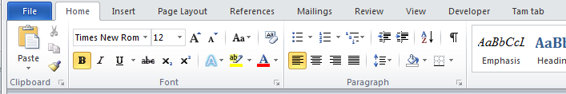
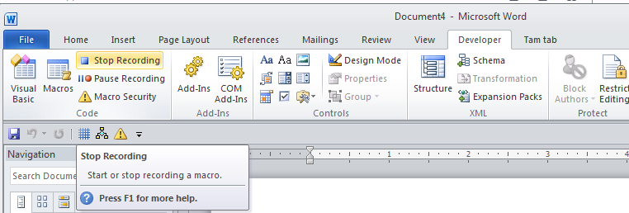
Recording A Macro (3)
Select whatever options you want to add to the recording of the macro
  In this case you would select bold font
  All commands have been entered so you can stop the recording

Slide 32
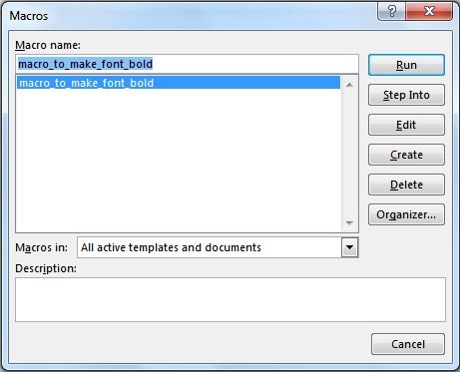
Running A Recorded Macro
Under the Developer ribbon select ‘macros’
Select the macro and then ‘run’ it

Slide 33
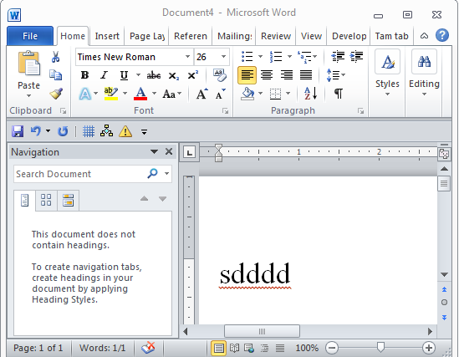
Running A Recorded Macro (2)
In this case nothing happened?
  This macro changes selected/highlighted text to bold
  You need to select some text before running the macro

Slide 34
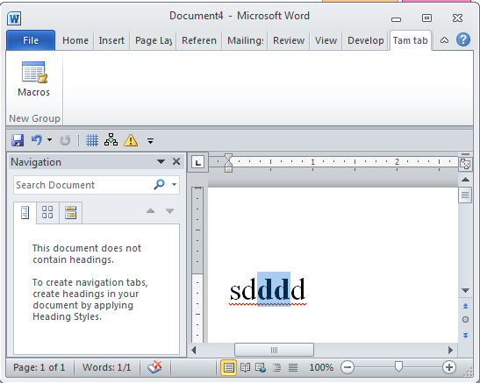
Running A Recorded Macro (3)
After selecting the text and running the macro again, whatever text was highlighted now becomes bold.

Slide 35
Recording Macros: Additional Comments
Don’t rely on creating all your macros by recording them.
Drawbacks:
  (Problem in terms of this class) to demonstrate your understanding of concepts you will be asked to manually write VBA code
    You won’t be adequately prepared if you rely on automatically recording your programs
  (Problem with doing this in real work) The automatically generated program code automatically is larger and more complicated than is necessary
    “Bloated” code
    Look under search terms such as +bloated "vba code" +recorded for examples of why automating recording VBA programs can be problematic.

Slide 36
Auto Generated VBA Program: 24 Lines
Sub heading()
With Selection.ParagraphFormat
.LeftIndent = InchesToPoints(0)
.RightIndent = InchesToPoints(0)
.SpaceBefore = 0
.SpaceBeforeAuto = False
.SpaceAfter = 6
.SpaceAfterAuto = False
.LineSpacingRule = wdLineSpaceSingle
.Alignment = wdAlignParagraphCenter
.WidowControl = True
.KeepWithNext = False
.KeepTogether = False
.PageBreakBefore = False
.NoLineNumber = False
.Hyphenation = True
.FirstLineIndent = InchesToPoints(0)
.OutlineLevel = wdOutlineLevelBodyText
.CharacterUnitLeftIndent = 0
.CharacterUnitRightIndent = 0
.CharacterUnitFirstLineIndent = 0
.LineUnitBefore = 0
.LineUnitAfter = 0
.MirrorIndents = False
.TextboxTightWrap = wdTightNone
End With
End Sub

Slide 37
VBA Statements Actually Needed: 1 Line
Sub headingManual()
Selection.ParagraphFormat.SpaceAfter = 6
End Sub

Slide 38
Recording Macros: Additional Comments
Benefits:
  You can use the macro code that is automatically generated in order to learn how to do manually.
  Sometimes this is very useful if you don’t know the wording of a command or how to access a property.
  Example (VBA program code for the previous example)
    Record the commands for the macro
    Then view the commands so you can learn how to do it manually
Sub AutoGeneratedFontChange()
Selection.Font.Bold = wdToggle
End Sub

Slide 39
Recording Macros
Bottom line: use it for learning “how to do” things
Don’t:
  Just use the auto-generated code to study for the exam without creating any code of your code
  Just hand in the auto-generated VBA code for your assignment
While taking this course: Use the auto-generated code to figure out how to “type the program from scratch” yourself (I will show how to do this shortly)
After this course is done: if ever you find your usage of Office tedious and repetitive (multiple clicks) then you can record all those steps into one macro!

Slide 40
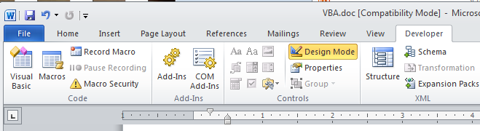
The Visual Basic Editor
You don’t need to familiarize yourself with every detail of the editor in order to create VBA programs.
Just a few key features should be sufficient
Starting the editor:
  Because VBA programs are associated with an office application open the editor from MS-Word
  Click the “Visual Basic” icon under “Developer”

Slide 41
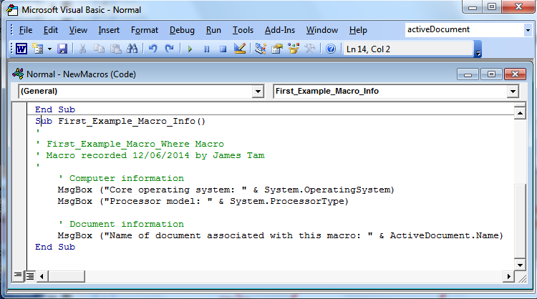
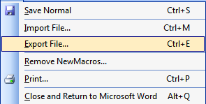
Overview Of The Important Parts Of The VBA Editor
Cut, copy, paste
Find, replace
Help lookup
Save
Program editor
Undo, redo
Export:
Useful for transferring or backing up your work
Run, pause, stop (VBA subroutine program)
Current location

Slide 42
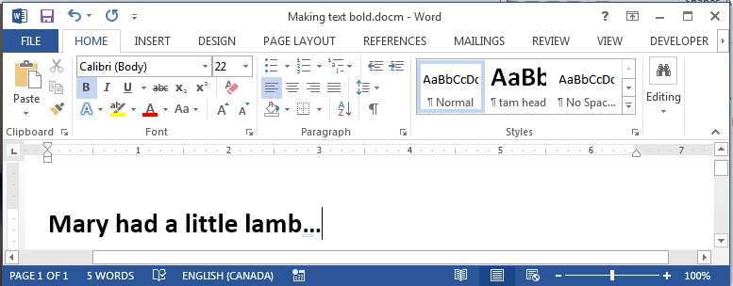
VBA Editor: Don’t Mix It Up With The Word Editor

Slide 43
Defining A Program In The VBA Editor
Format:
  ' Program documentation goes here (more on this later)
  sub <sub-program name>()
  End Sub
Example:
  ' Author, version, features etc.
  Sub first_example_macro_info()
  MsgBox ("Congratulations! This your first computer
  program")
  End Sub
Note: large VBA programs have multiple (sub) parts but for this class you only need to define a single ‘sub’.
Instructions in the body of program (indent 4 spaces)

Slide 44
The ‘Sub’ Keyword
Sub stands for ‘subroutine’ or a portion of a VBA program Format:
  Sub <subroutine name>()
  <Instructions in the subroutine>
  End Sub
Example:
  Sub First_Example_Macro_Info()
  End Sub
All executable VBA program statements must be inside the subroutine
Header, start of subroutine:
Has word ‘Sub’
Name of subroutine
Set of brackets
Note: all lines in between are indented (4 spaces)
End of subroutine:
Has ‘End Sub’

Slide 45
The ‘Sub’ Keyword: 2
Real world VBA programs will be broken down into multiple ‘subs’ (subroutines or program parts)
Because this is only brief introduction into writing VBA programs you will only have to define one subroutine for your assignment.

Slide 46
VBA Examples: This Point Onwards
Unlike the previous example you will be manually typing in the program instructions yourself rather than automatically recording the program as a series of steps
Reminder: some of the early examples are meant only as a learning/teaching tool
  They show you how to write simple VBA programs
  So they won’t yet focus on “doing useful things” yet
Try typing them into the VBA editor or cutting and pasting them yourself
  It’s important to “try things out for yourself”
  With programming you learn by “doing yourself” rather than by watching someone else ‘do’

Slide 47
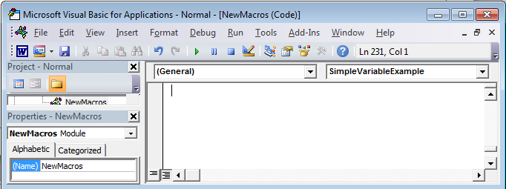
First VBA Example
Learning Objectives:
  Creating/running a VBA program
  Creating a Message Box “MsgBox”
Reminder steps (since this is your first example)
  Start up the application (MS-Word)
  Invoke the VBA editor: Developer->Visual Basic
  If successful you should see something similar to the image
Enter your program instructions here (program editor)

Slide 48
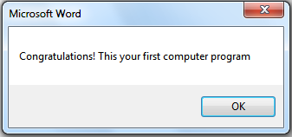
First VBA Example (2)
Type in or cut-and-paste the following example into the VBA editor (see last image for location of the editor, previous slide)
  This is NOT the same as pasting it directly into MS-Word.
  Word document containing the macro: 1firstExampleMacro.docm
  Sub first_example_macro_info()
  MsgBox ("Congratulations! This your first computer
  program")
  End Sub

Slide 49
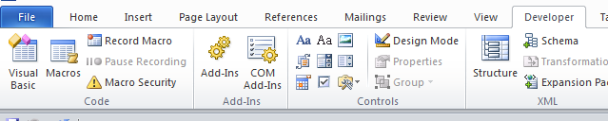
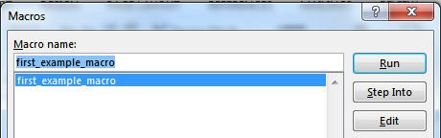
Reminder: Running Macros
(You must first have the ‘developer’ tab visible).
Developer->Macros
The single macro should be highlighted, then click ‘run’

Slide 50
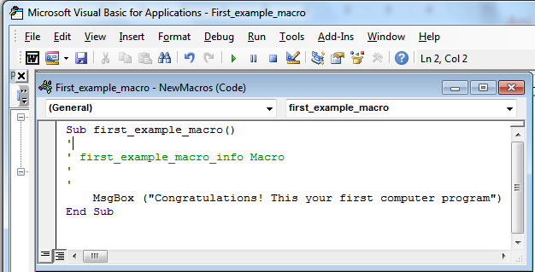
Running VBA Programs You Have Entered (2)
Or you can run the program right after you have entered it (in the editor).
Ensure correct program “sub” is to be executed (click there)
Press the ‘play/run’ button or “F5”

Slide 51
Structure Of VBA Programs: Reminder Of Important Points
As you just saw a program must begin with the “sub” keyword followed by the name of the “subroutine” (sub-part of the program).
It also ends with end “end sub”
Important style requirement: The part between the ‘sub’ and ‘end sub’ must be indented by 4 spaces (8 spaces if sub-indenting is used – next set of notes).
sub first_example_macro()
end Sub
MsgBox(“Congrats!”)

Slide 52
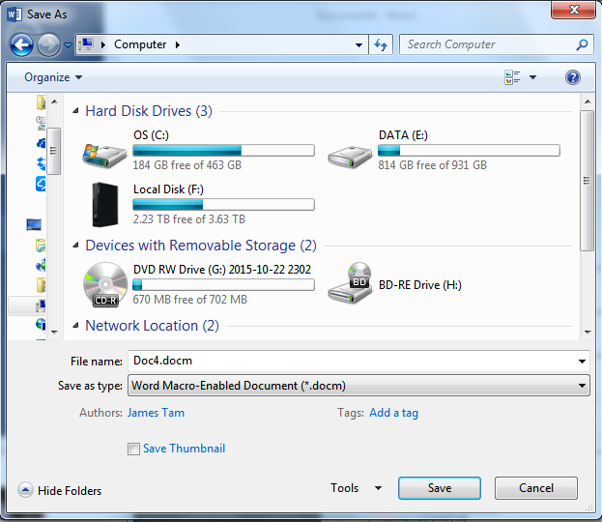
Saving Your Macro
You can save your macro into a Word document:
Create a new Word document
Save the document as a macro-enable document (Word document that has a macro computer program embedded within it).

Slide 53
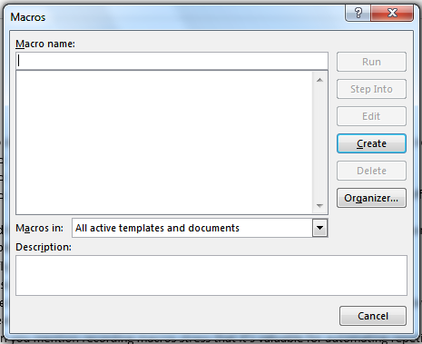
Saving Your Macro (2)
Next you have tell Word that you want to save your macro program inside this macro-enabled document.
  By default when you save your macros Word will select “Normal.dotm” as the location.
    DO NOT save your macro in this document:
      You will have trouble transferring your macro to other computers
      Because “Normal.dotm” is the default template used to create some Word documents it may result in security warnings.

Slide 54
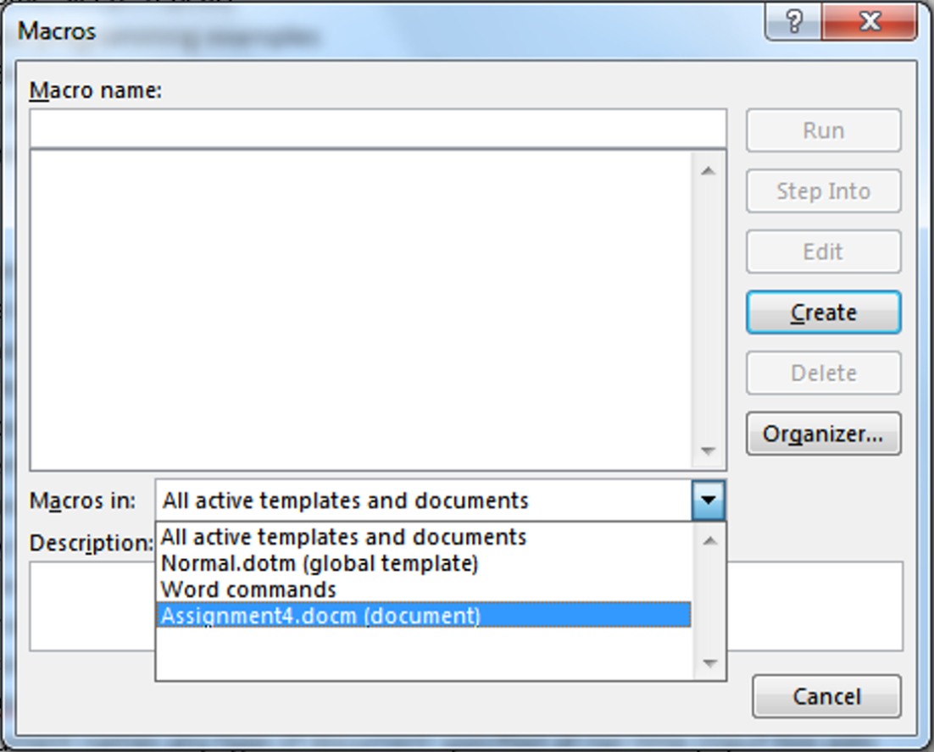
Saving Your Macro (3)
  Instead: Save your macro in your current document (in the example below it’s “Assignment4.docm”.
    Transferring this document will allow the macros to be transferred as well.

Slide 55
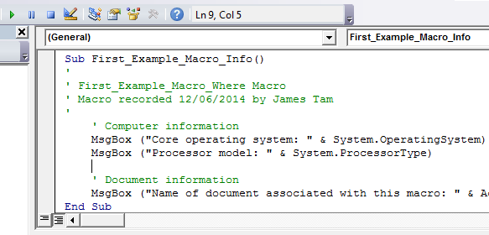
Viewing Macros
All macros that you have created can be viewed in the VBA macro editor:
  Macros manually entered in the editor (Message Box example)
  Macros automatically recorded (previous example: changing font to bold)
Previous example: auto recorded

Slide 56
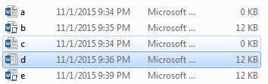
Which Document Contains A Macro?

Slide 57
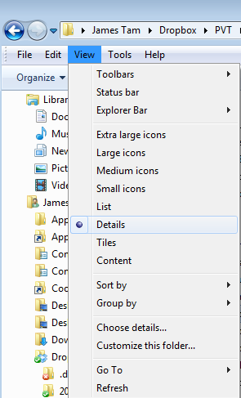
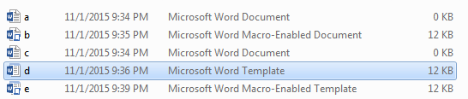
Viewing File Information
View details: select ‘view’ in a folder

Slide 58
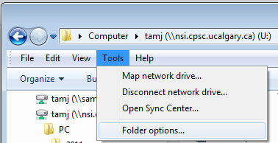
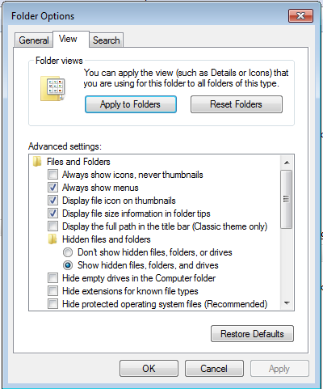

Viewing File Suffixes
In a folder select: Tools->Folder options
Under the ‘view’ tab uncheck ‘Hide extensions for known file types’

Slide 59
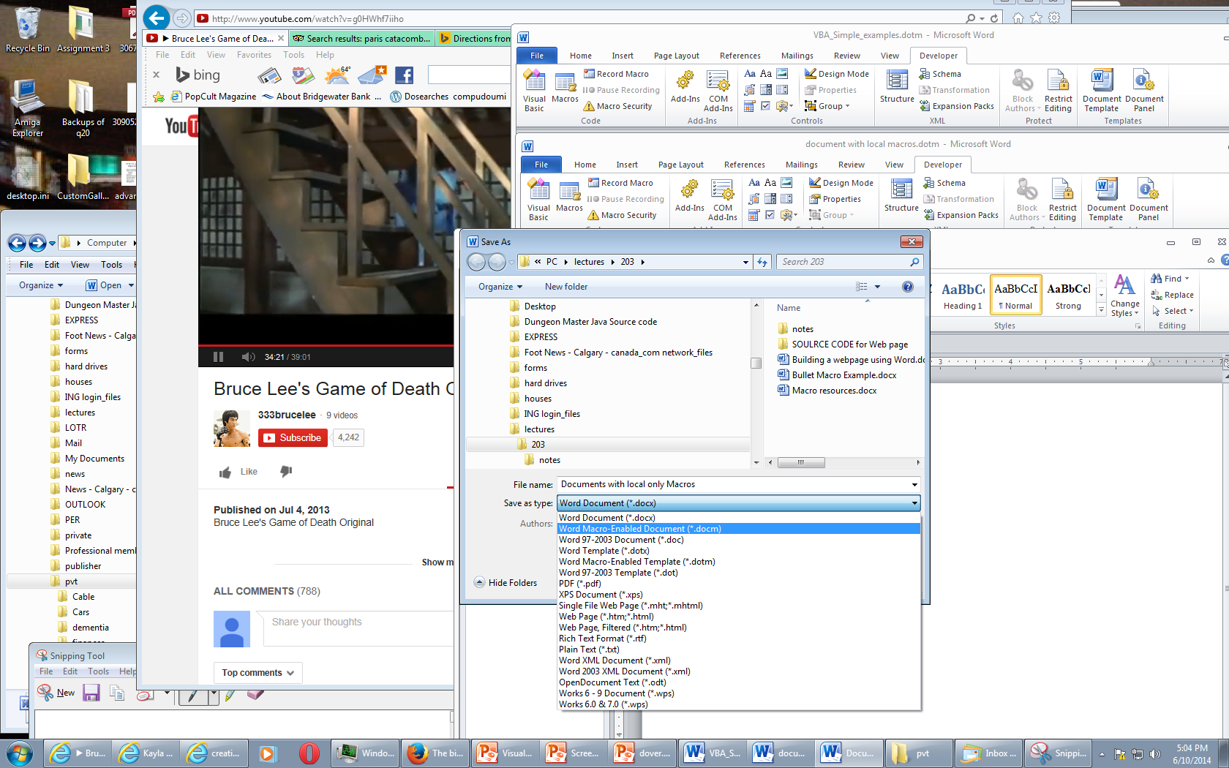
Transferring Your Macros (This Class)
If you create a macro-enabled MS-Word document (file name suffix “.docm”) then transfer the Word document itself.

Slide 60
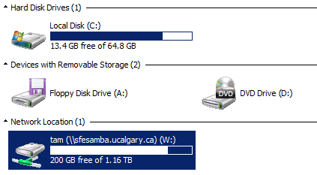
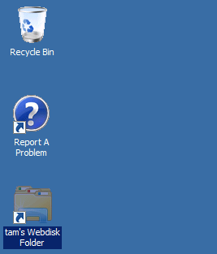
Transferring Your Macros (This Class): 2
In the 203 computer lab
Save the macro enabled word document to your portable USB flash drive
OR
Save the template document on your web disk drive
  To download files stored on web disk onto another computer: https://webdisk.ucalgary.ca/

Slide 61
More On Macro Security
A macro is a computer program that is attached to another program’s documents (e.g., MS-Word documents)
It can supplement the program’s features by automating repetitive tasks
But like another computer program the instructions can either be useful or malicious
  Security setting are specified in the MS-Office “Trust Centre”

Slide 62
Types Of Documents That Can Contain Macros
You store the macros that you write for this class this way
  In a single document ‘doc-m’ document
You can also store macros in these documents (not for this class but important to be aware in terms of computer security).
  Normal ‘dot-m’ template
  Custom ‘dot-m’ template

Slide 63
Question: What Is The Security Difference?
Opening the following documents:
  Document.docm
  Document.docx
  Document.doc

Slide 64
.DOCX (And .XLSX, .PPTX)
As mentioned these types of files cannot have macros attached to them.
  Reduced capabilities (no macros) but increased security (no macros)
Question: Are these files with these extensions 100% safe?

Slide 65
Message Box
(Details of the previous example)
Creates a popup window
Useful for testing
  Is my program working?
  Which part is running?
Also useful for displaying status messages about the current state of the program

Slide 66
Creating A Message Box
Format:
  MsgBox ("<Message to appear>")
Example:
  MsgBox ("Congratulations! This your first computer program")
Notes on ‘Format’:
Italicized: you have a choice for this part
Non-italicized: mandatory (enter it as-is)
Don’t type in the angled brackets (used to help you visually group)

Slide 67
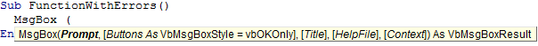
VBA Visual Aids: Function Arguments
As you type in the name of VB functions you will see visual hints about the arguments/inputs for the function.
  Enter the function name and then a space
Function arguments
(Bold): mandatory arguments

Slide 68
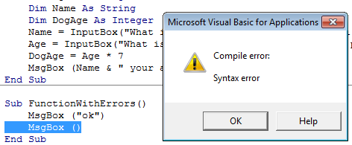

VBA Visual Aids: Error Information
Required argument missing
Part of program that contains errors (yellow highlight)
Specific statement/instruction causing the error (red font)

Slide 69



Real-World Objects
You are of course familiar with objects in the everyday world.
  These are physical entities
Each object is described by its properties (information)
Each object can have a set of functions associated with it (actions)

Slide 70
VBA OBject
Similar to everyday objects VBA-Objects have properties and actions
  Properties: information that describe the object
    E.g., the name of a document, size of the document, date modified etc.
  Capabilities: actions that can be performed (sometimes referred to as ‘methods’ or ‘functions’)
    E.g., save, print, spell check etc.

Slide 71
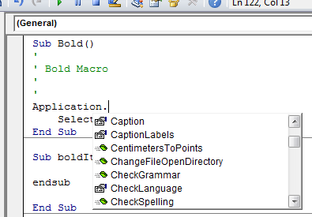
Common VBA Objects
Application: the MS-Office program running (for CPSC 203 it will always be MS-Word)
ActiveDocument
Selection
When enter one of these keywords in the editor followed by the ‘dot’ you can see more information.
Take advantage of the benefits:
The list of properties and methods is a useful reminder if you can’t remember the name
If you don’t see the pull down then this is clue that you entered the wrong name for the object

Slide 72
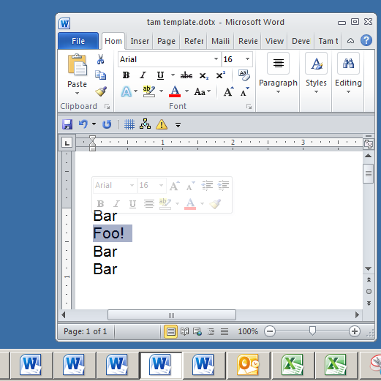
Example: What Are The Three Objects
Application:
  MS-Word
Current Document:
  “tamj template”
Selection
  “Foo!”

Slide 73
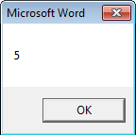
Using Pre-Built Capabilities/Properties Of Objects
Format:
  <Object name>.<method or attribute name>
Example:
  Sub ApplicationTest()
  MsgBox (Application.Windows.Count)
  End Sub
Application.Windows.Count
Property of Window:
Number
Accessing the Windows property of Word (the application)
Info about the windows currently opened
Object referred to: ‘Application’

Slide 74
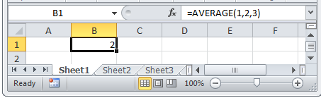
Properties Vs. Methods/Functions
Recall
  Property: information about an object
  Method: capabilities of an object (possible actions)
Property: current cell
Using the ‘average()’ function

Slide 75
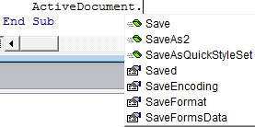
Properties Vs. Methods: Appearance
Methods
Property
Similar to functions in MS-Excel some object’s methods may require an argument or arguments
Examples
  ActiveDocument.CountNumberedItems
  ActiveDocument.Save
  ActiveDocument.SaveAs2("<name>")
No argument required
Argument: New name of document needed

Slide 76
More On Objects
This is only a very brief introduction on VBA objects
What you should now know
  The 3 common objects (application, active document, selection)
  Objects consist of attributes and methods and how to access/use them
As the need arises you will learn more about these objects (and perhaps others) in the next section

Slide 77
Basic Mathematical Operators
Operation | Symbol used in VBA | Example
Addition | + | 2 + 2
Subtraction | - | 3 – 2
Multiplication | * | 10 * 10
Division | / | 81 / 9
Exponent | ^ | 2 ^ 3

Slide 78
Variables
Used to temporarily store information at location in memory
Variables must be declared (created) before they can be used.
Format for declaration:
  Dim <Variable name> as <Type of variable>
Example declaration:
  Dim BirthYear as Long
Image curtesy of James Tam

Slide 79
Some Types Of Variables
Type of information stored | VBA Name | Example variable declaration | Default Value
Whole numbers | Long | Dim LuckyNumber as Long | 0
Real numbers | Double | Dim MyWeight As Double | 0
Chararacters¹ | String² | Dim Name As String | Empty string
Date³ | Date | Dim BirthDate As Date | 00:00:00
1) Any visible character you can type and more e.g., ‘Enter’ key
2) Each string can contain up to a maximum of 2 billion characters
3) Format: Day/month/year

Slide 80
Examples Of Assigning Values To Variables
Note: some types of variables requires some mechanism to specify the type of information to be stored:
Strings: the start and end of the string must be marked with double quotes "
Date: the start and end of the string must be marked with the number sign #
Dim LuckyNumber As Long
LuckNumber = 888
Dim BirthDay As Date
BirthDay = #11/01/1977#
Dim MyName As String
MyName = "James"

Slide 81


Variables: Metaphor To Use
www.colourbox.com
Think of VBA variables like a “mailslot in memory”
Unlike an actual mailslot computer variables can only hold one piece of information
  Adding new information results in the old information being replaced by the new information
Dim num as Long
num
num
num = 1
1
17
num = 17

Slide 82
Variables: Metaphor To Use (2)
  Also each computer variable is separate location in memory.
  Each location can hold information independently of other locations.
    Note: This works differently than mathematical variables!
    What is the result?
Dim num1 as Long
Dim num2 as Long
num1 = 1
num2 = num1
num1 = 2

Slide 83
MsgBox: Dislaying Mixes Of Strings And Variables
Format:
  MsgBox ("<Message1>" & <variable name>)
Example:
  Dim num as Long
  num = 7
  MsgBox ("num=" & num)
"num=" : A literal string
num: : contents of a variable (slot in memory)

Slide 84
Second Example: Basics Of Variables
Name of the online example: 2variablesMixedOutput.docm
  Sub secondExample()
  Dim num1 As Long
  Dim num2 As Long
  num1 = 1
  num2 = num1
  MsgBox ("num1=" & num1 & ", " & "num2=" & num2)
  num1 = 2
  MsgBox ("num1=" & num1 & ", " & "num2=" & num2)
  End Sub

Slide 85
Third VBA Example
Learning Objectives:
  Using variables
  Using mathematical operators

Slide 86
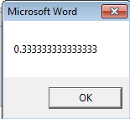
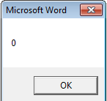
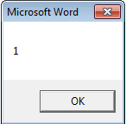
Third VBA Example (2)
  Word document containing the macro: 3types.docm
  Sub thirdExample()
  Dim RealNumber As Double
  Dim WholeNumber As Integer
  RealNumber = 1 / 3
  MsgBox (RealNumber)
  WholeNumber = 5 / 10
  MsgBox (WholeNumber)
  WholeNumber = 6 / 10
  MsgBox (WholeNumber)
  End Sub
JT’s note: Anything over 0.5 is rounded up

Slide 87
Student Exercise #1
What would appear as output (MsgBox) when the following VBA macro program was executed
Sub exercise1()
Dim num1 As Long
num1 = 1
MsgBox (num1)
num1 = num1 + 1
MsgBox (num1)
End Sub

Slide 88
Student Exercise #2
What would appear as output (MsgBox) when the following VBA macro program was executed
Sub exercise2()
Dim num1 As Long
Dim num2 As Double
num1 = 10
num2 = 10.5
MsgBox (num1 & "---" & num2)
num1 = num2 + 10
num2 = num1 * 2 / 3
MsgBox (num1 & "---" & num2)
End Sub

Slide 89
Variable Naming Conventions
Language requirements:
  Rules built into the Visual Basic (recall VBA is essentially Visual Basic tied to an MS-Office Application) language.
  Somewhat analogous to the grammar of a ‘human’ language.
  If the rules are violated then the typical outcome is the program cannot execute.
Style requirements:
  Approaches for producing a well written program.
  (The real life analogy is that something written in a human language may follow the grammar but still be poorly written).
  If style requirements are not followed then the program can execute but there may be other problems (e.g., it is difficult to understand because it’s overly long and complex - more on this during the term).

Slide 90
Naming Variables: VBA Language Requirements
Names must begin with an alphabetic character
  OK: name1 Not OK: 1name
Names cannot contain a space
  OK: firstName Not OK: first name
Names cannot use special characters anywhere in the name
  Punctuation: ! ? .
  Mathematical operators: + - * / ^
  Comparison operators: < <= > >= <> =

Slide 91
Naming Variables: Style Conventions
Style requirement (all languages): The name should be meaningful.
Style requirement (from the Microsoft Developer Network¹):
  Choose easily readable identifier names
  Favor readability over brevity.
Examples
#1:
age (yes)
x, y (no)
HorizontalAlignment (yes)
AlignmentHorizontal (no)
CanScrollHorizontally (yes)
ScrollableX (no)
1 http://msdn.microsoft.com/en-us/library/ms229045.aspx

Slide 92
Naming Variables: Style Conventions (2)
Style requirement: Variable names should generally be all lower case except perhaps for the first letter (see next point for the exception).
Style requirement: For names composed of multiple words separate each word by capitalizing the first letter of each word (save for the first word) or by using an underscore. (Either approach is acceptable but don’t mix and match.)
Avoid using keywords as names (next slide)
Examples
#3:
age, height, weight (yes)
HEIGHT (no)
#4
firstName, last_name
(yes to either approach)

Slide 93
Some Common Visual Basic Keywords¹
And Boolean Call Case Catch Continue
Date Decimal Default Dim Do Double
Each Else End Erase Error Event
Exit False Finally For Friend Function
Get Global Handles If In Inherits
Integer Interface Is Let Lib Like
Long Loop Me Mod Module Next
Not Nothing Of On Operator Option
Optional Or Out Overrides Partial Private
Property Protected Public Resume Return Select
Set Shadows Short Single Static Step
Stop String Sub Then Throw To
True Try Using Variant When While
Widening With
1 The full list can be found on the MSDN http://msdn.microsoft.com/en-us/library/dd409611.aspx
Notes:
93

Slide 94
Variable Naming Conventions: Bottom Line
Both the language and style requirements should be followed when declaring your variables.

Slide 95

Obtrusive Popup Windows/Messages
Great! I’ve got the info that I need.

Slide 96
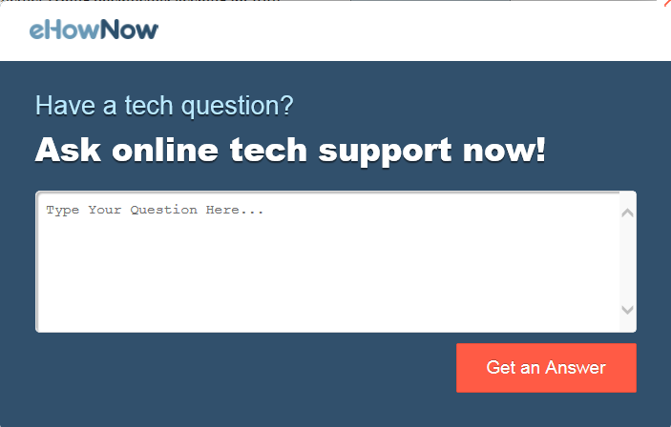
Obtrusive Popup Windows/Messages
Hey I was reading that

Slide 97

Alternate To Using Popup Messages

Slide 98


An Alternate To The MsgBox: The Title Bar
Finding the MsgBox popups too obtrusive?
You can display messages in a more subtle fashion by changing the title bar.
Before
After

Slide 99
Changing The Title Bar
Format:
  ActiveDocument.ActiveWindow.Caption =
  "<New text for the title bar>"
Word document containing the macro: 4titleBar.docm
  Sub firstTitleBarExample()
  ActiveDocument.ActiveWindow.Caption = "A NEW TITLE!"
  End Sub

Slide 100

Comparison: Popups Vs. Status Messages
Popup dialogs:
  Often used for important messages that you don’t want the user to miss
  Overuse can simply result in the user “clicking past” the dialog without reading them
Status messages:
  More subtle presentation of information.
  Easy to miss.
  Multiple updates result in only the last change appearing to the user

Slide 101

Missing The Message
  Word document containing the macro: 5titleBarV2.docm
  Sub secondTitleBarExample()
  Dim num1 As Integer
  Dim num2 As Integer
  num1 = 666
  num2 = 888
  ActiveDocument.ActiveWindow.Caption = num1
  ActiveDocument.ActiveWindow.Caption = num2
  End Sub

Slide 102

Getting User Input
A simple approach is to use an Input Box
Format:
  <Variable name> = InputBox(<"Prompt">, <"Title bar">)
Example:
  Name = InputBox("What is your name"), "Getting Personal")
Note: only the string for the prompt is mandatory.
If the title bar information is omitted then the default is the application name (“Microsoft Word”)

Slide 103



Example: InputBox
Learning: getting user input with an InputBox
Word document containing the macro: 6inputBox.docm
  Sub InputExample()
  Dim Age As Integer
  Dim Name As String
  Dim DogAge As Integer
  Name = InputBox("What is your name", "Getting personal: name")
  Age = InputBox("What is your age", "Getting even more personal: age")
  DogAge = Age * 7
  MsgBox (Name & " your age in dog years is " & DogAge)
  End Sub
  Note: there are two input boxes, one that prompts for the name and the other for the age. Each is given a self-descriptive name to distinguish them (an example of good programming style – more on this shortly)

Slide 104


The VBA Debugger
Debuggers can be used to help find errors in your program
Setting up breakpoints
  Points in the program that will ‘pause’ until you proceed to the next step
  Useful in different situations
    The program ‘crashes’ but you don’t know where it is occurring
      Pause before the crash
    An incorrect result is produced but where is the calculation wrong
Set up breakpoints
  Click in the left margin

Slide 105





The VBA Debugger (2)
Multiple breakpoints
Program pauses when breakpoints are reached
  The contents of variables can be displayed at that point in the program

Slide 106
The VBA Debugger (3)
Because the VBA debugger is interactive it’s best to see the results live in “real time”
So you will see more on the debugger in tutorial

Slide 107
Break Points: Final Note
They only meant as a temporary mechanism for finding the errors in your program.
  (Having them ‘permanently’ included with the program would be a nuisance because it will pause at each break point).
Consequently break points are not saved either with: the document, template or the VBA program

Slide 108

Review: Lookup Tables (For Constants)
Excel: Lookup tables are used to define values that do not typically change but are referred to in multiple parts of a spreadsheet.

Slide 109
Named Constants
They are similar to variables: a memory location that’s been given a name.
Unlike variables their contents cannot change.
The naming conventions for choosing variable names generally apply to constants but constants should be all UPPER CASE. (You can separate multiple words with an underscore).
  This isn’t a usual Visual Basic convention but since it’s very common with most other languages so you will be required to follow it for this class.
Example CONST PI = 3.14
  PI = Named constant, 3.14 = Unnamed constant
They are capitalized so the reader of the program can quickly distinguish them from variables.

Slide 110
Declaring Named Constants
1 The expression can be any mathematical operation but can’t be the result of a function call
Format:
  Const <Name of constant> = <Expression>¹
  JT: it’s preceded by the keyword ‘const’ to indicate that it is a constant
Example:
  Sub ConstantExample()
  Const PI = 3.14
  End Sub

Slide 111
Why Use Named Constants
No ☹
Yes ☺
They can make your programs easier to read and understand
Example:
  Income = 315 * 80
Vs.
  Income = WORKING_DAYS_PER_YEAR * DAILY_PAY

Slide 112
Predefined Constants: MS-Word
Microsoft uses their owning naming convention
Example:
  wdPromptToSaveChanges
Usage:
  ActiveDocument.Close(wdPromptToSaveChanges)

Slide 113

Closing Documents
Default action when closing a MS-Word document that has been modified
VBA code to close a document in this fashion:
  ActiveDocument.Close (wdPromptToSaveChanges)
Pre-defined constant

Slide 114
More Pre-Defined Constants: Closing Documents
Word document containing the macro: “7closingActions.docm”
  Sub ClosingActions()
  ActiveDocument.Close (<Constant for closing action>)
  End Sub
'Choose one constant
wdPromptToSaveChanges
wdDoNotSaveChanges
wdSaveChanges

Slide 115
Formatting Text
Allows formatting changes to be applied to the text in a Word document:
  Examples: bold, underline, font type, font size
Some approaches:
  Apply the formatting changes to the entire document
  Apply the formatting changes to select parts of the document

Slide 116

Formatting An Entire Document
You first need to indicate the document to be formatted
This can be done through the ‘ActiveDocument’ object
Then choose the ‘Select’ method of that document.
  Review: it’s a method and not a property because it applies an action: select = selecting the text of the entire document

Slide 117
Active Document: Which One?
Remember: the active document is the one you are currently working on.
When writing VBA programs this can be tricky to determine.
So it’s best to work with only a single document at a time when writing your programs.

Slide 118
Formatting Text: An Example
Suppose you want to format a document in the following way
Entire document
  Font = Calibri

Slide 119
Formatting: Entire Document
As mentioned the entire document can be selected.
Now for the ‘selected text’ (in this case it’s the whole document) access the ‘Font’ property and the ‘Name’ property of that font and give it the desired name.
Word document containing the macro: 8formattingEntireDocument.docm
ActiveDocument.Select
Selection.Font = Calibri
Sub formattingEntireDocument()
ActiveDocument.Select
Selection.Font.Name = "Calibri"
End Sub

Slide 120

Formatting The Text Currently Selected
This can be done through the ‘Selection’ object
This object accesses the text in a document that has been selected

Slide 121

Changing Selected Text
Word document containing the macro: 9cutAndPaste.docm
  Learning concepts: editing selected text, cutting and pasting text, using constants
Sub cutAndPaste()
Selection.Expand
Selection.Copy
Selection.MoveRight
Selection.PasteAndFormat
(wdFormatOriginalFormatting)
End Sub
A predefined constant
Another is “wdFormatPlainText”

Slide 122

Student Exercise #3
What would happen to the following document…
…if the following macro was executed?
Sub exercise2()
Selection.Expand
Selection.Copy
Selection.MoveRight
Selection.PasteAndFormat (wdFormatPlainText)
End Sub

Slide 123
Formatting Selected Text: Multiple Changes
Desired formatting:
  Font size = 14 point
  Bold
  Underline
  Center the heading
  6 point spacing after the heading
Word document name: 10formattingSelectedTextMultiple.docm
Sub formattingHeadings()
Selection.Font.Size = 14
Selection.Font.Bold = True
Selection.Font.Underline = True
Selection.ParagraphFormat.Alignment =
wdAlignParagraphCenter
Selection.ParagraphFormat.SpaceAfter = 6
End Sub

Slide 124


Effect
Before:
After

Slide 125


Formatting Selected Paragraphs
Desired formatting:
  Font size = 10 point
  Left and right margins indented by 0.2 inches
Word document: 11formattingSelectedParagraphs.docm
Sub formattingParagraphs()
Selection.Font.Size = 10
Selection.Font.Bold = True
Selection.ParagraphFormat.LeftIndent = InchesToPoints(0.2)
Selection.ParagraphFormat.RightIndent = InchesToPoints(0.2)
End Sub

Slide 126
What’s The Difference?
‘ First example
Selection.Font.Bold = wdToggle
‘ Part of the example just covered
Selection.Font.Bold = True

Slide 127
Advanced Concept: What If there Is No Selection?
The VBA program attempts to format the currently selected text but there is ‘no’ selection.
(Rhetorical questions - for now)
  What will happen?
  What modifications can be made to the program to handle this case?

Slide 128
Formatting: Recap
Formatting the entire document: access the ActiveDocument object
Formatting the currently selected text: access the Selection object
Then select the property of the selection that you wish to set/change
Example: changing font of selected text
  Now for the ‘selected text’ (in this case it’s the whole document) access the ‘Font’ property and the ‘Name’ property of that font and give it the desired name.
ActiveDocument.Select
Selection.Font = Calibri

Slide 129
Printing: Single
Printing a single document (currently opened, active MS-Word document)
  Word document containing the macro example: “12singleDocumentPrint.docm”
  Sub PrintSingleDocument()
  ActiveDocument.PrintOut
  End Subs

Slide 130

Program Documentation
Instructions for the computer
(Computer): problem, I don’t know how to “James Tam”
Your VBA assignment submission must include identification information:
  Full name
  Student identification number
  Tutorial number
  List the program features (from the assignment description) and clearly indicate if the feature was completed or not completed.
DON’T just enter this information into your program instructions

Slide 131
Program Documentation (2)
You must ‘mark’ this information so it doesn’t cause an error
  The marking will indicate to the VBA translation mechanism that the line is for the reader of the program and not to be translated and executed
  The marking is done with the single quote '
Format:
  ' <Documentation>
Example:
  ' Author: James Tam
No error: Everything after the quote until the end of the line will not be translated into machine language/binary
That means documentation doesn’t have to be a valid and executable instruction

Slide 132

Program Documentation (3)
Contact information should be located before your program
Before the ‘sub’ keyword
Documentation: marked in red

Slide 133

Program Documentation (4)
Program features (this will be worth many marks)
Assignment description
Program documentation
  ' Author: James Tam ID: 123456
  ' Version: Nov 2, 2015
  ' Tutorial: 99
  ' PROGRAM FEATURES
  ' Word search and replace: completed
  ' Style search and replace: not completed
  etc

Slide 134

Built In Search/Help

Slide 135
Another Source Of Help
The macro recorder!
Although you are writing your programs manually (typing them in) you can use the macro recorder to help you determine which objects, methods and properties are needed for a particular task.
Example (from toggling bold and italic font):
  Selection.Font.Italic = wdToggle
  Selection.Font.Bold = wdToggle

Slide 136
Recorded Macros
Sometimes the auto generated code is too complicated to be useful
  Toggle bold, italic, printed document
Sub Macro3()
Selection.Font.Bold = wdToggle
Selection.Font.Italic = wdToggle
Application.PrintOut FileName:="",
Range:=wdPrintAllDocument, Item:= _
wdPrintDocumentWithMarkup, Copies:=1, Pages:="",
PageType:= _
wdPrintAllPages, Collate:=True, Background:=True,
PrintToFile:=False, _
PrintZoomColumn:=0, PrintZoomRow:=0,
PrintZoomPaperWidth:=0, _
PrintZoomPaperHeight:=0
End Sub

Slide 137
After This Section You Should Know
The history and background behind VBA
How to copy and run the pre-created lecture examples
How to create and execute simple VBA macros
  Automatically recording macros
  Manually entering programs into the VB editor yourself
How to create/use a Message Box “MsgBox”
How the VB editor identifies programming errors
What is a VB object, how to use the properties and methods of objects
How to use basic mathematical operators in VB expressions
How to create and use variables
How to use the title bar to display information

Slide 138
After This Section You Should Know (2)
What is a named constant, why use them (benefits)
What is a predefined constant and what are some useful, commonly used predefined constants
Naming conventions for variables and constants
What are commonly used variable ‘types’ in VB
How to get user input with an Input Box “InputBox”
How/why use the VB debugger
Common formatting effects that can be applied to an entire document or selected parts
How to create program documentation (as well contact information that should be included in documentation)

Slide 139
After This Section You Should Now Know (3)
The security settings in the MS-Office “Trust Center”
How different types of MS-Word documents have different levels of security
How to print the currently active Word document using a macro

