Slide 1

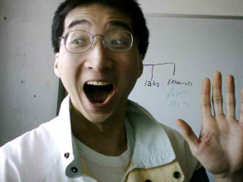
Assignment Overview
Pursuer class
Manager (functions)
Target class
Attributes:
Number of “X’s”
Number of “Y’s”
Probability of “X’s”
Probability of “Y’s”
Tally of successful interactions
Methods:
Initialization constructor
Ability to determine Pursuer’s behavior during an interaction
Display report: after each interaction
Display report: at very end
Attributes:
Number of “X’s”
Number of “Y’s”
Probability of “X’s”
Probability of “Y’s”
Methods:
Initialization constructor
Ability to determine Target’s behavior during an interaction
Responsibilities:
  Gets required information from the user (number interactions, probability of X-behavior).
  Creates the Pursuer and Target
  Runs the Pursuer’s and Target’s methods at the appropriate time.
  Runs the simulated date for the specified number of interactions.

Slide 2


Each Round Of Interaction
Pursuer and the Target each determine the type of behavior exhibited (‘X’ or ‘Y’)
Match = success
No. success!
Mismatch = failure

Slide 3

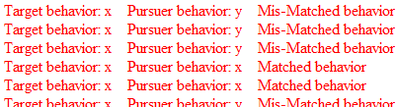

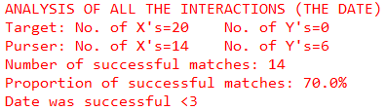
Role Of The Manger
Runs the specified number of interactions
For each interaction round:
The Manager tells the Pursuer and Target to run appropriate behaviors for an interaction
Creates Pursuer and Target
Near the end of the simulation (interactions finished) the manager tells the Pursuer to generate the final report
Prompts the user for the required information (# interactions, probability of ‘X-behaviors’ (Target)

