Slide 1
Networking & Security
Peeking into Computer Science

Slide 2
Reading Assignment
Mandatory: Section 6.2

Slide 3
Secure Channels & Authentication

Slide 4
Objectives
By the end of this section, you will be able to
List and explain the three types of threats
List and explain the two types of security mechanisms
Explain and contrast the two types of cryptosystems
List at list 4 components of a digital certificate
Explain how the Secure Socket Layer (SSL) work

Slide 5



JT: Test Of Your Security Savviness
You get a file attachment in a message, from which of the following people would should you accept it and why?
???
A total stranger
Someone you only know online
Your best friend (forever)
This guy!!!

Slide 6

JT: How To Be 100% Virus Safe
Leave them off all the time
Disconnect your computer and all devices from the Internet
Put your electronics in a vault

Slide 7
JT: Lesson Learned
You are never guaranteed to have 100% protection.
What taking precautions (e.g., getting anti-virus software) provide is a reduced chance of an infection or other security-related problem.

Slide 8
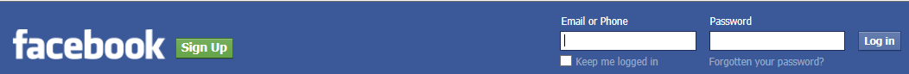

JT: When A Threat Can Occur
Recall that there are two web interactions previously covered:
  GET: click on a link
  POST: sending information on the web
    During a POST operation using regular web protocols:
    …whatever information you post (information you have filled in) may be intercepted.
    “Packet sniffing” (viewing contents):
    http://www.wikihow.com/Sniff-Packets

Slide 9

Types of Threats
Interception
  an unauthorized party obtains access to messages, data, or services
JT’s packets

Slide 10


Types of Threats
Modification
  unauthorized change of messages, data, or services
Steals your information
Your bank’s website
Fake copy of banking website
JT: This is a change in a DNS service that redirects web requests

Slide 11
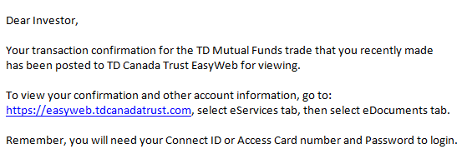
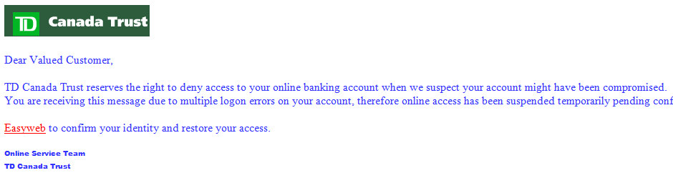
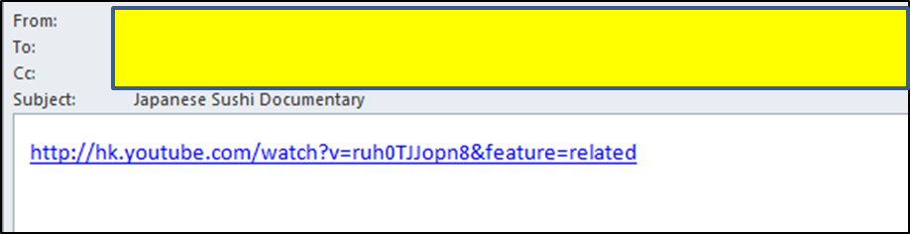
Types of Threats
Fabrication
  unauthorized creation of messages, data, or services
    JT: Real or fake?

Slide 12
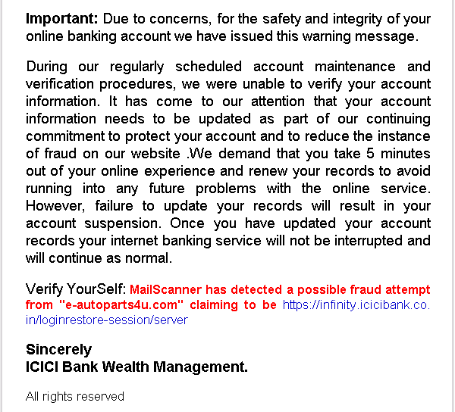

Slide 13
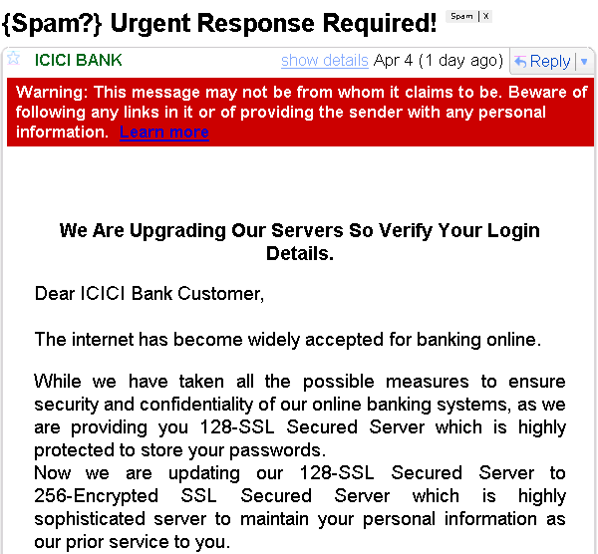

Slide 14
Security Measures against Threats
Encryption
  encode data and messages so that only intended parties can decode them
Authentication
  verify that the claimed identity by some party is authentic

Slide 15
JT: Encryption
‘Scrambling’ information so it cannot be easily interpreted.
Example:
  Original message: MARY HAD A LITTLE LAMB
  Encrypted message: LZQX GZC Z KHSSKD KZLA

Slide 16
Encryption
Sender
Receiver
Encrypt P
Decrypt C
P
C
C
P
SEND
RECV
Network
C

Slide 17
Julius Caesar
Julius Caesar had a method to encrypt text
ISHDTMOIWEDTAWI.
ISHD
TMOI
WEDT
AWI.
The message: IT WAS ME WHO DID IT.

Slide 18
Naïve Encryption Example
Plain text: CPSC 203
Encryption: scramble the plain text
Cipher text: 0S2PC3 C

Slide 19
Naïve Encryption Example
1 | 2 | 3 | 4 | 5 | 6 | 7 | 8
C | P | S | C |  | 2 | 0 | 3
Plain text
1 | 2 | 3 | 4 | 5 | 6 | 7 | 8
7 | 3 | 6 | 2 | 1 | 8 | 5 | 4
Permutation
Key
1 | 2 | 3 | 4 | 5 | 6 | 7 | 8
0 | S | 2 | P | C | 3 |  | C
Cipher text

Slide 20
Interception
Sender
Receiver
P
P
SEND
RECV
Network
C

Slide 21
Modification
Sender
Receiver
P
SEND
Network
C

Slide 22
Modification
Sender
Receiver
P
SEND
RECV
Network

Slide 23
Fabrication
Receiver
RECV
Network

Slide 24
Notes
Key must be secretly shared between sender and receiver
This naïve approach can be cracked
  Not good encryption algorithm
In real life, encryption is done at the bit-level
In real life, encryption algorithms are far more complex and are more difficult to crack

Slide 25
JT: Problem With Permutation Keys
Permutation keys just use different permutations (ordering) of existing characters.
  Original message: Newton
  Encrypted message: Notwen
The number of possibilities is very limited making it easier to crack.

Slide 26
Why Permutation Keys are Bad
C = amd
Not sure yet what the key is:
a couple more cipher texts,
it can be cracked
amd
adm
mad
mda
dam
dma
3! possibilities
20! is
2,432,902,008,176,640,000
Even larger messages can be
cracked given enough resources

Slide 27
JT: The Number Of Guesses Can Be Reduced
Encryption is used to secure information e.g., financial, national defense, intelligence.
Sometimes to speed up the decryption process only valid combinations will be attempted.
Previous example: AMD
In English the only valid combinations that need be examined: MAD, DAM
  At first 3! attempts needed, this gets reduced down to 2 attempts needed.

Slide 28
JT: Longer/Complex Passwords Are Better For A Reason
More combinations means it’s harder to guess
  Either it takes longer to crack or if it’s long and complex enough (with a good encryption algorithm) it will be practically impossible to try all combinations (sometimes tens of thousands of years).
Guidelines for picking good passwords:
  http://www.ucalgary.ca/it/help/articles/security/awareness/passwords

Slide 29
Types of cryptosystems
Symmetric or shared-key
  Sender and receiver use the same secret key
Asymmetric or public-key:
  Each part has a pair of keys: public and private
  Public keys are published
  Private keys are kept secret

Slide 30
JT: Why Bother?
Many methods of communication are not secure!
  E.g., Email, instant messaging, http
  Third parties may view the contents
  Administrators of the intermediate computers between the sender and transmitter who have the desire (and a bit of technical knowledge can view the information)

Slide 31
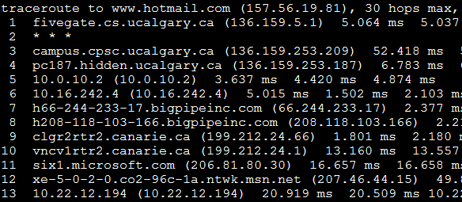
JT: Why Bother?
Example communication (my office computer to Microsoft’s Hotmail server)

Slide 32
JT: Public-Private Key Encryption
There are two levels of security
In the example that follows (securing the contents of a message):
  The public key:
    Anyone who wants to send the receiver a message can access it
    Used to encrypt the data
    It is sent along with the data
  The private key
    Only the receiver has a copy (should be kept inaccessible)
    Decrypts the message for the receiver

Slide 33
Public-Key Cryptosystem Example
I have a collection of combination locks
All are identical and can be unlocked by the same code
I distribute the locks to my friends
But I keep the code to myself (private)

Slide 34
Public-Key Cryptosystem Example
If Alice wants to send me a secure message
She puts the message into a box
Locks the box with my combination lock and sends it to me
Who can open the box?

Slide 35
Public-Key Cryptosystem Example
The combination lock is the public-key
The code to unlock it is the private-key

Slide 36
JT: Private-Public Keys In Practice
My computer
  It has a public key and a private key
  The private key is retained on my computer
  The public key is provided to any computer that needs to establish a secure connection with my computer.
  Other computers can use that public key to encrypt messages sent to my computer.
  Only my computer can use that private key to decrypt messages sent to it.

Slide 37
Public and private keys
    X’s public key is denoted K_{X}⁺
    X’s private key is denoted K_{X}⁻
K_{X}⁺ and K_{X}⁻ are reciprocal
  JT: Normally done this way
    Cipher text:
    Plaintext:
  JT: Normally NOT done this way (it’s just included to be complete)
    Cipher text:
    Plaintext:
Sender
C = Encrypt(P, K_{X}⁺)
P = Decrypt(C, K_{X}⁻)
Receiver
Sender
C = Encrypt(P, K_{X}⁻)
P= Decrypt(C, K_{X}⁺)
Receiver

Slide 38
Asymmetric encryption
Sender S, receiver R
S sends R the secure message
Only R knows K_{R}⁻ and can decrypt C
C = Encrypt(P, K_{R}⁺)
P = Decrypt(C, K_{R}⁻)

Slide 39
JT: Symmetric Encryption
FYI: this has already been covered.
In this case both the sender and the receiver share the same private key (encryption algorithm e.g., Caesar cipher shift alpha letter forward by one).

Slide 40
JT: Employing Private-Public Key Encryption On Your Computer
There are many implementations
  Some are free and work fairly well (pretty good level of privacy: PGP)
  They can be used to encrypt many things e.g., email, files on your computer
  Example: http://www.pgpi.org/

Slide 41
Authentication
Encryption alone is not enough
Need to verify claimed identity
  JT: if a public key is used to encrypt a message and that public key can be accessed how can you tell if that message really came from a particular source?
Authenticate that a certain Web site is what it claims to be
  Phishing (fabrication threat)

Slide 42
JT: Authentication In Practice
The message to be sent is still encrypted using the recipient computer’s public key (and only the recipient computer’s private key can decode it).
To authenticate my computer (prove that the message was sent by me – recall any computer can send a message to someone with a private-public key combination)
  More encryption must occur!

Slide 43
JT: Authentication In Practice (2)
This is Tam’s secret message
Step 1: Encrypt message (no one can read or modify the message)
  My computer encrypts message using recipient computer’s public key
Step 2: Prove the message came from me (protect against phishing fabrication attempts)
  My computer encrypts a digital signature using a private key
  The recipient computer uses a corresponding public key to view the digital signature.

Slide 44
JT: Authentication In Practice (3)
  My computer is the only one can encrypt the digital signature with that private key
  Properly implemented digital signatures are more difficult to forge than a handwritten signature.

Slide 45
Asymmetric Authentication
R needs to authenticate S
S sends R message:
  ds is a digital signature
  If
  R authenticates S
[P, ds]
ds = Encrypt(S, K_{S}⁻)
JT: S = Proof of source
Decrypt(ds, K_{S}⁺) == S
JT: Step 2 encrypt the digital signature using sender’s private key
(later the receiver will decrypt the signature using the sender’s public key)

Slide 46
Asymmetric Authentication
The message is insecure
S sends
  Only R can decrypt the message
  R can then authenticate S
[S, ds]
Encrypt([S, ds], K_{R}⁺)
JT: Step 1 encrypt the plain text message using receiver’s public key
(later the receiver will decrypt the message using the receiver’s private key)

Slide 47
JT: Summary (Encrypting Message And Authenticating The Source)
Encryption must be used twice for:
  The digital signature
  The message to be sent

Slide 48
JT: Summary (Authenticating The Source)
To verify the source of a message
  A digital signature is created from the document to be sent
  The sender uses a private key to encrypt the digital signature
  The receiver can use the sender’s public key to de-crypt the signature
  The sender is the only one who has the private key

Slide 49
JT: Summary (Protecting The Message)
This is Tam’s secret message
To prevent unauthorized viewing/tampering of the message being sent encrypt it:
  The sender uses the public key of the receiver
  The receiver uses his/own private key to decrypt the message
  The receiver is the only one with a copy of the private key
Vijt jt Ubn’t tfdsfu nfttbhf
This is Tam’s secret message

Slide 50
The Secure Socket Layer
WWW’s security

Slide 51
Digital Certificates
Special message sent from a server S to a client B (browser)
Allows B to authenticate S
Provided by certification authorities
  For a fee

Slide 52
Digital Certificates
Includes:
S’s public key K_{S}⁺
S’s identity (host name part of URL)
Expiration date for DC
Name of the CA
Serial number
Digital signature ds (JT: again it’s generated via the sender’s - in this case the website – private key)
  ds = ENCRYPT(S, K_{CA}⁻)
Other things

Slide 53
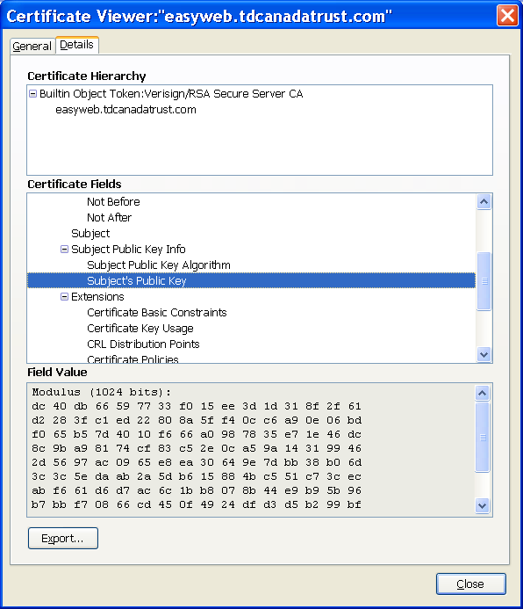

Slide 54
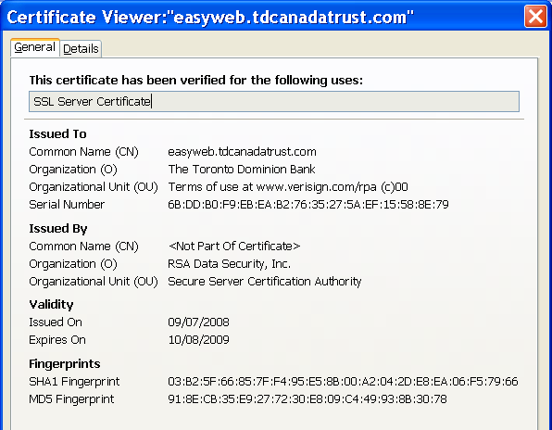
Viewing a DS in FireFox

Slide 55
JT: Where Are Digital Certificates Used?
As mentioned they can be used to ensure that you are viewing the intended website.
  You haven’t been re-directed to another website by a malicious program)
  You haven’t mistakenly typed in the wrong URL.
    Sometimes occurs when you try to get the “Canadian” version of a website
    Instead of www.companyname.com
    You type: www.companyname.ca

Slide 56
JT: Where Are Digital Certificates Used? (2)
Ensuring that software comes from the intended source.
Also it can be used that software has not been altered.
  Example: the developer provides a free download but someone else has modified the program to include a malicious component.
    How do you know if downloadable versions of familiar software is safe?
  Example of digital certificates for programs (software developers)
    http://support.microsoft.com/kb/206637

Slide 57
Secure Socket Layer (SSL)
Turned on by HTTPS
Browser and server establish secure channel
Browser authenticates server
  Uses digital certificate

Slide 58
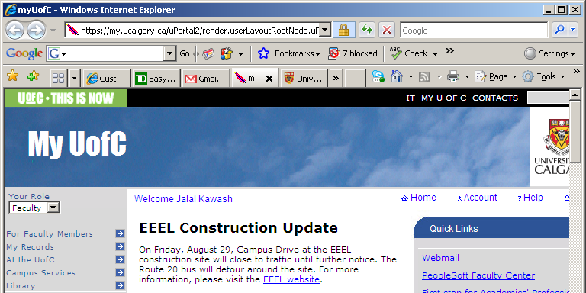
HTTPS

Slide 59
B
S
1
https – request secure connection
send [K_{S}⁺, S , ed, CA, sn, ds]
2
3
K’_{B,S} ← ENCRYPT(K_{B,S} ,K_{S}⁺);
send K’_{B,S}
C₁ ← ENCRYPT(P₁, K_{B,S}); send C₁
4
5
C₂ ← ENCRYPT(P₂, K_{B,S}); send C₂
. . .
Dispose K_{B,S}; close connection

Slide 60
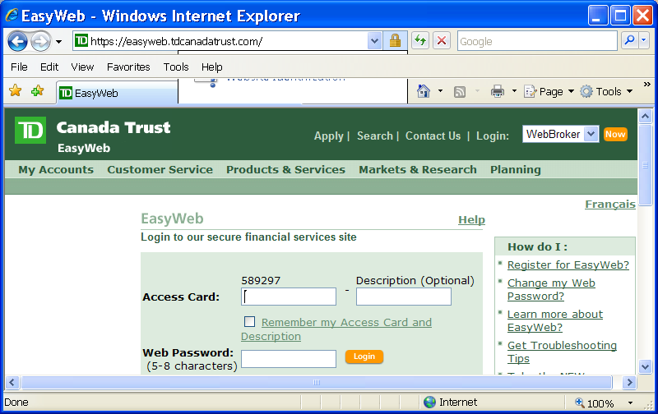
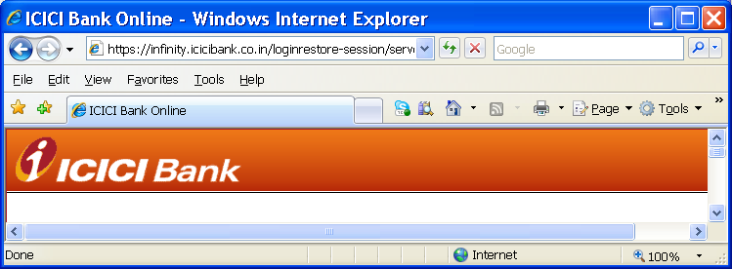
Internet Explorer

Slide 61
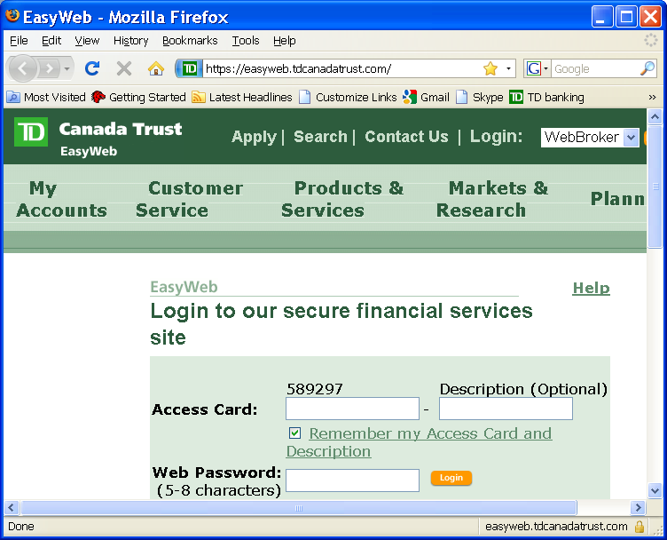
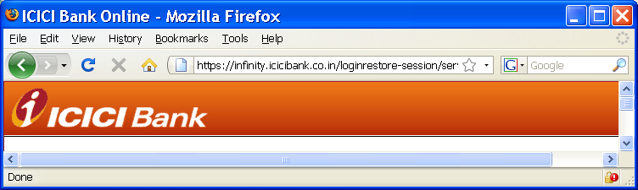
Fire Fox

Slide 62
Firewalls
Protect your Computers

Slide 63
Firewalls
Firewall: a monitor program dedicated to “external” access control
All communication in and out of the intranet (JT: local network) with the external world are inspected by the firewall
  Unauthorized traffic is blocked

Slide 64
Firewalls
A firewall must be highly secure
Firewalls are often implemented at two levels:
Packet-filtering gateway
  Firewall examines the FROM and TO fields in a packet’s header
  Example: block access to an internal Web site
Application-level gateway
  Firewall examines the CONTENTS of messages
  Example: filtering spam mail

Slide 65
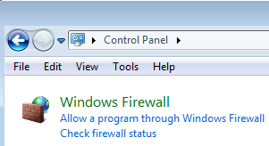
JT: Types Of Firewalls
Firewalls may be included in hardware (built into network routers) or software

Slide 66
JT: Firewalls (Practical Application)
Firewalls can be used to customize ports
  Ports that have been maliciously probed from the Internet may be disabled
  For certain communications non-standard ports may be used instead e.g., UC-IT uses port 465 instead of 110 because many ‘spam’ programs send junk mail using #110.

Slide 67
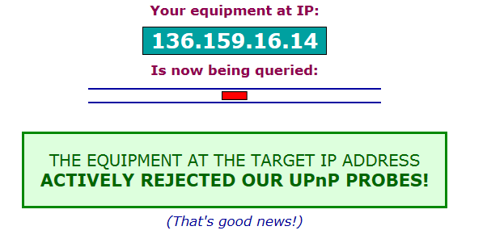
JT: Evaluating The Security Of Your Connection
  Example: “Shields up” https://www.grc.com/x/ne.dll?bh0bkyd2

