Slide 1
Networking & Security
Peeking into Computer Science

Slide 2
Reading Assignment
Mandatory: Section 6.1

Slide 3
Basics of Networking – The Internet

Slide 4
Objectives
By the end of this section, you will be able to
Define the Internet and name its components
Describe the protocols of the Internet (TCP/IP and UDP)
Differentiate between connection-oriented and connectionless protocols

Slide 5
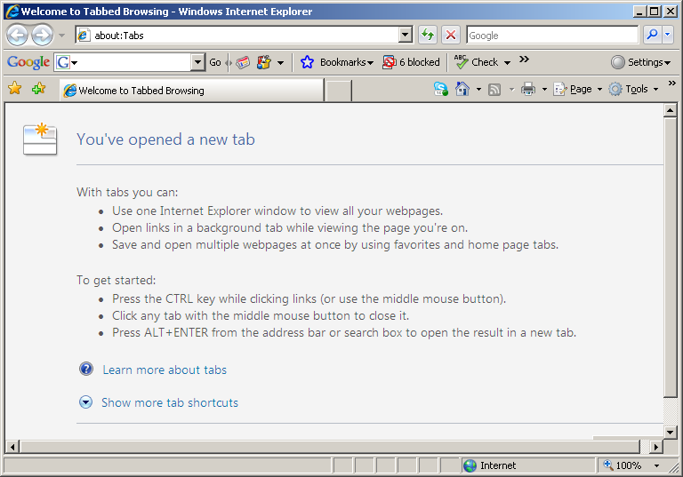
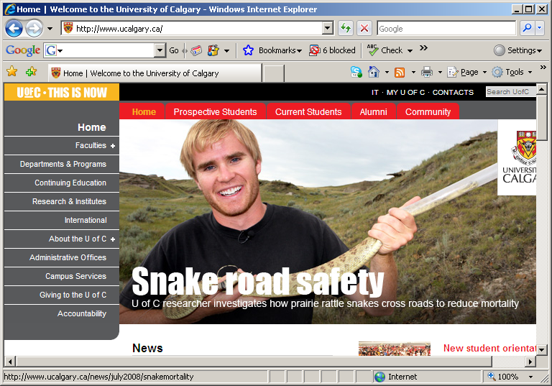
Browsing
www.ucalgary.ca
Your Computer

Slide 6
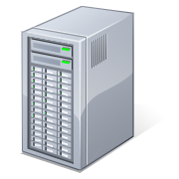
What Happened?
Request a page
Respond with page
Your Computer
U Calgary
Web Server

Slide 7
JT: Early Note About Security
Similar to how a web page can be downloaded, computer software can also transfer to your computer and execute after you visit a website.
Software can enhance a website (e.g., ‘apps’ for a sites such as Facebook):
    https://developers.facebook.com/docs/other-sdks

Slide 8
JT: Early Note About Security
Of course not all software is beneficial
‘Malicious’ websites:
  Going to these sites may result in ‘malware’ or malicious software being downloaded and executed on your computer or mobile device.
  Google reporting link:
    http://www.google.com/safebrowsing/report_badware/
  Symantec database:
    http://www.symantec.com/threatreport/topic.jsp?id=threat_activity_trends&aid=malicious_website_activity
  McAfee database:
    http://www.siteadvisor.com/webmasters/index.html
  Note: it’s not always obvious which sites are risky to visit!
    Legitimate websites could get ‘hacked’

Slide 9
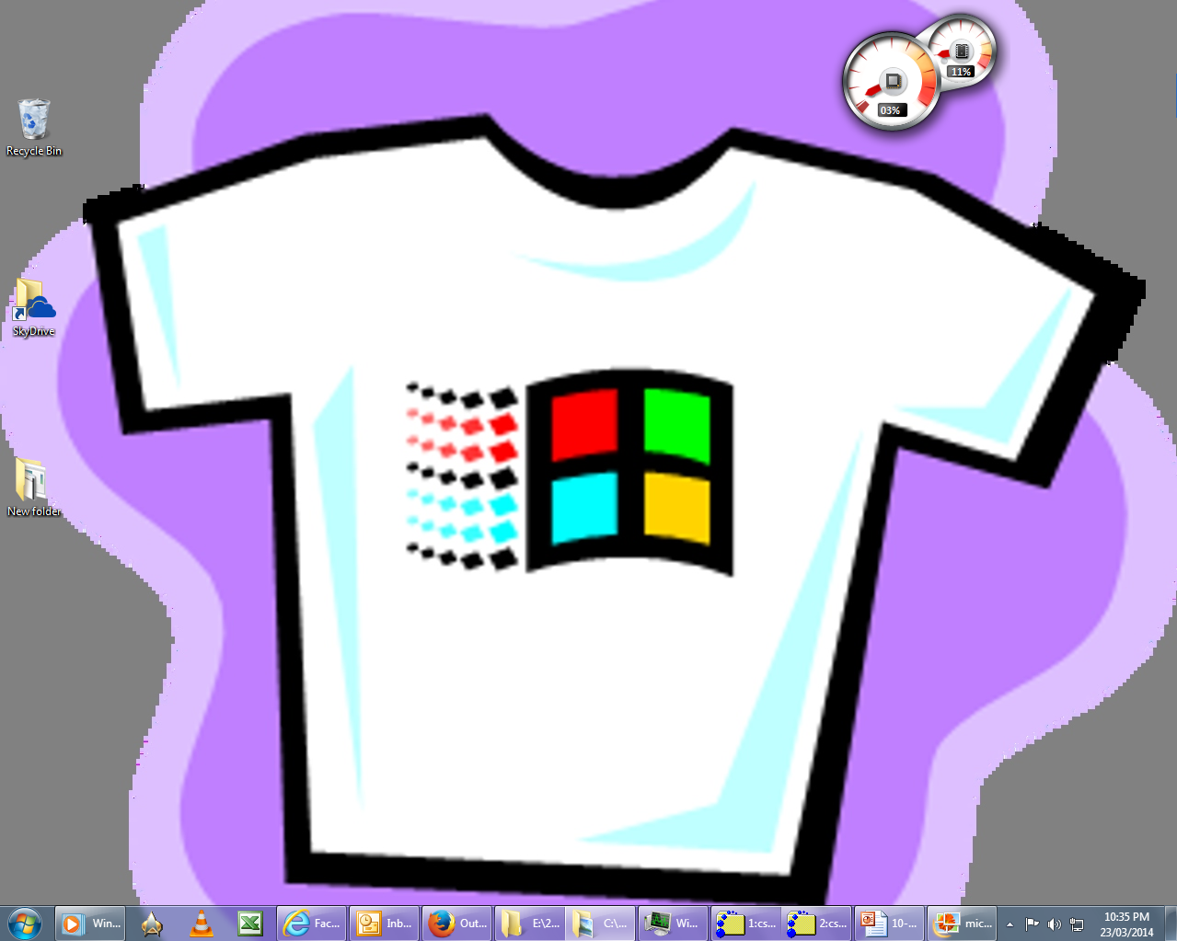
JT: Computer Communications
MAC
Windows
All computers can only understand machine language (binary: two state model).
Different computer operating systems have their own version of binary.
  That’s why you can’t directly install a program written for one operating system (O/S) onto a computer with a different O/S

Slide 10

JT: The Internet
Google
Facebook
UC
What is the Internet?
  A very large collection of connected networks
  Protocols: the rules of communication for the interconnected devices on the Internet

Slide 11
The Internet (JT: Common Protocols)
HTTP
(www)
SMTP
(email)
Protocols
(TCP/IP)
Network
Your Computer
Server

Slide 12
The Network
Cables
Wires
Routers
Computers
Network
Your Computer
Server

Slide 13
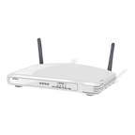
JT: Networks
#1 The connections to the network
Connection
Connection
Connection
Connection

Slide 14
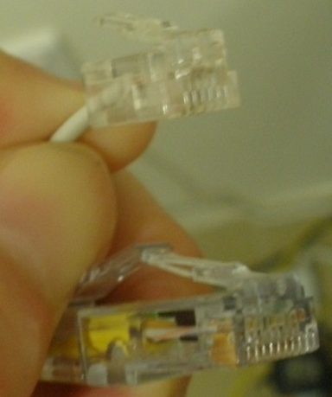
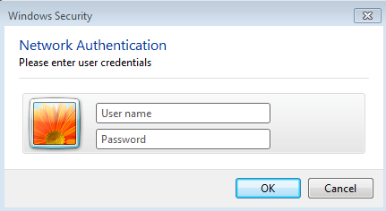
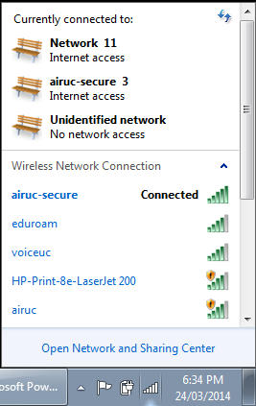
JT: Connections
Network connections can be:
  Wired
  Wireless
Telephone
Network

Slide 15
JT: Types Of Wireless Network Connections (wired ~100 – 1000 Mbps)
All are based on the 802.11 standard (also known as Wi-Fi) for wireless transmissions
Transmission protocol | Bandwidth | Approximate time to transmit a two hour DVD movie
802.11b | 11 Mbps | 48 minutes, 26 seconds
802.11g | 52 Mbps | 10 minutes, 15 seconds
802.11n | 540 Mbps | 62 seconds

Slide 16
JT: Networks
#2 The connection to the outside (Internet)
Connection

Slide 17
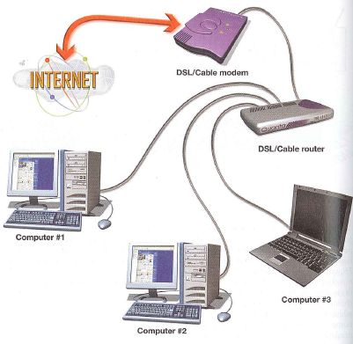
JT: Router And Modem
The router is the gateway to the Internet for the entire household.
Example: these are the computers in one house.
Image from “Technology in Action” by Evans, Martin and Poatsy

Slide 18
JT: All The Network Hardware Is Still Not Sufficient
Need addresses to deliver the information (IP address)
Need a common means of communication across the network (protocols)

Slide 19
JT: The Internet
Click to login to profile
Download profile page
Click to login to profile
Download profile page
Web server for social network
There must be a way of uniquely identifying each computer or device connected to the Internet
Allows information to be correctly ‘delivered’.
Internet Protocol (IP) addresses are assigned to each computer or device connected to the Internet.

Slide 20
Internet Protocol
12.0.126.5
150.203.1.2
127.15.30.12
Network
100.23.67.0
255.0.4.18
57.83.77.90
(JT: These are example IP Addresses)

Slide 21
IP Analogy
212 435 7777
403 202 4774
403 202 8484
Telephone
Network
212 367 8887
780 671 4118
780 671 4119

Slide 22
JT: Address Restrictions And Registrations
Example: 136.159.34.3
Each part of the address (e.g., ‘136’) must consist of a number that ranges from 0 – 255.
The first two numbers often indicate the indicate the provider or connection to the Internet
  136.159.XXX.YYY: A computer on the UC network
  68.147.XXX.YYY: Shaw
  205.206.XXX.YYY: Telus

Slide 23
Port Numbers
Web Server
HTML pages
Port 80
Mail Server
Email
Port 25
Something
Else
Another Port
12.5.7.8.90
(JT: Ports provides different ways of communicating online)

Slide 24
Transmission Control Protocol
Listen to a port number for connection requests
12.5.7.8.90

Slide 25




JT: TCP And Port Numbers
The Internet
Internet accessible programs on the computer can be found via port numbers:
Find computer:
IP = 136.159.5.16
Email in = 25
Web pages = 80
Email out = 110

Slide 26
Transmission Control Protocol
Accept
connection
Network
Connect(IP address, port no)

Slide 27
Transmission Control Protocol
Network
Connection established

Slide 28
Transmission Control Protocol
Send
“request”
Network
Connection established

Slide 29
Transmission Control Protocol
Network
Message Received

Slide 30
Transmission Control Protocol
Network
Send
“response”
Message Received

Slide 31
Transmission Control Protocol
Network
Close connection

Slide 32
How does it Happen?
Request a page
Respond with page
Your Computer
Establish a connection
U Calgary
Web Server

Slide 33
JT: Non-Default Port Numbers And Security
As mentioned computers are configured to automatically scan for certain types of network communications at particular port numbers e.g., Email is sent via port 110.
Malicious and other unauthorized used of a computer (i.e., a program installs itself on your computer and sends out spam mail) to take advantage of these ports.
Consequently non-default ports may be used when there have been known and commonly used security (and other) issues.

Slide 34
JT: Non-Default Port Numbers And Security (2)
Example (configuring your University of Calgary email account):
  http://www.ucalgary.ca/it/email
 | Default ports | UC ports used
Incoming email | 25 | 993
Outgoing email | 110 | 465

Slide 35


JT: Effect Of Using Non-Default Port Numbers
www.evil.com
Port 110: Buy Viagra! Cialis! Get rich quick: buy high, sell low!!!
You
UC Mail server (listens at port #465 to receive mail to be sent)

Slide 36

JT: Packet Switched Networks, What Are They
Same method of encoding and transmitting (packets) regardless of what data is sent

Slide 37
Packet Switching
Message
Packet 0
Packet 1
Packet 2
Packet n

Slide 38
Packet Switching (JT: How It Works)
Packet 0
Packet 1
Packet 2
Packet n

Slide 39
Internet Protocols (again)
Example protocols that are employed on packet switched networks
  Connection-based protocol
  TCP (Transmission Control Protocol)
    JT: Make sure the data is received, check and resend if needed
  Connectionless protocol
  UDP (Universal Datagram Protocol)
    JT: send and forget

Slide 40
UDP
Datagrams = packets
Connectionless
UDP: going to the post office, sticking a stamp, and dropping off the packet
  JT: sending the data without using time to check if it was properly received (let alone resend it).

Slide 41
TCP
Connection-oriented
TCP: picking up the phone, establishing a connection, exchanging information, and destroying the connection
Packets are guaranteed to be sent
  JT: checks occur if the information was properly received and if not then it’s resent.

Slide 42
TCP
Y
X
Z
A
B
XYZ

Slide 43
JT: TCP Vs. UDP
TCP
  Slower but reliable: used when all the information must be received (e.g., secure web page where all the data is crucial)
UDP
  Faster but not reliable: used when timely delivery is important (e.g., streaming video, video games) but some information may be lost

Slide 44

JT: Internet History (Context)
What was happening in the 1950’s
The Cold War

Slide 45

JT: The Cold War And The Space Race
At the same time that each side (USSR-USA) was trying to be dominant on the ground they also wanted to be dominant in space.
Both sides tried to be the first to send a satellite into space.
In the 1950’s it appeared that the USSR had a technological edge:
  Americans in 1957: A sophisticated three stage rocket was planned as the first human-made vehicle to be spent into space.
  The USSR in 1957: surprised the world by launching Sputnik I (first artificial satellite).
  The launch of Sputnik motivated the creation of ARPA (Advanced Research Projects Agency) in the US.
!!!

Slide 46
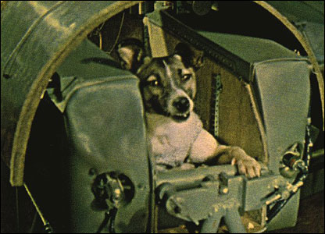
JT: The Cold War And The Space Race
Later in 1957 the USSR launched another satellite carrying the dog Laika “bark/barker” into space
http://news.bbc.co.uk

Slide 47
JT: ARPA (Advanced Research Projects Agency)
APRA was a branch of the ministry of defense.
The focus was on:
  Getting different types of computers communicating
  Current approaches were far from satisfactory

Slide 48
JT: The ARPANET
The first computers were connected via ARPANET (Advanced Research Projects Agency Network).
  It was the early form of the Internet.
The initial ARPANET consisted of 2 computers (UCLA-Stanford) which were connected at the start of 1969 (birth of the early Internet!)
  A standard protocol was used so the computers could communicate
UCLA
Stanford

Slide 49
JT: The First Data Sent¹
Originally the message ‘login’ was to be transmitted.
But the transmission stopped (i.e., it “died” after the first two characters).
  …and thus ‘LO’ the Internet was born!
1 “On the Way to the Web” (Michael A. Banks, Wiley)

Slide 50
Brief History of the Internet (Summary)
Attempts to network computers
  Mainly for academic and military applications
ARPANET
  Advanced Research Projects Agency NETwork
  US Defense
  Predecessor of Internet
  Packet switching
  60s: USDD and few universities (west coast)
  70s: ARPA reached the east coast
  83: military portion (JT: MILNET) separated

Slide 51
The World Wide Web

Slide 52
Objectives
By the end of this section, you will be able to
Define the WWW and differentiate it from the Internet
Explain how naming services work
Explain the Hyper-Text Transfer Protocol (HTTP)

Slide 53
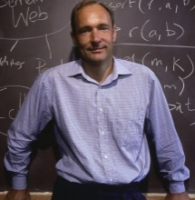
JT: The History Of The World Wide Web
Designed in 1989 by Tim Berners-Lee and scientists in Geneva who were interested in making it easier to share research documents.
Documents could be linked through a protocol called http (hyper text transfer protocol).
  Https: later version (s = secure)
Documents were made available for free browsing and downloading from the web (substantially easier than the alternative).
From www.computerhistory.org

Slide 54
JT: The History Of The World Wide Web (2)
1990:
  The first web browser “WorldWideWeb” (later renamed ‘Nexus’¹ was written.
1993:
  Mark Andreessen of NCSA (National Center for Super Computing Applications) launched Mosaic X the first popular web browser.
Prior to the advent of the WWW the Internet was largely used by a niche user group.
The advent of the WWW drastically changed that.
  Now some people even equate the World-Wide-Web with the Internet itself!
1 http://www.w3.org/People/Berners-Lee/WorldWideWeb.html

Slide 55
JT: Growth Of The WWW

Slide 56
The Internet
HTTP
(www)
SMTP
(email)
Protocols
(TCP/IP)
Network
Your Computer
Server

Slide 57
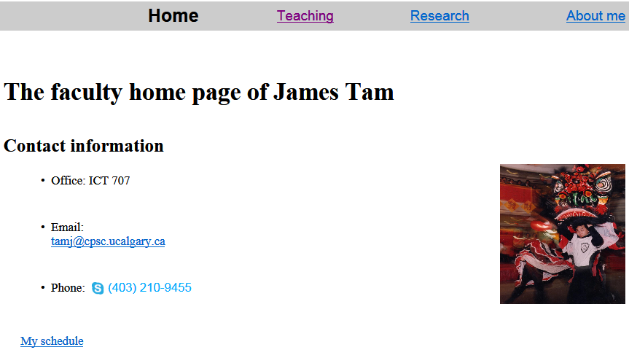
JT: URL’s
URL = Universal Resource Locator
A link to a web resource
  E.g., http://www.cpsc.ucalgary.ca/~tamj/index.html
  (A web page document)

Slide 58
Parts Of A URL
http://www.cpsc.ucalgary.ca/~tamj/index.html
Protocol¹
Web server
User name (matches up to a folder name)
Document name
1 Other protocols may also be used in a web browser e.g., telnet (remote login), ftp (file transfer), https (secure http)

Slide 59
com
net
org
edu
gov
ca
fr
ch
hrw
cbc
Each vertex has
an associated
naming server
Local machines
and files
www
www
en
news
news

Slide 60
Naming (JT: Converts Text URL To A Numerical IP Address)
Local naming server
lookup
www.ucalgary.ca
124.65.244.6
www.ucalgary.ca
is IP address
136.159.37.42
http://www.ucalgary.ca/index.html

Slide 61
Resolving a Name (JT: Website Name To Numerical Address)
ca
Name
Server
www.ucalgary
lookup
Local
Name
Sever
IP for ucalgary.ca
Name Server
www.ucalgary.ca
client
136.159.37.42
www
136.159.37.42
ucalgary.ca
Name
Server

Slide 62
Naming (…JT: And How Names Are Used in Web Connection)
Local naming server
lookup
www.ucalgary.ca
136.159.37.42
Connect(136.159.37.42)
136.159.37.42

Slide 63
http://www.ucalgary.ca/index.html
Accept connection

Slide 64
http://www.ucalgary.ca/index.html
Connection established

Slide 65
HTTP
http://www.ucalgary.ca/index.html
“Get me” index.html

Slide 66
Hyper Text Transfer Protocol
The protocol between browsers and Web servers
Defines structures on requests and responses
Two major request types
  GET: link-click
  POST: submit button of form information
Keep in mind: messages are sent over TCP/IP (JT: ‘sent over’ means that web connection employs TCP/IP)

Slide 67
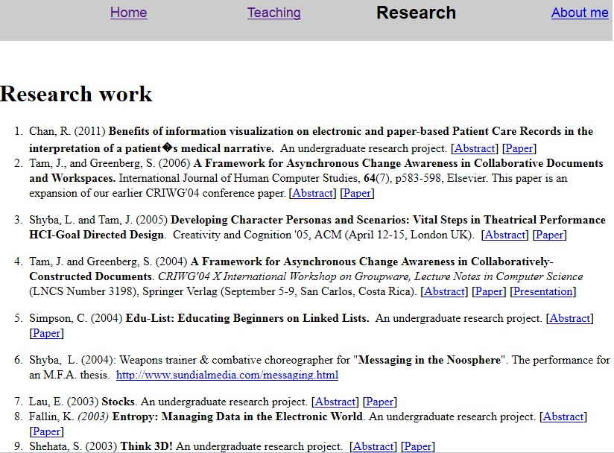
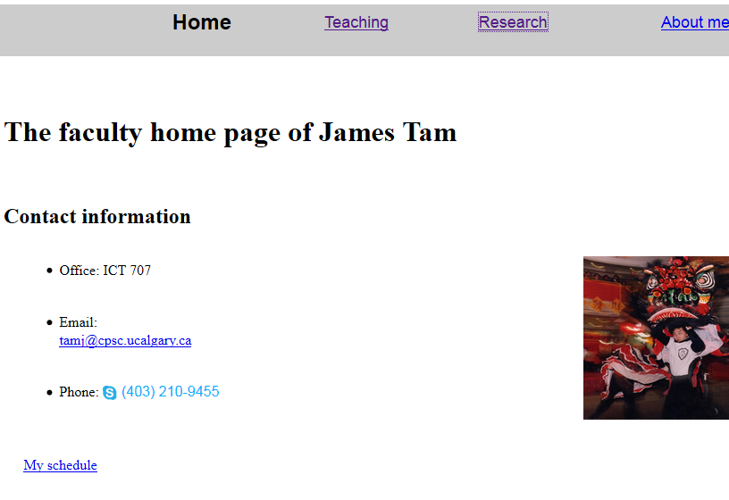
JT: Get Request

Slide 68
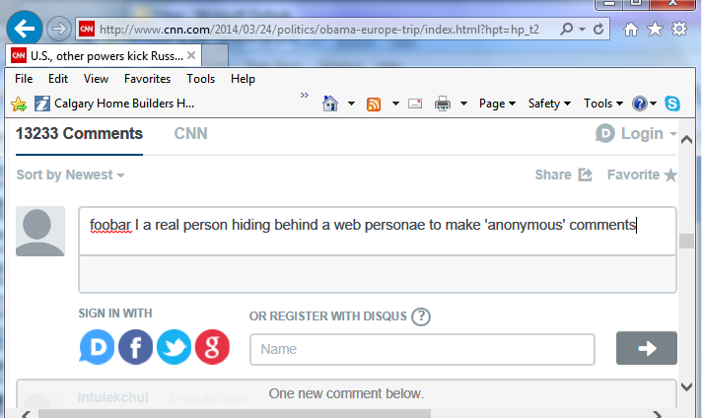
JT: Post (Sending Info Via Web)

Slide 69
Message Structure
Line 1: general header
Following lines: zero or more headers
Blank line
Optional message

Slide 70
JT: A ‘Blank’ Webpage
<head>
<title>A 'blank' web page</title>
</head>
<body>
</body>

Slide 71
A Single Link Webpage
<head>
<title>A webpage with one link</title>
</head>
<body>
Facebook: <a href="http://www.thefacebook.com">www.facebook.com</a>
</body>

Slide 72
A Table Of Links
<head>
<title>My FAV websites</title>
</head>
<body>
My favs
<table border="1" width="100%">
<td><a href="http://www.facebook.com">Facebook</a></td>
<td><a href="http://www.cnn.com">CNN</a></td>
<td><a href="http://www.howstuffworks.com">Meaning of life, the universe and everything</a></td>
</table>
</body>

Slide 73
Example GET
GET /index.html HTTP/1.0
Empty line
Requesting file /index.html using HTTP version 1.0

Slide 74
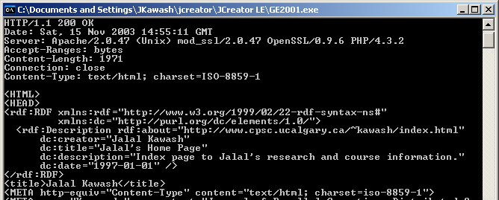
Example Response

