Slide 1
2 Databases &
Data Modelling
Peeking into Computer Science

Slide 2
Reading Assignment
Mandatory: Chapter 4 – Sections 4.4 & 4.5

Slide 3
Mapping ERDs to Schema

Slide 4
Objectives
At the end of this section, you will be able to:
Apply the mapping algorithm to translate an ERD to a database schema
Understand foreign keys

Slide 5
Mapping Algorithm (4.1)
Each entity type is translated to a table; its attributes become columns
Each many-to-many relationship type becomes a table; the columns are the primary keys of the participating entity types
    JT: Recall the example from previous notes (Slide #38): Student-Classes
For each one-to-many relationship type, add the primary keys of the entity type on the one side as columns in the table corresponding to the entity type on the many side

Slide 6
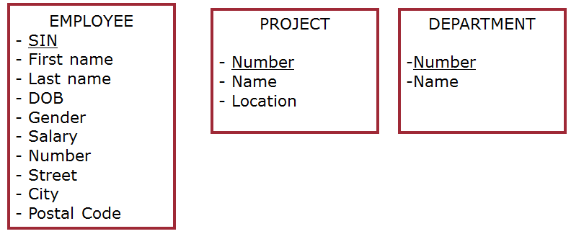
Mapping Entity Types
Each entity type is translated to a table; its attributes become columns

Slide 7
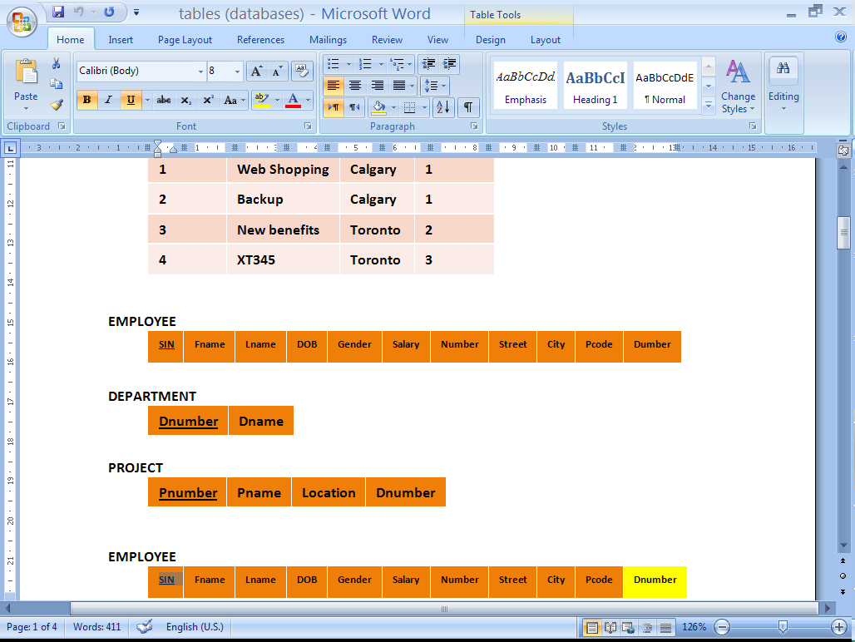
EMPLOYEE
SIN
First name
Last name
DOB
Gender
Salary
Number
Street
City
Postal Code
PROJECT
Number
Name
Location
DEPARTMENT
Number
Name

Slide 8
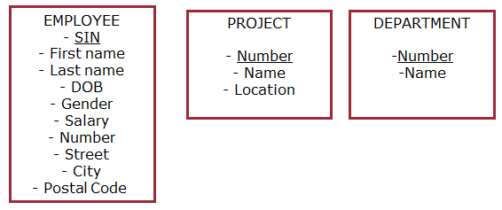
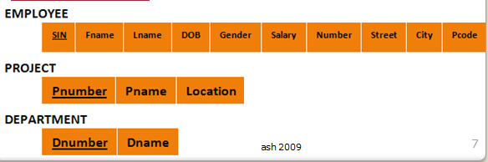
JT’s Extra:
Entities (conceptual information to be stored)
The actual tables in a database

Slide 9
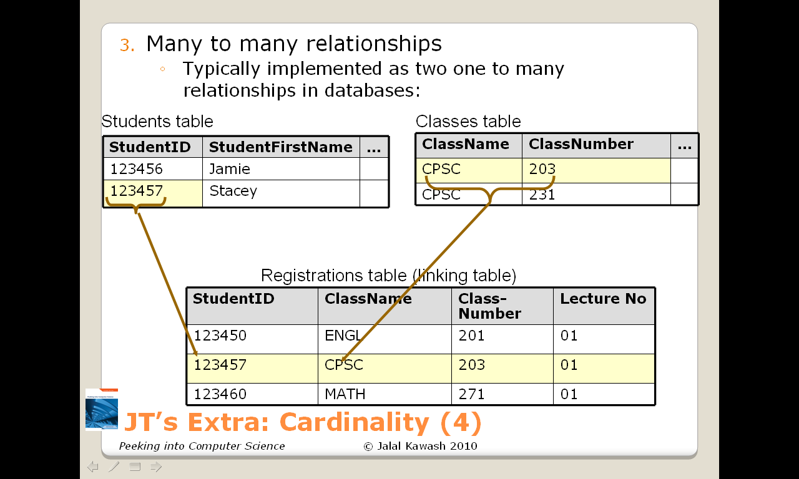
JT’s Extra: Recall Many : Many Relations Can’t Be Directly Implemented

Slide 10
Mapping Many-Many Relationship Types
JT’s Extra
10
Each many-to-many relationship type becomes a table; the columns are the primary keys of the participating entity types

Slide 11
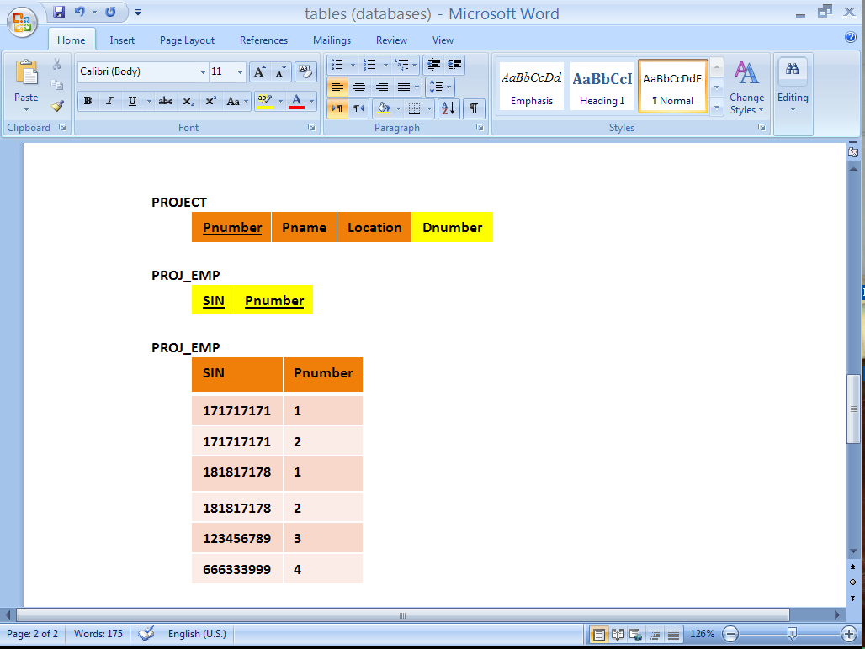
Participation Levels
EMPLOYEE
SIN
First name
Last name
DOB
Gender
Salary
Number
Street
City
Postal Code
WORKS FOR
DEPARTMENT
Number
Name
CONTROLS
PROJECT
Number
Name
Location
WORKS ON

Slide 12
There will be no more tables
Step 3 simply augments the existing tables (JT’s extra i.e., you add more columns).

Slide 13
There will be no more tables
Step 3 simply augments the existing tables
JT’s Extra: (In case you missed it in Jalal’s example)

Slide 14
Mapping One-Many Relationship Types
14
For each one-to-many relationship type, add the primary keys of the entity type on the one side as columns in the table corresponding to the entity type on the many side

Slide 15
JT’s Extra: Foreign Keys
A key in one table that refers to a key in another field.

Slide 16
Mapping One-Many Relationship Types
For each one-to-many relationship type, add the primary keys of the entity type on the one side as columns in the table corresponding to the entity type on the many side
JT’s Extra
Table 1
Table 2
1
Primary key
Primary key
Many
Foreign key

Slide 17
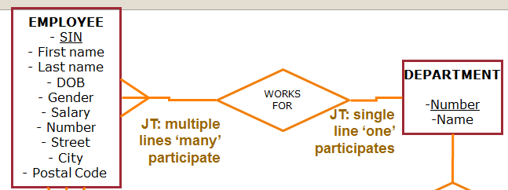
JT’s Extra: Mapping 1:Many
The relationship between Department and Employee is 1 to many.
The primary of Department table (“One side”)
…becomes a column in the Employee table (“Many side”).

Slide 18
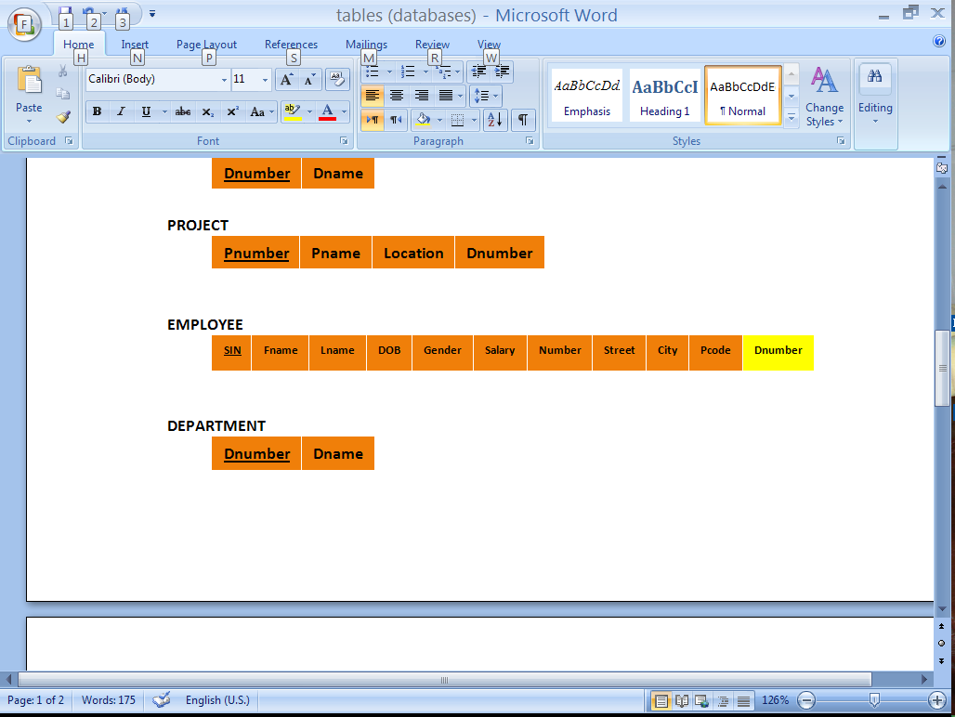
EMPLOYEE
SIN
First name
Last name
DOB
Gender
Salary
Number
Street
City
Postal Code
WORKS FOR
DEPARTMENT
Number
Name
Dnumber tells us which Department an employee works for
Dnumber is a foreign Key
CONTROLS
PROJECT
Number
Name
Location
WORKS ON

Slide 19
EMPLOYEE
SIN
First name
Last name
DOB
Gender
Salary
Number
Street
City
Postal Code
WORKS FOR
DEPARTMENT
Number
Name
CONTROLS
PROJECT
Number
Name
Location
WORKS ON
19

Slide 20
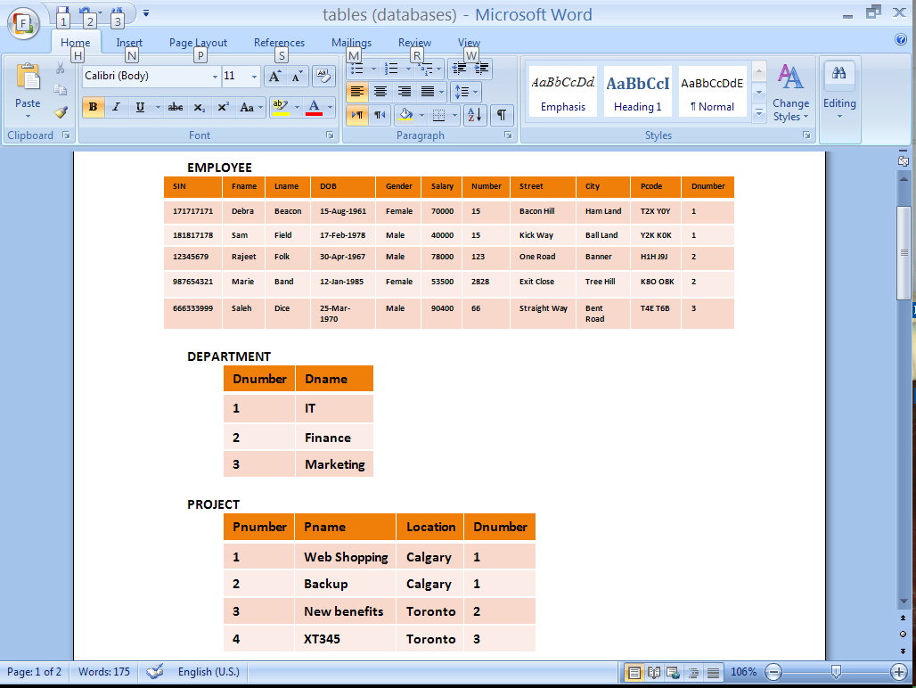

Slide 21
EMPLOYEE
SIN
First name
Last name
DOB
Gender
Salary
Number
Street
City
Postal Code
WORKS FOR
DEPARTMENT
Number
Name
CONTROLS
PROJECT
Number
Name
Location
WORKS ON
Dnumber

Slide 23
The Complete Schema

Slide 24
Two Missing Things
The mapping algorithm does not include one-to-one relationship types
  We need to include these
Sometimes, relationship types may need to have their own attributes
Will revise ERDs and the mapping algorithm to include these.

Slide 25
MANAGES Relationship Type
A department is managed by one employee
Each department has a manager which is also an employee
EMPLOYEE and DEPARTMENT are related by the MANAGES relationship type
Each department can have only one manager, and each employee can manage at most one department. This is a one-to-one relationship
Notes:
© Copyright: All rights reserved. Not to be reproduced by any means without prior written consent

Slide 26
MANAGES
EMPLOYEE
SIN
First name
Last name
DOB
Gender
Salary
Number
Street
City
Postal Code
WORKS FOR
DEPARTMENT
Number
Name
CONTROLS
PROJECT
Number
Name
Location
WORKS ON

Slide 27
Attributes for Relationship types
MANAGES
JT: explanation for ‘source data’ and ‘hours’ coming shortly
EMPLOYEE
SIN
First name
Last name
DOB
Gender
Salary
Number
Street
City
Postal Code
- Start date
WORKS FOR
DEPARTMENT
Number
Name
PROJECT
Number
Name
Location
- Hours
CONTROLS
WORKS ON

Slide 28
JT’s Extra: Notation Reminder
Entity (object in real world): E
Table (in database): T
Table (in database): T
Entity: E
Relationship: R
Entity: E
Table (in database): T

Slide 29

Complete mapping Algorithm
Each entity type E is translated to a table T (to emphasize that T is a result of E, we write T(E))
  T’s columns are E’s attributes
Each many-to-many relationship type R, relating entity types E1 and E2, becomes a table T (relationship becomes a table)
  T’s columns are R’s attributes
  the primary key of E1 and E2 is added as columns in T
Database Table (DOGS)
Entity (DOG) attributes
Color (Rover = yellow)
Weight (Rover = 5 llbs)
Name | Color | Weight
Rover | Yellow | 5

Slide 30
Complete mapping Algorithm
For each one-to-many relationship type R, relating E1 to E2 with E1 on the “one” side:
  add the primary key of E1 (one) as a column or columns in T(E2)
  any attributes that R has become columns in T(E2)

Slide 31
JT’s Extra: 1 to 1 Relationships
T1
T2
OR
T1
T2
To ensure compliance with good design principles, examine participation levels when determining which table’s primary key is used as the other table’s foreign key.
  If both tables participate equally (both partial or both full) then the choice is arbitrary.

Slide 32
JT’s Extra: 1 to 1 Relationships (2)
Table 1
Table 2
Primary key
Partial
Foreign key
Full
  If participation levels aren’t equal: If one table partially participates in the relationship while the other table participates partially in the relationship.

Slide 33
Complete mapping Algorithm
For each one-to-one relationship type R, relating E1 to E2 with E1 on a partial participation side or both E1 and E2 fully participate in R:
  add the primary key of E1 (JT: partial) as a column or columns in T(E2, JT: full)
  any attributes that R has become columns in T(E2)

Slide 34
JT’s Extra: Attributes Of Relationships
Employee
Hours?
Many
Works on
Hours!
Many
Project
Hours?

Slide 35
JT’s Extra: Attributes Of Relationships (2)
Start date?
Manages
One
One
Start date?
Department
Employee
Start date!
Works for
One
Many
Many

Slide 36
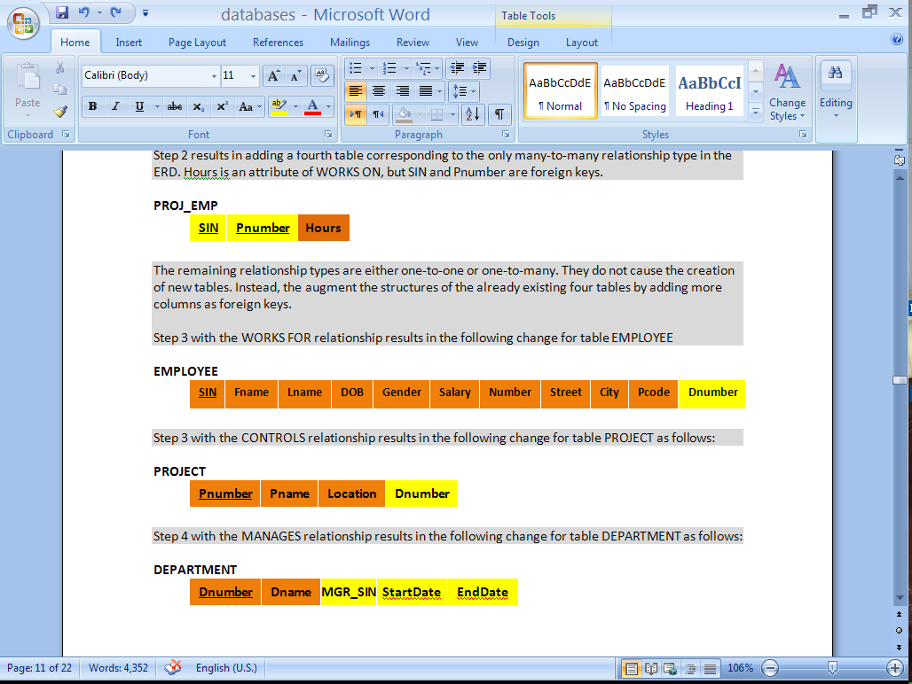
MANAGES
EMPLOYEE
SIN
First name
Last name
DOB
Gender
Salary
Number
Street
City
Postal Code
- Start date
WORKS FOR
DEPARTMENT
Number
Name
PROJECT
Number
Name
Location
- Hours
CONTROLS
WORKS ON

Slide 37
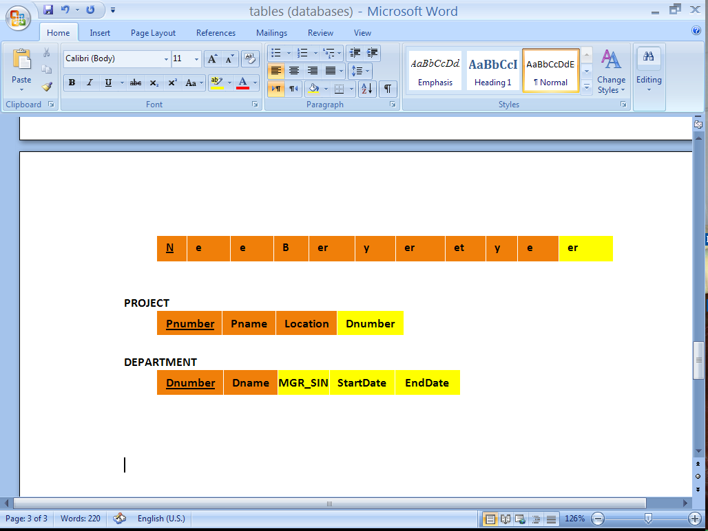
MANAGES
EMPLOYEE
SIN
First name
Last name
DOB
Gender
Salary
Number
Street
City
Postal Code
- Start date
WORKS FOR
DEPARTMENT
Number
Name
PROJECT
Number
Name
Location
- Hours
CONTROLS
WORKS ON

Slide 38
The Complete Schema

Slide 39
Design Principles
What makes a Good Design?

Slide 40
Objectives
At the end of this section, you will be able to:
List and entertain the three basic design principles
Understand how our mapping algorithm satisfies these three principles

Slide 41
Basic Design Principles
Meaning of a Schema should be easily explained
Reduce Redundancy
Reduce NULL values

Slide 42
Design Principle (1)
Design a schema so that its meaning can be easily explained
Do NOT combine attributes from different entity types into a single table

Slide 43
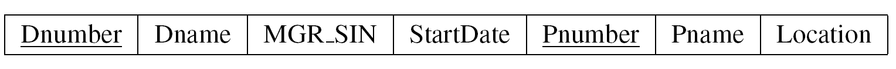
A schema with no clear meaning
Project, department, or controls table?
  JT: what is the collective info stored, it’s a smattering of unrelated attributes.

Slide 44
Design Principle (2)
Design a schema so that Redundancy is reduced
Unnecessary Redundancy can lead to modification anomalies

Slide 45
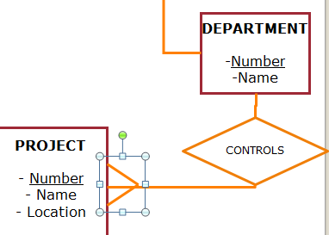
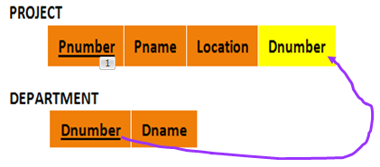
JT: Recall Department And Project
1
With 1:Many relationship the primary key of the ‘1’ became foreign key on the ‘many’ side
Many

Slide 46
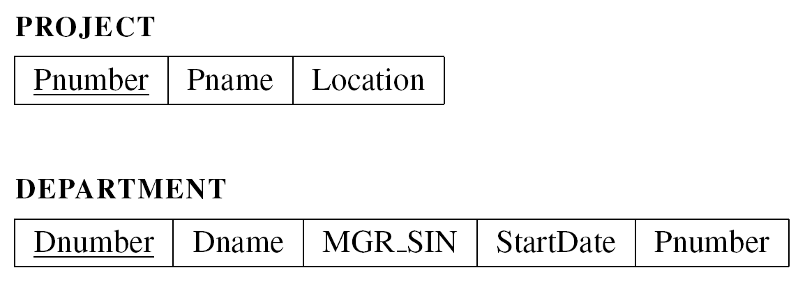
Unnecessary Redundancy
Assume the schema definition for Project and Department
  migrating Pnumber to DEPARTMENT

Slide 47
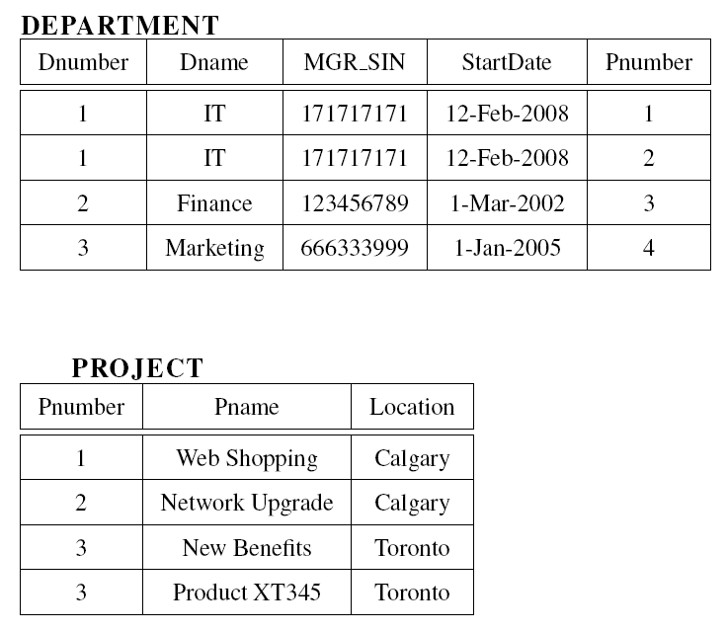
More than one place to change IT
4

Slide 48
Modification Anomaly Example
ABC company decides to change the name of IT department to Technology

Slide 49
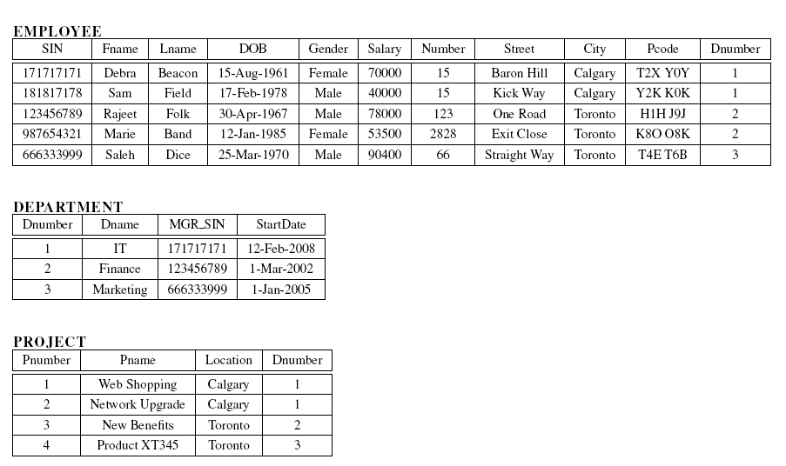
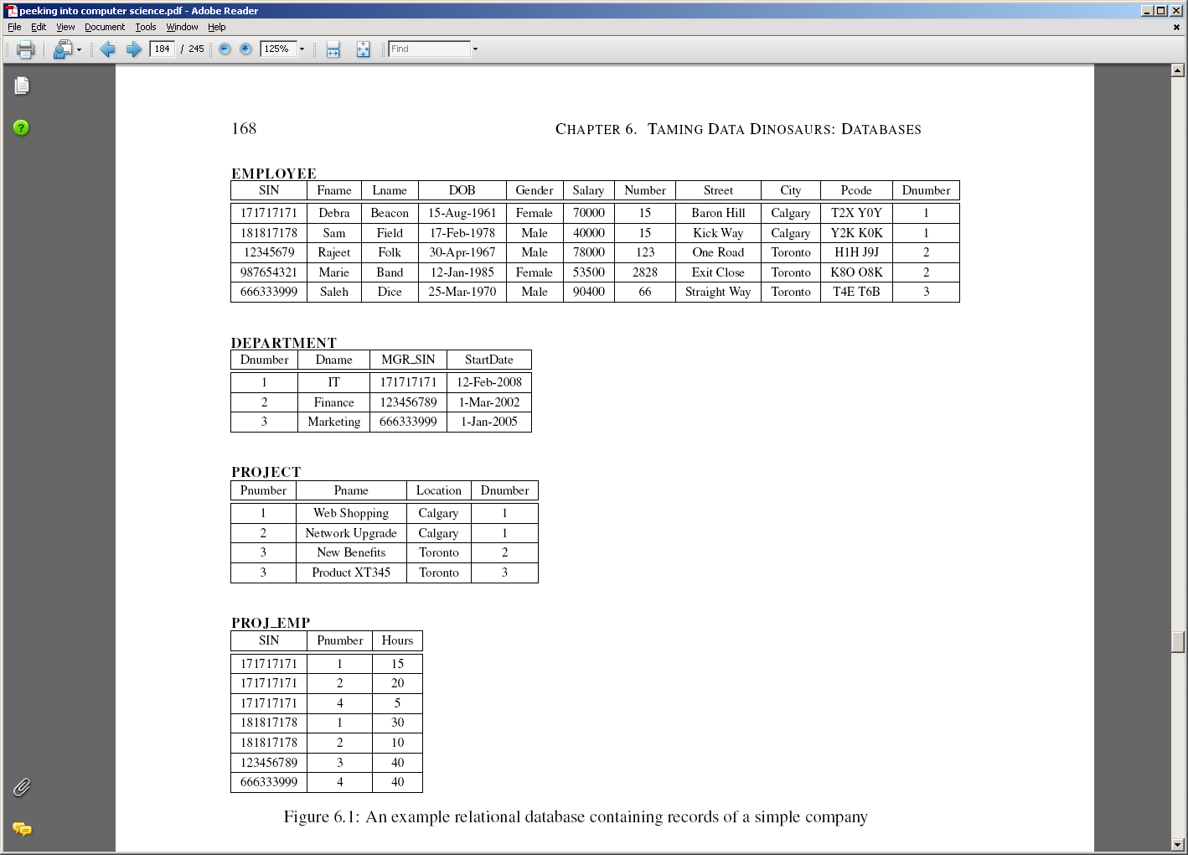
No Anomalies Here
The only place to change IT

Slide 50
IT occurs in more than one place
Must change all occurrences of IT here and elsewhere

Slide 51
JT’s Extra: Null Values
Refers to empty fields of a record.
Primary keys cannot be null but other fields may be null.
Notes:
51

Slide 52
Design Principle (3)
Design a schema so that NULL values are minimized as much as possible
Waste space
Result in confusion:
  A NULL value could mean:
    Does not apply
    Unknown
    To be recorded

Slide 53
NULL Values Confusion
NULL
NULL
Arrangement to work until completion
We do not know the hours yet
Someone else will enter it (it is known)

Slide 54
NULL Values Example
We migrated the managers SIN (partial participation side) to the DEPARTMENT table (full participation side)
  JT: this is what we should do

Slide 55
NULL Values Example
What if we migrated the department Number to the EMPLOYEE table?
  JT: again this is what should be done (1:many, primary key of ‘one’ becomes foreign key of many)

Slide 56
Original Design

Slide 57
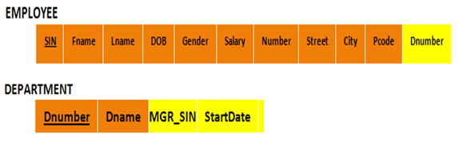
JT: Manager Info (Manager ‘Manages’ A Department)

Slide 58
JT: What If Manager Info Stored Elsewhere?
Manager info stored in ‘employees’ table rather than department table.

Slide 59
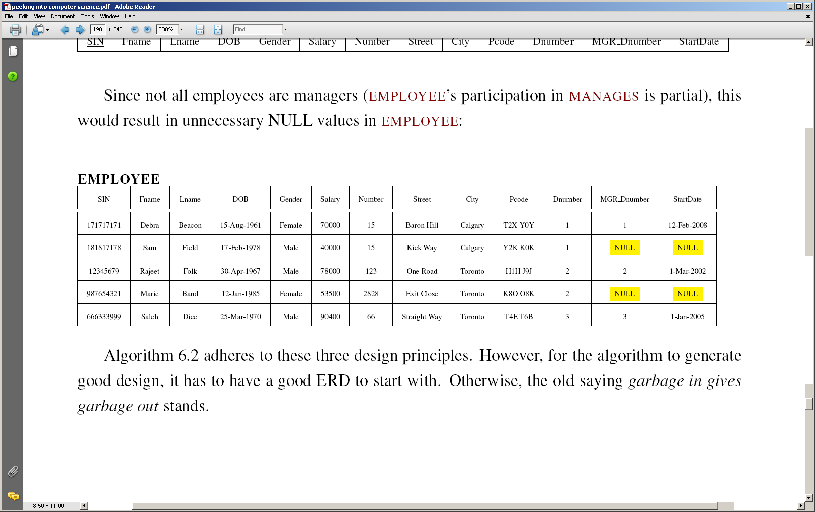
Alternative Design
JT’s Extra: zoom

Slide 60
JT’s Extra (Null): Many to many relationships: directly modeled in a database.
Students table
StudentID | StudentFirstName | StudentLastName
123456 | Jamie | Smyth
123457 | Stacey | Walls
123458 | Angel | Lam
Classes table
ClassName | ClassNumber | Lecture No | ClassDescription
CPSC | 203 | 01 | Introduction to Computers
CPSC | 231 | 01 | Introduction to Computer Science I
CPSC | 233 | 01 | Introduction to Computer Science II

Slide 61
JT’s Extra (Null): Many to many relationships: directly modeled in a database.
Students table
StudentID | StudentFirstName | StudentLastName
123456 | Jamie | Smyth
123457 | Stacey | Walls
123458 | Angel | Lam
Class 1 | Class 2 | Class 3 | Class 4 | Class 5 | … | Class ‘N’
CPSC 203 | PSYC 205 | MATH 221 | MATH 251 | SOCI 201 |  | NULL
CPSC 203 | ART 201 | MATH 271 | NULL | NULL |  | NULL
CPSC 203 | CHIN 201 | KINE 221 | MGIS 323 | OPMA 341 |  | NULL

Slide 62
JT’s Extra (Null): Many to many relationships: directly modeled in a database.
Classes table
ClassName | ClassNumber | Lecture No | ClassDescription
CPSC | 203 | 01 | Introduction to Computers
CPSC | 231 | 01 | Introduction to Computer Science I
CPSC | 233 | 01 | Introduction to Computer Science II
S₁ | S₂ | S₃ | S₄ | S₅ | S₆ | S₇ | … | S_{N}
Bill | Bob | Mary | Jane | NULL | NULL | NULL |  | NULL
Jim | NULL | NULL | NULL | NULL | NULL | NULL |  | NULL
Alice | Brett | Charlie | Deacon | Ernie | Edgar | Freda |  | NULL

