Slide 1
1 Databases &
Data Modeling
Peeking into Computer Science

Slide 2
Reading Assignment
Mandatory: Chapter 4 – Sections 4.1 to 4.3

Slide 3
Databases

Slide 4
Objectives
At the end of this section, you will be able to:
Describe what a database is
Draw the relationship between databases and mathematical relations
Describe what a database schema is

Slide 5
JT’s Extra: Purpose
Sale $$$
Sale $$$
Database: Customer information
To store & retrieve information
Notes:
5

Slide 6
JT’s Extra: Why Bother?
MILES EDWARD O’BRIAN
DS9 Corp
Electrical engineering
2007 purchases: $10,0000,000
2006 purchases: $1,750,000
JAMIE SMYTHE
Cooperative services
Gasoline refining
2006 purchases: $5,000,0000
2005 purchases: $5,000,0000
2004 purchases: $5,000,0000
2003 purchases: $5,000,0000
2002 purchases: $5,000,0000
SCOTT BRUCE
Bryce Consulting
Investment analysis
2007 purchases: $500,000
2006 purchases: $1,500,000
2005 purchases: $2,500,000
2004 purchases: $500,000
ETC.
If the list is short then a simple text file may suffice.
As the list grows organizing and updating the information becomes more challenging (duplicates or inaccuracies?)
Validity must be manually checked.
Also searching the list according to specific criteria may become difficult .
  e.g., Show all clients whose purchases in 2007 were between one and five million dollars
  e.g., Show all clients that made in one year a purchase exceeding 10 million dollars.
Why bother, why not use a simple file as an alternative?
  E.g., tracking client information
Notes:
6

Slide 7
Database
Organized collection of data
Minimizes redundancy:
  Wastes space and produce anomalies
Makes it easier to access and modify data
Examples: University and bank records
Typically is a collection of tables

Slide 8
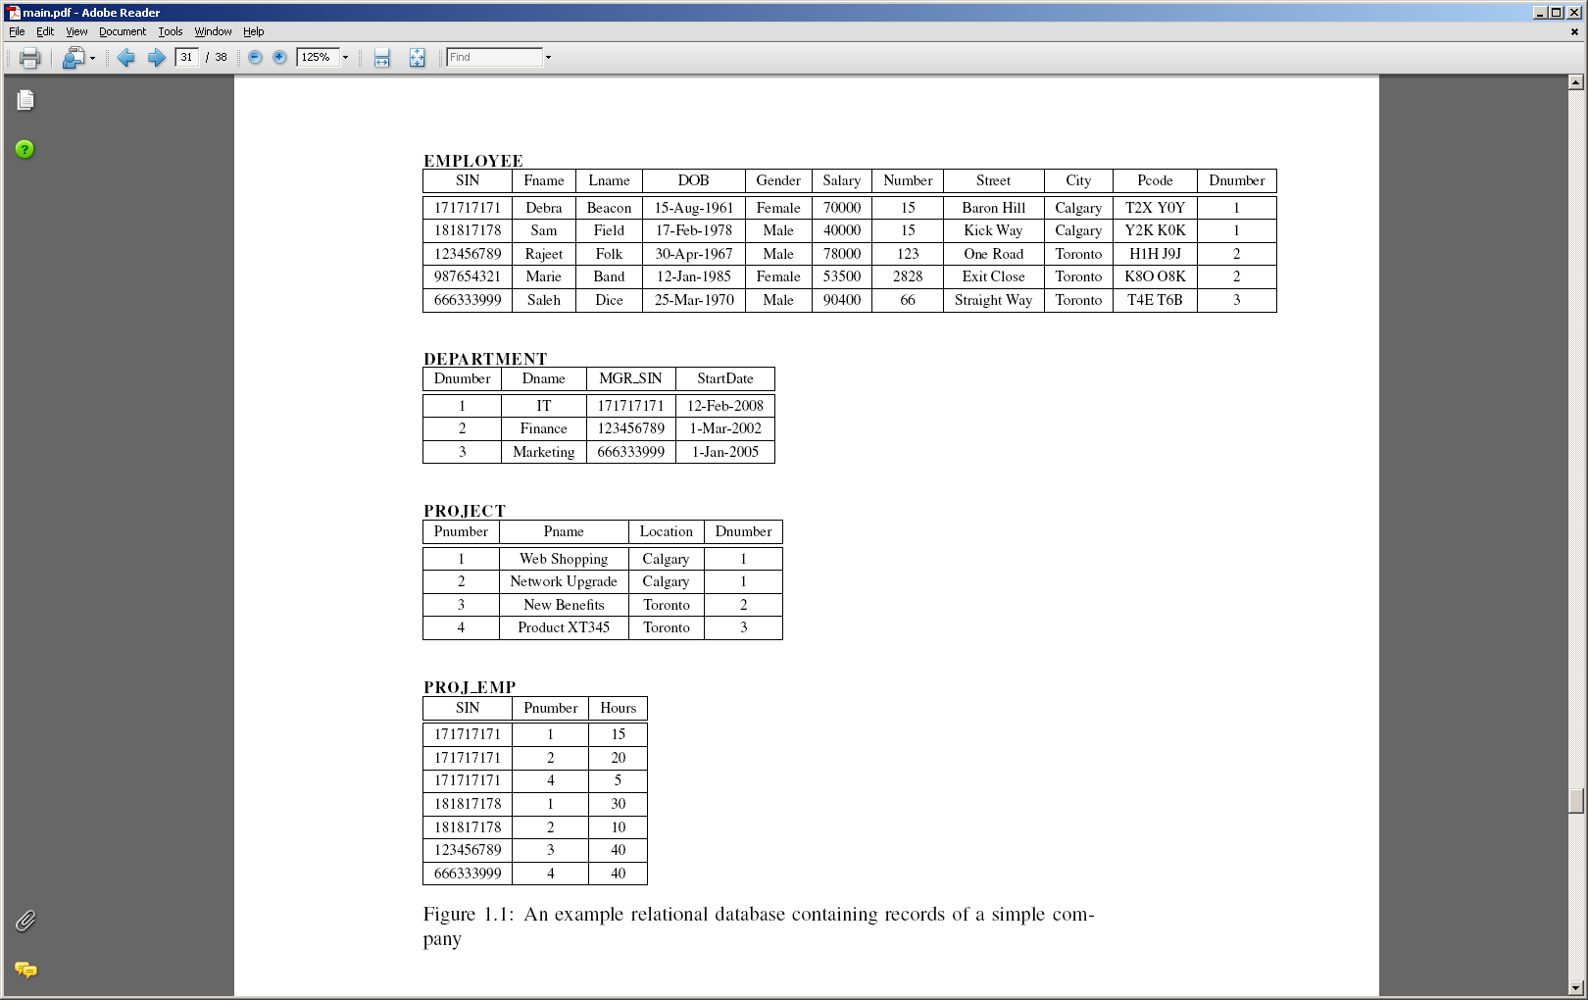
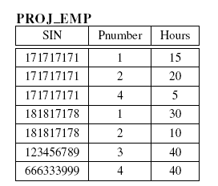
Example Database

Slide 9
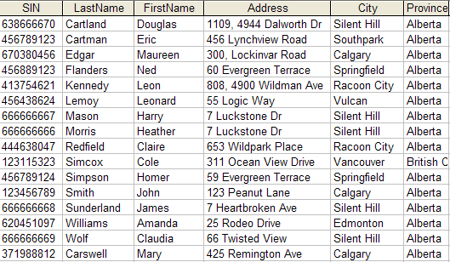
JT’s Extra: Storing Information In A Database
Employees’ table
Information is commonly stored in tables:
Notes:
9

Slide 10
JT’s Extra: Storing Information In A Database (2)
Records of the table (rows)
One record, ‘Simpson, Homer’
Record: An example instance (row) of data within the table.
Notes:
10

Slide 11
Fields of the table (columns)
‘Address’ field describes location
JT’s Extra: Storing Information In A Database (3)
Field: are attributes used to describe each record in a table
Notes:
11

Slide 12
JT’s Extra: Guidelines For Naming Tables
Create a unique and descriptive name.
Do not use words that convey physical characteristics or database terminology.
While names should be short avoid using acronyms and abbreviations unless they are well-known.
Do not use proper names or words that will restrict the type of data to be entered into the table.
Consider using the plural form of a name.
Avoid the use of spaces in names.
Notes:
12

Slide 13
JT’s Extra: Guidelines For Naming Fields
Create a unique and descriptive name.
Create a name that accurately, clearly and unambiguously identifies the characteristic that the field represents.
While names should be short avoid using acronyms and abbreviations unless they are well-known.
Use the singular form of a name.
Avoid the use of spaces in names.
Notes:
13

Slide 14
JT’s Extra: Relational databases
There are different types of databases.
In this course we will be concerned with relational databases.

Slide 15
JT’s Extra: What You Should Know About Relations
A relation from A to B is a subset of A x B
Example (games):
  A = set of developers = {EA, Maxis, Konami, Zinga, King.com}
  B = set of genres = {Action, Adventure, Fighting, Mobile, Role playing, Simulation, Strategy, Survival Horror}
  A x B = Set of tuples, “all combinations” of A, B e.g., = {(EA, Action), (EA, Adventure)…}
  An example relation could be the type of games owned by JT
  RJT = {(EA,Simulation), (Maxis,Simulation), (Konami,Survival horror)}
  A relational database tracks a particular relation (subset of ‘all combinations’)

Slide 16
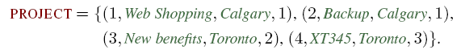
Relations

Slide 17
Relations
Let:
  N be the set of natural numbers
  M be the set of names
  L be the set of locations
Then:
  PROJECT ⊆ N x M x L

Slide 18
JT’s Extra: Creating Databases
A database stores information about entities and their attributes
  Entities: can be physical real-world objects (e.g., Cars, books, clients, games) or purely conceptual (e.g., bus routes, jobs)
  Attributes: the common characteristics that describe particular entities (e.g., All employees have names although they are likely different names)

Slide 19
JT’s Extra: Mapping Of Entities To Databases
Employee
Project
Department
Department
DNumber Name
Each entity becomes a table in the database
  Example: Employee, Project, Department
Characteristics that describe each entity becomes a column in the database.
  Example:

Slide 20
JT’s Extra: Mapping Of Entities To Databases
Specific instances of an entity make up the rows in the database.
  Example:
Department
DNumber Name
Finance
IT
Human resources
Accounting
Operations

Slide 21
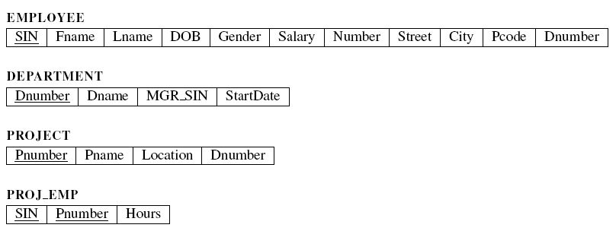
Database Schema
JT’s Extra (database schema)
Tables?
Fields?
Relationships?
21

Slide 22
JT’s Extra: Example Database Schema
 | SIN | Last name | Given names | Sales
 | 111111111 | Tam | James | $1
 | SIN | Last name | Given names | Position
 | 222222222 | Gretzky | Wayne | Center

Slide 23
Data Modeling
Entity-Relationship Model

Slide 24
Objectives
At the end of this section, you will be able to:
Understand ER the model
  Understand and differentiate between entity types, entities, relationship types, and relationships
  Understand attributes and primary keys
Understand relationship type cardinality
Understand universal and existential participation in relationships
Use ER diagrams to design data models

Slide 25
Entities
Entity: an object that exists in the real world (JT as you should know)
  Physically: book, car, student
  Conceptually: job, route
Entity-type: a class of entities
  Employee
  Project
  Department

Slide 26
Attributes
Entities have attributes (JT: as you should know)
  Properties that describe entities
An Employee can be described by:
  SIN
  Name
  DOB
  Gender
  Address

Slide 27
JT’s Extra: E.R.D.’s (Entity-Relation Diagrams)
They are used to graphically represent a database.
An ERD shows:
  Tables,
  Fields of a table
  Relationships between tables (more on this later).

Slide 28
Entity Types in ER Diagrams
EMPLOYEE
SIN
First name
Last name
DOB
Gender
Salary
Number
Street
City
Postal Code
PROJECT
Number
Name
Location
DEPARTMENT
Number
Name
JT’s: the field that uniquely identifies a particular entity is underlined in an ERD

Slide 29
JT’s Extra: Primary Key
Primary Key for table ‘Employees’ is the ‘SIN’ field
Each table should typically have one field designated as the primary key:
  The primary key must be unique (identifies one record from another).
Notes:
29

Slide 30
Primary Keys
Primary Key: a collection of attributes the uniquely identify an entity
  One attribute most of the time
SIN for employee
Student ID
Underlined in ERD

Slide 31
JT’s Extra: Choosing A Primary Key
A primary key must be unique to each record because it is the one thing that distinguishes them.
If there is at least (or even exactly) one instance (however unlikely) where records can take on the same value for a field then that field cannot be a primary key. (When in doubt if this will ever be the case then verify with your database users).
If a single key field cannot be found then several fields can be combined into a composite key. (Each field is still a separate field but together they form a unique primary key for each record).
Notes:
31

Slide 32
JT’s Extra: Choosing A Primary Key (2)
(If all else fails): If a unique primary key still cannot be found then ‘invent’ one e.g., SIN number, post secondary student number etc.

Slide 33
Cardinality (JT: Multiplicity) of Relationships
One-to-one
One-to-many (many-to-one)
Many-to-many

Slide 34
JT’s Extra: Cardinality
One to one relationships
  One entity participates in the relationship from the ‘left’ and one entity participates in the relationship from the ‘right’.
  Person : head
  Worker : Social Insurance Number
  This type of relationship is rare in databases
One to many relationships
  On one side of the relationship one entity participates in the relationship while on the other side: zero or more entities may participate in the relationship.
  Person : Hair
  Department : Employee
Notes:
34

Slide 35
JT’s Extra: Cardinality (2)
Many to many relationships
  On each side of the relationship zero or more entities may participate in the relationship.
  Students : Classes
Notes:
35

Slide 36
JT’s Extra: Cardinality (3)
Many to many relationships
  This type of relationship is not directly implemented in databases:
Students table
StudentID | StudentFirstName | StudentLastName | StudentPhone
123456 | Jamie | Smyth | 553-3992
123457 | Stacey | Walls | 790-3992
123458 | Angel | Lam | 551-4993
Classes table
ClassName | ClassNumber | Lecture No | ClassDescription
CPSC | 203 | 01 | Introduction to Problem…
CPSC | 231 | 01 | Introduction to Computer..
CPSC | 233 | 01 | Introduction to Computer..
Notes:
36

Slide 37
JT’s Extra: Cardinality (4)
Many to many relationships
  Typically implemented as two one to many relationships in databases:
Students table
Classes table
StudentID | StudentFirstName | …
123456 | Jamie
123457 | Stacey
ClassName | ClassNumber | …
CPSC | 203
CPSC | 231
Registrations table (linking table)
StudentID | ClassName | Class- Number | Lecture No
123450 | ENGL | 201 | 01
123457 | CPSC | 203 | 01
123460 | MATH | 271 | 01
Notes:
37

Slide 38
JT’s Extra: Cardinality (5)
New database schema:
  Student : Registrations (1: Many)
  Registration: Lecture (Many: 1)
Original schema (unworkable):
  Student : Lecture (Many: Many)

Slide 39
Relationships Types
EMPLOYEE
SIN
First name
Last name
DOB
Gender
Salary
Number
Street
City
Postal Code
DEPARTMENT
Number
Name
WORKS FOR
JT: single line ‘one’ participates
JT: multiple lines ‘many’ participate
CONTROLS
PROJECT
Number
Name
Location
WORKS ON

Slide 40
Relationship Degrees
The degree of a relationship is the number of entity types it relates
“Controls” is a binary relationship type
PROJECT
Number
Name
Location
CONTROLS
DEPARTMENT
Number
Name

Slide 41
Participation Levels
Entity types participate
  fully (universal participation),
  partially (existential participation)
in relationship types
JT’s Extra:
  Fully: Every instance of the records in a table must participate in the relationship.
  Partially: only some instances of the records in a table must participate in the relationship.

Slide 42
JT’s Extra: Full Participation (ERD Representation)
Employee
WORKS FOR
Department
Every employee must belong to a department
Every department must have employees
Represented using a solid line.

Slide 43
JT’s Extra: Partial Participation (ERD Representation)
Employee
Some employees that may not participate in the relationship between employees and projects (some don’t work on projects)
WORKS ON
There are no projects that don’t participate in the relationship between employees and projects (all projects must have employees working on it).
Project
Represented using a dashed line.

Slide 44
Participation Levels
EMPLOYEE
SIN
First name
Last name
DOB
Gender
Salary
Number
Street
City
Postal Code
WORKS FOR
DEPARTMENT
Number
Name
CONTROLS
PROJECT
Number
Name
Location
WORKS ON

Slide 45
ERD Examples

Slide 46
BOOK
-ID
-ISBN
-Title
-Author
-Price
-Publisher
-Year
SELLER
-ID
-Name
-email
-Rating
SELLS
COURSE
-ID
-School
-Department
-Code
-Section
-Term
-Year
TEXT

Slide 47
SINGER
-ID
-Name
-Bio
-Website
ALBUM
-ID
-Title
-Release date
RECORDS
SONG
-ID
-Title
-Duration
-Genre
PERFORMS
CONTAINS

Slide 48
MEASUREMENT
-Meas#
-Branch#
-Height
-Trunk width
-Month
-Year
TREE
-Tree#
- Year planted
ON
OF
IN
SPECIES
-Name
-Bark color
-Max height
BY
FOREST
-Fname
-Area
-Location
-Altitude
EMPLOYEE
-Emp#
-Name
-Salary
WORKS

