Slide 1
1 Logic
Peeking into Computer Science

Slide 2
Reading Assignment
Mandatory: Chapter 2 – Section 2.1

Slide 3
Propositional Logic

Slide 4
Objectives
By the end of this section, you will be able to:
Define a proposition
Define and combine the logic operators: AND, OR, NOT, XOR, and implies
Use truth tables to determine equivalence of propositions
Determine if a proposition is a tautology, contradiction, or contingency

Slide 5
JT’s Extra-Extra
Because students need more help with this section: There will be several extra slides and examples covered in class in addition to the material covered in the online version.

Slide 6
Propositions and Truth Values
A proposition is a statement whose value is either TRUE or FALSE
It is snowing today
I am not older than you
Canada is the largest country
Canada shares a border with the US
JT’s Extra: recall computers always work on a two state model (on/off, true/false, pitted/smooth etc.) which is one reason why logic is included in this course.

Slide 7
Not Propositions
X > 12
Mr. X is taller than 250cm
X+Y = 5
Mrs. Y weighs 50kg
Unless we know what the values of X and Y are, these are not propositions

Slide 8
JT’s Extra: Not Propositions
  The number 5
  lolz!

Slide 9
Compound propositions
Propositions can be built from other propositions using logical operators:
  AND, OR, NOT, and XOR (exclusive OR)
It is raining today AND it is very warm
At 12:00 today, I will be eating OR I will be home (inclusive OR)
I will be either at the beach OR hiking (XOR)
  JT: this is exclusive-OR, having one case true excludes the possibility of the other being true)
I will NOT be home at 6

Slide 10
JT’s Extra: Logical AND
The popular usage of the logical AND applies when ALL conditions must be met (very stringent).
  In terms of logic: ‘AND’ applies when all propositions must be true.
  Example: I picked up all the kids today.
  Picked up son AND picked up daughter.

Slide 11
JT’s Extra: Logical OR
The correct everyday usage of the logical OR applies when ATLEAST one condition must be met (less stringent).
    In terms of logic: ‘OR’ applies when one or more propositions are true.
    Example:
    Using the ‘Peeking’ book OR using another book to supplement your learning.

Slide 12
JT’s Extra: Logical NOT
The everyday usage of logical NOT negates (or reverses) a statement.
In terms of logic: ‘NOT’ reverses a proposition (true becomes false and false becomes true).
I am finding this class quite stimulating and exciting
NOT!!!
Statement (logical condition)
Negation of the statement/condition

Slide 13
JT’s Extra: Double Negation
Double negation in logic is similar to mathematics
-
-
10
I am finding this class quite stimulating and exciting
    NOT!!!
    NOT!!!

Slide 14
Example: U of C Calendar
Bachelor of Commerce (Year 1) Required Grade 12 High School Subject
  English 30 or ELA 30-1 and
  Pure Mathematics 30 and
  Subject from Group A or B

Slide 15
Example: Income Tax Guide
Eligible tuition fees
Generally, a course qualifies if it was taken at the post-secondary level or (for individuals aged 16 or over at the end of the year) it develops or improves skills in an occupation and the educational institution has been certified by Human Resources and Social Development Canada. In addition, you must have taken the course in 2007.

Slide 16
Example: Income Tax Guide
Line 349 - Donations and gifts
You can claim donations either you or your spouse or common-law partner made. For more information about donations and gifts, or if you donated any of the following:
gifts of property other than cash; or
gifts to organizations outside Canada; or
gifts to Canada, a province, or a territory made after 1997 and agreed to in writing before February 19, 1997.

Slide 17
Negation (JT ‘NOT’)
If A is a proposition,
then ¬A is a proposition
that is true when A is false
And false when A is true
¬A is read NOT A

Slide 18
Truth Table for Negation
A | ¬ A
T
F
F
T
It is raining today
It is not raining today

Slide 19
Conjunction (JT: ‘AND’)
If A and B are a propositions,
then A ∧ B is a proposition
that is true when both A and B are true
otherwise, it is false
A ∧ B is read A and B

Slide 20
Truth Table for Conjunction
A | B | A ∧ B
T
T
T
T
F
F
F
T
F
F
F
F
It is raining today and it is cold
JT: Column A
JT: Column B

Slide 21
Disjunction (JT: ‘OR’)
If A and B are a propositions,
then A ∨ B is a proposition
that is false when both A and B are false
otherwise, it is true
A ∨ B is read A or B

Slide 22
Truth Table for Disjunction
A | B | A OR B
T
T
T
T
F
T
F
T
T
F
F
F
It is raining today or it is cold
JT: Column A
JT: Column B

Slide 23
JT’s Extra: Who Gets Hired?
X
In order to be hired for this position applicants must have at least one of the following: a grade point over 3.0, at least 5 years of relevant job experience.
  Alice: GPA 3.7, 10 years experience.
  Bob: GPA 4.0, no work experience.
  Charlie: GPA = 2.0, 5 years work experience.
  Jim: GPA = 1.7, 1 year work experience.
√

Slide 24
JT’s Extra: Who Do We Let Go?
X
√
The company will be downsized with the following group of people to be laid off: employees who were on the job for less than two years and earn over $50,000 per year.
  Alice: 10 years on the job, $30,000 salary.
  Bob: 5 years on the job, $100,000 salary.
  Charlie: 1 year on the job, $45,000 salary.
  Jim: 0 years on the job, $1,000,000 salary.

Slide 25

JT’s Extra: Fashion Sense?
X
√
Your Ace Game Show Host Jim Tam ™
Keen eye for fashion: true or false?
  It is not the case that the course instructor for this CPSC 203 lecture has a keen fashion sense.

Slide 26
Inclusive Vs. Exclusive OR
JT’s Extra: sometimes the everyday usage of ‘OR’ does not correspond to ‘Logical OR’.
To be eligible for the job, you have to be above 21 or attending a post-secondary institution
We’ll drive you to your place: my friend or I will be driving your car
Example: Flight attendant asks if you would like beer or wine?

Slide 27
Exclusive OR
If A and B are a propositions,
then A ⊕ B is a proposition
that is true when exactly one of A and B is true
otherwise, it is false
A ⊕ B is read A xor B

Slide 28
Truth Table for XOR
A | B | A ⊕ B
T
T
F
T
F
T
F
T
T
F
F
F
It will be at home or at school

Slide 29
JT’s Extra: Inclusive Or Exclusive?
1) From “The Simpsons” © Fox
It will rain or it will not rain today.
Either “Santa’s little helper”¹ or “Lucky 7” will win the race. (Assume clear cut outcome).
You can take it or leave it.
Her grades are excellent so she’s either very bright or studies hard.

Slide 30
JT: In Class Exercise
Use truth tables to prove the equivalence of the two sets of logical expressions:
  NOT (A OR B)
  Is equivalent to
  NOT(A) AND NOT(B)
Notes:
30

Slide 31
JT’s Extra: Another Equivalency
You have just proved DeMorgan’s Law
  Example from
    http://people.hofstra.edu/Stefan_Waner/RealWorld/logic/logic2.html
Let p: "The President is a Democrat,"
Let q: "The President is a Republican."
Then ~(p AND q): "The President is not both a Democrat and a Republican."
This is the same as saying: "Either the President is not a Democrat, or he is not a Republican, or he is neither," which is (~p) OR (~q).

Slide 32
XOR is Redundant
A | B | A ⊕ B
A ∨ B
A ∧ B
¬(A ∧ B)
T
T
F
T
T
F
T
F
T
T
F
T
F
T
T
T
F
T
F
F
F
F
F
T
A xor B = (A or B) and not (A and B)

Slide 33
XOR is Redundant
A | B | A ⊕ B
A ∨ B
A ∧ B
¬(A ∧ B)
T
T
F
T
T
F
T
F
T
T
F
T
F
T
T
T
F
T
F
F
F
F
F
T
A ⊕ B = (A ∨ B) ∧ ¬ (A ∧ B)

Slide 34
XOR is Redundant
A ⊕ B
A ∨ B
A ∧ B
¬(A ∧ B)
F
T
T
F
T
T
F
T
T
T
F
T
F
F
F
T
A ⊕ B = (A ∨ B) ∧ ¬ (A ∧ B)

Slide 35
XOR is Redundant
C
D
A ⊕ B
A ∨ B
A ∧ B
¬(A ∧ B)
C ∧ D
F
T
T
F
F
T
T
F
T
T
T
T
F
T
T
F
F
F
T
F
A ⊕ B = (A ∨ B) ∧ ¬ (A ∧ B)

Slide 36
XOR is Redundant
C
D
A ⊕ B
A ∨B
A ∧ B
¬(A ∧ B)
C ∧ D
F
T
T
F
F
T
T
F
T
T
T
T
F
T
T
F
F
F
T
F
A ⊕ B = (A ∨ B) ∧ ¬ (A ∧ B)

Slide 37
DeMorgan’s Rules
Use a truth table to show that the following propositions are equivalent
¬ (A ∧ B) = (¬ A) ∨ (¬ B)
I never drink wine at the beach
It is never the case that I drink wine AND I am at the beach
It is always the case that I do NOT drink wine OR I am NOT at the beach

Slide 38
Truth Table
A | B | A ∧ B
¬ (A ∧ B)
T
T
T
F
T
F
F
T
F
T
F
T
F
F
F
T
¬ (A ∧ B) = (¬ A) ∨ (¬ B)

Slide 39
Truth Table
A | B | A ∧ B
¬ (A ∧ B)
¬ A
T
T
T
F
F
T
F
F
T
F
F
T
F
T
T
F
F
F
T
T
¬ (A ∧ B) = (¬ A) ∨ (¬ B)

Slide 40
Truth Table
A | B | A ∧ B
¬ (A ∧ B)
¬ A
¬ B
T
T
T
F
F
F
T
F
F
T
F
T
F
T
F
T
T
F
F
F
F
T
T
T
¬ (A ∧ B) = (¬ A) ∨ (¬ B)

Slide 41
Truth Table
A | B | A ∧ B
¬ (A ∧ B)
¬ A
¬ B
¬ A ∨ ¬ B
T
T
T
F
F
F
F
T
F
F
T
F
T
T
F
T
F
T
T
F
T
F
F
F
T
T
T
T
¬ (A ∧ B) = (¬ A) ∨ (¬ B)

Slide 42
Truth Table
A | B | A ∧ B
¬ (A ∧ B)
¬A
¬ B
¬ A ∨ ¬ B
T
T
T
F
F
F
F
T
F
F
T
F
T
T
F
T
F
T
T
F
T
F
F
F
T
T
T
T
¬ (A ∧ B) = (¬ A) ∨ (¬ B)

Slide 43
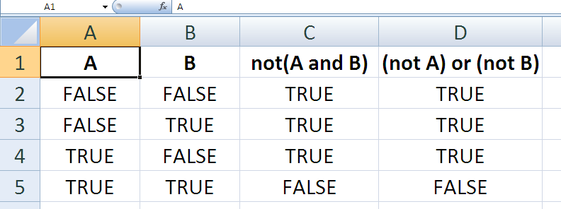
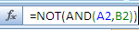
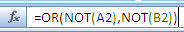
Truth Tables in Excel

Slide 44
DeMorgan’s Rules
Use a truth table to show that the following propositions are equivalent
  JT: already done as an in-class exercise!
¬ (A ∨ B) = (¬ A) ∧ (¬ B)
It is never the case that I am bored OR tired
It is always the case that I am NOT bored AND NOT tired

Slide 45
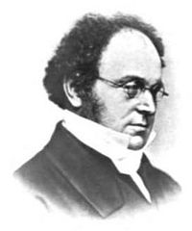
Augusts DeMorgan
1806-1871
British Mathematician born in India
Wrote more than 1000 articles!
He introduced Mathematical Induction in1838

Slide 46
Implication
If A and B are a propositions,
then A → B is a proposition
that is false when A is true and B is false
otherwise, it is true
A → B is read if A then B, or A implies B

Slide 47
Implication
If you have a Canadian passport, then you’re a Canadian citizen
A = you have a Canadian passport
B = you’re a Canadian citizen
Logical expression:
A → B

Slide 48
Implication
If you have a Canadian passport, then you’re a Canadian citizen
Maybe you have a Canadian passport (T) and you’re a Canadian citizen (T)
  JT: Can be true
Maybe you do not have a Canadian passport (F) and you’re a Canadian citizen (T)
  JT: Can be true
Maybe you do not have a Canadian passport (F) and you’re not a Canadian citizen (F)
  JT: Can be true
It is not the case that (you have a Canadian passport (T) and you’re not a Canadian citizen) (F)
  JT: Claim cannot be true (i.e., it’s a False claim)

Slide 49
Truth Table Implication
A | B | A → B
T
T
T
T
F
F
F
T
T
F
F
T
If you have a DL, then you can drive

Slide 50
JT’s Extra Example
Let p be the statement: x is in Calgary
Let q be the statement: x is in Alberta
P | Q | P->Q
T | T | T
T | F | F
F | T | T
F | F | T
Calgary, Alberta : TRUE
Calgary, Not Alberta : FALSE
Not Calgary, Alberta : TRUE
Not Calgary, Not Alberta : TRUE

Slide 51
Truth Table for Implication
A | B | A → B
T
T
T
Have pass, citizen
T
F
F
Have pass, not citizen
F
T
T
Have not pass, citizen
F
F
T
Have not pass, not citizen

Slide 52
Implication is Redundant
A → B is logically equivalent to:
  ¬A ∨ B
  Prove it using a truth table
If you have a Canadian passport, then you’re a Canadian citizen
You do not have a Canadian passport or you’re a Canadian Citizen

Slide 53
JT Exercise: Show That Implication Is Redundant
Using truth tables show how the result of implication can be derived with an equivalent logical expression.

Slide 54
Contrapositive
A → B is logically equivalent to:
  ¬B → ¬A
If you have a Canadian passport, then you’re a Canadian citizen
If you you’re not a Canadian citizen, then you do not have a Canadian passport

Slide 55
JT Exercise: Contrapositive And Implication
Using truth tables show the equivalency of these logical operations.

Slide 56
Precedence
If a complex proposition does not have brackets apply operators in the following order
  ¬
  ∧ or ∨ or xor, left to right
  →
¬A ∧ B = (¬ A) ∧ B
This is different from ¬(A ∧ B)
A ∨ B ∧ C = (A ∨ B) ∧ C

Slide 57
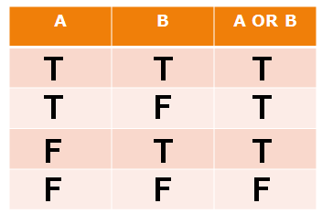
Tautologies
A tautology is a proposition that is always true
At the end, I will pass the course or I will not pass it
  JT: one or the other outcome must come to pass (be true)
  JT: Since logical-OR requires only one true input, the result is true
A = I will pass the course
A ∨ (¬ A)

Slide 58
Tautologies
A | ¬A
A ∨(¬ A)
T
F
T
F
T
T

Slide 59
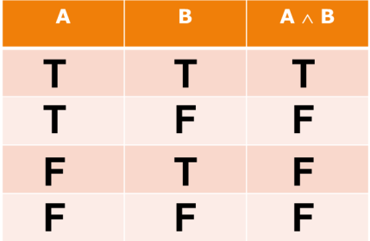
Contradictions
A contradiction is a proposition that is always false
  The past season, the Flames won the Stanley Cup and the Oilers won the Stanley Cup
  If the Oilers won, then the Flames lost
  A = The Flames won
  A ∧ (¬ A)
  JT’s extra:
    JT: one or the other outcome must come to pass (be true) while the other will not (false)
    JT: Since logical-AND requires all inputs to be true, the result is always false

Slide 60
Contradictions
A | ¬ A
A ∧(¬A)
T
F
F
F
T
F

Slide 61
Contingencies
A contingency is a proposition that is neither a contradiction nor a tautology
This season, the Flames will win the Stanley Cup

