Slide 1
4 Finite State Machines
Peeking into Computer Science

Slide 2
Reading Assignment
Mandatory: Chapter 3 – Section 3.6

Slide 3
Finite State Machines
Graphs as Solutions

Slide 4
Objectives
At the end of this section, the student will be able to:
Define Finite State Machines (FSMs)
Represent FSMs using state-tables and state-diagrams
Use FSMs to design High-Level programs
Understand FSM examples

Slide 5
JT’s Extra: What Is A Finite State Machine?
It’s a special form of multi graph (vertices and edges) that have conditions that show how you go from one vertex to another.
Condition
Vertex 1
Vertex 2
Condition

Slide 6
Finite State Machines
Vertices are States
Edges are labeled Transitions
jog
eat
eat
Hungry
Full
jog

Slide 7
JT’s Extra: Video
State machine: illustrating a treasure hunt.

Slide 8
JT’ Extra: First Example: Robot Redux (State Machine)
Wall not found
Search for wall
Hug the wall
Wall found

Slide 9
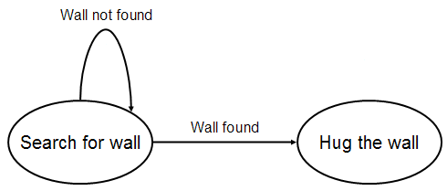
JT’s Extra: Why Learn About State Machines
A state machine is another level of abstraction that specifies what a computer is supposed to do.
  Level I: Finite state machine
  Level II: Human language instructions (pseudo code)
Search for wall
If RS = W, then done this phase
If FS = W, then L, done this phase
If FS = S, then F
Hug the wall
Repeat the following steps:
If RS = W and FS = S, then F
If FS = W, then L
If RS = S and FS = S, then R and F

Slide 10
JT’s Extra: Why Learn About State Machines
  Level III: Programming language instructions
if (robot.wallToRight () == true)
{
isDone = true;
return;
}

Slide 11
Automatic Door Controller
Door
Front
Pad
Rear
Pad
Based on Sipser, Introduction to the Theory of Computation, Thomson

Slide 12
Automatic Door Controller
Identify the door states
Identify events that trigger transitions
Version 1 : sliding door
Door
Front
Pad
Rear
Pad

Slide 13
FSM – Sliding Door
Identify the door states
Identify events that trigger transitions
Events
NONE
FRONT
REAR
BOTH
Door
States
CLOSED
CLOSED
OPEN
OPEN
OPEN
OPEN
CLOSED
OPEN
OPEN
OPEN

Slide 14
FSM Diagram – Sliding Door
Events
NONE
FRONT
REAR
BOTH
Door
States
CLOSED
CLOSED
OPEN
OPEN
OPEN
OPEN
CLOSED
OPEN
OPEN
OPEN
FRONT
REAR
NONE
BOTH
FRONT
BOTH
CLOSED
OPEN
REAR
NONE

Slide 15
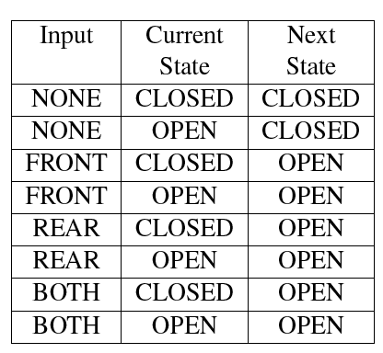
Alternative Table
NONE
FRONT
REAR
BOTH
CLOSED
CLOSED
OPEN
OPEN
OPEN
OPEN
CLOSED
OPEN
OPEN
OPEN

Slide 16
Door Open Both Ways
Version 2 : door opens both ways
Door
Front
Pad
Rear
Pad

Slide 17
FSM – Door Opens Both Ways
Identify the door states
Identify events that trigger transitions
Events
NONE
FRONT
REAR
BOTH
Door
States
CLOSED
CLOSED
OPENR
OPENF
CLOSED
OPENF
CLOSED
OPENF
OPENF
OPENF
OPENR
CLOSED
OPENR
OPENR
OPENR

Slide 18
FSM Diagram
Events
NONE
FRONT
REAR
BOTH
Door
States
CLOSED
CLOSED
OPENR
OPENF
CLOSED
OPENF
CLOSED
OPENF
OPENF
OPENF
OPENR
CLOSED
OPENR
OPENR
OPENR
REAR
OPENF
FRONT
NONE
REAR
BOTH
BOTH
NONE
CLOSED
FRONT
REAR
OPENR
FRONT
NONE
BOTH

Slide 19
JT’s Extra, Real Life Example: Table Of States
Events | States
Tired | Seek (place to sleep)
Found sleep place | Sleep
Seek time expired | Sleep
Wake up | Awake
Hungry | Eating
Full | Return (awake)
Nature calls | Relieving
Relieved | Return (awake)
Lonely | Socializing
Socialized | Return (awake)
Bored | Have fun
Amused | Return (awake)

Slide 20
JT’s Extra, Real Life Example: State Machine
Found place
Sleeping
Time expired
Eating
Seeking
Hungry
Tired
Wake up
Full
Awake
Bored
Nature calls
Have fun
Relieved
Relieving
Lonely
Amused
Socialized
Socializing

Slide 21
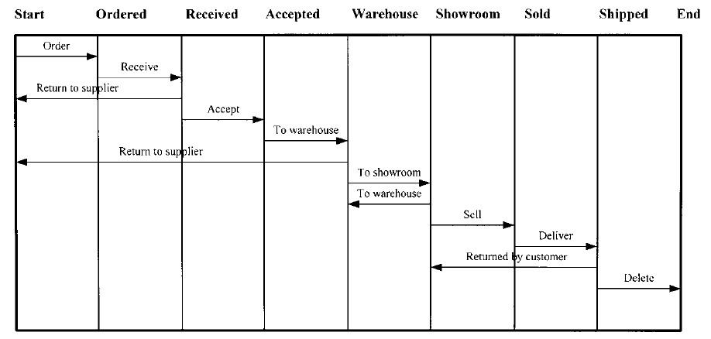
JT’s Extra, Real Life Example: State Machine
^{1 From www.hit.ac.il}
Control flows or steps in a process¹

Slide 22
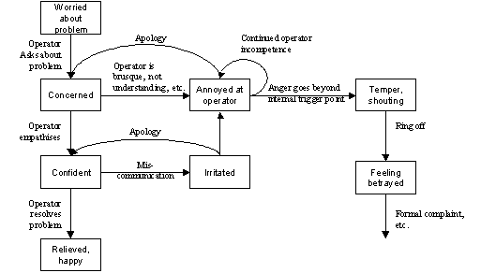
JT’s Extra: State Machines Can Model More Than Just Electronics/Machinery
1From http://syque.com/articles/state-transition/state-transition.htm
Emotional states during an interaction¹

Slide 23
JT’s Extra 1, A Chess Game
There are two colors in the game of chess: white and black. White begins the game and thereafter the game alternates between white and black until either player wins (checkmate) or the game is a draw (stalemate). A win or stalemate can occur during either player’s turn.

Slide 24
JT’s Extra 1, A Chess Game: Solution
Start
White wins
Checkmate
White’s turn
White moves
Stalemate
Black moves
Draw
Stalemate
Black’s turn
Checkmate
Black wins

Slide 25
Exercise
Design a controller for a garage door
The door receives input from one remote control only
It also responds to sensing obstacles

Slide 26
JT’s Extra 2, Water Taps
Consider a faucet with two taps: hot and cold. For simplicity consider that there’s four possibilities. If both taps are off then no water comes out. If the hot tap is on then only hot water comes out. If the cold tap is on then only cold water comes out. If the hot and cold tap are on then warm water comes out.

Slide 27
Simple Vending Machine
Dispenses $3 phone cards
Accepts $1 or $2 only
No change
Keeps coins in coin collector until a card is dispensed; then, coins are dropped into the piggy bank
User
  Insert coins
  Press COLLECT to collect
  Press CANCEL to cancel
Loonies or Twonies only
CANCEL
COLLECT
Exact Change
only

Slide 28

That is
Loonies or Twonies only
Coin
collector
CANCEL
COLLECT
COLLECT
CANCEL
Exact Change
only
Piggy
bank
$3 Card

Slide 29
Vending Machine – States
Need five states:
ONE: Total in coin collector is $1
TWO: Total in coin collector is $2
THREE: Total in coin collector is $3
DISP: dispenses a card, roll in coins to piggy (coin collector becomes empty)
ZERO: return coins in coin collector; also serves as a start state
  Initially coin collector is empty

Slide 30
Vending Machine – Events
Events/Transition labels:
$1: user inserts a loonie
$2: user inserts twonie
CANCEL: user presses CANCEL
COLLECT: user presses COLLECT

Slide 31
FSM
COLLECT
ONE
CANCEL
$2
CANCEL
$1
$1
$1
ZERO
TWO
DISP
$2
CANCEL
$2
$2
$1
$1
$2
Treat missing arrows as stay in the same state
THREE
COLLECT
CANCEL

Slide 32
JT’s Extra: For More Information
State-transition diagram
Finite state automata
Finite state machines

Slide 33
JT’s Extra: Other Sources Of Practice
Personal electronics e.g. digital watch, MP3 player, regular (non-smart) phones.
Home electronics e.g. PVR, DVD, TV, VCR, clock radio (some PVR’s and VCR’s may be too complex).
Simple machines e.g., vending machines, ticket dispenser, car dashboard controls, ATM (some could be too complex).
Simple interactive websites (must allow for user interaction rather than ones that just statically display information e.g., Facebook or a banking site as opposed to a news site that doesn’t allow for user comments).
Software that is modal e.g., drawing and painting programs

