Slide 1
Trees &
Information Coding: 3
Peeking into Computer Science

Slide 2
Reading Assignment
Mandatory: Chapter 3 – Section 3.5

Slide 3
Information Coding
An application of trees

Slide 4
Objectives
At the end of this section, the student will be able to:
Understand the need for variable-length coding (VLC)
Understand how compression works
Calculate the space savings with VLC
Understand decoding problems with VLC
Define non-prefix VLC
Use Huffman’s algorithm and binary trees to assign optimized non-prefix VLC
Represent BL trees as nested lists

Slide 5
Back to Coding (JT: Review)
Assume we have a file that contains data composed of 6 symbols only:
A, I, C, D, E, and S (for space)
ACE DICE AIDE CAID EAD DAICED …

Slide 6
Back to Coding
Assume we have a file that contains data composed of 6 symbols only:
A, I, C, D, E, and S (for space)
ACESDICESAIDESCAID EADSDAICED …

Slide 7
Coding
If the file has 1000 characters, how many bits (0s and 1s) are needed to code the file?

Slide 8
Coding (JT: Review)
The first question is
How many symbols do we need to represent each character?
The objective is to keep the size of the file as small as possible
We have 6 characters (messages) and two symbols (0 and 1)
2 is not enough, since 2² is 4

Slide 9
2 bits are not enough (JT: Review)
00 for A
01 for S
10 for I
11 for E
We cannot represent the rest C and D
3 works, since 2³ is 8, so we can represent up to 8 characters and we only have 6

Slide 10
3 bits are more than enough (JT: Review)
Say
000 for A
001 for S
010 for I
011 for E
100 for C
101 for D
110 not used
111 not used

Slide 11
Coding (JT: Review)
If the file has 1000 characters, how many bits (0s and 1s) are needed to code the file?
Each character needs 3 bits
Hence, we need 3x1000 = 3000 bits

Slide 12
Compression
How does file compression work?
Huffman’s codes reduce the size of a file by using variable-length codes for characters

Slide 13
Compression
Analyzing the file we find that
35% are S
28% of the characters are A
20% are E
7% are I
6% are C
4% are D
Some characters are more frequent than others

Slide 14
Variable-Length Codes
To reduce the size of the file, we can use shorter codes for frequent characters
  We can use longer codes for infrequent characters
35% are S (use 2 bits for S)
28% are A (use 2 bits for A)
20% are E (use 2 bits for E)
7% are I (use 3 bits for I)
6% are C (use 4 bits for C)
4% are D (use 4 bits for D)

Slide 15
Compressed File Size
If we use this coding, what is the size of the file?
350 S’s (35% of 1000) require 700 bits (2 bits for each S)
200 E’s require 400 bits (2 bits)
280 A’s require 560 bits (2 bits)
70 I’s require 210 bits (3 bits)
60 C’s require 240 bits (4 bits)
40 D’s require 160 bits (4 bits)
Total is 2270 bits
Recall that with fixed codes, the size is 3000 bits
Compressed file size is about 76% of original size

Slide 16
Problems with Variable-Length Codes
Not any variable-length code works
Assume A’s code is 0
C’s code is 1
E’s code is 01
The code 0101 could correspond to ACE, EAC, ACAC, or EE

Slide 17
Prefix Codes
Codes that work must have the property:
No code can be the prefix of another code
Called Non-Prefix Codes
0 is a prefix of 01, this is why our coding failed
Another example: 0101 is a prefix of 010111

Slide 18
Non-Prefix Codes
Non-Prefix codes can be generated using a binary tree
Start from a binary tree
Label edges to left children with 0
Label edges to right children with 1
Record the labels on the path from the root to the leaves
Each path corresponds to a non-prefix code

Slide 19
Non-Prefix Codes from a Binary Tree
0
1
1
1
0
0
0
1
0
1

Slide 20
Non-Prefix Codes from a Binary Tree
A’s code: 00
B’s 0100
C’s 0101
D’s 011
E’s 10
F’s 11
0
1
1
0
1
0
A
1
E
F
0
D
0
1
B
C
Notes:
\

Slide 21
No code is a prefix of another
00
0100
0101
011
10
11
0
1
1
0
1
0
A
1
E
F
0
D
0
1
B
C

Slide 22
No Confusion
A:00, B:0100, C:0101, D:011, E:10, F:11
010000011
No other interpretation
  Parsing left to right
  (JT’s extra: parsing refers to ‘reading’ or ‘breaking into meaningful portions’)
B
A
D

Slide 23
No Confusion
A:00, B:0100, C:0101, D:011, E:10, F:11
111010011
So How do we generate such codes?
F
E
E
D

Slide 24
Huffman’s Coding
Build a binary tree
The characters in a file are the leaves
The most frequent characters should be closer to the root, generating shorter codes
Assign the codes, based on this tree

Slide 25
Huffman's Coding – Step 1
Assign to each symbol its weight (frequency)
Each of these is a tree of size one!
A
C
D
E
S
I
28
6
4
20
35
7

Slide 26
Huffman's Coding – Step 2
Choose two trees that have the minimum weights
  Replace these two trees with a new tree with new root
  Make the tree with the smaller weight a right child
  The weight of the new tree is the sum of old weights (JT: next slide)
A
C
D
E
S
I
28
6
4
20
35
7
New tree
C
D
New tree weight 6+4 = 10

Slide 27
Huffman's Coding – Step 2
Choose two trees that have the minimum weights
  Replace these two trees with a new tree with new root
  Make the tree with the smaller weight a right child
  The weight of the new tree is the sum of old weights
A
E
S
I
28
20
35
7
C
D
10

Slide 28
Huffman's Coding – Repeat
Repeat Step 2 until we have a single tree
A
C
D
E
S
I
28
10
20
35
7

Slide 29
Step 2 Again
Choose two trees that have the minimum weights
  Replace these two trees with a new tree with new root
  Make the tree with the smaller weight a right child
  The weight of the new tree is the sum of old weights
A
C
C
D
D
E
S
I
I
28
10
20
35
7

Slide 30
Step 2 Again
Choose two trees that have the minimum weights
  Replace these two trees with a new tree with new root
  Make the tree with the smaller weight a right child
  The weight of the new tree is the sum of old weights
A
C
D
E
S
I
28
10
20
35
7
New tree weight 10+7 = 17
I
C
D

Slide 31
A
E
S
28
20
35
I
C
D
17

Slide 32
Step 2 Again
I
A
E
C
D
S
17
35
28
20

Slide 33
I
A
E
C
D
S
17
35
28
20

Slide 34
E
I
A
E
C
D
S
37
28
20
35
Weight is 20+17 = 37

Slide 35
E
I
A
C
D
S
37
35
28
Weight is 20+17 = 37

Slide 36
E
I
S
A
C
D
37
35
63
28
Weight is 35+28 = 63

Slide 37
E
I
S
A
C
D
37
63

Slide 38
S
A
E
63
I
C
D
37

Slide 39
S
A
E
I
C
D

Slide 40
Step 3
Label left edges with 0 and right edges with 1
0
1
0
0
1
1
E
0
1
S
A
I
1
0
C
D

Slide 41
Read the labels on the path from the root to each leaf, this is its code
0
1
0
0
1
1
E
0
1
S
A
I
0
1
C
D

Slide 42
A’s code is 01
0
1
0
0
1
1
E
0
1
S
A
I
0
1
C
D

Slide 43
A’s code is 01
C’s is 1100
S’s is 00
E’s is 10
D’s is1101
I’s is 111
0
1
0
0
1
1
E
0
1
S
A
I
0
1
C
D

Slide 44
More Frequent Characters have shorter codes
35% are S (00, 2 bits)
28% are A (01, 2 bits)
20% are E (10, 2 bits)
7% are I (111, 3 bits)
6% are C (1100, 4 bits)
4% are D (1101, 4 bits)

Slide 45
Recall This Analysis?
If we use this coding, what is the size of the file?
350 S’s (35% of 1000) require 700 bits (2 bits for each S)
280 A’s require 560 bits
200 E’s require 400 bits
70 I’s require 210 bits
60 C’s require 240 bits
40 D’s require 160 bits
Total is 2270 bits
Recall that with fixed codes, the size is 3000 bits
Compressed file size is about 76% of original size

Slide 46
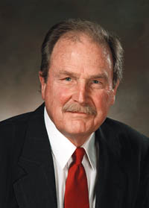
David Huffman
1925-1999
US Electrical Engineer
Contributions in coding theory, signal design for radar and communications, and logic circuits
He wrote his coding algorithm as a graduate students at MIT

Slide 47
Concluding Notes
Even though coding gave C and D codes of length 4 (compared to 3 in fixed coding), it was beneficial
No code generated by Huffman’s method can be a prefix of another code
Many compression tools use a combination of different coding methods, Huffman’s is among them

Slide 48
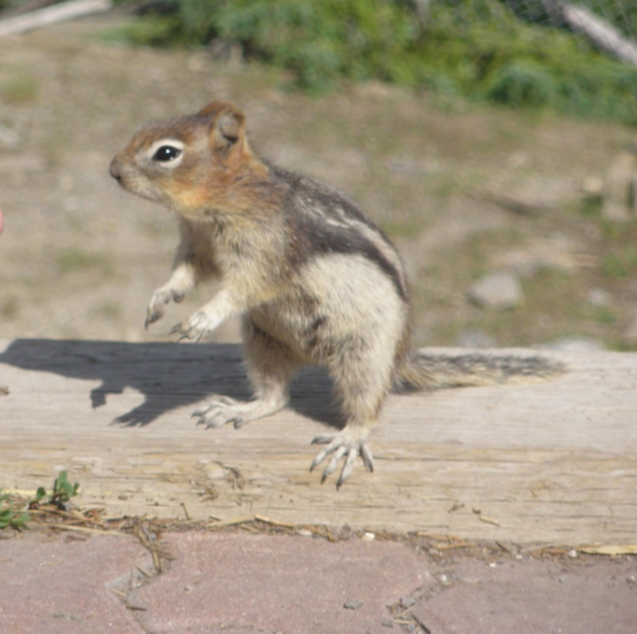

JT’s Extra: Uses Of Compression
Hi-res: JPEG 322 KB
Hi-res: TIF 14.1 MB
Images: Courtesy of James Tam
Image and video files
Notes:
Huffman coding today is often used as a "back-end" to some other compression methods. DEFLATE (PKZIP's algorithm) and multimedia codecs such as JPEG and MP3 have a front-end model and quantization followed by Huffman coding (or variable-length prefix-free codes with a similar structure, although perhaps not necessarily designed by using Huffman's algorithm

