Slide 1
Graphs
Peeking into Computer Science

Slide 2
Reading Assignment
Mandatory: Chapter 3 – Sections 3.3 & 3.4

Slide 3
Graph Coloring

Slide 4
Objectives
At the end of this section, you will be able to:
Understand (once more) how graphs are used to represent data
Learn the graph coloring algorithm
Apply graph coloring to solve for various scheduling problems

Slide 5
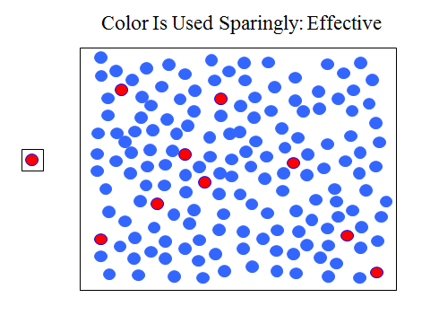
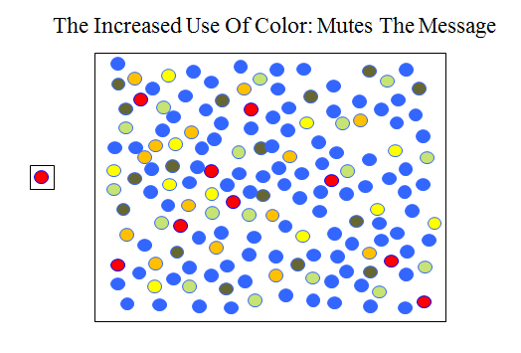
JT’s Extra
Recall:
  When color is used to draw attention or otherwise used to communicate information the number of colors used should be minimized.
Vs.

Slide 6
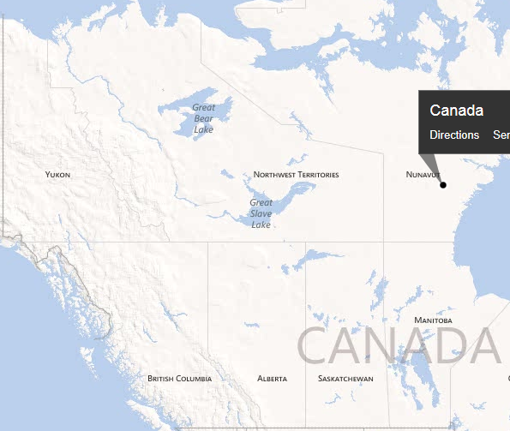
JT’s Extra: A Subset Of Canada: Color The Map Using As Few Colors As Possible And No Adjacent Colors

Slide 7
JT’s Extra: Canada (As A Graph)
YK
NWT
NU
BC
AB
SK
MB

Slide 8
Simple Intersection
D
C
A
B
Based on Aho, Hopcroft, and Ullman, Data Structures and Algorithms, Addison-Wesley

Slide 9
Another Example Problem
Design a traffic light for a complex intersection
Identify allowed turns
  Going straight is a turn!
Group turns so that permitted simultaneous turns are in the same group
Find the smallest number of groups
  This means a traffic light with the smallest number of phases

Slide 10
Simple Intersection
D
C
A
B
Based on Aho, Hopcroft, and Ullman, Data Structures and Algorithms, Addison-Wesley

Slide 11
9 Possible Turns
From A to B (denoted AB)
From A to C (AC)
From A to D (AD)
BA
BC
BD
DA
DB
DC
D
C
A
B

Slide 12
Example Simultaneous Turns
AC
AD
BA
D
C
A
B

Slide 13
Example Conflicting Turns
AC conflicts with
DB
BD
BC
DC
D
C
A
B

Slide 14
Objective
Build a graph model
Vertices are turns
An edge connects conflicting turns

Slide 15
Graph Model of Conflicting Turns
AB
AC
AD
D
BA
BC
BD
C
DA
DB
DC
A
B

Slide 16
Graph Coloring
Color the vertices of the graph
No two adjacent vertices can have the same color
  Adjacent: and edge connects them
Each color represents a group of turns that can be simultaneous
Note: more than one solution

Slide 17
Graph Coloring Algorithm
Repeat the following two steps until the graph is colored
Select an uncolored vertex and color it with a new color, C
For each uncolored vertex,
  Determine if it has an edge with a vertex that is colored with color C
  If not, color it with color C
  If yes, skip it

Slide 18
JT’s Extra, Graph Coloring Example 1: Final Exams
You are to schedule final exams so that a student will not have two final exams scheduled at the same time.
Although you could schedule each exam in it’s own individual time slot (i.e., no two exams run simultaneously) this would be highly inefficient.
  Another constraint is to schedule exams with the minimum number of time slots.
Examinations for a lecture will be represented with vertices.
A pair of vertices will be connected if there is at least one student who is registered in both.

Slide 19
JT’s Extra, Graph Coloring Example 1: Final Exams (2)
Lecture A
Student 2
Lecture B
Student 1
Student 4
Lecture C
Student 5
Lecture D
Lecture A:
  Student 1, student 2
Lecture B:
  Student 2, student 4, student 6
Lecture C:
  Student 1, student 3, student 5
Lecture D:
  Student 4, student 5
Notes:
One solution:
Slot 1: A, D
Slot 2: B, C

Slide 20
JT’s Extra, Graph Coloring Example 2: Final Exams
Lecture A
Student 2, 4
Lecture B
Student 1
Student 4
Student 4
Lecture C
Student 5
Lecture D
Lecture A:
  Student 1, student 2, student 4
Lecture B:
  Student 2, student 4, student 6
Lecture C:
  Student 1, student 3, student 5
Lecture D:
  Student 4, student 5
Notes:
One solution:
Slot 1: A
Slot 2: B, C
Slot 3: D

Slide 21
JT’s Extra: Color This Graph

Slide 22
Graph Model of Conflicting Turns
AB
AB
AC
AC
AD
AD
D
BA
BA
BC
BC
BD
BD
C
DA
DA
DB
DB
DC
DC
A
B

Slide 23
Graph Model of Conflicting Turns
AB
AB
AC
AC
AD
AD
D
BA
BA
BC
BC
BD
BD
C
DA
DA
DB
DB
DC
DC
A
B

Slide 24
Graph Model of Conflicting Turns
AB
AB
AC
AC
AD
AD
D
BA
BA
BC
BC
BD
BD
C
DA
DA
DB
DB
DC
DC
A
B

Slide 25
Complex Intersection
D
E
C
A
B
From Aho, Hopcroft, and Ullman, Data Structures and Algorithms, Addison-Wesley

Slide 26
JT’s Extra: Graph Coloring Applications
Scheduling
Mobile radio frequency assignment
Sudoku
Notes:
Register allocation: most frequently used values has to be in multiple registers
Sudoku can be seen as completing a 9-coloring on given specific graph with 81 vertices.
The grid (also called "boxes", "blocks", "regions", or "sub-squares") contains all of the digits from 1 to 9.
The puzzle setter provides a partially completed grid, which typically has a unique solution.
Solving Sudoku puzzles can be expressed as a graph coloring problem. Consider the 9 × 9 = 3² × 3² case.
The aim of the puzzle in its standard form is to construct a proper 9-coloring of a particular graph, given a partial 9-coloring.
The graph in question has 81 vertices, one vertex for each cell of the grid.
The vertices can be labeled with the ordered pairs (x, y), where x and y are integers between 1 and 9.
In this case, two distinct vertices labeled by (x, y) and (x′, y′) are joined by an edge if and only if:
x = x′ (same column) or,
y = y′ (same row) or,

Slide 27
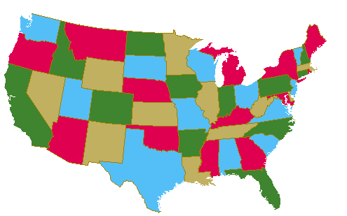
JT’s Extra: Complex Graphs Requiring Only 4 Colors

Slide 28

JT’s Extra: Complex Graphs Requiring Only 4 Colors

Slide 29
Trees
A popular special case of graphs

Slide 30
Objectives
At the end of this section, the student will be able to:
Identify when a graph is a tree
Use tree terminology
Identify different applications of trees
Define binary trees

Slide 31
Computer Science Trees
Trees are a special case of graphs
A tree is a (directed) graph with the properties:
There is a designated vertex, called the root of the tree
There is a unique directed path from the root to every other vertex in the tree
Grow downwards!

Slide 32
Example Tree
A
B
C
D
E
F
G
H

Slide 33
Example Tree
A tree always “grows” downward
We omit the arrows
A
B
C
D
E
F
G
H

Slide 34
Tree Terminology
Root
Child
Parent
Ancestor
Descendant
Distance
Siblings
Leaf
A
B
C
D
E
F
G
H

Slide 35
Root
A
Vertex ‘A’ is the root of the tree
B
C
D
E
F
G
H

Slide 36
Parent-Child (Above/Below), Ancestor-Descendant
A is the parent of B, C, D.
B, C, D are the children of A.
B,C,D,E are descendants of A.
A is ancestor of B, C, D, E
A
B
C
D
E

Slide 37
Parent-Child
All vertices have exactly one parent except for the root (which has none).
    JT: (by definition – the root is at the ‘top’ and because there are no vertices that aren’t part of the tree).

Slide 38
Siblings
Siblings have the same parent.
B,C,D are siblings
E, F are siblings
A, G have no siblings
A
B
C
D
E
F
G
Notes:
http://en.wikipedia.org/wiki/Binary_tree

Slide 39
Leaf
Leaves are vertices with no children
B, D, E are leaves
“Bottom level”
A
B
C
D
E

Slide 40
Distance
The distance from the root to a vertex is the number of intervening edges
A
Distance
B
C
D
Distance
E
Distances
A to B = 1
A to E = 2

Slide 41
Organizational Trees
President
VP
R&D
VP Finance
VP
Marketing
Research
Director
Development
Director
Accounting Director
Sales
Director

Slide 42
Game Trees
Paper-Rock-Scissors
1S
1R
1P
1S 2S
1S 2R
1S 2P
1R
2S
1R
2R
1R
2P
1P
2S
1P
2R
1P
2P
draw
2 wins
1 wins
1 wins
draw
2 wins
2 wins
1 wins
draw

Slide 43
Game Trees
Tic-Tac-Toe
…
X
X
…

Slide 44
Game Trees
X
X
X
X
X
X
X
X
…
X
X
X
X

Slide 45
X
X
X
X
X
X
X
X
X
X
X
X
X
X
X
X
X
X
X
X
X
X
X
X
X
X
X
X
X
X
X
Leaf: O Wins
Leaf: O Wins
X
X
X
X
X
X
X
X
X
X
Leaf: Draw
Leaf: X Wins

Slide 46
Binary Trees
A binary tree is a tree with the following properties:
The edges are labeled with the labels left or right
Every vertex has at most two children; if both children exist, then one edge must be labeled with left and the other right.

Slide 47
Example Binary Tree
A
left
right
D
C
right
left
right
G
E
F
left
H

Slide 48
Example Binary Tree
Drop the labels, if the tree is drawn with no confusion
A
D’s
Right Child
C’s
Right Child
D
C
D has no
Left Child
C’s
Left Child
G
E
F
H

