Slide 1
Graphs And Algorithms
Peeking into Computer Science

Slide 2
Reading Assignment
Mandatory: Chapter 3 – Sections 3.1 & 3.2

Slide 3
Graphs
Abstraction of Data

Slide 4
Objectives
At the end of this section, you will be able to:
Define directed and undirected graphs
Use graphs to model data
Use graph terminology
Represent graphs using adjacency matrices

Slide 5
JT’s Extra: What Is A Graph Used For?
To show relationships (people, objects, locations etc.)
Jane
Jim
Anne
Joe
Mark
Mike
Mary

Slide 6
JT’s Extra: What Is A Graph Used For?
Visualizing connections e.g., “6 degrees of separation”
A
1
1
2
2
3
3
4
4
5
5
6
B
Notes:
Why:
Pick travel rouute?

Slide 7
JT’s Extra: Practical Applications (Graphs)
They can be used anytime that the relationships between some entities must be visualized.
Examples:
  A few from will be used in the following slides:
    http://www.graph-magics.com/practic_use.php

Slide 8
JT’s Extra Example: JT’s Vacation
Jerash
Jerusalem
$100/8 hours
$400/12 hours
$75/6 hours
Hotel :Ammanl
Mount Nebo
$225/10 hours
Wadi Rum

Slide 9
JT’s Extra: Other Examples¹
Logistics:
  Making sure that you deliver your items to every street within a part of the city. You want to cover every street but at the same time minimize travel time.
  Telecommuincations: Find the cheapest way to connect communication stations (TV, telephone, computer network) so that a station is connected to any other (directly, or through intermediate stations).
    1 http://www.graph-magics.com/practic_use.php

Slide 10
JT’s Extra: Other Examples¹ (2)
(More logistics)
  A warehouse should be placed in a city (a region) so that the sum of shortest distances to all other points (regions) is minimal. This is useful for lowering the cost of transporting goods from a warehouse to clients.
    1 http://www.graph-magics.com/practic_use.php

Slide 11
JT’s Extra: Why Learn Graph Theory?
Solving everyday problems by abstracting details:
  In this case the problem is represented by (abstracted into) a graph.
  Other types of problems can be abstracted into other structures such as trees (later section).
Removing extraneous details through abstraction may make the problem easier to solve (or even make the seemingly impossible possible).
Notes:
11

Slide 12
Graphs
Calgary
9.5
6
9
Frankfurt
5.5
Havana
12
11.5
5.5
Cairo
6

Slide 13
JT's Extra: How Will Graphs Be Used In This Section
To graphically show the relations in a set
Example graph:
  S = {A, B, C}
A graph can show the relationships between elements
A
B
C

Slide 14
Definition
A graph G is defined as:
        G = (V,E)
where
  V(G) is a set of vertices
  E(G) is a set of edges (pairs of vertices)
  JT’s note: Vertices are the ‘things’ being connected, edges are the connectors.
Directed Graph: edges are one-way
Undirected Graph: edges are two-way
Labeled Graphs: edges have weights
Vertex
Edge
Vertex

Slide 15
An undirected graph
A
V = {A, B, C, D}
E = {{A,B},{A,C},{A,D},{B,C}}
B
C
D

Slide 16
JT’ Extra: Undirected Graphs
Edges are two-way
  Alberta towns, cities and the highways that connect them.
  V = {Edmonton, Red Deer, Calgary, Canmore, Banff}
  E = {{Banff, Canmore},
  {Calgary, Canmore},
  {Calgary, Red Deer},
  {Edmonton, Red Deer}}
Edmonton
Red Deer
Banff
Canmore
Calgary
16

Slide 17
A directed graph
V = {A, B, C, D, E, F}
A
E = { (A,B), (B,A),
(B,C),(A,D),
(C,A),(D,E),(C,F),(E,A), (E,E),
(F,E)}.
B
C
E
D
F

Slide 18
JT’s Extra: Directed Graph
  Organizational structure (“reports to”)
CEO
VP
Information Technology
VP
Finance
Webmaster
Database
Administrator
Payroll
Accounting
18
Notes:
18

Slide 19
A labeled undirected graph
A
200
1
50
B
C
D
65
44
2
E

Slide 20
Graph Terminology
Adjacent vertices: connected by an edge
A and B are adjacent
D and C are not
A
B
C
D

Slide 21
Graph Terminology
There is a Path from A to C
  One path: A to B to C
Cycle = a path starting and
ending with the same vertex
A
B
C
D

Slide 22
JT’s Extra: Path Example
There is a path between vertices if they are: 1) directly connected by an edge or 2) indirectly connected.
  Red Deer and Lethbridge are not adjacent but there is at least one path from Red Deer to Lethbridge.
Edmonton
Red Deer
Banff
Calgary
Canmore
Medicine Hat
Lethbridge

Slide 23
Graph Terminology
Degree of a vertex =
Number of edges touching it
degree of C = 2
degree of A = 3
A
B
C
D

Slide 24
Graph Terminology
A is adjacent to B
B is adjacent from A
There is a Path from A to C
There is no path that starts at D
In-degree of A is 1
Out-degree of A is 2
A
B
C
D

Slide 25
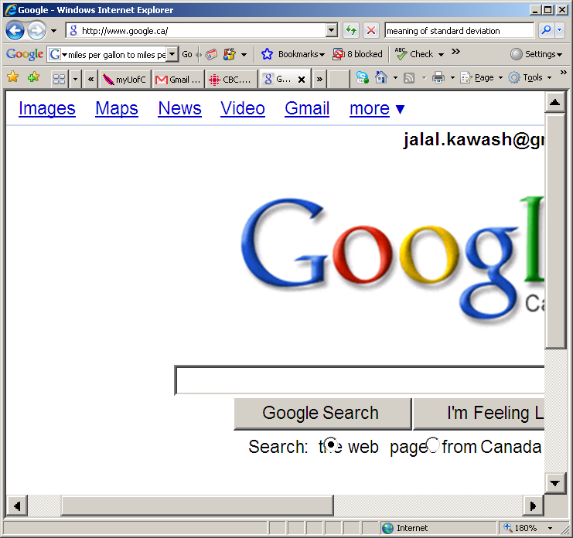

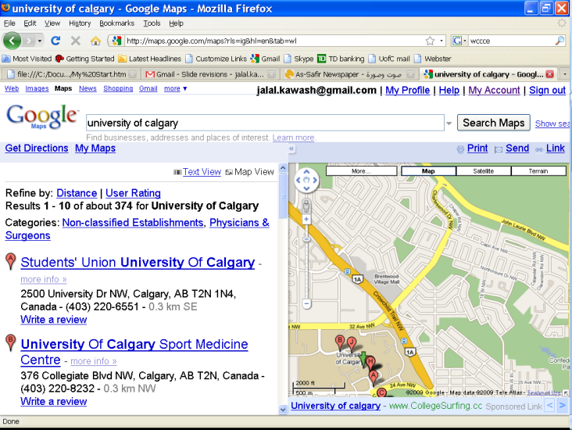
The Web as a Directed Graph

Slide 26
The WWW Is A Graph
The World Wide Web itself can be visualized as a directed graph.
  Vertex = web page, Edge = link between pages.

Slide 27
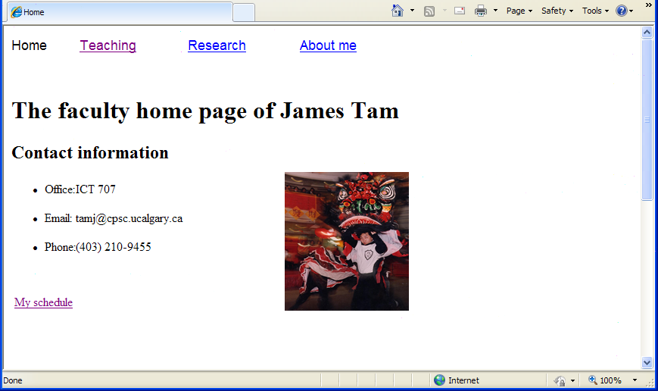
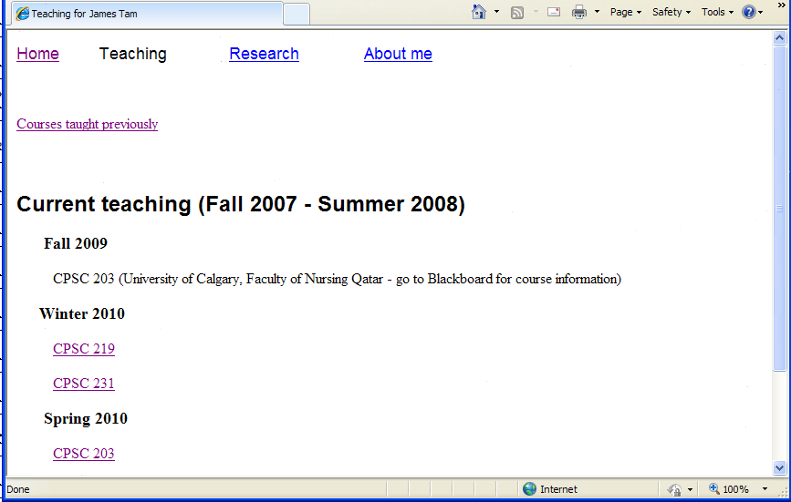
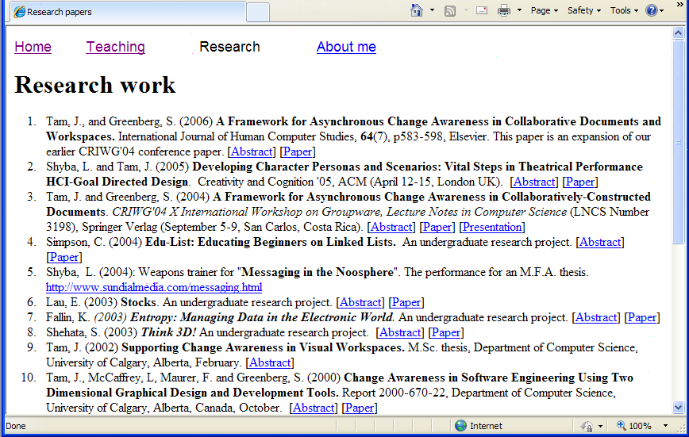
The WWW Is A Graph (2)

Slide 28
JT’s Extra: Applying Graphs To Web Design
Visualizing the layout of a page as a graph can be useful in web design.
  Are there sufficient connections between pages?
  Do the connections (links) make sense to visitor?
  Although it should be possible to reach any page without too much clicking (rule of thumb is 3), there are some pages that should always be accessible e.g., home page, contact page etc.

Slide 29
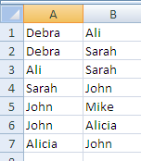
Graph Representation
Debra
John
Mike
Ali
Sarah
Alicia

Slide 30
Graph Representation
C
A
B
E
D
 | A | B | C | D | E
A | 0 | 1 | 0 | 0 | 0
B | 1 | 0 | 1 | 1 | 0
C | 0 | 1 | 0 | 0 | 1
D | 0 | 1 | 0 | 0 | 1
E | 0 | 0 | 1 | 1 | 0

Slide 31
JT’s Extra: Repeated Connections
Graphs Up To This Point:
  Do not allow for multiple edges between any pair of vertices.
Multi-graphs are a type of graph that allows for these cases.

Slide 32
Multi-graphs
In a multi-graph the set of edges is a multi-set (JT: recall a multi-set is a set that allows for duplications)
Edges can be repeated
Graphs are special cases of multi-graphs
C
A
B
E
D
Parallel edges
32
Notes:
Multiset does allow for duplicates but order is still not important
32

Slide 33
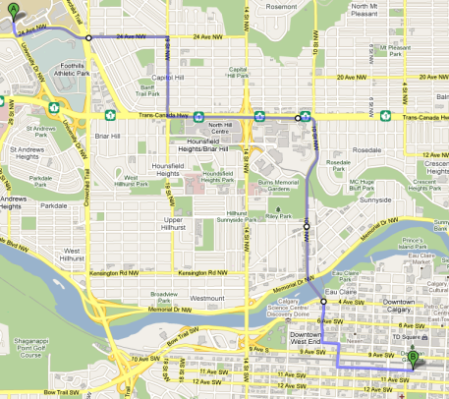
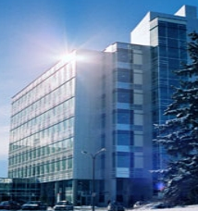
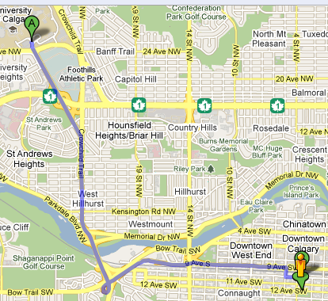

JT’s Extra: Application Multi-graphs
Example: path finding when alternatives are possible.
A
B

Slide 34
Euler Paths

Slide 35
Objectives
At the end of this section, you will be able to:
Understand how graphs are used to represent data
Appreciate the ability of graphs to lead to generalized conclusions
Define Euler tours and paths
Identify under which conditions an Euler circuit or path exists in a graph
Understand why such conditions are required
Learn the Euler circuit algorithm

Slide 36
Konigsberg
Today called Kaliningrad in the Russian Republic
In 1736 was in Prussia
The town had seven bridges on the Pregel River

Slide 37
Konigsberg Layout
Land
River
River
Land
Island
River
Land

Slide 38
Seven Bridges
C
D
A
B

Slide 39
Konigsberg’s Walk
People in 1736 wondered if it is possible to take the following walk in town:
Start at some location in town
Travel across all bridges without crossing any bridge twice
End the walk where it started
They wrote to Swiss Mathematician Leonhard Euler for help

Slide 40
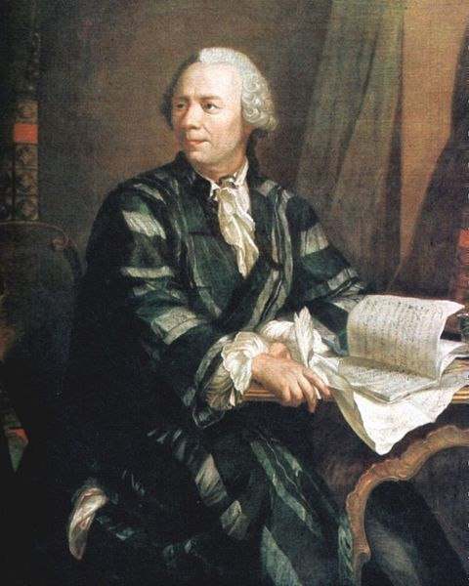
Leonhard Euler
1707 –1783
The greatest mathematician of the 18th century and one of the greatest of all time
a pioneering Swiss mathematician and physicist
important discoveries in graph theory
introduced much of the modern mathematical terminology and notation

Slide 41
Konigsberg Multigraph
C
D
A
B

Slide 42
Konigsberg multigraph
C
D
A
B

Slide 43
Konigsberg multigraph
C
D
A
B

Slide 44
Konigsberg multigraph
C
D
A
B

Slide 45
Euler’s Response
Is there a path through this graph that
  Starts at a vertex
  Ends in the same vertex
  Passes through every edge once
  Does not cross an edge more than once?
Called an Euler Circuit
Such a walk is impossible on any graph as long as the graph has one vertex with an odd degree

Slide 46

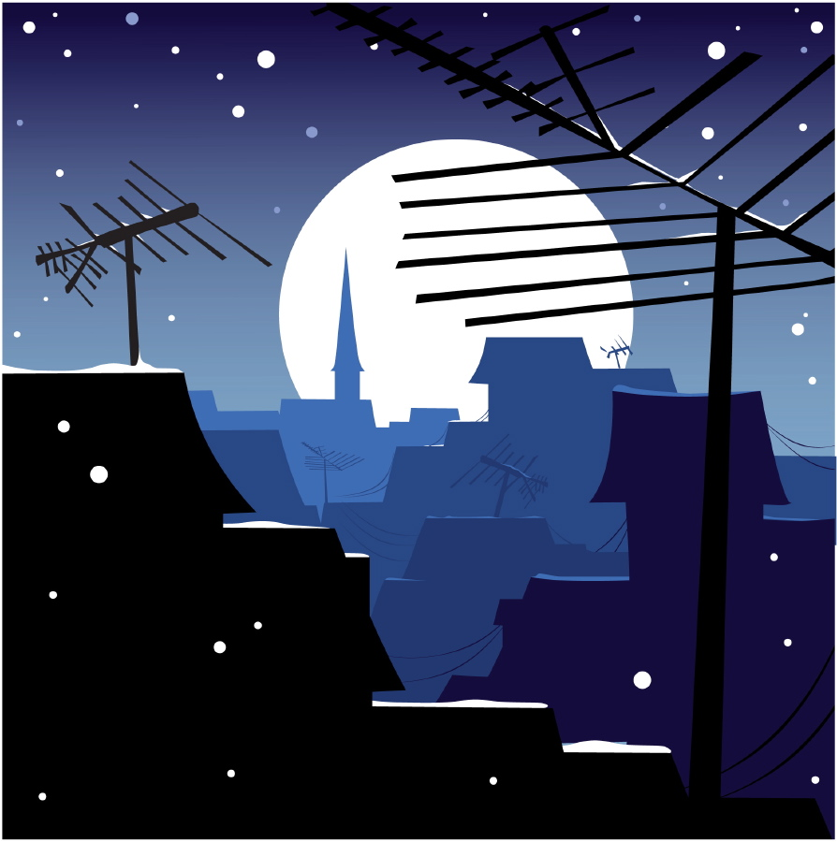
Euler’s Response
There is at least one vertex of an odd degree
Does not work
(the start vertex must
have an even degree)
C
D
A
Success!
B
46

Slide 47
Even-Degree Vertex (JT: Not Start/End)
To cross every bridge once
Each vertex must have an even degree
Coming in using this bridge
vertex
Must leave using a different bridge
47
Notes:
47

Slide 48
Odd-Degree Vertex (JT: Not Start/End)
Must come in using some bridge
Must leave using a different bridge
We’re stuck
Coming in using this bridge
vertex
This bridge cannot be used
Except to come in
Leaving using this bridge
48
Notes:
Problem with an odd degree vertex for all but the starting/end point
The third one is a problem: to cross it you come in and you cannot leave

Slide 49
The Starting/Ending Vertex
Must leave using some bridge
Either we come back to leave again (need two new bridges)
Or we come back to stay (using another bridge)
Cannot be of an odd degree: we need another bridge to come back
Start/end
vertex
Leave
Come back to leave
Come back to end tour
Leaving using this bridge

Slide 50
An Easier Problem
Is there a path through this graph that
  Starts at some vertex
  Ends at a (possibly different) vertex
  Passes through every edge once
  Does not cross an edge more than once?
Called a Euler Path
Note that if there is a circuit, then there is a path
If not, then the path is necessarily not a circuit

Slide 51
Euler Path – Start Vertex
The starting vertex must have an odd degree
Never come back to stay
Start
vertex
Leave
Come back to leave
Leaving using this bridge

Slide 52
Euler Path – End Vertex
The end vertex must have an odd degree
end
vertex
Leave
Come back to leave
end tour

Slide 53
Other Vertices
All other vertices must have an even degree
Every in must have a matching out on “new” bridges
other
vertex
in
out

Slide 54
Euler (non-cycle) Path Requirements
Start and end vertices must have odd degrees
Every other vertex must have an even degree
There is no Euler Path for the Konigsberg graph

Slide 55
No Euler Path for this Graph
C
D
A
B

Slide 56
A Similar Problem
Can you draw this shape with the rules:
  Draw continuously, cannot lift pen from one position to another
  Draw each line once, cannot let pen run on top of an already drawn line

Slide 57
Graph Representation
A
B
C
D
E

Slide 58
Graph Representation
Is there a Euler Circuit
  No (some vertices have odd degrees)
Is there a Euler Path
  Yes (exactly two vertices have odd degrees)
Path must start at an odd-degree vertex and ends at another odd-degree one
A
B
C
D
E

Slide 59
Euler Circuit Algorithm
Given a graph G (all vertices have even degrees):
Construct a circuit c, starting and ending at arbitrary vertex in G
Remove all the edges of c from G
Repeat until G has no edges:
  Construct a circuit c’ in G that starts (ends) in a vertex v that is in c
  Add c’ to c at v
  Remove all the edges of c’ from G
59
Notes:
Step1: Construct a circuit (not constrained to Euler circuit)
Step 2: removes the edges of some circuit
Step 3: remove all remaining edges (must start at a vertex that is part of the circuit from step 1)

Slide 60
J
I
A
C
B
D
E
F

Slide 61
Construct a circuit c, starting and ending at arbitrary vertex in G
J
I
A
C
Note: other choices for
c are possible
B
D
E
c: A, B, D, C, A
F

Slide 62
Remove all the edges of c from G
J
I
A
C
B
D
E
c: A, B, D, C, A
F

Slide 63
Repeat until G has no edges:
J
I
A
C
B
D
E
c: A, B, D, C, A
F

Slide 64
  Construct a circuit c’ in G that starts (ends) in a vertex v that is in c
J
c’: A, J, I, A
I
A
C
B
D
E
c: A, B, D, C, A
F

Slide 65
  Construct a circuit c’ in G that starts (ends) in a vertex v that is in c
J
c’: A, J, I, A
I
A
C
B
D
E
c: A, B, D, C, A
F

Slide 66
  Add c’ to c at v
  Remove all the edges of c’ from G
J
c’: A, J, I, A
I
A
C
B
D
E
c: A, B, D, C, A
c: A, J, I, A, B, D, C, A
F

Slide 67
  Add c’ to c at v
  Remove all the edges of c’ from G
J
I
A
C
B
D
E
c: A, J, I, A, B, D, C, A
F

Slide 68
  Repeat a), b), and c)
J
c’: D, F, E, D
I
A
C
An Euler circuit
c: A, J, I, A, B, D, F, E, D, C, A
B
D
E
c: A, J, I, A, B, D, C, A
c: A, J, I, A, B, D, C, A
F

Slide 69
  The graph has no more edges, stop
J
I
A
C
An Euler circuit
c: A, J, I, A, B, D, F, E, D, C, A
B
D
E
F

Slide 70
JT’s Extra: Euler Cycle Or Path?
70

