Slide 1
Elementary Set Theory
Peeking into Computer Science

Slide 2
Reading Assignment
Mandatory: Chapter 2 – Sections 2.3 and 2.4

Slide 3
Relations
Relating sets

Slide 4
Objectives
At the end of this section, you will be able to:
Define relations and represent them in two ways (sets and graphical)
Understand the property of symmetric relations
Identify which relation is a function

Slide 5
JT’s Extra: Reminder
Set = {elem₁, elem₂…elem_{n}}
  Order unimportant
  E.g., colors on my shirt = {red, blue, green}
Tuple = (elem₁, elem₂…elem_{n})
  Order is important
  E.g., my ranking of favorite colors = (black, white, red, blue, green, yellow, purple)

Slide 6
Relations
A relation from A to B is a subset of A x B
Example
  Let A = {book, lion, plate}
  Let B = {colored, made-from-paper, has-bones, contains-glass}
  The association of objects A with properties B is a relation from A to B
  R = {(book, colored), (book, made-from-paper), (lion, has-bones), (plate, colored), (plate, made-from-paper), (plate, contains-glass)}
In general, A relation on A₁ , A₂ , … , A_{n} is a subset of A₁ x A₂ x … x A_{n}
    JT: A x B includes all possible combinations
    JT: The relation of A to B only includes some combinations

Slide 7
JT’s Extra Exercise
A = {Lion, leopard}
B = {Tan, white, spotted}
Specify:
  A x B, set multiplication
  The real-life relation of the elements from A to B (i.e., only certain colour combinations possible)

Slide 8
JT’s Extra: Relations And Pictures
Recall from the InfoViz slides (JT’s extra info on when to use images, what type etc.)
Graphical representations work well for showing how things are inter-related.
Consequently it may be easier to show relations between sets in the form of graph (image).

Slide 9
JT’s Extra: Relation Graph (Previous Example)
plate
paper
colored
contains-glass
lion
book
made-from-paper
has-bones

Slide 10
Set Relations: Types
Relations can be directed (one way) as the previous example and the example below.
  Love graph: Problem! :’(
Relations can also be symmetric (two way the same e.g., example below).
  Love graph: Life is good! :D
You
Her
Him
Somebody else
Her
Him
OR
Her
Him

Slide 11
A “Likes” Relation Graph
Debra
John
Mike
Ali
Sarah
Alicia

Slide 12
Symmetric Relations
Whenever (a,b) ∈ R, implies that (b,a) A ∈ R, the relation is called symmetric
Debra
John
Mike
Ali
Sarah
Alicia

Slide 13
Symmetric Relations
Has-the-same age
Has-the-same name
Children of a common parent

Slide 14
Functions
A function f from A to B
Written f: A → B
Is a relation from A to B, such that:
There is exactly one pair (a,b) ∈ f for each a ∈ A
We write f(a) = b

Slide 15
JT’s Extra: Example Function
Square function
  A = {0, 1, 2, 3…}
  B = results
  F(a) = {0, 1, 4, 9..}
  It is a function because for a given number in set A it will map to or produce only one result in B
  e.g., f(2) = 4

Slide 16
JT’s Extra: Terminology
With the ‘square’ function
  f(a) = b
  ‘a’ is the argument (input) to function ‘f’
  ‘b’ is the return value (output/result) of function ‘f’

Slide 17
Functions
A = {1,2,3}, B={yes,no}
{(1,yes), (2,yes), (3,no)} is a function
{(1,yes) (2,no), (2,yes), (3,no)} is not a function
{(2,yes), (3,no)} is not a function

Slide 18
Functions
Functions “return values”
f(x) = 2x
f(1) returns 2
f(20) returns 40

Slide 19
Algorithms
Computer recipes

Slide 20
Objectives
At the end of this section, you will be able to:
Understand what algorithms are and how to specify them
Understand the importance of algorithms to computers
Understand what pseudo-code is
Develop and specify an example algorithm using pseudo-code
Differentiate between the correctness and efficiency of algorithms
Work out an example to assess the efficiency of algorithms

Slide 21
Problems
A problem is a specification of the relationship between input and output
  WHAT needs to be done, not HOW
Cooking problem
  Input: ingredients
  Output: cooked food
Computational problems are the ones to be carried out by computers

Slide 22
Algorithms
The algorithm specifies how to solve the problem
  How to convert the input to output
Cooking problem
Cooking recipe (“algorithm?”)
Algorithms are specific to Computational problems

Slide 23
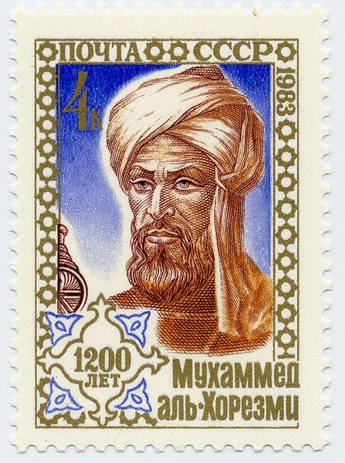
Mohamed Bin Musa Al Khawarizmi
780-850
Left behind the most important Math book
  Kitab Al Jaber Wal Mokaballa
  The book of Restoration and Comparison
  Al Jaber (restoration) became Algebra
When his book was translated to Greek, it was called: Thus said Algorismi
With time, it became algorithmi

Slide 24
‘Algorithm’
Was given to mathematical operations used by merchant’s to simplify their accounting
Today, it is used to mean: computational procedure that accepts input, processes it, and produces output

Slide 25
Modern ‘Algorithm’
Computational
Procedure
Processing
input
output

Slide 26
Computational?
‘algorithm’ for washing your hair
Wet your hair
Open the shampoo bottle
Pour 5ml of shampoo to your palm
Apply to hair and rub for 1 minute
Rinse hair with water
Not really an algorithm, unless performed by a computer

Slide 27
JT’s Extra: Ways Of Specifying Algorithms
Code (Computer program – JT’s comment ‘app’)
  Flash and HTML5
  Java
  C++
  Etc.
Finite State Machine (one of the later sections)
Pseudo-code
  English like code
Flow charts
  Visual representation
27

Slide 28
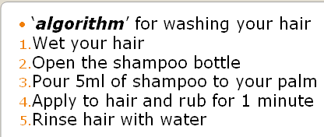
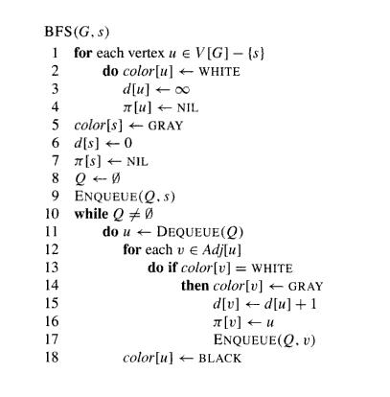
JT’s Extra: Pseudo Code
Image: http://www.cs.tufts.edu/comp/150GA

Slide 29
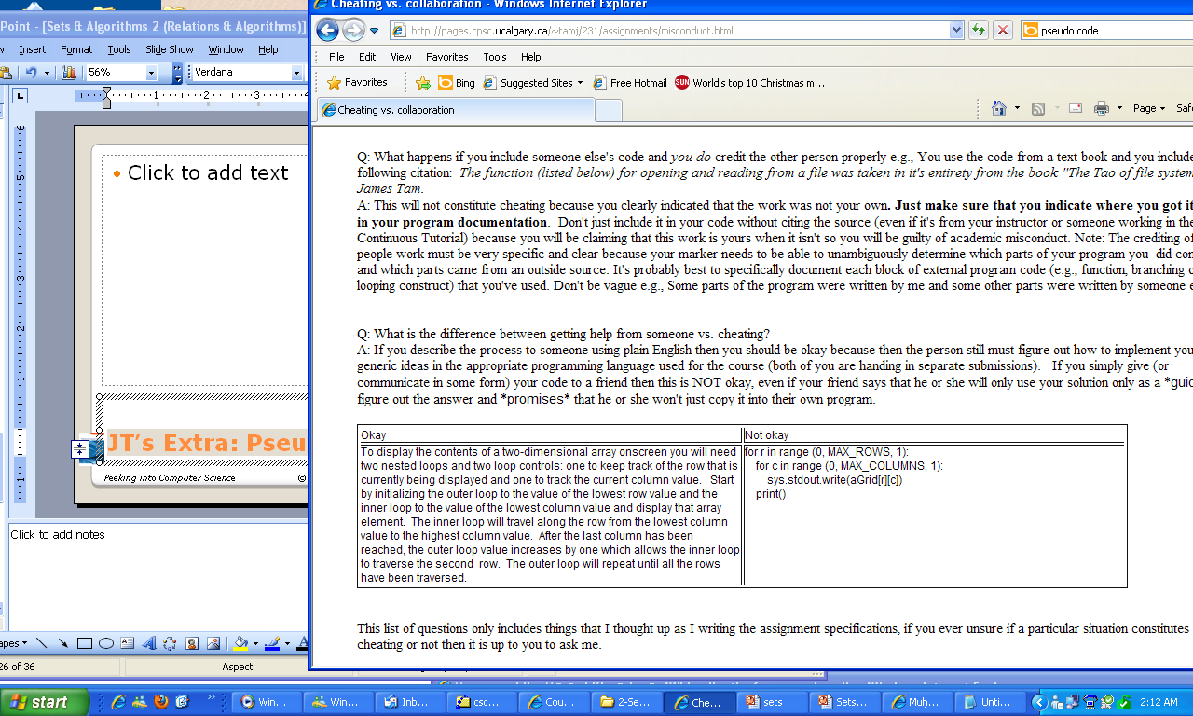
JT’s Extra: Pseudo Vs. Real Code
PSEUDO CODE From: www.cpsc.ucalgary.ca/~tamj
REAL CODE: From: www.cpsc.ucalgary.ca/~tamj

Slide 30
Min Algorithm
Given a set of objects (numbers)
How do we find the smallest member of the set?
Example input : {10, 46, 3, 100}
Output: 3
30

Slide 31
Attempt
Given input S, a set
Let the first element in S be min-so-far
Check if the next element is less than min-so-far
  If so, make it the min-so-far
  If not ignore it
Repeat step 2 until all elements in S have been examined
The minimum is min-so-far

Slide 32


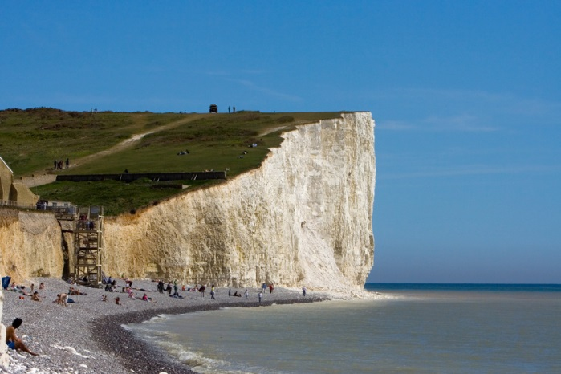
JT’s Extra: Computers Are Like Very Young Children
Why???!!!
Notes:
You must include all details cannot leave out – computer can’t assume
(comp not kid) Must be very careful with details may literally do as you say (drive off cliff)

Slide 33
Problems with the attempt
What if the input set is empty?
What if the input set is a singleton (contains one element only)?

Slide 34
The Min Algorithm
Input: set S
Output: minimum element in S
If S is empty, stop, there is no min
Otherwise, let the first element be MSF
Repeat the following until all elements in S have been examined:
check if the next element is less than MSF
  If so, make it the MSF
  If not ignore it
The minimum is MSF

Slide 35
Correctness vs. Efficiency
Algorithms must be correct
  Solve a problem, taking care of all special cases
Algorithms should be efficient
  Take less time to compute solution (time-efficiency)
  Use less space (space-efficiency)
  Use less power (power-efficiency)
  Use fewer message (message-efficiency)
Here, we only focus on time-efficiency

Slide 36

Example
A merchant learnt that one of his 4096 golden coins is fake
All coins look exactly the same (including the fake one)
The only difference between a fake and a real coin is in the weight
A fake coin is lighter
Find an efficient algorithm to
locate the fake coin
Hint: Can be done
in 12 comparisons

Slide 37
A partial tree
8
4
4
2
2
2
2
1
1
1
1
1
1
1
1

Slide 38
Efficient Algorithms
If you compare each pair of coins, you may need 4096/2 = 2048 “operations”
Weigh 2048 against 2048, pick the lighter pile
Weigh 1024 against 1024, pick the lighter pile
Weigh 512 against 512, pick the lighter pile
Weigh 256 against 256, pick the lighter pile
Weigh 128 against 128, pick the lighter pile
Weigh 64 against 64, pick the lighter pile
Weigh 32 against 32, pick the lighter pile
Weigh 16 against 16, pick the lighter pile
Weigh 8 against 8, pick the lighter pile
Weigh 4 against 4, pick the lighter pile
Weigh 2 against 2, pick the lighter pile
Weigh 1 against 1, pick the lighter coin

Slide 39
Logarithmic Time
It can be shown that the height of this binary tree is log₂n, where n is the number of coins
log₂4096 = 12
@#$$&^&)(&*^$##$%^$#

Slide 40
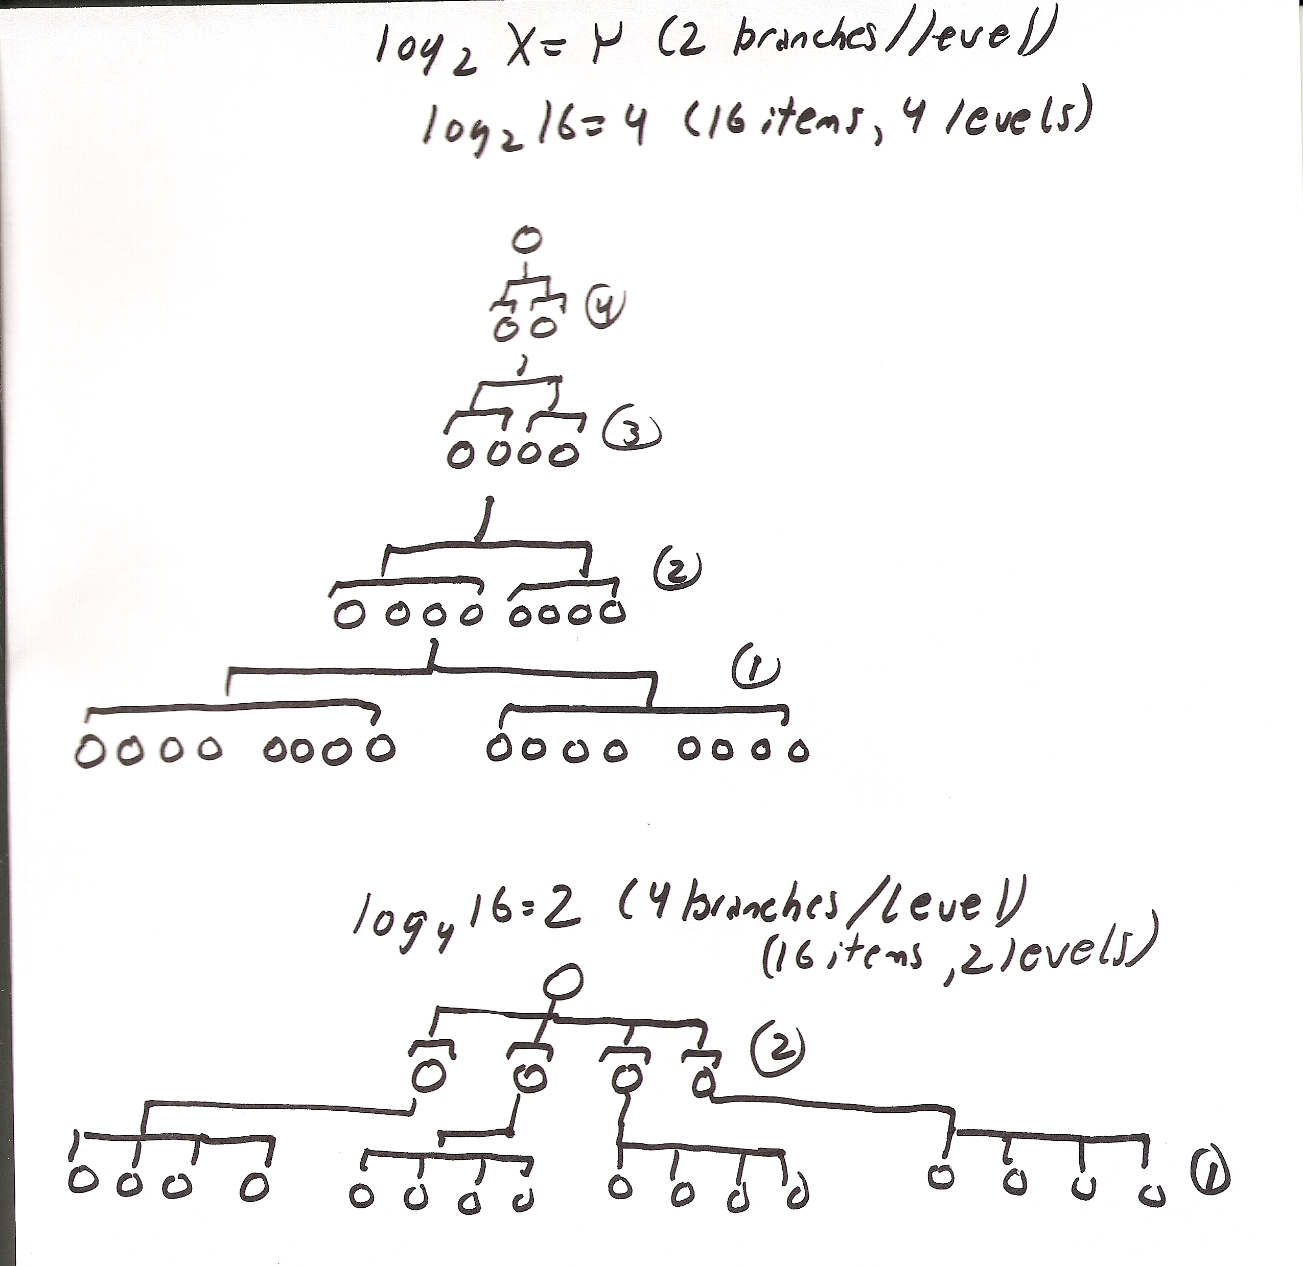
JT’s Extra (H): Why 2^{y} (log2x = y)
2 branches per level

Slide 41
JT’s Extra (H): Why 2^{y} (log2x = y)
4 branches per level

