Slide 1
Introduction
Peeking into Computer Science

Slide 2
Reading Assignment
Mandatory: Chapter 1
Optional: None

Slide 3
Spreadsheet Design
Long-lasting spreadsheets

Slide 4
Objectives
At the end of this section, the student will be able to:
Judge the design of a spreadsheet
Divide a spreadsheet into five sections
Understand the role of each section

Slide 5
Spreadsheet Properties
Good character
Easy to build
Easy to read
Easy to use
Easy to change
Error free

Slide 6
Example of Poor Spreadsheet

Slide 7
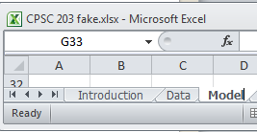
Spreadsheet Sections
Introduction:
Data:
Model:
Data Dictionary
Conclusions
Each section corresponds to an Excel tab

Slide 8
Introduction Section
What are the research questions?
How will the questions be answered?
Summary of the findings.
References (use only reputable ones)

Slide 9
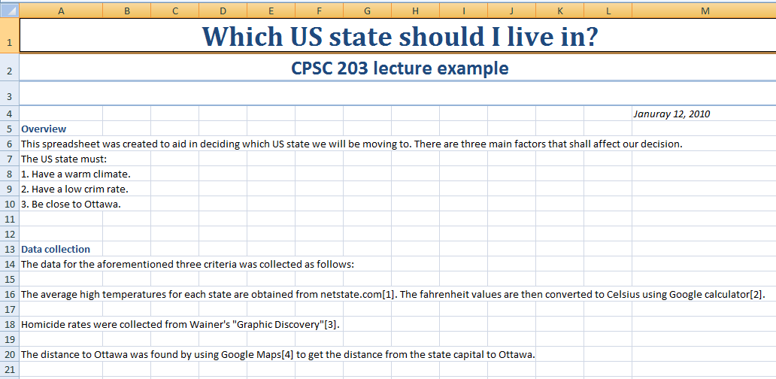
Example Intro

Slide 10
JT’s Extra, Introduction: References
Use APA or other format for citation:
http://pages.cpsc.ucalgary.ca/~tamj/2007/203W/assignments/references.html (if you have no idea for a format)
J. Nevison, The Elements of Spreadsheet Style, Prentice-Hall, 1987 (for these notes)
Sometimes the ideas are so common or so simple that a citation is unneeded.
Other times listing the sources can be quite useful.
Basis of assumptions, places to look for more information.

Slide 11
Example Intro

Slide 12
Data Section
Raw data
Example (from “Problems and spreadsheets” 203 notes, finding a place to live in the U.S.): temperature, homicide rates, distance.
Use trusted sources of data (e.g., Stats’ Can over some random blog)
Calculations
Custom formulas you created
e.g. = D3 + (E1 – F1)
Built-in ones e.g., SUM() or even more complex like ‘if’
JT’s Extra:
It’s an important section but the whole sheet should not consist just of data and calculations

Slide 13
Example Raw Data

Slide 14
Model Section
Model includes assumptions and calculations
Explain the model:
Should provide three levels of explanation:
Explain the values appearing in the model
Explain tricky formulas
Lists all formulas explaining in steps with all assumptions stated clearly.

Slide 15
Example Model

Slide 16
JT Extra: Poor Model
(From “ELEMENTS OF SPREADSHEET STYLE” by JOHN M. NEVISON)

Slide 17
JT Extra: Clearer Model
(From “ELEMENTS OF SPREADSHEET STYLE” by JOHN M. NEVISON)

Slide 18
JT’s Extra: Instructions, am I clear enough now?
When providing instructions:
A numbered list can sometimes be a tremendous improvement over text bunched into a single paragraph
Evaluating clarity:
Write out the instructions and then see if an outsider can follow them.

Slide 19
Data Dictionary
Explains the meaning of your data (raw data or calculated data)
For each field/piece of data there will be 4 columns in the data dictionary
A name: brief but clear description or label
A field type: categorization, raw data, column calculation, row calculation
A data type: text, number, integer, percentage, etc…
A sheet/cell reference: the sheet where the field is and where in the sheet (cell range)

Slide 20
Example Data Dictionary

Slide 21
Conclusions Section
Summarizes important data (trends found your research) into 3 charts (not pie)
Add appropriate annotations:
charts have appropriate titles,
axes are also titled and have an appropriate scale (include a legend if necessary).
Conclusions should be tied to the original research questions: what, how, findings of your research, reference list (citations).

Slide 22
Conclusions section (2)
Use as little ‘ink’ as possible:
Obviously you should avoid redundancy i.e. each chart should analyze a different trend
But go beyond this - don’t add clutter, make annotations concise as possible but still conveying a clear message
Also make sure that the message is represented using the most effective mechanism possible (see my extra notes on ‘visualizing data’)

Slide 23
Dashboard
Visual Charts and conclusions

Slide 24
5) JT Extra: What Is A Dashboard
“Essentially, a dashboard report is a way to visually present critical data in summary form so that you can make quick and effective decisions, in much the same way that a car dashboard works.”¹
1 One source (by no means the only or definitive one):
http://office.microsoft.com/en-us/excel-help/the-power-of-dashboard-reporting-with-excel-HA001226127.aspx

Slide 25
Example Dashboard

Slide 26
Example Dashboard

Slide 27
Abstraction
The power to simplify

Slide 28
Abstraction
Problems (and solutions) can be overwhelming
Too many details
Abstraction: hiding irrelevant details

Slide 29
Abstraction Example
Library
Very complex
To an end-user, it can be abstracted by the circulation desk

Slide 30
Abstraction Example
Car
Also very complex
To driver, it can be abstracted by how to operate it
To a passenger, it is simply a commuting device

Slide 31
JT: Robot example (minor modifications to the Kawash example)

Slide 32
Another Problem: Robotic Movement¹
Develop an algorithm for a simple robot (similar in movement capabilities to a RoombaTM).
Movement:
The robot can move forward one distance unit (a ‘square’).
Rotation:
If forward motion is not possible then the robot can rotate left or right by 90 degrees.
Short range sensors:
One is mounted forwards, the other is mounted on the right.
The sensors check for obstacles in the next square.
1 From “Peeking into Computer Science” and the lecture notes of Jalal Kawash

Slide 33
Specifying The Problem
What does the robot need to do:
Find a wall/obstacle.
Hug the wall, indefinitely moving forward.
Input:
Whatever is detected by the sensors (front, right).
Output:
The robot’s movement

Slide 34
The Contents Of The Robot’s World
Since the robot can either move onto a square that’s empty or avoid a square that is occupied, the world can be simplified into two cases:
The destination square is empty: ‘space’.
The destination square is not empty: ‘wall’ (contains a wall, furniture, person, pet etc.)
Details about exactly why the destination isn’t empty isn’t important so simplify the problem.

Slide 35
Inputs/Outputs Based On The World
ROBOT
FS = W or FS = S
Forward, Rotate (R), Rotate (L)
RS = W or RS = S

Slide 36
Robot’s Orientation
UP
LEFT
RIGHT
DOWN

Slide 37
Robot: Moving Forward

Slide 38
Robot: Rotations
Left 90○
Right 90○

Slide 39
Solution: The Generic Algorithm For Movement
Search for the wall
Once found, keep it to the robot’s right
Move forward
Each move, make sure the wall is still to the robot’s right.
(This means there should be a space in front and the wall to the right).
Robot’s modes:
Search for the wall
Hug the wall

Slide 40
Algorithm: Search For The Wall
Repeat the following steps, until this phase is done (wall found, change to the wall hugging mode)
If RS = W, then done this phase
Right sensor detects a wall
If FS = W, then L, done this phase
Front sensor detects a wall, rotate left
If FS = S, then F
Right sensor senses a space, take a step forward

Slide 41
Algorithm: Hug The Wall
Need to make sure that the wall is not “lost” during movement.
Complexity: all cases must be considered.

Slide 42
Hug The Wall: Case 1
R
Input
RS = W
FS = S

Slide 43
Hug The Wall: Case 1
R
Output
Movement: forward

Slide 44
Hug The Wall: Case 2
R
Input
FS = W

Slide 45
Hug The Wall: Case 2
R
Output
Rotate: left

Slide 46
Hug The Wall: Case 3
R
Input
FS = W

Slide 47
Hug The Wall: Case 3
R
Output
Rotate: Left

Slide 48
Hug The Wall: Case 3
R
Input
FS = W

Slide 49
Hug The Wall: Case 3
R
Output
Rotate: Left

Slide 50
Hug The Wall: Case 3
R
Input
FS = W

Slide 51
Hug The Wall: Case 3
R
Output
Rotate left

Slide 52
Hug The Wall: Case 3
R
Input
FS = W

Slide 53
Hug The Wall: Case 3
R
Output
Rotate left

Slide 54
Hug The Wall: Case 3
R
Input
FS = W

Slide 55
Hug The Wall: Case 3
R
Output
Rotate left
Notes:
Never stops according to the algorithm, no stop case
If FS = W, then L

Slide 56
Hug The Wall: Case 4
R
Input
FS = S
RS = W

Slide 57
Hug The Wall: Case 4
R
Output
Movement: Forward

Slide 58
Hug The Wall: Case 4
R
Input
FS = S
RS = S

Slide 59
Hug The Wall: Case 4
R
Output (Step 1)
Rotate: right
Notes:
Works now because under search mode:
If FS = S, then F
Right sensor senses a space, take a step forward

Slide 60
Hug The Wall: Case 4
R
Output (Step 2):
Movement: forward

Slide 61
Hug The Wall: Case 4
R
Input:
FS = S
RS = W

Slide 62
Hug The Wall: Case 4
R
Output:
Movement: forward

Slide 63
Hug The Wall: Case 4
R
Input:
FS = S
RS = S

Slide 64
Hug The Wall: Case 4
R
Output (step 1):
Rotate: right

Slide 65
Hug The Wall: Case 4
R
Output (step 2):
Movement: foward

Slide 66
Algorithm: Hug The Wall
Repeat the following steps:
If RS = W and FS = S, then F
If FS = W, then L
If RS = S and FS = S, then R and F

