Slide 1
4 Programming
Peeking into Computer Science

Slide 2
Reading Assignment
Mandatory: Chapter 5 – Section 5.5
Jalal’s resources:
  “How to” movies and example programs available at:
    http://pages.cpsc.ucalgary.ca/~kawash/peeking/alice-how-to.html
JT’s resources:
  www.cpsc.ucalgary.ca/~tamj/203/extras/alice

Slide 3
JT’s Extra: What Is A List?
A list is a variable that can be treated as one entity.
…but also a list consists of elements and the individual elements can be accessed separately.
Student 1 | Student 2 | Student 3 | Student 4 | Student 5
Example: I need to print out the whole class list
Student 1 | Student 2 | Student 3 | Student 4 | Student 5
Example: I need to fix this one student’s grade

Slide 4
Objectives
At the end of this section, you will be able to:
Understand the list structure
Create lists in Alice
Apply the for all in order construct to lists
Apply the for all together construct to lists
Use functions to collect user input

Slide 5

A list of Astronauts in Alice

Slide 6
Lists
A list is a tuple of numbered (indexed) objects
A list is a variable
0
1
2
3
4
John
Frank
Alicia
Jenn
James

Slide 7
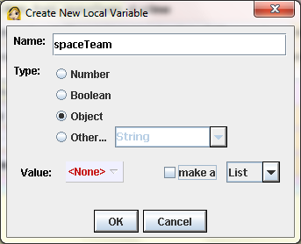
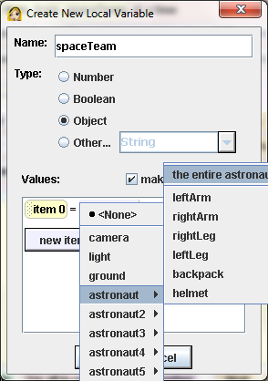
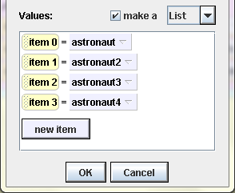
Creating a List in Alice

Slide 8
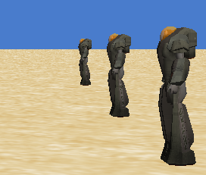

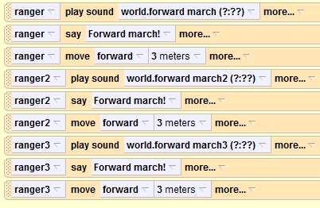
JT’s Extra: What If A List Weren’t Used?
March 3 soldiers forward
Example 12:
‘How not to’ approach
Without lists: you would create three soldier objects
The actions for each list would have to be repeated three times (once per object)
A list would allow the soldiers to be grouped together and instructions wouldn’t have to be repeated explicitly

Slide 9
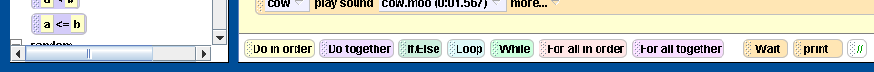
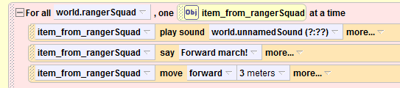
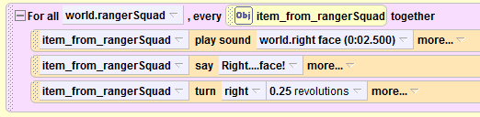
JT’s Extra: For all in order and together
FOR ALL IN ORDER
Each list element carries out instructions one element-at-a-time
FOR ALL TOGETHER
The instructions are performed at the same time by each list element

Slide 10
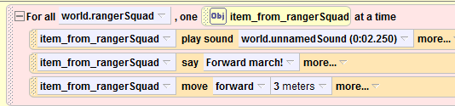
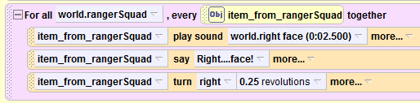
JT’s Extra: March Example (Soldiers Again)
Example 13:
Lists, for all in order, for all together
For all in order: body of loop repeats three actions for each list element (soldier) one at-a-time
For all together: body of loop repeats three actions for each list element (soldier) simultaneously

Slide 11
JT: For all
INORDER Flowchart
Start
For all INORDER list
JT: for-all-body
action(s) to perform,
each element list[i]
i = 0
While
i < size-of list
true
false
for-all-body
Play sound
Each soldier ‘say’
Each soldier moves
Increment I by 1
Stop
11
Notes:
I = index of list item
Outer while loop counts by one for each list element
For-all-body is not a loop but whatever you want to do for each list element

Slide 12
JT’s: For all
TOGETHER
Start
For all TOGETHER list
for-all-body (JT: each simultaneous action)
if
List is empty
JT’s Extra: perform same action on each list element at same time
true
false
for-all-body(list[0])
...
Ffor-all-body(list[n-1])
Example program
Play sound
Each soldier ‘say’
Each soldier moves
Stop
12

Slide 13
More Complex Example

Slide 14
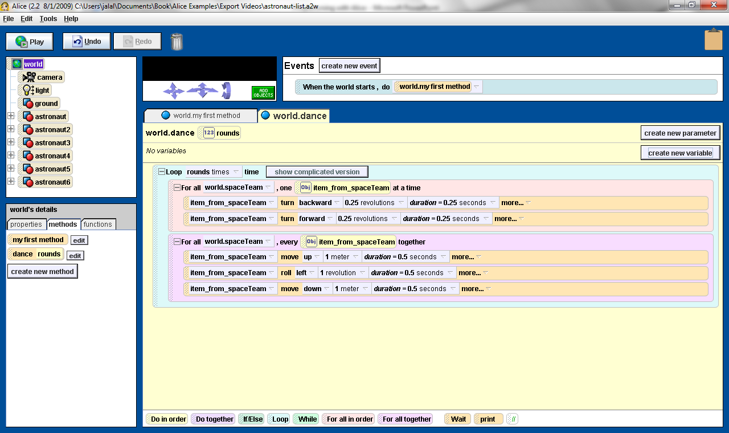
world.dance Method

Slide 15
world.dance Method

Slide 16
For all
INORDER
Start
For all INORDER list
for-all-body
i = 0
While
i < size-of list
true
false
for-all-body(list[i])
Increment I by 1
Stop
Notes:
I = index of list item
Outer while loop counts by one for each list element
For-all-body is not a loop but whatever you want to do for each list element

Slide 17
For all
TOGETHER
Start
For all TOGETHER list
for-all-body
if
List is empty
true
false
for-all-body(list[0])
...
Ffor-all-body(list[n-1])
Stop

Slide 18
For all in Flowcharts
Start
Loop rounds times
For all x in spaceTeam INORDER
x turns backward
x turns forward
For all x in spaceTeam TOGETHER
x moves up
x rolls left
x moves down
Stop

Slide 19
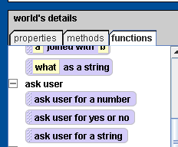
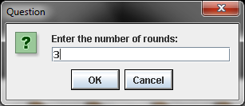
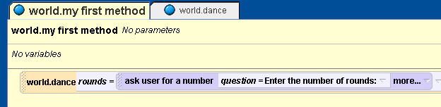
Collecting User Input

