Slide 1
3 Programming
Peeking into Computer Science

Slide 2
Reading Assignment
Mandatory: Chapter 5 – Section 5.5
Jalal’s resources:
  “How to” movies and example programs available at:
    http://pages.cpsc.ucalgary.ca/~kawash/peeking/alice-how-to.html
JT’s resources:
  www.cpsc.ucalgary.ca/~tamj/203/extras/alice

Slide 3
JT’s Extra: Random Numbers
To simulate the possibility of different events occurring as a program is a run a random number function can be employed.
Typically the function generates a number within a certain range:
  1 – 2 (coin flip)
  1 – 6 (normal die roll)
  1 – 100 (percentage)
  Etc.

Slide 4
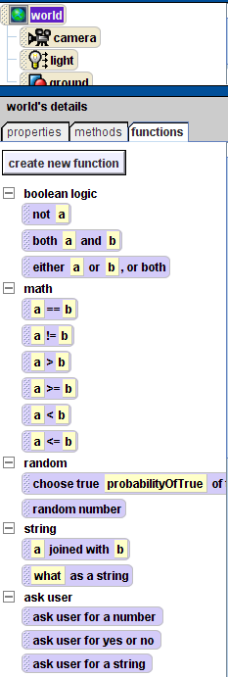
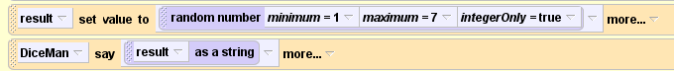
JT’s Extra: Dice Example
Example 9: random numbers
It can be invoked by the random function of class ‘World’
The only values generate: 1, 2, 3, 4, 5, 6 (no real numbers)
Inclusive
Exclusive

Slide 5
If-Else Statements
Alice makes decisions

Slide 6
Objectives
At the end of this section, you will be able to:
Understand conditional execution
Understand and use the Alice if/else statement
Use functions as arguments to other methods
Use conditional structures in flowcharts

Slide 7
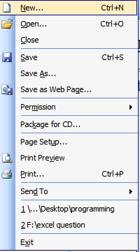
JT’s Extra: Choosing Among Alternative Course Of Action
New: series of instructions
Open: series of instructions
Save: series of instructions
Etc.
Frequently this is needed when the program must react to user input or the actions of the user.

Slide 8
Branching/Decision Making
Question
It’s the mechanism used in many programming languages used to execute different instructions when alternatives are faced.
At the branch (where the decision must be made) a logical statement determines which alternative occurs.
  Another way of looking at it: a question is asked which has a true or false answer.
  The answer to the question determines which branch executes.
The flowchart symbol used to represent a branch/decision is a diamond.

Slide 9
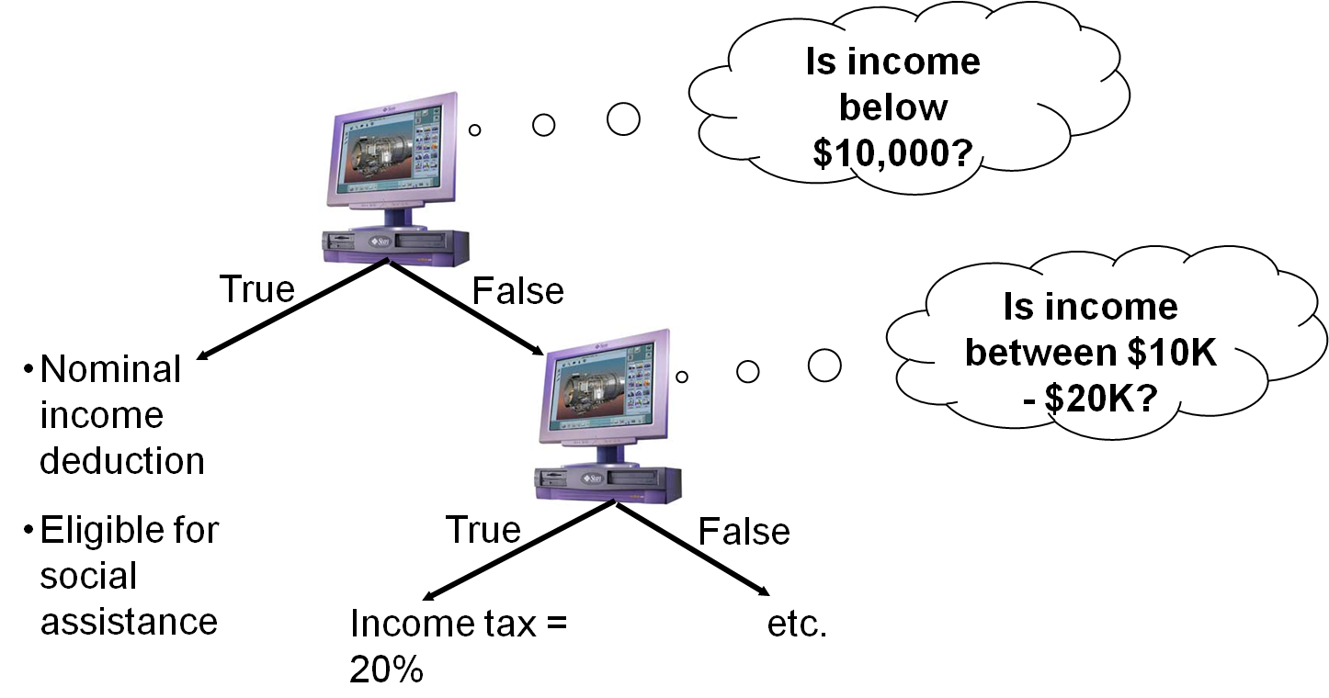
Branching/Decision Making (2)

Slide 10
Conditional Execution
Programs need to make decisions
An ATM program must verify your password to know how to proceed
This is called conditional Execution
The execution of a group of statements is conditional on a Boolean condition
If the password is correct then
go to the next step
Else
give an error message
JT (new terminology): body is the part that executes only under a certain condition

Slide 11
If-Else Flowchart
Statement before if
Test
if
condition
true
false
if body
else body
Statement
after if

Slide 12
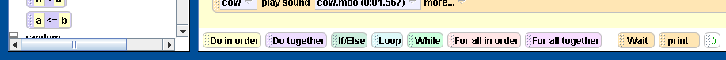
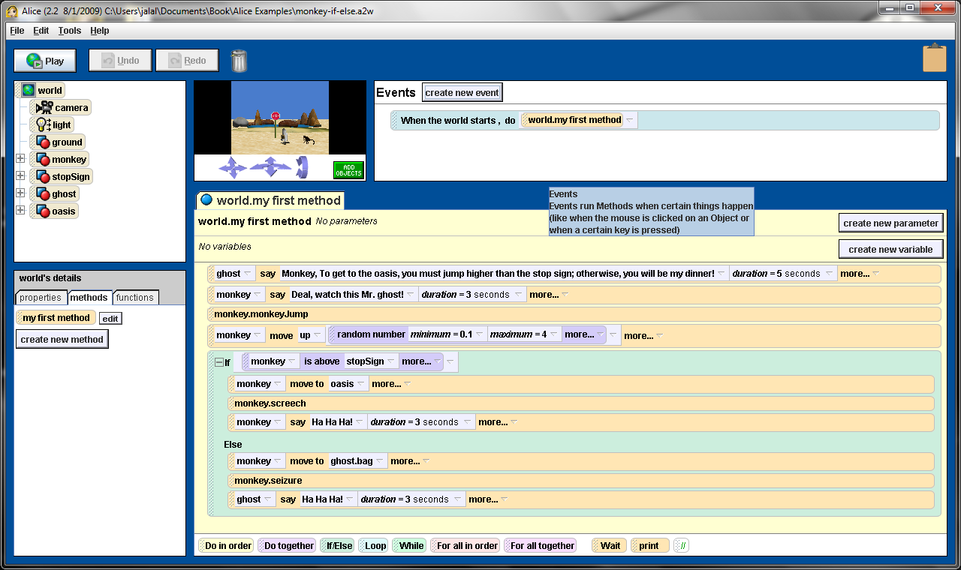
If-Else Statement in Alice
JT: ‘if’ body
JT: ‘else’ body

Slide 13
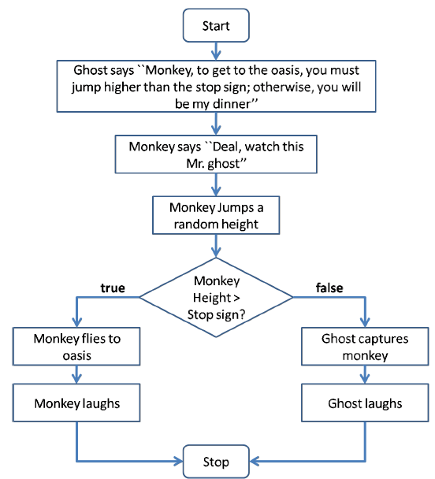
Example Story Line

Slide 14
Use of Functions
Returns a random number between 0.1 and 4
value substituted for distance parameter of move
Returns a Boolean value

Slide 15

When the if condition is true

Slide 16
When the if condition is false

Slide 17
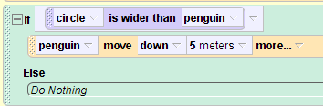
JT, One Action: Do Something When True
If you want the program to react when the logical statement evaluates to true (the answer to the question is true).
Just use the ‘if’ and leave the ‘else’ portion empty.
Hole wider
Than
Penguin?
TRUE
FALSE
Penguin falls into the hole
(Rest of the program)
Indented part after the ‘if’: what executes if the statement is true

Slide 18
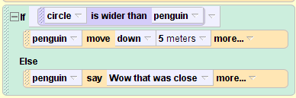
JT: Do Something For Both True/False Cases
Hole wider
Than
Penguin?
TRUE
FALSE
Penguin falls into the hole
Penguin: “Wow!”
(Rest of the program)
You want the program to do something when the logical statement evaluates to true and something different when the statement evaluates to false.
Add instructions for both the ‘if’ and the ‘else’ portion of the instruction.

Slide 19
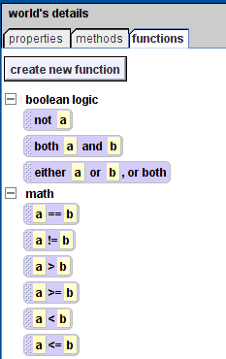
JT: Logical Operators
Are used in conjunction with logical statements and relate or compare things.
The comparison will result in a true or false result.
  E.g., temperature is above freezing (greater than zero).
Accessing the logical operators in Alice.
  Look under the functions of the ‘world’ object.

Slide 20
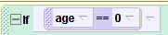



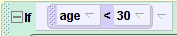
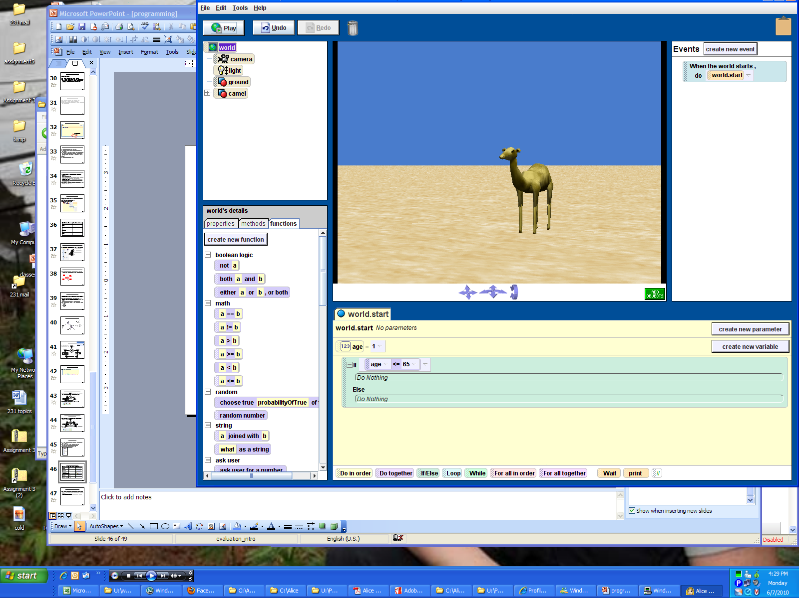
JT: Types Of Logical Operators
Desired comparison | Operator (Alice) | Example
Equality | ==
Not equal to (inequality) | !=
Greater than | >
Greater than, equal to | >=
Less than | <
Less than, equal to | <=

Slide 21
JT: Multiple Branches: Independent
FALSE
Q1
TRUE
Do something
Q2?
TRUE
Do something
FALSE
Rest of program
If a number of questions must by asked by a program and the answer to one question has no impact on the answer to the other questions.
  That means that all questions will be asked regardless of whether any questions answered true or false.

Slide 22
JT: Multiple Branches: Independent
FALSE
Q1
TRUE
Do something
Always ask second question
Q2?
TRUE
Do something
FALSE
Rest of program
If a number of questions must by asked by a program and the answer to one question has no impact on the answer to the other questions.
  That means that all questions will be asked regardless of whether any questions answered true or false.

Slide 23
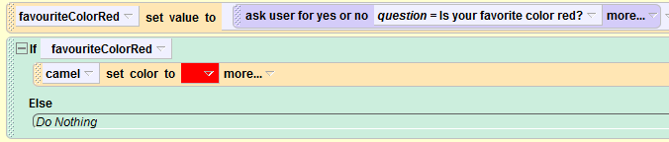
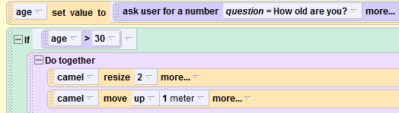
JT’s Extra: Multiple Branches
Example 10: multiple successive branches
First Boolean question: Always asked
Second Boolean question: Not indented, always asked

Slide 24
Nested Branches
Sometimes the answer to one question will determine whether or not other questions will be asked.
  The answer to one question (true or false) has an effect on whether another question is asked.
  The asking of the second question is dependent on the answer to the first question.
  (Alternatively: the second question is nested inside the first question).

Slide 25
Nested Branches: Flowchart
FALSE
Q1
TRUE
Q1
TRUE
FALSE
Q2?
TRUE
Do something
Q2?
TRUE
Do something
FALSE
FALSE
Rest of program
Rest of program

Slide 26
Nested Branches: Flowchart
Answer to first ‘if’ determines whether second ‘if’ executes
FALSE
Q1
TRUE
Q1
TRUE
FALSE
Q2?
TRUE
Do something
Q2?
TRUE
Do something
FALSE
FALSE
Rest of program
Rest of program

Slide 27

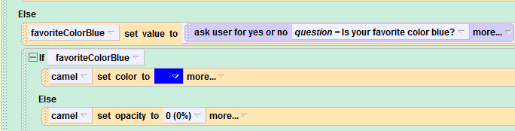
JT: Multiple Branches: Dependent (RHS Case)
Multiple if/else statements can be used in succession.
Example program 11: nested_branches
Indented: executes if first ‘if’ is true
Also indented: execution is dependent on the first ‘if’
(Only ask about blue if user does not indicate that red is the favorite)
Indented twice: only executes if other cases answer false

Slide 28
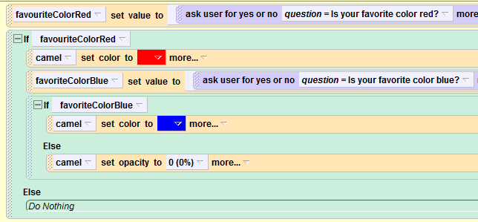
JT: Multiple Branches: Dependent (LHS Case: Nonsensical)

Slide 29
Loops
Do it again

Slide 30
Objectives
At the end of this section, you will be able to:
Understand repetition structures
Use the loop statement
Use the while statement
Understand when to use a loop or a while
Use loop structures in flowcharts

Slide 31
Loop Statement
A loop statement allows a group of statements to be repeated for a number of times
loop for 5 times
  monkey.monkeyJump
  monkey.move(up,1 meter)
  monkey.move(down,1 meter)

Slide 32
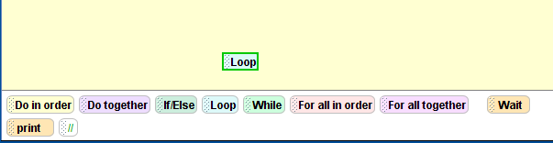
JT’s Extra: Adding A Loop In Alice

Slide 33
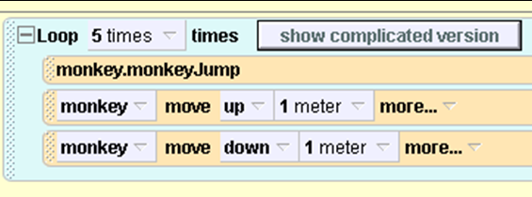
Loop Statement in Alice

Slide 34
Loop in Flowcharts
Start
Loop 5 times
Monkey Jumps
Monkey moves up 1m
Monkey moves down 1m
Stop

Slide 35
JT’s Extra: Boolean-Controlled Loops
Loops are used to repeat a part of the program (or potentially the entire program itself).
They are similar to branches where a logical statement is employed.
In the case of a loop if the logical statement evaluates to true then a part of the program will repeat (loop).
The repetition will continue until the logical statement evaluates to false.

Slide 36
While Statement
Statement before while
Test
while
condition
true
false
while body
Statement
after while

Slide 37
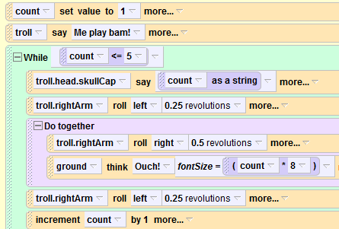
JT’s Extra: Counting With While
Starting value
Example 11
Condition for repeating
Loop ‘body’:
Instructions that are repeated

Slide 38
JT’s Extra: Example Flowchart
START
count = 1
count <= 5?
False
True
Troll counts, arm moves up
Arm moves down
Ground cries out
Arm moves up, count = count + 1
END

Slide 39
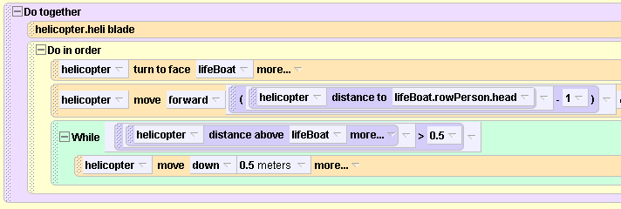
While Example

Slide 40
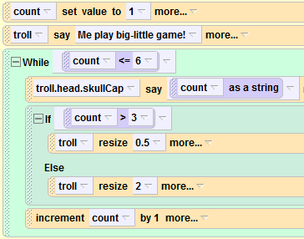
JT’s Extra: Combining Loops And Branches
Example 12
If-Else branch is part of the body of the loop

Slide 41
While Example

