Slide 1
1 Programming
Peeking into Computer Science

Slide 2
Reading Assignment
2
Mandatory: Chapter 5 – Sections 5.1 to 5.4
Download Alice 2.2 from www.alice.org
  JT: I downloaded version 2.2:
    http://www.alice.org/index.php?page=downloads/alice2.2_archive
Jalal’s resources:
  “How to” movies and example programs available at:
    http://pages.cpsc.ucalgary.ca/~kawash/peeking/alice-how-to.html
JT’s resources:
  www.cpsc.ucalgary.ca/~tamj/203/extras/alice

Slide 3
JT’s Extra: Additional Resources
A detailed step-by-step getting started guide
  http://www.cs.utexas.edu/~scottm/firstbytes/AliceProgrammingIntroFindingNemoCharades.pdf
Alice tutorials
  http://www.dickbaldwin.com/tocalice.htm
Alice training videos
  http://www.vtc.com/products/Programming-With-Alice-Tutorials.htm

Slide 4
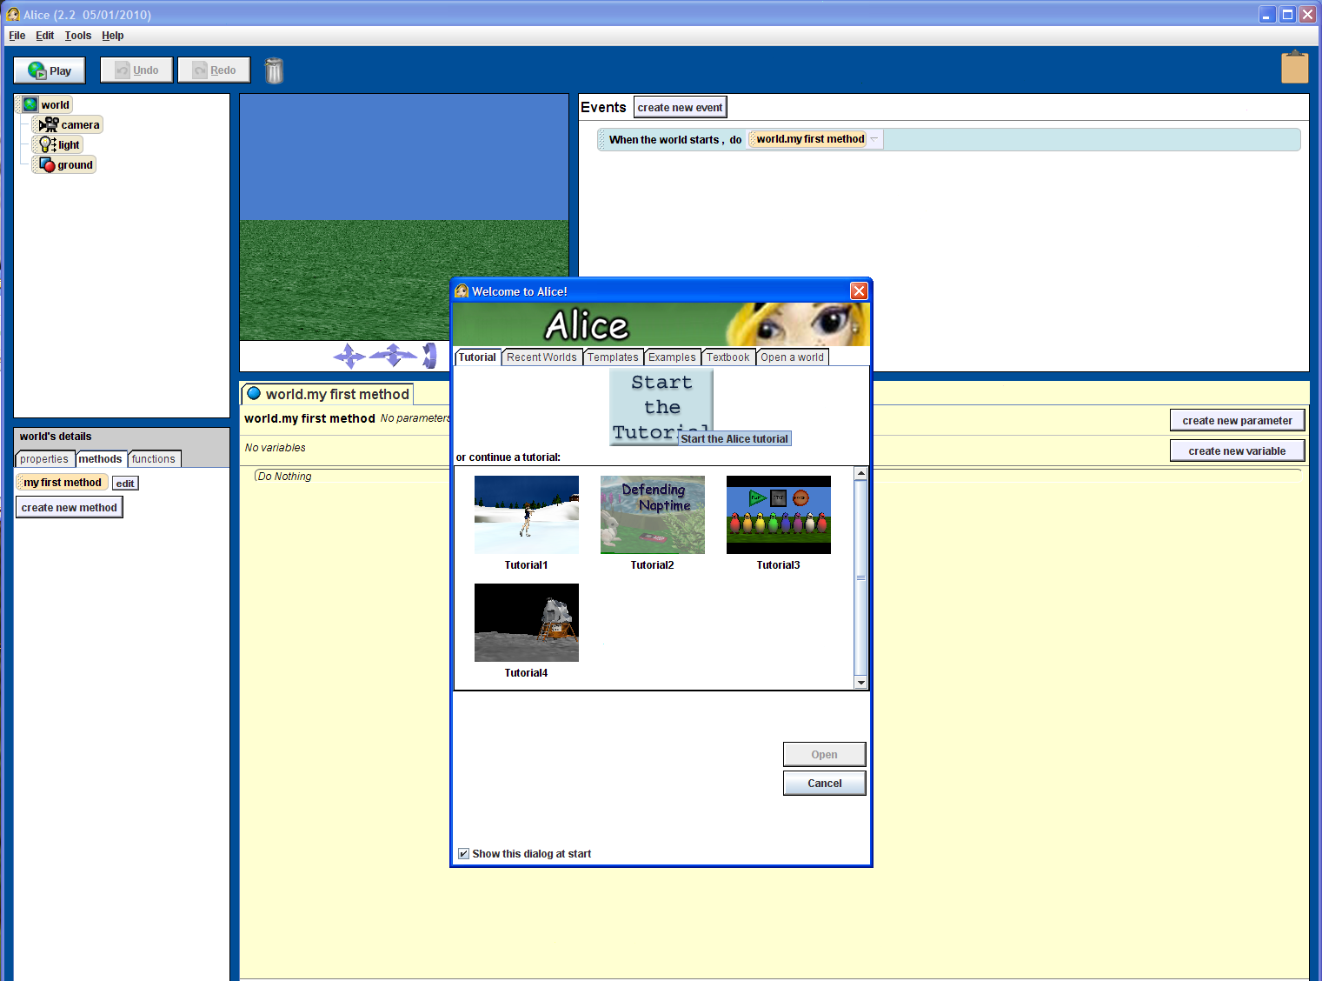
Alice Tutorials To Complete (In Tutorial)

Slide 5

JT: How To Study/Prepare For This Section?
Practice things yourself.
  “I wish he [JT] would help us more by giving us code [parts of a computer program] that can be directly used in the assignment.”
  How Computer Science works: You get better by doing things for yourself (this is a ‘hands-on’ field of study and work).
JT? (No not really)
You have to do it yourself
Similar to getting fit: you can’t just watch

Slide 6
JT: What Can You Do To Practice?
Write (lots of) programs.
  At the very least attempt the assignment and quiz.
  Try to do some additional practice work (some examples may be given in class).
  Write lots of little ‘test’ programs to help you understand and apply the concepts being taught.
    Example: branching/if was covered in class, write a program that employs branching.
Read (lots of) programs: ‘tracing’
  Reading through programs that other people have written, and executing it ‘by hand’ (getting the answer on your own without running the program) in order to understand how and why it works the way that it does.

Slide 7
JT: Asking Questions
If you find concepts unclear trying to understand them on your own can be beneficial (because this is a ‘hands on’ field).
  Looking at online resources:
    Remember when looking for academic resources, just like resources for other web searches, not all websites are good sources.
    Start with more reputable sources e.g., www.alice.org and the ones that I may have recommended.
If you are still unclear on concepts then make sure that you ask for help.
  Don’t wait too long to do this because latter concepts may strongly depend on the understanding of earlier concepts.

Slide 8
JT: Start Studying/Working On The Assignment As Early As Possible
  Don't cram the material just before the exam, instead you should be studying the concepts as you learn them throughout the term.
  It’s important to work through and understand concepts *before* you start the assignment. If you try to learn a new concept and work out a solution for the assignment at the same time then you may become overwhelmed.
  Don’t start assignments the night (or day!) that they are due, they may take more time than you first thought so start as soon as possible.

Slide 9
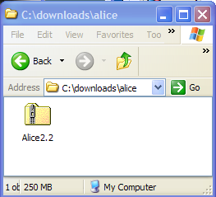
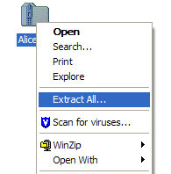
JT’s Extra: Setting Up Alice
Download version: 2.2
What you get: A compressed (zip) file.
This file needs to be uncompressed.
9

Slide 10
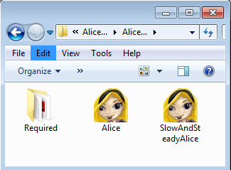
JT’s Extra: Starting Alice (2)
Alice (2.x) doesn’t need to be installed on your computer after it’s be uncompressed.
Just find the folder containing the executable program:
  “Alice” or “SlowAndSteady” (recommended)
  These programs can be found in the folder where you uncompressed the Alice files (Alice2.2)
10

Slide 11
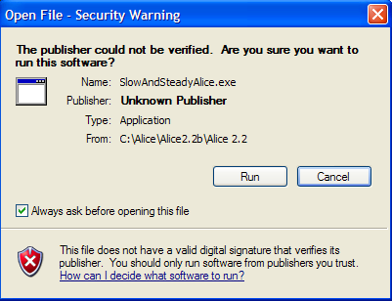
JT’s Extra: Scary Message???!!!
If you see this message you should normally pay attention!
If it’s for a program that you trust then it’s safe to proceed otherwise you should proceed with caution (probably select ‘cancel’).
  If you downloaded Alice (from the correct website) then you can just ignore it.

Slide 12
Programs
Communicating with Computers

Slide 13
Objectives
At the end of this section, you will be able to:
Differentiate between high-level and low-level programs
Differentiate between the two types of translators

Slide 14
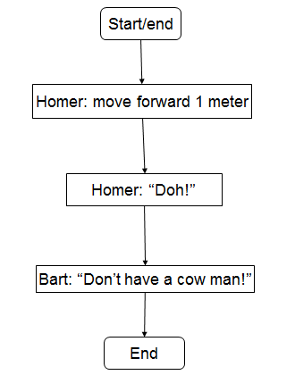
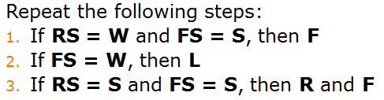
Algorithms
Algorithms can be specified in different ways
Graphical flowchart
Pseudo code (sort of program code

Slide 15
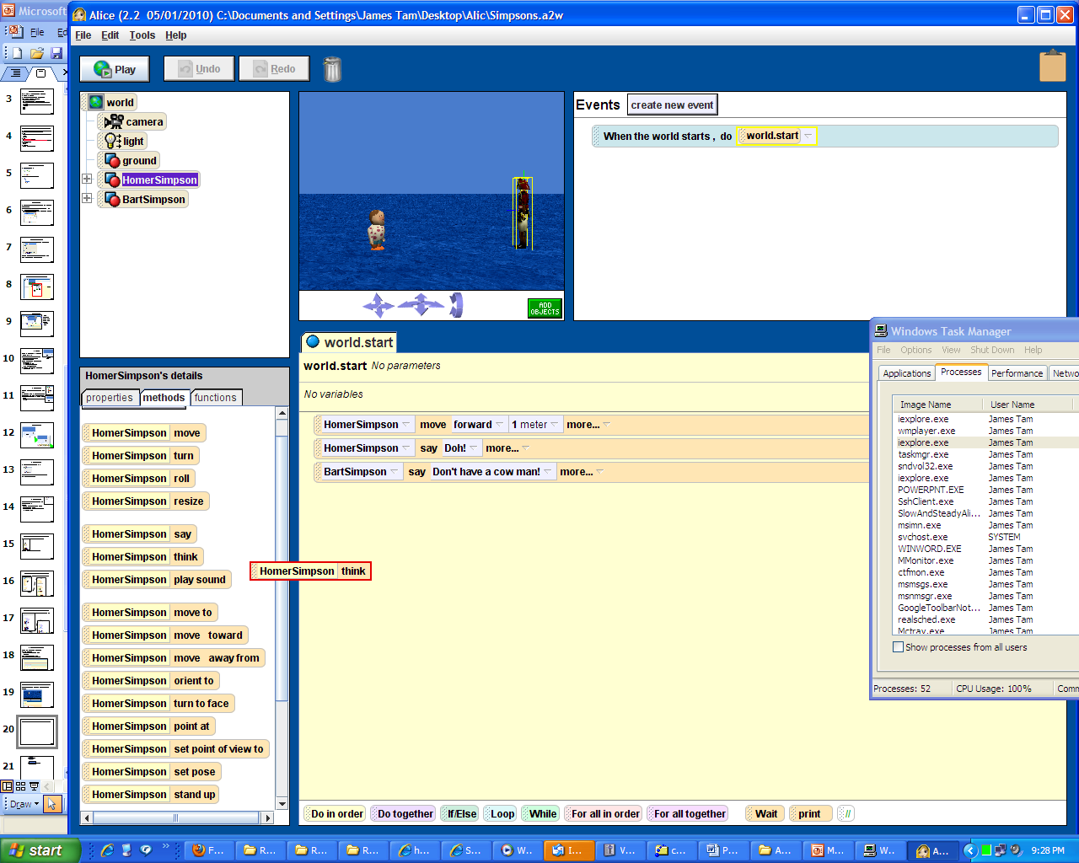
Algorithms (2)
JT: For this part of the course we focus on specifying algorithms using a programming language (Alice)

Slide 16


Programming Levels
Computers understand 0s and 1s
  Machine language
  Low Level (LL) language
Programmers use High Level (HL) languages
  Easier to understand and work with
010001
If true then
?

Slide 17
Translation
Translator: a program that translates HL to LL code
Two types: Compilers & Interpreters
010001
If true then
Translator

Slide 18
Translators
Compilers: translate the whole HL program to LL program
Interpreters: translate the HL program to LL program, one instruction at a time

Slide 19
Objects and Classes
Object-Oriented Programming

Slide 20
Objectives
At the end of this section, you will be able to:
Understand what objects are
Understand properties and behavior of objects
Understand what classes are
Understand how objects and classes are related
Understand object composition

Slide 21

An Example Alice Movie

Slide 22
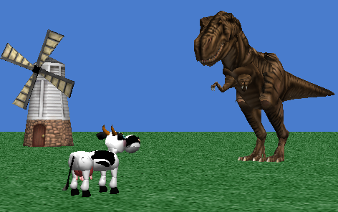
Alice Concepts
Alice is an Object-Oriented language
An Alice program is called a world
Everything in the scene is an object:
  Cow, Trex, mill, grass, etc…

Slide 23
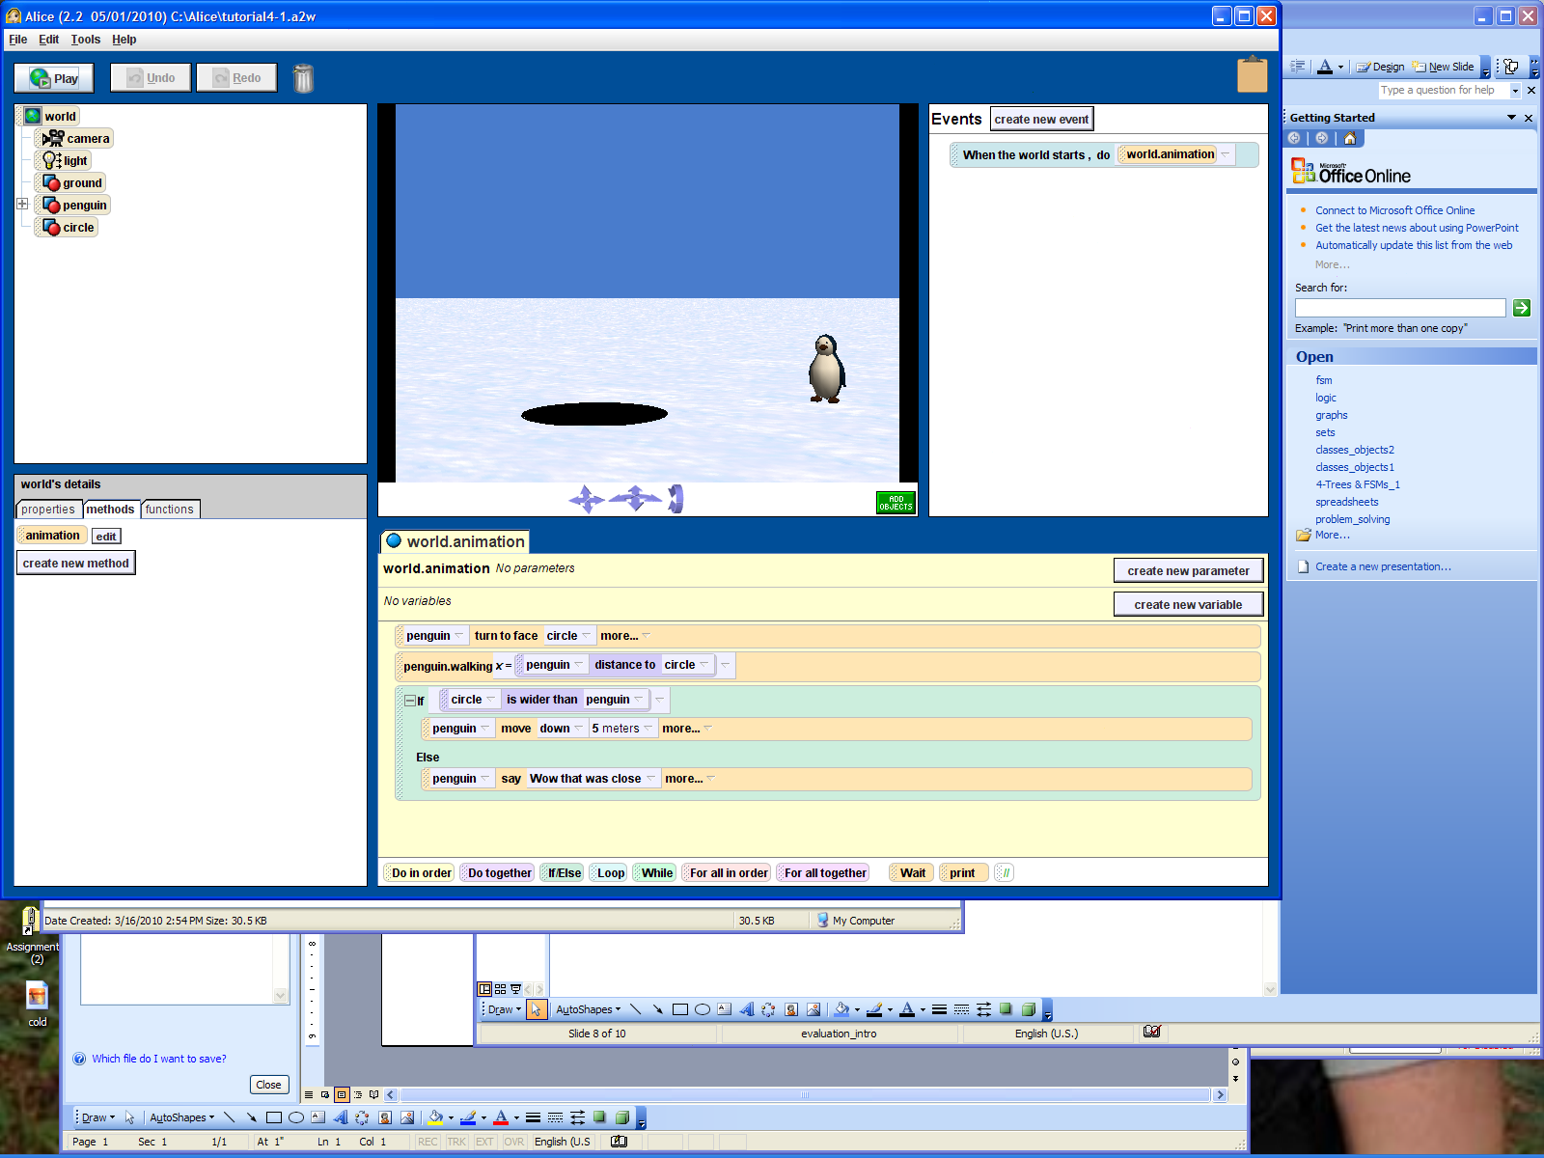
JT’s Extra: More On Objects
Head object
Arm object
Arm object
Torso object
Leg object
Leg object
‘Person’ object
JT: objects are the physical things that can be ‘seen’ and ‘grasped’.
Objects can also be composed of other objects.

Slide 24
Objects
An object is similar to an entity in Databases
  It has properties (attributes)
  In addition, it has behaviour
Cow objects have at least the properties:
  Size and color
Different objects may have different values for properties

Slide 25
Object Behaviour
Objects have behaviour
A cow can talk, walk, and eat
The behaviour is specified as a collection of methods
A method is a small program
  Allows the object to do something specific

Slide 26
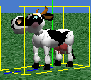

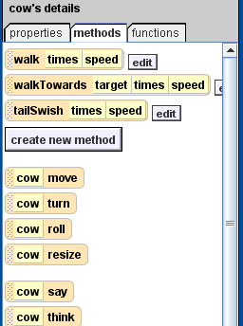
JT’s Extra: Attributes Vs. Behaviors
Attributes (information)
Behaviors (actions)

Slide 27

JT’s Extra: A Class Is Like A Blueprint
It is a general template.
Specifies the methods and attributes of objects which are examples/instances of the class.
Notes:
Analogous to a blueprint for a car doesn't actually create a car but indicates what that car should be like when you create one.

Slide 28
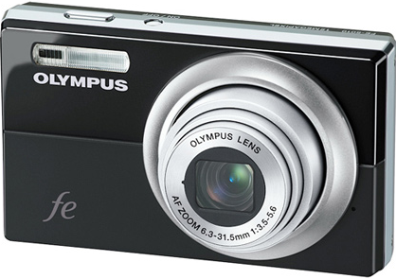
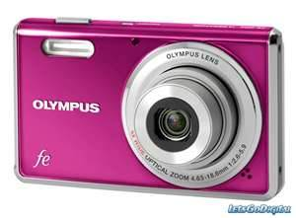
JT’s Extra: Objects Vs. Classes
Class: General design
Objects: actual instances based on the design
A class is used as a design guide from which objects are created.
Objects are instances of or examples of a class.
Notes:
Attributes can differ in the actual instances:
For example the class specifies that it has two colors but the actual colors can vary

Slide 29
Classes
A class is similar to an entity type in Databases
  It is a blueprint for objects
Objects are called instances of classes
Creating an object instantiates the object
  JT: Instantiation is the creation of an actual instance of an object (“instant”) from the description provided in the class.
29

Slide 30
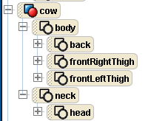
Composition
An object can be made from other objects
  JT: as described earlier “decomposed person” example
The cow object has two component objects:
  Neck and body
  Further composed
  of other objects
30

Slide 31
Object-Oriented Programs
An object-oriented program is a collection of objects
  An Alice world is an OO program
The objects exhibit a certain behaviour through executing their methods
  Calling their methods
cow.turn, trex.turn, trex.walk, windmill.blades.roll

Slide 32
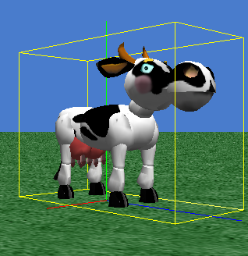
Directions, Center Point, and Bounding Box

Slide 33
Meet Alice
The basics

Slide 34
Objectives
At the end of this section, you will be able to:
Identify the 5 basic components of an Alice window
Understand the functions of each such component
Go through the steps to create an Alice program

Slide 35
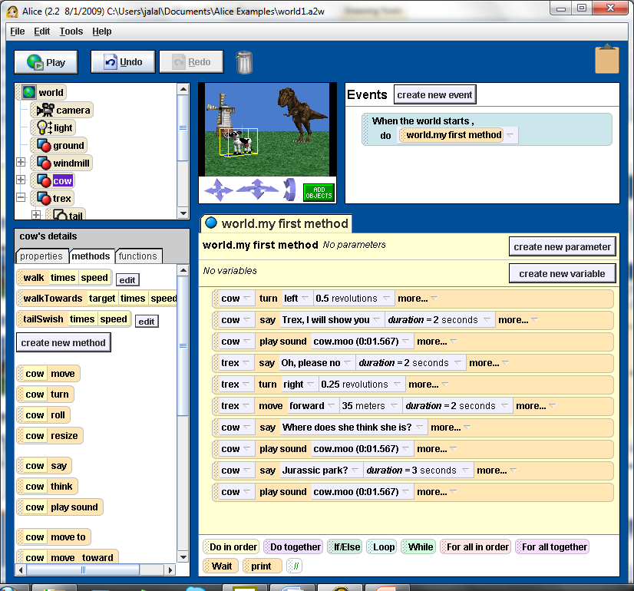
Alice World Window
World
view
Object
tree
Event
editor
Details
window
Method
editor

Slide 36
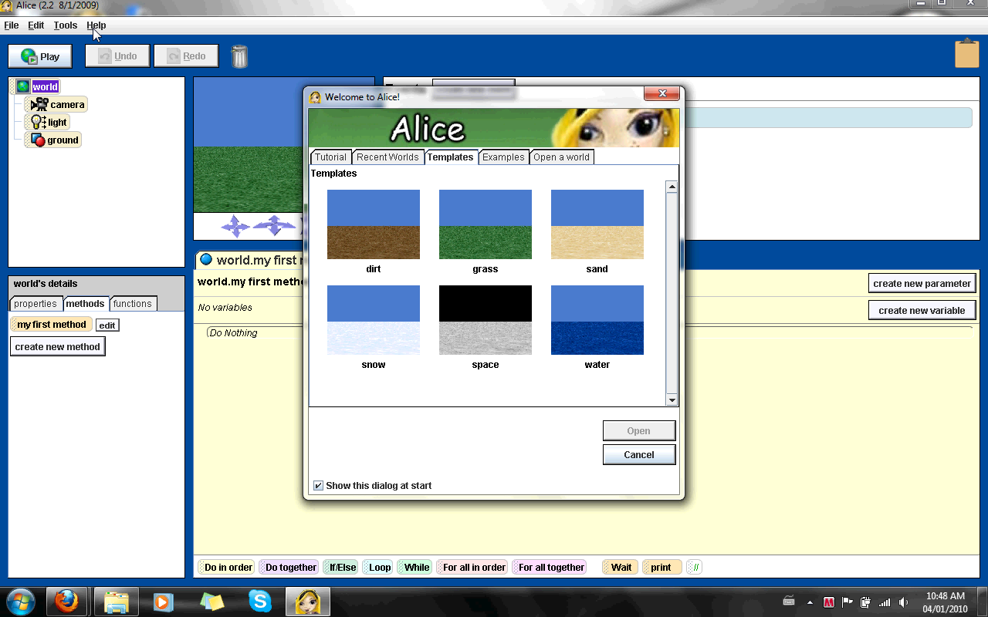
Creating an Alice Program
36

Slide 37
World (JT’s Extra)
Your computer program will be written for a virtual world.
There are different worlds that can be chosen but generally it’s just the appearance that differs.
Your view of the world can be changed using the controls.
  Up, down, left, right
  Forward, backward, left, right
  Tilt forward and backward
(JT’s note: don’t get to carried away with the camera controls)
Perspective controls
Notes:
* The difference between #1 and #2 is you can move in combinations e.g., #1 you can move up and left with #2 you can move forward and left

Slide 38
Object Tree (JT’s Extra)
The world contains objects that are shown in tree form.
Although your world will consist of three objects by default (camera, light, ground) it’s the extra objects that you add to this world that will be of interest most of the time.
  (In the example to the right the extra objects: penguin, circle).

Slide 39
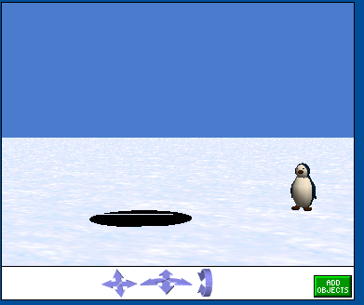
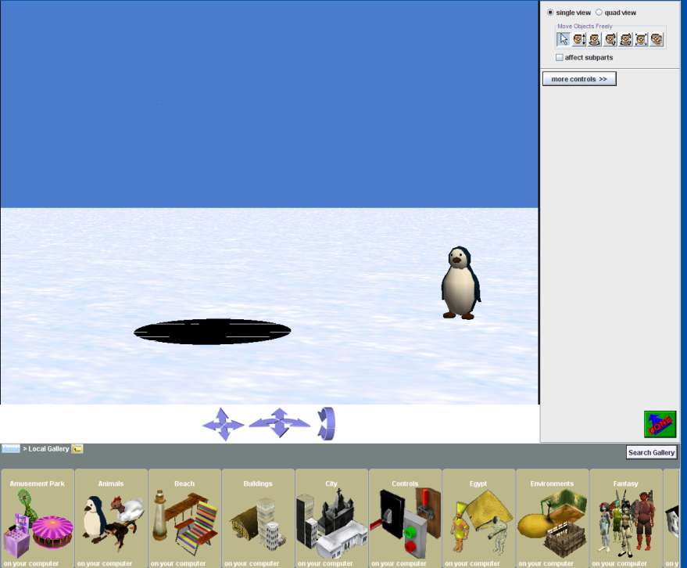
Adding Objects (JT’s Extra)

Slide 40
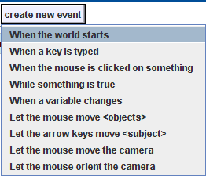
World Events (JT’s Extra)
Different events can occur in the world
The event that we’ll focus on for now is when the world starts (simulation begins running).

Slide 41
World Details (JT’s Extra)
Used to see the details of the virtual world (or objects in the world).
Details:
  Physical characteristics (“properties” in Alice).
  Actions (“methods” in Alice).
  Actions that perform an action and generates a value (“functions” in Alice).

Slide 42
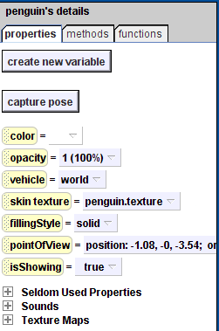
Properties Of An Example Object: Penguin (JT’s Extra)
Properties provide information about an object
Many (most) properties can be changed.

Slide 43
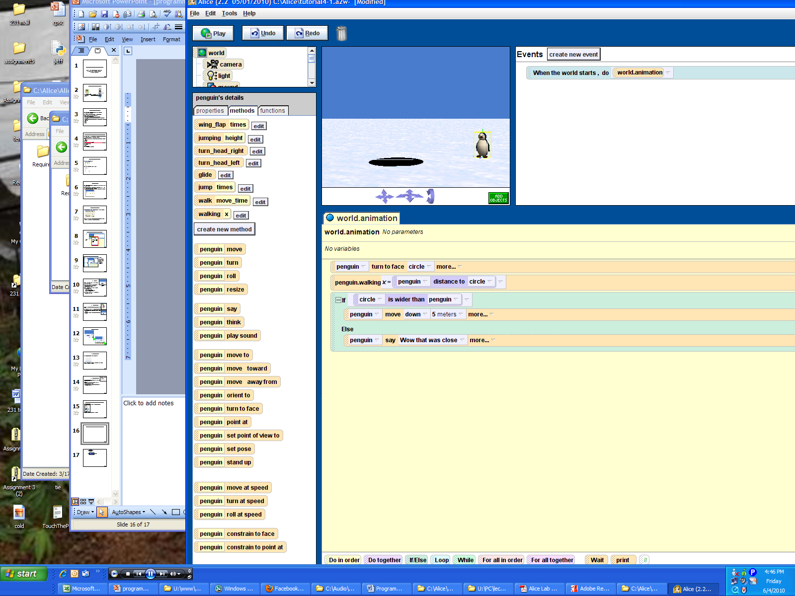
Methods Of An Example Object: Penguin (JT’s Extra)
Methods are the actions that an object is capable of carrying out.

Slide 44
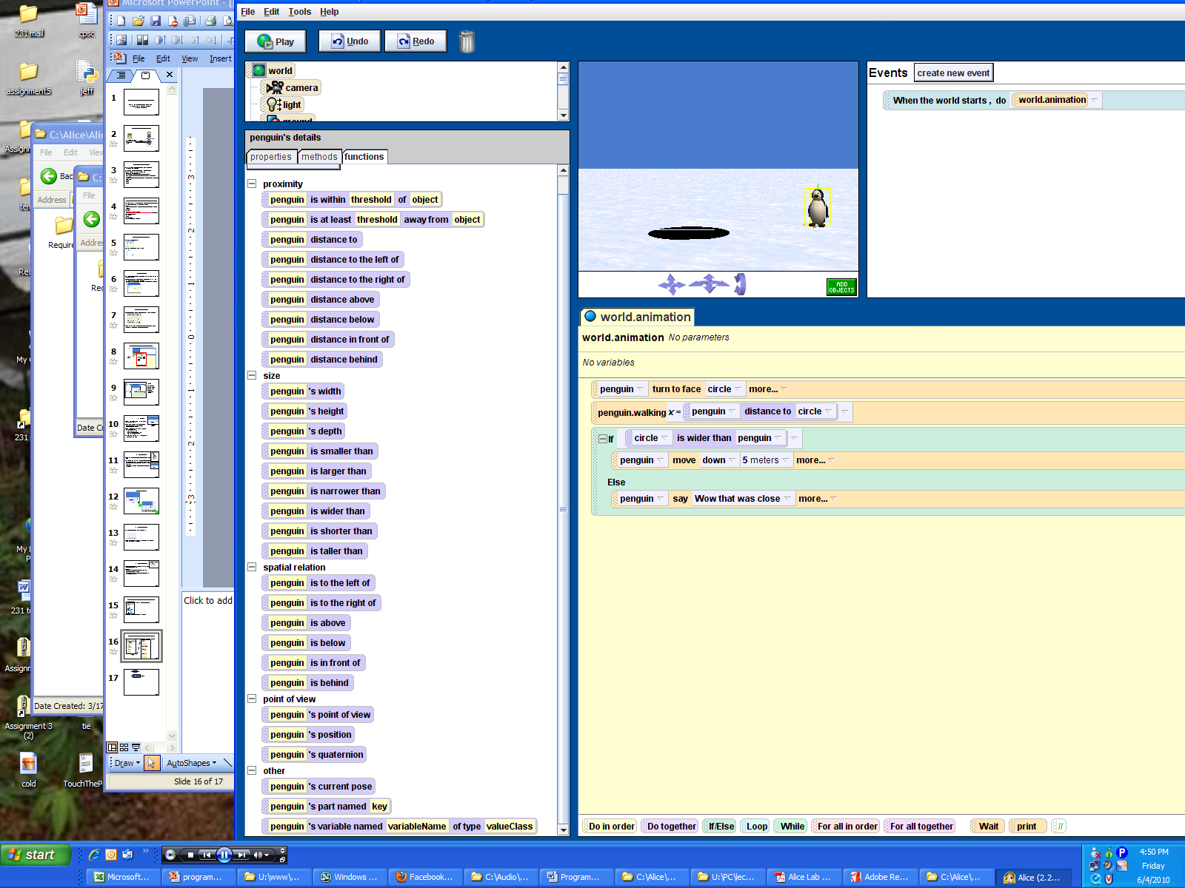
Functions Of An Example Object: Penguin (JT’s Extra)
Functions are typically asking a question (logical statement).

Slide 45
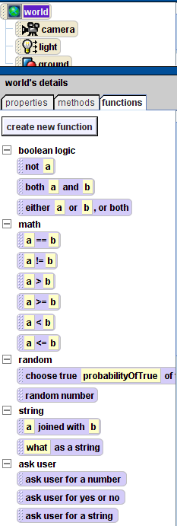
Some Useful Functions Of The World (JT’s Extra)
Logical operations (“Boolean logic”, “math”)
Generating random numbers
Prompting the user of the program for information (“ask user”)

Slide 46
Event (Method) Editor (JT’s Extra)
A computer program consists of a series of instructions
  (e.g., save document, print document, spell check etc.)
This is where you use the methods, functions and the other parts of Alice to ‘program’ (create) those instructions.

Slide 47
Story Lines
Must have a story line before you start programming:
In an open field with a windmill in the background,
a trex approaches a cow from behind;
the cow turns towards the trex, says ”Trex, I will show you”, and moos;
the trex, says “Oh please no”, turns, and runs away, until she disappears from the scene;
the cow says “where does she think she is”, moos, continues “Jurassic Park?”, and moos.

Slide 48
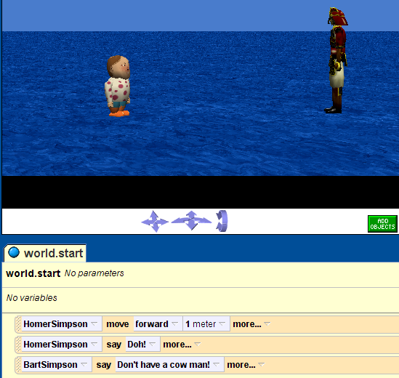
JT’s Extra: Programs Are Written In A Narrative Story Form
Basic instructions are provided in a linear fashion (one after another).

Slide 49
JT’s Extra: Instructions Are Given To The Program Visually
Dragging an instruction from the available list into the editor.

Slide 50
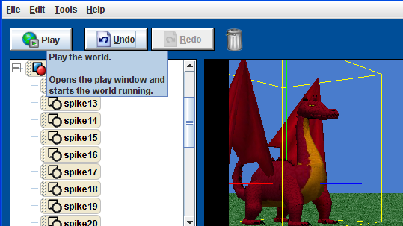
JT’s Extra: Running Your Program
This is when the instructions in your program are executed.

Slide 51
JT’s Extra: World.my first method
This method is executed when you run an Alice world
Call the methods you want to run on objects from this method
This is your main program
Rename to a sensible name e.g., “start”, “main”
51

