Slide 1
4 Database Queries
Peeking into Computer Science

Slide 2
Reading Assignment
Mandatory: Chapter 4 – Sections 4.6 &4.7

Slide 3
Join Queries

Slide 4
Objectives
By the end of this section, you will be able to:
Formulate queries on multiple tables
Understand how natural joins work
Determine the result of a multi-table query

Slide 5
JT’s Extra: Set Multiplication
Recall: set multiplication ‘determines all possible combinations of elements from each set’.
In actual databases not all combinations may occur.
  E.g., an employee typically is just a member of one department not all departments.
The database implementation of a set multiplication is ‘join’.

Slide 6
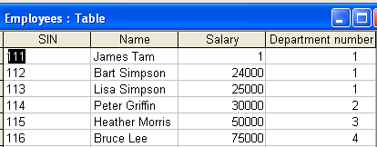
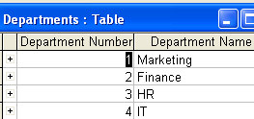
JT’s Extra: Join Example

Slide 7
JT’s Extra: Query For Join Example
SELECT *
FROM Employees, Departments;

Slide 8
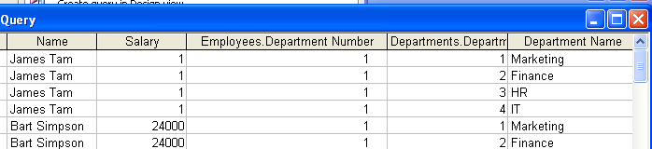
JT’s Extra: Result Of The Query
James Tam is only in Department 1 but the query yields all possible combinations (whether they actually occur in the data or not)

Slide 9

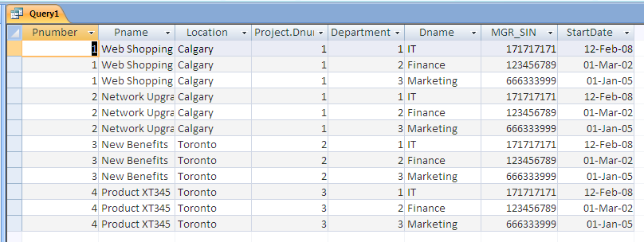
PROJECT x DEPARTMENT

Slide 10
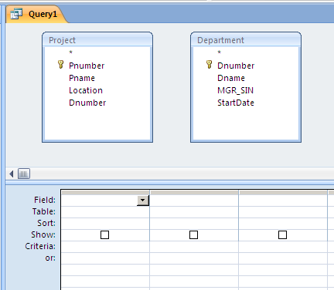
QBE

Slide 11
JT’s Extra: Join Of Actual Cases From The Database
In the previous example this would only include the cases where the department number of the Employees table matched the department number of the Departments table.
  (It should exclude non-existent combinations of employees and departments.

Slide 12
JT’s Extra: MS-Access SQL Query
SELECT Departments.*, Employees.*
FROM Departments INNER JOIN Employees ON
  Departments.[Department Number] = Employees.[Department number];

Slide 13
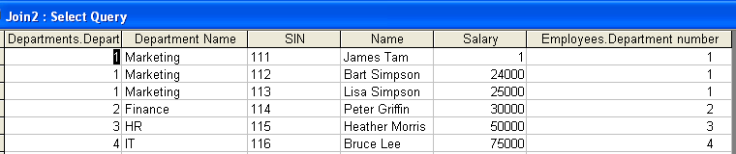
JT’s Extra: Query Results
Results
Employees table

Slide 14
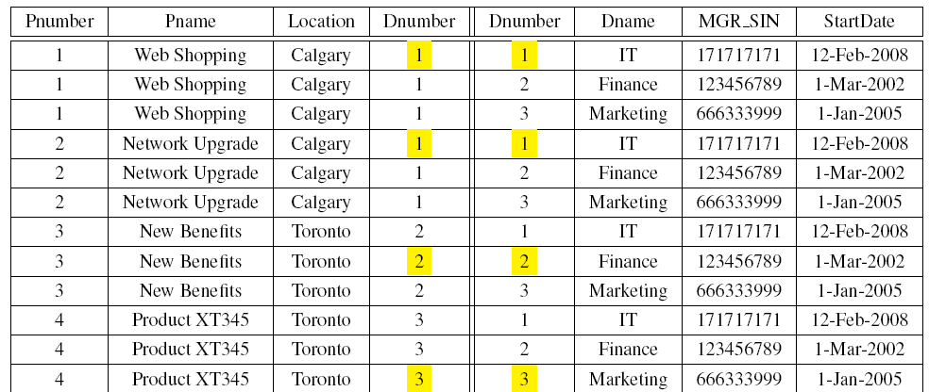
Where Dnumbers Match

Slide 15
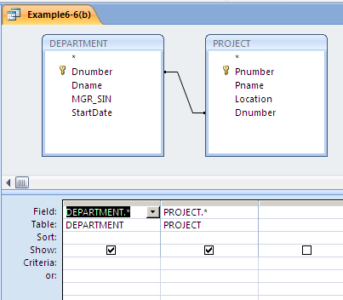
Natural Join

Slide 16
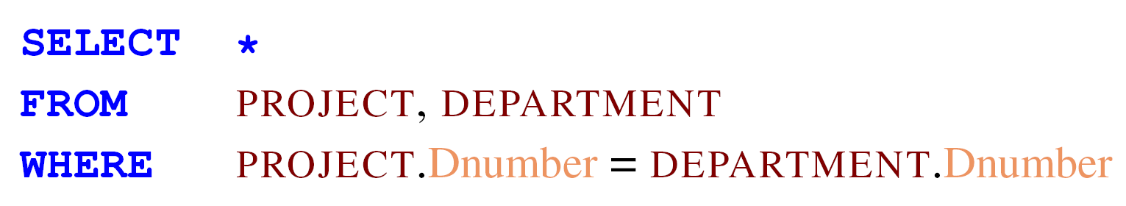
Natural Join Condition

Slide 17
Natural Join Result

Slide 18
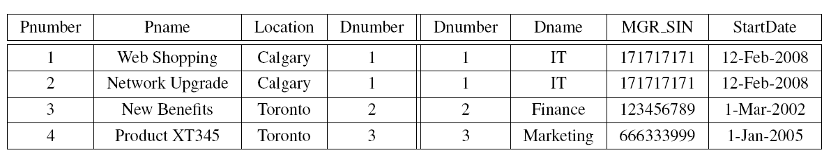
Natural Join Result

Slide 19
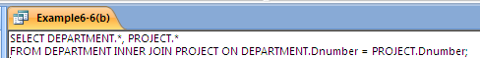
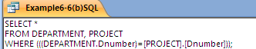
Default QBE Joins in ACCESS
Can be also done explicitly

Slide 20
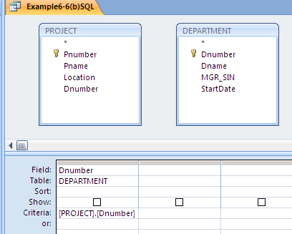
QBE with Explicit Join

Slide 21
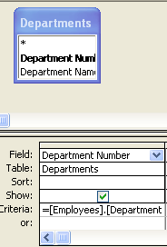
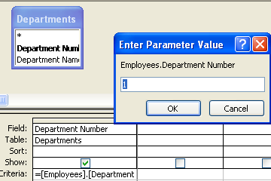
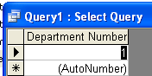
JT’s Extra: Effect Of QBE With Explicit Join
Query criteria
QBE
Query result

Slide 22
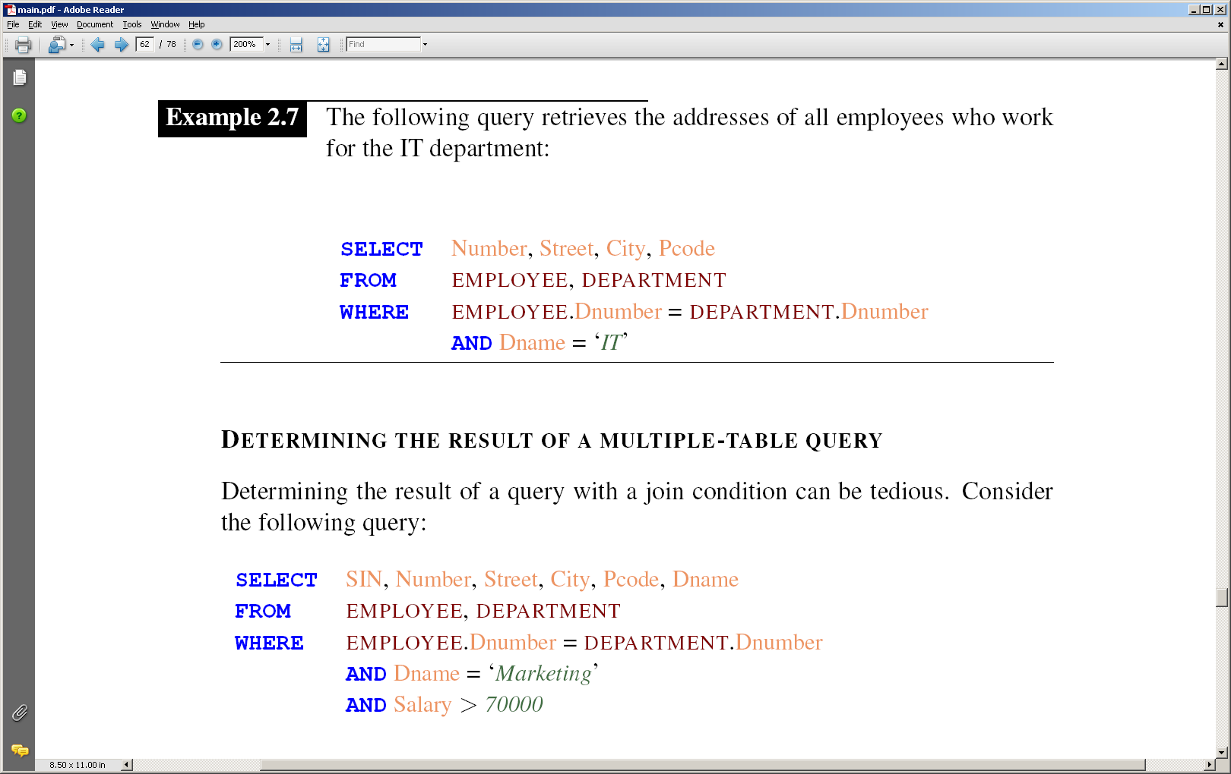
Join Example
Retrieve the address of each employee of the
IT department

Slide 23
Determining the Result of a Join Query

Slide 24
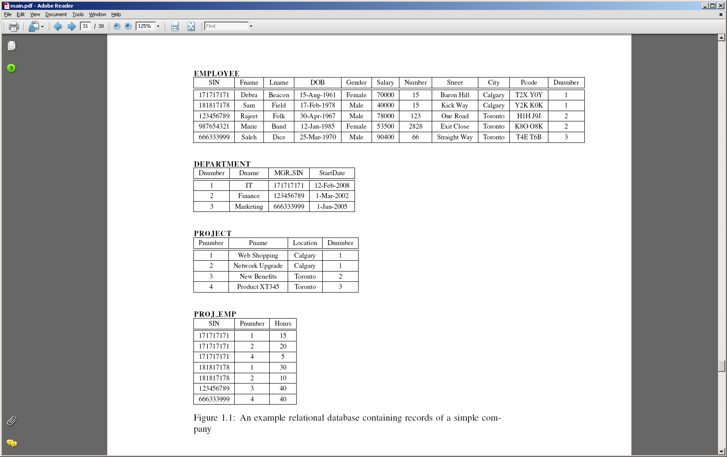
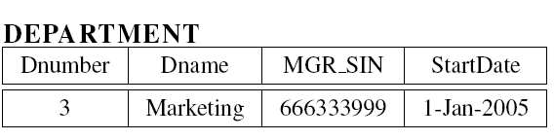
Reduce the size of the joined tables

Slide 25
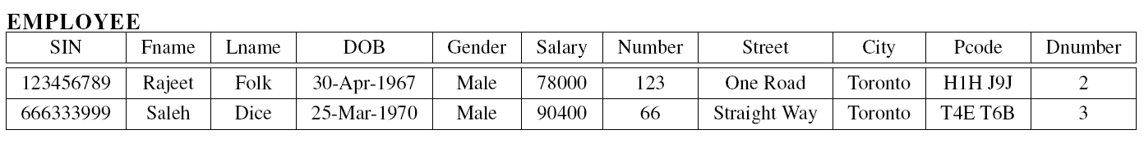

Slide 26
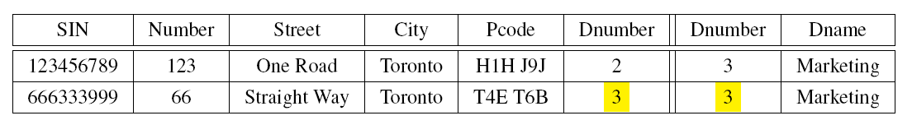
Multiply the resulting relations and project

Slide 27
Apply the join condition

Slide 28
Aggregate Functions, Ordering, & Grouping

Slide 29
Objectives
By the end of this section, you will be able to:
Use aggregate functions
Group the calculations of aggregate functions
Formulate SQL queries with HAVING and ORDER BY clauses

Slide 30
JT’s Extra: Basic Parts Of An SQL Query
  SELECT: Specifies the fields/columns shown in the query results e.g., SIN field.
  FROM: Lists the tables from which the data is to be selected e.g., look in the Employees table.
  WHERE: Provides the conditions to determine if rows/records are shown by the query.
  ORDER BY: Specifies the order in which rows are to be returned by the query.

Slide 31
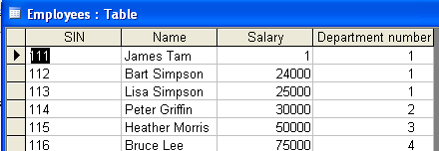
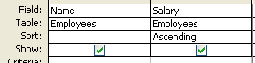
JT’s Extra: ‘Order By’ (Data and Query)
Original table
QBE
SQL
SELECT Employees.Name, Employees.Salary
FROM Employees
ORDER BY Employees.Salary;

Slide 32
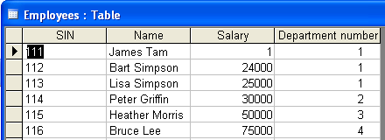
JT’s Extra: Query Results

Slide 33
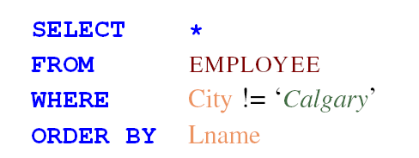
Order By Clause
Orders the result of a query

Slide 34
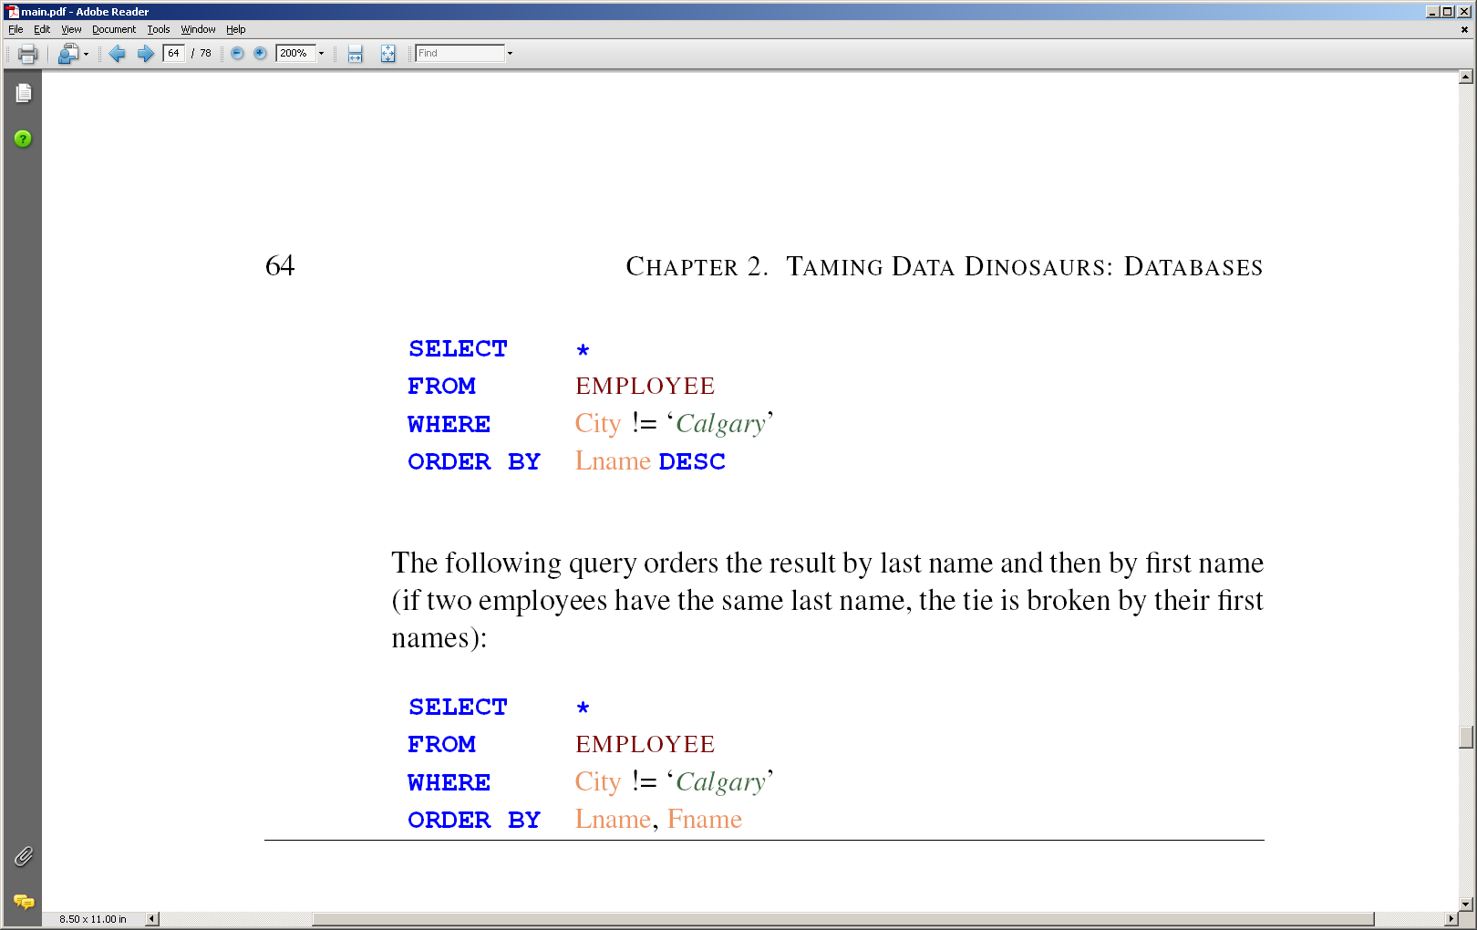
Descending Order

Slide 35
Order By Clause

Slide 36
Aggregate Functions¹
1: JT’s extra, Aggregate functions allow you to perform calculations on multiple rows of data, but will only return a single value in the response.
36
Sum
Average
Minimum
Maximum
Count

Slide 37
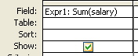
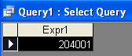
JT’s Extra: SUM
Original table
QBE
SQL
SELECT Sum(salary) AS Expr1
FROM Employees;
Query result

Slide 38
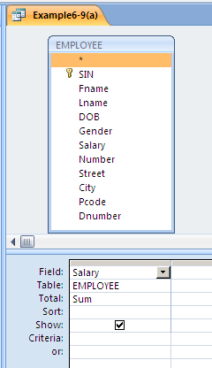
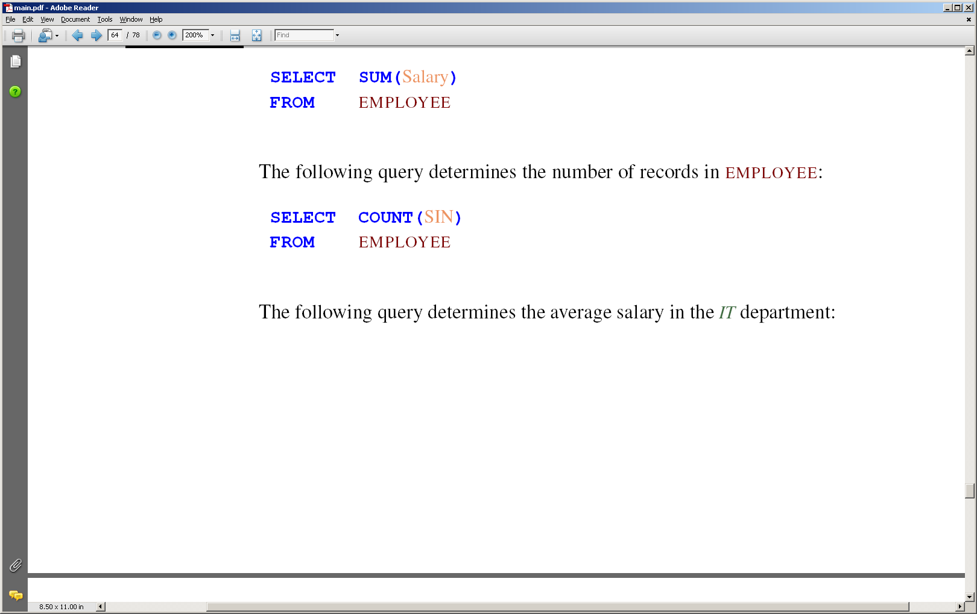
Sum

Slide 39
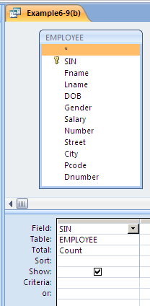
COUNT

Slide 40
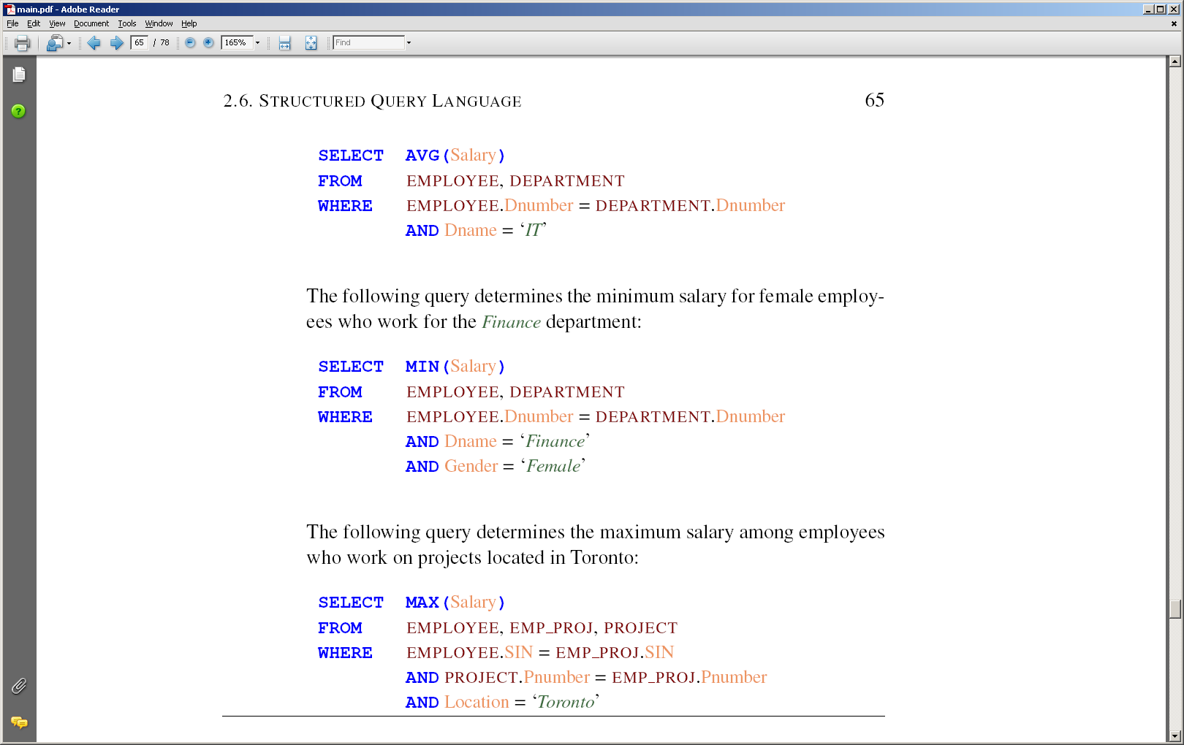
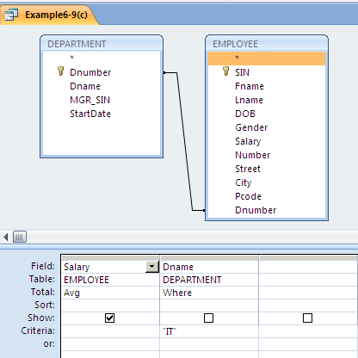
AVG

Slide 41
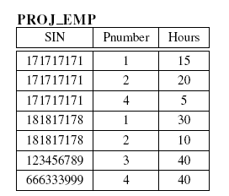
Exercise
Retrieve the min salary of female employees who work for the Finance department
Use function Min()

Slide 42
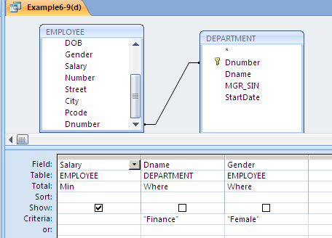
MIN

Slide 43
Exercise
Retrieve the max salary of employees who work on projects located in Toronto
Use function Max()

Slide 44
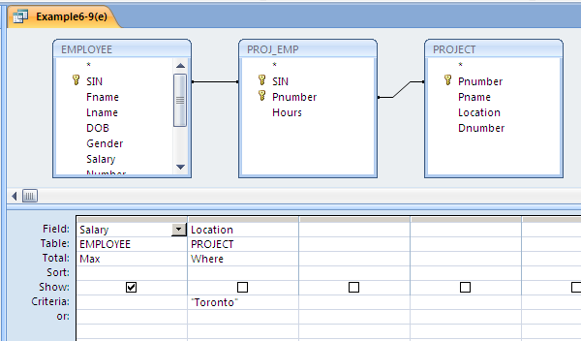
MAX

Slide 45
Grouping Calculations
How to find the sum of salary per department
SQL has the GROUP BY clause
Groups calculations of an aggregate function

Slide 46
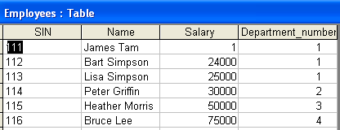
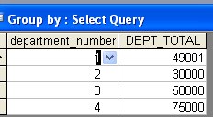
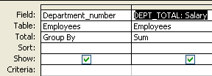
JT’s Extra: Group By (Small Example)
Employees table
Query result
QBE
SQL
SELECT department_number, sum(salary) AS DEPT_TOTAL
FROM Employees
GROUP BY department_number;

Slide 47
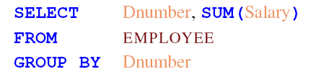
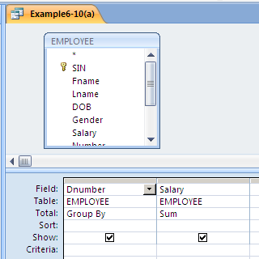
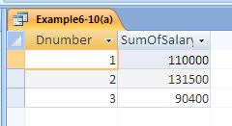
GROUP BY

Slide 48
HAVING Clause
To show only some of the groups
WHERE filters tuples
HAVING filters groups

Slide 49
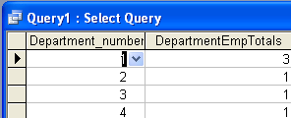
JT’s Extra: Group By (All Departments)
Employees table
SQL
SELECT Department_number, COUNT(*) as DepartmentEmpTotals
FROM Employees
GROUP BY Department_number;
Query result

Slide 50
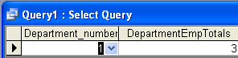
JT’s Extra: Having Clause (Bigger Dept.’s)
Employees table
SQL
SELECT Department_number, COUNT(*) as DepartmentEmpTotals
FROM Employees
GROUP BY Department_number
HAVING COUNT(*)>1
Query result

Slide 51
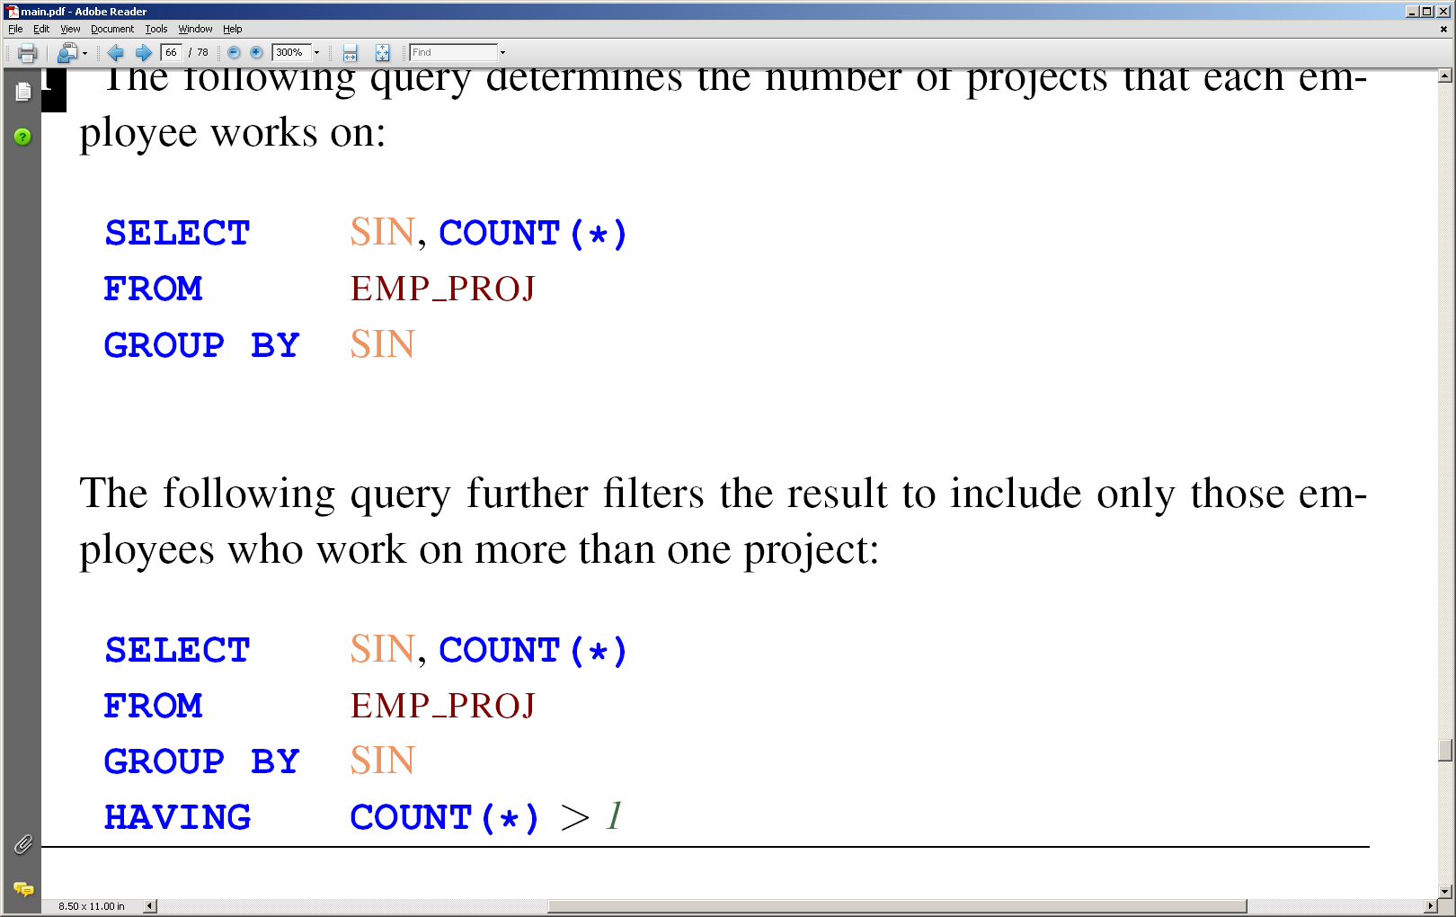
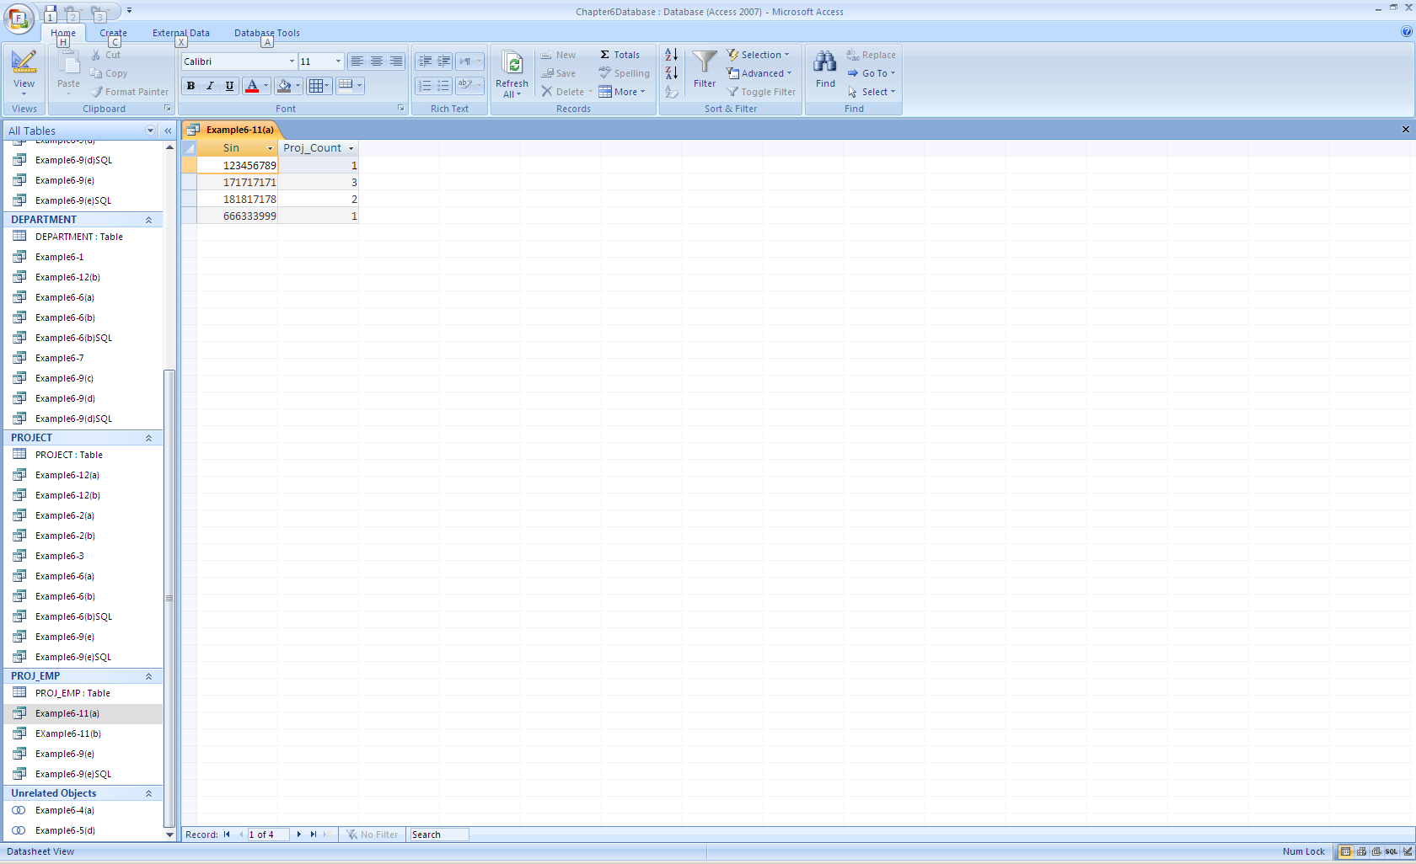
HAVING Clause

Slide 52
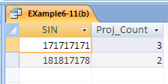
HAVING Clause

Slide 53
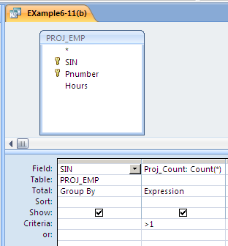
HAVING Clause

Slide 54
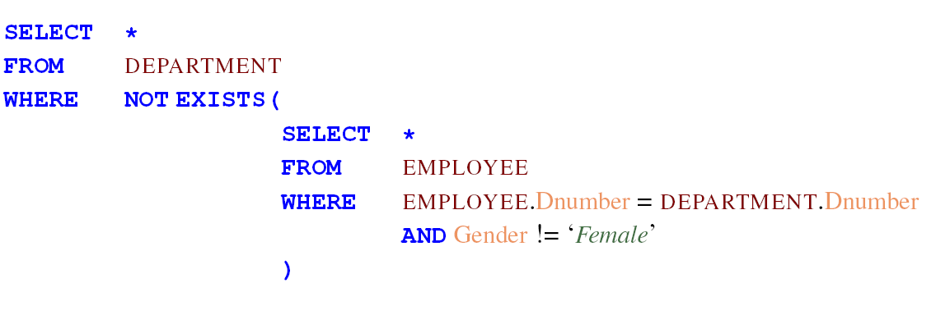
EXISTS – Optional Reading

