Slide 1
3 Database Queries
Peeking into Computer Science

Slide 2
Reading Assignment
Mandatory: Chapter 4 – Sections 4.6 & 4.7

Slide 3
Example Access DB
Can be found on:
http://pages.cpsc.ucalgary.ca/~kawash/peeking.html
Includes all examples in the book
  Numbered by exercise numbers

Slide 4
Structured Query Language

Slide 5
Objectives
By the end of this section, you will be able to:
Name the two parts of SQL
Understand the function of each part
Formulate basic DDL & DML statements in SQL

Slide 6
JT’s Extra: Purpose
Sale $$$
Sale $$$
Database: Customer information
To store & retrieve information
Notes:
6

Slide 7
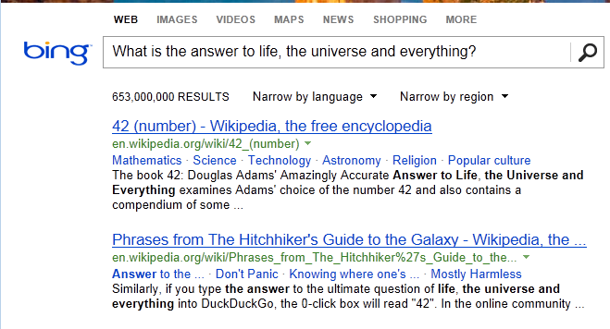
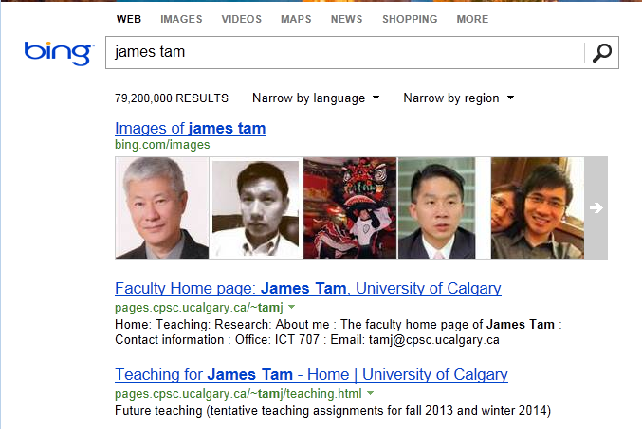
JT’s Extra: Queries
Queries are questions ‘asked’ of/to the database in order to retrieve information.
Notes:
Searching database occurs when you enter a phrase into a search website
The question can be obvious
The question can be implicit (what web pages contain the words ‘james’ and ‘tam’)

Slide 8
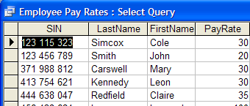
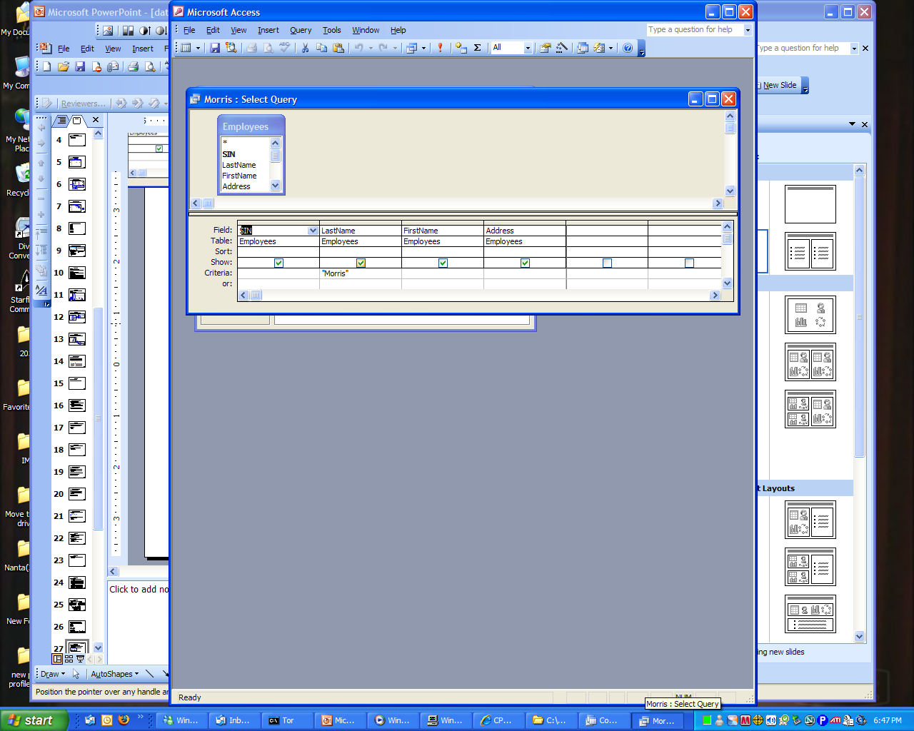
JT’s Extra: Retrieving Data Via Queries
Query
Data retrieval occurs through the use of ‘queries’:
  A query is a question asked of the data in the database.
  Typically worded to show only the parts of the database for which the answer to the question is true.
  Example 1: What is the SIN, name and pay rate of every employee in the Employees Table:
  Example 2: What employees have the last name of Morris?
Notes:
8

Slide 9
Structured Query Language
SQL
Programming language, specialized for databases
Data Definition Language (DDL)
  Defining the structure of the DB
Data Manipulation Language (DML)
  Manipulating the contents of the DB
JT’s Extra: SQL = Structured Query Language
JT’s Extra: Creating the data (table)
What fields?
What will each field store?
JT’s Extra: Modifying the data (table)
Insertions
Deletions

Slide 10
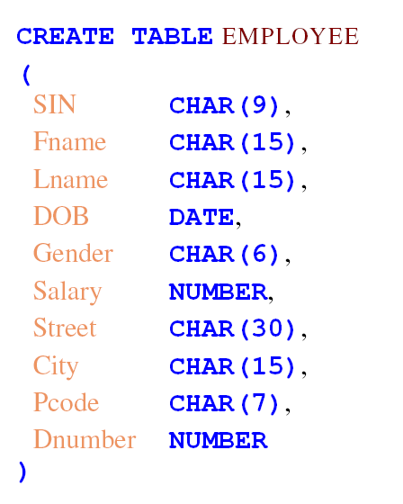
DDL

Slide 11
DDL
DROP TABLE EMPLOYEE

Slide 12
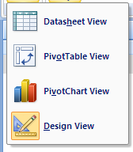
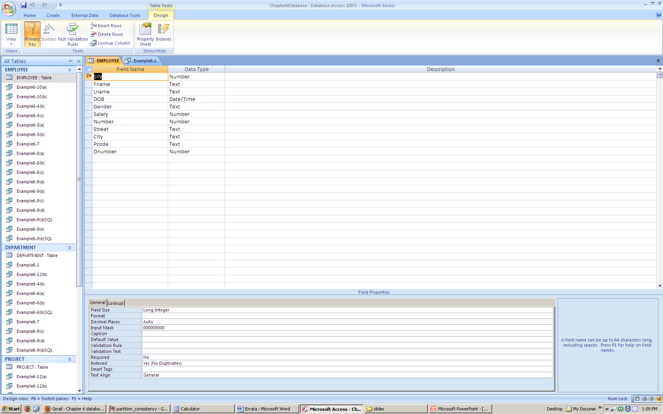
Access Table Creation

Slide 13
JT’s Extra: DML General Structure
Recall: Data manipulation language modifies the tables
General format:
<Action> into/from <Table name>
Example:
Insert into Employees {some values}
Delete from Employees {conditions for deletion }
Notes:
13
* The textbook refers these as QBE: Query by example

Slide 14
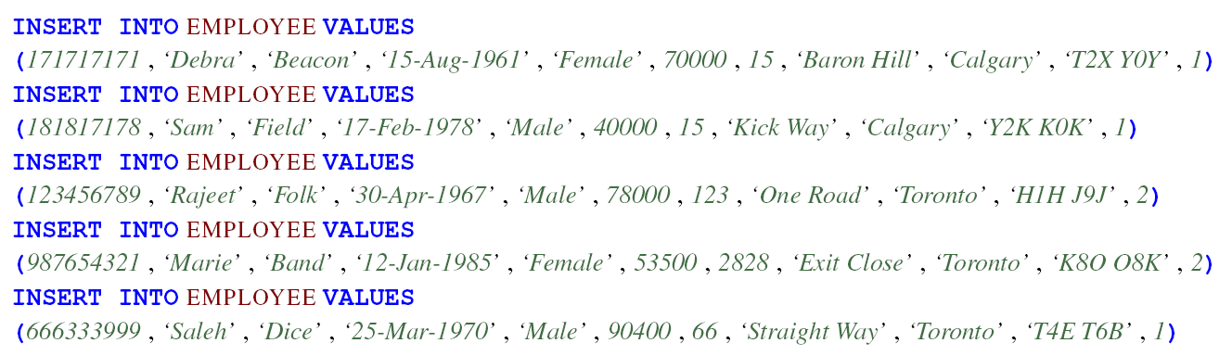
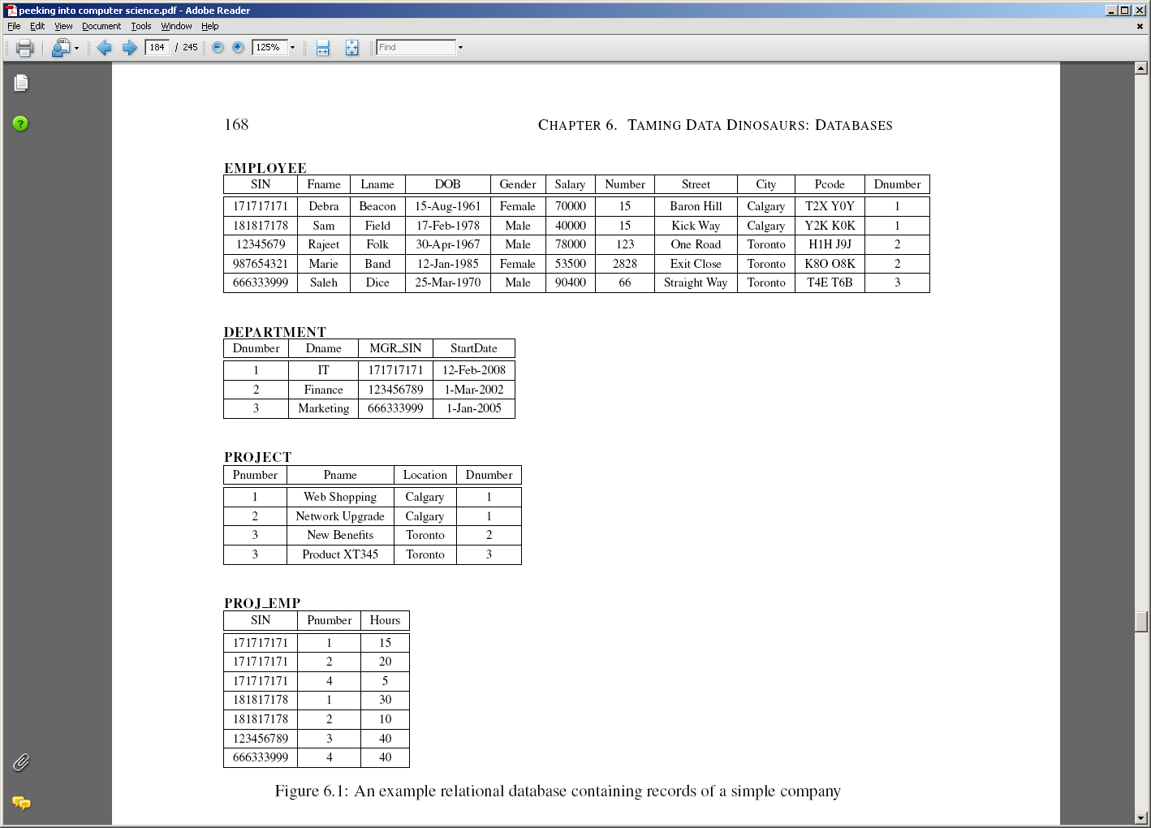
DML - Insertion

Slide 15
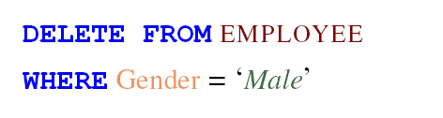
DML - Deletion

Slide 16
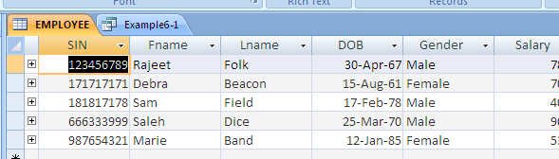
Access Insertion and Deletion

Slide 17
SQL Queries
Questioning the database

Slide 18
Objectives
By the end of this section, you will be able to:
Know the basic parts of speech in SQL
Formulate SQL queries
Use set operations in SQL queries
Use complex logic in SQL queries

Slide 19
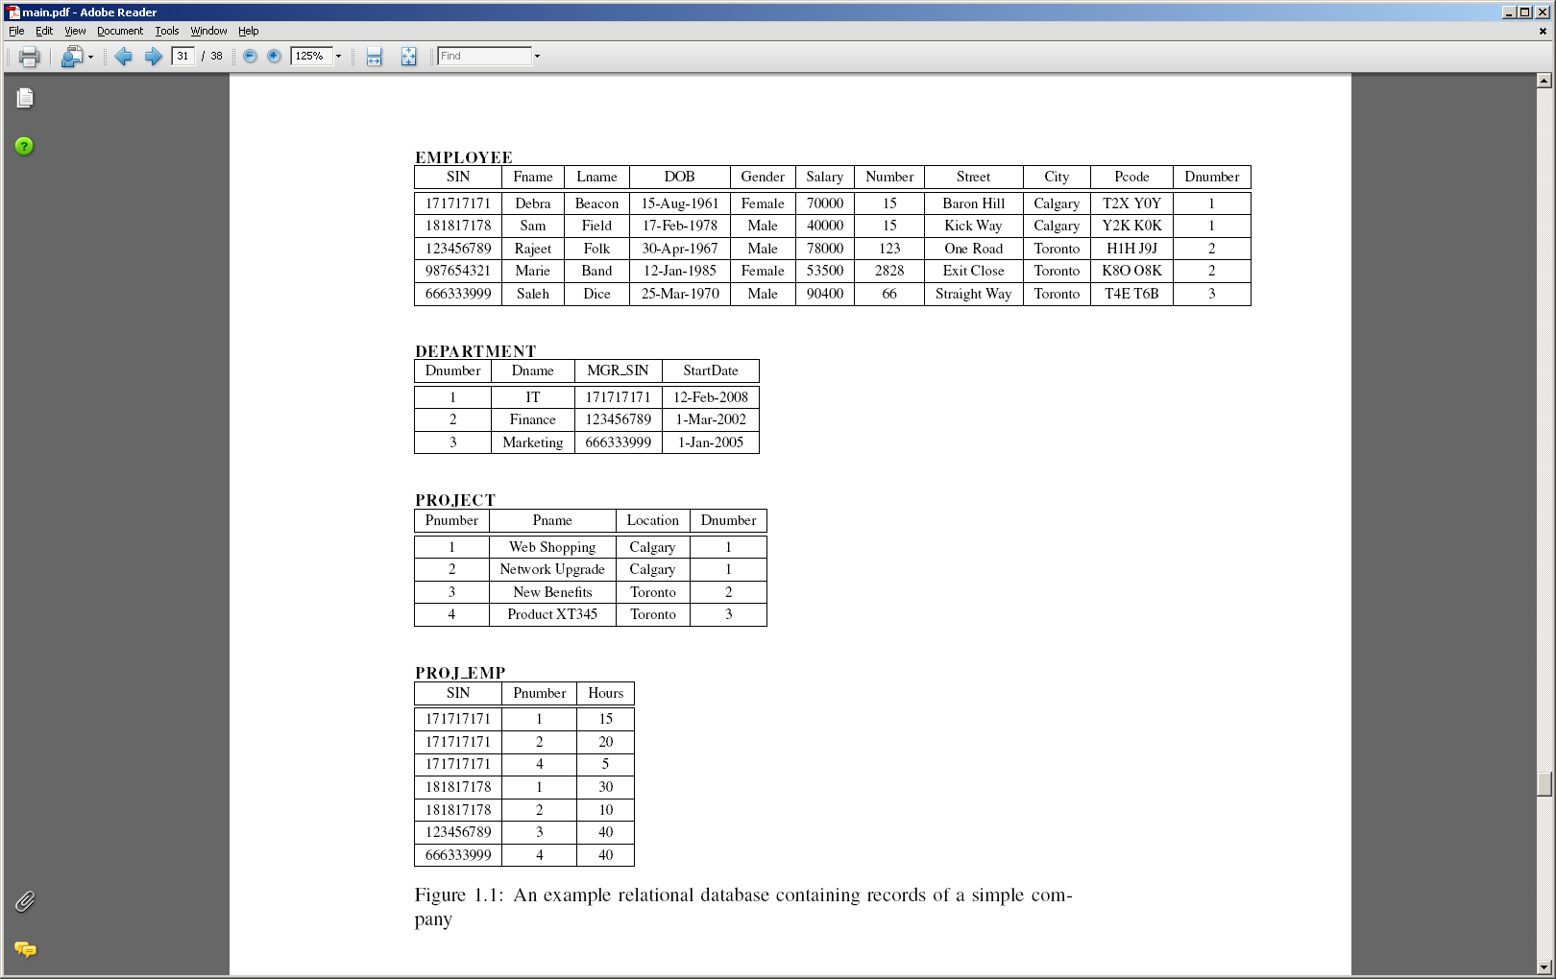
Example Database

Slide 20
Queries
Questions submitted to the DB
Query By Example (QBE)
Using SQL

Slide 21
JT’s Extra: Basic Format Of SQL Queries
Informal English description
Given some condition(s) is/are met what columns of what tables will appear.
Example:
If last name is “Morris” show the employee number, first name and last name from the employees table.

Slide 22
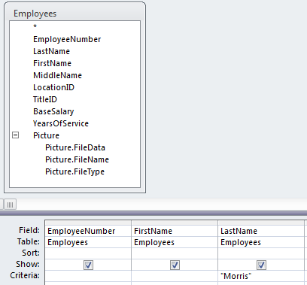
JT’s Extra: Basic Format Of SQL Queries (2)
Specifying the query in the form of QBE (Query by example) in MS-Access

Slide 23
JT’s Extra: Basic Format Of SQL Queries (3)
Formal SQL structure
SELECT <columns of table(s)>
FROM <table(s) >
WHERE <Boolean expression(s)>
ORDER BY¹
1 Optional section: used to format or rank query results

Slide 24
JT’s Extra: Example SQL Query
SELECT
  Employees.EmployeeNumber,
  Employees.FirstName,
  Employees.LastName
FROM EMPLOYEES
WHERE
  EMPLOYEES.LastName="Morris";

Slide 25
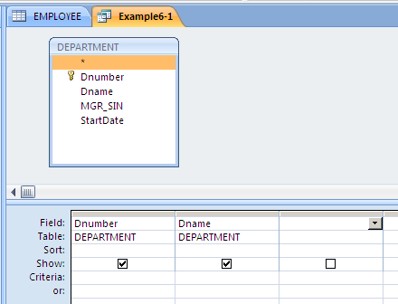
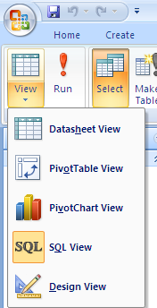
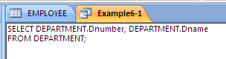
QBE – Projection

Slide 26
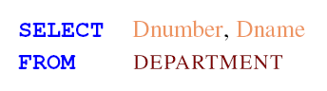
SQL - Projection
X
X

Slide 27
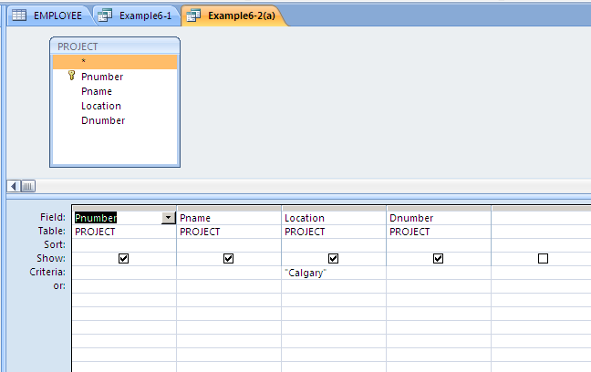
QBE - Selection

Slide 28
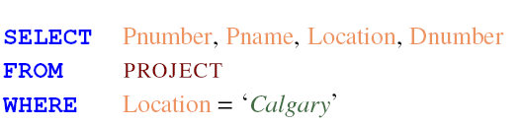
SQL - Selection

Slide 29
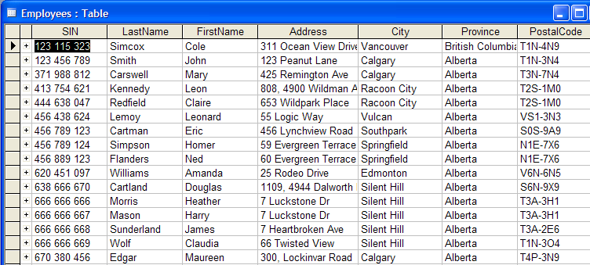
JT’s Extra: Using The Wildcard In Queries
The ‘wildcard’ character can stand for any number of characters in the position that it’s placed:
  Example queries that follow will be from the Employees table:
Notes:
29
Q1: m* - under first name
Q2: *s – under last name

Slide 30
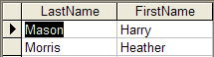
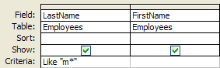
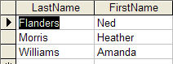
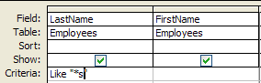
JT’s Extra: Using The Wildcard In Queries (Access)
Examples:
  Which employees have a last name that begins with ‘m’?
  Which employees have a last name ends with ‘s’?
Notes:
30
Q1: m* - under first name field
Q2: *s – under last name
Q3: *a* - under first name

Slide 31
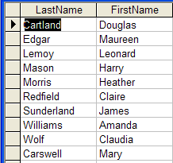

  Which employees have the letter ‘a’ anywhere in their first name?
JT’s Extra: Using The Wildcard In Queries (Access: 2)

Slide 32
Wild Cards
*

Slide 33
JT’s Extra: Set Operations On Databases
UNION
INTERSECT
MINUS

Slide 34
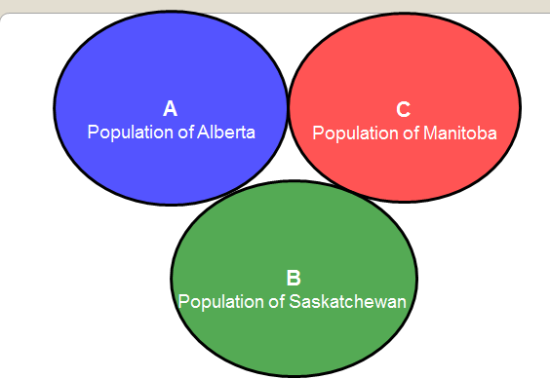
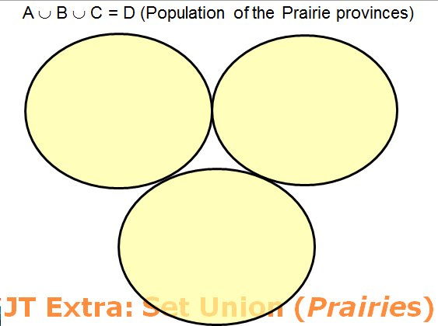
JT’s Extra: Union (Logical “OR”)

Slide 35
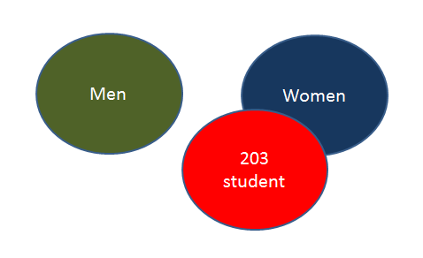
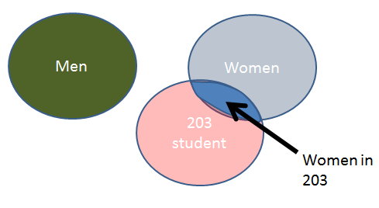
JT’s Extra: Intersection (Logical “AND”)
(203 student) AND (Women)

Slide 36
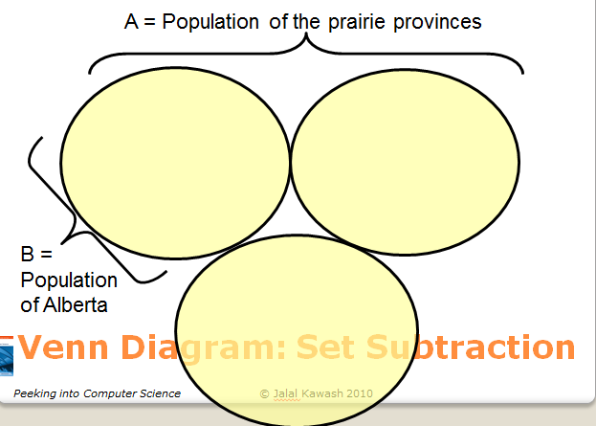
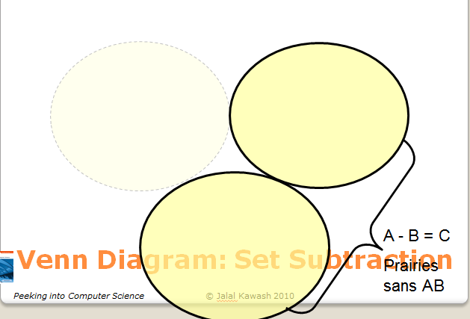
JT’s Extra: Subtraction “Minus”

Slide 37
JT’s Extra: Forming SQL Queries Using The Set Operations
Format:
  <SQL Query 1>
  <SQL Query 2>
SET OPERATION

Slide 38
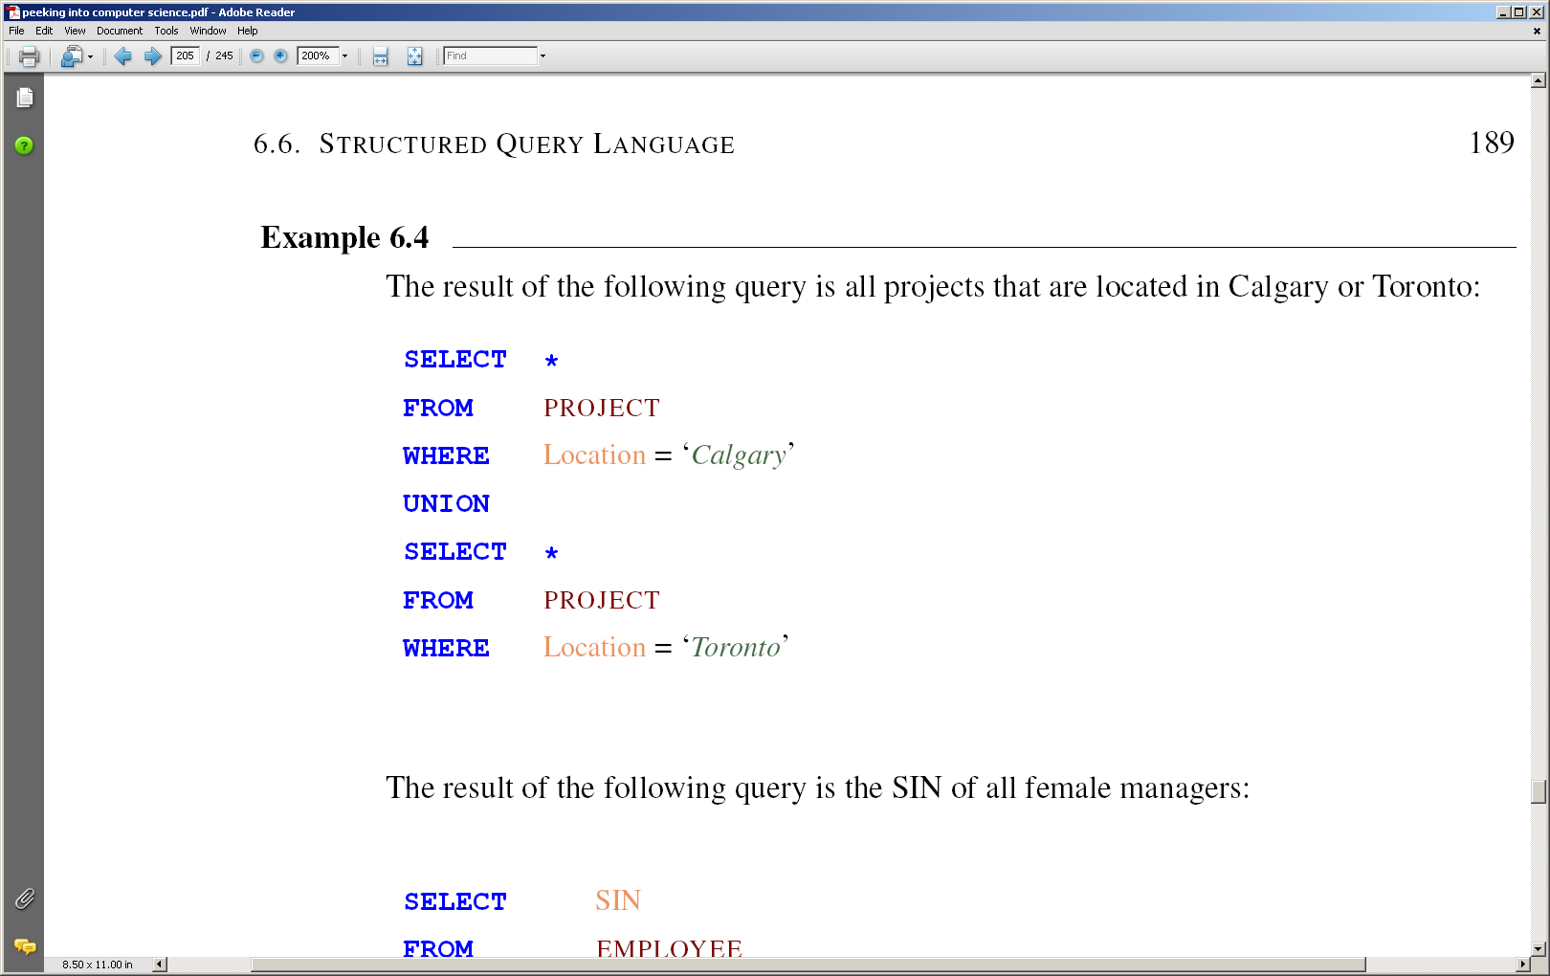
SQL – Set Operations

Slide 39
SQL – Set Operations

Slide 40
SQL – Set Operations

Slide 41
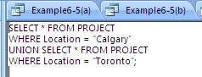
Union in Access
Cannot be done in design view, only in SQL view

Slide 42
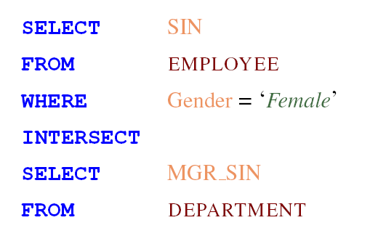
SQL – Set Operations

Slide 43
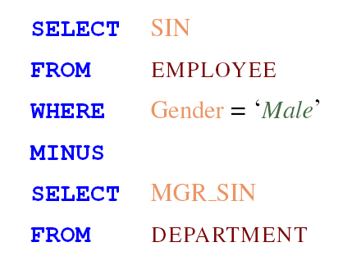
SQL – Set Operations

Slide 44
INTERSECT and MINUS in Access
No direct support
Can use IN for intersect
Can use NOT IN for Minus

Slide 45
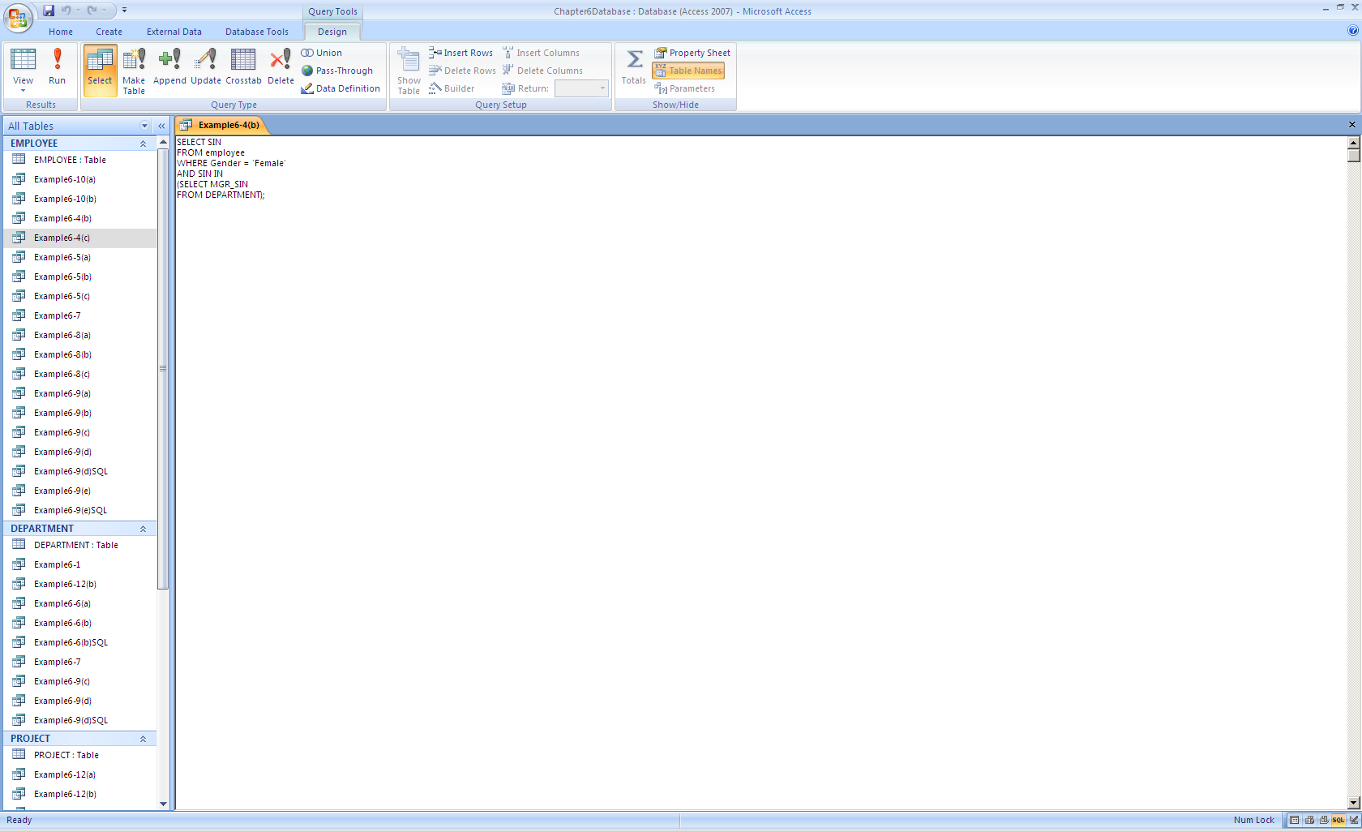
INTERSECT in Access

Slide 46
How IN Works
Result
171717171

Slide 47
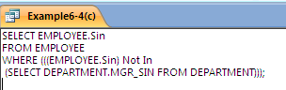
MINUS in Access

Slide 48
Comparison Operators
Equals =
Not equal !=
Greater >
Greater or equal >=
Less than <
Less than or equal <=

Slide 49
Boolean Operators
AND
OR
NOT

Slide 50
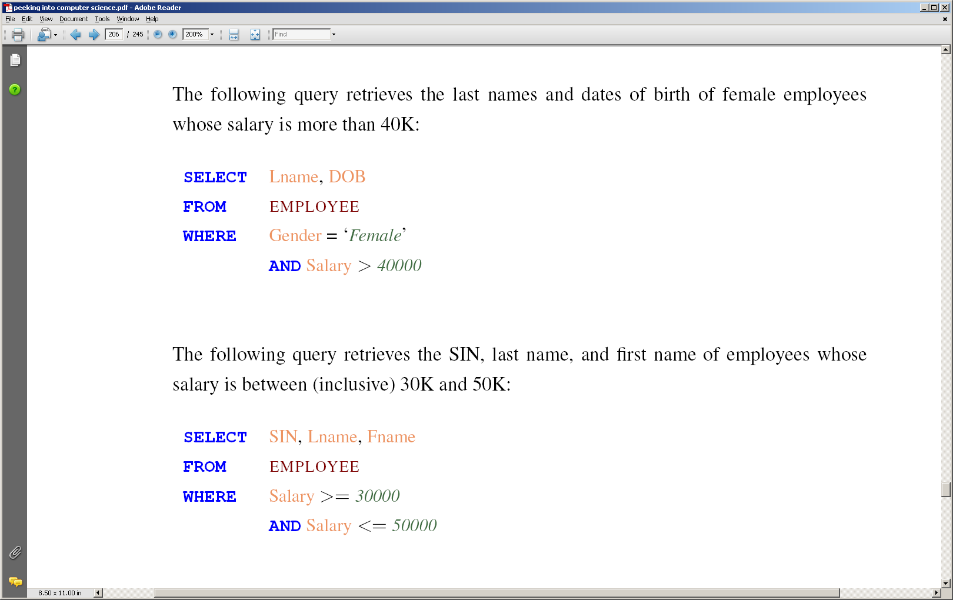
SQL – Example Query

Slide 51
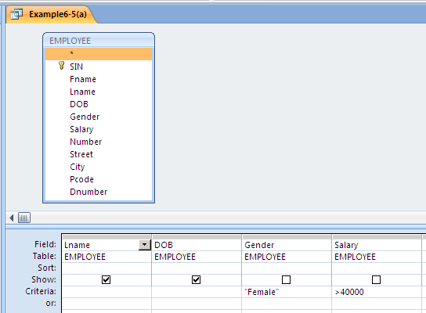
QBE – Example Query

Slide 52
SQL – Example Query

Slide 53
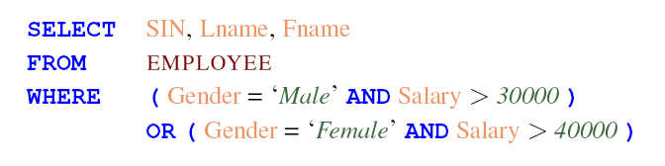
SQL – Example Query

Slide 54
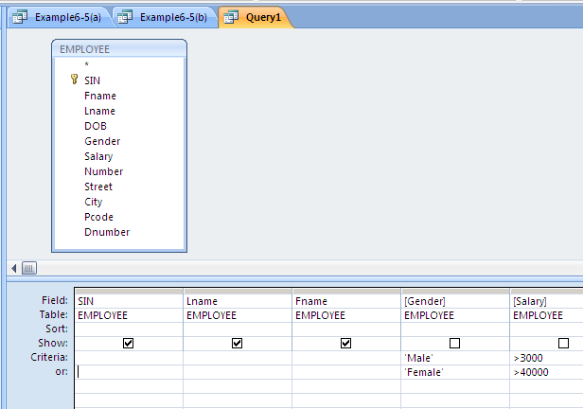
QBE – Example Query
JT: >30000

Slide 55
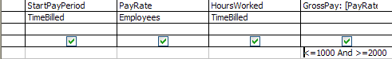
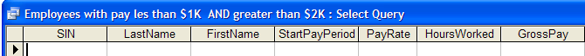
JT’s Extra: Empty Queries (Contradiction)
Query
Result of the (empty) query
Wav file from “The Simpson” © Fox
Take care not to specify queries that can never be true! (Logic: contradiction)
This will result in an “Empty Query”, a query that yields no results.
  Example: Which employees have a gross pay lower than $1,000 AND higher than $2,000 (inclusive for both) on one of their time cards?
Notes:
55

Slide 56
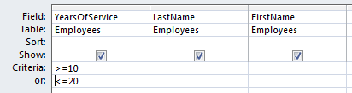
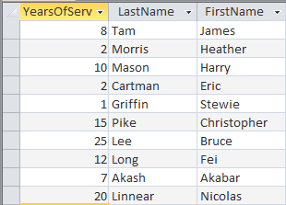
JT’s Extra: Queries Resulting From A Tautology
Query
SQL
SELECT Employees.YearsOfService, Employees.LastName, Employees.FirstName
FROM Employees
WHERE (((Employees.YearsOfService)>=10)) OR (((Employees.YearsOfService)<=20));
Query result
In a similar fashion take care not to specify queries that are always true. (Tautology)
Notes:
56

