Slide 1
Databases &
Data Modelling
Peeking into Computer Science

Slide 2
Reading Assignment
Mandatory: Chapter 4 – Sections 4.4 & 4.5

Slide 3
Mapping ERDs to Schema

Slide 4
Objectives
At the end of this section, you will be able to:
Apply the mapping algorithm to translate an ERD to a database schema
Understand foreign keys

Slide 5
Mapping Algorithm (4.1)
Each entity type is translated to a table; its attributes become columns
Each many-to-many relationship type becomes a table; the columns are the primary keys of the participating entity types
For each one-to-many relationship type, add the primary keys of the entity type on the one side as columns in the table corresponding to the entity type on the many side

Slide 6
Mapping Entity Types
Each entity type is translated to a table; its attributes become columns

Slide 7
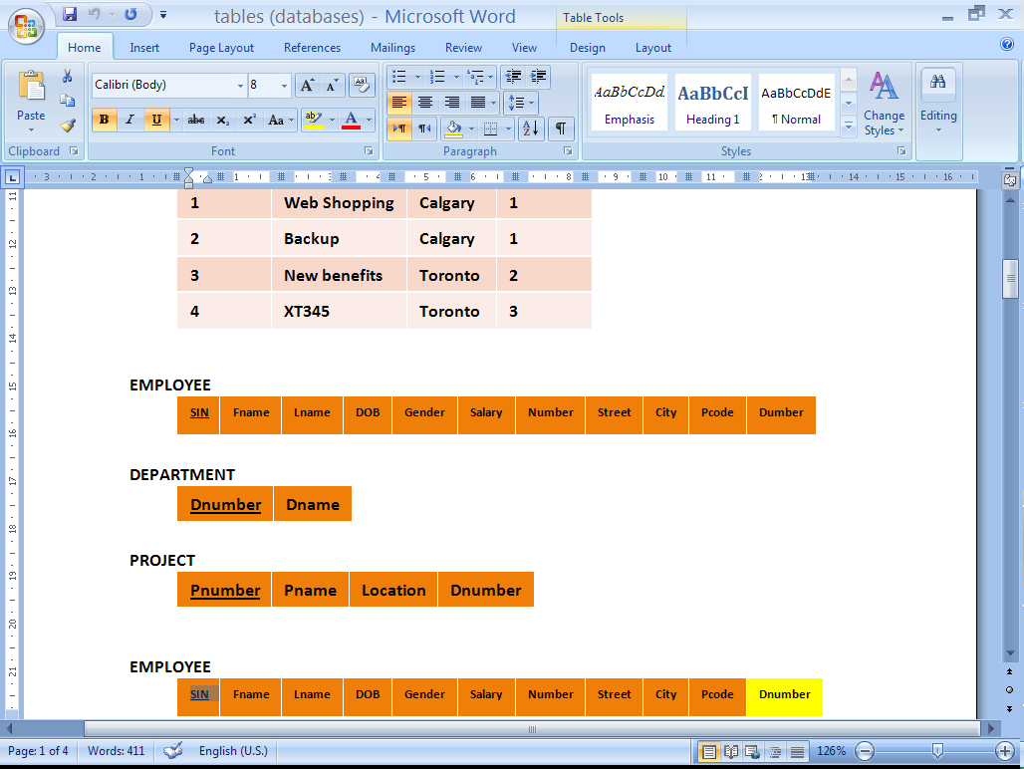
EMPLOYEE
SIN
First name
Last name
DOB
Gender
Salary
Number
Street
City
Postal Code
PROJECT
Number
Name
Location
DEPARTMENT
Number
Name

Slide 8
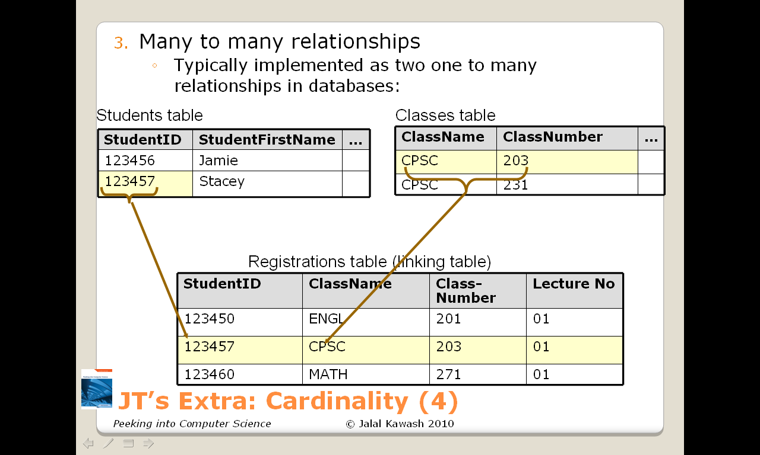
JT’s Extra: Recall Many : Many Relations Can’t Be Implemented

Slide 9
Mapping Many-Many Relationship Types
JT’s Extra
9
Each many-to-many relationship type becomes a table; the columns are the primary keys of the participating entity types

Slide 10
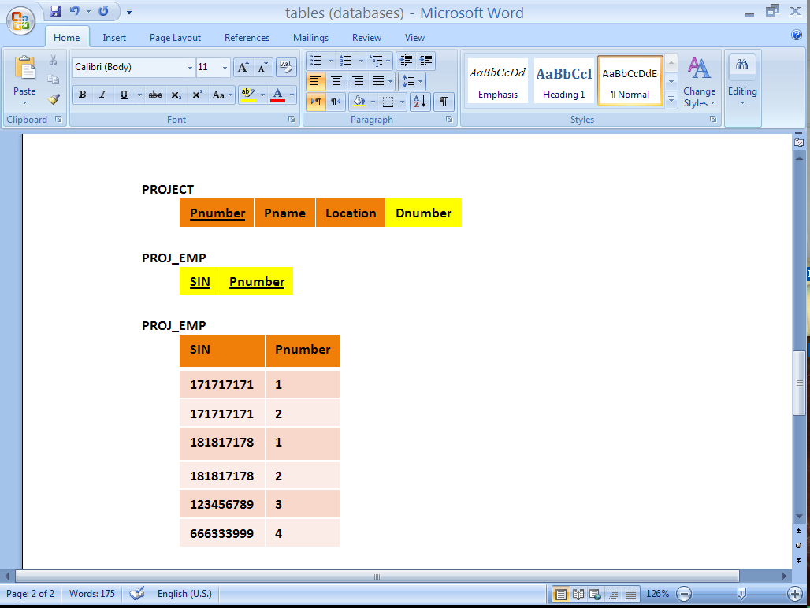
Participation Levels
EMPLOYEE
SIN
First name
Last name
DOB
Gender
Salary
Number
Street
City
Postal Code
WORKS FOR
DEPARTMENT
Number
Name
CONTROLS
PROJECT
Number
Name
Location
WORKS ON

Slide 11
There will be no more tables
Step 3 simply augments the existing tables

Slide 12
There will be no more tables
Step 3 simply augments the existing tables
JT’s Extra: (In case you missed it in Jalal’s example)

Slide 13
Mapping One-Many Relationship Types
For each one-to-many relationship type, add the primary keys of the entity type on the one side as columns in the table corresponding to the entity type on the many side

Slide 14
Mapping One-Many Relationship Types
For each one-to-many relationship type, add the primary keys of the entity type on the one side as columns in the table corresponding to the entity type on the many side
JT’s Extra
Table 1
Table 2
1
Primary key
Primary key
Many
Foreign key
14

Slide 15
JT’s Extra: Foreign Keys
A key in one table that refers to a key in another field.

Slide 16
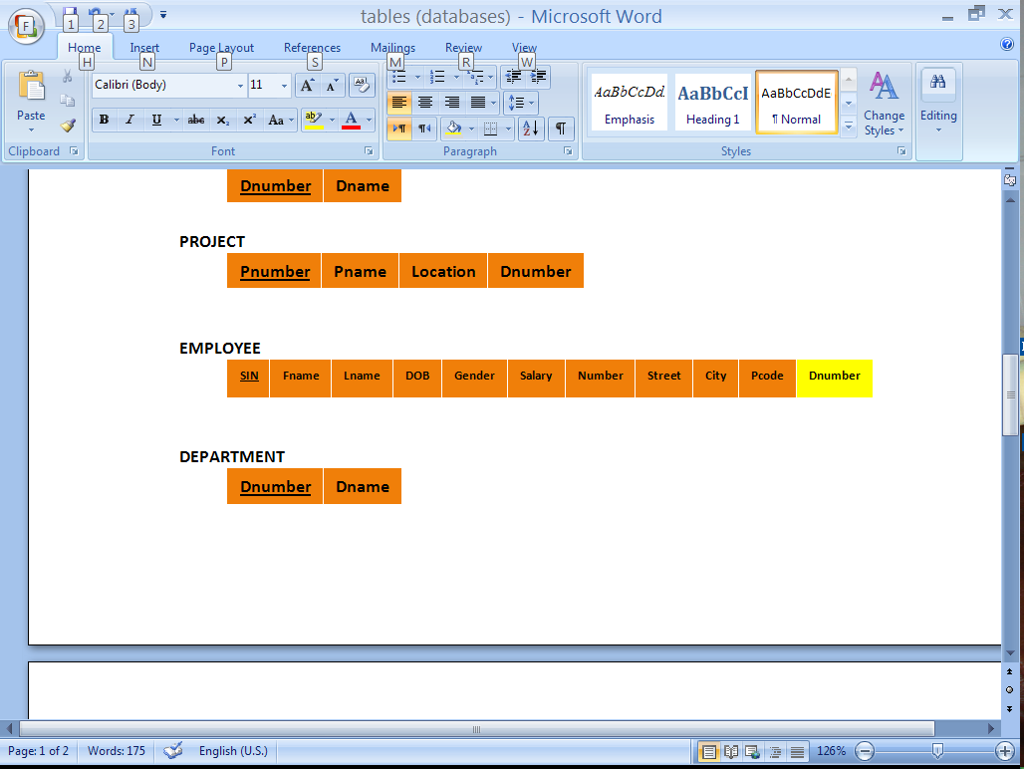
EMPLOYEE
SIN
First name
Last name
DOB
Gender
Salary
Number
Street
City
Postal Code
WORKS FOR
DEPARTMENT
Number
Name
Dnumber tells us which Department an employee works for
Dnumber is a foreign Key
CONTROLS
PROJECT
Number
Name
Location
WORKS ON

Slide 17
EMPLOYEE
SIN
First name
Last name
DOB
Gender
Salary
Number
Street
City
Postal Code
WORKS FOR
DEPARTMENT
Number
Name
JT’s Extra (in case you missed in Jalal’s slide):
“Number” (primary key in ‘Department’ table): “one” side
“Dnumber” (foreign key in ‘Employee’ table): “many” side
CONTROLS
PROJECT
Number
Name
Location
WORKS ON
17

Slide 18
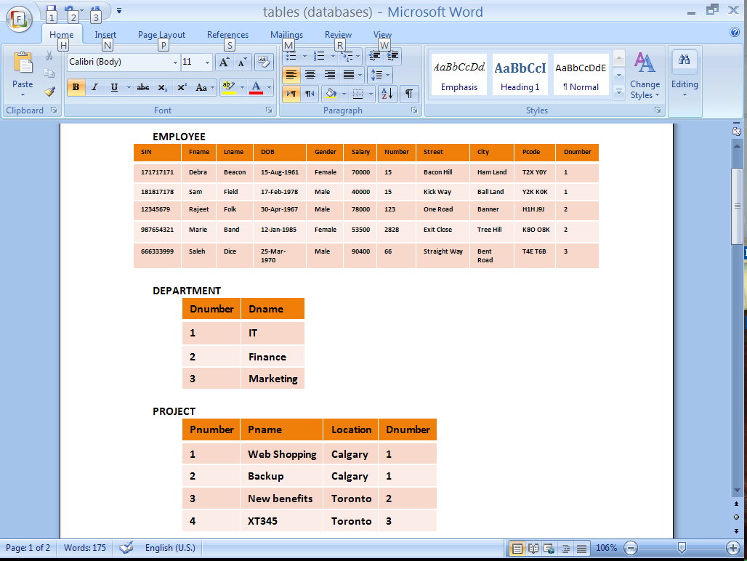

Slide 19
EMPLOYEE
SIN
First name
Last name
DOB
Gender
Salary
Number
Street
City
Postal Code
WORKS FOR
DEPARTMENT
Number
Name
CONTROLS
PROJECT
Number
Name
Location
WORKS ON

Slide 21
The Complete Schema

Slide 22
Two Missing Things
The mapping algorithm does not include one-to-one relationship types
  We need to include these
Sometimes, relationship types may need to have their own attributes
Will revise ERDs and the mapping algorithm to include these.

Slide 23
MANAGES Relationship Type
A department is managed by one employee
Each department has a manager which is also an employee
EMPLOYEE and DEPARTMENT are related by the MANAGES relationship type
Each department can have only one manager, and each employee can manage at most one department. This is a one-to-one relationship
Notes:
© Copyright: All rights reserved. Not to be reproduced by any means without prior written consent

Slide 24
MANAGES
EMPLOYEE
SIN
First name
Last name
DOB
Gender
Salary
Number
Street
City
Postal Code
WORKS FOR
DEPARTMENT
Number
Name
CONTROLS
PROJECT
Number
Name
Location
WORKS ON

Slide 25
Attributes for Relationship types
MANAGES
EMPLOYEE
SIN
First name
Last name
DOB
Gender
Salary
Number
Street
City
Postal Code
- Start date
WORKS FOR
DEPARTMENT
Number
Name
PROJECT
Number
Name
Location
- Hours
CONTROLS
WORKS ON

Slide 26
JT’s Extra: Notation Reminder
Entity (object in real world): E
Table (in database): T
Table (in database): T
Entity: E
Relationship: R
Entity: E
Table (in database): T

Slide 27
Complete mapping Algorithm
Each entity type E is translated to a table T (to emphasize that T is a result of E, we write T(E))
  T’s columns are E’s attributes
Each many-to-many relationship type R, relating entity types E1 and E2, becomes a table T
  T’s columns are R’s attributes
  the primary key of E1 and E2 is added as columns in T

Slide 28
Complete mapping Algorithm
For each one-to-many relationship type R, relating E1 to E2 with E1 on the “one” side:
  add the primary key of E1 as columns in T(E2)
  any attributes that R has become columns in T(E2)

Slide 29
Complete mapping Algorithm
For each one-to-one relationship type R, relating E1 to E2 with E1 on a partial participation side or both E1 and E2 fully participate in R:
  add the primary key of E1 as columns in T(E2)
  any attributes that R has become columns in T(E2)

Slide 30
JT’s Extra: 1 to 1 Relationships
T1
T2
OR
T1
T2
To ensure compliance with good design principles, examine participation levels when determining which table’s primary key is used as the other table’s foreign key.
  If both tables participate equally (both partial or both full) then the choice is arbitrary.

Slide 31
JT’s Extra: 1 to 1 Relationships (2)
Table 1
Table 2
Primary key
Partial
Foreign key
Full
  If participation levels aren’t equal: If one table partially participates in the relationship while the other table participates partially in the relationship.

Slide 32
JT’s Extra: Attributes Of Relationships
Employee
Hours?
Many
Works on
Hours!
Many
Project
Hours?

Slide 33
JT’s Extra: Attributes Of Relationships (2)
Start date?
Manages
One
One
Department
Employee
Start date!
Works for
One
Many
Many

Slide 34
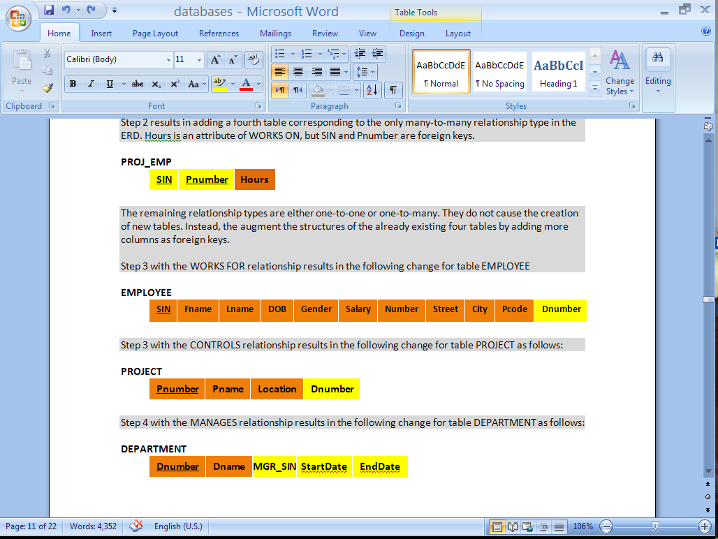
MANAGES
EMPLOYEE
SIN
First name
Last name
DOB
Gender
Salary
Number
Street
City
Postal Code
- Start date
WORKS FOR
DEPARTMENT
Number
Name
PROJECT
Number
Name
Location
- Hours
CONTROLS
WORKS ON

Slide 35
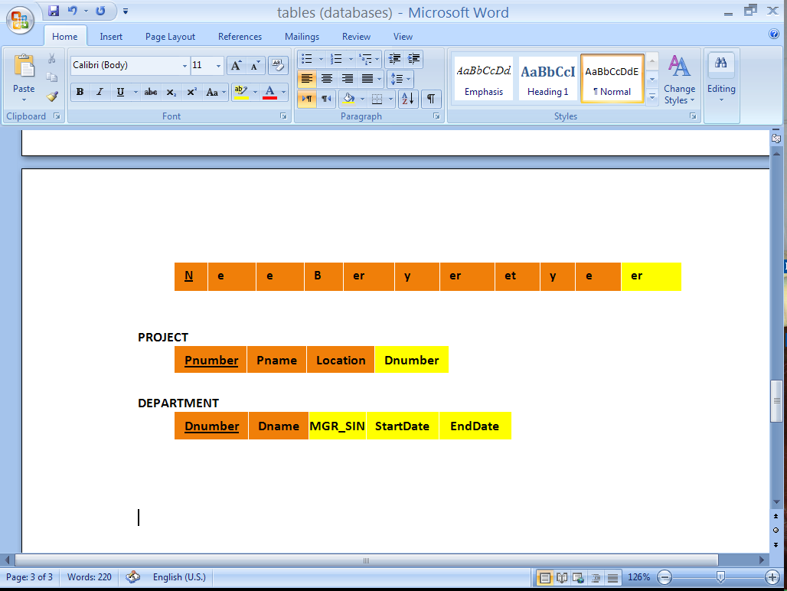
MANAGES
EMPLOYEE
SIN
First name
Last name
DOB
Gender
Salary
Number
Street
City
Postal Code
- Start date
WORKS FOR
DEPARTMENT
Number
Name
PROJECT
Number
Name
Location
- Hours
CONTROLS
WORKS ON

Slide 36
The Complete Schema

Slide 37
Design Principles
What makes a Good Design?

Slide 38
Objectives
At the end of this section, you will be able to:
List and entertain the three basic design principles
Understand how our mapping algorithm satisfies these three principles

Slide 39
Basic Design Principles
Meaning of a Schema should be easily explained
Reduce Redundancy
Reduce NULL values

Slide 40
Design Principle (1)
Design a schema so that its meaning can be easily explained
Do NOT combine attributes from different entity types into a single table

Slide 41
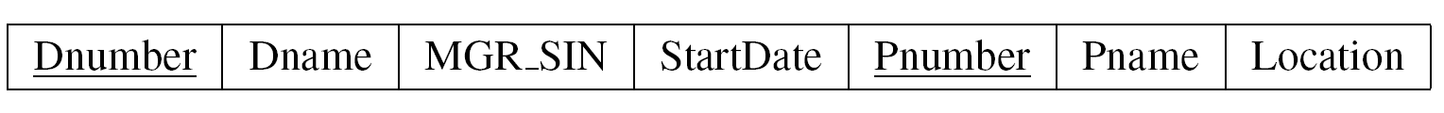
A schema with no clear meaning
Project, department, or controls table?

Slide 42
Design Principle (2)
Design a schema so that Redundancy is reduced
Unnecessary Redundancy can lead to modification anomalies

Slide 43
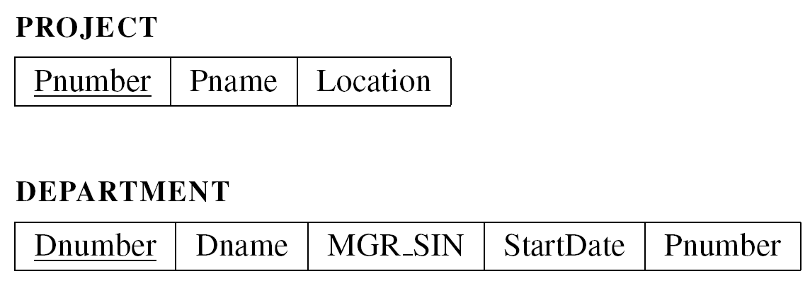
Unnecessary Redundancy
Assume the schema definition for Project and Department
  migrating Pnumber to DEPARTMENT

Slide 44
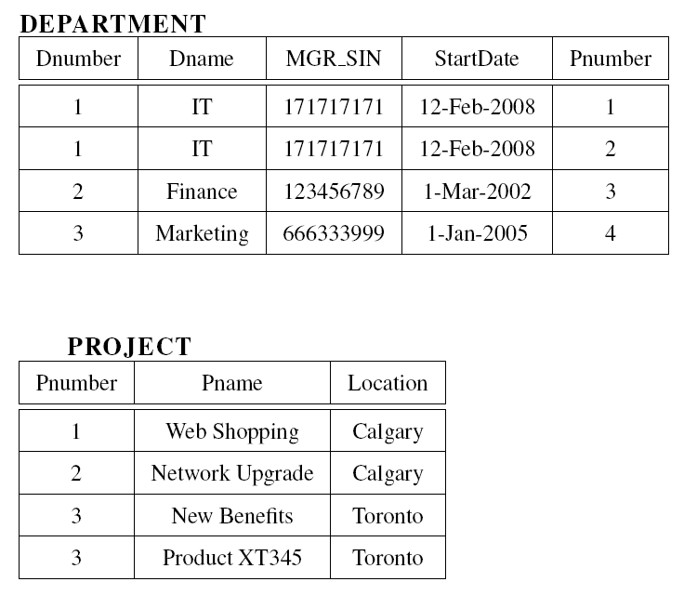
More than one place to change IT
4

Slide 45
Modification Anomaly Example
ABC company decides to change the name of IT department to Technology

Slide 46
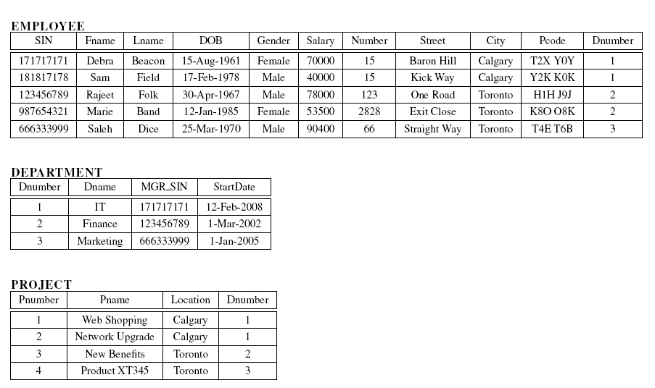
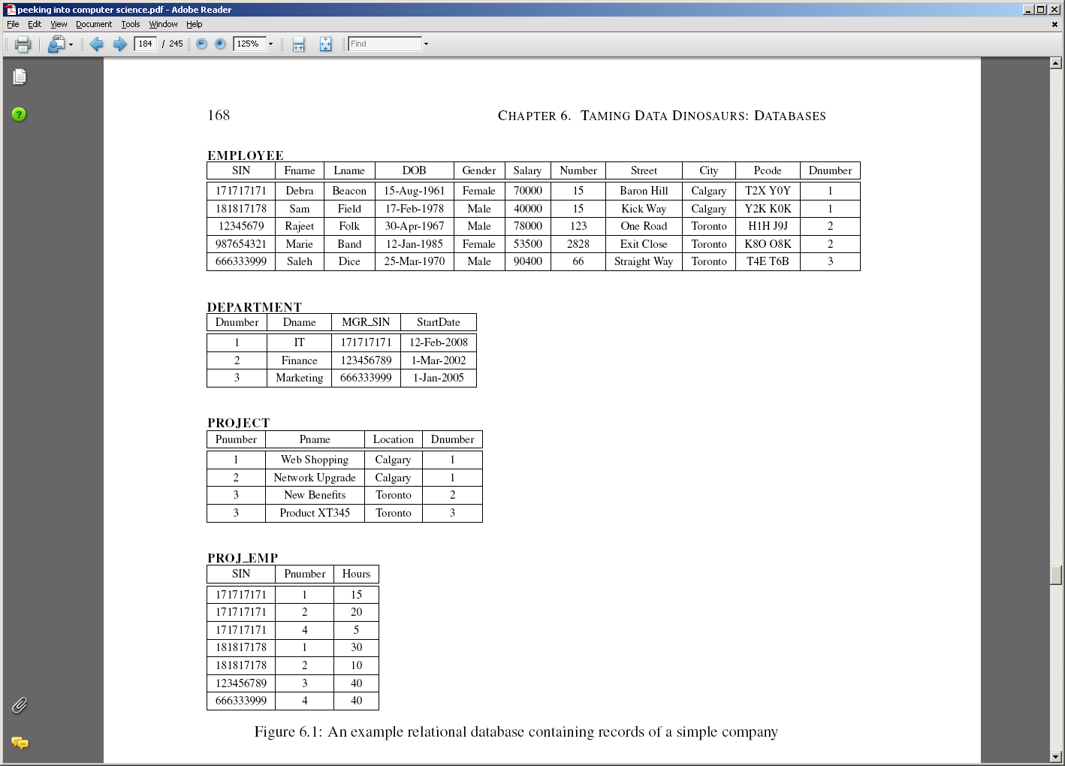
No Anomalies Here
The only place to change IT

Slide 47
IT occurs in more than one place
Must change all occurrences of IT here and elsewhere

Slide 48
JT’s Extra: Null Values
Refers to empty fields of a record.
Primary keys cannot be null but other fields may be null.
Notes:
48

Slide 49
Design Principle (3)
Design a schema so that NULL values are minimized as much as possible
Waste space
Result in confusion:
  A NULL value could mean:
    Does not apply
    Unknown
    To be recorded

Slide 50
NULL Values Confusion
NULL
NULL
Arrangement to work until completion
We do not know the hours yet
Someone else will enter it (it is known)

Slide 51
NULL Values Example
We migrated the managers SIN (partial participation side) to the DEPARTMENT table (full participation side)

Slide 52
NULL Values Example
What if we migrated the department Number to the EMPLOYEE table?

Slide 53
Original Design

Slide 54
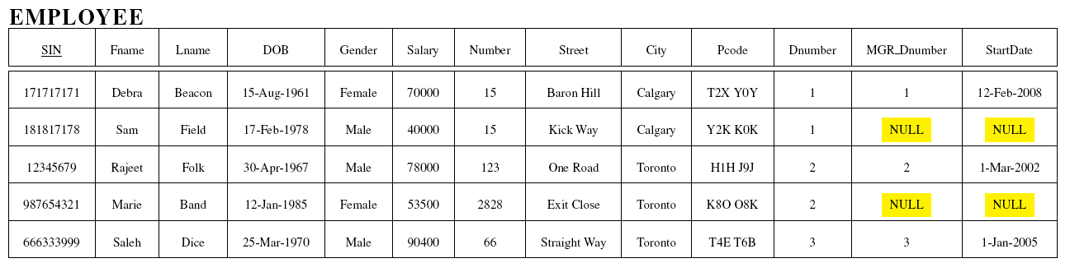
Alternative Design

Slide 55
JT’s Extra (Null): Many to many relationships: directly modeled in a database.
Students table
StudentID | StudentFirstName | StudentLastName
123456 | Jamie | Smyth
123457 | Stacey | Walls
123458 | Angel | Lam
Classes table
ClassName | ClassNumber | Lecture No | ClassDescription
CPSC | 203 | 01 | Introduction to Computers
CPSC | 231 | 01 | Introduction to Computer Science I
CPSC | 233 | 01 | Introduction to Computer Science II

Slide 56
JT’s Extra (Null): Many to many relationships: directly modeled in a database.
Students table
StudentID | StudentFirstName | StudentLastName
123456 | Jamie | Smyth
123457 | Stacey | Walls
123458 | Angel | Lam
Class 1 | Class 2 | Class 3 | Class 4 | Class 5 | … | Class ‘N’
CPSC 203 | PSYC 205 | MATH 221 | MATH 251 | SOCI 201 |  | NULL
CPSC 203 | ART 201 | MATH 271 | NULL | NULL |  | NULL
CPSC 203 | CHIN 201 | KINE 221 | MGIS 323 | OPMA 341 |  | NULL

Slide 57
JT’s Extra (Null): Many to many relationships: directly modeled in a database.
Classes table
ClassName | ClassNumber | Lecture No | ClassDescription
CPSC | 203 | 01 | Introduction to Computers
CPSC | 231 | 01 | Introduction to Computer Science I
CPSC | 233 | 01 | Introduction to Computer Science II
S₁ | S₂ | S₃ | S₄ | S₅ | S₆ | S₇ | … | S_{N}
Bill | Bob | Mary | Jane | NULL | NULL | NULL |  | NULL
Jim | NULL | NULL | NULL | NULL | NULL | NULL |  | NULL
Alice | Brett | Charlie | Deacon | Ernie | Edgar | Freda |  | NULL

