Slide 1
Introduction
Peeking into Computer Science

Slide 2
Reading Assignment
Mandatory: Chapter 1
Optional: None

Slide 3
Computers, Zeros, and Ones
The big picture

Slide 4
Objectives
At the end of this section, the student will be able to:
Name the 5 basic components of a computer & identify their functions
Explain how processor speed is measured
Understand Dual-Core architectures
Describe the operation of Hard disks and optical CDs
Describe the memory hierarchy
Understand how information is represented in a computer by 0s and 1s

Slide 5
Computers
Computers are general purpose machines
  Music/Movies
  Communication
  More complex operation

Slide 6
CPU
Control Unit (CU)
Arithmetic and Logic Unit (ALU)
Main Memory
Hard
Disk
Other I/O devices
Registers
bus

Slide 7
Central Processing Unit
CPU is the brain of the computer
Also called processor
Has two components:
  Arithmetic and Logic Unit (ALU)
    Simple arithmetic and logic operations
  Control Unit
    Controls the operations of the rest
    of the machine
Has a scratch pad
  Collection of registers
Connected to the rest of the
system components
CPU
Control Unit (CU)
Arithmetic and Logic Unit (ALU)
Registers

Slide 8
The Bus
CPU
Control Unit (CU)
Arithmetic and Logic Unit (ALU)
Main Memory
Hard
Disk
Other I/O devices
Registers
bus

Slide 9
Signals
Signal is absent
An unlit lamp
Represents a 0
No signal (0 bit)
Signal is present
A lit lamp
Represents a 1
Signal (1 bit)

Slide 10
Robot’s World

Slide 11
Robot’s World
1 | 1 | 1 | 1 | 1 | 1 | 1 | 1 | 1 | 1
1 | o | o | o | 1 | o | 1 | o | o | 1
1 | o | o | o | 1 | o | 1 | o | o | 1
1 | o | o | 1 | 1 | o | 1 | o | o | 1
1 | o | o | o | 1 | o | 1 | o | o | 1
1 | o | o | o | 1 | o | o | o | o | 1
1 | o | o | o | o | o | o | o | o | 1
1 | 1 | 1 | 1 | 1 | 1 | 1 | 1 | 1 | 1

Slide 12
Main Memory
Random Access Memory
Holds programs and Data for CPU
Every thing the CPU operates on (executing a program, playing a song, working on a file) must be in RAM
Volatile: do not hold data if power is lost
Need non-volatile storage

Slide 13
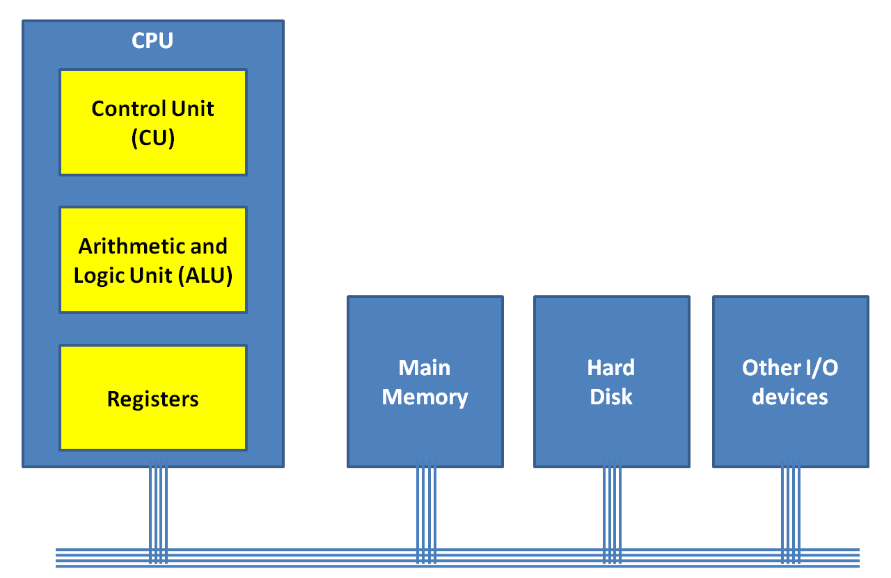
Disks
Non-volatile Storage
Electro-magnetic signals that stay in the absence of power

Slide 14
Other Input/Output Devices
Printer
Keyboard
Screen
Mouse
Etc …

Slide 15
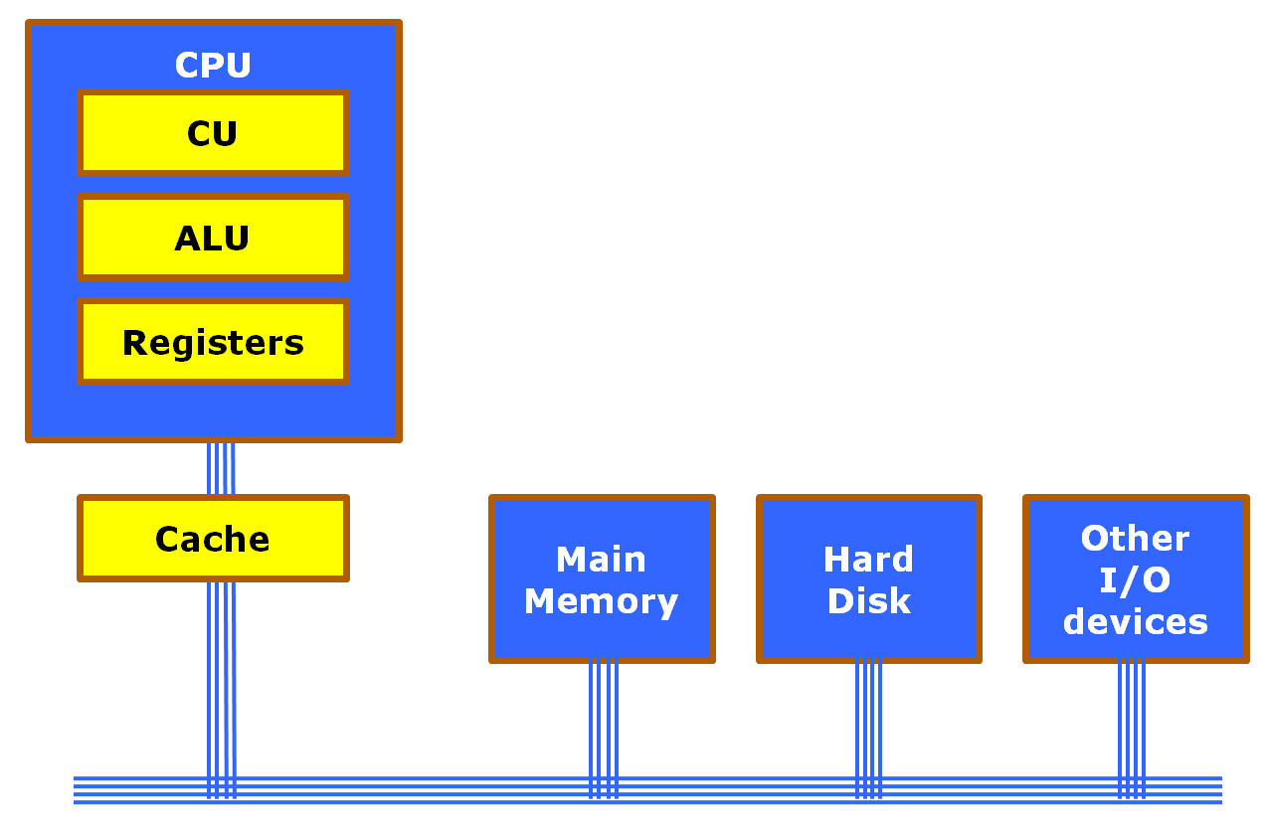
Cache Memory
Fast Memory that sits between main memory and CPU

Slide 16
CPU Operation

Slide 17
Main Memory
Registers
A
B
C
A
B
ALU input
Registers
ALU
CU signal to ADD
A+B
Accumulator
(ALU output register)

Slide 18
Talking Gigahertz
What does a 3.0 GHz CPU mean?
CPU can perform about 3 billion micro-instructions per second

Slide 19
Dual Core?
A Computer that contains two CPUs on the same chip

Slide 20
Processor Chip
CPU1
CPU2
CU
CU
ALU
ALU
Registers
Registers
Cache
Main Memory
Hard
Disk
Other I/O devices

Slide 21
Storage Units
Byte = 8 bits
Kilobyte = 1024 bytes
Megabyte = 1024 Kilobytes
  1,048,576 bytes
Gigabyte = 1024 Megabytes
  1,073,741,824 bytes
Terabyte = 1024 Gigabyte
  1,099,511,627,776 bytes

Slide 22
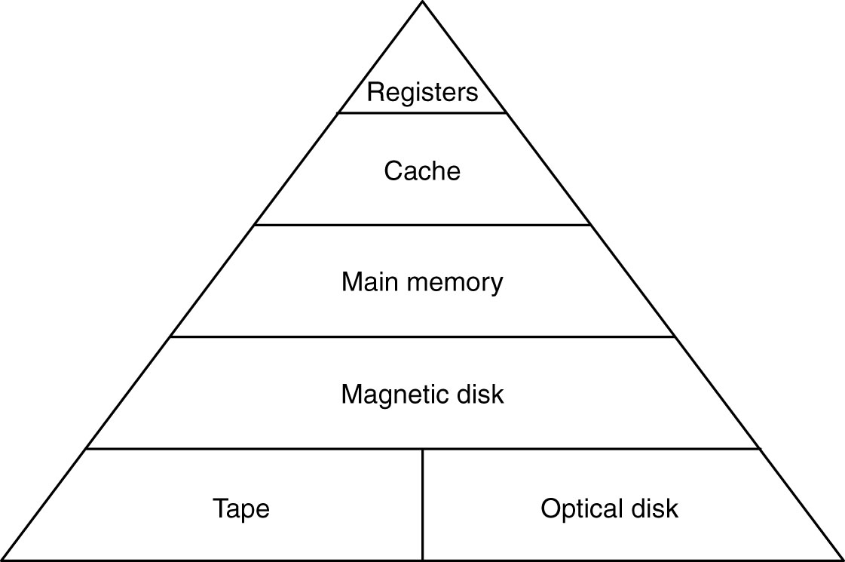
Memory Hierarchy

Slide 23
Magnetic (Hard) Disk
arm
movement
spindle
platter
Read/write
head
arm

Slide 24
CD-ROMs
Disk Label
Protective Lacquer Layer
Reflective Layer
Dye Layer
pit
1.2 mm
Plastic Layer
A pit prevents a
laser beam from
being reflected
reflected
laser
beam

Slide 25
Information Coding
Beyond images

Slide 26
Objectives
At the end of this section, the student will be able to:
Understand how characters are represented by 0s and 1s
Understand the encoding and decoding process
Find the minimum number of bits needed to code character information

Slide 27
Fixed-Length Codes
Symbols in a computer’s memory are stored as 0s and 1s
Each symbol is given a fixed-length code
ASCII codes:
  A is 0100 0001
  B is 0100 0010
  C is 0100 0011
  D is 0100 0100
  E is 0100 0101
  Etc..

Slide 28
Fixed-Length Codes
The Word ACE is stored in a computer as:
  010000010100001101000101
A
C
E

Slide 29
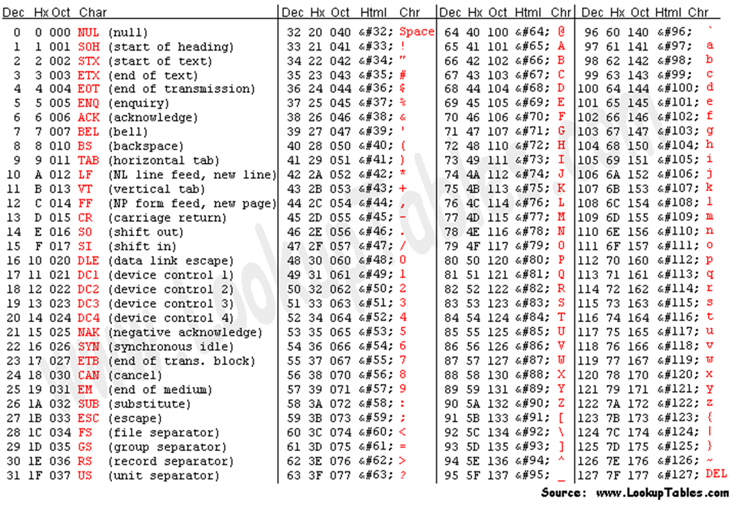
More ASCII Codes

Slide 30
A Counting Problem
If the alphabet has two letters only (say 0 and 1), how many one-letter words can be formed?
Only two possibilities exist
0
1
So, two words

Slide 31
A Counting Problem
Think of it this way:
We have a box that can fit one ball only
Balls have one of two colors
How many distinct boxes can we produce?

Slide 32
A Counting Problem
If the alphabet has two letters only (say 0 and 1), how many two-letter words can be formed?
Bigger box
Can hold 2 balls

Slide 33
A Counting Problem
If the alphabet has two letters only (say 0 and 1), how many two-letter words can be formed?
00
01
10
11
So, four words

Slide 34
A Counting Problem
If the alphabet has two letters only (say 0 and 1), how many three-letter words can be formed?
000, 001, 010, 011, 100, 101, 110, 111
So, eight words

Slide 35
A Counting Problem
If the alphabet has two letters only (say 0 and 1), how many n-letter words can be formed?
2^{n} words

Slide 36
A Counting Problem
If the alphabet has β letters, how many n-letter words can be formed?
β^{n} words

Slide 37
Back to Coding
Assume we have a file that contains data composed of 6 letters (symbols) only:
A, I, C, D, E, and S (for space)
ACE DICE AIDE CAID EAD DAICED …

Slide 38
Back to Coding
Assume we have a file that contains data composed of 6 letters (symbols) only:
A, I, C, D, E, and S (for space)
ACESDICESAIDESCAID EADSDAICED …

Slide 39
Coding
If the file has 1000 characters, how many bits (0s and 1s) are needed to code the file?

Slide 40
Coding
The first question is
How many symbols do we need to represent each character?
The objective is to keep the size of the file as small as possible
We have 6 characters (messages) and two alphabet symbols (0 and 1)
2 is not enough, since 2² is 4

Slide 41
2 bits are not enough
00 for A
01 for S
10 for I
11 for E
We cannot represent the rest C and D
3 works, since 2³ is 8, so we can represent up to 8 characters and we only have 6

Slide 42
3 bits are more than enough
Say
000 for A
001 for S
010 for I
011 for E
100 for C
101 for D
110 not used
111 not used

Slide 43
Coding
If the file has 1000 characters, how many bits (0s and 1s) are needed to code the file?
Each character needs 3 bits
Hence, we need 3x1000 = 3000 bits

