Slide 1
Introduction
Peeking into Computer Science

Slide 2
Reading Assignment
Mandatory: Chapter 1
Optional: None

Slide 3
Spreadsheet Design
Long-lasting spreadsheets

Slide 4
Objectives
At the end of this section, the student will be able to:
Judge the design of a spreadsheet
Divide a spreadsheet into five sections
Understand the role of each section

Slide 5
Spreadsheet Properties
Good character
Easy to build
Easy to read
Easy to use
Easy to change
Error free

Slide 6
Example of Poor Spreadsheet

Slide 7
Contents of a Spreadsheet
Introduction:
Introduction, title, description, and contents
Model:
Main form data
Data Dictionary
Explains columns and calculations
Data:
Data used in your sheet
Dashboard
Visual reports (charts)

Slide 8
Notes
The actual data forms are determined by the purpose of the spreadsheet
What is the function of the sheet?
Sections should be in different ‘tabs’ (sheets)
Especially for larger examples

Slide 9
Intro Section – Design Tips
Make a formal introduction
Title of the sheet must be informative
Declare the purpose
Give clear instructions
Reference critical ideas
Map the content

Slide 10
Intro – 1. Make a formal intro
Intro section should give the user a clear idea of how the sheet ties with the real world
Intro devices:
Include a title that passes critical info
Declare the purpose
Give directions on how to use the model
Include references
Include a table of contents

Slide 11
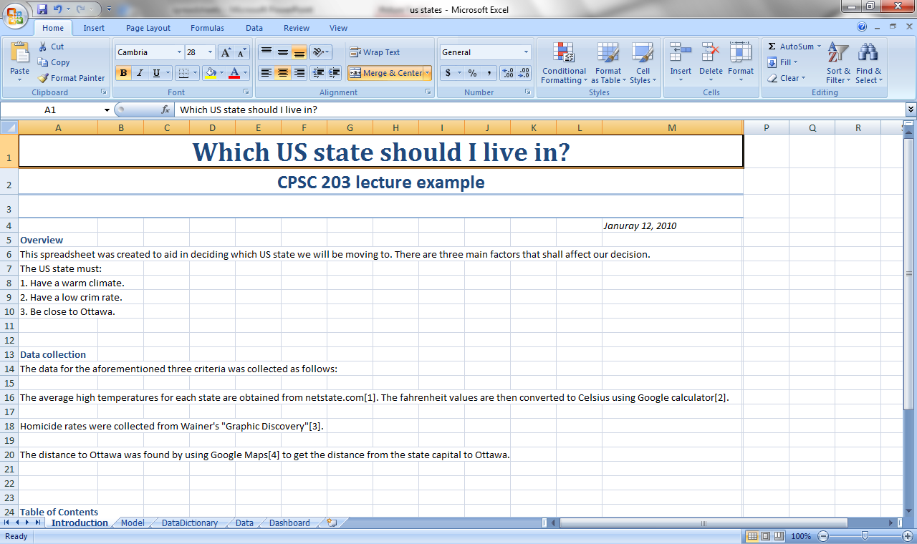
Example Intro

Slide 12
Intro – 2. Informative Title
Title must at least include:
Name of the model
Date
Name of creator
Properties of a title:
Short
Apt (to the point)
Memorable

Slide 13
Intro – 3. Declare the Purpose
Tell the spreadsheet user what the spread sheet is all about

Slide 14
Intro – 4. Give Instructions
Give clear step-by-step Instructions on how to use the spreadsheet
Especially important if the user needs to later make changes to the data or calculations
Not necessary for small examples (such as our US States example)

Slide 15
Intro – 5 & 6. Refs and TOCs
Cite all resources used to create the spreadsheet if any
Use APA or other format for citation:
J. Nevison, The Elements of Spreadsheet Style, Prentice-Hall, 1987
http://pages.cpsc.ucalgary.ca/~tamj/2007/203W/assignments/references.html (if you have no clue as to what format to use)
A Table of Contents (TOC) can be a good idea too

Slide 16
Example Intro

Slide 17
Data
Includes raw and calculated data
This is the actual spread sheet

Slide 18
Example Raw Data

Slide 19
Model Section
Model includes assumptions and calculations
Explain the model:
Should provide three levels of explanation:
Explain the values appearing in the model
Explain tricky formulas
A complete listing of all used formulas

Slide 20
Example Model

Slide 21
Data Dictionary
Explains the meaning of your data
Give each field:
A type: categorization, raw data, column calculation, row calculation
A data type: text, number, integer, percentage, etc…
A sheet/cell reference: the sheet where the field is and where in the sheet (cell range)
A description: brief narrative

Slide 22
Example Data Dictionary

Slide 23
Dashboard
Visual Charts and conclusions

Slide 24
Example Dashboard

Slide 25
Example Dashboard

Slide 26
Dashboard (or Conclusion)
Analyze and comment on every chart
Include a conclusion/discussion section

Slide 27
Abstraction
The power to simplify

Slide 28
Abstraction
Problems (and solutions) can be overwhelming
Too much details
Abstraction: hiding irrelevant details

Slide 29
Abstraction Example
Library
Very complex
To an end-user, it can be abstracted by the circulation desk

Slide 30
Abstraction Example
Car
Also very complex
To driver, it can be abstracted by how to operate it
To a passenger, it is simply a commuting device

Slide 31
JT: Robot example (minor modifications to the Kawash example)

Slide 32
Another Problem: Robotic Movement¹
Develop an algorithm for a simple robot (similar in movement capabilities to a RoombaTM).
Movement:
The robot can move forward one distance unit (a ‘square’).
Rotation:
If forward motion is not possible then the robot can rotate left or right by 90 degrees.
Short range sensors:
One is mounted forwards, the other is mounted on the right.
The sensors check for obstacles in the next square.
1 From “Peeking into Computer Science” and the lecture notes of Jalal Kawash

Slide 33
Specifying The Problem
What does the robot need to do:
Find a wall/obstacle.
Hug the wall, indefinitely moving forward.
Input:
Whatever is detected by the sensors (front, right).
Output:
The robot’s movement

Slide 34
The Contents Of The Robot’s World
Since the robot can either move onto a square that’s empty or avoid a square that is occupied, the world can be simplified into two cases:
The destination square is empty: ‘space’.
The destination square is not empty: ‘wall’ (contains a wall, furniture, person, pet etc.)
Details about exactly why the destination isn’t empty isn’t important so simplify the problem.

Slide 35
Inputs/Outputs Based On The World
ROBOT
FS = W or FS = S
Forward, Rotate (R), Rotate (L)
RS = W or RS = S

Slide 36
Robot’s Orientation
UP
LEFT
RIGHT
DOWN

Slide 37
Robot: Moving Forward

Slide 38
Robot: Rotations
Left 90○
Right 90○

Slide 39
Solution: The Generic Algorithm For Movement
Search for the wall
Once found, keep it to the robot’s right
Move forward
Each move, make sure the wall is still to the robot’s right.
(This means there should be a space in front and the wall to the right).
Robot’s modes:
Search for the wall
Hug the wall

Slide 40
Algorithm: Search For The Wall
Repeat the following steps, until this phase is done (wall found, change to the wall hugging mode)
If RS = W, then done this phase
Right sensor detects a wall
If FS = W, then L, done this phase
Front sensor detects a wall, rotate left
If FS = S, then F
Right sensor senses a space, take a step forward

Slide 41
Algorithm: Hug The Wall
Need to make sure that the wall is not “lost” during movement.
Complexity: all cases must be considered.

Slide 42
Hug The Wall: Case 1
R
Input
RS = W
FS = S

Slide 43
Hug The Wall: Case 1
R
Output
Movement: forward

Slide 44
Hug The Wall: Case 2
R
Input
FS = W

Slide 45
Hug The Wall: Case 2
R
Output
Rotate: left

Slide 46
Hug The Wall: Case 3
R
Input
FS = W

Slide 47
Hug The Wall: Case 3
R
Output
Rotate: Left

Slide 48
Hug The Wall: Case 3
R
Input
FS = W

Slide 49
Hug The Wall: Case 3
R
Output
Rotate: Left

Slide 50
Hug The Wall: Case 3
R
Input
FS = W

Slide 51
Hug The Wall: Case 3
R
Output
Rotate left

Slide 52
Hug The Wall: Case 3
R
Input
FS = W

Slide 53
Hug The Wall: Case 3
R
Output
Rotate left

Slide 54
Hug The Wall: Case 3
R
Input
FS = W

Slide 55
Hug The Wall: Case 3
R
Output
Rotate left
http://adorablay.wordpress.com/
Notes:
Never stops according to the algorithm, no stop case
If FS = W, then L

Slide 56
Hug The Wall: Case 4
R
Input
FS = S
RS = W

Slide 57
Hug The Wall: Case 4
R
Output
Movement: Forward

Slide 58
Hug The Wall: Case 4
R
Input
FS = S
RS = S

Slide 59
Hug The Wall: Case 4
R
Output (Step 1)
Rotate: right
Notes:
Works now because under search mode:
If FS = S, then F
Right sensor senses a space, take a step forward

Slide 60
Hug The Wall: Case 4
R
Output (Step 2):
Movement: forward

Slide 61
Hug The Wall: Case 4
R
Input:
FS = S
RS = W

Slide 62
Hug The Wall: Case 4
R
Output:
Movement: forward

Slide 63
Hug The Wall: Case 4
R
Input:
FS = S
RS = S

Slide 64
Hug The Wall: Case 4
R
Output (step 1):
Rotate: right

Slide 65
Hug The Wall: Case 4
R
Output (step 2):
Movement: foward

Slide 66
Algorithm: Hug The Wall
Repeat the following steps:
If RS = W and FS = S, then F
If FS = W, then L
If RS = S and FS = S, then R and F

