Slide 1
Introduction
Peeking into Computer Science

Slide 2
Reading Assignment
Mandatory: Chapter 1
Optional: None

Slide 3
Problems & Solutions
Computer Science perspective

Slide 4
Objectives
At the end of this section, you will be able to:
Define a (computational) problem
Understand the terms algorithm and program
Start working with Microsoft Excel Spreadsheets

Slide 5
Computer Science
Studying computers and utilizing them to solve problems
Computational problems are solved by computers
Computer scientists use methodological thinking when approaching problems

Slide 6
Problems
Any problem has input and output
  Examples: laundry, cooking, building
The problem specifies what needs to be done
It specifies the relationship between input and output
The problem is not concerned with how

Slide 7
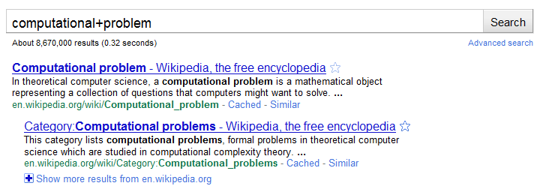
Example: Searching the Web
Searching the Web is a computational problem
Input: A collection of keywords
Output: A ranked list of Web documents that are relevant to the input keywords

Slide 8
Solution: Search Engine
Collects and records information about Web documents in a database
Web crawlers or spiders collect information
You can use a search engine through a Web browser
All are programs

Slide 9
Programs
Solutions to computational problems are represented as programs
Program = sequence of computer instructions
Written in a programming language
Algorithm = A program that is not written in a programming language
It is the specification of a program

Slide 10
Web Crawler Algorithm
to-visit = a non-empty list of initial URLs to be visited
For each URL in to-visit:
  Open that URL document d
  Record information about d in the database
  Scan d for hyperlinks
  For each hyperlink in d:
    Add the hyperlink to to-visit

Slide 11
General-Purpose Programs
Browsers and crawlers are specialized programs
General-purpose programs can be used to solve variety of problems
Example: Microsoft Excel program

Slide 12
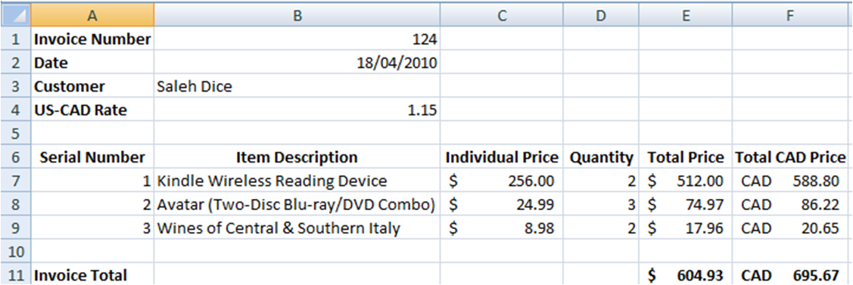
Spreadsheets
Gird of cells
Cell = intersection of a column and row
Columns are referenced by letters
Rows are referenced by numbers
Example cell: B1 contains 124

Slide 13
Formulas
Allow us to perform calculations
Formulas start with =
  = is an instruction to perform calculations
=C7*D7

Slide 14
Functions
Allow us to perform group calculations
Some example functions: sum, average, minimum, and maximum
=SUM(E7:E9)

Slide 15
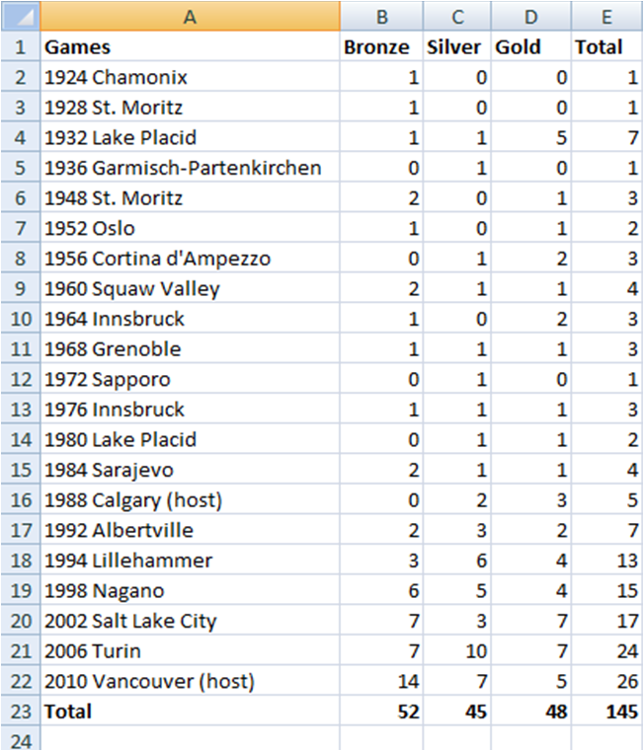
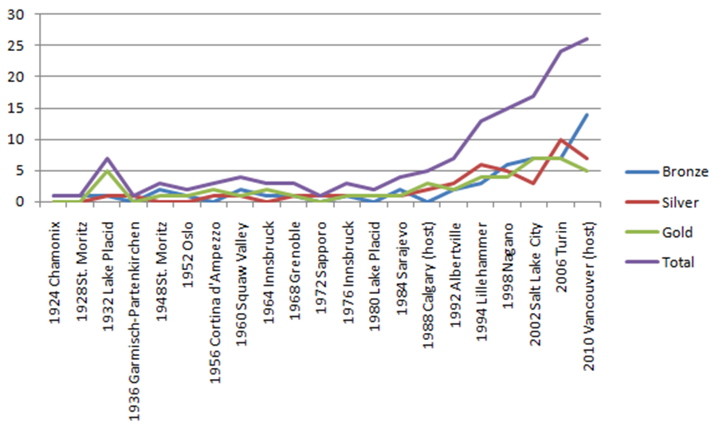
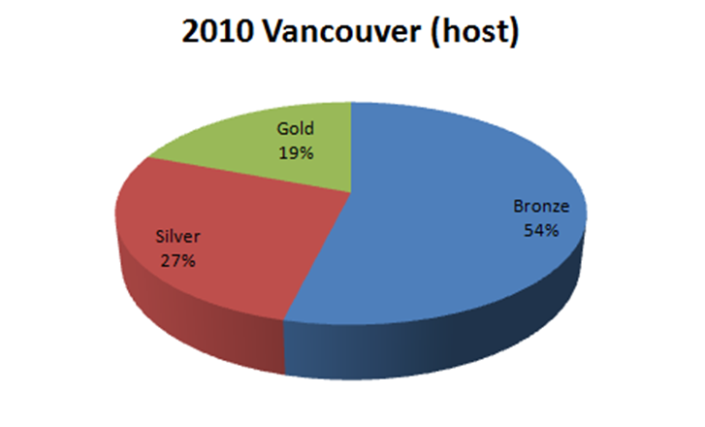
Charts
A picture is worth thousand words!

Slide 16
Divide and Conquer
The power to solve

Slide 17
Objectives
At the end of this section, you will be able to:
Understand and use the Divide & Conquer technique
Apply Divide & Conquer to a spreadsheet example

Slide 18
Divide & Conquer Approach
Divide and Conquer:
Divide the problem into smaller easier to solve problems
Solve the sub-problems
Combine the sub-solutions

Slide 19
Divide & Conquer
Start with an overview of the solution
  Specify the components
Overview
Component 1
Component 2
Component n

Slide 20
Divide & Conquer
Repeat for the components, specify subcomponents
Overview
1
2
n

Slide 21
Divide and Conquer
Making a table
Easier:
  Make the legs
  Make the top
  Combine them

Slide 22
Making a Table
Can go further down the tree if need be
Table
Legs
Top

Slide 23
Making a Table
Table
Legs
Top

Slide 24
Design Example
Spreadsheets

Slide 25
The Problem
I would like to move to a US state that:
  Has a warm climate
  Has a low crime rate
  Is close to Ottawa
Dividing the problem:
  Collect the avg high temperature per state
  Collect homicide rates from US states
  Measure the time it takes to drive from each state to Ottawa

Slide 26
1. Collecting avg high temperatures
www.netstate.com
Avg high temperature is recorded in Fahrenheit
Use Google calculator to convert to Celsius
Record the data in a spreadsheet

Slide 27
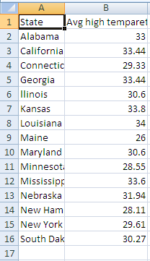
The spreadsheet

Slide 28
2. Collecting Homicide Rates
Find some source and record the rates in the spreadsheet.
My source is: "graphic Discovery" by Howard Wainer.

Slide 29
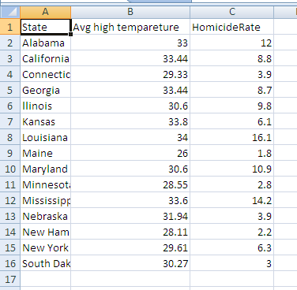
The spreadsheet

Slide 30
3. Time to Ottawa
This needs to be further divided into sub-problems:
  Find a point in the state
  Measure the distance from that point to Ottawa
For 2, we can simply use Google maps
For 1, the geographic center, the capital city, or something else?
We choose the capital city

Slide 31
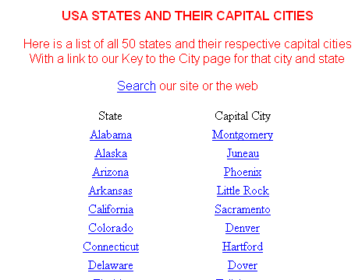
http://www.usacitiesonline.com/

Slide 32
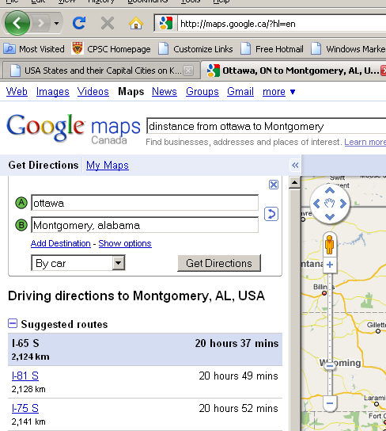
Google Maps

Slide 33
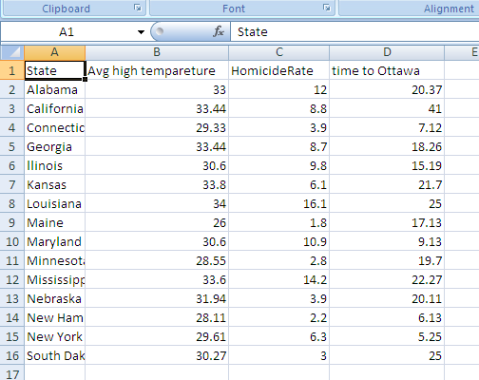
The Spreadsheet

Slide 34
Combining Sub-Solutions
Since we have more than one factor, we need to weigh the factors based on preference
One way is to use a weighted average
My preferences are:
  Warmer: 30%
  Fewer homicide: 50%
  Closer to Ottawa: 20%

Slide 35
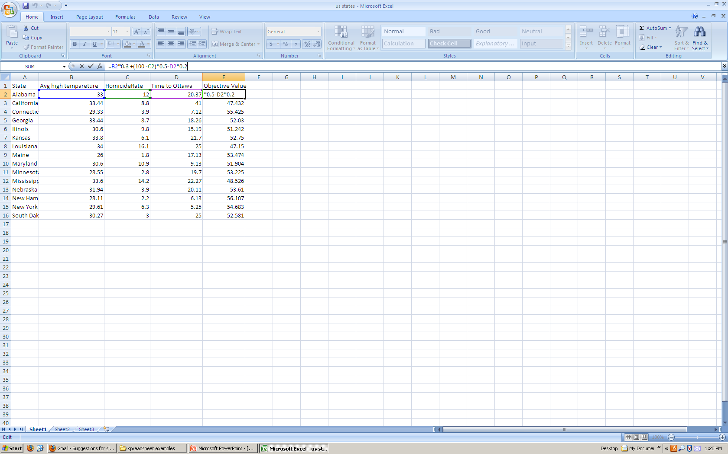
The Spreadsheet

Slide 36
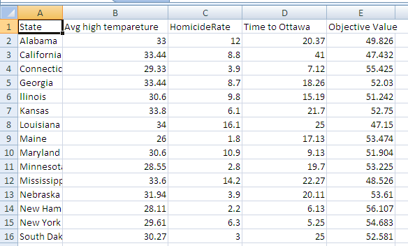
The Solution

