Slide 1
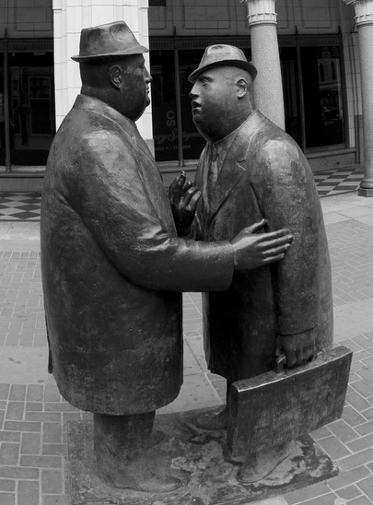
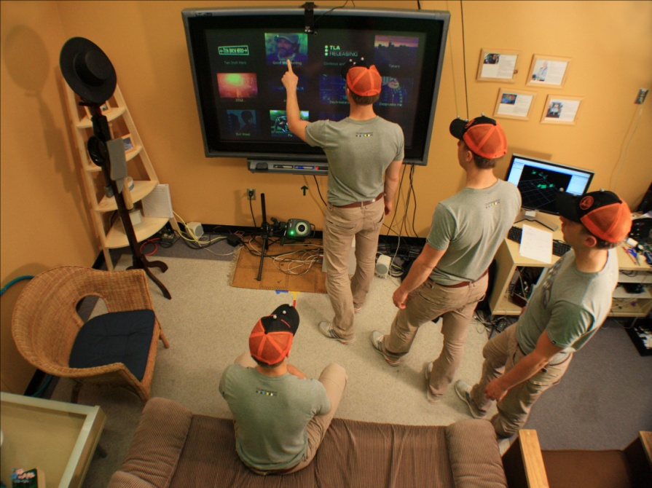
CPSC 781
Ubiquitous Computing
Topic: Proxemic Interactions
#include <stdio.h>
#include <sys/types.h>
#include <sys/socket.h>
#include <netinet/in.h>
#define PORT 12997 /* The port number of the server */
main()
{
int main_sock, new_sock, count;
struct sockaddr_in server;
/* Create a socket */
if (( main_sock = socket(AF_INET, SOCK_STREAM, 0)) < 0
problem("Socket problem");
/* Name the socket using wildcards */
bzero (&server, sizeof (server));
server.sin_family = AF_INET;
server.sin_addr.s_addr = INADDR_ANY;
server.sin_port = htons(PORT);
/* Set the options of the socket */
count = 1;
if ((setsockopt(main_sock, SOL_SOCKET)
SO_REUSEADDR,
problem ("Bind problem.")
}
/* Bind the socket to the address */
if (bind(main_sock, &server, sizeof server) < 0)

Slide 2
Course contents
  in-depth course in Ubiquitous Computing
  case-study: leading edge research topic in Ubicomp
    proxemic interactions
  involves
    significant research component
    background knowledge / experience in HCI

Slide 3
Course contents
Core concepts
  What is ubiquitous computing?
  What is proxemic interactions?
lectures, readings, discussions, mentoring…

Slide 4
Course contents
Core concepts
Case studies
  How can proxemic interactions be realized in various situations?
  Sources:
    readings supplied to you
    readings you discover
    presentations by you and visitors
    discussions / blog entries
    your research projects

Slide 5
Course contents
Core concepts
Case studies
  How can proxemic interactions be realized in various situations?
  Coverage:
    social theory
    technological infrastructures
    toolkits
    interaction techniques
    application domains
    ways it has been applied to design
    …

Slide 6
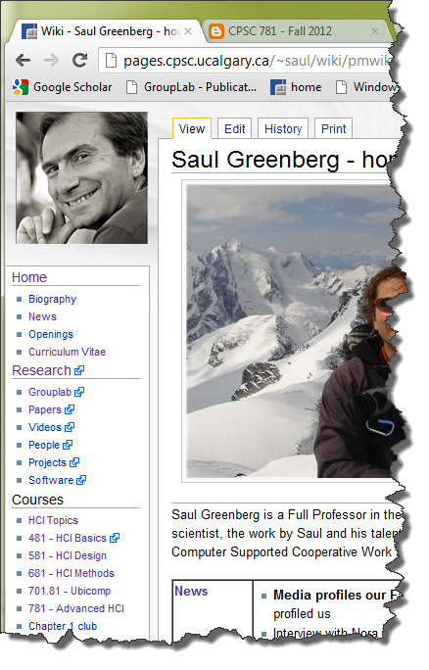
Primary Resources
course site
  www.cpsc.ucalgary.ca/~saul/
lecture materials
  slides and readings
  see web site
readings
  see web site
software
  software cookbook
video archive
.

Slide 7
Primary Resources
course site
  www.cpsc.ucalgary.ca/~saul/
lecture materials
  slides and readings
  see web site
readings
  see web site
software
  software cookbook
video archive
.

Slide 8
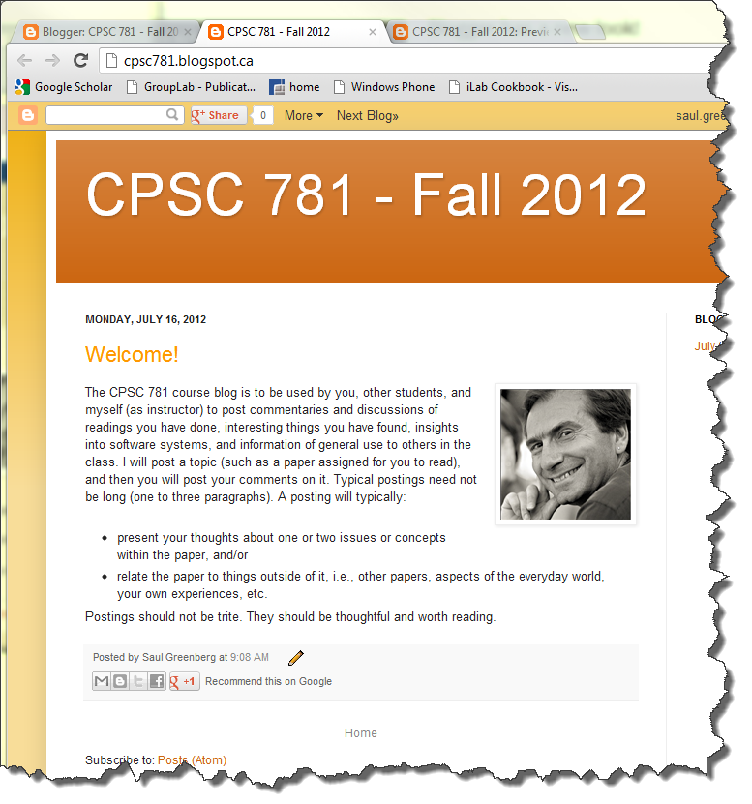
The Blog
blog site
  http://cpsc781.blogspot.com/
You can
  read
  post
  comment
Expected of all readings
  thoughts of one or two issues
  relate reading to
    other papers or
    everyday word or
    personal experiences / research, etc,
.

Slide 9

How you will be evaluated
Assignments- 20%
  Various exercises in learning/applying a technique
  Monday: Proximity toolkit hello world
  Others:
    AR Toolkit, Phidgets, Arduino, OpenCV, Kinect, etc…
    sketching exercises
  Assignments are on-going: ‘on demand’ vs. scheduled

Slide 10
How you will be evaluated
Written / oral presentations – 20%
  formal topics (1 or 2)
  paper presentations
  class discussions
  design critiques
  blog entries
  participation

Slide 11
How you will be evaluated
Project - 60%
  propose and carry out a major project in this area
  usually concerns applied technology development
    realistic and of value
    personally relevant e.g., related to thesis
    innovative
    publishable
Deliverables
  initial proposal
  detailed proposal
  literature review
  periodic reporting / demonstrations of milestones
  end of term:
    conference-style presentation
    paper (8-10 pages, ACM style) + 4-7 minute video
    archive

Slide 12
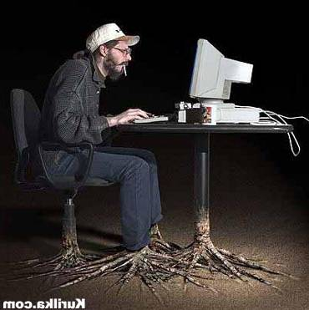


Slide 13
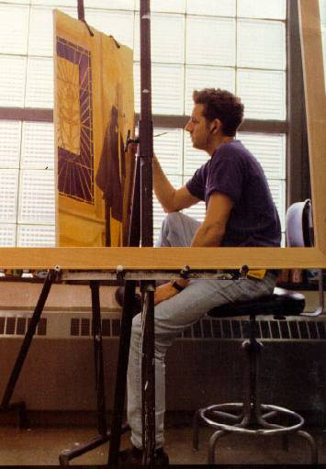
You are a Researcher, not a Hacker
Learner
  to learn, to know, to understand, to apply
Professional
  speaking, writing, presentations
Contributor
  participate in all ways, in depth
Critique
  question and challenge
Computer Scientist
  process, coding, competent
Social Scientist
  query, observe, analyze, understand
Designer
  Implications, insight and application

Slide 14
For Next Week
Readings
  as assigned : see web site
The blog
  Sign up to the blog
  Write a short summary of your thoughts about each paper
  Take, post and describe a digital photo showing:
    an existing (non-technical) example of proxemic interaction
    an idea of a proxemic-aware system (be creative!)

Slide 15
For Next Week
Presentation
  presentation topic suggestions
Project
  proposal suggestions

