Slide 1
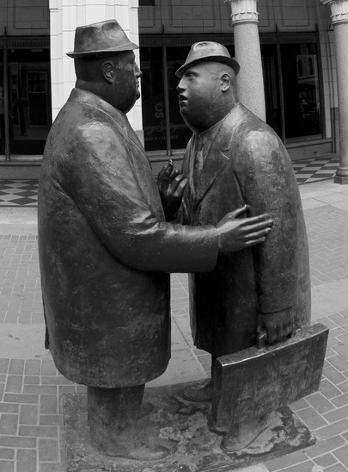
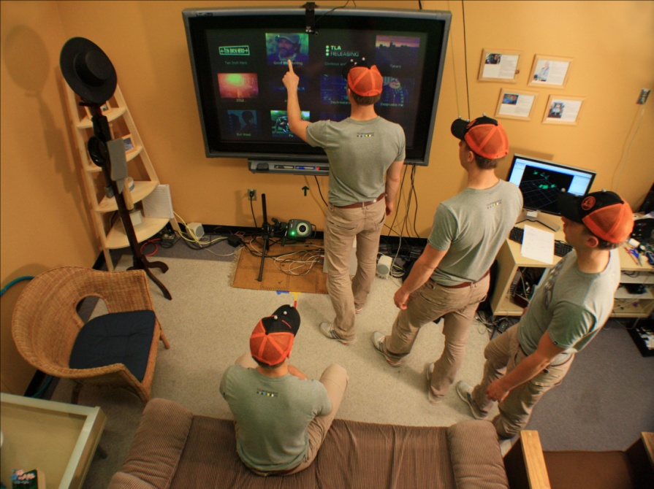
CPSC 781
Ubiquitous Computing
#include <stdio.h>
#include <sys/types.h>
#include <sys/socket.h>
#include <netinet/in.h>
#define PORT 12997 /* The port number of the server */
main()
{
int main_sock, new_sock, count;
struct sockaddr_in server;
/* Create a socket */
if (( main_sock = socket(AF_INET, SOCK_STREAM, 0)) < 0
problem("Socket problem");
/* Name the socket using wildcards */
bzero (&server, sizeof (server));
server.sin_family = AF_INET;
server.sin_addr.s_addr = INADDR_ANY;
server.sin_port = htons(PORT);
/* Set the options of the socket */
count = 1;
if ((setsockopt(main_sock, SOL_SOCKET)
SO_REUSEADDR,
problem ("Bind problem.")
}
/* Bind the socket to the address */
if (bind(main_sock, &server, sizeof server) < 0)

Slide 2
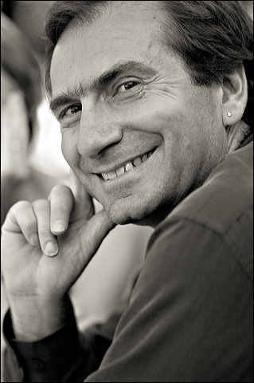
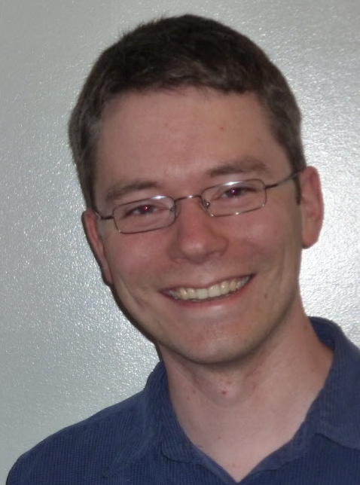
Your Host
Saul Greenberg
With occassional help from
Nic Marquardt
  human computer interaction
  computer supported cooperative work
  ubicomp
  PhD student
  proxemic interactions

Slide 3
Your Host
Contact information
  saul@ucalgary.ca
Office hours
  MS 680 – Interactions Laboratory or ME-dia Space
  by appointment:
    email to arrange one
  by email any time
  before class for brief meetings
  drop in for urgent requests
    but no guarantees!

Slide 4
Draw a computer

Slide 6
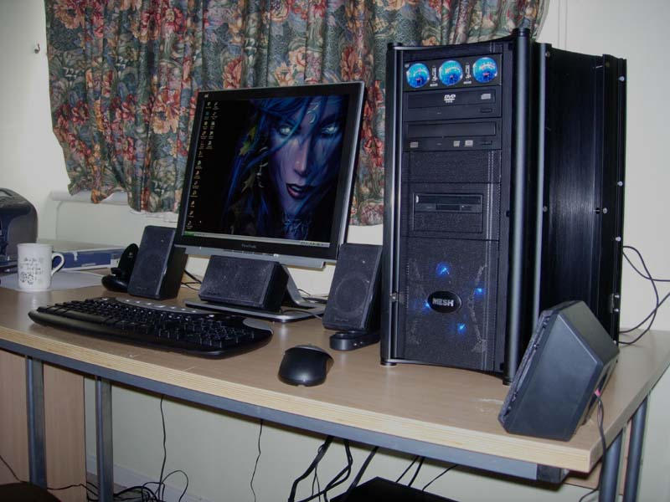
http://www.mysector.co.uk/images/potm/004large.jpg

Slide 7
Work

Slide 8
Tasks

Slide 9
Focused

Slide 10
Computers in our lives

Slide 11
We can do better

Slide 12
But we need to revisit how we think about computers

Slide 13
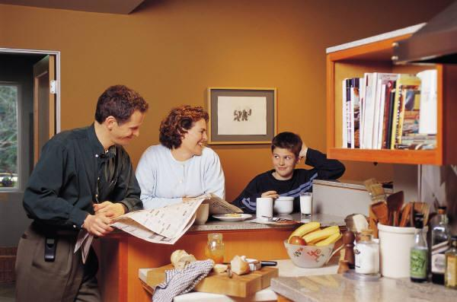
Reconsidering HCI in the age of ubiquity

Slide 14
things you carry

Slide 15
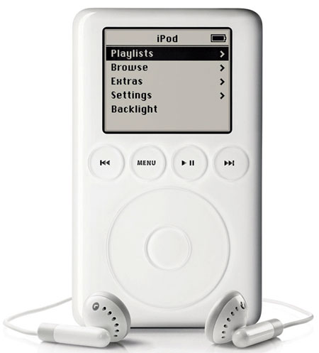

Slide 16
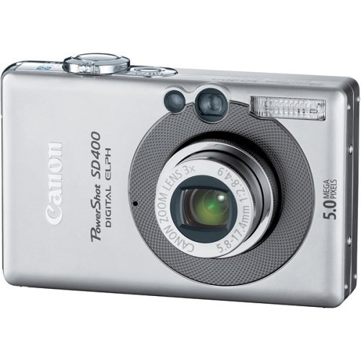

Slide 17
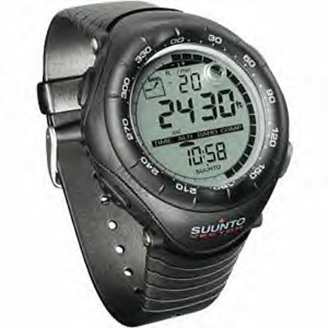

Slide 18
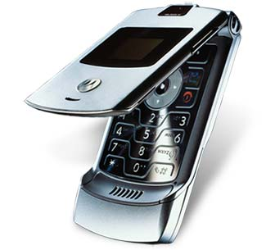

Slide 19
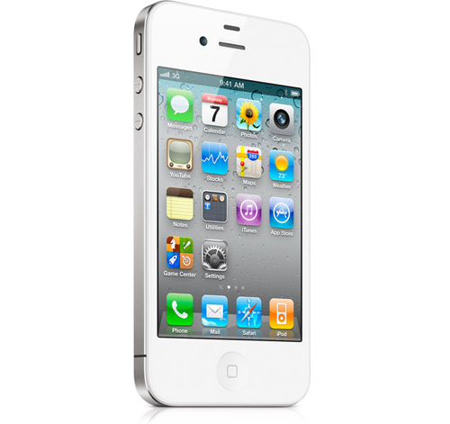
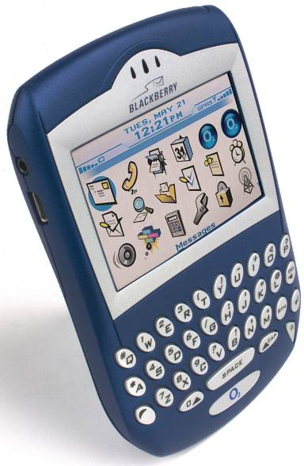

Slide 20
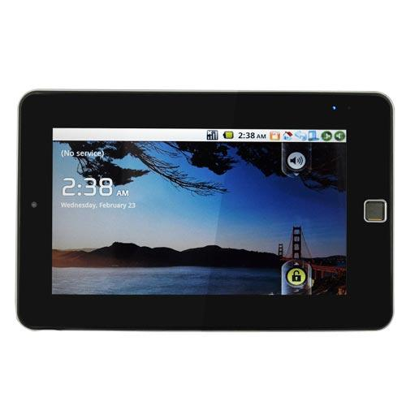
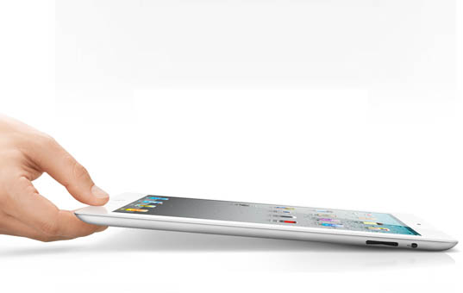

Slide 21
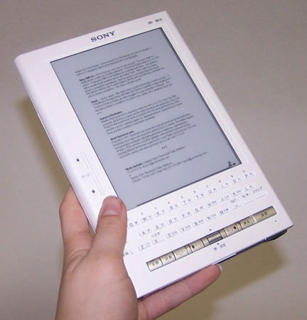
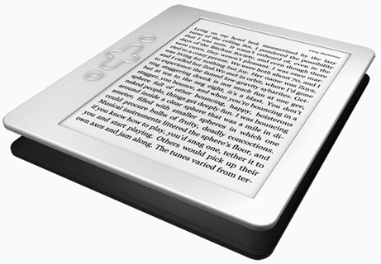

Slide 22
things scattered around you

Slide 23
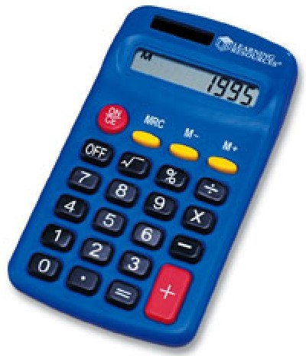

Slide 24
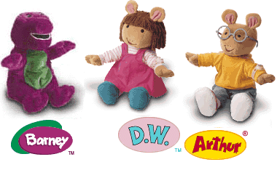

Slide 25
things you visit

Slide 26
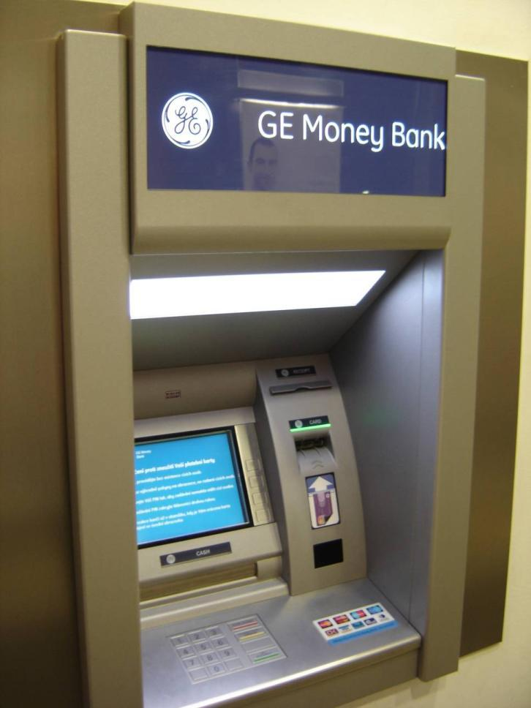

Slide 27
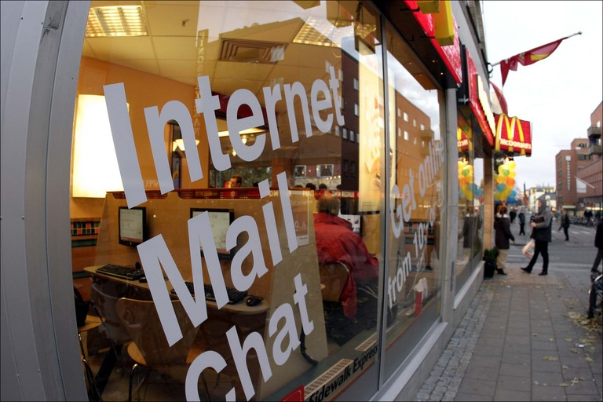

Slide 28
things in your things

Slide 29

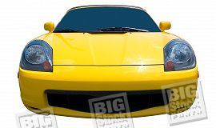
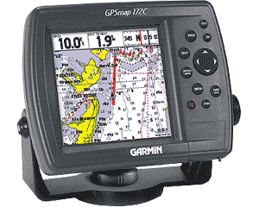

Slide 30
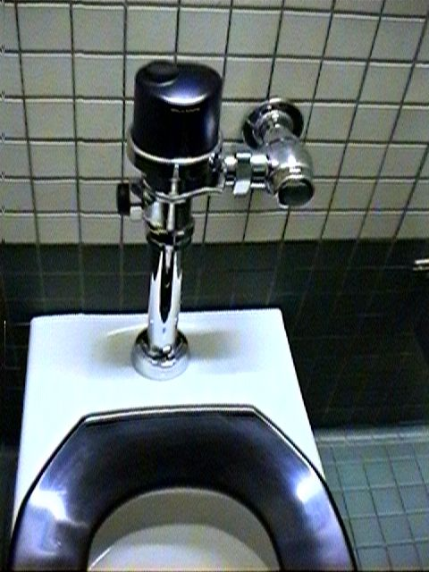
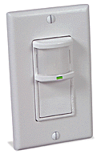

Slide 31
things to be social

Slide 32
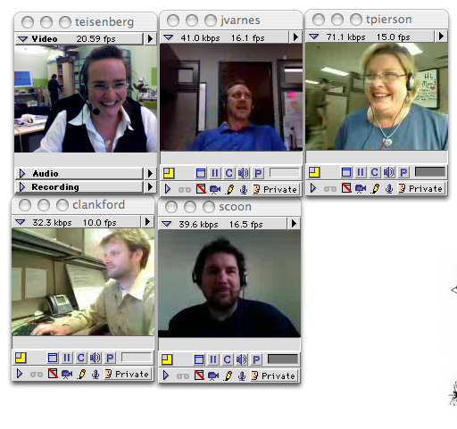
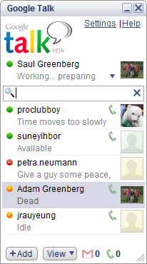
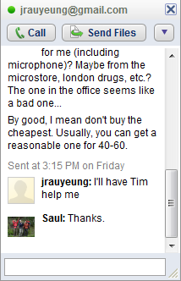
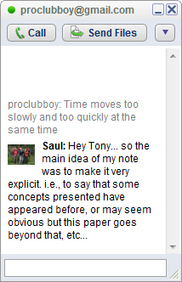
http://swissmiss.typepad.com/photos/uncategorized/2007/10/15/picture_15.png

Slide 33
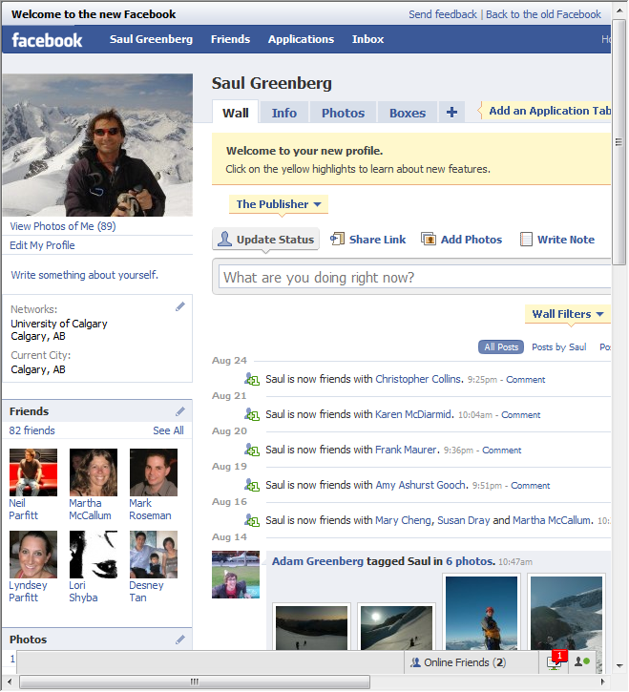

Slide 34
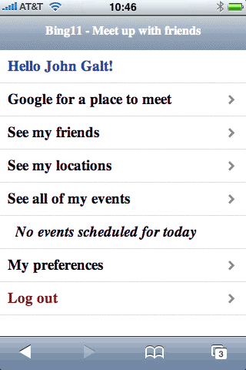
www.bing.com
Bing11TM is an exciting new mobile social networking service for planning events and hooking up with friends.
With it you can search for places to meet on your cell phone and send them to friends then track what everyone is doing. With just a few clicks on your mobile phone you can save time consuming phone calls and text messages.

Slide 35
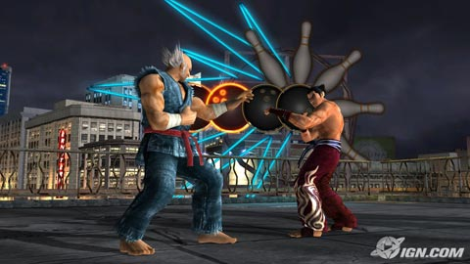
http://ps3media.ign.com/ps3/image/article/799/799444/ign-aus-top-5-playstation-network-games-20070626001523789.jpg

Slide 36
things in your home

Slide 37
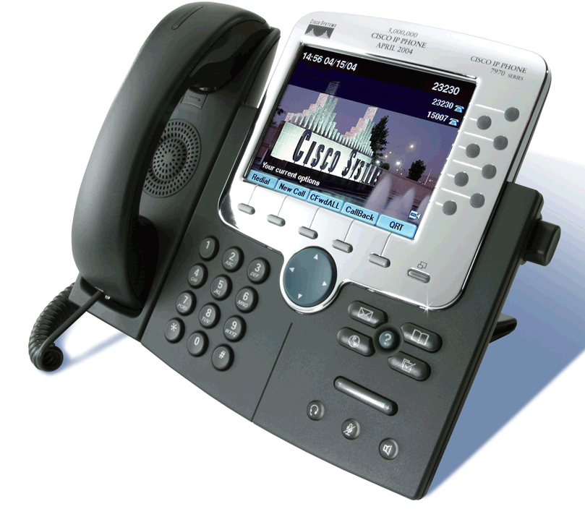

Slide 38
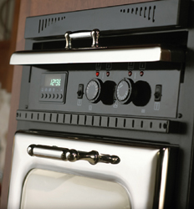

Slide 39
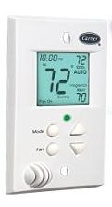

Slide 40
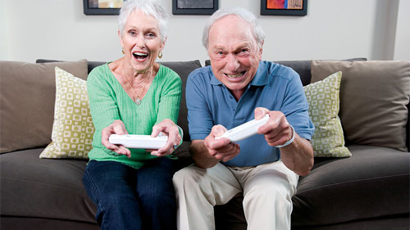
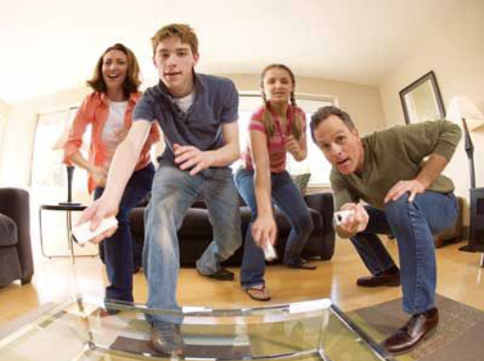
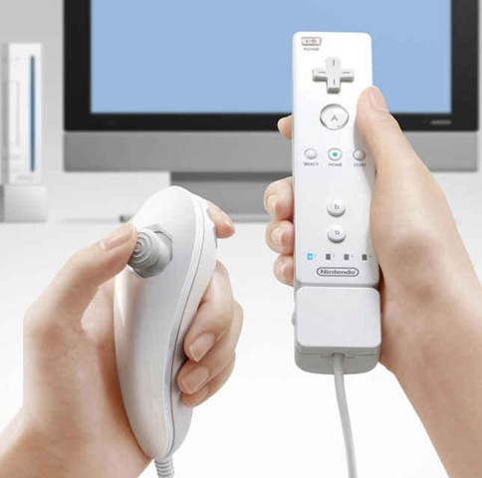
http://cache.kotaku.com/assets/resources/2007/04/wii_old_folks.jpg, http://shiftcontrolmedia.com/blog/wp-content/uploads/2007/11/playing-wii.png, http://www.betadaily.com/wp-content/uploads/2008/04/wii-controller.jpg
Notes:
Nanny cams

Slide 41
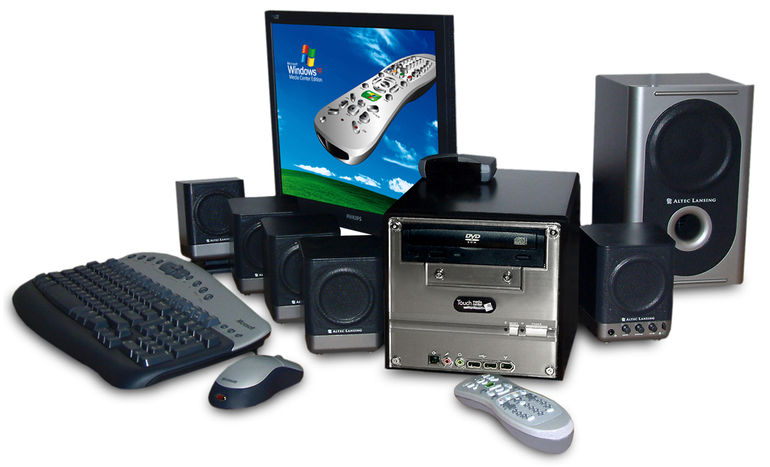

Slide 42
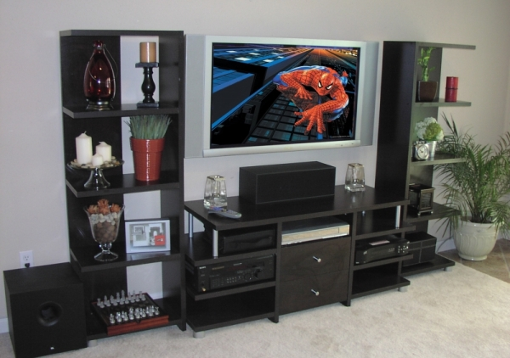

Slide 43
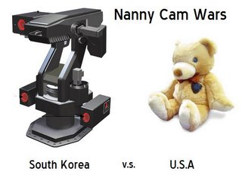

hubpages.com/hub/NannySpy-Cameras , http://nannycameras.blogspot.com/2008/02/south-koreas-military-grade-nanny.html
Notes:
Nanny cams

Slide 44
things taking care
of your home

Slide 45
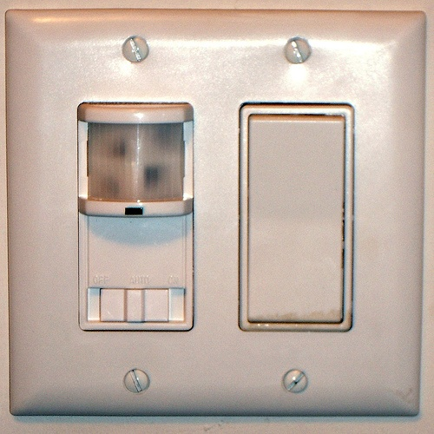
http://farm1.static.flickr.com/88/243112860_025cb6afc1.jpg?v=0
Notes:
Motion sensor light switch

Slide 46
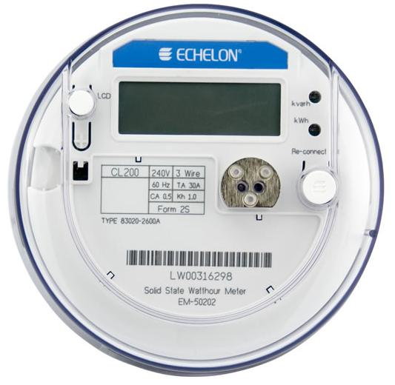
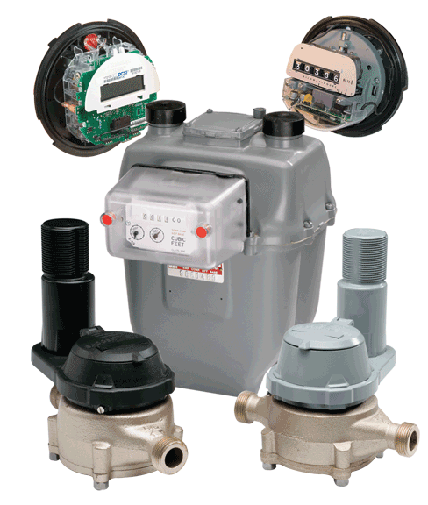
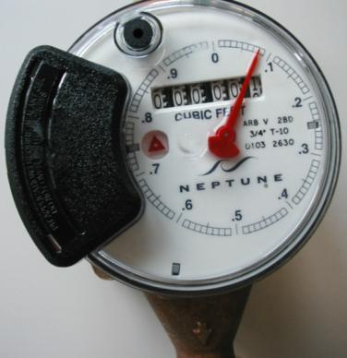
Electricity
Gas
Water
http://www.echelon.com/company/press/2007/meter_canada.htm ,
www.cambridgema.gov/CWD/ad_watermeter.cfm , http://www.badgermeter.com/Gas/Alliances---Multiutility-Solutions/PLC-Technology.aspx
Notes:
Various utility meters

Slide 47
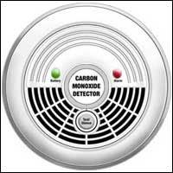
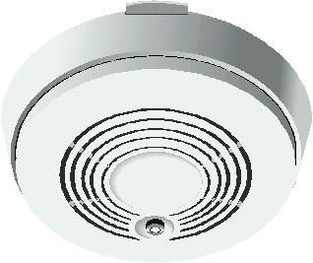
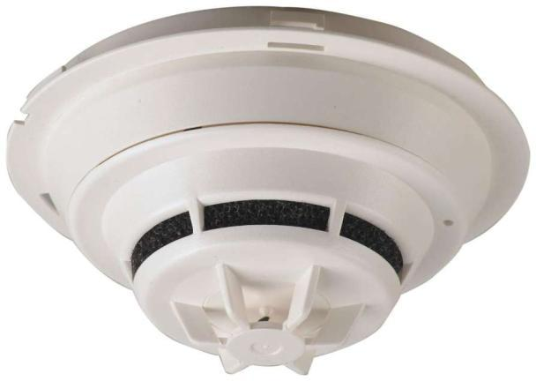
Carbon Monoxide
Smoke
Fire
http://www.bobvila.com/images/ArticleImages/CarbonMonoxideDetector_01.jpg , http://news.thomasnet.com/images/large/029/29555.jpg , http://www.anaheim.net/depts_servc/fire/com_svc/sm_det.html
Notes:
Danger alarms

Slide 48
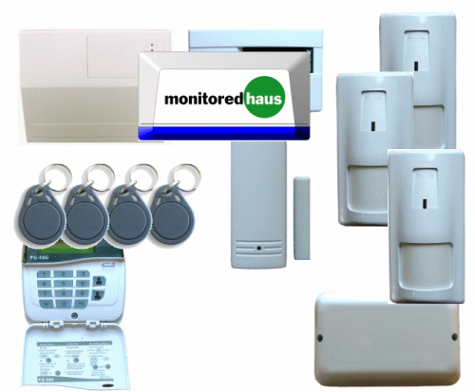
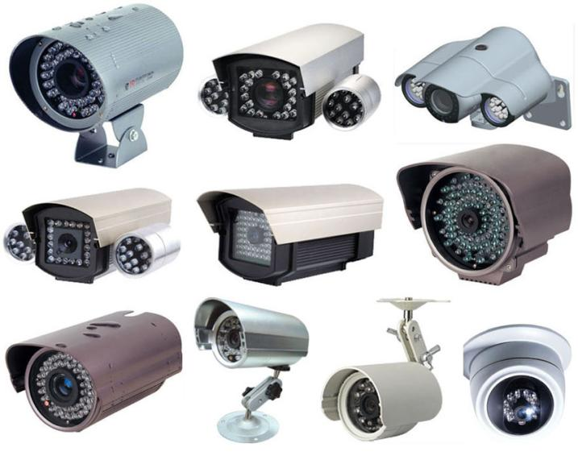
http://ushomesecuritysystem.com/uploads/images/camera.jpg, http://www.windowstoday.co.uk/images/alarms.gif
Notes:
Home security

Slide 49
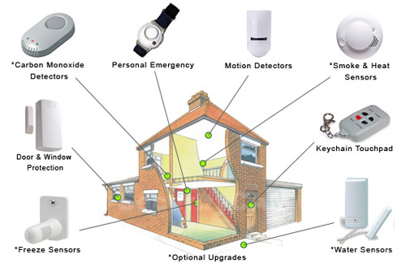
http://www.ehomeprotection.com/home-security-package-detai.jpg
Notes:
Integrated security systems

Slide 50
infrastructure

Slide 51

Home Office –

Slide 52

External hard
drives
Home Office

Slide 53

Scanner
Printer
Home Office

Slide 54

Cable modem
Wired
wireless
less router
Home Office

Slide 55

Family computer

Slide 56

Plasma
Wireless
KB/Mouse
Photo printer
Wii
6 remotes
DVD/VCR
Computer
XBox
TV/Game area

Slide 57

Laptop - anywhere

Slide 58

Chumby
UMPC
Kodak picture frame
Still to come…

Slide 59


Networking
http://www.cablemanstore.co.uk/images/section_d/planet_pl201_app.gif http://www.thumbandhammer.com/images/network/routers.jpg
http://i122.photobucket.com/albums/o272/softarchive/img31/63787_s__home_networking_for_dummie.jpg
Notes:
Home networking, security, wireless, neighborhood access,

Slide 60


Cabling

Slide 61

Machine and Network Security

Slide 62


Slide 63
Personal, Social, Play not work

Slide 64
opportunistic, discretionary not focused tasks

Slide 65
New disciplines and genres of computing
  ubiquitous computing
  pervasive computing
  context-aware computing
  mixed / augmented reality
  attentive user interfaces
  wearable computing
  sensor networks
  information appliances
  tangible user interfaces
  alternative input and output devices
  cooperative buildings
  smart homes
  smart furniture / clothes
  consumer robotics …

Slide 66

Mark Weiser Xerox Parc
Ubiquitous Computing - many computers per person
It is invisible, everywhere computing that does not live on a personal device of any sort, but is in the woodwork everywhere. Its highest ideal is to make a
computer so embedded, so fitting, so natural,
that we use it without even thinking about it.
invisible
  designed to fit
  exploits our everyday participation in the world
Source: Mark Weiser’s UbiqCom web site

Slide 67

Hiroshi Ishii MIT Media Lab
Tangible Computing
gives physical form to digital information,
seamlessly couple the dual worlds of bits and atoms
From painted to tangible bits
  input: grasp and manipulate
  output: change physical properties of object
Source: Hiroshi Ishii publications

Slide 68

Embodied Interaction
Embodied Interaction
People create, manipulate and share meaning
by the way they engage with the world
  everyday routines
  situated actions
  surrounding environments
  surrounding people
  …
The systems we use are embedded in systems of social meaning, fluid and negotiated between us and those around us… Users create and communicate meaning through their interaction with the system (and with each other…)
Source: Dourish web site

Slide 69

Situated Computing
Exploits our everyday participation in our world
  physicality
  placement in space
  affordances
  proximity
  is out here with us
  is in many small and large places, including trivial ones
Source: Mark Weiser’s UbiqCom web site

Slide 70
Domestic Computing
Computing that stresses
  family and friends
  domestic life
  social engagement
  personal environments
  social routines, coordination, relationships vs. tasks
It is not just the home!

Slide 71

Context-Aware Computing
Context as information
  … characterizes a situation of a person, place or object relevant to the interaction between a user and an application
    location
    identity
    state and activities of people, groups
    state of computational and physical objects
Context-aware computing
  uses contextual information to
    selectively present information and services
    automatically execute a service
    attach context information for later retrieval
Source: Dey, Abowd and Salber, HCI Journal 2001; Image from Hong and Landay (Berkeley)

Slide 72
Is HCI ready for this?

Slide 73
Barely

