Slide 1
Embodied Interaction
By Matthew Dunlap
Notes:
Define Artifacts?

Slide 2
Overview
In this presentation I will explore Paul Dourish’s idea of Embodied Interaction, looking into its:
  Presence in Tangible and Social computing
  Philosophical Background
  The foundation it creates for HCI
  Its effect on HCI design
Notes:
Taking the idea Embodied Interaction and applying it back through the concepts in the book.

Slide 3
What is Embodied Interaction?
“Embodied Interaction is the creation, manipulation, and sharing of meaning through engaged interaction with artifacts.”
“Embodied Interaction is based on the understanding that users create and communicate meaning through their interaction with the system (and with each other, through the system).”
Notes:
To understand embodiment better, we will first look at two of the fields of computing that reflect its ideals.

Slide 4
Embodied interaction is based upon the marriage of two computing concepts…

Slide 5
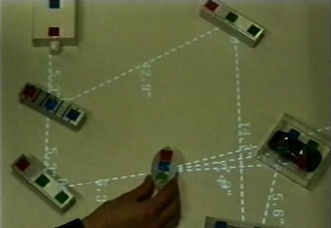
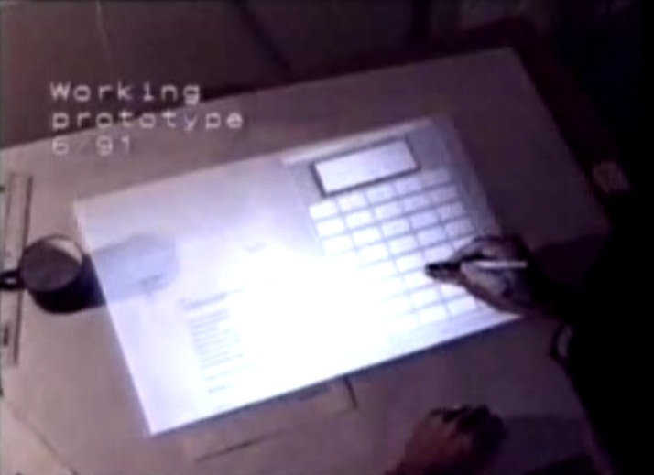
Tangible Computing
Allows interaction with digital information through the physical world.
Interfaces like Illuminating Light and The Digital Desk
Allows the user to “explore, adopt and adapt interactive technology… to create and communicate the meaning of the actions they perform.”
Notes:
Explain Illuminating Light and The Digital Desk

Slide 6
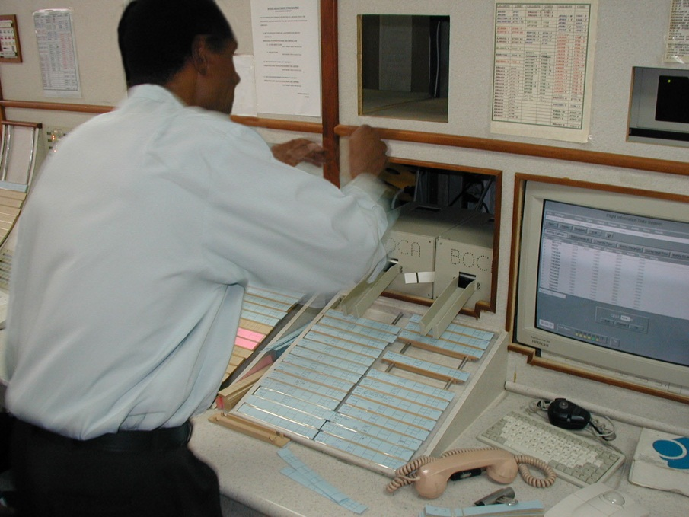
Social Computing
Applies sociological methods to designing interactive systems.
Understands that systems are built upon abstraction, which hide implementation.
Looks at the context and meaning behind the use of systems.
Notes:
Philosophy next
Explain importance of flight strips in Hughes et al. 1995.
The subtle position of the strips indicates information
The crossing out of information on the strips is important
Positioning of strips indicates to other people the state of the air space

Slide 7
Philosophical Background: Embodiment
“Embodied phenomena are those that by their very nature occur in real time and real space.” … what?
  Embodiment emphasizes that our interaction with the world around us occurs through our body.
  Is important to understanding a person’s experience in the world.
Embodiment comes out of the philosophical tradition of Phenomenology.

Slide 8
Phenomenology
Looks to human experience to solve questions of being and knowledge, seeing the mind and body as one.
This is opposed to previous philosophical traditions that separate the mind and the body.

Slide 9
Edmund Husserl
Father of phenomenology.
Built upon intentionality, which sees all consciousness as being about something.
Separated the objects that cause our experience from our consciousness of them.
Saw that experience is a study-able phenomenon.

Slide 10
Martin Heidegger
Studied under Husserl
Disagreed with Husserl’s Cartesian Dualism, the idea that there is a separation between the mind and the body/world.
  One must be in order to think
  Instead, we get our meaning from the world.
Dasein – being-in-the-world. Essence of being human.
  Dasein acts on things in the world, but also acts through them.
  Ready-to-hand vs. present-at-hand
Notes:
Ready-to-hand – using the mouse to control the computer. I am acting through the mouse
Present-at-hand – moving the mouse to the center of the mousepad. I am acting on the mouse

Slide 11
Alfred Schutz
Applied phenomenology to the social world
Dealt with intersubjectivity, the sharing of a common experience
To Schutz, we use our experience in the world when sharing experience with others.
Brought sociological problems into the world.
Notes:
Intersubjectivity - imparting of personal reasons onto another. (why are you in grad school example)
Sociological problems are part of our experience of the world. Instead of being built into abstract laws that govern our behavior, they become built into the everyday problems we solve.

Slide 12
Foundations for Embodied Systems
Notes:
Examples:
Ontology:
Intersubjectivity:
Intentionality

Slide 13
Ontology
The study of being/reality.
In Embodied Interaction:
  Understanding the internal representation of a system and its entities
  Conveying this representation through the extension of affordances to digital systems.
Notes:
Example:
Filing system paradigm.
-Files in folders
-Folders can be stored in other folders

Slide 14
Intersubjectivity
How meaning arises from the community
In Embodied Interaction:
  Allowing a system to be modified by a community to better suit its needs
  Customizing a system through the needs of a community
Notes:
Example:
Online community study.
mIRC : /me slaps "nick“
Yourname slap's NICK around a bit with a large trout.

Slide 15
Intentionality
The sharing of experience between individuals.
In Embodied Interaction:
  How do people share meaning?
  How can the system understand the meaning conveyed through an action?
  How do we act through a system to effect the world?

Slide 16

Coupling
Intentional reference made
effective
How we act through tools.
Physical example: Using a fork
to eat dinner. The fork becomes
an extension of our intention.
In software, we use abstractions in the same way.
Physical/software example: using the arrow keys to control a character in a game. We change our attention between the buttons, the position of our character in the game, and our living of the characters actions.
Notes:
Arrow keys: trying to control flying
Position: trying to place ourselves under the box
Actions: Keeping Mario away from the flying dudes.

Slide 17
Design Principles
Computation is a medium:
Computers act as an extensions of our own activities
Meaning arises on multiple levels:
Systems and artifacts should be designed with a focus on the numerous meaning they can possess.
Users, not designers, manage meaning and coupling: The goal of designers should be towards suggesting meaning and coupling for artifacts, focusing on “ways for the user to understand the tool and understand how to apply it to each situation.
Notes:
explain

Slide 18
More Design Principles
Embodied technologies participate in the world they represent:
The representation and the object exist in the same reality.
  Example: the representation of a file system effects the existence and use of the filing system.
Embodied interaction turns action into meaning:
Meaning is not in the system itself, but is expressed by how the user acts through the system.

Slide 19
Conclusion
Embodied interaction is a highly useful way to look at system design.
Emphasizes the user as a being who interacts in ways that contain meaning.
Encourages the creation of systems that take the users environment and meaning into account.

