Slide 1
Embodied Interaction
By Matthew Dunlap
Notes:
Define Artifacts?
Overview Next

Slide 2

Overview
I will explore Embodied Interaction, looking into its:
  Presence in Tangible and Social computing
  Philosophical Background
  The foundation it creates for HCI
  Its effect on HCI design
Paul Dourish
Notes:
Embodied interaction is a shift in model in which we design interactive systems.
If you have any questions, ask at any time.
What is Embodied Interaction next.

Slide 3
What is Embodied Interaction?
“Embodied Interaction is the creation, manipulation, and sharing of meaning through engaged interaction with artifacts.”
“Embodied Interaction is based on the understanding that users create and communicate meaning through their interaction with the system (and with each other, through the system).”
Notes:
Don’t let your eyes glaze over
Ok, so we’re done, right? Nah.
Marriage of two concepts next

Slide 4
Embodied interaction is based upon the marriage of two computing concepts…
Notes:
Tangible Computing next

Slide 5
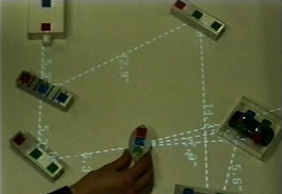
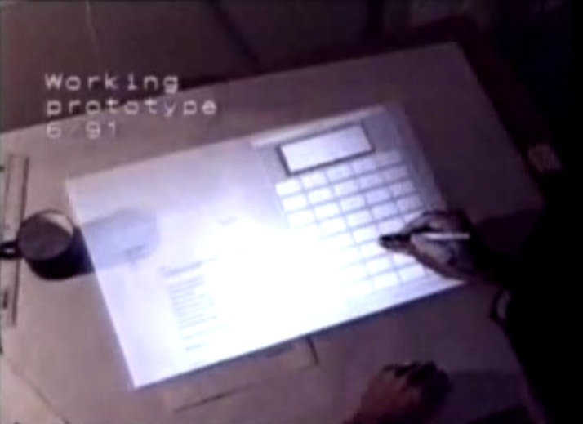
Tangible Computing
Allows interaction with digital information through the physical world.
Illuminating Light
Digital Desk
Ishii et al.
Wellner
Notes:
Pretty familiar to everyone here
Allows interaction with a system through objects with affordances.
Moves our interaction away from a single point (cursor), and single focus (window).
These affording objects can be created in such a way to encourage and explain these more com
Allows the user to “explore, adopt and adapt interactive technology… to create and communicate the meaning of the actions they perform.”
Social Computing next

Slide 6
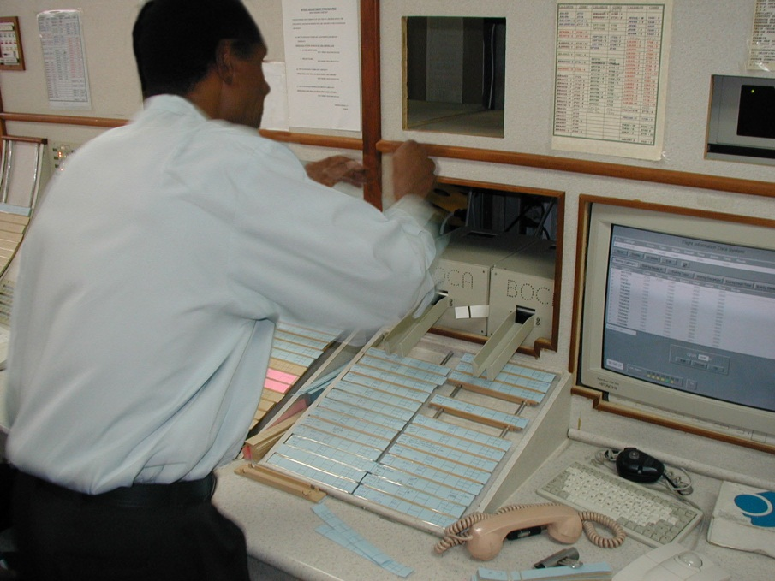
Social Computing
Applies sociological methods to designing interactive systems.
Looks at the context and meaning behind the use of systems.
Notes:
Explain importance of flight strips in Hughes et al. 1995.
The subtle position of the strips indicates information
The crossing out of information on the strips is important
Positioning of strips indicates to other people the state of the air space
More Social Computing next

Slide 7
Social Computing
Social action is embedded
Technology changes social interaction
Technology is a radically different social medium.
Notes:
Social action is embedded in the in it’s setting. How it takes place is based upon physical, social, cultural, historical and other factors.
Technology changes social interaction.
Technology is becoming the medium through which we interact socially. It is a medium that’s rules are much different than physical world.
[Any questions]
Philosophy and Terms next

Slide 8
Philosophy and Terms
The study of questions in reality.
  Existence
  Knowledge
  Values
  Reason
  Mind
  Language
Notes:
Kinda silly
Philosophy is often a very murky enterprise, because it attempts to discuss the fundamental nature of reality inside that reality
Hahahahahahah I defined philosophy!
Every philosophical term here could be discussed for the whole class period.
[Explain terms]
Philosophical Background next

Slide 9
Philosophical Background: Embodiment
“Embodied phenomena are those that by their very nature occur in real time and real space.” … what?
Comes from philosophical tradition of Phenomenology.
Notes:
Embodiment emphasizes that our interaction with the world around us occurs through our body.
Is important to understanding a person’s experience in the world.
[Stop me if you want definitions of terms]
Phenomenology next

Slide 10
Phenomenology
Human experience (phenomena) answers philosophical questions.
Previous traditions separated the mind and the body.
Phenomenology unified the two.
Notes:
Looks to human experience (phenomena) to solve questions of being and knowledge.
This is opposed to previous philosophical traditions that separate the mind and the body.
[Explain being and knowledge]
[Explain Cartesian Dualism]
[Ask for questions]
Husserl next

Slide 11
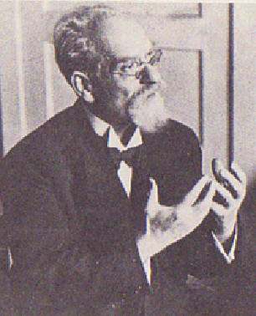
Edmund Husserl
Father of phenomenology.
Separated the objects that cause our experience from our consciousness of them.
Saw that experience is a study-able phenomenon.
What are things?
Notes:
Although he is the father of phenomenology, it changed in many ways from when he birthed it.
Phenomenology built upon intentionality, which sees all consciousness as being about something.
[second point] We experience the Phenomena of Saul when we see him, as well as when we imagine him or remember him.
Adhered to the Cartesian Dualistic approach.
Heidegger next

Slide 12
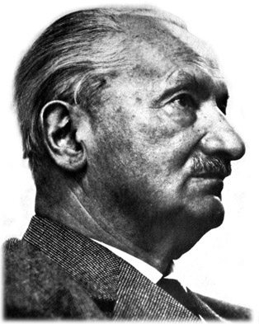
Martin Heidegger
Disagreed with Husserl’s Cartesian Dualism
Thinking and being are one.
Meaning is in the world.
Instead of :“How can we know about the world?”
We ask: “How does the world reveal itself to us through our encounters with it?”
Notes:
Student of Husserl
Notoriously confusing, even to me.
Disagreed…:
Husserl focused on mental phenomena separated from the physical world.
One must be in order to think
Instead, we get our meaning from the world.
Changed phenomenology from a knowledge question to an existence question.
Schultz next

Slide 13
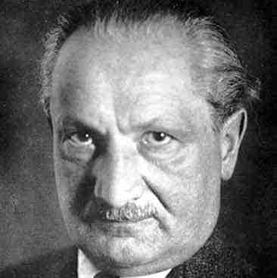
Heidegger & Dasein
We are embodied.
Dasein – being-in-the-world.
  Essence of being human.
  Ready-to-hand vs. present-at-hand
Notes:
We encounter the world practically through our embodiment.
Dasein acts on things in the world, but also acts through them.
Ready-to-hand – using the mouse to control the computer. I am acting through the mouse
Present-at-hand – moving the mouse to the center of the mousepad. I am acting on the mouse

Slide 14
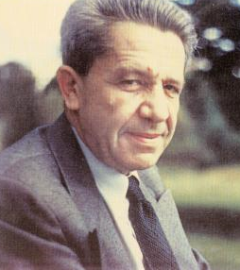
Alfred Schütz
Applied phenomenology to the sociology.
Intersubjectivity
Sociological problems are part of our experience of the world.
Notes:
Intersubjectivity - imparting of personal reasons onto another. (why are you in grad school example)
To Schutz, we use our experience in the world when sharing experience with others.
Old sociological view saw sociology as the study of the laws that govern people.
To Schutz, sociological problems are part of our experience of the world. Instead of being built into abstract laws that govern our behavior, they become built into the everyday problems we solve.
We’ll touch on intersubjectivity later
Phenomenology Summary next

Slide 15
Philosophy Summary
We are a part of the world, and we engage with it practically to find meaning.
“Embodiment is the property of our engagement with the world that allows us to make it meaningful.”
Notes:
Embodiment is central to these philosophical views.
Foundations for Embodied Systems next

Slide 16
Foundations for Embodied Systems
Notes:
Ontology next

Slide 17
Ontology
The study of categories of being.
Ontology is a term used in computer science, but its connotations are flawed.
Notes:
Categories of being meaning what differentiates one object from the next.
In computer science, the ontology means the internal layout of a software system. The problem is that ontology is thought of as something that can be designed, but how a user will use and interpret a system cannot.

Slide 18
Applying Ontology
Allowing the user control over the ontology of a system.
Conveying the representation of a system through digital/physical affordances
Notes:
Example:
Filing system paradigm.
-Files in folders
-Folders can be stored in other folders
Intersubjectivity next

Slide 19
Intersubjectivity
The sharing of experience/meaning between individuals.
Notes:
Meaning is in the world…

Slide 20
Applying Intersubjectivity
Allowing the designer to communicate meaning to the user.
Allowing the users to use and appropriate a system to communicate with one another.
Notes:
Not directly brought up by Dourish: How can the system understand the meaning conveyed through an action?
Appropriation is important. Allowing the user to control a system as verbosely as possible allows for better communication.
Coupling Next

Slide 21
Intentionality
What a concept it “directed” towards
Can intention be shared?
Original vs. derived
Notes:
Example: When I think about sleep, my intention of the thought it towards the act of closing my eyes and drifting off. There is meaning in this intention.
Original intentionality is the intentionality that occurs in our mind.
Derived intentionality is the intentionality interpreted by others.

Slide 22
Applying Intentionality
Computation is intentional.
How do we act through this intention?
Notes:
Computation is an intentional phenomena and refers to things
Intentionality next

Slide 23

Coupling
Intentional reference made effective
How we act through tools.
In software, we use abstractions in the same way.
Notes:
Tied to Heideggers Ready-to-hand vs. present-at-hand concept
Physical example: Using a fork to eat dinner. The fork becomes an extension of our intention.
Arrow keys: trying to control flying
Position: trying to place ourselves under the box
Actions: Keeping Mario away from the flying dudes.
Design Principles next

Slide 24
Design Principles
Notes:
Ontology next

Slide 25
Computation is a medium:
Computers act as an extensions of our own activities

Slide 26
Meaning arises on multiple levels:
Systems and artifacts should be designed with a focus on the numerous meaning they can possess.

Slide 27
Users, not designers, manage meaning and coupling:
The goal of designers should be towards suggesting meaning and coupling for artifacts, focusing on “ways for the user to understand the tool and understand how to apply it to each situation.”

Slide 28
Embodied technologies participate in the world they represent:
The representation and the object exist in the same reality.
Notes:
Example: the representation of a file system effects the existence and use of the filing system.

Slide 29
Embodied interaction turns action into meaning:
Meaning is not in the system itself, but is expressed by how the user acts through the system.

Slide 30
Conclusion
Embodied interaction is a highly useful way to look at system design.
Emphasizes the user as a being who interacts in ways that contain meaning.
Encourages the creation of systems that take the users environment and meaning into account.
Notes:
Criticism: It would have been nice to see a bit more clarity in how to apply these design principles.
DONEEEEEEEEEEEEEE

Slide 31
Abstraction
“The very essence of software system design is the manipulation, combination and creation of abstractions.”
Hides implementation
Notes:
Allows us to do complicated things simply.
Philosophy Background next

Slide 32
Intentionthing?
How meaning arises from the community
In Embodied Interaction:
  Allowing a system to be modified by a community to better suit its needs
  Customizing a system through the needs of a community
Notes:
Example:
Online community study.
mIRC : /me slaps "nick“
Yourname slap's NICK around a bit with a large trout.

