Slide 1
Exploring Naturalistic Gestures for Digital Tabletops
Darren Andreychuk
Shahedul Khandkar
Josy Oliveira

Slide 2
Outline
Research Objective
Related Works
Methodologies
Findings
Limitations
Future Work

Slide 3
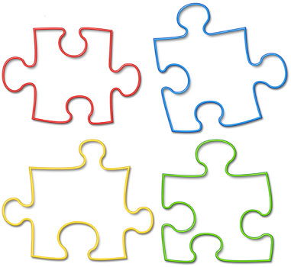
Research Objective
Determine the natural gestures for common tasks in touch enabled applications
http://www.robincooperresearch.com

Slide 4
Related Works
1. User-Defined Gestures for Surface Computing (Wobbrock, Morris, Wilson. ‘09)

Slide 5
Methodologies

Slide 6
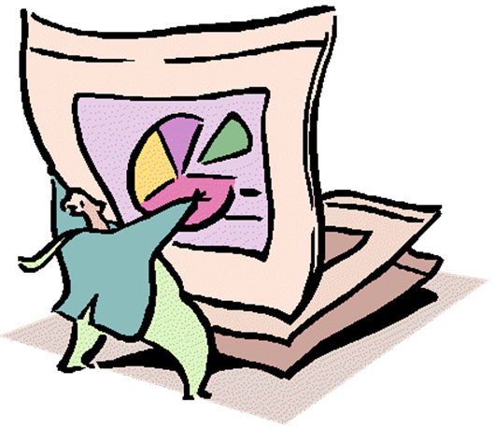
Data Collection
Techniques
  Wizard of Oz
  Direct Observation
  Interview
    Fixed questionnaire
    Open ended questions
http://www.micromationinc.com/images/PE01571_.gif

Slide 7
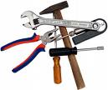
Data Collection
Tools
  Video & audio recording
  Screen capture
  Notes
tvgasm.com

Slide 8
Study Setup - Organization
Each interview consisted of
  an interviewer
  an interviewee
  an experimenter to observe and control the camera
  an experimenter to manipulate the system

Slide 9
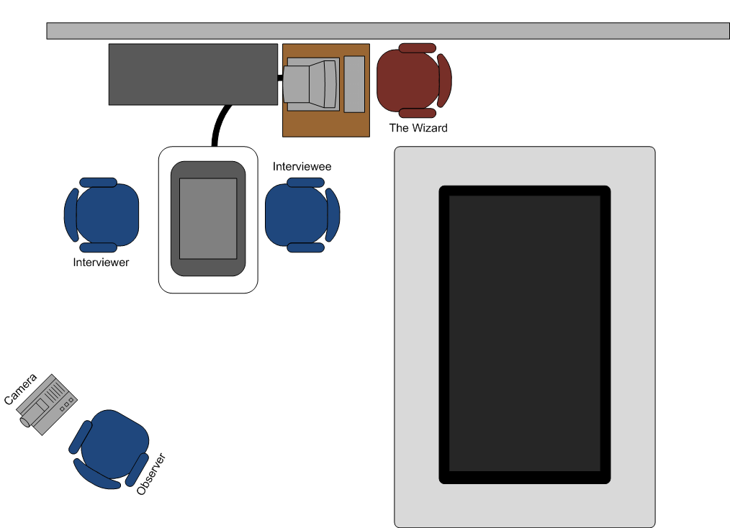
Study Setup - Organization

Slide 10
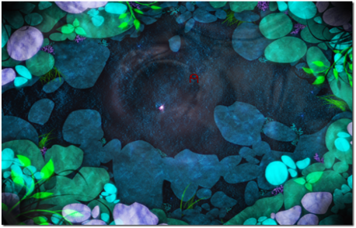
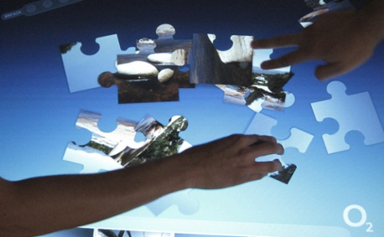
Study Setup - Organization
Experiment was conducted during the weekend and on a holiday to ensure that we were not disturbed
Before interview each participant was introduced to the Microsoft Surface and touch capabilities
  Played with the water
  Played a puzzle game

Slide 11
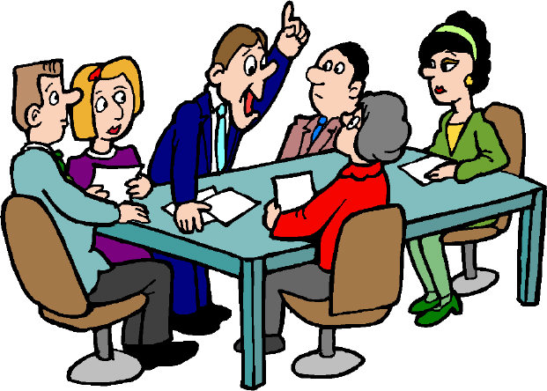
Data Analysis
Open Coding
Quantitative analysis
Group discussion
http://www.behaviorresearch.net

Slide 12
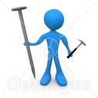
Tasks
Create Personal Space
Delete an Object
Ask for Help
Collect multiple objects
  No Instruction
  Fast gathering
clipartof.com

Slide 13
Participants
Profession
Age Group
Personal info
  Left or Right handed
  Native Language
  Hobby (i.e. photography)

Slide 14
Findings

Slide 15
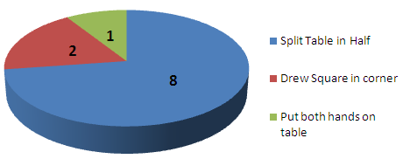
Creating Personal Space
Common behavior
Level of Behavior
  Split table: limited single touch experience
  Draw square: experienced multi-touch user
  Hand gesture: never used touch before

Slide 16
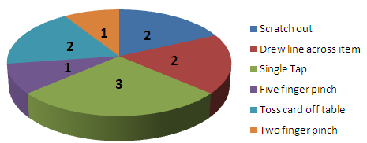
Delete an Object
1st Round: Common behavior
Level of Behavior
  Single tap: Social work, Teacher, Business Assistant
  Line across: Knows about tabletop system
  5 finger pinch: A Java developer
  Two finger pinch: Network developer (hobby: Photography)

Slide 17
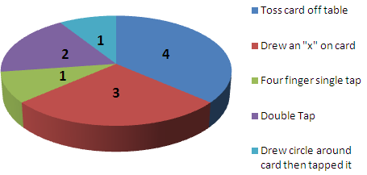
Delete an Object
2nd Round: Common behavior
Level of Behavior
  Toss out: Java developer, Journalist, Business Analyst, Network Admin
  ‘X’ gesture: Student, .Net Developer & Engineer

Slide 18
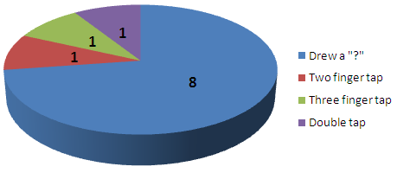
Ask for Help
Common behavior
Findings:
  2 finger tap: Social Worker
  3 finger tap: Teacher
  Double tap: Journalist
Notes:
All of them were female & works with people used simple gesture.

Slide 19
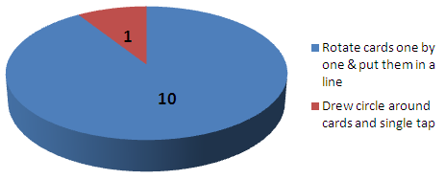
Gather Multiple Items
No Instructions
Findings
  People worried about item orientation & organization style
  Draw circle & tap: .net developer that always use multi touch (expert).

Slide 20
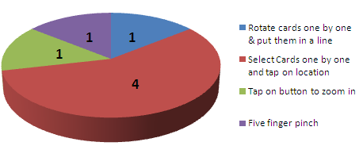
Gather Multiple Items
Fast Gathering
Findings:
  Rotate cards one by one (line): Network administrator
  Select items & tap: Java developer, business assistant, teacher, engineer (male)
  Tap on button to zoom in: journalist
  Five fingers pinch: engineer (female)
Notes:
We introduced this step from the 4th participant

Slide 21
General Findings
Effects of
  Professional Background
  Hobby
  Gender
Notes:
No IT people use simple gestures
Photography Hobby: take care about details
Female: in general use simple gesture

Slide 22
Effects of Professional Background
Social works and teacher use hand gestures where as technical users prefer finger gestures
For novice users, the number of fingers they use does not matter

Slide 23
Limitations

Slide 24

Limited Participants
The participants were not evenly distributed among different groups
  Professions
  Ages
Source: us.fotolia.com

Slide 25
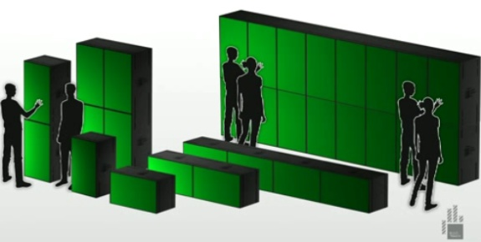
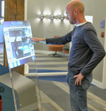


Types of Surfaces
We only used Microsoft Surface in our study
Touch enabled devices can vary by
  Size & Shape
  Orientation
  Sitting arrangement
Notes:
Recall: 8 participants chose to cut the Surface in half
Also: Only two people were seated at the Surface during each experiment

Slide 26
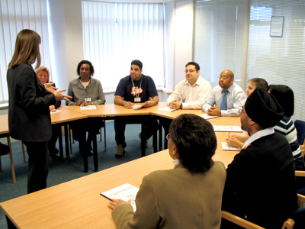
Limited Training
Additional training may help participants to think wider range of gestures
Notes:
Wow factor

Slide 27
Future Work

Slide 28
Wider range of Participants
Get participants with different demographic background
  First Language
  Way of writing
  Professional background
  Age group
Include expert users
  Tablet users
  Surface users

Slide 29
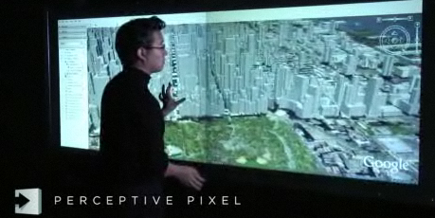
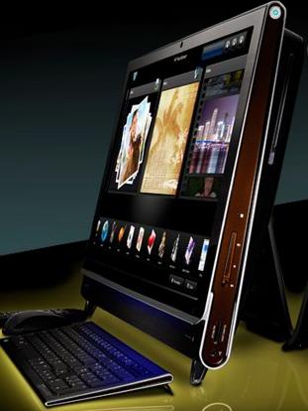
Different Types of Devices
Run user study on different types of Touch Devices
  Size & Orientation
  Single Vs. Multi-user

Slide 30
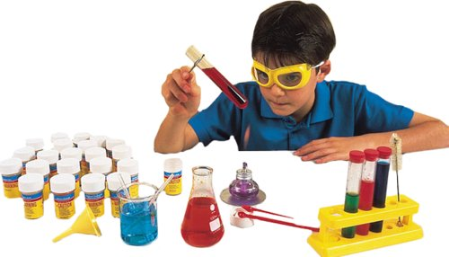
More Pilot Studies
Helps refine the study plan
  Training sessions
  Task planning
  Interview questions

Slide 31
Outcome of the Study
Instead of a single gesture for a particular task, we may have a set of gestures for the same task.
  E.g. Single line, cross & scratch out for delete

Slide 32
Reference
Wobbrock, Jacob. Meredith Ringel Morris, Andrew D. Wilson. User-Defined Gestures for Surface Computing, CHI 2009, April 4-9, 2009, Boston, MA, USA.

Slide 33
Questions?

