Slide 1
Open Coding
Presented by
Shahedul Huq Khandkar

Slide 2
Outline
Overview
How to do Open Coding
Benefits of collaborative coding
Tools
Exercise
When to stop?
Pros & Cons

Slide 3
Qualitative Data Analysis
Notice, Collect and think about interesting things^{[1]}
It’s a non-linear process
Notice
Collect
Analyze
[1] Qualitative Data Analysis. John V. Seidel
Notes:
Different Data types

Slide 4

Open Coding
Brings themes to the surface from deep inside the data
Notes:
Now, Open Coding is the tool we can use to notice & collect the interesting things
Its main objective is to bring the themes to the surface from deep inside the data
So, its about building concepts from the raw data source

Slide 5
Building Concepts
Break down the data
Find relations, similarities & Dissimilarities
Mark important sections with labels or “codes”
rebellious act
Interviewer: Tell me about teens and drug use.
Respondent: I think teens use drugs as a release from their parents. Well, I don’t know. I can only talk for myself.
Experience
Source: Basics of Qualitative Research, Second Edition by Anselm Strauss & Juliet Corbin
Notes:
OC is used to Notice & Collect

Slide 6
Abstracting Concepts
In vivo codes
  Words taken from data
Constructed Codes
  Created by researcher
Interviewer: Tell me about teens and drug use.
Respondent: … Well, I don’t know. I can only talk for myself. For me, it was an experience. You hear a lot about drugs. …
Experience
Drag Talks
Source: Basics of Qualitative Research, Second Edition by Anselm Strauss & Juliet Corbin
Notes:
Giving the right name
Some automated tools use these terms

Slide 7
Record Thoughts
Thoughts that can’t be expressed with few words
Interviewer: Tell me about teens and drug use.
Respondent: I think teens use drugs as a release from their parents
Memo: The first thing that strikes me in this sentence is the work “use”. This is a strange term because, when taken out of the context of drug taking, the word means that an object or a person is being employed for some purpose…
Source: Basics of Qualitative Research, Second Edition by Anselm Strauss & Juliet Corbin
Notes:
There are some thoughts that you can not express in few words

Slide 8
Guidelines for Memo
Glaser’s (1978) guidelines for effective memos:
  Keep memos separate from data
  Stop coding when an idea for memo occurs
  Collapse codes when similar memos found
  When you have two ideas, add two separate memos
Notes:
- One memo should carry one Idea

Slide 9

Defining Categories
When you have pages of codes
  Find similarities & group them in categories
Notes:
You can also start doing this from the beginning. Some people use different color cards or sticky notes

Slide 10

Doing the Coding Alone
Greater change to miss a concept
Harder to compare with existing theories
Often difficult to name new concepts

Slide 11

Work in a Group
Concept definitions become more exact
Data perspective is maintained more consistently
More number of phenomena are discovered and processed
Source: A Coding Scheme Development Methodology Using Grounded Theory for Qualitative Analysis of Pair Programming. Stephan Salinger, Laura Plonka, Lutz Prechelt. Berlin
Notes:
Collective minds
Using Grounded Theory for Qualitative Analysis of Pair Programming - Berlin

Slide 12
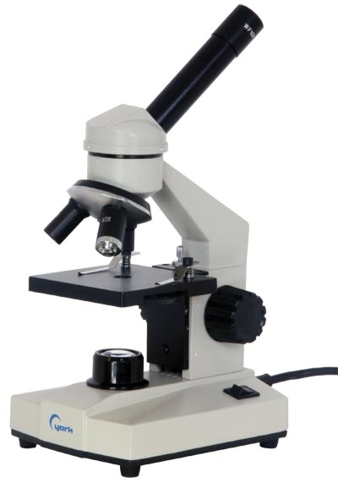
Levels of Details in Coding
Line by line coding
Code against
  Sentences or Paragraphs
  Chapters or Documents

Slide 13
Role of Open Coding in QDA
Open Coding can be used for inductive, deductive or verification modes of inquiry
Example: Grounded Theory (inductive approach)
Code 1
Code 2
Code 3
Code 4
Code 5
Code 6
Code 7
Code 8
Code 9
Category1
Category 2
Category 3
Category 4
Category 5
Pattern 1
Pattern 2
Grounded Theory

Slide 14
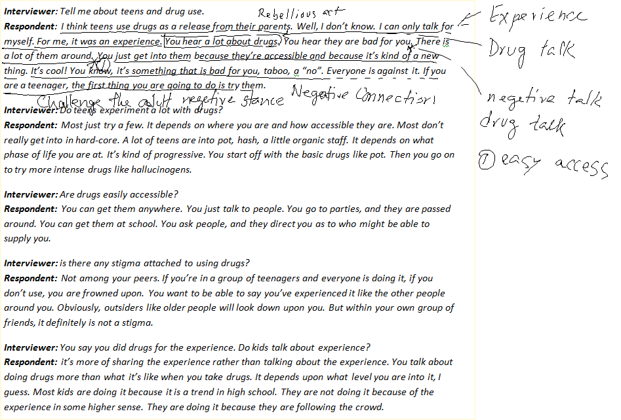
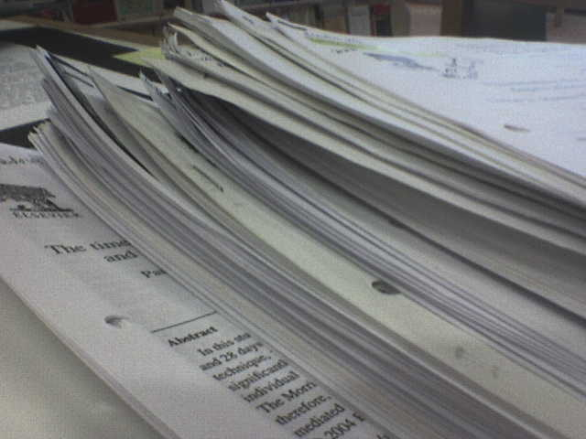
Open Coding using Pen & Paper

Slide 15
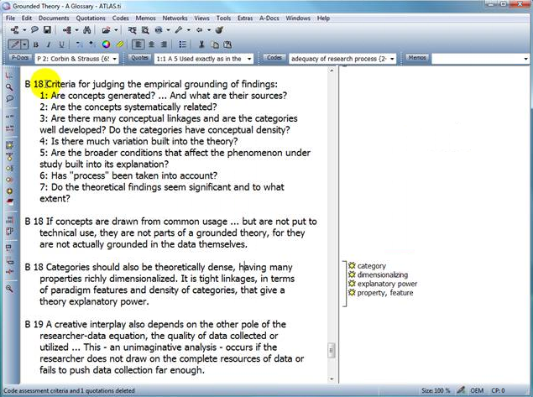
Automated Tools
Atlas.ti
  Desktop application
  Commercial License
  Supports different Coding styles (i.e. in-vivo, constructed)

Slide 16
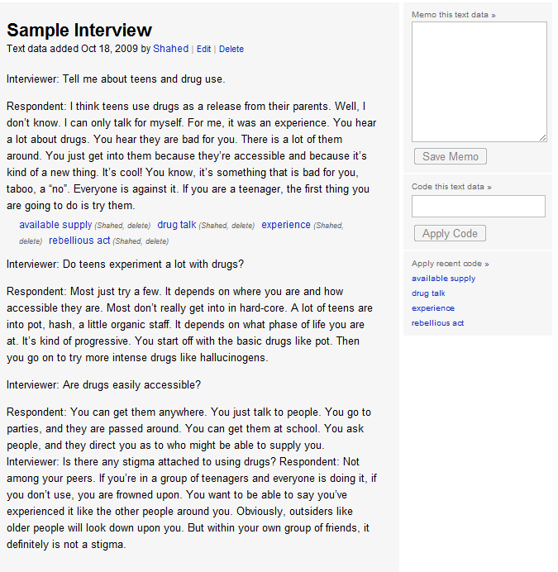
Automated Tools (2)
Saturate
  Web Application
  Free
  Supports: constructed coding and memo.
Source: http://www.saturateapp.com. Developed by Dr. Sillito

Slide 17
Exercise

Slide 18
Research Topic
The role of patch review process in software evolution
  What is the process of conducting reviews?
  When are reviews performed?

Slide 19
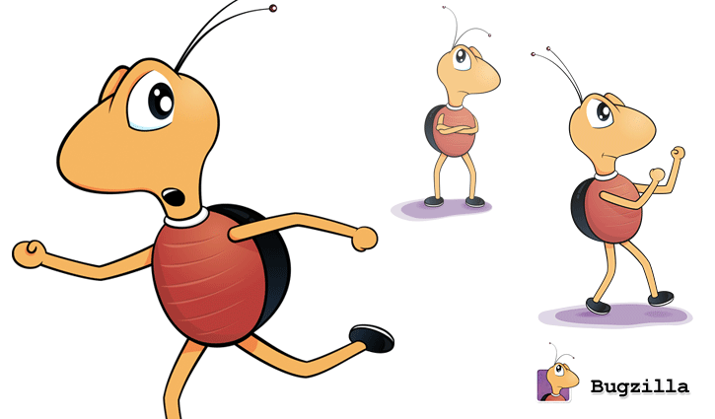
Data Source
Bugzilla: The bug tracking system of Mozilla Firefox

Slide 20
Demo

Slide 21

Results of Open Coding
Behavior Patterns
  Patchy Patcher
  Merciful Reviewer
  Doubtful Reviewer

Slide 22
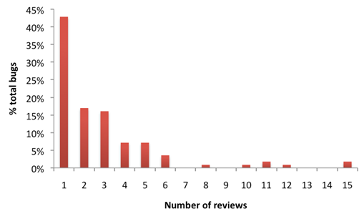
Results of Open Coding
Number of reviews per bug report

Slide 23

When to Stop Line by Line Coding?
When you are not really finding any new concepts
  Go to the next level (i.e. Selective Coding)
  Use analytic tools to collect more information
Notes:
1) Microanalysis

Slide 24

Benefits of Open Coding
Hard to miss any critical concept
Instead of assumption, theories emerge from data
Data can be analyzed qualitatively & quantitatively

Slide 25
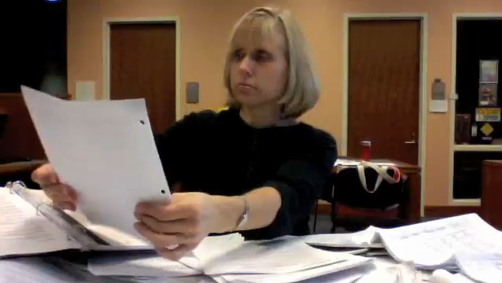
Critics
Tedious and time consuming process
Often difficult to decide when to stop
If missed something, may need to restart

Slide 26
Resources
Books:
  Basics of Qualitative Research, Second Edition by Anselm Strauss & Juliet Corbin
  Nursing research: principles and methods by Denise F. Polit, Cheryl Tatano Beck
  Symbolic Interactionism. Bulmer H.
Publications:
  Qualitative Data Analysis. John V. Seidel
  A Coding Scheme Development Methodology Using Grounded Theory for Qualitative Analysis of Pair Programming. Institut für Informatik, Freie Universität Berlin
  Building Inductive Theory of Collaboration in Virtual Teams: An Adapted Grounded Theory Approach. S. Sarker, F. Lau, S. Sahay
Media Contents
  flickr.com/photos/jepoirrier
  youtube.com
  indiamart.com

Slide 27

Questions
Overview
How to do Open Coding
Benefits of collaborative coding
Tools
Exercise
When to stop?
Pros & Cons

