Slide 1
Open Coding
Presented by
Shahedul Huq Khandkar

Slide 2
Outline
Overview
Building Concepts
When to stop coding?
Research Group Size
Open Coding in DQA
Exercise
Critics

Slide 3
Qualitative Data Analysis (QDA)
Notice, Collect and think about interesting things^{[1]}
QDA is a non-linear process
Notice things
Analyze Data
Collect Data
[1] Qualitative Data Analysis. John V. Seidel

Slide 4
Introduction
Express your thoughts
Analyze and share ideas
Compare with existing theories
Choose the right name

Slide 5
Building Concepts
Break down the data
Find relations, similarities & Dissimilarities
Mark important sections with labels or “codes”
rebellious act
Interviewer: Tell me about teens and drug use.
Respondent: I think teens use drugs as a release from their parents. Well, I don’t know. I can only talk for myself.
Experience

Slide 6
Abstracting Concepts
In vivo codes
  Words taken from data
Constructed Codes
  Created by researcher
Interviewer: Tell me about teens and drug use.
Respondent: … Well, I don’t know. I can only talk for myself. For me, it was an experience. You hear a lot about drugs. …
Experience
Drag Talks

Slide 7
Record Concepts
Thoughts that can’t be expressed with few words
Interviewer: Tell me about teens and drug use.
Respondent: I think teens use drugs as a release from their parents
Memo: The first thing that strikes me in this sentence is the work “use”. This is a strange term because, when taken out of the context of drug taking, the work means that an object or a person is being employed for some purpose. It implies a willful and directed act. In making a comparison, when I think about a computer, I think about employing it to accomplish a task. I think of it as being at my disposal.
Source: Basics of Qualitative Research, Second Edition by Anselm Strauss & Juliet Corbin

Slide 8
Guidelines for Memo
Glaser’s (1978) guidelines for effective memos:
  Keep memos separate from data
  Stop coding when an idea for memo occurs
  Collapse codes when similar memos found
  When you have two ideas, add two separate memos

Slide 9
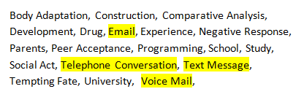
Defining Categories
When you have pages of codes
  Find similarities & group them in categories
Example:
  Communication:
  { Email, Telephone Conversation, Text Message, Voice Mail}

Slide 10
When to Stop Coding?
When you are not really finding any new concepts
  Go to the next level (i.e. Selective Coding)
  Use analytic tools to collect more information
Notes:
1) Microanalysis

Slide 11
Levels of Detail in Coding
Line by line coding
Code against
  Sentences or Paragraphs
  Chapters or Documents

Slide 12
Doing Open Coding with peers
Concept definitions become more exact
Data perspective is maintained more consistently
Generally, more number of phenomena are discovered and processed
Source: A Coding Scheme Development Methodology Using Grounded Theory for Qualitative Analysis of Pair Programming. Stephan Salinger, Laura Plonka, Lutz Prechelt. Berlin

Slide 13
Role of Open Coding in QDA
Open Coding can be used for inductive, deductive or verification modes of inquiry
Example: Grounded Theory (inductive approach)
Code 1
Code 2
Code 3
Code 4
Code 5
Code 6
Code 7
Code 8
Code 9
Category1
Category 2
Category 3
Category 4
Category 5
Pattern 1
Pattern 2
Grounded Theory

Slide 14
Exercise

Slide 15
Sample Data
An interview with a woman in her 20s
  Its about drug use by teens
  The interviewer didn’t have preset questions
  It was recorded and later transcribed

Slide 16
Sample Data: Interview Transcript
Interviewer: Do teens experiment a lot with drugs?
Respondent: Most just try a few. It depends on where you are and how accessible they are. Most don’t really get into in hard-core. A lot of teens are into pot, hash, a little organic staff. It depends on what phase of life you are at. It’s kind of progressive…
limited experience
degree of accessibility
hard-core use
limited experimenting
soft core drug types
personal development stage
progressive using

Slide 17
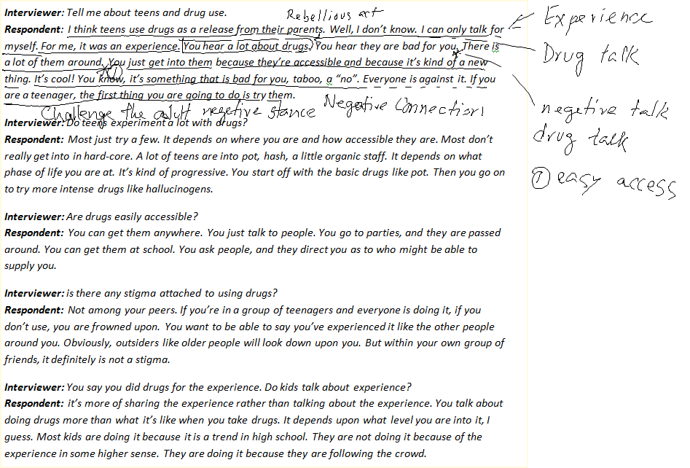
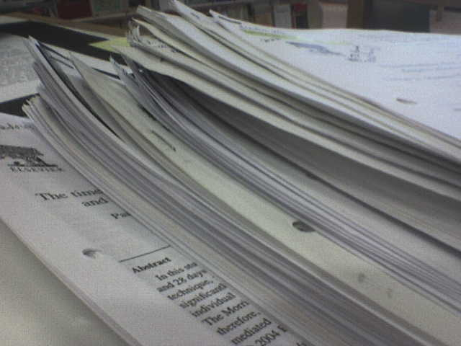
Open Coding using Pen & Paper
Source: http://www.flickr.com/photos/jepoirrier/376900808/sizes/o/

Slide 18
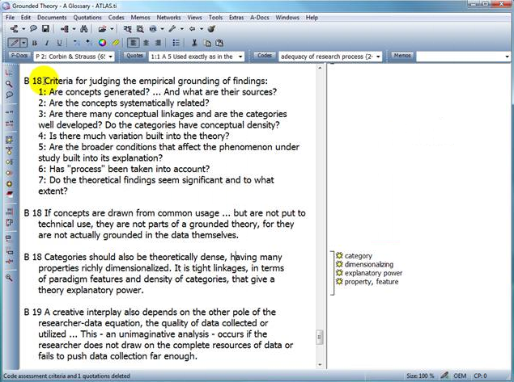
Automated Tools
Atlas.ti
  Desktop application
  Commercial License
  Supports different Coding styles (i.e. in-vivo, constructed)

Slide 19
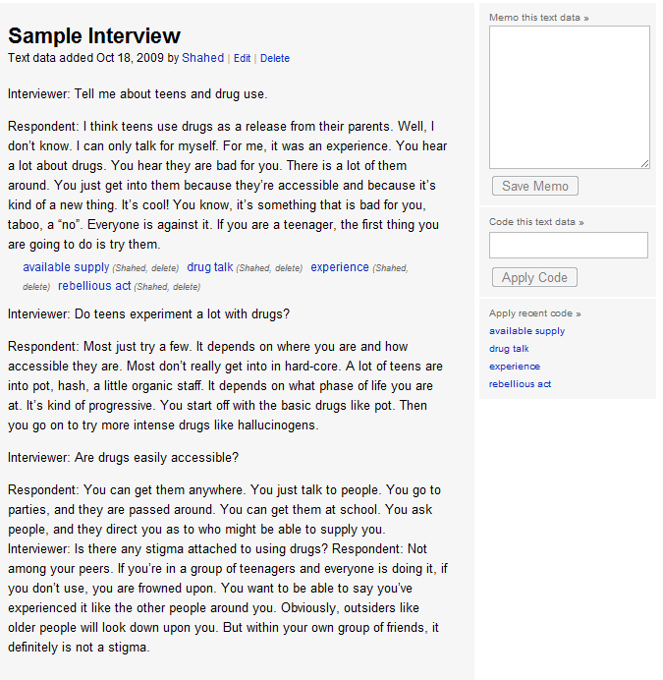
Automated Tools (2)
Saturate
  Web Application
  Free
  Supports: constructed coding and memo.
Source: http://www.saturateapp.com. Developed by Dr. Sillito

Slide 20
Do Open Coding using Saturate
http://vimeo.com/6736972

Slide 21
Benefits
Hard to miss any critical information
Instead of assumption, theories emerge from data

Slide 22
Critics
Tedious and time consuming process
Often difficult to decide when to stop
If missed something, may need to restart

Slide 23
Resources
Books:
  Basics of Qualitative Research, Second Edition by Anselm Strauss & Juliet Corbin
  Nursing research: principles and methods by Denise F. Polit, Cheryl Tatano Beck
  Symbolic Interactionism. Bulmer H.
Publications:
  Qualitative Data Analysis. John V. Seidel
  A Coding Scheme Development Methodology Using Grounded Theory for Qualitative Analysis of Pair Programming. Institut für Informatik, Freie Universität Berlin
  Building Inductive Theory of Collaboration in Virtual Teams: An Adapted Grounded Theory Approach. S. Sarker, F. Lau, S. Sahay

Slide 24
Question?

