Slide 1
Towards a better method of searching source code
Jamie Starke

Slide 2
Outline
Why improve search
What did we want to investigate
What was our setup
What did we find
What would we change
Conclusion

Slide 3
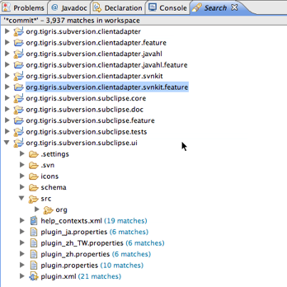
Why Improve Search

Slide 4
Why Improve Search
Previous Study
  How people search through source code
  10 programmers (8 industrial, 2 academic)
  2 behaviours

Slide 5

Why Improve Search
Lack of information on which to base relevance and exploration
  “you don't get any other information other than the name itself”

Slide 6
Why Improve Search
# Results Opened | # Episodes Occurred
0 | 17
1 | 33
2 | 4
3 | 2
4 | 1

Slide 7
Why Improve Search
2 Behaviours
  Chaining
  Adjusting
Initial Idea
Perform Query
Information in Results
New Idea
Initial Idea
Perform Query
Too Many/Too Few/Wrong Results
Alternate way of describing idea

Slide 8
What did we want to investigate
How does the presentation of results effect the developers choices of what to explore and what they consider to be relevant
In what ways does providing a search history aid their understanding of their current search context, and aid them with performing future searches
How does presenting of alternative searches effect the programmer's search strategy and ability to scope their searches

Slide 9
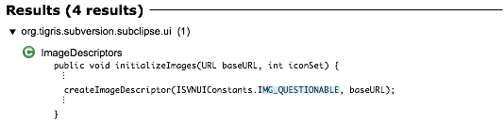
Presentation of results
Original Presentation of results
Prototype Presentation of results

Slide 10
History
Prototype History

Slide 11


Alternatives
Explicit Query Box
Advanced Options
Possible Refinements

Slide 12
What was our setup
4 Participants
  Asked to Think Aloud
  Given searching scenarios based on bug fixing task
  Provided with results to the given search
  Asked to describe what result they would do with these results
  Asked for feedback on what they found helpful, and what they think could be improved

Slide 13
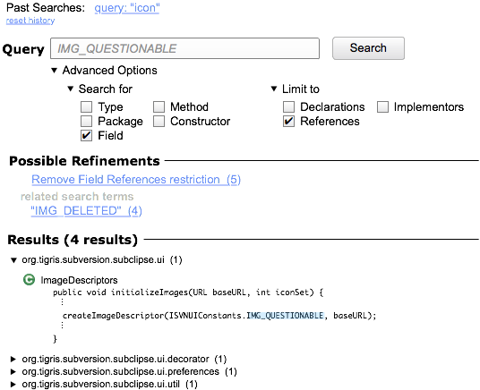
Example

Slide 14
What did we find
What works
Issues

Slide 15
What works
Include or Exclude branch of results
  Name still useful
    “first thing I see here is wizards, and that looks like a good place to search.”
  Size of results useful to scope
    “right off the bat, I would excludes all of the entries that have just far to many entries associated with them, for example, subclipse.ui has over 1000, that wouldn't be possible.”

Slide 16
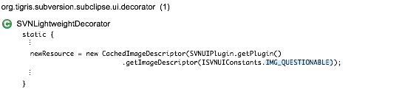
What works
Telling if a result is likely relevant
  Based on context of result
    “So, we're getting the image back from image descriptor. Ok, resource, some sort of, actually, exact same definition. So, that implies to me, since these are static especially, that neither of those is actually what I'm looking for.”

Slide 17
What works
Deciding what to do next
  What actually occurs in the code
    “It also gives you related search terms, which is a lot more helpful then me just sitting there, typing different combinations of commit, like commit to, commit from, commit page, I just want to know what actually shows up in the code, rather then me typing it in myself”

Slide 18

Issues
Confusion over number of results
  Packages – Classes – Results
Displaying results by default
  “What happens if I have one package with 16 results in the same class even. What happens then, do I see all the code in one continuous blow.”

Slide 19

Issues
What would a possible refinement yield
  “Search by type declarations, it's not as clear exactly what, what it is exactly I'm going to be returned, like what would those 14 look like?”
  “how does commitTo or search by type declaration, how does that actually affect the next step. What will that actually give me?”

Slide 20
Issues
Needing more information
  “I want to bring that up in the code editor, because even though right here, I don't initially see what I think I need to see, I want to bring it up in the code editor, just to see everything in that class.”

Slide 21

Issues
Use of Ellipses
  “You don't notice the ellipses on the right hand side of statements unless you look all the way over there. … it looked like to me was that all of this was one block … it's a bit misleading.”

Slide 22
Possible design improvements
Result size
  (1) ➔ (1 result in 1 class, 1 method)
“QuickLook” at search results or possible refinements
Condensing or concatenating long lines
Selectable amount of contextual information
  Smart default
Expandable hierarchy
Rank tree by number of results?

Slide 23
Future Work
Little information about Search history was found.
  Likely because users were not forced to use this as part of the task
  Using a scenario where they have to use this would provide useful information about how to improve Search History
Future Designs

