Slide 1
Questionnaire
Miaosen Wang

Slide 2
Outline
What is a questionnaire?
What is the class exercise?
What is the design process?
What are the benefits and problems?

Slide 3
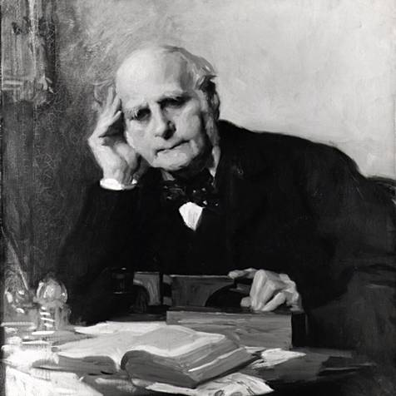
What is a questionnaire?
A way of collecting information in the form of questions.
Highly structured
Quantitative study
Invented by
Sir Francis Galton

Slide 4
When to use it?
Used in early definition phase
Used during studies on the prototype
After the system is completed

Slide 5
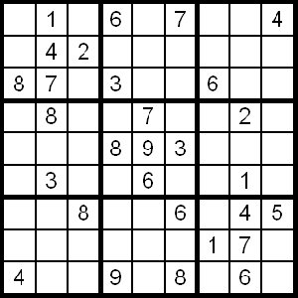
Exercise Introduction
You developed a web based feature called “clear mind email” that forces the users to solve a Sudoku puzzle before they send
an Email
You want to know why
would people disable your
software
Target Respondent?

Slide 6
Writing & Designing
Two main objectives:
  Increase response rate
  Obtain accurate information

Slide 7
Designing the Questions
Question sequence
  Logical
  General, easy, factual ones first
External predictability – Asking indirect questions
Internal predictability – Asking similar questions

Slide 8
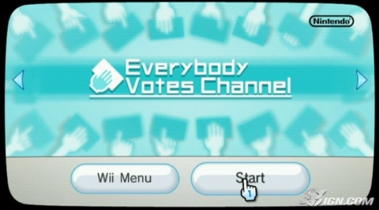

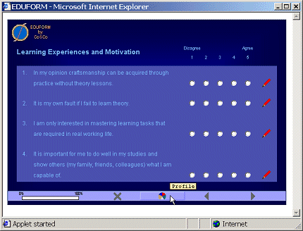

Deliver the Questionnaire

Slide 9
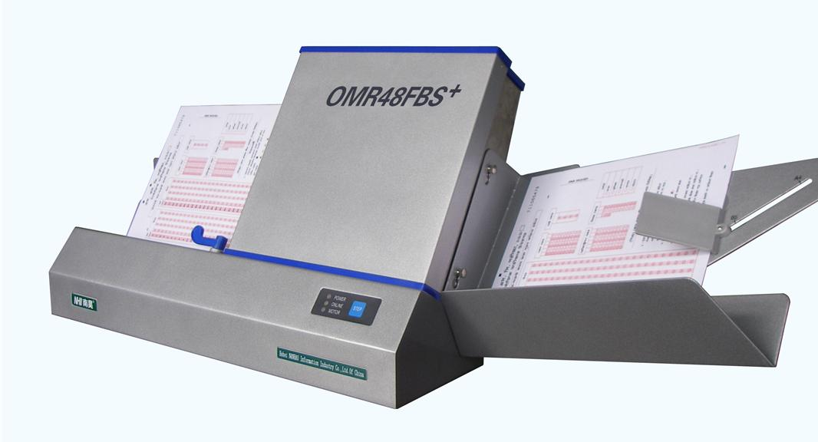
Benefits
Cheap
Large sample size
Large geographical
area
Computer process
results

Slide 10
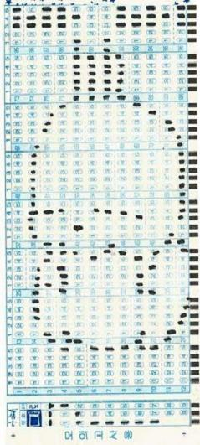
Problems
Low response rate
Inaccurate information
Lots of effort to design

Slide 11
Review
Defining the questionnaire objective
Determining the sampling Group
Writing questions
Designing the questionnaire
Administrating the questionnaire
Analyzing the data

