Slide 1
System: Advanced Python
CPSC 217: Introduction to Computer Science for Multidisciplinary Studies I
Winter 2023
Jonathan Hudson, Ph.D.
Instructor
Department of Computer Science
University of Calgary
January 9, 2023
Copyright © 2023

Slide 2
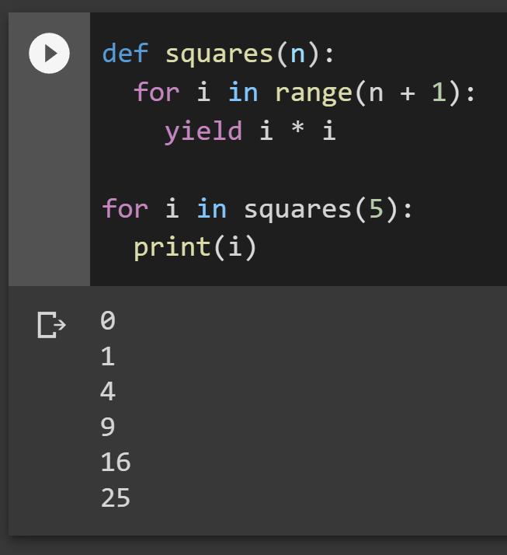
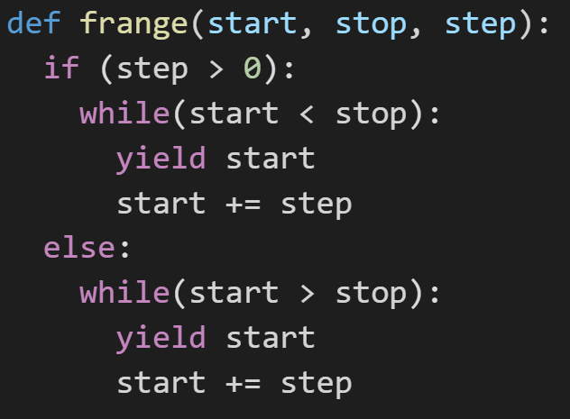
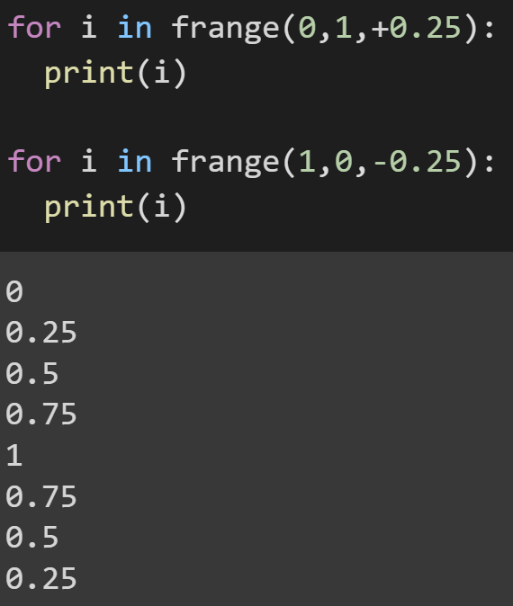
Generators
Function that returns on each yield call, tracking state so it can be restarted to continue
Can make a quick float range function this way for looping
Notes:
def squares(n):
for i in range(n + 1):
yield i * i
for i in squares(5):
print(i)
def frange(start, stop, step):
if (step > 0):
while(start < stop):
yield start
start += step
else:
while(start > stop):
yield start
start += step
for i in frange(0,1,+0.25):
print(i)
for i in frange(1,0,-0.25):
print(i)

Slide 3
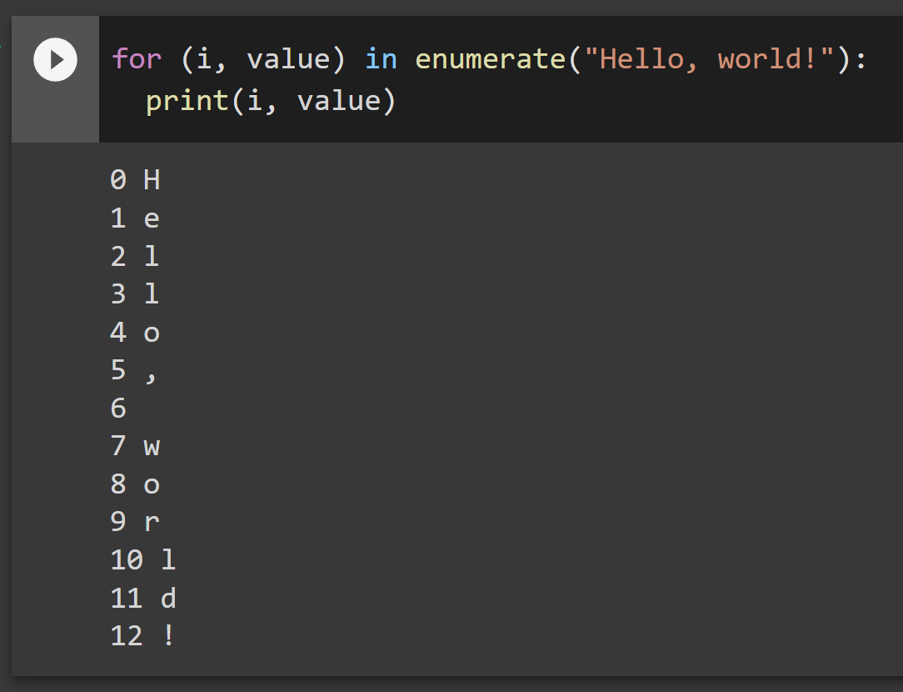
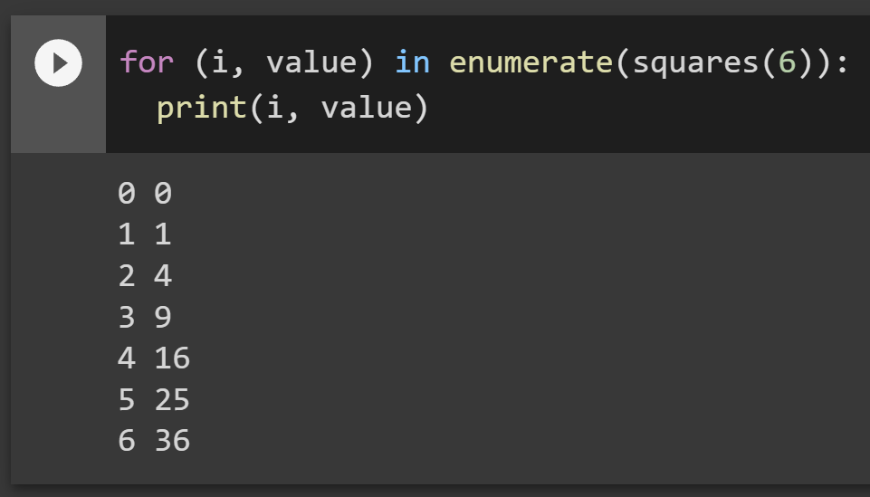
Enumerate
Creates tuple with incrementing index
Input can be any generator
Notes:
for (i, value) in enumerate("Hello, world!"):
print(i, value)

Slide 4
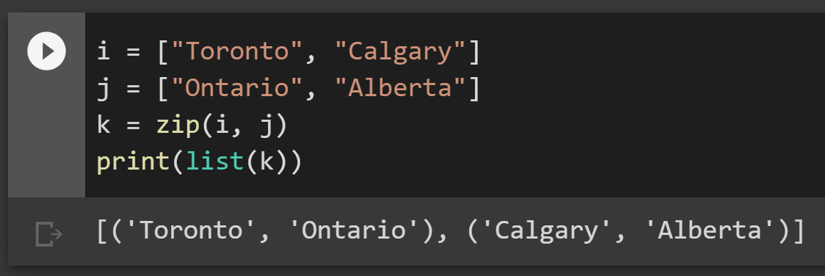
Zip
Put two similar length things together (list/tuples)
Extra length part in either list would be ignored
Notes:
i = ["Toronto", "Calgary"]
j = ["Ontario", "Alberta"]
k = zip(i, j)
print(list(k))

Slide 5
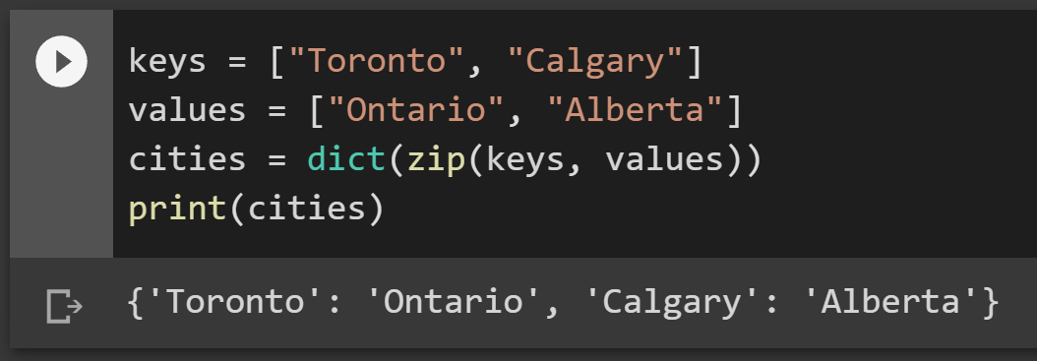
Zip to dictionary
Dict via zip mapping
Notes:
keys = ["Toronto", "Calgary"]
values = ["Ontario", "Alberta"]
cities = dict(zip(keys, values))
print(cities)

Slide 6
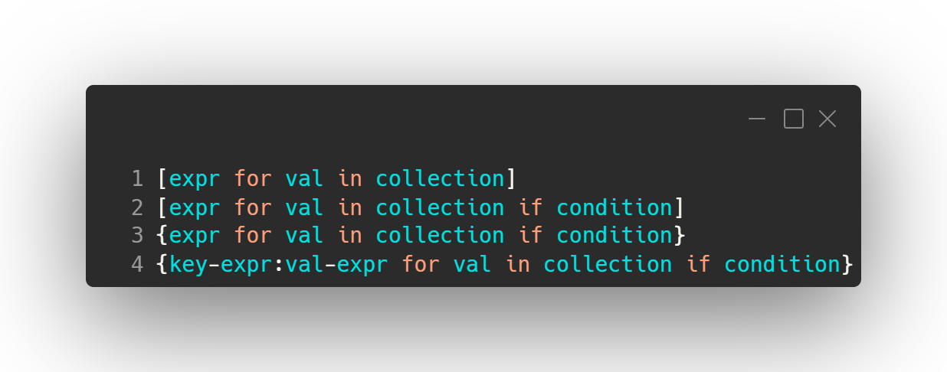
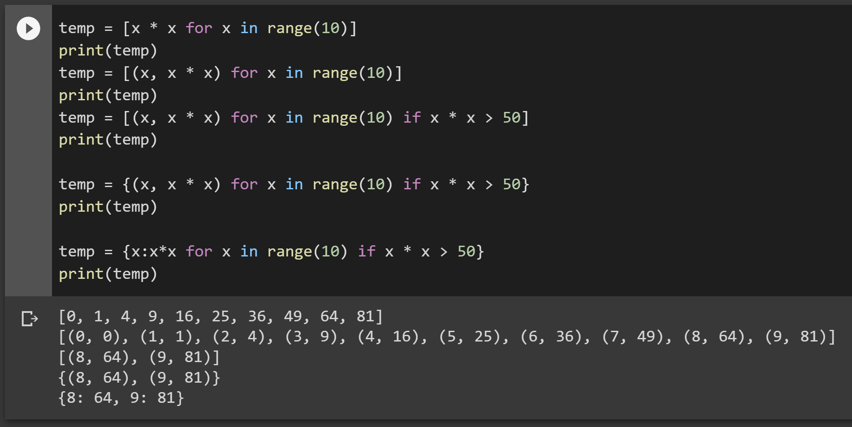
Data structure comprehension
Create list in-line
dict/set applicable
Notes:
temp = [x * x for x in range(10)]
print(temp)
temp = [(x, x * x) for x in range(10)]
print(temp)
temp = [(x, x * x) for x in range(10) if x * x > 50]
print(temp)
temp = {(x, x * x) for x in range(10) if x * x > 50}
print(temp)
temp = {x:x*x for x in range(10) if x * x > 50}
print(temp)

Slide 7
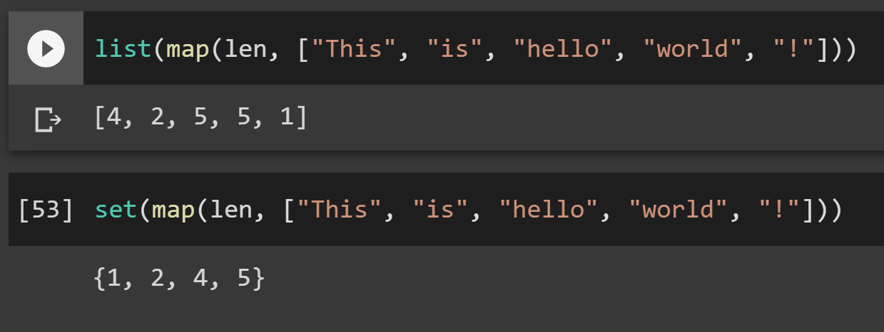
Mapping
Map a function onto another collection
Notes:
list(map(len, ["This", "is", "hello", "world", "!"]))
set(map(len, ["This", "is", "hello", "world", "!"]))

Slide 8
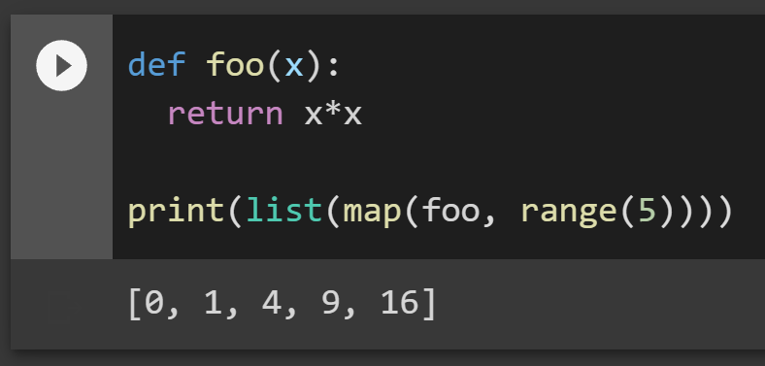
Mapping – functions are objects
Even your own function can be applied as mapping
Notes:
def foo(x):
return x*x
list(map(foo, range(5)))

Slide 9
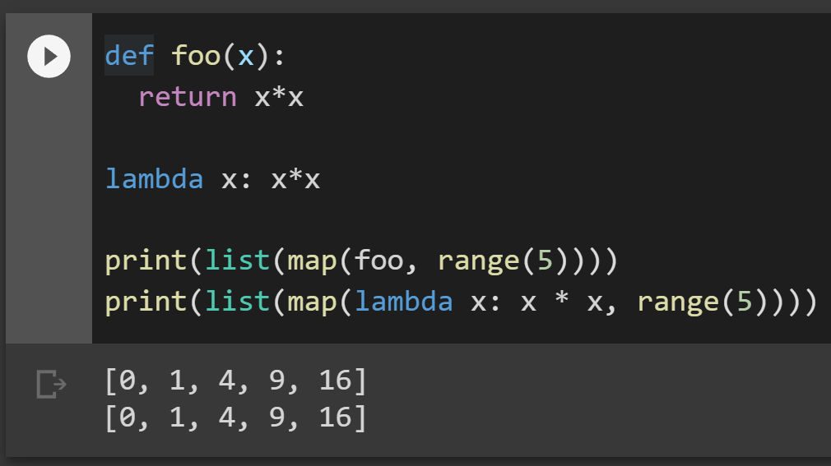
Lambdas
Lambda – make short function into inline expression (easy for mapping)
Notes:
def foo(x):
return x*x
lambda x: x*x
print(list(map(foo, range(5))))
print(list(map(lambda x: x * x, range(5))))

Slide 10
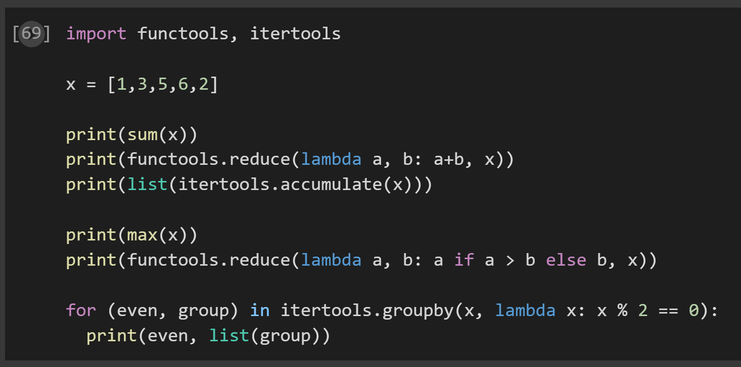
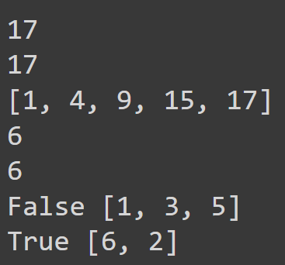
Accumulate, Reduce, Groupby
https://docs.python.org/3/library/itertools.html accumulate, groupby
https://docs.python.org/3/library/functools.html reduce
Notes:
import functools, itertools
x = [1,3,5,6,2]
print(sum(x))
print(functools.reduce(lambda a, b: a+b, x))
print(list(itertools.accumulate(x)))
print(max(x))
print(functools.reduce(lambda a, b: a if a > b else b, x))
for (even, group) in itertools.groupby(x, lambda x: x % 2 == 0):
print(even, list(group))

Slide 11
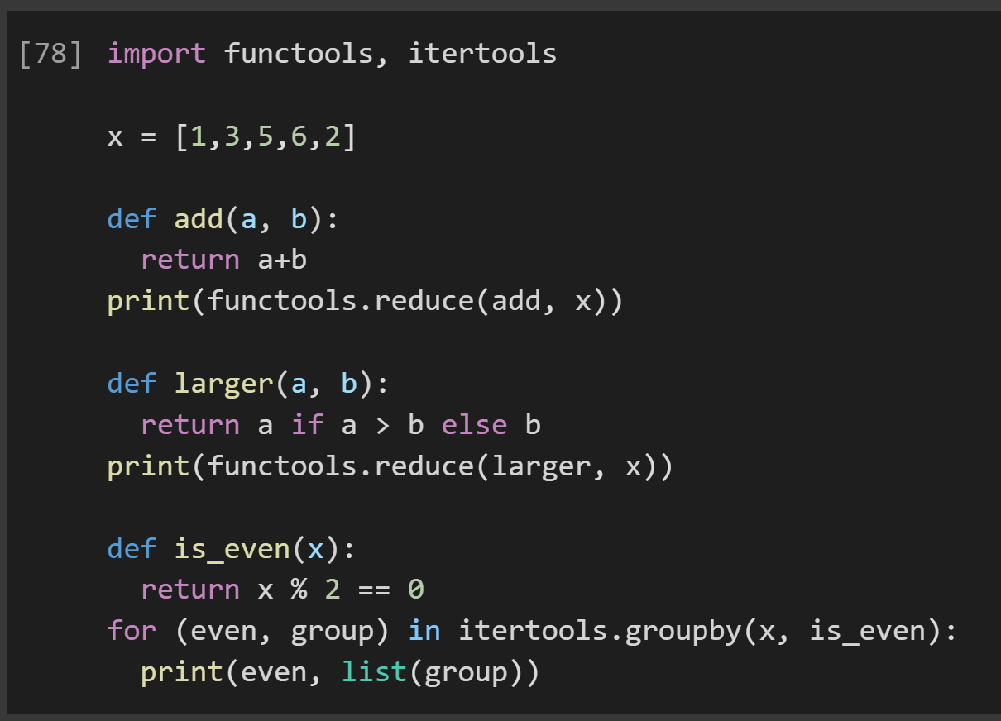
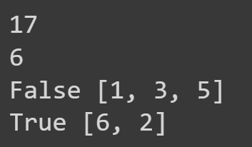
Reduce, Groupby (non-lambda)
If lambdas were overwhelming
Reduce is a 2 argument function, groupby is 1 argument boolean function
Notes:
import functools, itertools
x = [1,3,5,6,2]
def add(a, b):
return a+b
print(functools.reduce(add, x))
def larger(a, b):
return a if a > b else b
print(functools.reduce(larger, x))
def is_even(x):
return x % 2 == 0
for (even, group) in itertools.groupby(x, is_even):
print(even, list(group))

Slide 12
Product, Permutations, Combinations
[('A', 'A'), ('A', 'B'), ('A', 'C'), ('A', 'D'), ('B', 'A'), ('B', 'B'), ('B', 'C'), ('B', 'D'), ('C', 'A'), ('C', 'B'), ('C', 'C'), ('C', 'D'), ('D', 'A'), ('D', 'B'), ('D', 'C'), ('D', 'D’)]
[('A', 'B'), ('A', 'C'), ('A', 'D'), ('B', 'A'), ('B', 'C'), ('B', 'D'), ('C', 'A'), ('C', 'B'), ('C', 'D'), ('D', 'A'), ('D', 'B'), ('D', 'C’)]
[('A', 'B'), ('A', 'C'), ('A', 'D'), ('B', 'C'), ('B', 'D'), ('C', 'D’)]
Notes:
from itertools import *
print(list(product("ABCD", repeat=2)))
print(list(permutations("ABCD", 2)))
print(list(combinations("ABCD", 2)))

Slide 13
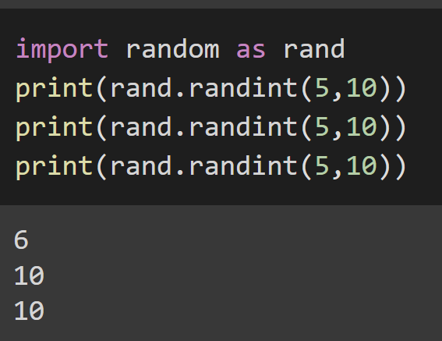
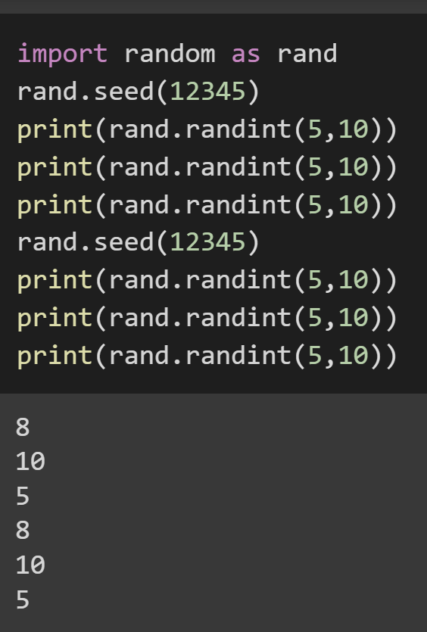
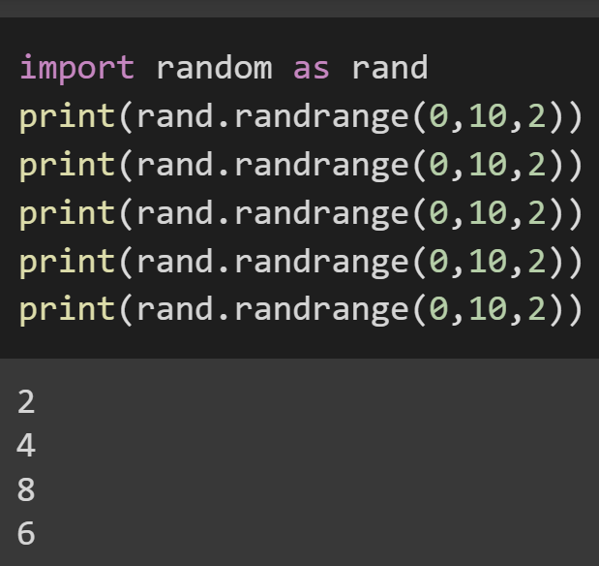
Random
Psuedo-random number generation -> ‘pseudo’ because everything is a numerical sequence beginning at some seed
import random as rand
rand.seed(<seed>) -> is used to set this starting point if we want consistent behaviour each time program is run
randint is single integer, randrange can allow you to select integer from dictate consistent range
Notes:
from itertools import *
print(list(product("ABCD", repeat=2)))
print(list(permutations("ABCD", 2)))
print(list(combinations("ABCD", 2)))

Slide 14
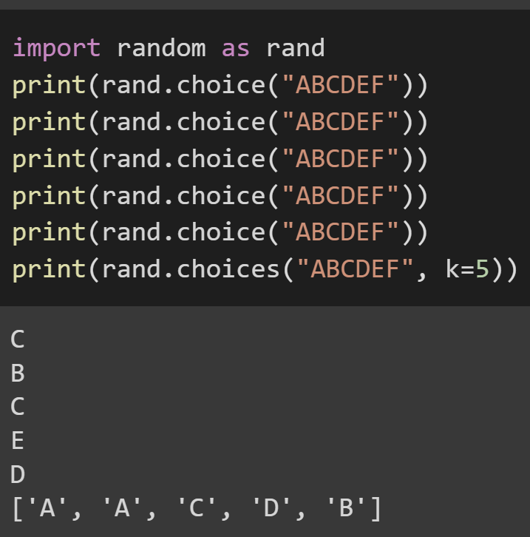
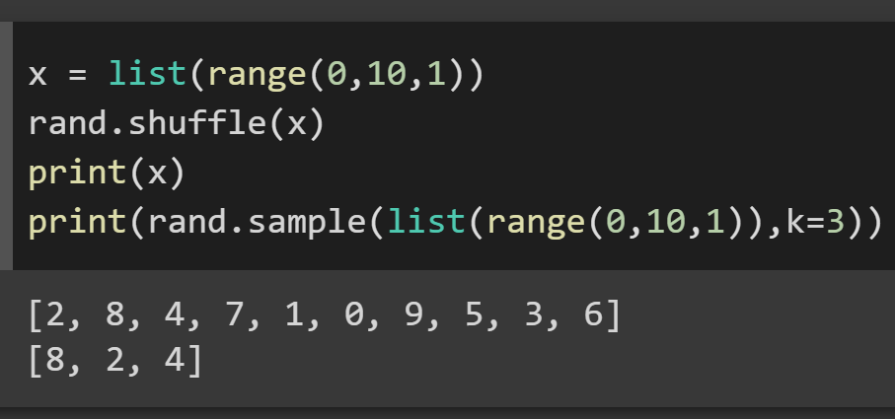
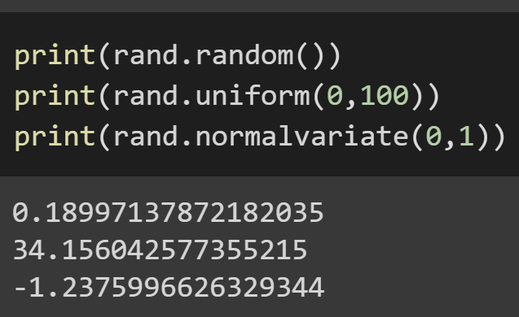
Random
rand.choice() lets you select from a collection, and choices() a collection from a collection (valid to re-select things)
rand.shuffle() will randomly permutate your collection, rand sample is like choices() without replacement (select each item once)
rand.random() -> random real number between 0 and 1
rand.uniform() -> random real number in dictate range
rand.normalvariate() -> one of a number of distribution based random real number range selectors
Notes:
from itertools import *
print(list(product("ABCD", repeat=2)))
print(list(permutations("ABCD", 2)))
print(list(combinations("ABCD", 2)))

Slide 15
Onward to … Recursion.
Jonathan Hudson
jwhudson@ucalgary.ca
https://pages.cpsc.ucalgary.ca/~jwhudson/

