Slide 1
Structures: Lists: Complex
CPSC 217: Introduction to Computer Science for Multidisciplinary Studies I
Winter 2023
Jonathan Hudson, Ph.D.
Instructor
Department of Computer Science
University of Calgary
January 9, 2023
Copyright © 2023

Slide 2
Slicing

Slide 3
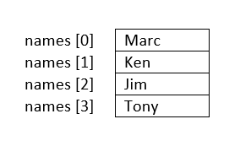
Slicing a List
You can produce copies and sub-lists of a list using the range of indices (:). The following produces a copy of list from a to b-1:
a is the starting index of the slice. The default is 0.
list[a:b]
b is the ending index of the slice. The default is len(list). b itself is excluded from the slice.
names[start:end] → to produce a sub-list
names[:] returns a copy of names
names[0:2] returns the first two elements in names
names[-2:] returns the last two elements in names

Slide 4
Slicing a List
You can produce a sub-list of a list that consists of certain elements of a list using :step in the range of indices
a and b are defined in previous slide.
list[a:b:step]
step is the amount by which a increments. The default is 1.
step be positive (increment) or negative (decrement).
names[0:len(names):1] returns a copy of list
names[::] returns a copy of list
names[::-1] returns a reversed list
names[-2::] returns last two elements
names[::2] returns a list with every other element in names is skipped.
names[start:end:step] → to produce a sub-list

Slide 5
Copy List

Slide 6
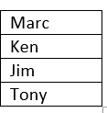
Same List
A list variable is a reference to the list.
names<address of the ﬁrst byte of the list in memory>
When duplicating a list variable, the address is duplicated, not the actual list.
>new_names = names
If you change names you change new_names. Also true the other way.
>new_names[0] = “Jonathan”
>print(names[0]) → ‘Jonathan’

Slide 7
Passing List to Functions
When passing mutable types, such as lists, to functions, remember that any changes to the list, will be reflected in the original list in the caller’s scope.
def func2(list2):
...
def func1(list):
list2 = list
func2 (list2)
myList = […]
func1(myList)
memory
Main body
myList
values
func1()
list
Memory address is passed
func2()
list2

Slide 8
Duplicate a List
Many ways to create a copy of a list (also known as shallow-copy):
Using slice:
new_names = names[:]
Using the repetition operator:
new_names = names*1
Using extend():
new_names = []
new_names.extend(names)
Using a loop to duplicate the list element by element:
new_names = []
for i in range (0, len(names), 1):
new_names.append(names[i])

Slide 9
Operations

Slide 10
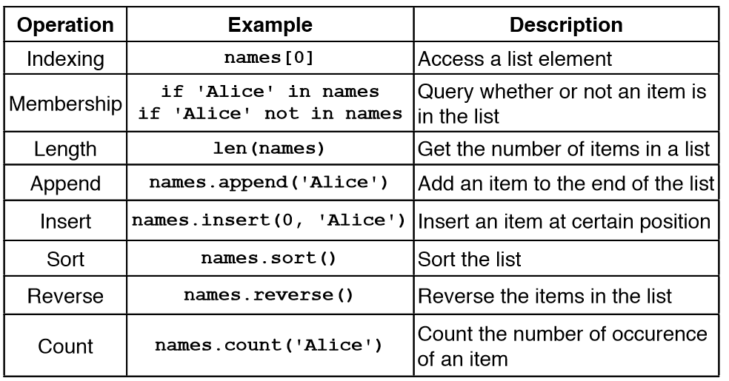
List Operations and Methods

Slide 11
Search/Remove List

Slide 12
Searching For Elements
Use in to check if an item is present in a list
data = [1,2,3,4,5]
2 in data evaluates to True
8 in data evaluates to False
Use index to determine where it is in the list
data = [11,12,13,14]
data.index(12) evaluates to 1
data.index(8) results in a ValueError

Slide 13
Removing Elements
How can we remove an item from a list?
Use the remove method
Removes the first occurrence of the item
Subsequent identical items remain in the list
Item must exist or a ValueError will occur
x = [1,2,1,3,4,2,1]
x.remove(1)
print(x)

Slide 14
Removing Elements
What if we want to remove all occurrences of an item from a list?
Use a while loop:
while x in myList:
myList.remove(x)

Slide 15
Removing Elements
What if we know the index of the item we want to remove?
Use pop(index)
With no parameters: Removes last item
With one parameter: Removes item at the index specified
Returns the item that is removed
myList = [1,2,3,4]
myList.pop()
print(myList)
myList.pop(0)
print(myList)
myList.pop(myList.index(2))
print(myList)
[1, 2, 3]
[2, 3]
[3]

Slide 16
Sorting a List

Slide 17
Sorting
Sorting is the process of ordering elements of a list in ascending or descending order.
[4, 2, 1, 3, 0]
[0, 1, 2, 3, 4]
[4, 3, 2, 1, 0]
How do we sort the list?
Unordered list
Ordered list in ascending order
Ordered list in descending order

Slide 18
Sorting
Sorting is an important task
Needed when working with large data sets
Frequently occurs as part of other algorithms
Sorting has been studied extensively
Many algorithms, some of which are quite complex

Slide 19
Sorting - Bubble Sort
General idea (ascending order)
go through list from beginning to end
compare adjacent elements
swap if previous element is larger than current element
repeat until no swaps are performed
https://www.youtube.com/watch?v=nmhjrI-aW5o
You can download a solution: 1_Bubble.py

Slide 20
Sorting - Selection Sort
General idea (ascending order): The list is initially considered entirely unordered.
Select the smallest element in the unordered portion of list
Remove the element from unordered portion of the list and place it at the end of the ordered portion of the list.
Repeat until no elements remain in the unordered portion of the list.
https://www.youtube.com/watch?v=xWBP4lzkoyM
Lets implement this!
You can download another solution: 2_Selection.py

Slide 21
Sorting in Python
Python makes sorting a list easy
Use the sorted function
Takes one parameter which is an unsorted list
Returns a new list sorted into increasing order
Use the sort(order) method
Order is a Boolean parameter. Default is True for ascending order. False sorts in descending order.
Invoked on a list using dot notation
Modifies the list
list=[0,1,6,2,10]
list.sort()
print(list)
[0, 1, 2, 6, 10]

Slide 22
List Example

Slide 23
Practice Example
Compute the median of a list of values entered by the user
User will enter an unknown number of values
A blank line will be used to indicate that no additional values will be entered
If the list has an odd number of elements
Median is the middle value
If the list has an even number of elements
Median is average of the two middle values

Slide 24
Practice Example Design
read values from user and store in a list (using append)
sort list (put numbers in ascending order)
if list length is odd, display middle value (index = len(list)/2)
if list length is even, display the average of two middle values (index len(list)/2 and len(list)/2 – 1)
Lets code this!

Slide 25
Tracing

Slide 26
Trace The Code 1:
def f1(list1) :
list2 = list1
for index in range(len(list1)):
list2[index] = list1[index]+1
print(list1)
print(list2)
f1([1,2,3])
[2, 3, 4]
[2, 3, 4]

Slide 27
Trace The Code 2:
def f2(list1) :
list2 = list1[:]
for index in range(len(list1)):
list2[index] = list1[index]+1
print(list1)
print(list2)
f2([1,2,3])
[1, 2, 3]
[2, 3, 4]

Slide 28
Trace The Code 3:
def f3(list1) :
list2 = list1*2
for index in range(len(list2)):
list2[index] += 1
print(list1)
print(list2)
f3([1,2,3])
[1, 2, 3]
[2, 3, 4, 2, 3, 4]

Slide 29
Trace The Code 4:
List 1
List 2
def f4(list1) :
list2 = [list1]*3
for index in range(len(list2)):
innerList = list2[index]
for innerIndex in range(len(innerList)) :
innerList[innerIndex] += 1
print(list1)
print(list2)
f4([1,2,3])
[4, 5, 6]
[[4, 5, 6], [4, 5, 6],[4, 5, 6]]

Slide 30
Trace The Code 5:
def f5(list1) :
list2 = [list1]*2
for index in range(len(list2)):
innerList = list2[index]
innerList = innerList[:]
for innerIndex in range(len(innerList)) :
innerList[innerIndex] += 1
list2[index] = innerList
print(list1)
print(list2)
f5([1,2,3])
[1, 2, 3]
[[2, 3, 4], [2, 3, 4]]

Slide 31
Onward to … sets and tuples.
Jonathan Hudson
jwhudson@ucalgary.ca
https://pages.cpsc.ucalgary.ca/~jwhudson/

