Slide 1
Structures: Lists: Basics
CPSC 217: Introduction to Computer Science for Multidisciplinary Studies I
Winter 2023
Jonathan Hudson, Ph.D.
Instructor
Department of Computer Science
University of Calgary
January 9, 2023
Copyright © 2023

Slide 2
What is a List?
A collection of values
Values
May all have the same type, or
May have different types
Each item is referred to as an element
Each element has an index (ORDERED)
Unique integer identifying its position in the list
A list is one type of data structure
A mechanism for organizing related data

Slide 3
Creating a List
Format:
<list name> = [<value 1>, ..., <value n>]
Examples:
names = [] → defines an empty list
nums = [10.0, 9.0, 8.5, 5.0, 7.5]
letters = ['a', 'b', 'c', 'd', 'e', 'f', 'g']
names = ['Marc', 'Jim', 'Ken’]
mixed = [1.0, 1, ”this”, True]
By defining the list memory is allocated for it

Slide 4
* Works on Lists?

Slide 5
Repetition Operator (*)
Just like strings, you can use asterisk to repeat a list
>list = [0]*5
>newList = list*5
Produces a list of size 5 with all elements = 0
Produces a new list of size 25 with all elements = 0

Slide 6
Indices

Slide 7
Accessing Elements
Each list element has two unique indices, a positive one and a negative one:
Positive indices range from 0 to the length of the list minus one (len(list)-1)
Negative indices range from -len(list) to –1
0 | 1 | 2 | 3 | 4 | 5 | 6 | 7
A | B | C | D | E | F | G | H
-8 | -7 | -6 | -5 | -4 | -3 | -2 | -1

Slide 8
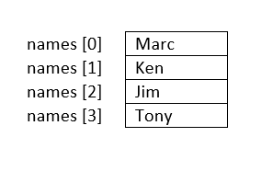
Accessing Elements - Accessing a Single Element
To access one element, use the name of the list, followed by the index of that element in square brackets
Use this one element just like any other variable
names[index] → returns the value stored at location index.
names refers to the whole list
len(names)→4
names.index(‘Ken’) → 1

Slide 9
Loop on List

Slide 10
Accessing Elements - Iterating Over List Items
A for loop can be used iterates over the list values:
stuff = [1, "ICT", 3.14]
for item in stuff:
print(item)

Slide 11
Accessing Elements - Iterating Over List Indices
Sometimes we need a loop where the control variable varies over the indices rather than the values
stuff = [1, "ICT", 3.14]
for i in range(0, len(stuff))
print(stuff[i])
List length changes as elements are added/removed.
So, use len() function to determine the length of list.

Slide 12
Modifying List

Slide 13
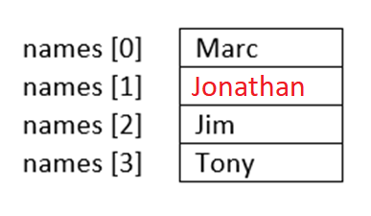
Modifying Elements
Lists are mutable, so their elements can be changed as follows:
names[index] = new_data
names[1] = “Jonathan”

Slide 14
Adding Elements
Lists are mutable, so we can add more elements to them.
There are three ways to add elements to a list
append(x): adds a single element to the end of the list
names.append('Daniel')
insert(i, x): inserts a single element into a list at index i, shifts elements at index 3+ up
names.insert(3, 'Chris')
extend(L): extends the list by appending the given second list to it
names.extend(['Eric', 'Frank'])

Slide 15
Adding Elements
Example:
names = []
name = input("Enter a name:")
names.append(name)
names_str = [“Joe”,”James”]
names.extend(names_str)
print(names)

Slide 16
Printing List

Slide 17
Printing List
There are many ways to print the content of a list.
Two common ways are:
using print()
print('names = %s‘ , (names))
Using a loop → allows us to print the list in a customized format:
for i in range(0, len(names), 1):
print("names[%d] = %s" % (i, names[i]))

Slide 18
2D Lists

Slide 19
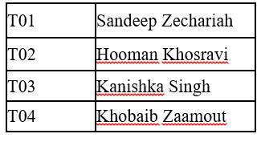
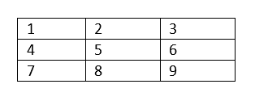
2D Lists
A list of lists (images,movies,tables,matrices -> all 2D data)
[does not have to be rectangular]
A table
A matrix

Slide 20
2D Lists
Format:
<list name> = [[<value 1>, <value 2>, ... , <value n>],
[<value 1>, <value 2>, ... , <value n>],
…
[<value 1>, <value 2>, ... , <value n>]]
rows
columns

Slide 21
Accessing 2D Lists
matrix1 = [[1, 2, 3], [4, 5, 6], [7, 8, 9]]
print(matrix1)
print(matrix1[0])
print(matrix1[1])
print(matrix1[2])
row = matrix1[0]
print(row[0])
print(row[1])
print(row[2])
[[1, 2, 3], [4, 5, 6], [7, 8, 9]]
[1, 2, 3]
[4, 5, 6]
[7, 8, 9]
1
2
3

Slide 22
Accessing 2D Lists
matrix1 = [[1, 2, 3], [4, 5, 6], [7, 8, 9]]
print(matrix1[0][0])
print(matrix1[0][1])
print(matrix1[0][2])
1
2
3

Slide 23
2D List: Example

Slide 24
Example: Boggle
Generate a random board for Boggle
4x4 board
Store the board in a 2D list
Each space on the board contains one randomly selected letter
Display the board
Sample Board:
S
N
K
O
V
R
E
R
I
D
I
N
N
E
G
U

Slide 25
Example: Boggle
from pprint import pprint
from random import choice
NUM_ROWS = 4
NUM_COLS = 4
board = [] # Create a new, empty board
for row in range(NUM_ROWS): # Add the correct number of rows to the board
board.append([""]* NUM_COLS) # Append a row of size NUM_COLS
pprint(board) #pretty print the board
# Set each element in the board to a random letter
for row in range(NUM_ROWS):
for col in range(NUM_COLS):
board[row][col] = choice("ABCDEFGHIJKLMNOPQRSTUVWXYZ")
pprint(board) # Pretty print the board

Slide 26
2D-List Creation
Creating the following matrix programmatically:
matrix1 = [[1, 2, 3], [4, 5, 6], [7, 8, 9]]

Slide 27
2D-List Creation
Creating the following matrix programmatically:
matrix1 = [[1, 2, 3], [4, 5, 6], [7, 8, 9]]
matrix1 = []
for i in range (1, 10, 3):
row = [i , i + 1, i + 2]
matrix1.append(row)
print(matrix1)
matrix2=[]
ROWS=3
COLS=3
for row in range(ROWS):
matrix2.append([])
for col in range(COLS):
matrix2[row].append(counter)
print(matrix2)

Slide 28
2D-List Printing
Using print (matrix)
Using loops:
Print one row per iteration
for row in matrix:
print(row)
for row in matrix:
output = ''
for num in row:
output += str(num) + ' '
print (output)
[1, 2, 3]
[4, 5, 6]
[7, 8, 9]
Print one row per iteration
1 2 3
4 5 6
7 8 9

Slide 29
Onward to … more complicated lists.
Jonathan Hudson
jwhudson@ucalgary.ca
https://pages.cpsc.ucalgary.ca/~jwhudson/

