Slide 1
Functions: Usage
CPSC 217: Introduction to Computer Science for Multidisciplinary Studies I
Winter 2023
Jonathan Hudson, Ph.D.
Instructor
Department of Computer Science
University of Calgary
January 9, 2023
Copyright © 2023

Slide 2
Function calling review
Select a descriptive name for your function
Use brackets when calling functions even if you are not passing any arguments
At least one statement needs to be in a function.
Functions must be defined before they are called!

Slide 3
How to use a function?
Call function
Pass valid inputs
Store the result in a variable
If function returns a value:
returnedValue = functionName(values/variables)
If no value is returned
functionName(values/variables)

Slide 4
Functions that do nothing
Functions have to have one line of code in them
Only way to make pythons syntax parsing that is looking for indentation happy
(Once you put something indented in function the rest of indentation has to match)
This is also true for conditionals and loop indentation
Can use pass keyword to do nothing

Slide 5
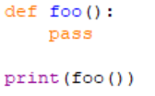
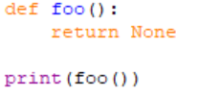
Functions return None by default
Functions in python always return something
That something is by default nothing or None
None is a special keyword
(We often use None in other places in our code to show nothing has been stored in a variable yet)

Slide 6
Return multiple things

Slide 7
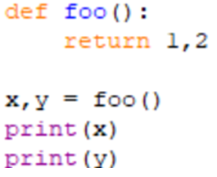
Functions can return multiple things

Slide 8
Return values
Format
The results can be stored into variables for later use
def <function name> (param1, param2, ...): body
return var1, var2, ...
var1, var2, ... = <function name> (arg1, arg2, ...)

Slide 9
Namespace
Must define functions before use

Slide 10
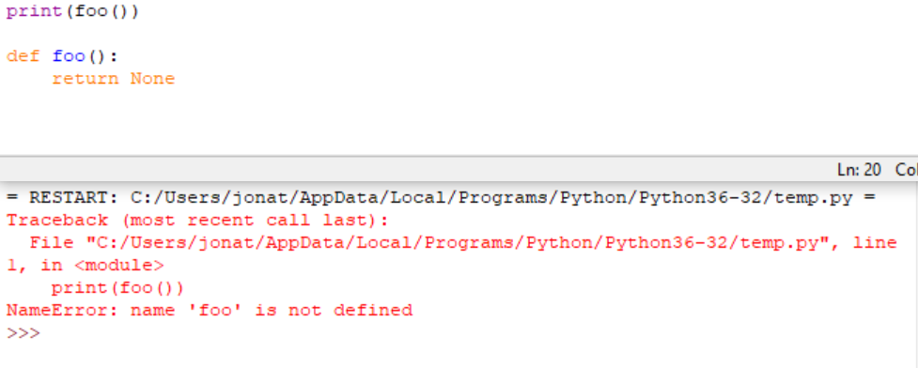
Functions must be declared before use

Slide 11
Examples

Slide 12
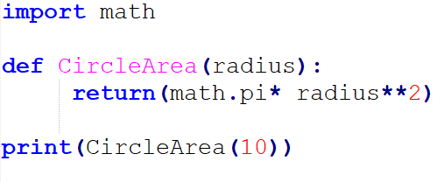
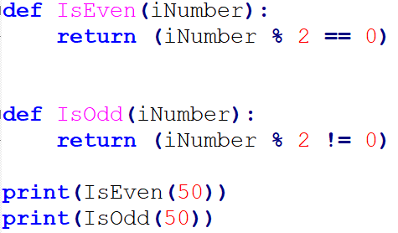
Some simple functions

Slide 13
Design

Slide 14
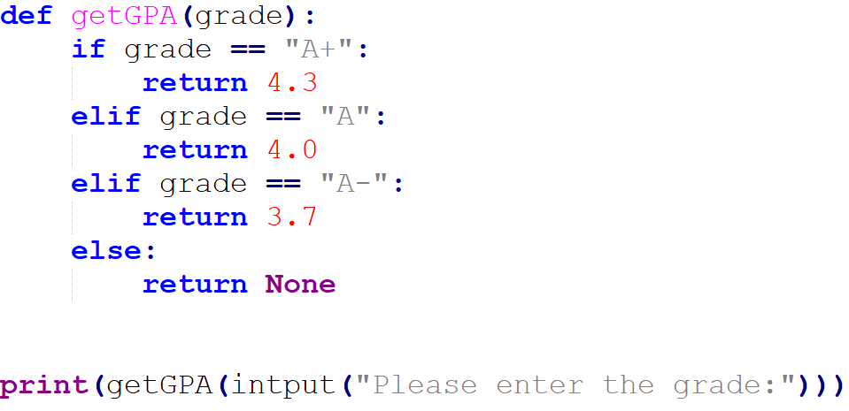
There are challenges in defining a function

Slide 15
User-Defined Functions - Commenting
A good function always contains explicit comments that describe the purpose of the function, the parameters, and returned values.
See: https://docs.python.org/3/library/functions.html

Slide 16
Namespace
Re-defining functions

Slide 17
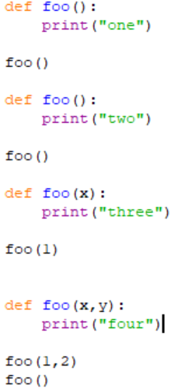
Dangers of functions (re-use name)
Python only lets you have one function per name, but you can override previous usage (ignores parameters unlike other languages)

Slide 18
Parameter order

Slide 19
Calling Functions - Order of Parameters
Function parameters are position sensitive.
When calling a function that accepts parameters, make sure your arguments are in the same order of the parameters.
WARNING: Not following the order of the parameters will result in parameters having wrong values, which may lead to semantic and runtime errors.
def printbar(char, num = 10):
bar = ''
for i in range(num + 1):
bar = bar + char
print(bar)
printbar(20, '=')

Slide 20
Keyword parameters
Keyword parameters allow us to match arguments with parameters by name, instead of positions
def payroll (rate, hours):
bounus = 5
salary = rate * (hours + bounus)
return (salary)
payment = payroll (hours = 40, rate = 15)
print ("$%d has been paid." % (payment))
$675 has been paid.

Slide 21
We can do this with functions you already use

Slide 22
Scope

Slide 23
Scope of Variables
Variables are memory locations that are used for the temporary storage of data
The scope of a variable is the section of code in which it is accessible
var1 = …
The global scope: Accessible by both functions
def fee():
var2 = …
Local scopes: Two different memory spaces,
Accessible only within their functions
def foo():
var2 = …

Slide 24
Scope of Variables - Local Variables
Local variables are only accessible to the function where they are defined.
The memory for local variables is only allocated (reserve the memory) when the function is running and deallocated (free up the memory) when the function reaches the end.
Local variables are defined (memory allocated and value stored) each time the function is called.

Slide 25
Scope of Variables - Local Variables
string
“Hello World”
Function body is executed
Function is done
string is a local variable
Memory deallocated
string

Slide 26
Scope of Variables - Global Variables
Variables that are declared within the body of a function have a local scope → Accessible from inside the function only
This includes the parameters
Variables that are declared outside the body of a function have a global scope → Accessible from anywhere in the program
In Python, global variables can only be modified in global scope.
They cannot be modified in local scope unless the global keyword is used:
global variableName

Slide 27
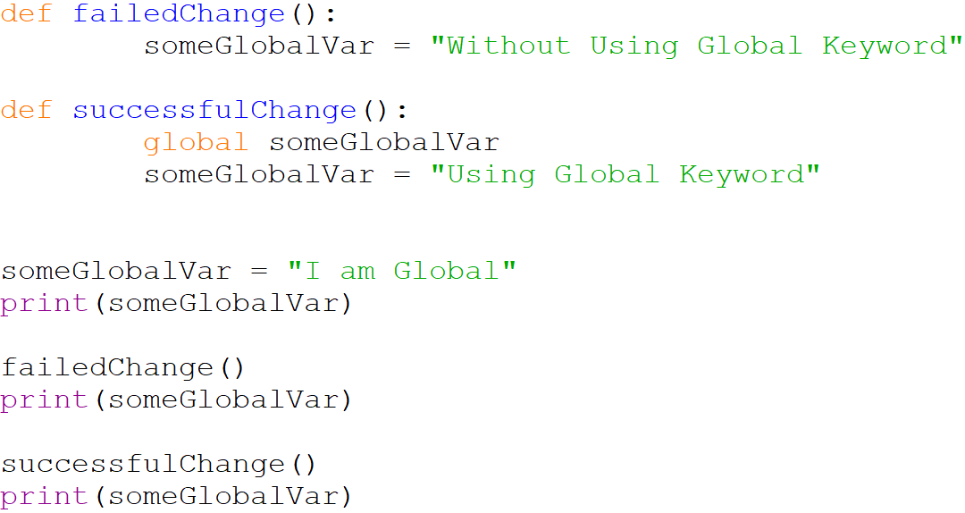
Scope of Variables - Global Variables
I am Global
I am Global
Using Global Keyword

Slide 28
Scope of Variables - Variable lifetime
The lifetime of a variable is the time that a variable is allocated a memory space.
The memory is allocated at the time of variable declaration
Global variables exist until the program terminates
Local variables exist until the function containing it finishes

Slide 29
Memory

Slide 30
Memory Organization
The memory for a program is organized into three regions
Text (Instructions)
Dynamic Data (Heap)
Stack
Notes:
Text: holds program instructions. Contrary to what the name suggests, code is in binary machine code (not human-readable). Generally read-only
Data: constants and variables with global scope
Heap: objects allocated as the program runs
Stack: information about function calls, including all pointers for local variables. Very common to have pointers from the stack into the heap (not common the other way around).
Low: text, data (fixed size)
High: heap, stack (size changes as program runs). Heap grows up from data. Stack grows down from end of memory.

Slide 31
Memory Organization
The memory for a program is organized into three regions
Text (Instructions): holds program instructions. Contrary to what the name suggests, code is in binary machine code (not human-readable). Generally read-only.
Dynamic Data (Heap): objects allocated as the program runs
Stack: information about function calls, including all pointers for local variables. Very common to have pointers from the stack into the heap (not common the other way around).
Notes:
Text: holds program instructions. Contrary to what the name suggests, code is in binary machine code (not human-readable). Generally read-only
Data: constants and variables with global scope
Heap: objects allocated as the program runs
Stack: information about function calls, including all pointers for local variables. Very common to have pointers from the stack into the heap (not common the other way around).
Low: text, data (fixed size)
High: heap, stack (size changes as program runs). Heap grows up from data. Stack grows down from end of memory.

Slide 32
Memory Organization
Stack
writable; not executable
Managed “automatically” by compiler
Free Memory
Dynamic Data (Heap)
writable; not executable
Managed by programmer
Text (Instructions)
read-only; executable
Initialized when process starts
Notes:
Text: holds program instructions. Contrary to what the name suggests, code is in binary machine code (not human-readable). Generally read-only
Data: constants and variables with global scope
Heap: objects allocated as the program runs
Stack: information about function calls, including all pointers for local variables. Very common to have pointers from the stack into the heap (not common the other way around).
Low: text, data (fixed size)
High: heap, stack (size changes as program runs). Heap grows up from data. Stack grows down from end of memory.

Slide 33
Memory Organization
Everything in Python is an object. Variables are labels that refer to these objects.
All objects are stored in the heap.
If the labels (variables) are created in local scope, then the label is stored in the stack memory. Otherwise, the label is stored in heap memory.
Lets run through a simulation of Python’s memory organization to clarify these concepts. This simulation simplifies some aspects for clarity’s sake.

Slide 34
Memory Organization - Walkthrough
Define a global variable x by assigning the value 10 to it.
Instructions (code):
Stack Memory
Heap Memory

Slide 35
Memory Organization - Walkthrough
The value 10 is an object, so it is stored in heap. The variable is global, so it is stored in heap as well
Instructions (code):
Heap Memory
Stack Memory
10
x = 10 #global variable
x

Slide 36
Memory Organization - Walkthrough
Define another variable y = 10
Instructions (code):
Heap Memory
Stack Memory
10
x = 10 #global variable
x

Slide 37
Memory Organization - Walkthrough
Again, y is global and 10 is an object, so into the heap they go.
Notice that the object 10 is not recreated; to preserve memory space.
Instructions (code):
Heap Memory
Stack Memory
10
x = 10 #global variable
y = 10 #global variable
x
y

Slide 38
Memory Organization - Walkthrough
Increment y by 1.
Instructions (code):
Heap Memory
Stack Memory
10
x = 10 #global variable
y = 10 #global variable
x
y

Slide 39
Memory Organization - Walkthrough
A new object, 11, is created and y refers (points) to it.
Instructions (code):
Heap Memory
Stack Memory
10
x = 10 #global variable
y = 10 #global variable
y += 1 #increment by 1
x
11
y

Slide 40
Memory Organization - Walkthrough
Define a function, increment, that accepts one argument, a, add one to it and store it in variable z then return z.
Instructions (code):
Heap Memory
Stack Memory
10
x = 10 #global variable
y = 10 #global variable
y += 1 #increment by 1
x
11
y

Slide 41
Memory Organization - Walkthrough
The function code is stored in the Text memory. The reference to the function is global so it is stored in the heap.
*This is over simplified for this class’s purposes.
Instructions (code):
Heap Memory
Stack Memory
10
x = 10 #global variable
y = 10 #global variable
y += 1 #increment by 1
def increment(a):
z = a + 1
return z
func:increment
x
11
y

Slide 42
Memory Organization - Walkthrough
Call increment and pass y to it.
Instructions (code):
Heap Memory
Stack Memory
10
x = 10 #global variable
y = 10 #global variable
y += 1 #increment by 1
def increment(a):
z = a + 1
return z
func:increment
x
11
y

Slide 43
Memory Organization - Walkthrough
The function call gets stored in the stack along with all the local variables.
The parameter a points to the 11 object in the heap. A new object 12 is created and z points to it.
Instructions (code):
Heap Memory
Stack Memory
10
x = 10 #global variable
y = 10 #global variable
y += 1 #increment by 1
def increment(a):
z = a + 1
return z
z = increment(y)
func:increment
x
11
increment
y
a
z
12

Slide 44
Memory Organization - Walkthrough
When the function execution ends, it gets popped out of the stack; its local variables’ reference are deallocated. Its returned value is stored in the caller’s scope (global)
Instructions (code):
Heap Memory
Stack Memory
10
x = 10 #global variable
y = 10 #global variable
y += 1 #increment by 1
def increment(a):
z = a + 1
return z
z = increment(y)
func:increment
x
11
increment
y
a
z
12

Slide 45
Memory Organization - Walkthrough
When the function execution ends, it gets popped out of the stack; its local variables’ reference are deallocated. Its returned value is stored in the caller’s scope (global)
Instructions (code):
Heap Memory
Stack Memory
10
x = 10 #global variable
y = 10 #global variable
y += 1 #increment by 1
def increment(a):
z = a + 1
return z
z = increment(y)
func:increment
x
11
y
12
z

Slide 46
Memory Organization - Walkthrough
Delete the variables y, and z
Instructions (code):
Heap Memory
Stack Memory
10
x = 10 #global variable
y = 10 #global variable
y += 1 #increment by 1
def increment(a):
z = a + 1
return z
z = increment(y)
func:increment
x
11
y
12
z

Slide 47
Memory Organization - Walkthrough
The reference is removed. Objects remain in memory.
Instructions (code):
Heap Memory
Stack Memory
10
x = 10 #global variable
y = 10 #global variable
y += 1 #increment by 1
def increment(a):
z = a + 1
return z
z = increment(y)
del y
del z
func:increment
x
11
12

Slide 48
Memory Organization - Walkthrough
If no more references to the object exist, then garbage collection will remove it from memory and free up the space.
Instructions (code):
Heap Memory
Stack Memory
10
x = 10 #global variable
y = 10 #global variable
y += 1 #increment by 1
def increment(a):
z = a + 1
return z
z = increment(y)
del y
del z
func:increment
x
11
12

Slide 49
Memory Organization - Walkthrough
Starting fresh…
Instructions (code):
Stack Memory
Heap Memory

Slide 50
Memory Organization - Walkthrough
Consider the increment function and the new function, decrement, which calls it, decrement its output, and return the new value.
Instructions (code):
Stack Memory
Heap Memory
def increment(a):
return a + 1
def decrement(b):
c = increment(b) - 1
return c
func:increment
func:decrement

Slide 51
Memory Organization - Walkthrough
Create a global variable x = 10.
Instructions (code):
Stack Memory
Heap Memory
def increment(a):
return a + 1
def decrement(b):
c = increment(b) - 1
return c
func:increment
func:decrement

Slide 52
Memory Organization - Walkthrough
Call decrement, pass x to it, and store the result in y.
Instructions (code):
Stack Memory
Heap Memory
def increment(a):
return a + 1
def decrement(b):
c = increment(b) - 1
return c
x = 10
func:increment
func:decrement
x
10

Slide 53
Memory Organization - Walkthrough
Lets trace the execution starting the decrement function call…
Instructions (code):
Stack Memory
Heap Memory
def increment(a):
return a + 1
def decrement(b):
c = increment(b) - 1
return c
x = 10
y = decrement(x)
func:increment
func:decrement
x
10

Slide 54
Memory Organization - Walkthrough
Lets trace the execution starting the decrement function call…
Instructions (code):
Stack Memory
Heap Memory
def increment(a):
return a + 1
def decrement(b):
c = increment(b) - 1
return c
x = 10
y = decrement(x)
func:increment
func:decrement
x
10
<expr>

Slide 55
Memory Organization - Walkthrough
When decrement is called, its call is pushed into the stack.
Its parameter is created and points to the object 10.
Instructions (code):
Stack Memory
Heap Memory
def increment(a):
return a + 1
def decrement(b):
c = increment(b) - 1
return c
x = 10
y = decrement(x)
func:increment
func:decrement
x
10
decrement
b
<expr>

Slide 56
Memory Organization - Walkthrough
The next line is called. It is evaluated as follows: increment(b), then – 1, then assignment to c.
Instructions (code):
Stack Memory
Heap Memory
def increment(a):
return a + 1
def decrement(b):
c = increment(b) - 1
return c
x = 10
y = decrement(x)
func:increment
func:decrement
x
10
decrement
b
<expr>

Slide 57
Memory Organization - Walkthrough
The next line is called. It is evaluated as follows: increment(b), then – 1, then assignment to c.
Instructions (code):
Stack Memory
Heap Memory
def increment(a):
return a + 1
def decrement(b):
c = increment(b) - 1
return c
x = 10
y = decrement(x)
func:increment
func:decrement
x
10
decrement
b
<exp>
<expr>

Slide 58
Memory Organization - Walkthrough
Increment is called and its parameter a points to 10, as well.
Instructions (code):
Stack Memory
Heap Memory
def increment(a):
return a + 1
def decrement(b):
c = increment(b) - 1
return c
x = 10
y = decrement(x)
func:increment
func:decrement
x
10
increment
a
decrement
b
<exp>
<expr>

Slide 59
Memory Organization - Walkthrough
The return call does two things: 1) increments a, and 2) return the reference to the caller.
Instructions (code):
Stack Memory
Heap Memory
def increment(a):
return a + 1
def decrement(b):
c = increment(b) - 1
return c
x = 10
y = decrement(x)
func:increment
func:decrement
x
10
increment
a
decrement
b
<exp>
<expr>

Slide 60
Memory Organization - Walkthrough
The return call does two things: 1) increments a, and 2) return the reference to the caller.
Instructions (code):
Stack Memory
Heap Memory
def increment(a):
return a + 1
def decrement(b):
c = increment(b) - 1
return c
x = 10
y = decrement(x)
func:increment
func:decrement
x
10
increment
a
<exp>
11
decrement
b
<exp>
<expr>

Slide 61
Memory Organization - Walkthrough
The return call does two things: 1) increments a, and 2) return the reference to the caller, which ends the increment’s execution.
Instructions (code):
Stack Memory
Heap Memory
def increment(a):
return a + 1
def decrement(b):
c = increment(b) - 1
return c
x = 10
y = decrement(x)
Return a reference of 11 to caller
func:increment
func:decrement
x
10
increment
a
<exp>
11
decrement
b
<exp>
<expr>

Slide 62
Memory Organization - Walkthrough
Execution is back to the calling function.
The returned value remains in heap and its reference is returned to the expression.
Instructions (code):
Stack Memory
Heap Memory
def increment(a):
return a + 1
def decrement(b):
c = increment(b) - 1
return c
x = 10
y = decrement(x)
func:increment
func:decrement
x
10
11
decrement
b
<exp>
<expr>

Slide 63
Memory Organization - Walkthrough
The rest of the expression is evaluated. c points to back to 10.
The object 11 has no references, so eventually the garbage collection algorithm will remove it from memory.
Instructions (code):
Stack Memory
Heap Memory
def increment(a):
return a + 1
def decrement(b):
c = increment(b) - 1
return c
x = 10
y = decrement(x)
func:increment
func:decrement
x
10
11
decrement
b
c
<expr>

Slide 64
Memory Organization - Walkthrough
c is returned to the caller, which terminates the execution of decrement. Local variables are deleted.
Instructions (code):
Stack Memory
Heap Memory
def increment(a):
return a + 1
def decrement(b):
c = increment(b) - 1
return c
x = 10
y = decrement(x)
func:increment
func:decrement
x
10
decrement
b
c
<expr>

Slide 65
Memory Organization - Walkthrough
The expression is evaluated and the results are stored in y
Instructions (code):
Stack Memory
Heap Memory
def increment(a):
return a + 1
def decrement(b):
c = increment(b) - 1
return c
x = 10
y = decrement(x)
func:increment
func:decrement
x
10
<expr>

Slide 66
Memory Organization - Walkthrough
Instructions (code):
Stack Memory
Heap Memory
def increment(a):
return a + 1
def decrement(b):
c = increment(b) - 1
return c
x = 10
y = decrement(x)
func:increment
func:decrement
x
10
y

Slide 67
Program Structure – Functions

Slide 68
Structure
def func1():
def func2():
def func3():
…
The main function
def main():
func1()
func2()
…
The only code outside functions
main()

Slide 69
Function Tracing

Slide 70
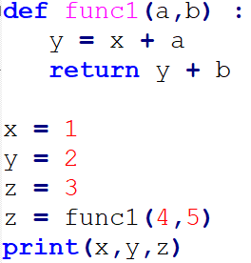
Scope
1 2 10

Slide 71
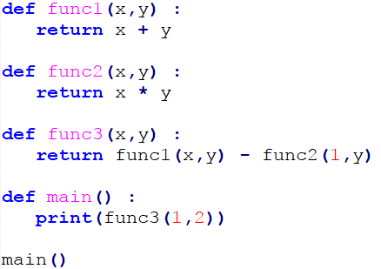
Scope
1

Slide 72
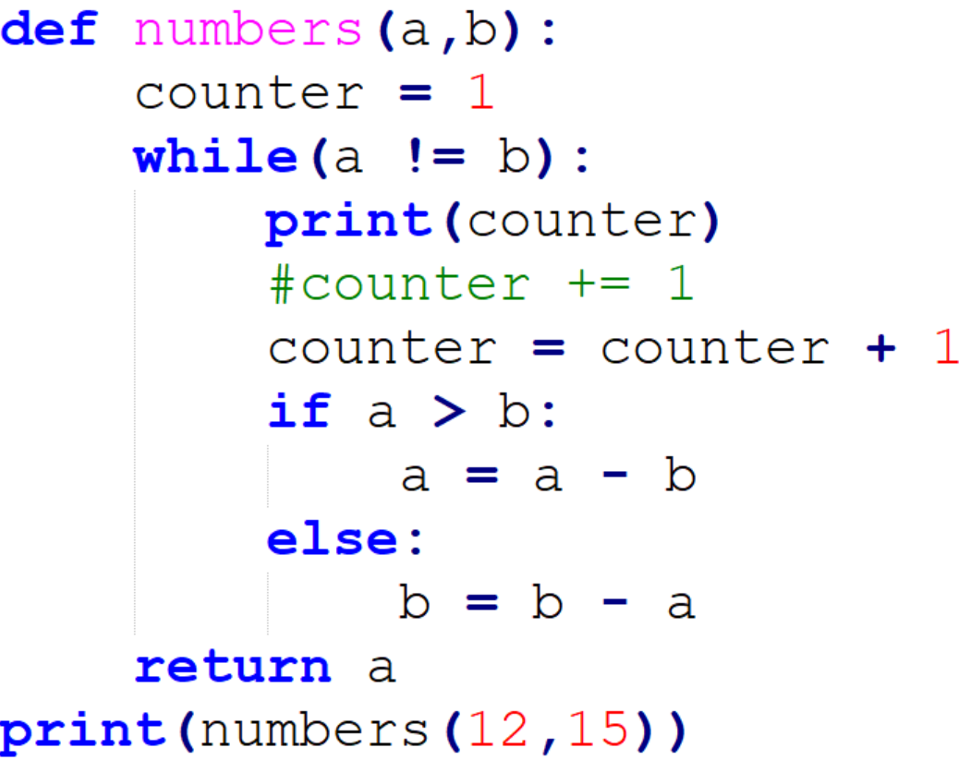
Trace the code
1
2
3
4
3

Slide 73
Onward to … lists, dictionaries, and strings.
Jonathan Hudson
jwhudson@ucalgary.ca
https://pages.cpsc.ucalgary.ca/~jwhudson/

