Slide 1
Functions: Create
CPSC 217: Introduction to Computer Science for Multidisciplinary Studies I
Winter 2023
Jonathan Hudson, Ph.D.
Instructor
Department of Computer Science
University of Calgary
January 9, 2023
Copyright © 2023

Slide 2
Functions
A function is a block of code that accomplishes a single purpose, such as calculating an average from a list of values, or printing a message to console.
A function (optionally) takes some inputs (also named arguments), performs some operations, and (optionally) gives back a result.
Proper design and use of functions can save time and make a program easy to read, maintain, organized, and efficient.

Slide 3
Great job!
You’ve already been using functions

Slide 4
You’ve already been using functions
Built-in functions are provided by the language
Library functions are similar but provided by another programmer
User-defined functions are created by programmers
All function operate the same

Slide 5
You’ve already been using functions
All function operate the same
Functions might receive some arguments to work with. This is handled as parameters in the function definition
When calling the function, we supply the actual data to the function as arguments in the function call
Functions may return results

Slide 6
Functions Overview
Functions are useful because they:
Facilitate code reuse
Write once, use many times
Reduce code complexity
Allow programmers to break problems into smaller sub problems
Details relevant to solving a specific sub problem are placed in the function
Programmer can concentrate on higher level problems
Ease Maintenance
Bugs only need to be corrected once
Functions can be tested separately

Slide 7
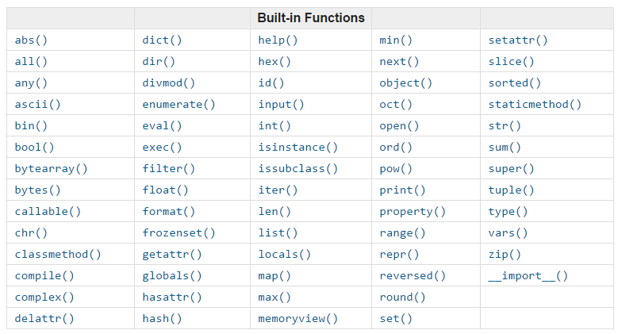
Python built-in functions

Slide 8
Good style function
Functions are like tools:
They need to have a self descriptive name
indicating a clear description of the task
One function serves one purpose, code with different purposes should not be combined into one function.
You do not design a fridge that is also a stove!
Functions can use (call) each other
There could be multiple correct solution
It depends on your design

Slide 9
Your functions

Slide 10
User-Defined Functions
Programmers can define their own functions.
A function consists of the following components:
(Required) Function name
(Optional) Function parameters
(Required) Function body (code), including a return statement: The function’s body must contain at least one line of code.
The following is a minimal function that does nothing:

Slide 11
User-Defined Functions
You can define your own function using the following syntax:
optional one or more parameters (separated by commas)
Function name
syntax
Keyword for defining function
A minimum one line of code
indentation
optional one or more return values (separated by commas)

Slide 12
Storing functions
Think of what “import math” did

Slide 13
Accessing functions in other libraries
def fun():
print ('Hello World!')
fun.py
def foo():
print ('Goodbye World!')
foo.py
from fun import *
import foo
def main():
fun ()
foo.foo()
# Main body
main()
main.py

Slide 14
Design

Slide 15
User-Defined Functions - Well Designed Functions
A Function should:
Have a descriptive name that indicates the tasks the function performs.
Serve one purpose; code with different purposes should not be combined into one function.
Reduce code redundancy
A function that has one line of code is generally not a good function
A function is that used only once in code is generally not a good function
Start with comments that describe the function’s purpose, the parameter(s), and any value(s) that will be returned.
Functions can call other functions, which further helps in minimizing code redundancy.

Slide 16
Parameters

Slide 17
Parameters
A parameter acts like a variable and holds the value we give to the function when we call it.
A parameter provides the needed data passed by the caller
def pay (amount):
print ("Direct bank deposit: $%d." % (amount))
def payroll ():
salary = 40 * 15
pay (salary)
payroll ()

Slide 18
Parameters
A parameter acts like a variable and holds the value we give to the function when we call it.
A parameter provides the needed data passed by the caller
def pay (amount):
print ("Direct bank deposit: $%d." % (amount))
def payroll ():
salary = 40 * 15
pay (salary)
payroll ()
The parameter name and argument name can be different.
The variable salary is a pointer to a place in memory
The parameter amount is a new variable created each time pay is called which is pointed to same information in memory

Slide 19
User-Defined Functions - Multiple Parameters
You can define a function that accepts multiple parameters
The function call must match the number of parameters
It must also match the expected data type (not enforced by python)
def printbar(char, num):
bar = ''
for i in range(1, num + 1, 1)
bar = bar + char
print(bar)
printbar('-', 3)
length = 10
printbar('=',length)
Do these work?
• printbar ('-')
• printbar (3)
• printbar (length)
• printbar (3, '-')

Slide 20
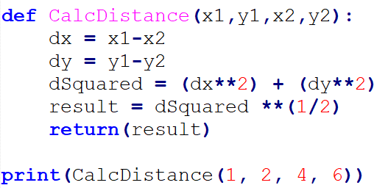
User-Defined Functions - Multiple Parameters
The following function takes two points (x1, y1) and (x2, y2) in Cartesian plane and return the Euclidean distance between them.

Slide 21
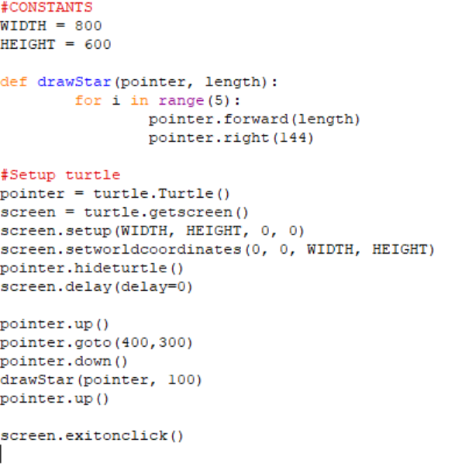
User-Defined Functions - Multiple Parameters

Slide 22
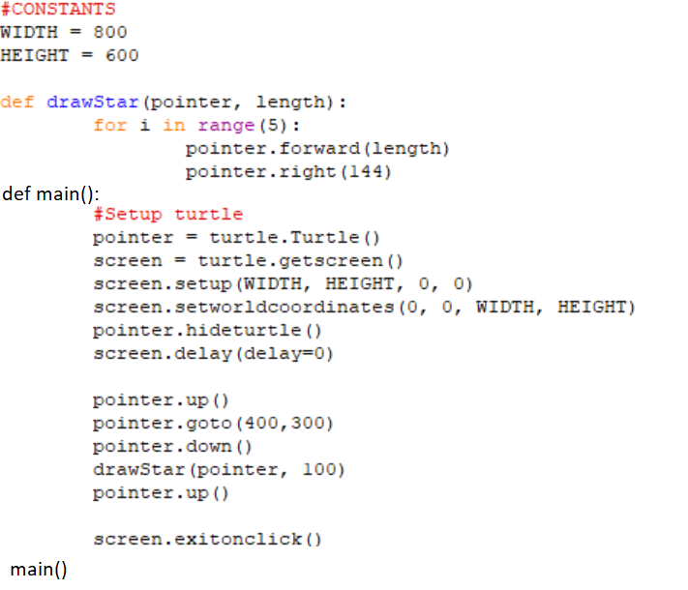
main() function

Slide 23
Optional Parameters

Slide 24
User-Defined Functions - Optional Parameters
Optional parameters are parameters that programmers do not have to pass to the function during function call.
They have default values that will be used if none were provided.
Optional parameters should appear at the end of the parameter list in the function definition:
def printbar(char, num = 10):
bar = ''
for i in range(num + 1):
bar = bar + char
print(bar)
printbar('-')
printbar('=', 20)

Slide 25
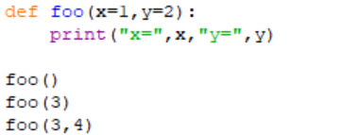
User-Defined Functions - Optional Parameters
You can define default parameter values
The function will always use these values unless new ones are declared

Slide 26
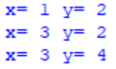
User-Defined Functions - Optional Parameters
You can define default parameter values
The function will always use these values unless new ones are declared

Slide 27
User-Defined Functions - Variadic Functions
Variadic functions are functions that accept a variable number of parameters.
Useful when you do not know a priori how many parameters the user may pass to the function:
Commonly used for functions that perform some operation on a series of inputs, such as summing numbers, concatenating strings, or formatting output.
Ex. print(“My name is”, name, “. I am from”, country)

Slide 28
User-Defined Functions - Variadic Functions
You can define a variadic function in python as follows:
def variadicFunction(*args):
for i in args:
print(i)
args is a conventional name. You can use any name you like.
You can pass any number of arguments when calling the function:
variadicFunction("a") → a
variadicFunction("a","b","c") → a
b
c

Slide 29
User-Defined Functions - Variadic Functions
You can include defined parameters at the beginning as follows:
def variadicFunction(param1,*args):
print(“Named param is:”, param1)
for i in args:
print(i)
Start with any named parameters you may have followed by the variable-length parameter list. You can have none.
You must pass the named params followed by any number of arguments when calling the function:
variadicFunction("a") → Named param is: a
variadicFunction("a","b“) → Named param is: a
b

Slide 30
Onward to … using functions.
Jonathan Hudson
jwhudson@ucalgary.ca
https://pages.cpsc.ucalgary.ca/~jwhudson/

