Slide 1
Decisions: If Else Statements
CPSC 217: Introduction to Computer Science for Multidisciplinary Studies I
Winter 2023
Jonathan Hudson, Ph.D.
Instructor
Department of Computer Science
University of Calgary
January 9, 2023
Copyright © 2023

Slide 2
Conditions in Python
Decision making/branching constructs in Python:
If
If-else
If-elif-else

Slide 3
Conditions in Python
Decision making/branching constructs in Python:
If
If-else
If-elif-else
If-elif
If-elif-elif…-elif
If-elif-else
If-elif-elif…-elif-else

Slide 4
if

Slide 5
Condition flowchart
if
True
Execute a statement(s)
Question?
False
Remainder of
the program

Slide 6
“if” statement format
The logical expression is evaluated
If True, the indented statements that follow are executed
If False, the indented statements that follow will not be executed
The program continues
if (logical expression):
Body
if age <= 17:
print ('You are underage!')
Note: Indenting the
body is required!

Slide 7
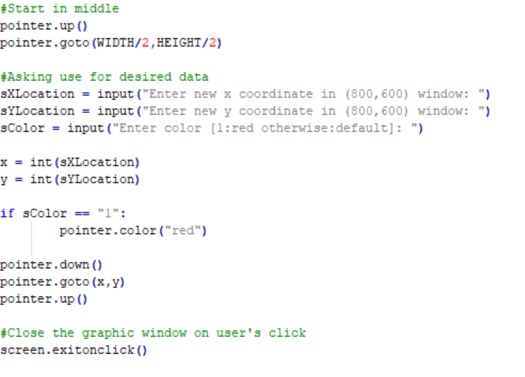
Using if

Slide 8
else

Slide 9
If-Else statement
if
else: Execute other statement(s)
False
True
Execute a statement(s)
Question?
Remainder of
the program

Slide 10
if-else format
if (logical expression):
body of ‘if’
else:
body of ‘else’
remainder of the program

Slide 11
Example for if-else
if (grade >= 50):
letterGrade = 'P'
print ('You pass!')
else:
letterGrade = 'F'
print (‘You did not pass.')
print ('Thank You!')
Indentation

Slide 12
Using if-else

Slide 13
elif
else if

Slide 14
if-elif-else format
if (logical expression):
body of ‘if’
elif (logical expression):
body of ‘elif’
else:
body of ‘else’
remainder of the program

Slide 15
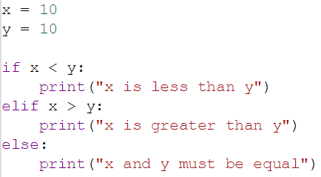
if –elif-else
if
True
Execute a statement(s)
Question?
False
elif
True
Execute a statement(s)
Question?
False
else: Execute other statement(s)
Remainder of
the program

Slide 16
Using elif
What is the output if grade is 97?
Multiple ‘ifs’ may not work for
some problems.

Slide 17
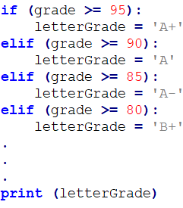
Using elif
What is the output if grade is 97?
Multiple ‘ifs’ may not work for
some problems.
if-elif-else provides the result.

Slide 18
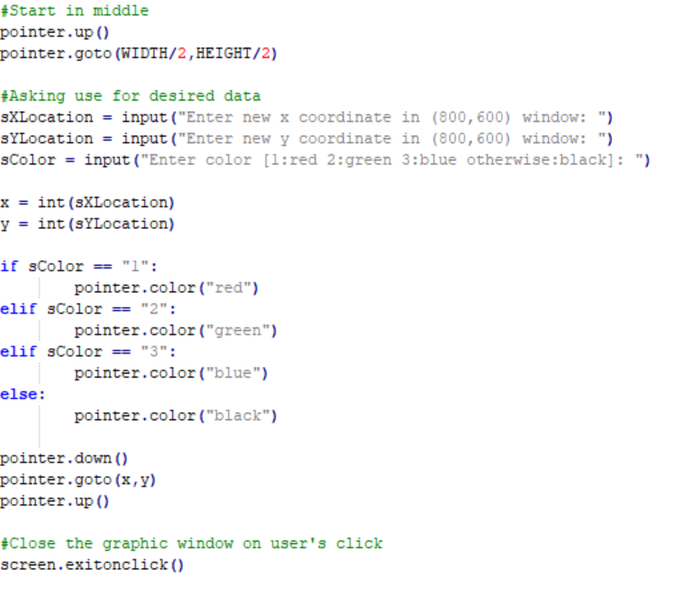
Using if elif else

Slide 19
if-elif-else
You can always have an ‘if’ without ‘elif’ or ‘else’
You can’t have ‘elif’ without ‘if’ first
You can’t have ‘else’ with ‘if’ or ‘elif’ ahead
You can only have one ‘if’ (in a chain)
You can only have one ‘else’ (in a chain)
You can have as many ‘elif’ as you desire (in middle of chain)

Slide 20
Nesting

Slide 21
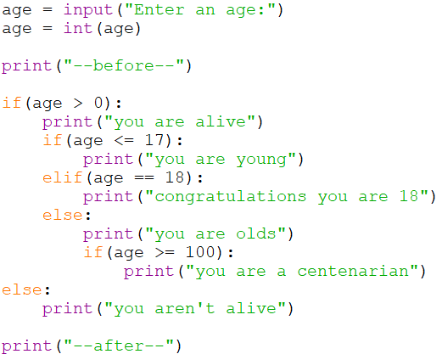
Nesting

Slide 22
Scope

Slide 23
Scope
Namespace - is a declarative region that provides a scope to the identifiers (the names of types, functions, variables, etc.) inside it.
Whenever you declare a variable it exists within a namespace
Whenever python sees you use a variable is looks with this storage area for the variable name you use and finds out what it is attached to
dir() returns to use all the things in the current namespace

Slide 24
Scope
The variables of
a = 2 , b = 3 , B = 4 , this = 10 , avacodo = 42
Would create variables of name a,b,B,this,avocado in the namespace (all of these will have the type int)
Python decides types for us (implicitly) based on what we put in
We can delete things from it using del <name>

Slide 25
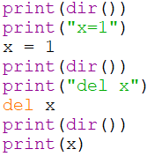
Scope
If we use a variable name that doesn’t exist

Slide 26
Scope
If we use a variable name that doesn’t exist

Slide 27
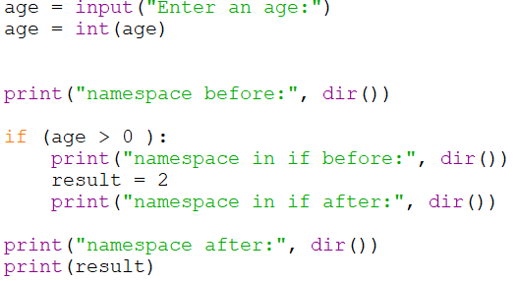
Scope
When we enter an indented block
This namespace can be changed
But we have to be careful to not create a variable SOMETIMES
That our code uses ALL the time

Slide 28
Testing

Slide 29
Testing
Black-box testing
Test the program without looking at the source code
Tests are generally functional / behavioural
White-box testing
Design test cases for the program by looking at its source code
Tests are generally structural

Slide 30
White Box Test Coverage
Condition Coverage: Every decision point in the program is executed
Statement Coverage: Every statement in the program is executed
Path Coverage: Every possible path through the program is executed
Weaker
Stronger

Slide 31
White Box Test Coverage
Condition Coverage: Every decision point in the program is executed
Statement Coverage: Every statement in the program is executed
Path Coverage: Every possible path through the program is executed
if x >= 0:
print(x)
else:
print(“x is neg”)
if y >= 0 :
print(y)
else:
print(“y is neg”)
print(“done”)

Slide 32
White Box Test Coverage
x >= 0
Condition Coverage: Every decision point in the program is executed
Statement Coverage: Every statement in the program is executed
Path Coverage: Every possible path through the program is executed
x
x is neg
y >= 0
y
y is neg
done

Slide 33
White Box Test Coverage
x >= 0
Condition Coverage: Every decision point in the program is executed
Test1: x=1, y=1
Statement Coverage: Every statement in the program is executed
Path Coverage: Every possible path through the program is executed
x
x is neg
y >= 0
y
y is neg
done

Slide 34
White Box Test Coverage
x >= 0
Condition Coverage: Every decision point in the program is executed
Test1: x=1, y=1
Statement Coverage: Every statement in the program is executed
Test1: x=1, y=1
Test2: x=-1, y=-1
Path Coverage: Every possible path through the program is executed
x
x is neg
y >= 0
y
y is neg
done

Slide 35
White Box Test Coverage
x >= 0
Condition Coverage: Every decision point in the program is executed
Test1: x=1, y=1
Statement Coverage: Every statement in the program is executed
Test1: x=1, y=1
Test2: x=-1, y=-1
Path Coverage: Every possible path through the program is executed
Test1: x=1, y=1
Test2: x=-1, y=-1
Test3: x=-1, y=1
Test4: x=1, y=-1
x
x is neg
y >= 0
y
y is neg
done

Slide 36
Boundary Testing
A fourth type of white box testing
Testing closely around border of decisions
Improvement on path testing
if x >= 0:
print(x)
else:
print(“x is neg”)
Boundary is around 0
Test integers x=-1,0,1
x >= 0
x
x is neg
done

Slide 37
Onward to … repetition.
Jonathan Hudson
jwhudson@ucalgary.ca
https://pages.cpsc.ucalgary.ca/~jwhudson/

