Slide 1
Information and Data
CPSC 217: Introduction to Computer Science for Multidisciplinary Studies I
Winter 2023
Jonathan Hudson, Ph.D.
Instructor
Department of Computer Science
University of Calgary
January 9, 2023
Copyright © 2023

Slide 2
What is Information?
Etymology: Latin, “to give form to” or “to form an idea of”
Definition: The state of being of an object or system of interest

Slide 3
What is Data?
Data: raw facts, representation of information, no context
Encoding: The translation of information into data
(Decoding the other direction
Data represents information

Slide 4
Information Processing
A change of information in any manner detectable by an observer
Using a computer?
Encode information into data
Process the data
Translate data back into information
Moral: computers process data, not information – it is our responsibility to interpret the data correctly.

Slide 5
Storing Data
All data in a computer is either a 0 or 1
Called a bit (binary digit)
Electrically, this is a switch that is either open or closed
Encoding schemes translate integers, real numbers, letters, pictures, … into bits

Slide 6
Boolean Data
Has two possible values
False
True
Easily encoded using a single bit
0: False
1: True

Slide 7
Integer Data
How do we represent the numbers 5, 24, or 367 using only ones and zeros?
Simplest idea:
11111 = 5
11111 11111 11111 11111 1111 = 24
Not practical for large integers!
Other ideas?

Slide 8
Number Systems
Decimal (Base 10)
10 distinct symbols (0,1,2,3,4,5,6,7,8,9)
Each digit is a factor of 10 larger than the digit to its right
Examples:
5 = 5 x 1
24 = 2 x 10 + 4 x 1
367 = 3 x 100 + 6 x 10 + 7 x 1

Slide 9
Number Systems
Decimal (Base 10)
10 distinct symbols (0,1,2,3,4,5,6,7,8,9)
Each digit is a factor of 10 larger than the digit to its right
Examples:
5 = 5 x 10⁰
24 = 2 x 10¹ + 4 x 10⁰
367 = 3 x 10² + 6 x 10¹ + 7 x 10⁰

Slide 10
Number Systems
This is a positional system – the position within the number impacts the factor by which the digit is multiplied.
Choice of base 10 is (somewhat) arbitrary – can use any integer base >= 1
Note: there is nothing special about base 10 – it’s just what we are used to!

Slide 11
Binary Data

Slide 12
Number Systems
Binary (Base 2)
2 distinct symbols (0,1)
Each digit is a factor of 2 larger than the digit to its right
Base 10: hundreds, tens, ones
Base 2: eights, fours, twos, ones

Slide 13
Counting in Binary
0 == 0
1 == 1
10 == 2
11 == 3
100 == 4
101 == 5
110 == 6
111 == 7
1000 == 8
You can see how when we have a single 1 in a column (ones, two, fours, eights) that it’s equivalent to that number in decimal (base 10)

Slide 14
Binary Numbers
Consider the base 2 number 1001101₂
1: ones (2⁰)
0: twos (2¹)
1: fours (2²)
1: eights (2³)
0: sixteens (2⁴)
0: thirty-twos (2⁵)
1: sixty-fours (2⁶)

Slide 15
Binary Numbers
Consider the base 2 number 1001101₂
1: ones (2⁰)
0: twos (2¹)
1: fours (2²)
1: eights (2³)
0: sixteens (2⁴)
0: thirty-twos (2⁵)
1: sixty-fours (2⁶)
1 x 2⁰ + 1 x 2² + 1 x 2³ + 1 x 2⁶ = 1 + 4 + 8 + 64 = 77₁₀ (base specified as a subscript)

Slide 16
Binary <-> Decimal

Slide 17
Binary to Decimal
Convert 1111₂ to base 10:
Convert 100010₂ to base 10:
Convert 0₂ to base 10:

Slide 18
Binary to Decimal
Convert 1111₂ to base 10:
1 x 2⁰ + 1 x 2¹ + 1 x 2² + 1 x 2³ = 1 + 2 + 4 + 8 = 15₁₀
Convert 100010₂ to base 10:
1 x 2¹ + 1 x 2⁵ = 2 + 32 = 34₁₀
Convert 0₂ to base 10:
0₁₀

Slide 19
The Division Algorithm
Allows us to convert from Decimal to Binary
Let Q represent the number to convert
Repeat
Divide Q by 2, recording the Quotient, Q, and the remainder, R
Until Q is 0
Read the remainders from bottom to top
Divide by the base to which we want to convert (algorithm works for conversion from decimal to any base)

Slide 20
Decimal to Binary
Convert 191₁₀ to Binary:
191 / 2 = 95, remainder 1
95 / 2 = 47, remainder 1
47 / 2 = 23, remainder 1
23 / 2 = 11, remainder 1
11 / 2 = 5, remainder 1
5 / 2 = 2, remainder 1
2 / 2 = 1, remainder 0
1 / 2 = 0, remainder 1

Slide 21
Decimal to Binary
Convert 191₁₀ to Binary:
191 / 2 = 95, remainder 1
95 / 2 = 47, remainder 1
47 / 2 = 23, remainder 1
23 / 2 = 11, remainder 1
11 / 2 = 5, remainder 1
5 / 2 = 2, remainder 1
2 / 2 = 1, remainder 0
1 / 2 = 0, remainder 1
Reading from bottom to top: 1011 1111₂
Check: 1 + 2¹ + 2² + 2³ + 2⁴ + 2⁵ + 2⁷ = 1 + 2 + 4 + 8 + 16 + 32 + 128 = 191₁₀

Slide 22
Integer Data

Slide 23
Integer Data
Base 10 integers can be represented using sequences of bits
Common sizes:
8 bits (referred to as a byte)
32 bits (referred to as a word)
64 bits (referred to as a double word / long)
16 bits (referred to as a half word / short)
N bits of data, each bit stores 2 things
2 * 2 * 2 * … * 2 (N times)
$2^{N}$ different things can be represented by N bits (generally numbers 0 to $2^{N}−1)$

Slide 24
Integer Data
Base 10 integers can be represented using sequences of bits
Byte [8 bits]: 0000 0000 – 1111 1111 (0 to 2⁸ – 1)
Word [32 bits]: 0 to 2³² – 1
Double word (long) [64 bits]: 0 to 2⁶⁴ – 1
Half word (short) [16 bits]; 0 to 2¹⁶ - 1

Slide 25
Negative Numbers (1)
One idea is called “Signed Magnitude”.
Idea (SM byte): right-most 7 bits represent the magnitude, first 8th bit represents the sign.
Example:
65₁₀ = 100 0001₂
+65 as a byte: 0100 0001
-65 as a SM byte: 1100 0001

Slide 26
Negative Numbers (1)
One idea is called “Signed Magnitude”.
Idea (SM byte): right-most 7 bits represent the magnitude, first 8th bit represents the sign.
Example:
65₁₀ = 100 0001₂
+65 as a byte: 0100 0001
-65 as a SM byte: 1100 0001
Losing 8th bit means we can only represent half as many positive numbers. We gain most back as negative numbers but…
what is 1000 0000?

Slide 27
Negative Numbers (1)
One idea is called “Signed Magnitude”.
Idea (SM byte): right-most 7 bits represent the magnitude, first 8th bit represents the sign.
Example:
65₁₀ = 100 0001₂
+65 as a byte: 0100 0001
-65 as a SM byte: 1100 0001
Losing 8th bit means we can only represent half as many positive numbers. We gain most back as negative numbers but…
what is 1000 0000? -0?

Slide 28
Negative Numbers (2)
Another idea is called “One’s Complement”.
The positive numbers remain same as prior idea, but the negative numbers are formed by swapping all 0s with 1s and all 1s with 0s
Preferred as it makes addition/subtraction easier to design
Example:
65₁₀ = 100 0001₂
+65 as a byte: 0100 0001
-65 as a 1’s comp. byte: 1011 1110
Losing 8th bit means we can only represent half as many positive numbers. We gain most back as negative numbers but…
what is 1111 1111? -0?

Slide 29
Other Bases

Slide 30
Other Bases
A number system can have any base
Decimal: Base 10 (0,1,2,3,4,5,6,7,8,9)
Binary: Base 2 (0,1)
Octal: Base 8 (0,1,2,3,4,5,6,7)
Hexadecimal: Base 16 (0,1,2,3,4,5,6,7,8,9,a,b,c,d,e,f)
Vigesimal: Base 20 (0,1,2,3,4,5,6,7,8,9,a,b,c,d,e,f,g,h,I,j)
Base 6 (0,1,2,3,4,5)
Any other number we choose…

Slide 31
Hexadecimal
Convert 0xA1 to decimal:
Convert 44 base 16 to decimal:
Convert CAFE₁₆ to base 10:

Slide 32
Hexadecimal
Convert 0xA1 to decimal:
A x 16¹ + 1 x 16⁰ =
10 x 16¹ + 1 x 16⁰ =
160 + 1 =
161₁₀
Convert 44 base 16 to decimal:
4 x 16¹ + 4 x 16⁰ =
64 + 4 =
68₁₀
Convert CAFE₁₆ to base 10:
C x 16³ + A x 16² + F x 16¹ + E x 16⁰ =
12 x 16³ + 10 x 16² + 15 x 16¹ + 14 x 16⁰ =
12 x 4095 + 10 x 256 + 15 x 16 + 14 x 1 =
51966₁₀

Slide 33
Hexadecimal
Convert 507₁₀ to base 16:
Use division method with 16 instead of 2:

Slide 34
Hexadecimal
Convert 507₁₀ to base 16:
Use division method with 16 instead of 2:
507/16 = 31, remainder 11 = B
31/16 = 1, remainder 15 = F
1/16 = 0, remainder 1

Slide 35
Hexadecimal
Convert 507₁₀ to base 16:
Use division method with 16 instead of 2:
507/16 = 31, remainder 11 = B
31/16 = 1, remainder 15 = F
1/16 = 0, remainder 1
Reading from bottom to top: 1FB₁₆
Check your work:
1 x 16² + F x 16¹ + B x 16⁰ = 1 x 16² + 15 x 16¹ + 11 x 16⁰ = 256 + 240 + 11 = 507₁₀

Slide 36
Utility of Hexadecimal
Common to have groups of 32 bits
32 bits is cumbersome to write
easy to make mistakes
Use hexadecimal as a shorthand
8 hex digits instead of 32 bits
Group bits from the right
Memorize mapping from binary to hex for values between 0 and F

Slide 37
Utility of Hexadecimal
Convert 0xF51A to binary
Convert 1001001010101011010100 from binary to hex

Slide 38
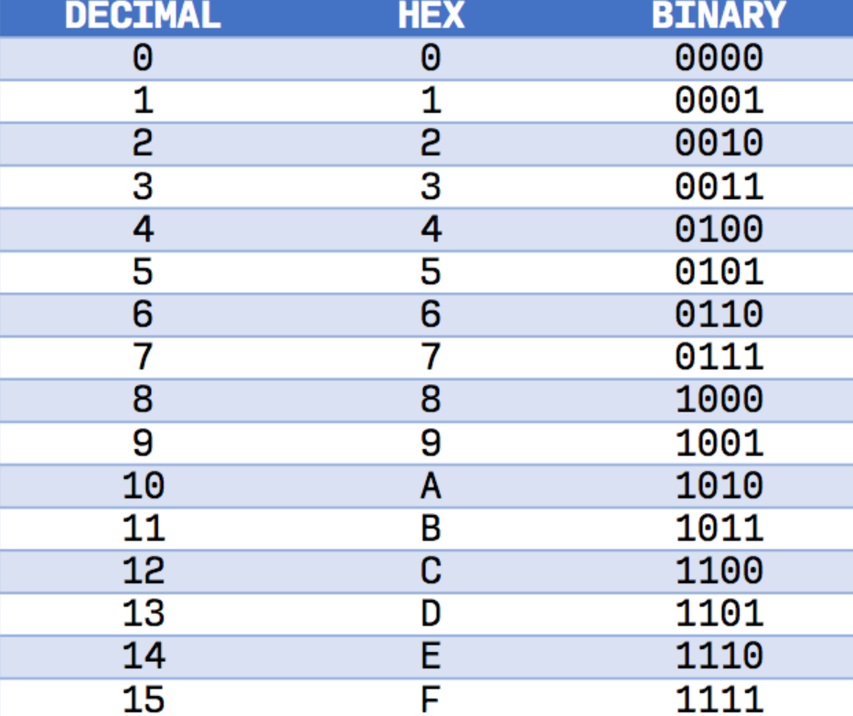
Utility of Hexadecimal
Convert 0xF51A to binary
Convert 1001001010101011010100 from binary to hex

Slide 39
Utility of Hexadecimal
Convert 0xF51A to binary
F=1111₂, 5 = 0101₂, 1 =0001₂, A=1010₂
1111 0101 0001 1010₂
Convert 1001001010101011010100 from binary to hex
10 0100 1010 1010 1101 0100
0010=2 0100=4 1010=10 1010=10 1101=13 0100=4
0010=2 0100=4 1010=a 1010=a 1101=d 0100=4
0x24aad4

Slide 40
Character Data

Slide 41
Representing Characters
Standard encoding scheme called ASCII
American Standard Code for Information Interchange
7 bits per character (2⁷ = 128 possible characters)
Includes printable characters
Includes “control characters” that impact formatting (tab, newline), data transmission (mostly obsolete)
Layout seems arbitrary, but actually contains some interesting patterns

Slide 42
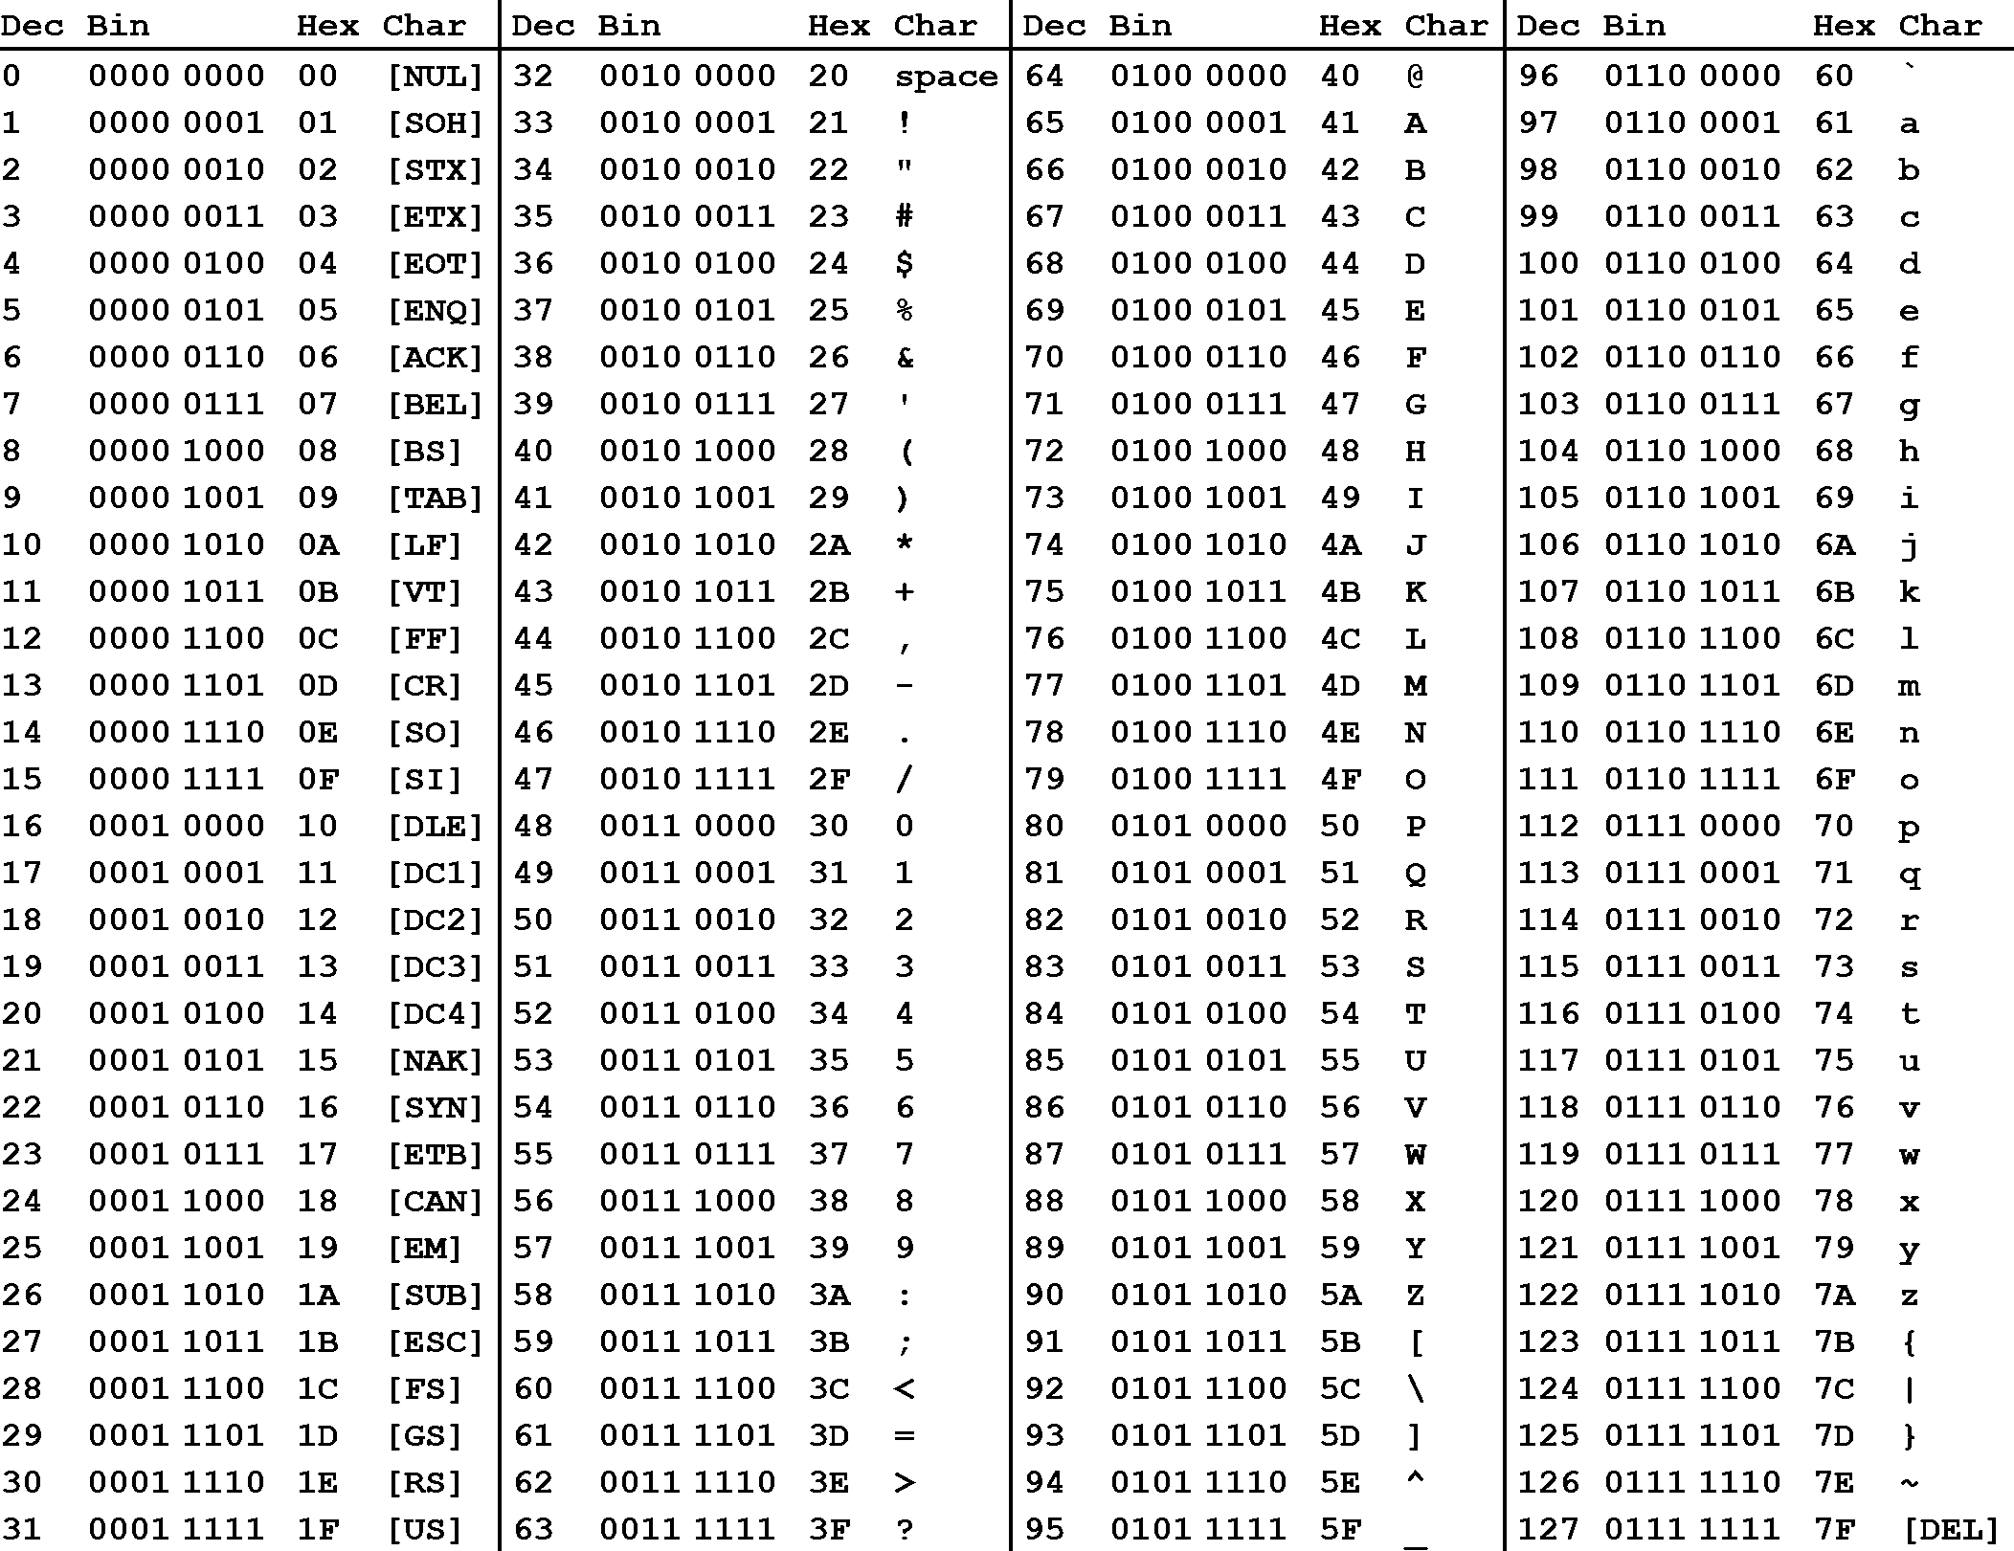

Slide 43
Representing More Characters
Limitation of ASCII?
Only supports Latin character set
No support for accents, additional character sets
Why aren’t we using 8th bit? We’re only using ½ our symbols possibilities?
Solutions?

Slide 44
Representing More Characters
UTF-8
Another encoding scheme for characters
Variable length – 1, 2, 3 or 4 bytes per character
Compatible with ASCII
Consider each byte
Left most bit is 0? Usual ASCII Character
Left most bits are 110? 2 byte character
Left most bits are 1110? 3 byte character
Left most bits are 11110? 4 byte character
This Photo by Unknown Author is licensed under CC BY-SA

Slide 45
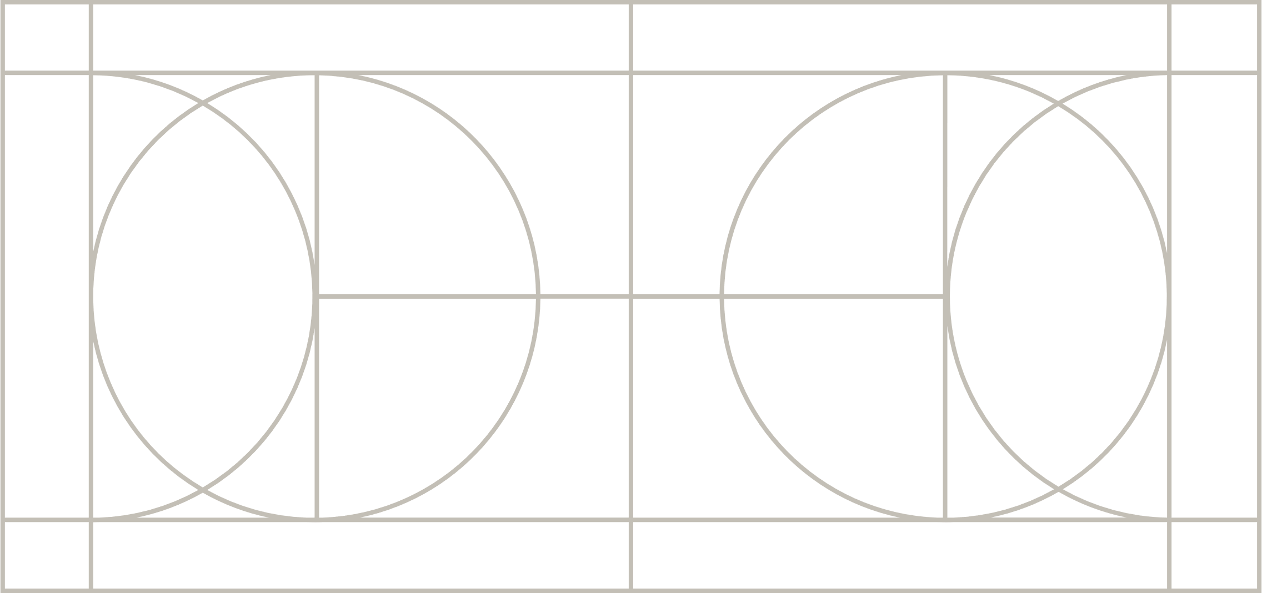
UTF-8
This Photo by Unknown Author is licensed under CC BY-SA

Slide 46
Representing More Characters
‘tears of joy’
0x F0 9F 98 82
0xF0 0x9F 0x98 0x82
11110000 10011111 10011000 10000010
11110 → 4 bytes
remove headers, 11110, and 10
000 011111 011000 000010
${000011111011000000010}_{2}$
${128514}_{10}$
The 128,514th UTF-8 character is tears of joy
This Photo by Unknown Author is licensed under CC BY-SA

Slide 47
Decimal Point Numbers

Slide 48
Representing Real Numbers
Standard Representation: IEEE 754 Floating Point
Express the number in scientific notation
-0.0002589 becomes -2.589 * 10⁻⁴
Need to store sign, exponent, and mantissa (the fraction)
32-bit floating point representation:
sign (1 bit), exponent (8 bits), mantissa (23 bits)
64-bits:
sign (1 bit), exponent (11 bits), mantissa (52 bits)

Slide 49
IEEE 754 – 32 Bit
This Photo by Unknown Author is licensed under CC BY-SA

Slide 50
Problems with Real Numbers
How many real numbers are there? Infinity
How many real numbers are there between 0 and 1? Infinity
How many values can be represented by 32 or 64 bits?
2³² = 4.2 billion,
2⁶⁴ = 1.8 x 10¹⁹
Largest values: 2³² – 1 and 2⁶⁴ – 1
What’s the problem?

Slide 51
Problems with Real Numbers
Problem: some real numbers exist that cannot be represented exactly in floating point
(eg. 1/3 = 0.3333333…., sqrt(2) = 1.414213…).
(Note, computers store base 2 floating points numbers. So these are the infinity repeating ones we are worried about.)
Thus floating point numbers only approximate real numbers (and maintaining accuracy is a very important concern!).

Slide 52
Image Data

Slide 53
Encoding Images
Common Techniques
Vector Images
Vector images: “line work” Image is encoded as a collection of geometric primitives such as points, lines, curves.
Raster Images
Raster images: constructed from a grid of pixels (picture elements), where each picture is assigned a color

Slide 54
Representing Colors
How do we represent a color as a sequence of bits?
Can represent almost any color as a combination of some red, some green, and some blue. Typically use a scale from 0 (no light of that color) to 255 (full on for that color). Yields 256x256x256 = 16 million different possible colors.
(256 = 16*16 or two hex symbols)
To represent an image: 3 color components for each pixel (becomes a lot of bytes very quickly!)

Slide 55
Videos
Raster image storage formats like jpg heavily use ‘compression’ to reduce storage size
Basic ideas, reduce quantity of colours stored, and group idea of ‘where colours are’ to store less information
Video compression works similar but since video is a sequence of frames where each frame is an image, they also make use of reducing data by grouping idea of ‘colours stay the same and where’ across multiple frames
Great example of compression failure → confetti
When confetti is in image, the colour of spot changes every frame and nearby spots are different each frame
This means more info is needed per frame, as a result at the same data rate, the image quality will go down (boxy artifacts will appear, or even decoding breaks down)
This is the same reasons sports struggle with compressed video

Slide 56
Onward to … decisions.
Jonathan Hudson
jwhudson@ucalgary.ca
https://pages.cpsc.ucalgary.ca/~jwhudson/

