Slide 1
Programming-IPython
CPSC 217: Introduction to Computer Science for Multidisciplinary Studies I
Winter 2023
Jonathan Hudson, Ph.D.
Instructor
Department of Computer Science
University of Calgary
January 9, 2023
Copyright © 2023

Slide 2
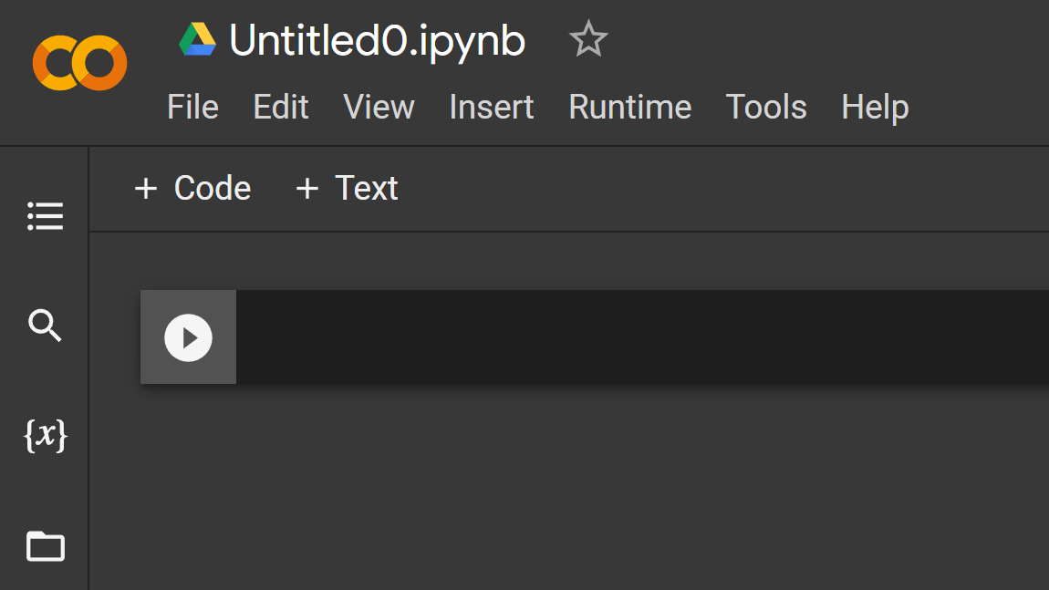
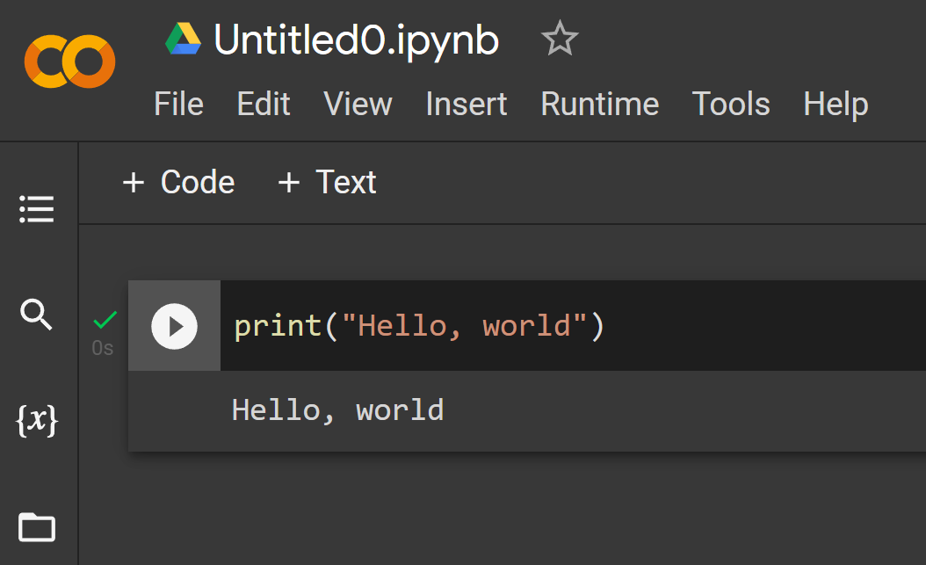
Beginner?
Just use Google Colaboratory! (web-based version of Python Juypter notebook)

Slide 3
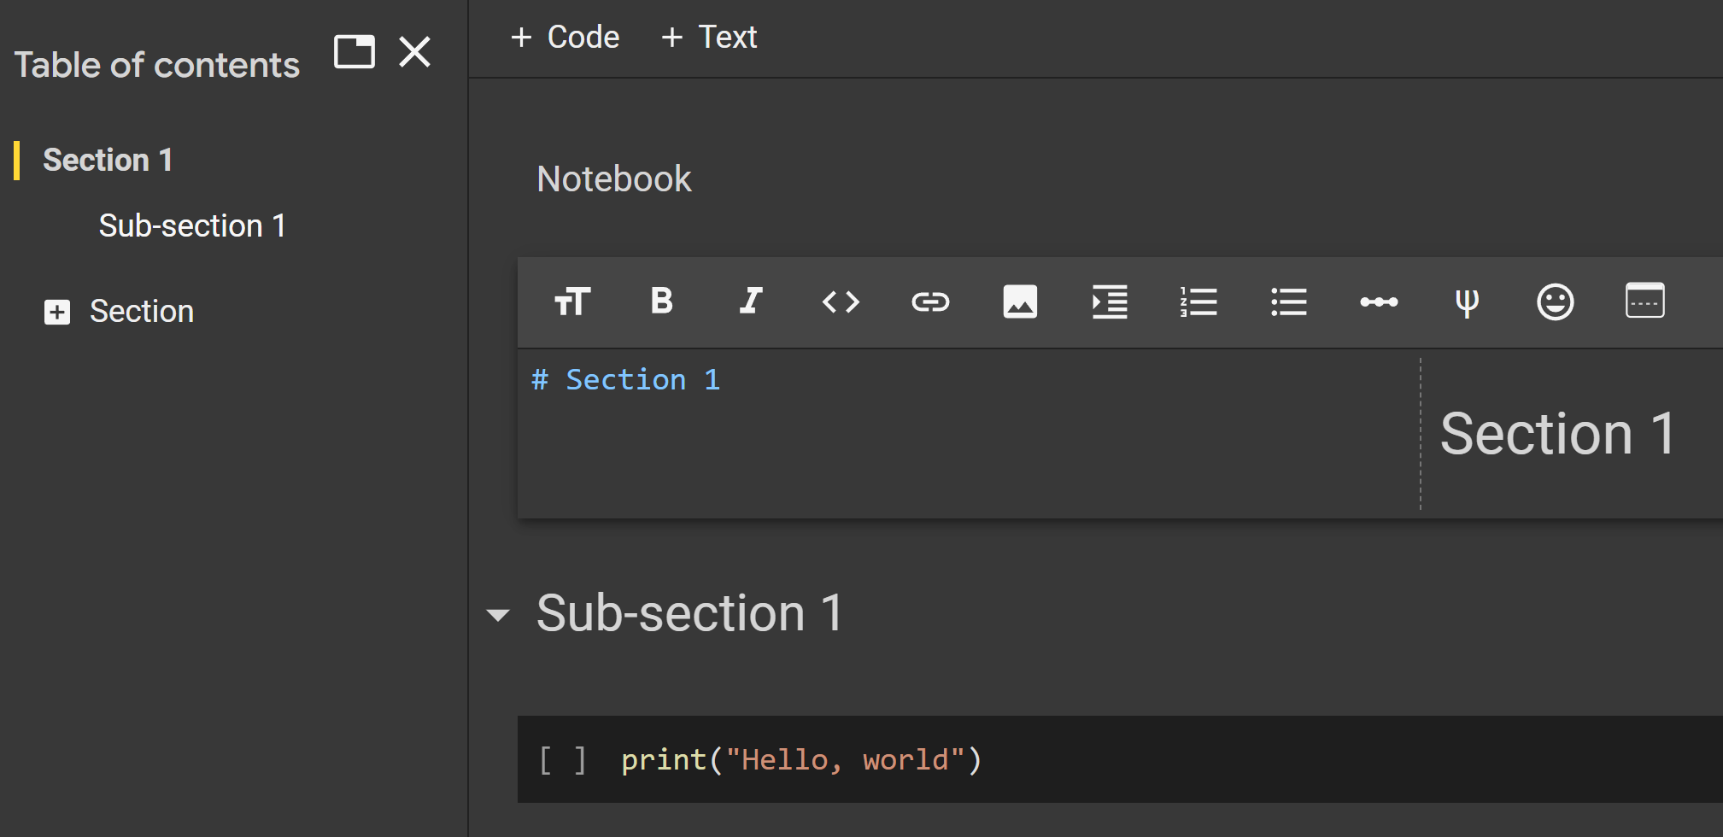
IPython (markdown language)
https://www.markdownguide.org/cheat-sheet/
Notes:
print("Hello, world!")

Slide 4
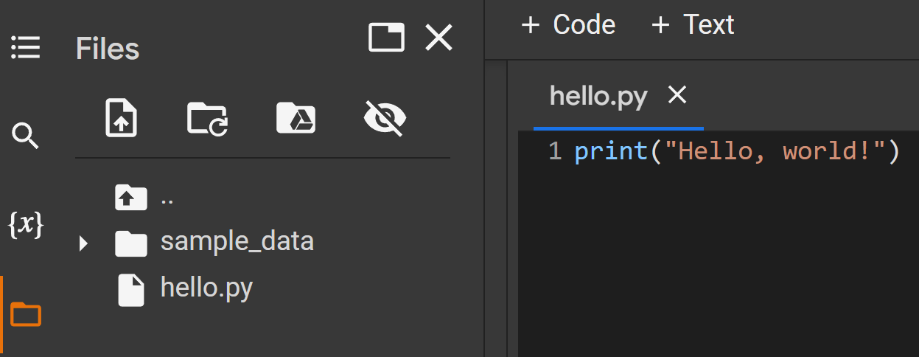
IPython (files)
Supports additional file creation and management (also Google Drive linking)
By default saved in Google Drive, can also save notebooks to Github or export
Notes:
print("Hello, world!")

Slide 5
IPython (getting information)
help(<item>)
<item>?
Notes:
help(len)
len?
def foo(x):
"""Return square of x"""
return x * x
foo?

Slide 6
IPython (getting source code)
item?? foo??
Notes:
def foo(x):
"""Return square of x"""
return x * x
foo??

Slide 7
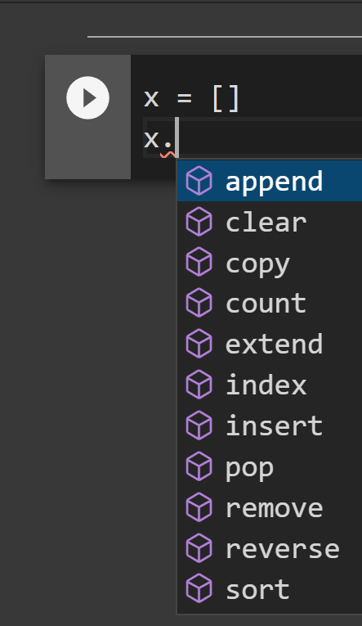
IPython (getting suggestions – table completion)
Tab completion (mimics the pop-up you get in most IDEs for completion)
Notes:
x = []
x.

Slide 8
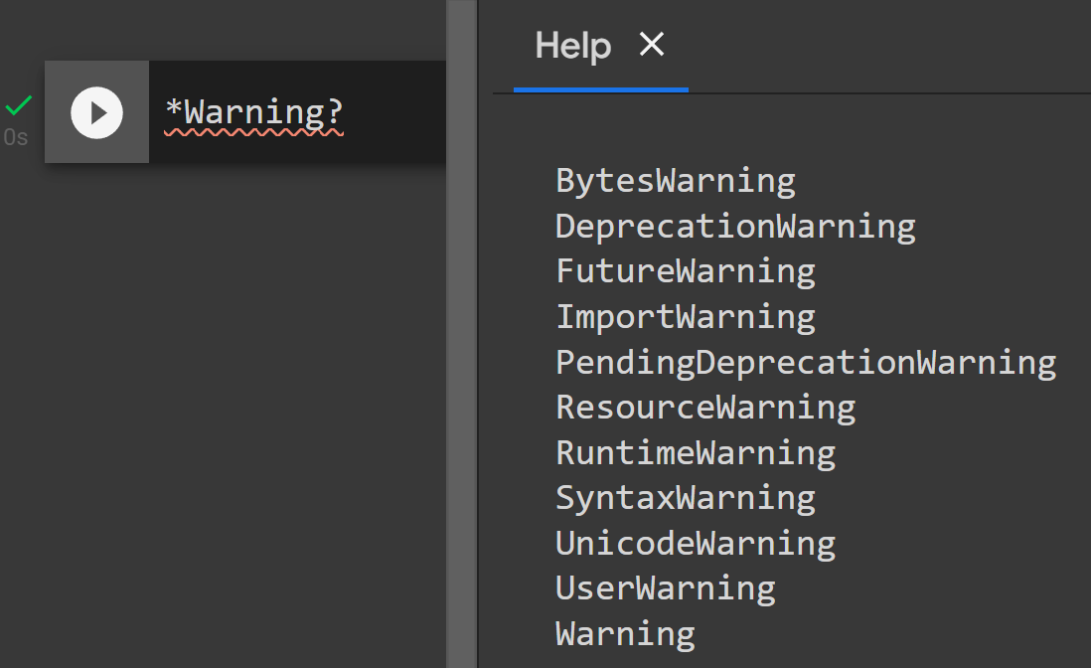
IPython (getting suggestions – wildcard)
*Text?
Notes:
*Warning?

Slide 9
IPython (running external python .py files)
Notes:
%run hello.py

Slide 10
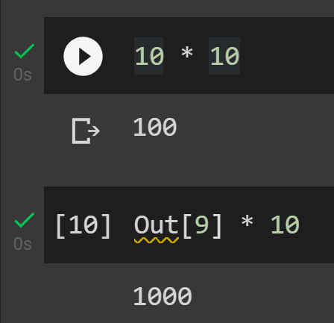
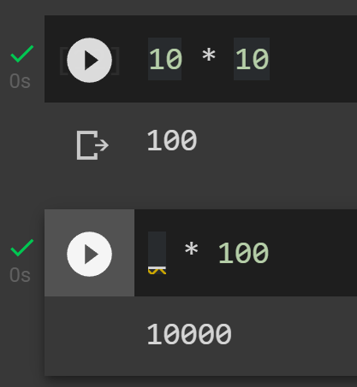
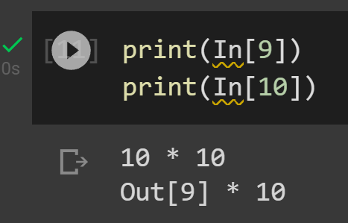
IPython (In/Out)
History stored in array blocks In and Out
Here In[9] produced Out[9] = 100, so we used it in In[10] as input to make Out[10]
Great when you have a long or large calculation you don’t want to re-calculate but didn’t store into variable
_ for previous
__ for previous previous
___ for previous previous previous
Notes:
10 * 10
Out[9] * 10
print(In[9])
print(In[10])
10 * 10
_ * 100

Slide 11
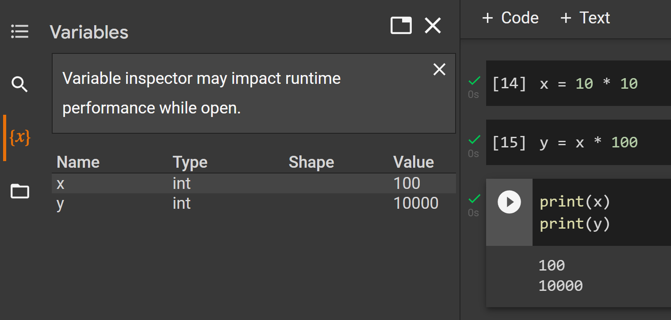
IPython (variables)
You can also use variables to store data in between blocks which is often a better
But do remember you have to run a previous block before later can access it
Notes:
x = 10 * 10
y = x * 100
print(x)
print(y)

Slide 12
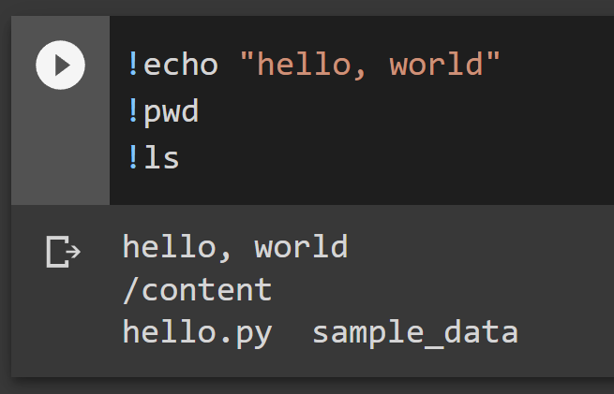
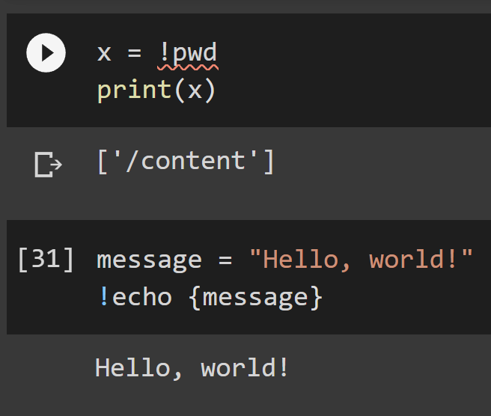
IPython (terminal commands)
Not only can use access terminal commands using !
But you can also get data from them, or send data out of program
Some commands don’t need !, like run, cd, mkdir, ls, cp, rm, cat, man, more, mv, …
Notes:
!echo "hello, world"
!pwd
!ls
x = !pwd
print(x)
message = "Hello, world!"
!echo {message}

Slide 13
IPython (timing)
%timeit for one line (%time run once)
%%timeit for multiple lines (%%time run multiple lines once)
Notes:
%timeit x = [n ** 2 for n in range(1000)]

Slide 14
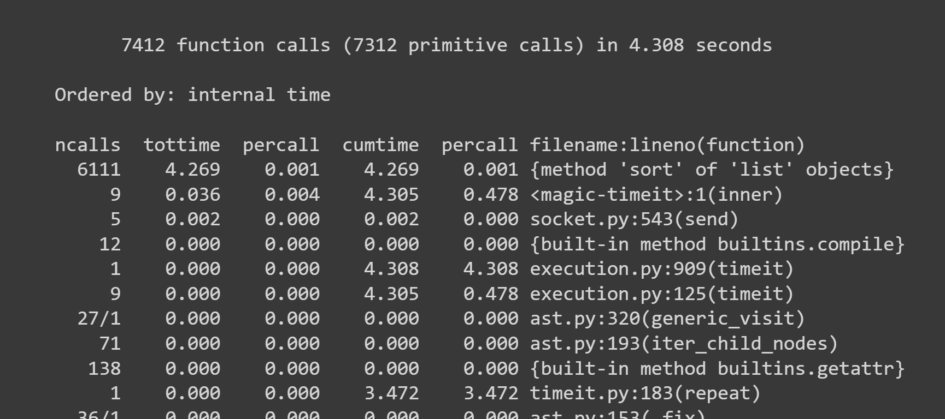
IPython (timing dangers)
Be wary of stored results in timeit (could use time to only run once, or make sure we are sorting random each time)
You can also profile something using prun
I profiled the timeit command
It ran 6111 samples
Notes:
import random
L = [random.random() for i in range(100000)]
%timeit L.sort()
import random
L = [random.random() for i in range(100000)]
%prun %timeit L.sort()

Slide 15
Onward to … coding!
Jonathan Hudson
jwhudson@ucalgary.ca
https://pages.cpsc.ucalgary.ca/~hudsonj/

