Slide 1
Programming: Writing a Program
CPSC 217: Introduction to Computer Science for Multidisciplinary Studies I
Winter 2023
Jonathan Hudson, Ph.D.
Instructor
Department of Computer Science
University of Calgary
January 9, 2023
Copyright © 2023

Slide 2
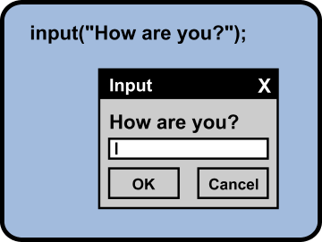
Input
A built-in function to get an input form the user.
sName = input("Please enter your name: ")
The obtained value will be stored in the variable in string form.
You need to convert the value type if necessary.
Variable
Function

Slide 3
Input
#Changing type (this is always a string)
sInput = input(“Enter a number:”)
#Change to float
fInput = float(sInput)
print(type(fInput))
#Change to integer
iInput = int(sInput)
print(type(iInput)

Slide 4
Meaningful sentences
Provide meaningful sentences to communicate questions and results to the user.
The programmer knows they need to do to complete the above program.
The user using program knows what to enter and what is output.

Slide 5
Errors

Slide 6
Types of Errors
Three categories
Syntax
Runtime
Logic

Slide 7
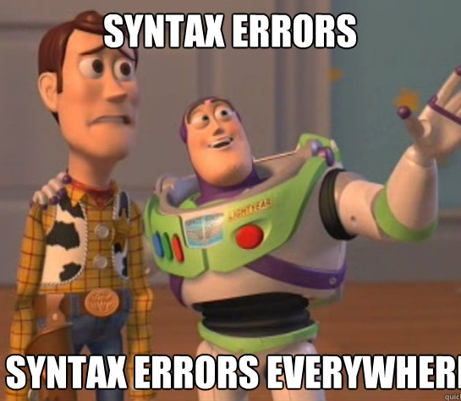
Syntax errors
Syntax refers to the structure of a program and the rules about that structure.
Easiest to find (your program will not begin to execute (after compiling))
Displays an error message and stops.
The compiler/interpreter finds syntax errors
Example:
name = "Jim
print(77

Slide 8
Runtime errors
Does not appear until the program is run (compiling is complete) (harder to find)
Also called exceptions
Example:
callMe = "Maybe"
print(callme)

Slide 9
Semantic/Logic Errors
Program will run successfully
It does not produce the correct answer:
It does what you told it to do
The hardest to find!
Result of a wrong algorithm
Identifying is tricky!
Example:
x = 3
y = 4
average = x + y / 2
print(average)
Program runs to completion, but result is wrong.

Slide 10
Remember
Getting errors in your code does not make you a bad programmer.
Errorless code is the goal
You need to debug your code
Add comments to your code
Grading is generally setup to give you credit for the parts that are complete and correct (as long as they run and can be verified)

Slide 11
Explore First Program

Slide 12
What Does this Program Do?
x = float(input())
y = (x - 32) * 5/9
print(y)
What’s wrong with this program?

Slide 13
Fahrenheit to Celsius
Examples on course website/python notebook

Slide 14
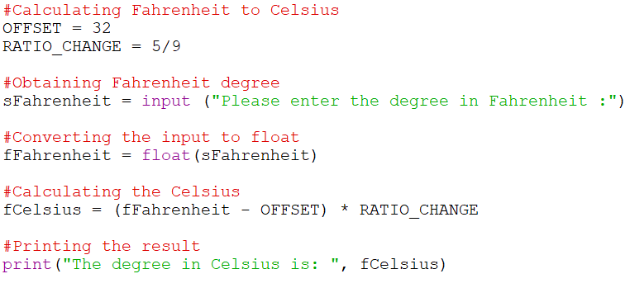
Comments
Notes and explanations in natural language
Intended only for the human reader → Completely ignored by the interpreter
# token starts a comment
Commenting is necessary!

Slide 15
Importing

Slide 16
Import
import <Module Name>
Import the packages that you need only!
Example:
import math
import turtle

Slide 17
Math Functions
Many additional math functions are available
Located in the math library
Import the math library
Precede the name of the function with math.
Examples:
import math
math.sqrt(x)
math.floor(x)
math.ceil(x)
math.cos(x)

Slide 18
Area of a circle

Slide 19
Data Types

Slide 20
Data Types
Some operations are only well defined for certain types
1 + 2
“Hello” + “ World”
1 + “Hello”
2 + “4”
1 / 3
2.0 / 4
“Hello”*3

Slide 21
Data Types
Some operations are only well defined for certain types
1 + 2 → GOOD
“Hello” + “ World” → GOOD
1 + “Hello” → TYPE ERROR (int + string)
2 + “4” → TYPE ERROR (int + string)
1 / 3 → GOOD
2.0 / 4 → GOOD
“Hello”*3 → GOOD

Slide 22
Type Conversions (Casting)
Python permits you to convert from one type to another
"1.0" / "3.0" → Makes no sense to python
float("1.0") / float("3.0") → But this does
float("asdf") → However this doesn’t
Other type conversions: int, bool, str

Slide 23
Type Conversions (Casting)
Python permits you to convert from one type to another
int(“1”) → 1 (string to int)
str(1) → “1” (int to string)
float(“1.0”) → 1.0 (string to float)
bool(“True”) → True (string to boolean)

Slide 24
Formatting

Slide 25
Formatting
Sometimes print doesn’t display things the way we would like
print(1 / 3.0) gives 0.333333333333
What if we want 0.33?

Slide 26
Formatting
Basic python format method can be used to format floats
Parts
A string “pi is %.2f”
Format float to 2 decimals %.2f
Format symbol for strings %
The value(s) to format (math.pi)
Example:
import math
print(“pi is %.2f when rounded to 2 decimal places” % (math.pi))

Slide 27
Formatting
types
f – float
g – scientific notation
s – string
d – integer
[width].[precision][type]
width – total characters in final result (“” is default ) (add 0 in front to pad 0’s)
precision – how many decimal points
Ex. 05.3f
float, pad with 0s if shorter than 5 to get width of 5, but only after showing precision of 3

Slide 28
Turtle - Drawing

Slide 29
Alex the turtle
Example in course website/python notebook

Slide 30
Onward to … information and data.
Jonathan Hudson
jwhudson@ucalgary.ca
https://pages.cpsc.ucalgary.ca/~jwhudson/

