Slide 1
Programming: Variables and Expressions
CPSC 217: Introduction to Computer Science for Multidisciplinary Studies I
Winter 2023
Jonathan Hudson, Ph.D.
Instructor
Department of Computer Science
University of Calgary
January 9, 2023
Copyright © 2023

Slide 2
Variables
Computers manipulate data of different types:
Integers, real numbers, strings, and many more
Variables are used to store data in a particular format determined by the type
A piece of memory is allocated to a variable.
The actual information and size of the information is determined by the type.
Variables and the information stored in it will be destroyed when the program terminates.

Slide 3
Variables
Some standard primitive variable types:
Integer (e.g., a = 100)
Floating point (e.g., b = 3.14)
Strings (e.g., str = ‘Hello World!’)
Variable initialization:
<name of variable> = <data to be stored in the variable>
In Python, the format of the data also determines the type of the variable.
Function “type” is used to find a variable type
Try: print(type("Hello, World!"))

Slide 4
Values
Use function type to find out what class a value falls into:
print(type("Hello, World!"))
print(type(17))
print("Hello, World")
<class 'str'> <class 'int'> Hello, World

Slide 5
Using Variables
Assignment
a = 100
b = 3.14
str = “Hello World!”
Use them in expressions
a = a * a → a = 100 * 100 = 10000
a = a * b → a = 10000 * 3.14 = 31400
Printing
print (a)
print (b)

Slide 6
Variable Names point to data in Memory
name = “Jonathan”
name = “Dr. J”
Changing a variable doesn’t change memory. It actually just points the name to a new memory spot with the new information. (Python eventually will get around to throwing away “Jonathan” via something called garbage collection)
MEMORY
name
“Jonathan”
name
“Jonathan”
“Dr. J”

Slide 7
Naming

Slide 8
Variable Naming
Python naming convention:
Names must start with a letter (e.g., a, ..., z, A, ..., Z) (can also start with _)
A name may contain any letter, any number (0, ..., 9), and the special character “_” (underscore).
White spaces and signs with special meanings (e.g., “+”, “-”, “*”, “/”) are not allowed.
Case sensitive “sum” is different than “Sum”
Cannot use reserved keywords.
Legal variable names: FooBar, X15Y, this_is_a_variable
Illegal variable names: 42Bars, How Much, Foo-Bar, Var$
ALL CAPITALS is used to indicate a constant where value won’t change (not enforced)

Slide 9
Reserved keywords
and | as | assert | break | class | continue
def | del | elif | else | except | exec
finally | for | from | global | if | import
in | is | lambda | nonlocal | not | or
pass | raise | return | try | while | with
yield | True | False | None
Cannot be used as variable name
This list can change as Python updates.
We will learn the use of most of these keywords in this course.

Slide 10
Variable Naming
Style requirement (not syntactically required):
Use meaningful names for readability.
Balance between brevity and descriptiveness
i (what is this)
index (slightly better)
indexToDatabaseOfMyCourses (maybe too long)
indexToCourseDB (maybe best)
Avoid using variables that are only distinguishable by upper/lower case
(e.g., donʼt use “Sum” and “sum” in the same program)

Slide 11
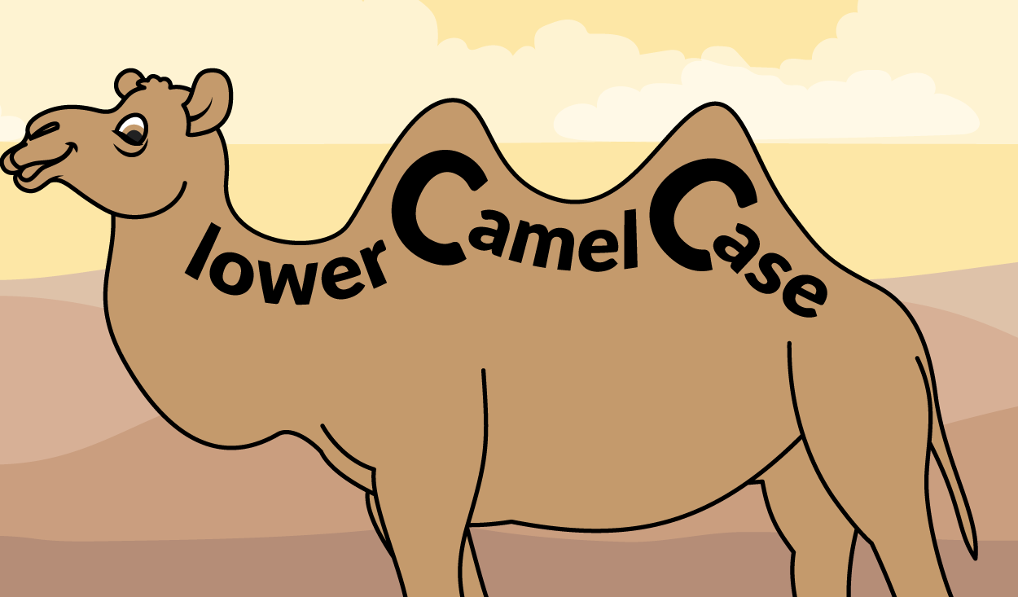
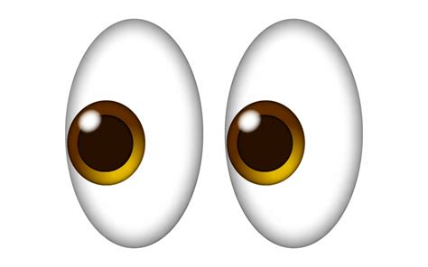
Variable Naming (common styles)
sumNetProfit sum_net_profit
- Popular in Java, used in Python - used more often in Python

Slide 12
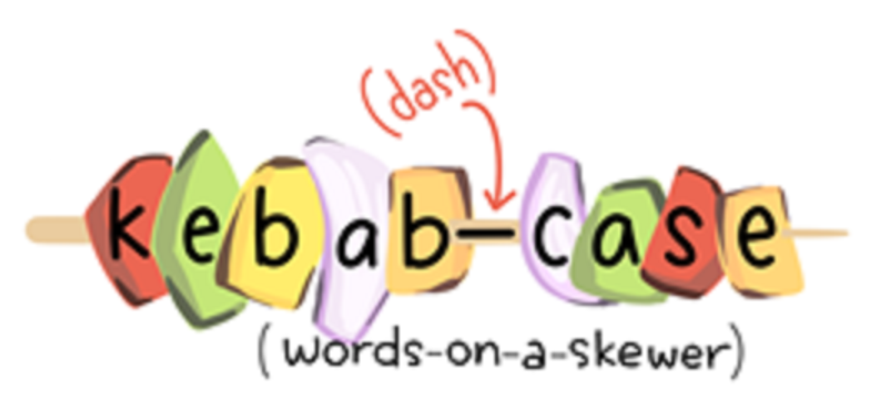
Variable Naming kebab-case?

Slide 13
Meaningful names
Use Meaningful names for anything that you create when programming
If a name is meaningful to human it is not necessarily meaningful to computer
For computer there is no difference between
Average = 10 and Ave = 10 and Jonathan = 10
They all require same space in memory.

Slide 14
Guess what this code is about!
m = 100 g = 0.2 p = m*g

Slide 15
Which one do you prefer?
m = 100 g = 0.2 p = m*g | miles = 100 gallons_of_gas_per_mile = 0.2 gallons_gas = miles * gallons_of_gas_per_mile
➔ Always use meaningful names!

Slide 16
Constants and Magic Numbers

Slide 17
Constants
Constants → Variables whose values should not be changed
Can be any type (e.g., Integers, real numbers, strings, ...)
In other languages: Java and C/C++, this is enforced
In Python, the programmer is expected to never change the value of a constant
Constants are names using upper case
e.g., PI = 3.1415

Slide 18
Constant changing value
final int MY_CONSTANT = 100
MY_CONSTANT = 12
Constant in Java (similar in C or C++)
Constant is Python
MY_CONSTANT = 100
MY_CONSTANT = 12
Illegal operation, Cause error
Does not produce an error but a very bad style
Do NOT change a constant value once you define it!

Slide 19
Magic numbers
If I need to change the tax rate to 0.07 percent:
Not clear what is this number
Higher risk to make a mistake
This is not the same number!
No find and replace

Slide 20
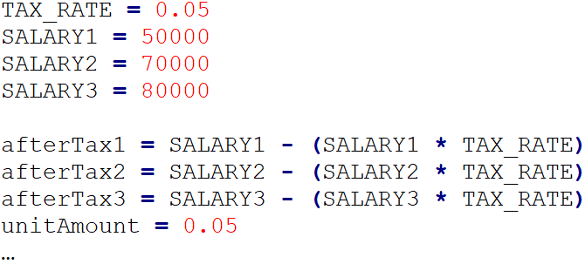
Using constant instead of magic numbers
Low risk to make a mistake
Clear definition of numbers
No mistake when rate is changed
No need to search and replace

Slide 21
Why use constants
Program becomes easier to understand and maintain
All references to the constant can be change by one single modification in constant initialization
Using constants is another way for being intelligently lazy!

Slide 22
Expressions

Slide 23
Expression
An expression is a combination of values, variables, operators, and calls to functions.
Composed of operators and operands
Evaluation produce a result
1+1 → 2
len(“hello”) → 5
Expressions can appear on the right-hand side of assignment statements.
A value or a variable all by itself is a simple expression.

Slide 24
Operators and Operands
Operators are special tokens that represent computations like addition, multiplication and division. The values the operator works on are called operands.
Operates:
+, -, *, / → are clear
** → exponentiation
// → integer division
% → remainder

Slide 25
Precedence

Slide 26
Precedence
Order | Operations | Precedence
1 | () | Highest
2 | x ** y
3 | -x, +x
4 | x * y, x / y, x % y, x // y
5 | x + y, x - y
6 | = | Lowest
The order of evaluation is determined by operator precedence (highest -> lowest)
Highest means the expression is collapse on execution of this operator first
Note: Negation to immediate to right of exponentiation has precedence
2 ** -1 is ½ = 0.5

Slide 27
Note
What is the output of the following expression?
16 - 2 * 5 // 3 + 1

Slide 28
Note
What is the output of the following expression?
16 - 2 * 5 // 3 + 1
(16 – ((2 * 5) // 3)) + 1 → 16 – 3 + 1 = 14 ← Correct
16 – (((2 * 5) // 3) + 1) → 16 –(3 +1) = 12 ← Incorrect

Slide 29
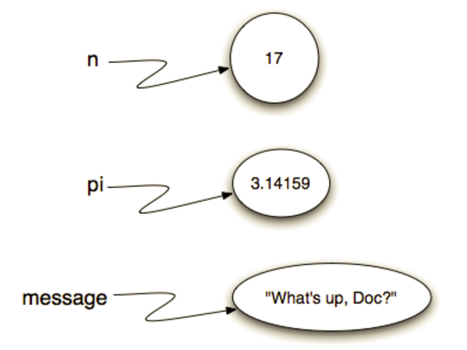
Values, Variables, Statements and Expressions
Value type: string, integer, float,…
Variables: for keeping values
Naming Convention
Statements: while, for, if, import,…
result doesn’t change value in a program
Expressions: combination of values and variables using operators and calls to functions
Produce results

Slide 30
Onward to … writing a program!
Jonathan Hudson
jwhudson@ucalgary.ca
https://pages.cpsc.ucalgary.ca/~jwhudson/

